Slide 1


DARE-NGS : Towards Extensible and Scalable NGS Analytics on the TeraGrid/XD
Joohyun Kim, Sharath Maddineni, Shantenu Jha
The Center for Computation and Technology (CCT)
Louisiana State University

Slide 2
Next-Generation DNA Sequencing (NGS) and Its Impact on Life Sciences
Unprecedented novel opportunities for life sciences
High-throughput DNA sequencing
Significant roles of computation (algorithm, methods, implementation, and infrastructure)
Data-intensive computation
Driving paradigm shift in computational biology touting the importance of distributed parallel execution

Slide 3
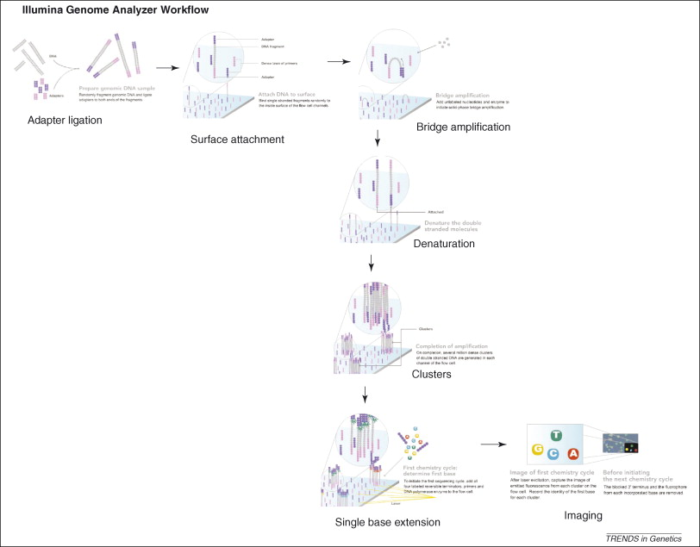
Next-Generation DNA Sequencing (NGS) and Its Impact on Life Sciences
E. R. Mardis, The impact of next-generation sequencing technology on genetics, Trends in Genetics, 24, 133 (2008)

Slide 4
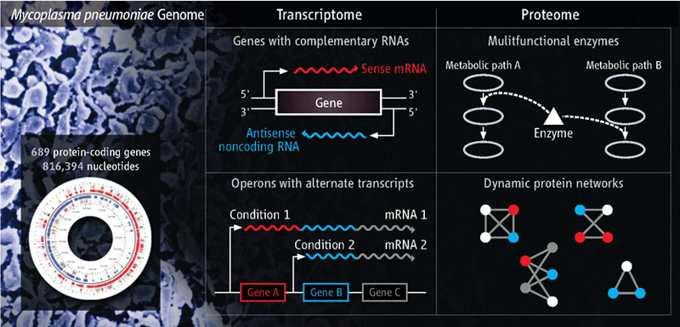
Next-Generation DNA Sequencing (NGS) and Its Impact on Life Sciences
High-throughput Sequencing Techniques and Ever-growing Genomic Data Sets
Dynamic gene expression and regulation mechanism (cell development and differentiation) : infection, immune response, cancer, epigenetics, gene localization, other diseases, ….
Dynamic gene expression and regulation mechanism
(cell development and differentiation) : infection,
immune response, cancer, epigenetics, gene localization, other diseases, ….
Need for Data- Intensive Computing
“Excavating the Functional Landscape of Bacterial Cells”
Howard Ochman and Rahul Raghavan, Science, 27 Nov. 2009

Slide 5
Next-Generation DNA Sequencing (NGS) and Its Impact on Life Sciences
Overview - Computational/Bioinformatics Strategies for Genomic Data Analysis
WGS, CHIP-Seq, RNA-Seq: Billions Short Reads
Mapping
De Novo Assembly
Genome Variation:
SNP, InDel, CNV
Comparative Genomics, Epigenetics
Gene Finding/Identification
Coding Gene
Non-coding RNA
Motif Finding
Whole Genome Analysis (WGS)
Transcriptome Analysis
(RNA-seq, ChIP-seq)
Exome Analysis
Functional Annotation, Pathway Analysis – Cell Development & Differentiation, Host-Pathogen interaction, Biomedical research

Slide 6
Next-Generation DNA Sequencing (NGS) and Its Impact on Life Sciences
Genome2Function : (Microbial System)
NGS Sequencing Data
(WGS/RNA-seq/CHIP-seq)
Assembly/Mapping
Whole Genome Sequence
Transcriptome Sequences
Coding Gene Finding/ncRNA Finding/DNA motif Finding/Gene Annotation/gemone-variation
Annotated Genes
Identified Genes
Structure Modeling/Structure Database Search
Structure
Docking/Binding Affinity
Function

Slide 7
Next-Generation DNA Sequencing (NGS) and Its Impact on Life Sciences
High-throughput Sequencing Techniques and Ever-growing Genomic Data Sets
Nature, 467, 1061 (2010)

Slide 8
Next-Generation DNA Sequencing (NGS) and Its Impact on Life Sciences
Unprecedented novel opportunities for life sciences
High-throughput DNA sequencing
Significant roles of computation (algorithm, methods, implementation, and infrastructure)
Data-intensive computation
Driving paradigm shift in computational biology touting the importance of distributed parallel execution

Slide 9
NGS Data Analytics on Distributed Resources
Motivations and challenges
Distributed computing approach with efficiency in Time-To-Solution (TTS) and resource (Data/Compute) utilization by balancing between scale-up and scale-out
- Developing extensible, agile, application-neutral, primarily data-intensive computing-friendly runtime environment : Distributed Adaptive Runtime Environment (DARE) Framework

Slide 10
NGS Data Analytics on Distributed Resources
Performance with scale out
 | HPC System | # of cores | Read File Size | # of tasks | Bfast (mapping)
DARE-NGS | Ranger | 64 | 2.4 GB | 4 | 6.5 h
 | Ranger | 128 | 1.2 GB | 8 | 3.4 h
 | Ranger | 256 | 0.6 GB | 16 | 1.95 h
Case | HPC System | # of cores | Bfast (mapping)
I | QB | 256 | 2.66 h
II | Ranger | 128 | 2.11 h
 | QB | 128
Read Data
Reference Genome
I
NGS reads alignment with BFAST
Human genome (HG18) as a reference genome
II

Slide 11
DARE Framework : A Case for Suitable Solution

Slide 12


SAGA: In a nutshell
There exists a lack of programmatic approaches that:
Provide general-purpose, basic &common grid functionality for applications and thus hide underlying complexity, varying semantics..
The building blocks upon which to construct “consistent” higher-levels of functionality and abstractions
Meets the need for a Broad Spectrum of Application:
Simple scripts, Gateways, Smart Applications and Production Grade Tooling, Workflow…
Simple, integrated, stable, uniform and high-level interface
Simple and Stable: 80:20 restricted scope and Standard
Integrated: Similar semantics & style across
Uniform: Same interface for different distributed systems

Slide 13
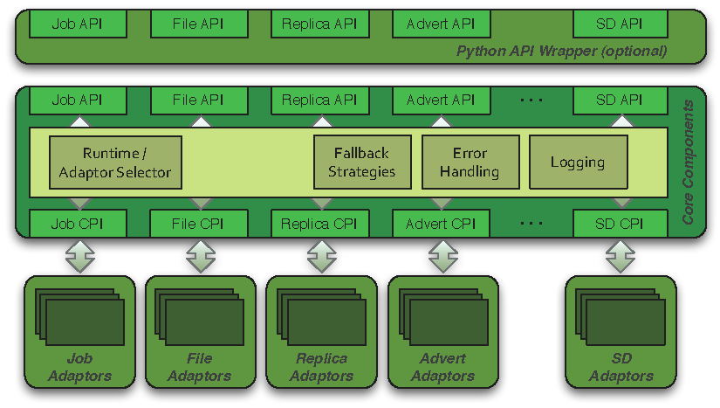
SAGA: Architecture

Slide 14
SAGA Implementation: Extensibility
Horizontal Extensibility – API Packages
Current packages:
file management, job management, remote procedure calls, replica management, data streaming
Steering, information services, checkpoint…
Vertical Extensibility – Middleware Bindings
Different adaptors for different middleware
Set of ‘local’ adaptors
Extensibility for Optimization and Features
Bulk optimization, modular design

Slide 15
SAGA: Access Layers Challenge of many Adaptors
Job Adaptors
BES, UNICORE, Globus GRAM2, gLite
Fork (localhost), SSH, Condor, OMII GridSAM, Amazon EC2, Platform LSF
File Adaptors
Local FS, Globus GridFTP, Hadoop Distributed Filesystem (HDFS), CloudStore KFS, OpenCloud Sector-Sphere
Replica Adaptors
PostgreSQL/SQLite3, Globus RLS
Advert Adaptors
PostgreSQL/SQLite3, Hadoop H-Base, Hypertable
Other Adaptors
Default RPC / Stream / SD

Slide 16
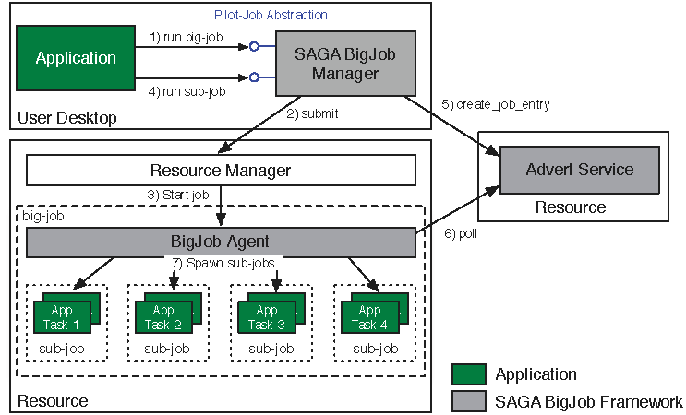
Abstractions for Dynamic Execution SAGA Pilot-Job (BigJob)

Slide 17
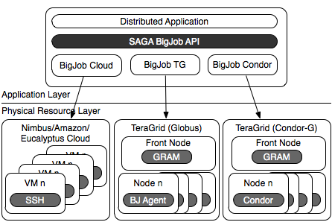
BigJob: Infrastructure Independent Pilot-Job

Slide 18
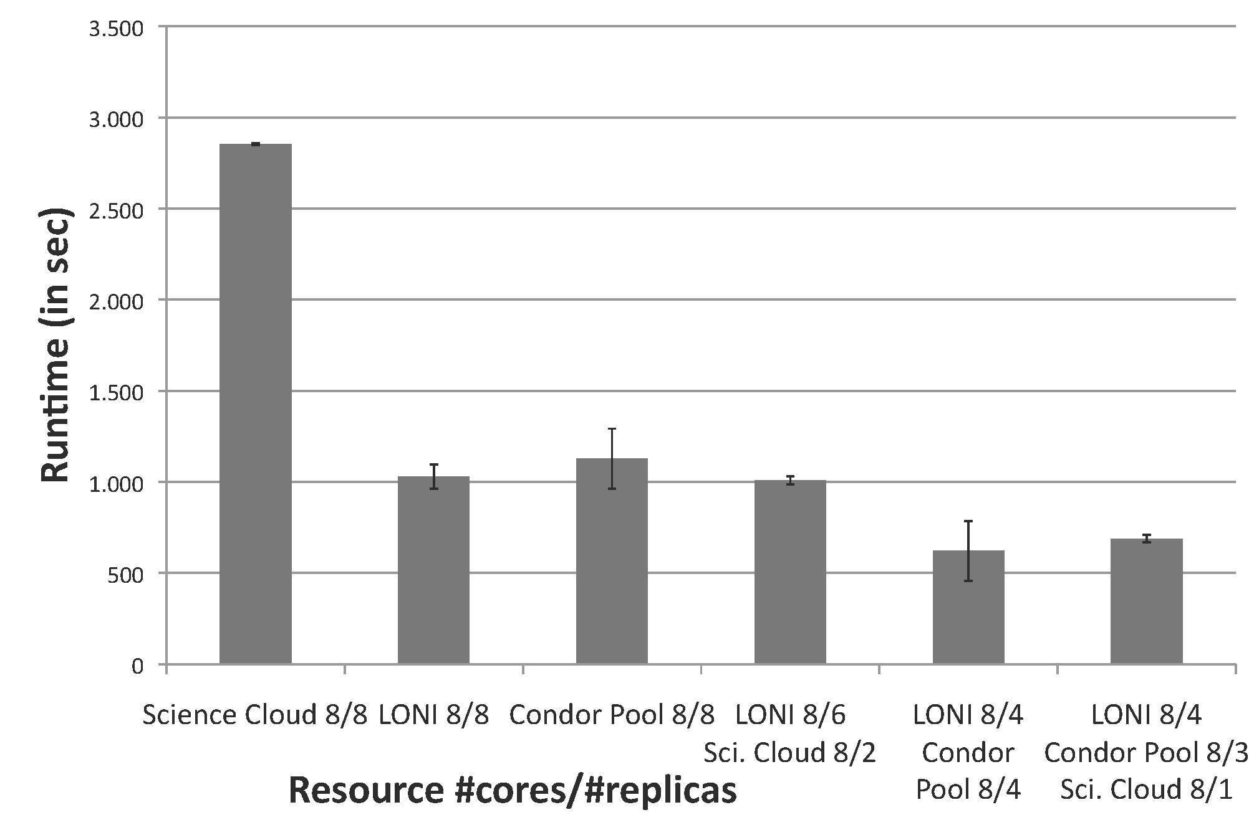
BigJob: Infrastructure Independent Pilot-Job (Each sub-job is a MPI-based MD)

Slide 19
SAGA Pilot-Jobs: What is different?
Pilot-Jobs: Decouple Resource Allocation from Resource-Workload binding
Pilot-Jobs are/have been typically used for:
Enhancing resource utilisation
Lowering wait time for multiple jobs (better predictibility)
Facilitate high-throughput simulations
Basis for Application-level Scheduling Resource binding
Two unique aspects about the SAGA-based Pilot-Job:
Pilot-Jobs have not been used for Science Driven Objectives:
First demonstration of supporting multi-physics simulations
Infrastructure Independent
Falkon, Condor Glide-in, Ganga-Diane (EGEE/EGI), DIRAC/WMS, PANDA
Frameworks based upon PJs (pull model) for specific PGI/back-end
Do not support MPI
SAGA-based Pilot-Job form the basis:
For autonomic scheduling and resource selection decisions
Advanced run-time frameworks for load-balancing and fault-tolerance

Slide 20
Development Distributed Application Frameworks
Frameworks: Logical structure for Capturing Application Requirements, Characteristics & Patterns
Pattern: Commonly recurring modes of computation
Programming, Deployment, Execution, Data-access..
Abstraction: Mechanism to support patterns and application characteristics
Frameworks designed to either:
Support Patterns: Map-Reduce, Master-Worker, Hierarchical Job-Submission
Provide the abstractions and/or support the requirements & characteristics of applications
i.e. Encode a Usage-Mode using a Framework

Slide 21
Adaptive Distributed Replica Exchange Scale-Out, Dynamic Resource Allocation and Aggregation

Slide 22
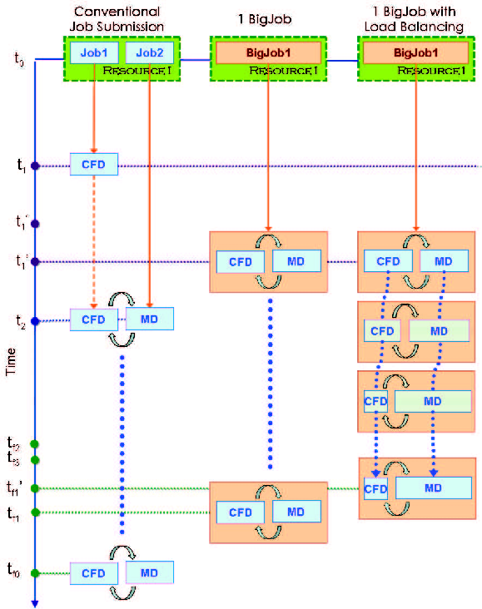
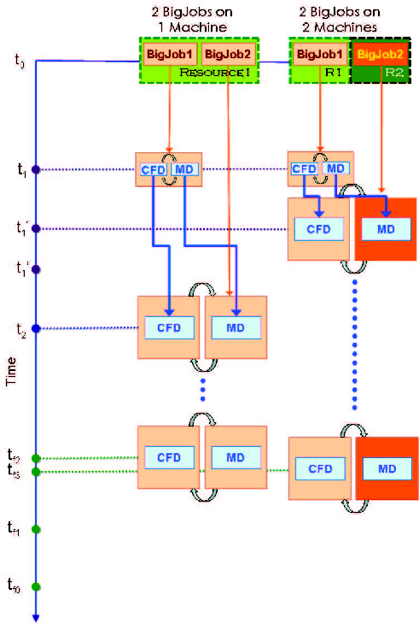
Dynamic Execution : Reduced Time to Solution

Slide 23
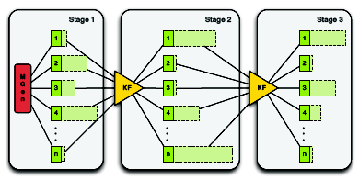
Ensemble Kalman Filters :Heterogeneous Sub-Tasks
Ensemble Kalman filters (EnKF), are recursive filters to handle large, noisy data; use the EnKF for history matching and reservoir characterization
EnKF is a particularly interesting case of irregular, hard-to-predict run time characteristics:

Slide 24
Understanding Distributed Applications Development Objectives Redux
Interoperability: Ability to work across multiple distributed resources
SAGA: Middleware Agnostic
Distributed Scale-Out: The ability to utilize multiple distributed resources concurrently
Support Multiple Pilot-Jobs: Ranger, Abe, QB
Extensibility: Support new patterns/abstractions, different programming systems, functionality & Infrastructure
Pilot-Job also Coupled CFD-MD, Integrated BQP
Adaptivity: Response to fluctuations in dynamic resource and availability of dynamic data
Simplicity: Accommodate above distributed concerns at different levels easily…

Slide 25
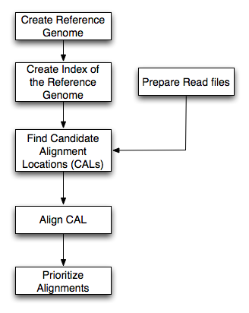
DARE-NGS : Mapping on Scalable Distributed HPC resources
Workflow for bfast match step
BFAST
Higher sensitivity (CAL finding and gapped Smith-Waterman alignment)
Relatively larger memory and disk space
Multi-threading support
Low-memory option (index file splitting)
Pipeline (index, match, localalign, and postprocess step) and extensible (e.g. BFAST-BWA for paired-end, and more)
Task Level concurrency (Data fragmentation of Reads and Chromosomes, different spaced seeds (match step), parallel task runs (localalign, postprocess steps)
Ref. Genome
(xxx.fa)
Mapping :
BFast
SNP finding :
diBayes
Dynamic situation (target species, NGS protocol, multi-core, cluster environment, disk space, main memory, and parallelization) for optimal performance
NGS short reads
(xxx.csfasta, xxx.qual)
or (xxx.fastaq)

Slide 26
DARE-NGS : Mapping on Scalable Distributed HPC resources
 | B. Glumae | HG18 | HG18-Chr21
Genome size | 7 Mbp | 3Gbp | 47 Mbp
NGS Data | Whole Genome | Exome | Exome
NGS Data size | 12.6 GB | 5.6 GB | 5.6 GB
Ref. Index size^{a)} | 40 GB | 130 GB | 70 GB
Minimum Memory^{b)} | 38 MB + α^{c)} | 12 GB + α | 164 MB + α
Human Genome (HG18) and Burkerholderia Glumae
Prokaryote vs. Eukaryote
B. Glumae : Small (7 Mbp) but multiple genomes (multiple strains or transcriptome study, and a potential for a fully extended pipeline for “genome to function”
Larger genome (3 Gbp) with 22 + XX (or XY) chromosomes. The significance of biomedical research toward diseases with cell development and differentiation
Two options generating 40 index files and 10 index files are considered
The cases with 10 index files. The option generating 40 index files require ¼ memory but needs 4 time computation
Read file size

Slide 27
DARE-NGS : Mapping on Scalable Distributed HPC resources
Time to Completion (Match Step) vs. Short Read File Size
HG18
HG18-Chr21
B.Glumae
Time to Completion (Match Step) vs. Num. of Threads

Slide 28
DARE-NGS : Mapping on Scalable Distributed HPC resources
ranger.tacc.utexas.edu/qb.loni.org
Prepare Read files step | Using Big job
Type | Size of .csfasta file | Size of .qual file | Machine used |  | Total Number of cores | Number of nodes | Time (sec)
Human Genome(hg18) | 40 | 129 | Ranger |  | 16
Human Genome(hg18) | 40 | 129 | QB |  | 8 | 1 | 1037
For matching step | Using Big job | all jobs are concurrent
Type | Number of Index Files | Size of all Index files(GB) | Machine used | Number of cores/ pre bfast | Total Number of cores | Number of jobs | Time(sec) | Number of threads per bfast
Human Genome(hg18) | 40 | 129 | Ranger | 4 | 128 | 29 | 8135 | 2
Human Genome(hg18) | 40 | 129 | QB | 8 | 256 | 32 | 11513 | 8
For local alignment step | Using Big job | all jobs are concurrent
Type | Number of Index Files | Size of all Index files(GB) | Machine used | Number of cores/ pre bfast | Total Number of cores | Number of jobs | Time (sec)
Human Genome(hg18) | 40 | 129 | Ranger | 2 | 64 | 29 | 2087.6
Human Genome(hg18) | 40 | 129 | QB | 8 | 256 | 32 | 1980
For Post Process step | Using Big job | all jobs are concurrent
Type | Number of Index Files | Size of all Index files(GB) | Machine used | Number of cores/ pre bfast | Total Number of cores | Number of jobs | Time (sec)
Human Genome(hg18) | 40 | 129 | Ranger | 2 | 64 | 29 | 424
Human Genome(hg18) | 40 | 129 | QB | 8 | 256 | 32 | 240

Slide 29
DARE-NGS : Mapping on Scalable Distributed HPC resources
Strength
Non-invasive runtime environment for life science applications
Lightweight, extensible, and full-fledge gateway template
SAGA/BigJob + α (distributed, scale-out, and large scale data management)
protocol | Local -> QB | Local -> Ranger | QB -> Ranger
SCP | 33 MB/s (1 hour) | 1.8 MB/s (20 hours) | 1 MB/s (36 hours)
GSIFTP | 70 MB/s (0.5 hour) | 6.8 MB/s (5.3 hours) | 25 MB/s (1.4 hours)
Challenges and Ongoing investigation
Distributed data management
Data transfer : Reference genome
index file (HG18 : 130 GB)
Interoperability between grids and clouds
HPC-HTC 1: EGEE-TG[-NAREGI] / HPC-HTC 2: KEK/NAREGI-TG /HPC-HTC 3: ExTENCI [TG-OSG] /HPC-HPC 1: TG-DEISA
GANGA/DIANE integration

Slide 30

Acknowledgements
SAGA Team and DPA Team and the UK-EPSRC
(UK EPSRC: DPA, OMII-UK , OMII-UK PAL)
People:
SAGA D&D: Hartmut Kaiser, Ole Weidner, Andre Merzky, Joohyun Kim, Lukasz Lacinski, João Abecasis, Chris Miceli, Bety Rodriguez-Milla
SAGA Users: Andre Luckow, Yaakoub el-Khamra, Kate Stamou, Cybertools (Abhinav Thota, Jeff, N. Kim), Owain Kenway
Google SoC: Michael Miceli, Saurabh Sehgal, Miklos Erdelyi
Collaborators and Contributors: Steve Fisher & Group, Sylvain Renaud (JSAGA), Go Iwai & Yoshiyuki Watase (KEK)
DPA: Dan Katz, Murray Cole, Manish Parashar, Omer Rana, Jon Weissman

