Slide 1
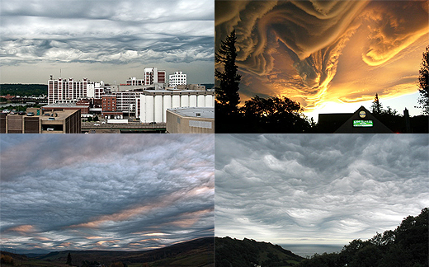

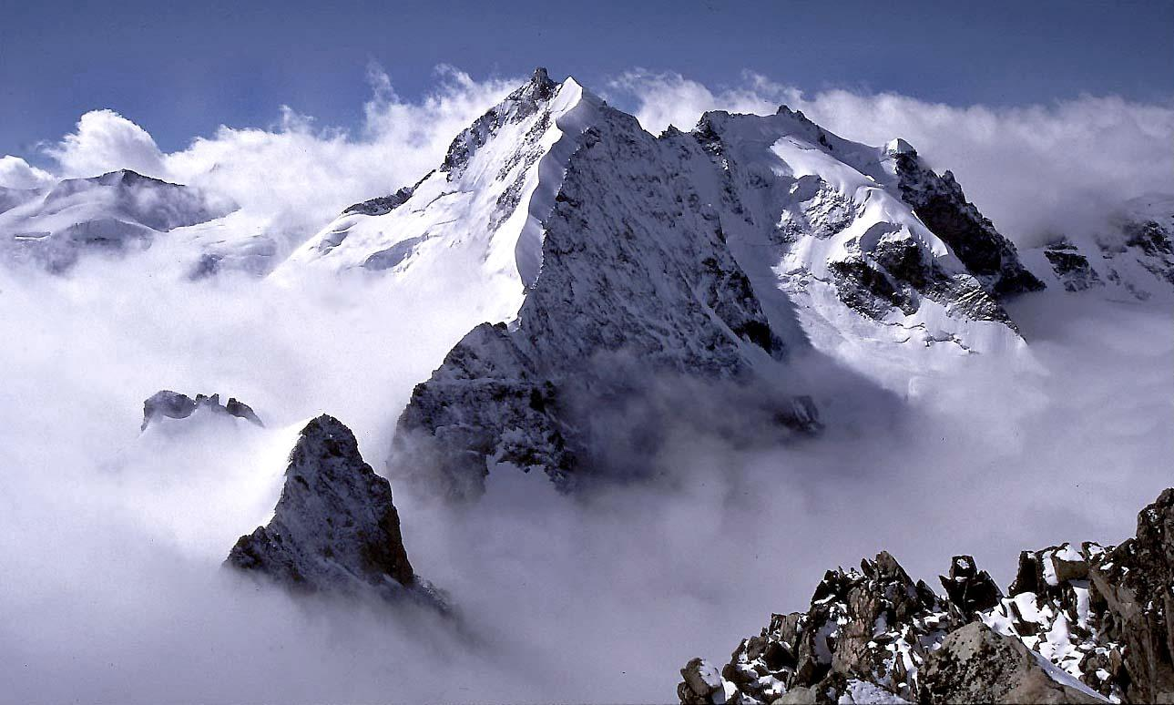


Cloud Models
Infrastructure as a Service
Provide a way to host virtual machines on demand
Amazon ec2 and S3 – you configure your VM, load and go
Platform as a Service
You write an App to cloud APIs and release it. The platform manages and scales it for you.
Google App engine:
Write a python program to access Big Table. Upload it and run it in a python cloud.
Hadoop and Dryad are application frameworks for data parallel analysis
Software as a Service
Delivery of software to the desktop from the cloud
Stand-alone applications (Word, Excel, etc)
Cloud hosted capability
doc lives in the cloud
Collaborative document creation
Adopting Clouds

Slide 2
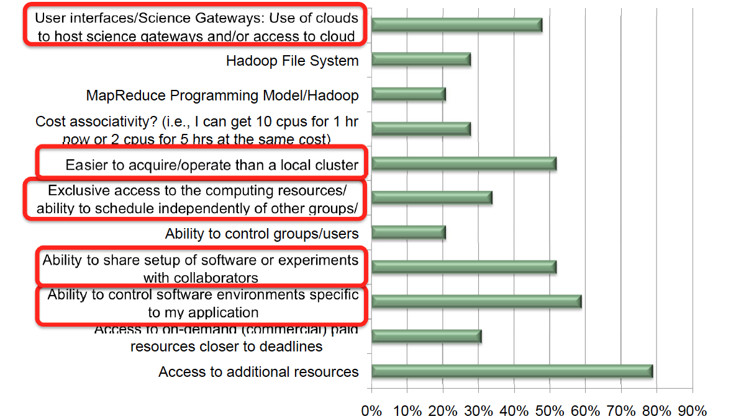
Cloud Computing Interest (adapted from Kathy Yelick)

Slide 3
Adopting Clouds: Research and Production Computational Science
Ability to control software environment
Using FG:
Research: Interoperabilty OGF-standard end-points
Teaching: LSU CSC 7700 Distributed Scientific Comp
Facilitate collaboration
Programming Models and RT Systems
Novel Usage Modes

Slide 4
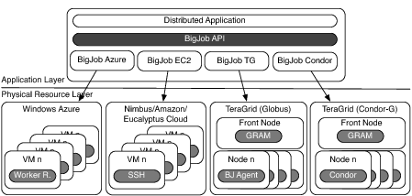
Deployment & Scheduling of Multiple Infrastructure Independent Pilot-Jobs

Slide 5
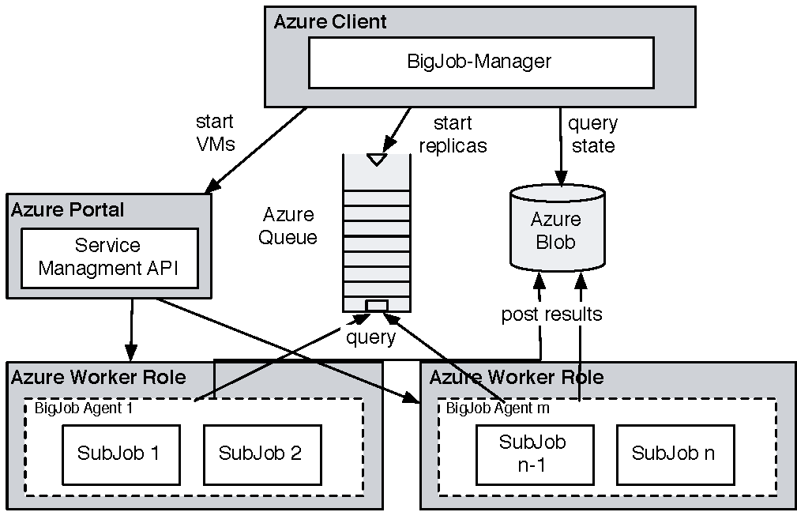
Azure: Using BigJob API and Coordinating Multiple Tasks
For Replica-Exchange application, take SAGA-BigJob and implement on Azure to test for performance
CONCLUSION: For same workload, comparable in performance to TG!
BUT SIMPLER to implement than TG!

Slide 6
Clouds: A Users Perspective
Nascent infrastructure do what Production DCI have not managed – easily or for the masses
Simplicity is the Ultimate Sophistication:
Production DCI Confuse Functionality with Usability
While we as a community busy agenda pushing, e.g, middleware/software stacks (think EMI), most innovation in DC has come from commercial sector!
Have we lost intellectual leadership to commercial providers??
They have more data than us
They have more $$$ than us
They have better approach than us -- Infrastructure, Abstractions/Algorithmic (or at least the applications e.g., re-discovering MapReduce) and Services

Slide 7
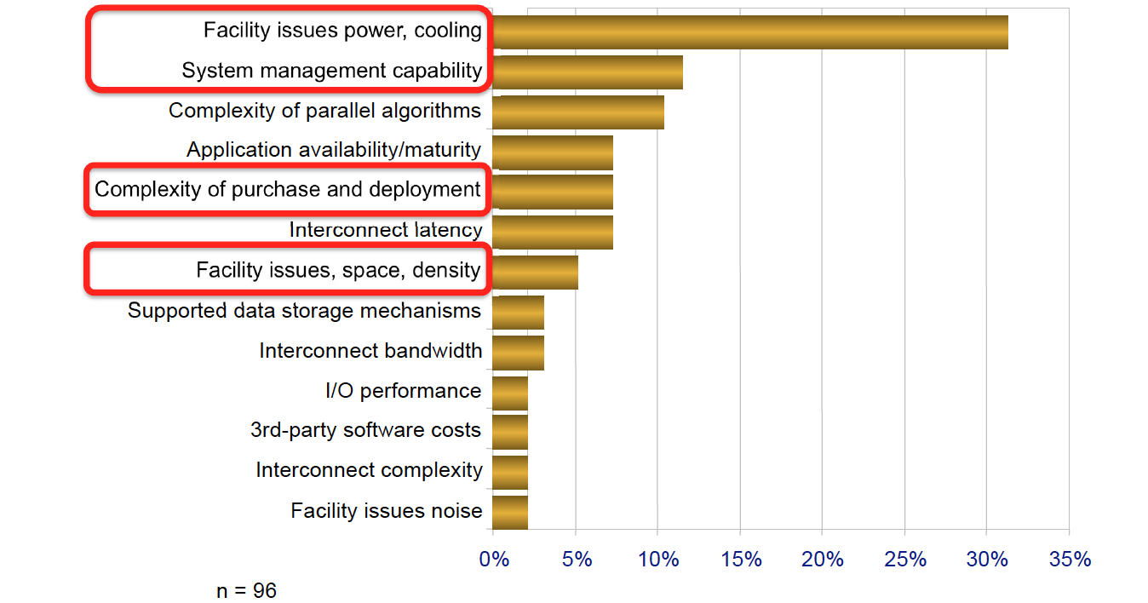
Top challenges to running own cluster (adapted from Kathy Yelick)

Slide 8
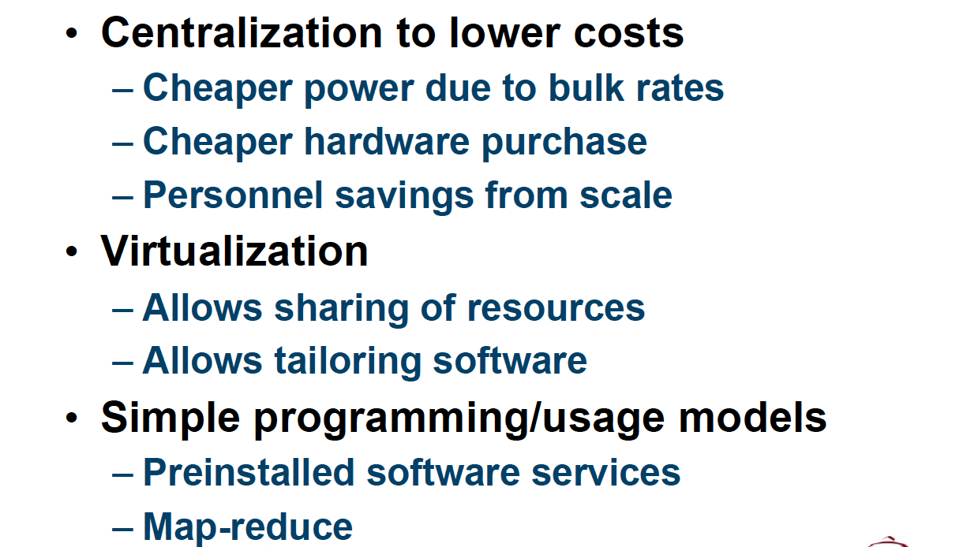
Cloud Computing: Enabling Technologies (adapted from Kathy Yelick)

Slide 9
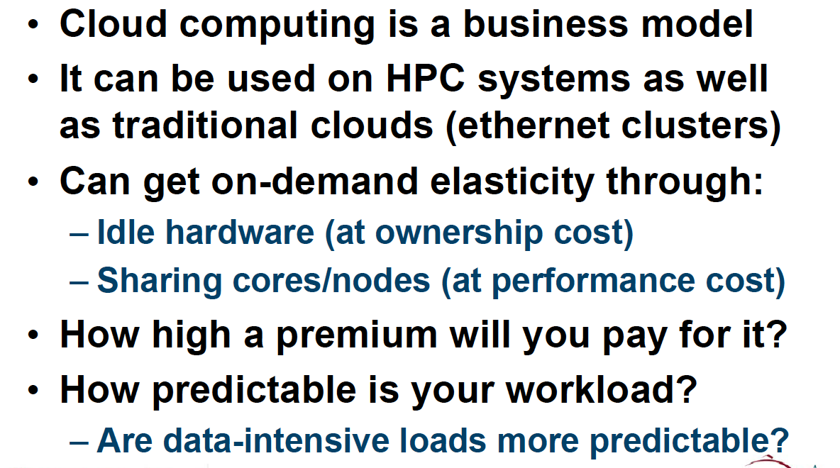
.. Its all about the Buisiness Model (adapted from Kathy Yelick)

