Slide 1
PetaShare
(storage)
generic.py
(HPC machine )
experiment
(local machine )
Uploading input files from
local experimental machine
to PS
if ‘tag.in’ is not exsited,
copy files to PS
write file ‘tag.in’ on PS
pull
push
run
Pull input files from PS
ex) tx.in
r.in
v.in
If ‘tag.in’ exists
then copy files
from PS to HPC
remove ‘tag.in’ for
version control
Push input files to PS
ex) tx.out
r.out
v.out
If ‘tag.out’ exists
then copy files
from HPC to PS
remove ‘tag.out’ for
version control
hit run through
SAGA(BigJob)
Downloading output files
from PS
to local experimental machine
if ‘tag.out’ is not exsited,
copy files from PS
write file ‘tag.out’ on PS

Slide 2
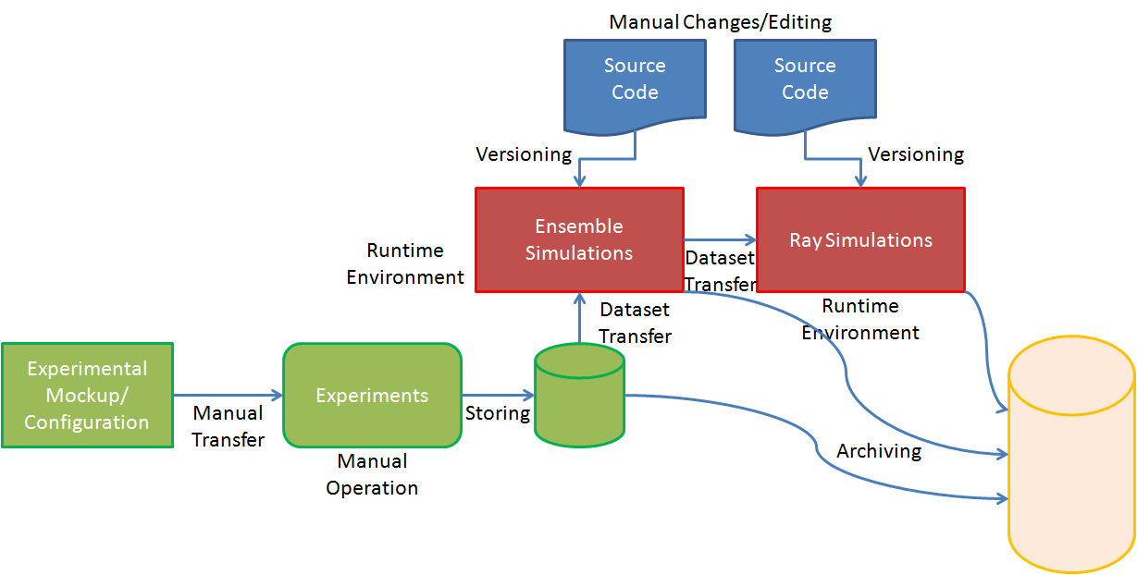

Slide 3
Manual Changes/Editing
Source Code
Source Code
Versioning
Versioning
Black Oil Reservoir Simulation
EnKF (Ensemble Karman Filter) Simulations
Runtime Environment
Dataset Transfer
Dataset Transfer
Runtime Environment
Experimental Mockup/ Configuration
Experiments
Monitoring
Manual Transfer
Storing
Manual Operation
Archiving

Slide 4
PetaShare
(Observation data)
n Reservoir Simulation
Results from reservoir sim.
Will be input to EnKF
EnKF
Simulation
n
Monitoring PetaShare
If new observation data are existed
Finish

