Slide 1



A Brief Introduction to SAGA
Building and Installing

Slide 2
Distributed Applications Development Challenges
Ability to develop simple or effective distributed applications
Distributed CI: Is the whole > than the sum of the parts?
App. that utilize resources sequentially, concurrently or asynchronously is low
Developing Distributed Applications is fundamentally hard:
Intrinsic:
Control & Coordination over Multiple & Distributed sites
Dynamical and Heterogeneous resources and variable control
Complex Design point/Models of Distributed Applications,
Reasons for using distributed CI -- more than (peak) performance result, thus a complex design point
Extrinsic:
(Complex) Underlying infrastructure & its provisioning
Deployment and Exec. environment dependent on development tools
Large number Programming systems, tools and environments
Lack of well-defined interfaces & abstractions
Interoperability and extensibility become difficult
See: DPA Survey Paper (sub. to ACM CS) & http://grid2009.org/bestpaper

Slide 3


SAGA: In a nutshell
There exists a lack of Programmatic approaches that:
Provide general-purpose, basic &common grid functionality for applications and thus hide underlying complexity, varying semantics..
The building blocks upon which to construct “consistent” higher-levels of functionality and abstractions
Meets the need for a Broad Spectrum of Application:
Simple scripts, Gateways, Smart Applications and Production Grade Tooling, Workflow…
Simple, integrated, stable, uniform and high-level interface
Simple and Stable: 80:20 restricted scope and Standard
Integrated: Similar semantics & style across
Uniform: Same interface for different distributed systems
SAGA: Provides Application* developers with units required to compose high-level functionality across (distinct) distributed systems
(*) One Person’s Application is another Person’s Tool

Slide 4
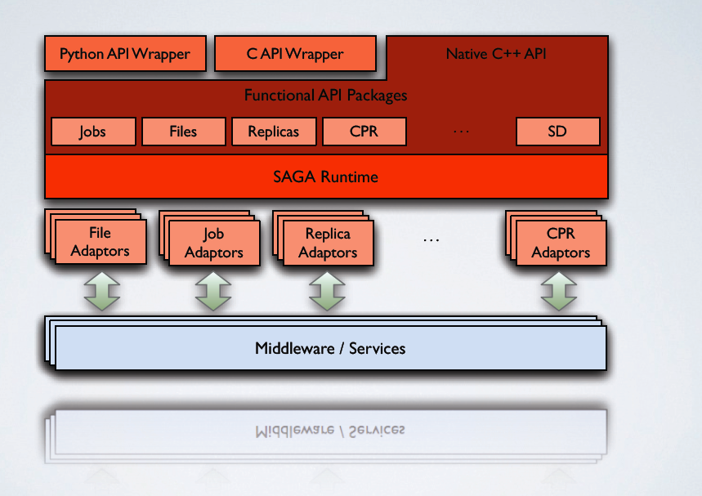
SAGA: In a thousand words

Slide 5
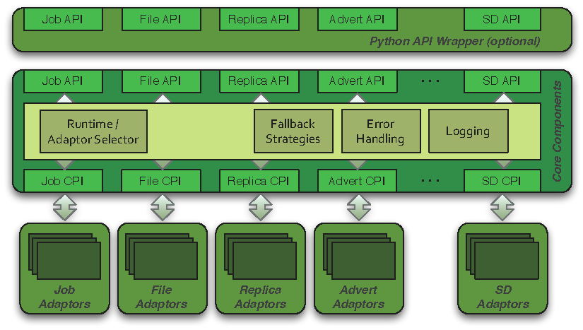
SAGA: Architecture

Slide 6
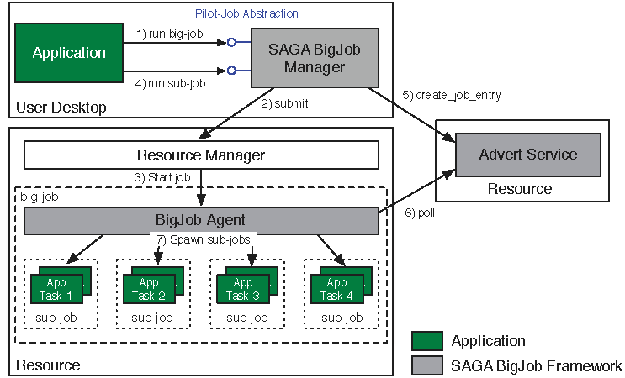
Abstractions for Dynamic Execution (2) SAGA Pilot-Job (BigJob)

Slide 7
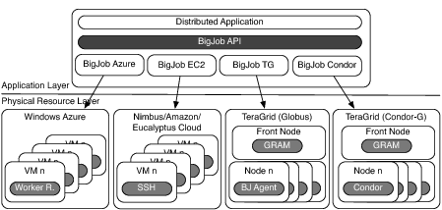
Deployment & Scheduling of Multiple Infrastructure Independent Pilot-Jobs

Slide 8
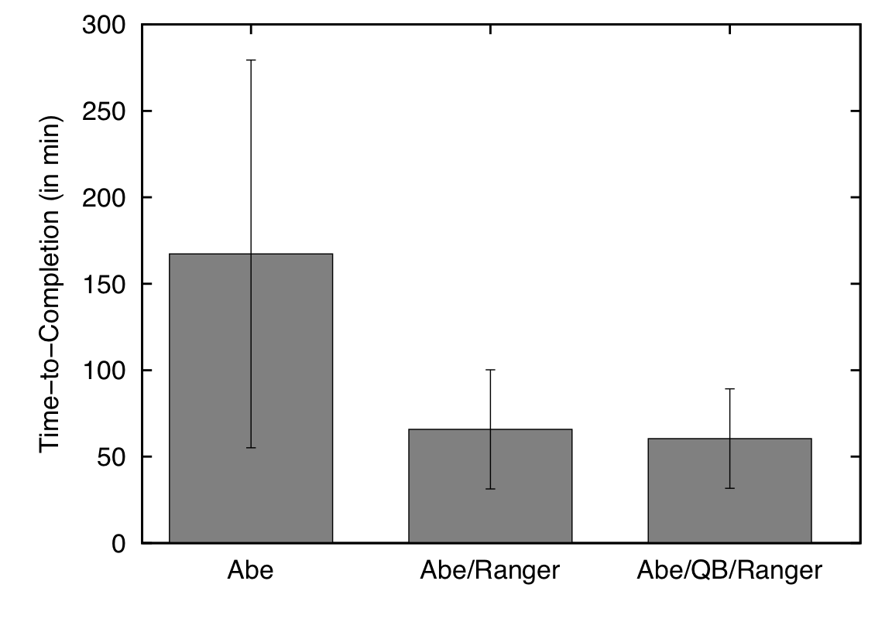
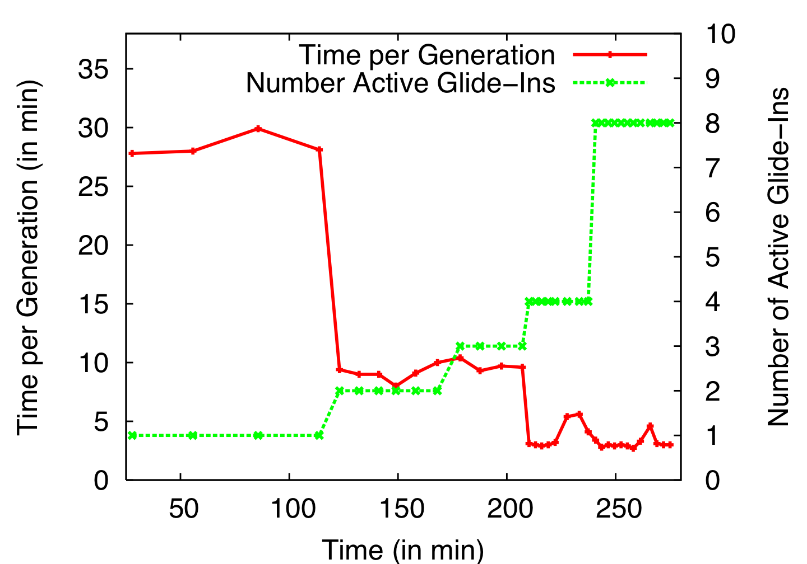
Distributed Adaptive Replica Exchange (DARE) Multiple Pilot-Jobs on the “Distributed” TeraGrid
Ability to dynamically add HPC resources. On TG:
Each Pilot-Job 64px
Each NAMD 16px
Time-to-completion improves
No loss of efficiency
Time-per-generation is measure of sampling
Variants of RE: Sync (local) vs async (distr.)
Luckow, Kim, Schnor, Jha
Adaptive Replica-Exchange,
Phil. Trans of Royal Society A (2009)

Slide 9
Innovation in Distributed Algorithms (1)

Slide 10
Innovation in Distributed Algorithms (2)

Slide 11
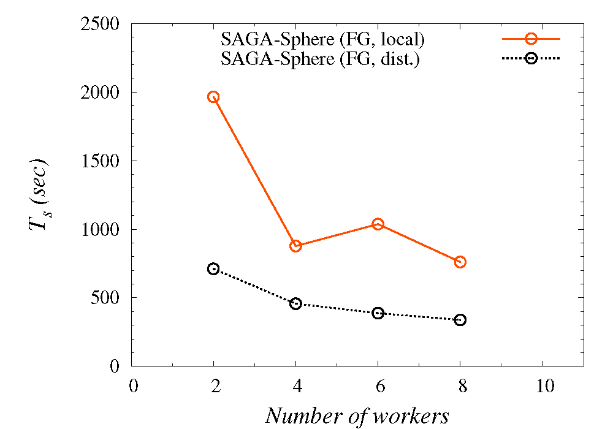
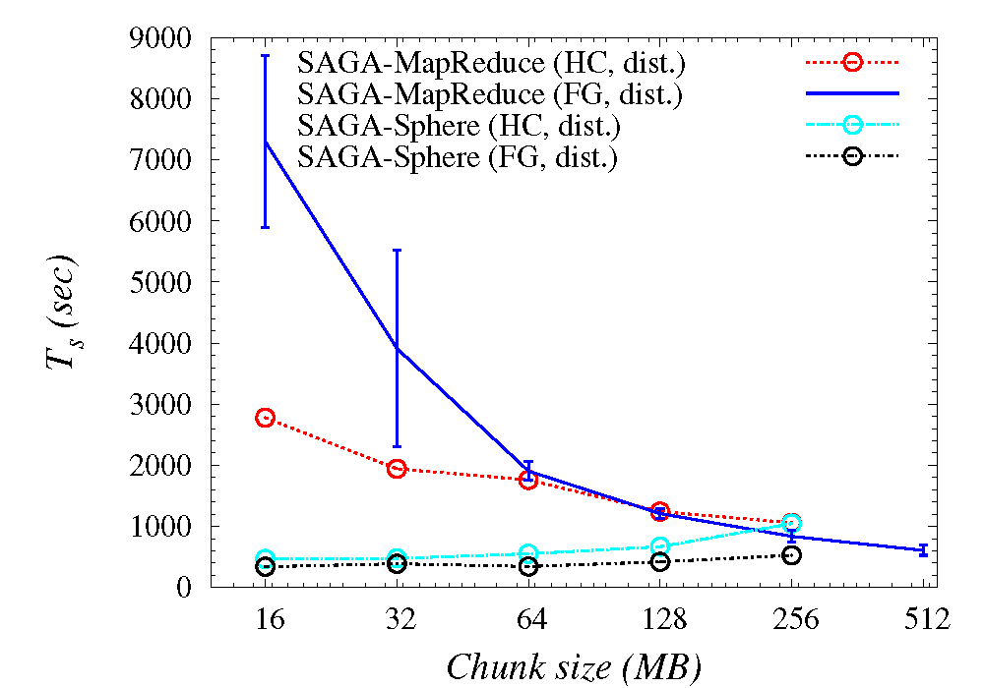
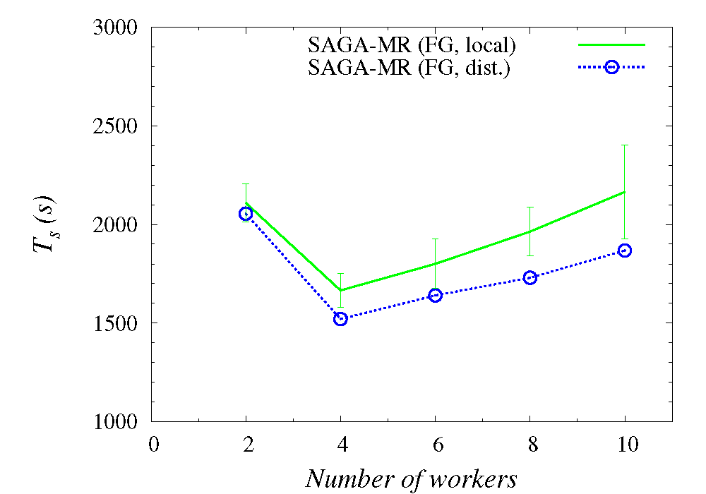
Understanding Distributed Programming Models

Slide 12
Java-based Python SAGA wrapper
C Python
Jython
a user application
a user application
Python Bindings for SAGA
SAGA-C++Py
?
JPySAGA
JySAGA
legacy python bind.
Boost wrapper
C++ Bindings for SAGA
Java Bindings for SAGA
SAGA-C++
JSAGA
Java SAGA
Java GAT

Slide 13
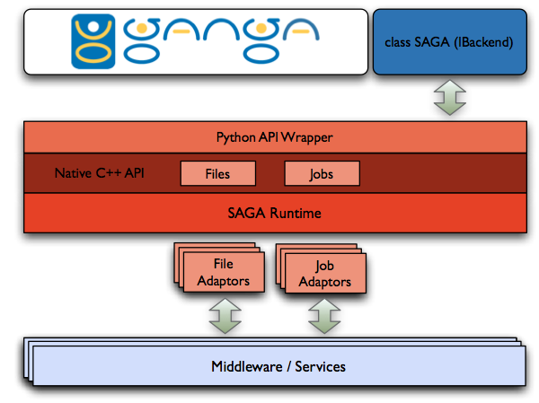
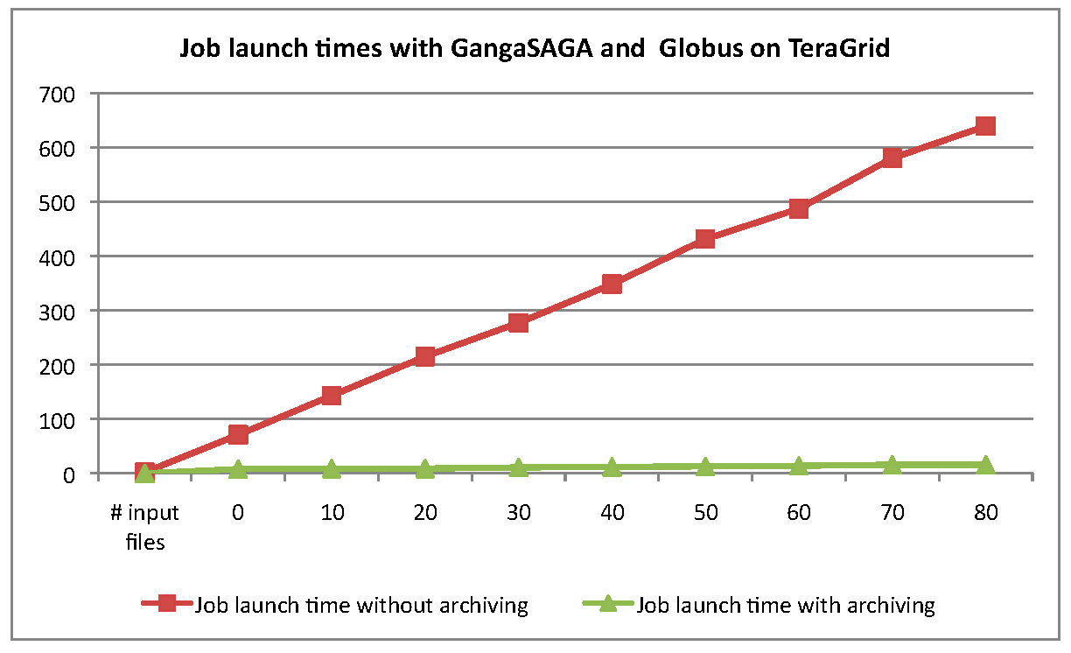
SAGA-GANGA Integration

Slide 14
ExTENCI: TeraGrid-OSG [2010-12] Cactus Application Scenarios
Problem size varies – determinant of Infrastructure used
TG, OSG or either..
MPI-based applications have a very complex SW environment that they need to worry about
Application Scenarios/Usage Modes
1. Ensemble of Cactus Simulations
NumRel, EnKF (Petroleum Eng)
2. Multiphysics Code
GR-MHD, CFD-MD
3. Spawning Simulations
Realtime ‘outsourcing’ from BlueWaters/Ranger to specialised architectures or less powerful resources

Slide 15
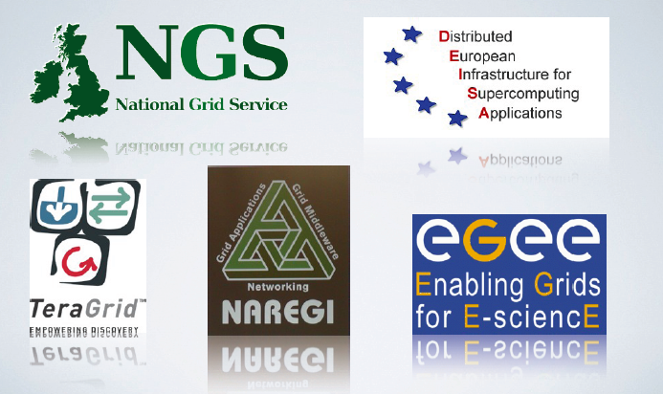
SAGA – Production Grade Software supporting fundamental research

