Slide 1





Joohyun Kim, Sharath Maddineni, Shantenu Jha, Center for Computation and Technology (CCT) Louisiana State University Christopher Gissendanner Department of Biology University of Louisiana at Monroe

Slide 2
Content
DARE-NGS : Demo (Sharath Maddineni)

Slide 3
DARE-NGS with CHiP-Seq
Go to
http://dare.cct.lsu.edu/gateways/ngs/users/login
Login
Email = “test@test.com”, Password= “demo” (without quotes)
Go to
http://dare.cct.lsu.edu/gateways/ngs/ngs/chipseq_form

Slide 4
Demo Cont..
Fill the form
Description = demo
CHOOSE REFERENCE GENOME = “C-elegans”(Drop Down)
CHOOSE MAPPING TOOL=‘’BWA” or “Bowtie”
COLOR SPACE= “Yes”
CHOOSE PEAK CALLING TOOL = “MACS”
CHOOSE CONTROL DATA FOR INPUT= “Snyder_NHR-6v2_Input_L2_rep1_ACGT.fastq”
CHOOSE TREAT DATA FOR INPUT= “Snyder_NHR-6v2_GFP_L2_rep1_ACGT.fastq”
EXPECTED COMPUTATION LOAD = “small”
Hit Submit
Press “OK” in the Popup box
It will take you to the Job Table View
http://dare.cct.lsu.edu/gateways/ngs/ngs/job_table_view

Slide 5
Demo Cont...
Go to Job 19 in 2nd page
Download the BED file
Go to External URL and hit custom tracks
Upload BED file
Go to view and zoom out

Slide 7
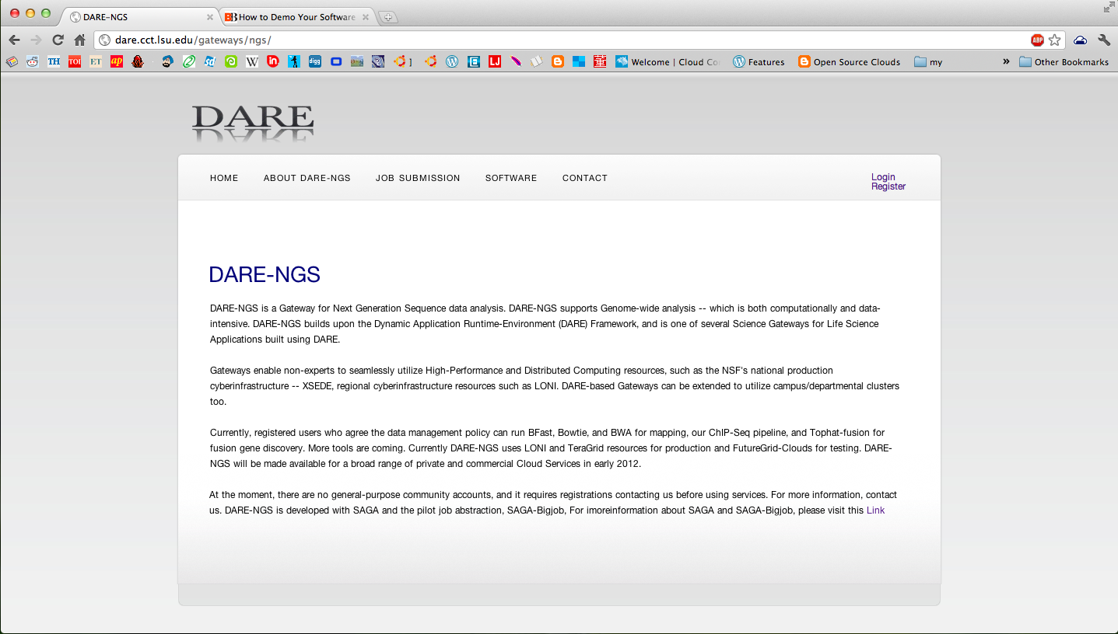

Slide 8
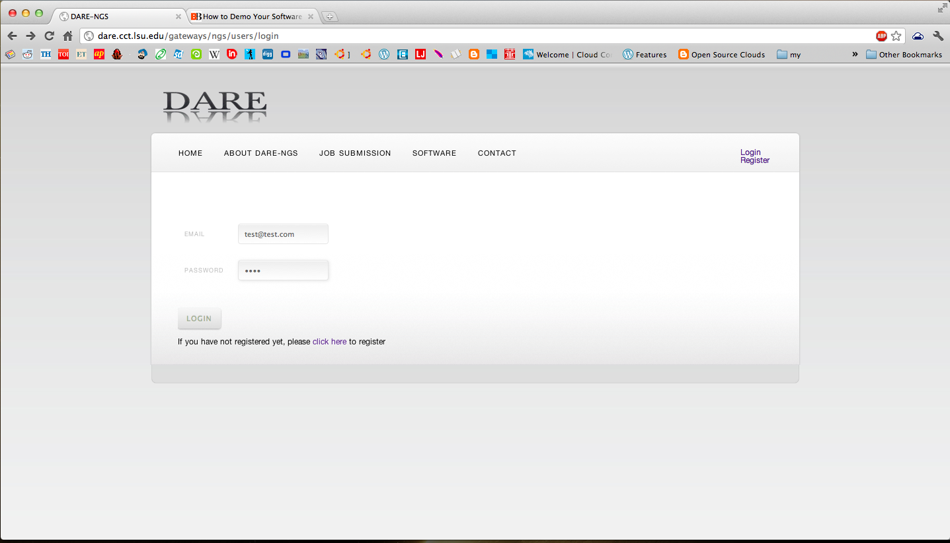

Slide 9
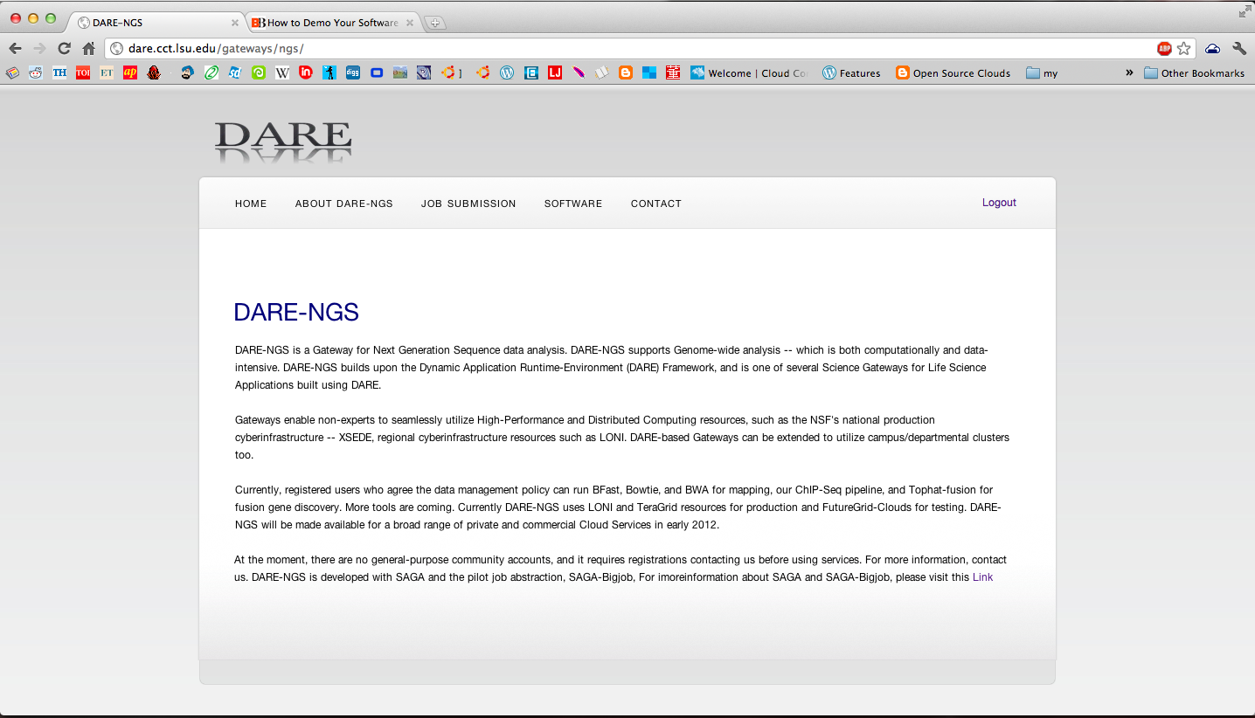

Slide 10
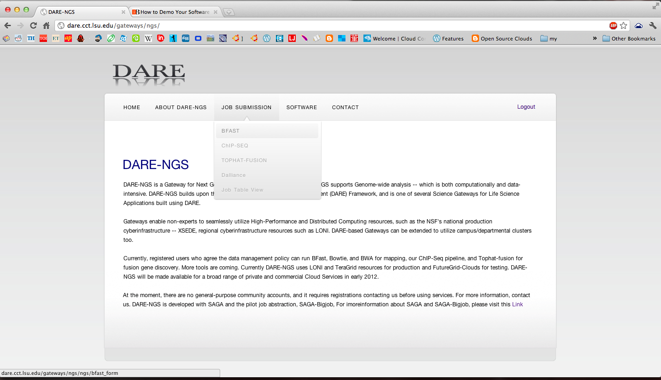

Slide 11
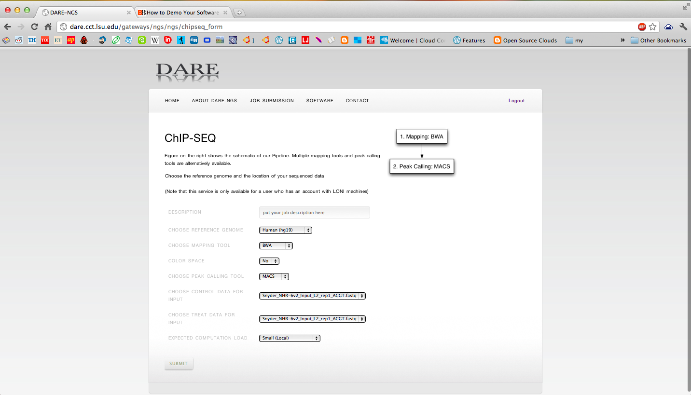

Slide 12
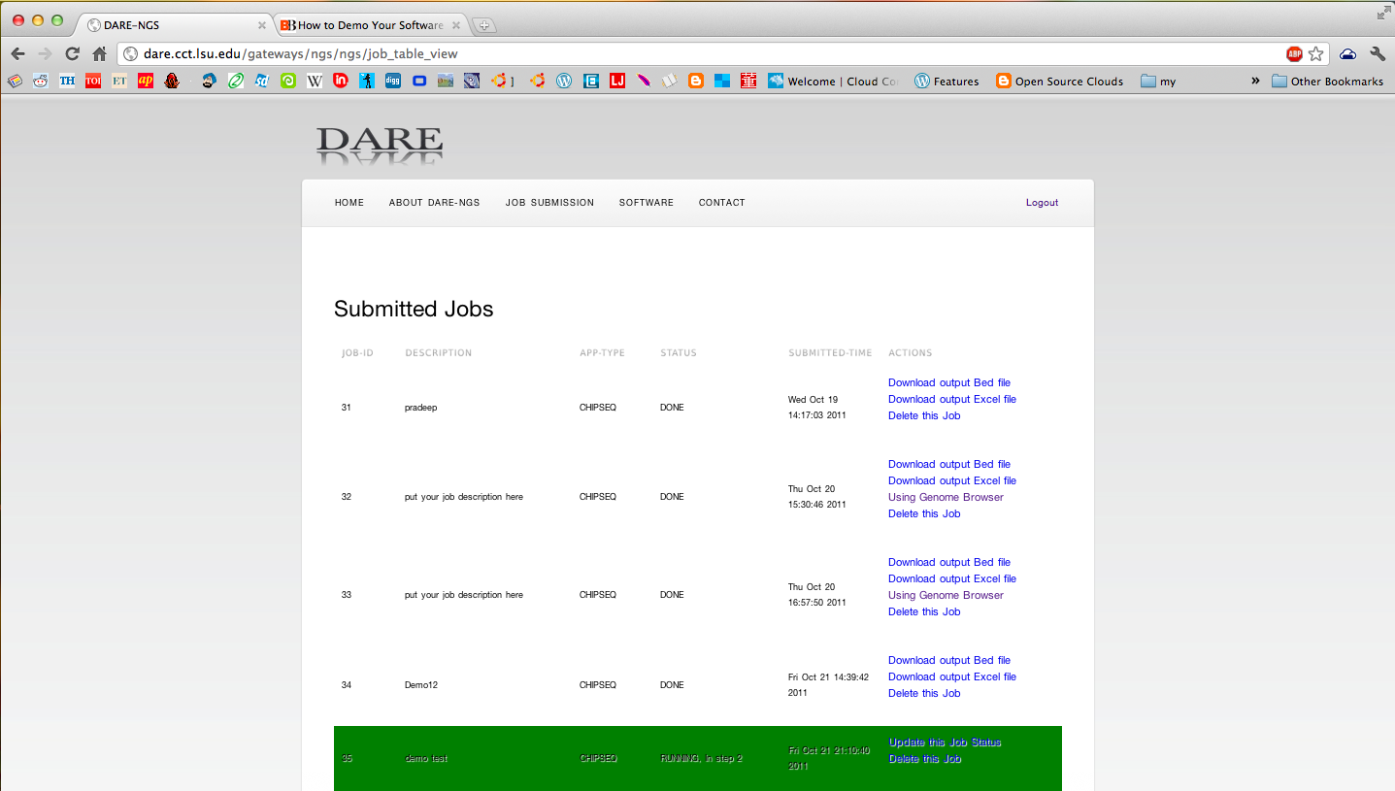

Slide 13
