Slide 1

Abstractions for Loosely-Coupled and Ensemble-based Simulations on Azure
Andre Luckow and Shantenu Jha
http://saga.cct.lsu.edu
http://www.cct.lsu.edu/~sjha/dpa_publications/
Notes:
Added slide 3
I think there will not be time to focus on “assertion based” approach, i.e slides 4-7. Possibly include slide 8

Slide 2
Overview
Introduction: Understanding Distributed Abstractions
Introduce IDEAS as minimal set of DA Design Objective
SAGA, Pilot-Jobs and SAGA BigJob
Abstractions for dynamic executions
Pilot-Job: Power of “right” Abstractions
Interoperability is the starting point
EnMD and RE Simulations
Free Energy Calculation (e.g replica-exchange) using bio-molecular simulations for range of biophysical and personalized medicine
BigJob on Azure: Architecture, Performance and Scalability
Utilizing Azure’s native abstractions

Slide 3
DPA: Primary Observations
Is large (and rich), but the number of effective and extensible DA small
More than just submitting jobs here and there!
Developing DA is a hard undertaking
Intrinsic and Extrinsic Factors
Unique role of the Execution Environment (Infrastructure)
Embrace “distributedness”
Understanding distributedness, heterogeneity & dynamic execution is fundamental (e.g., Exascale logically distributed prog. Models)
Data-centric application will be the drivers!
Role for Pattern-oriented and Abstractions-based Development
Autonomic approaches required to manage complexity and dynamism

Slide 4
Assertion #1: The space of possible DA is large, but number of effective DA small
TODO add slide from grid 2010

Slide 5
Assertion #2: Developing DA is a hard undertaking
Intrinsic reasons why developing DA is fundamentally hard:
Control & Coordination over Multiple & Distributed sites
Effective coordination in order for whole > sum of the parts
Complex design points; wide-range of models of DA
Many reasons for using DA, more than (just) peak performance
Extrinsic:
Execution environments will be dynamic, heterogeneous and varying degrees-of-control
Fundamental different variation in role of Execution Environment- distinguishing feature of DA from “regular environment” HPC
Application types strongly coupled to the infrastructure capabilities, abstractions/tools, & policy:
Often development tools assume “specific” deployment and execution environments, or don’t where needed!
Policies and tools, e.g production DCI has been missing for DDDAS

Slide 6
Assertion #3: Embrace Distribution
“History of computing like pendulum, swings from centralized to distributed”
Indications this time there is a fundamental paradigm shift due to DATA
Too much to move around; learn how to do analytics/compute in situ
Decoupling and delocalization of the producers-consumers of computation
Localized special services; people and collaborations are distributed
(Ironically) Most applications have been developed to hide from heterogeneity and dynamism; not embrace them
Programming models that provide dynamic execution (opposed to static), address heterogeneity etc
Logically vs Physically Distributed: NG programming models will need to support dynamic execution, heterogeneity at a logically-distributed level

Slide 7
Assertion #3: Embrace Distributedness Corollary: Clouds are not Panacea
Clouds: Novel or more of the same?
Better control over software environment via virtualization
Illusion of unlimited and immediate available resource can lead to better capacity planning and scheduling
Partly due to underlying economic model and SLAs
Clouds do not remove many/all of the challenges inherent in DA
Clouds are about provisioning, grids are about federation
Fundamental challenges in distribution remain
Makes some thing worse as impose a model of strong localization
“The reason why we are so well prepared to handle the multi-core era, is because we took the trouble to understand and learn parallel programming” – Ken Kennedy
Clouds part of a larger distributed CI
Certain tasks better suited for Grids, others on Clouds
Notes:
“Clouds are about provisioning, grids are about federation”
“IF you can keep your head when all about you, Are losing theirs and blaming it on you..”
“The reason why we are so well prepared to handle the multi-core era, is because we took the trouble to understand parallel programming

Slide 8
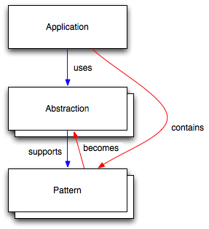
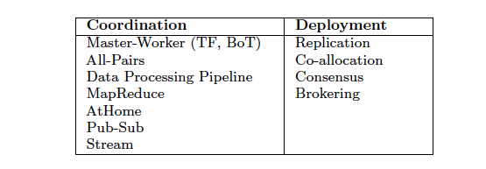
Role for a Pattern-Oriented and Abstraction-Based Development Cycle
Relation between Application, Abstractions and Patterns:
Application: Need or can use >1 R
Patterns: Formalizations of commonly occurring modes of computation, composition, and/or resource usage
Develop, Deploy & Exec Phase
Abstractions: Process, mechanism or infrastructure to support a commonly occurring usage

Slide 9
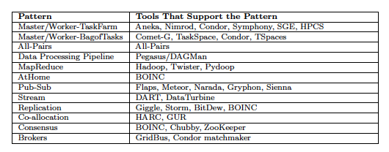
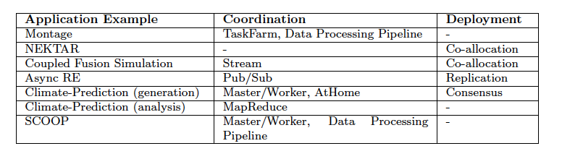
Assertion #4: Role for a Pattern-Oriented and Abstraction-Based Development Cycle
Analysis of Distributed Applications leads to three types of patterns
Patterns that appear in the Parallel Programming
Patterns driven by distributed concerns (eg @HOME, consensus)
Patterns addressing distributed environment concerns exclusively (eg co-allocation)
There exists tools that support patterns, i.e., provide abstractions

Slide 10
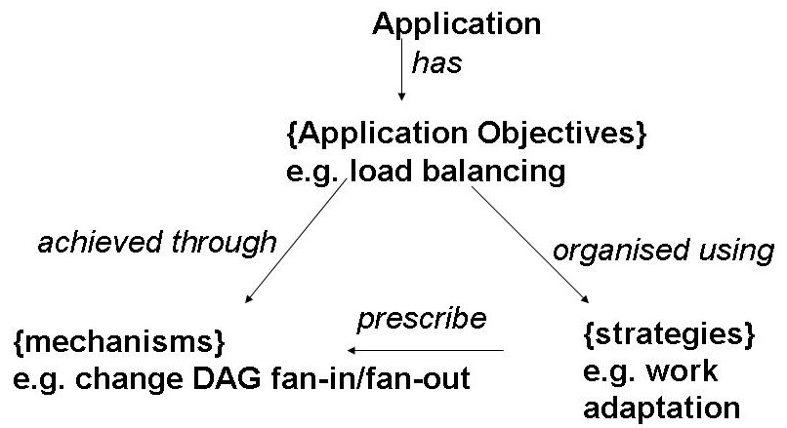
Assertion #5: Need an Autonomic Approach to managing complexity and dynamism
Challenges in Distributed Applications:
Complexity: Multiple-levels, External Dependency, Varying control
Dynamism: Changing resource availability and requirements
Posit that Autonomic Approaches can help address two challenges
Provide formulations that hide complexity & support dynamism
Programming the Infrastructure “autonomically”
Objective: Intelligence in Compute-Data placement
Sophisticated models of data-compute co-movement
Tier 0 data at BNL; all compute migrated to Tier 0
For an objective, which strategy?
S1: Assignment of workers determined by min T_{r}
S2: Assignment of workers, by min data transfer
S3: Upon tracked dependencies
Each SN: Could have different mechanism

Slide 11
IDEAS: DA Development Objectives
Interoperable: Ability to work across multiple resources concurrently
Includes jobs submission, coordination mechanism,
Dynamic: Beyond legacy static execution & resource allocation models
Decisions at both deployment and run-time
Dynamical execution is almost fundamental at scale
Extensible: Support new functionality & infrastructure without wholesale refactoring, i.e., lower coupling to tools & infrastructure
Adaptive/Autonomic: Flexible response to fluctuations in dynamic resources, availability of dynamic data
Scalable: Along many dimensions and design points
Challenge: To develop DA effectively and efficiently with IDEAS as first class objectives with simplicity an over-aching concern
Notes:
“User knows where to run”:
“Information Service is only required to determine decisions at the deployment stage not run time”
“Tool X provides Dynamic Decision Capabilties”

Slide 12

SAGA: In a nutshell
There exists a lack of Programmatic approaches that:
Provide general-purpose, basic & common grid functionality for applications; hide underlying complexity, varying semantics..
The building blocks upon which to construct “consistent” higher-levels of functionality and abstractions
Meets the need for a Broad Spectrum of Application:
Simple scripts, Gateways, Smart Applications and Production Grade Tooling, Workflow…
Simple, integrated, stable, uniform and high-level interface
Simple and Stable: 80:20 restricted scope and Standard
Integrated: Similar semantics & style across
Uniform: Same interface for different distributed systems
SAGA: Provides Application* developers with units required to compose high-level functionality across (distinct) distributed systems
(*) One Person’s Application is another Person’s Tool

Slide 13
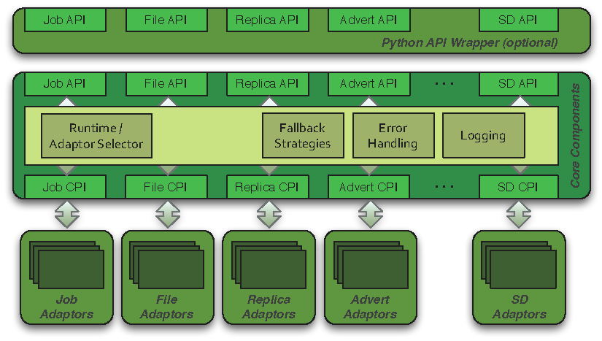
SAGA: Architecture

Slide 14
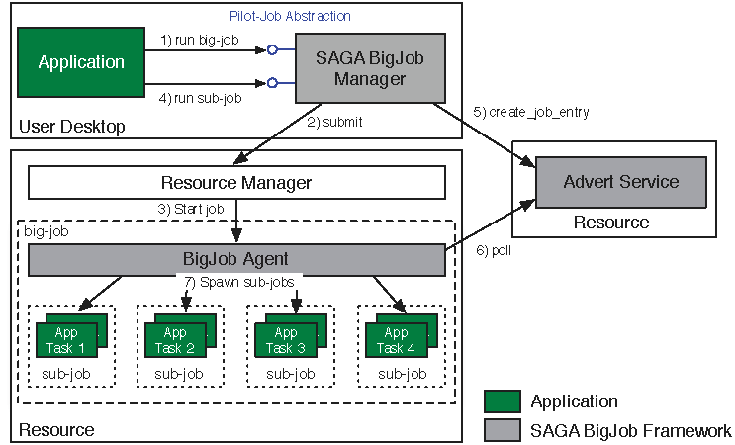
Abstractions for Dynamic Execution SAGA Pilot-Job (BigJob)

Slide 15
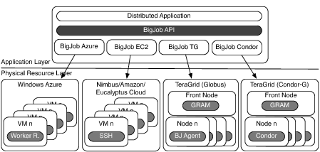
Deployment & Scheduling of Multiple Infrastructure Independent Pilot-Jobs

Slide 16
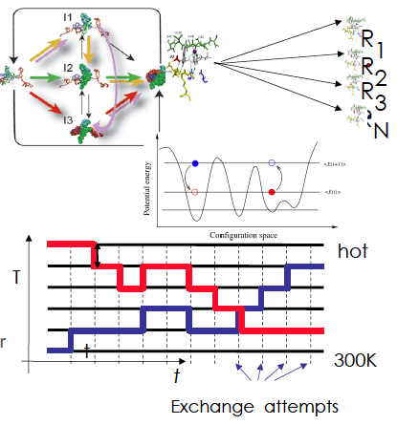
Ensemble and Replica-Exchange Simulations
Replica-Exchange (RE) methods:
Represent a class of algorithms that involve a large number of loosely coupled ensembles.
RE simulations are used to understand a range of physical phenomena
Protein folding, unfolding etc
MC simulations
Many successful implementations
e.g. folding@home [replica based]

Slide 17
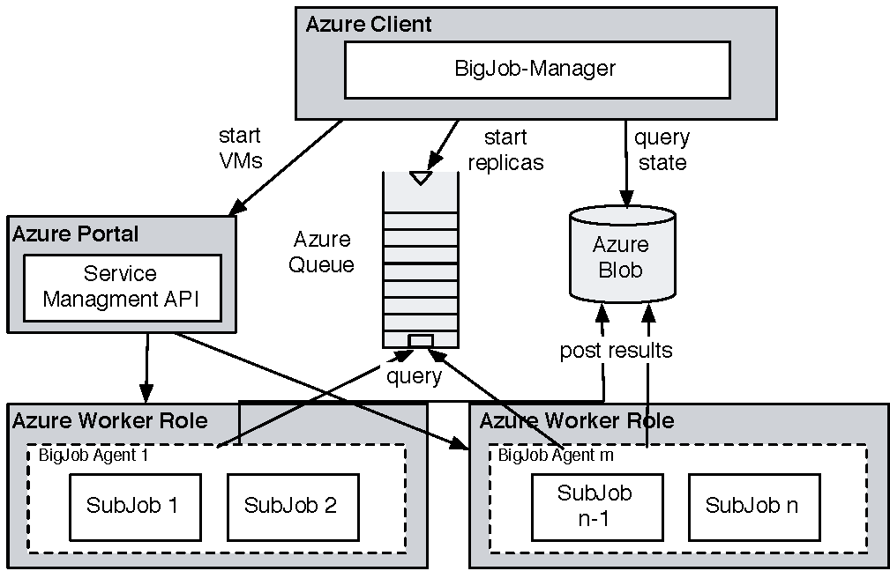
Azure: Using BigJob API and Coordinating Multiple Tasks
For Replica-Exchange application, take SAGA-BigJob and implement on Azure to test for performance
CONCLUSION: For same workload, comparable in performance to TG!
BUT SIMPLER to implement than TG!

Slide 18
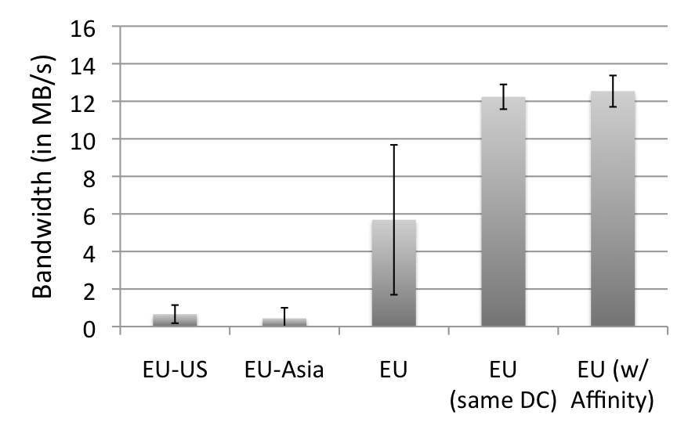
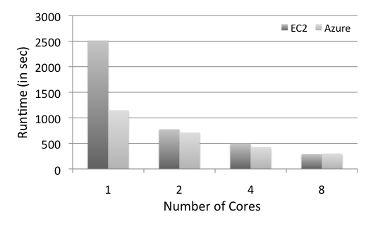
Azure: Scalability with Simplicity Providing Infra-level abstractions for DDIA
NAMD Performance on Azure
Three types of storage abstractions:
Azure Blob Service: Large amounts of raw data
Block Blob: Large chunks of 5GB
Page Blob: Mange storage as an array
Azure Table Storage: Semi-structured data
Azure Queue Storage: Message Queues
All three replicated and with strong consistency semantics
Current affinity operates at the data-center level;
Enhanced/finer-grained affinity to be made available
Azure Network Performance

Slide 19
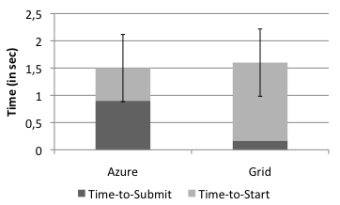
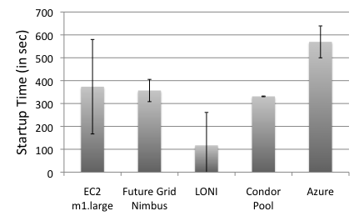
BigJob on Azure
BigJob Startup Times
In Grids the BigJob startup time depends mainly on queuing time
Azure shows a longer startup than Amazon EC2 and FutureGrid
Amazon EC2 has the highest fluctuation in the startup time (from all cloud resources)
Sub-Job submission times are comparable
BigJob Sub-Job Submission Times

Slide 20
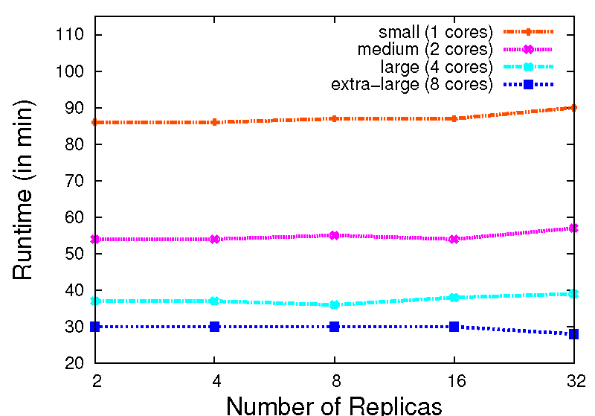
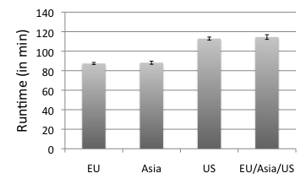
Replica-Exchange on Azure
Replica-Exchange has been ported to BigJob Azure
Azure BigJob scales well with the number of replicas.
Azure Queues proved to be effective for coordination of sub-jobs
Larger VMs have a better performance. But, efficiency drops <0.4 for the extra-large VM
The different Azure data centers show a slight fluctuation in their performance

Slide 21
Although Clouds are not Panacea..
Nascent infrastructure do what Production DCI have not managed!
“We” have lost intellectual leadership to commercial providers!
Community busy agenda pushing, e.g, middleware/software stacks, most innovation in DC has come from commercial sector!
Infrastructure, Algorithmic & Development
e.g., (re-discovering) MapReduce
Simplicity is the Ultimate Sophistication
“It seems that perfection is attained not when there remains nothing to add, but when there remains nothing to remove”
Confuse Functionality with Usability
“Confused Beauty for Truth”, -- “How Did Economists Get It So Wrong?”, in analogy to the Financial Crisis
Moral and Intellectual courage to admit we got it wrong
More condemnation in Grid2009, “Critical Analysis of PGI and DA”

Slide 22
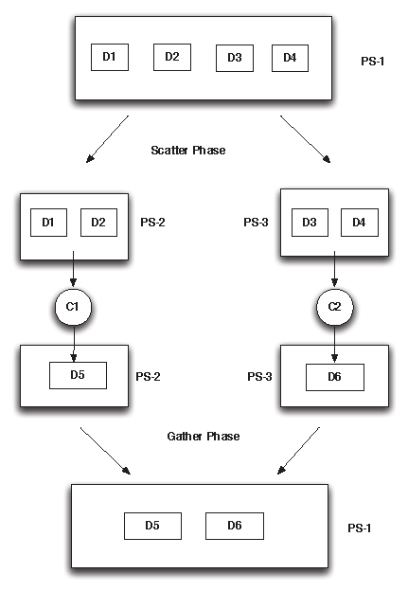
Future Work: Pilot Data
Pilot Data:
Abstraction for expressing data localities and affinities.
Pilot Data can be used to create groups of file that are always used together
Pilot Data provides a set of basic operations on top of these file groups
Pilot Store: A container that represents a logical group of physical files that share the same affinity.
Abstraction can be used to express C-C, C-D and D-D affinitities
Notes:
(D1) Data Management: This concerns all aspects associtaed with the lifecycle maintenance of data including: acquisition, access, archiving, to name a few. This includes the policies and practices that control, protect, deliver and enhance the value of data.
• (D2) Distribution: Data is either distributed or needs to be distributed. This raises the issue of efficient and reliable large-scale data transport and the association of computation to date.
• (D3) Dynamism: Data may be dynamically generated and collected (e.g. via sensors) that trigger adaptive computation and steering which may in turn impact the data collection process. This has been termed dynamic data driven application systems (DDDAS) or more recently InfoSymbiotic systems.
• (D4) Access Mechanisms: Data access includes low-level protocols that hide the distribution and heterogeneous nature of data sources via uniform interaces. This also includes access policy that govern who is allowed to access (read or write) data and under what conditions.
• (D5) Performance: Access to large-scale distributed data raises critical performance concerns with respect to scale-up and scale-out
• (D6) Data Integration : Data residing in different sources must be com- bined to provide users with a unified view. Associated issues include format conversion, the use of data shims, and semantic descriptors and ontologies to help harmonize the data.

