Slide 1


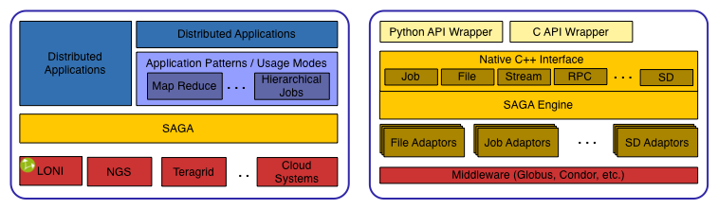
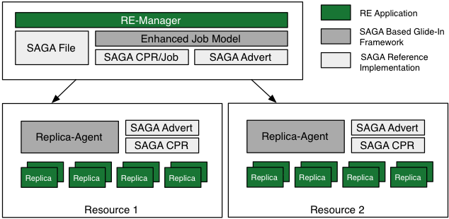
Enabling Distributed Applications with SAGA Shantenu Jha¹², Hartmut Kaiser¹, André Merzky¹, Ole Weidner¹, Joao Abecasis¹, Joohyun Kim¹ and Andre Luckow³ 1 Center for Computation & Technology, Louisiana State University, Baton Rouge, U.S.A. ²e-Science Institute, Edinburgh. ³Institute of Computer Science, Potsdam, Germany
Abstract
The Simple API for Grid Applications (SAGA), a proposed recommendation of the Open Grid Forum (OGF), defines a high-level programmatic interface for developers of Distributed Applications [1]. The fundamental idea of SAGA is to lower the barrier for applications and application scientists to utilize distributed infrastructure. SAGA provides a simple, uniform, stable interface to the most often required functionality in order to construct general purpose, extensible and scalable applications.
Our group has lead the SAGA effort, starting from the specification effort at the OGF to providing the first C++ implementation [2]. We are also developing several different novel applications, using SAGA to harness the power of distributed infrastructure.
SAGA has already been used to develop different types of distributed applications. Namely, (i) converting legacy applications to utilize distributed resources; (ii) development of applications based upon abstractions and frameworks that are themselves developed using SAGA; (iii) first principles applications, explicitly cognizant of the fact that they will operate in a distributed environment, where the application logic is coupled with the distributed logic. SAGA supports the development of these applications and many others, thus providing a tool to develop a broad and general class of applications.
Simple, Powerful Abstraction Layer
SAGA provides a simple, powerful, programmatic interface. Additionally, SAGA provides the abstractions from which commonly occurring patterns and usage modes can be supported. Thus SAGA is being used to facilitate the uptake of distributed infrastructure and development of distributed applications in several critical ways. See figures below. For example:
SAGA provides a single-interface across different middleware distributions and environments. SAGA provides adaptors for the most commonly occurring distributed environments. This enables the use of distributed infrastructure by. Therefore once an application has been written using SAGA it can be deployed and run on any environment in which SAGA is supported.
SAGA provides the ability to support different distributed applications types and their usage modes. For example, a common characteristic of applications is existence of multiple sub-jobs and the need to launch and coordinate these sub-jobs. These sub-jobs might be either identical (replicas) or different, and could be either loosely-coupled or de-coupled. SAGA supports these different application classes and usage modes by providing support for hierarchical job-submission patterns, migration, and bulk submission amongst others functionality. Other usage modes supported include Master-Worker.
For data-intensive applications, we create a framework that supports the common MapReduce pattern. There are many other patterns that can be created in a infrastructure-independent manner, thus enabling traditional applications (such as sequence alignment and searching) to be reformulated to use these patterns and exploit distributed infrastructure.
.
Enabling Distributed Applications
SAGA can support a wide range of applications types. Here we discuss three specific applications, belonging to difference categories, that have been developed using SAGA:
Providing “Legacy Applications” with novel, agile, distributed execution modes. For example, we have re-architected a Kalman-Filter based application to enable it to determine at run time, the optimal resource to launch sub-jobs and to be able to dynamically exploit multiple resources concurrently without prior arrangement.
Novel applications written for explicit deployment on distributed infrastructure, i.e. first-principles distributed application [Ref 3,4]
Expose “Legacy Applications” to distributed environments. In this approach, application kernels are implicitly deployed while the orchestration & management is done using agents written in SAGA. This approach has been used to implement distributed replica exchange (RE) (Fig below). The time-to-solution (ie. # of exchanges) decreases with greater number of distributed resources.
References
Goodale, T, Jha, S, Kaiser, H, Kielmann, T, et al (2007), GFD-R-P.90 A Simple API for Grid Applications (SAGA) Open Grid Forum
The SAGA Project [Online]: http://saga.cct.lsu.edu
SAGA Papers [Online]: http://saga.cct.lsu.edu/papers
SAGA Projects [Online]: http://saga.cct.lsu.edu/projects
Acknowledgements: This work was supported primarily by UK EPSRC grant number GR/D0766171/1 (via OMII-UK) and in part by NSF, the La Board-of-Regents and CCT funds.
Notes:
250 word abstract
Connections with cybertools
acknowledgements

