Slide 1
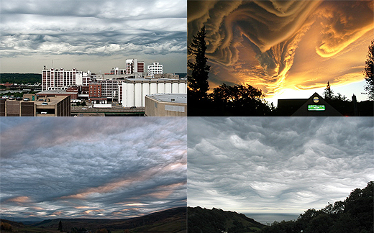




Cloud Models
Infrastructure as a Service
Provide a way to host virtual machines on demand
Amazon ec2 and S3 – you configure your VM, load and go
Platform as a Service
You write an App to cloud APIs and release it. The platform manages and scales it for you.
Google App engine:
Write a python program to access Big Table. Upload it and run it in a python cloud.
Hadoop and Dryad are application frameworks for data parallel analysis
Software as a Service
Delivery of software to the desktop from the cloud
Stand-alone applications (Word, Excel, etc)
Cloud hosted capability
doc lives in the cloud
Collaborative document creation
Adopting Clouds

Slide 2
Cloud Models
Infrastructure as a Service
Provide a way to host virtual machines on demand
Amazon ec2 and S3 – you configure your VM, load and go
Platform as a Service
You write an App to cloud APIs and release it. The platform manages and scales it for you.
Google App engine:
Write a python program to access Big Table. Upload it and run it in a python cloud.
Hadoop and Dryad are application frameworks for data parallel analysis
Software as a Service
Delivery of software to the desktop from the cloud
Stand-alone applications (Word, Excel, etc)
Cloud hosted capability
doc lives in the cloud
Collaborative document creation
Adopting Clouds
The issue is not whether to adopt or not, but what elements to adopt, for what and how?

Slide 3
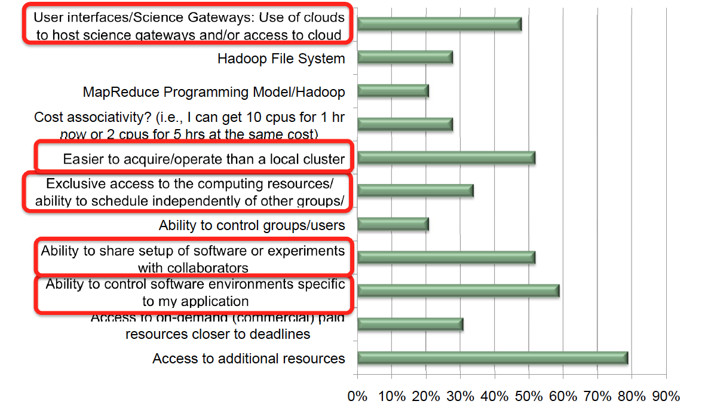
Cloud Computing Interest (adapted from Kathy Yelick)
X
Y/N
Y/N
X
Notes:
Will focus on SW environments and control/ease of deployment
Programming Model --- not necessarily Cloud-based, Confusing Good/Efficient Implementation with their validity!!
Access to “on-demand” – nothing unique about Clouds: It’s a buisness model, it’s a policy issue
“Exclusive Access” – or the abstraction of it..

Slide 4
Why Adopt Clouds? A Computer & Computational Science Perspective
Ability to control software environment
Research/Facilitate collaboration:
Programming Models and RT Systems for DIC
Interoperability Experiments of standard endpoint
Teaching:
FutureGrid: LSU CSC 7700 Distributed Scientific Comp
Computational Biology: Replica-Exchange Simulations
O(100) midsize parallelism ensemble loosely coupled
TeraGrid or Clouds?
Azure: Simplicity with Performance and Scalability
Basis for Application Novel Usage (Execution) Modes

Slide 5
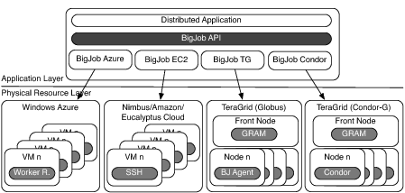
SAGA-BigJob: Infrastructure Independent Pilot-Jobs

Slide 6
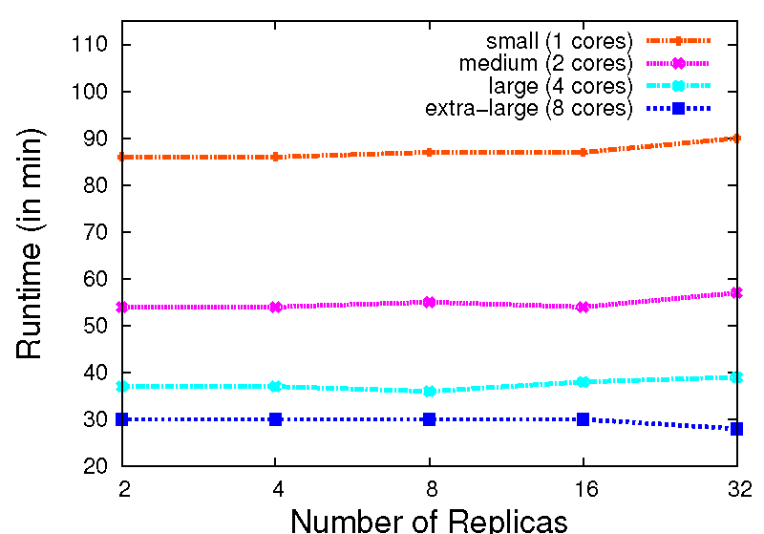
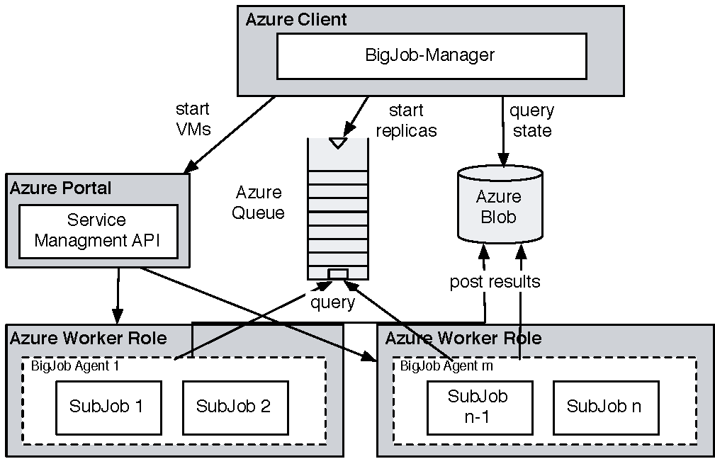
Azure: Using BigJob API and Coordinating Multiple Tasks
Azure BigJob scales well with the number of replicas.
AQS proved to be effective for coordination of replicas
For same workload, comparable in performance to TG BUT SIMPLER to implement

Slide 7
Clouds: A Bottom-Up Perspective
Nascent infrastructure does what production DCI have not managed easily or for the masses (Joe Scientist vs $100M project)
Production DCI Confuse functionality with Usability
While we have been pushing, e.g, middleware/software stacks (think EMI), much innovation in DC has come from commercial sector!
Simplicity is the Ultimate Sophistication:
Data-Intensive: Have we lost intellectual leadership to commercial/enterprise??
It used to be that we were solving different problems, but now:
They have more data than us
They have more $$$ than us
Do they have better approaches than us?
Infrastructure, Abstractions (or at least the applications e.g., re-discovering MapReduce) and Services

Slide 8
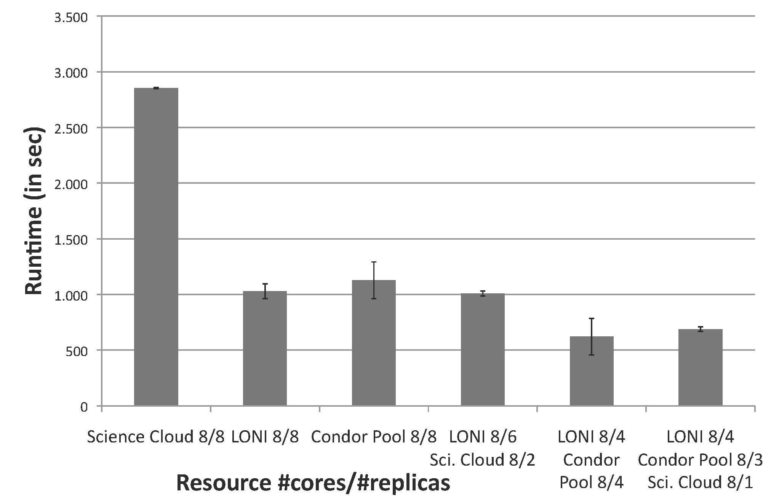
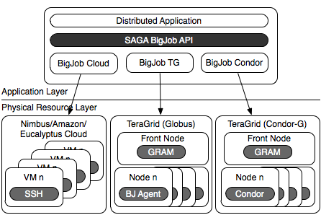
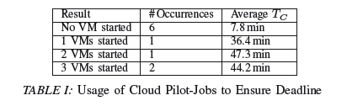
Novel Execution Modes
Scale-out enable new ways of resource planning and application execution
Deadline-driven scheduling: e.g., task done before time T
Adapt workload distribution and resource utilization to ensure completion

