Slide 1

Abstractions for Loosely-Coupled and Ensemble-based Simulations on Azure
Andre Luckow and Shantenu Jha
http://saga.cct.lsu.edu
http://www.cct.lsu.edu/~sjha/
Notes:
Added slide 3
I think there will not be time to focus on “assertion based” approach, i.e slides 4-7. Possibly include slide 8

Slide 2
Overview
Introduction: Understanding Distributed Abstractions
Unique Role for Abstractions for Distributed Applications
Explore abstractions that Azure provides and their suitability for loosely-coupled simulations
Pattern not quite amenable to CIRRUS (at least not out of box)
Thus abstractions for dynamic executions
Interoperable Pilot-Job
EnMD and RE Simulations
Free Energy Calculation using replica-exchange simulations for range of biophysical and personalized medicine
BigJob on Azure: Architecture, Performance and Scalability
Utilizing Azure’s native abstractions

Slide 3
Some Primary Observations
Space of Distributed Applications (DA) Is large (and rich), but the number of effective and extensible DA small
More than just submitting jobs here and there!
Developing DA is a hard undertaking
Intrinsic and Extrinsic Factors:
Coordination across resources & Execution Environment
Embrace “distributedness”
Understanding distributedness -- data-centric application will be the drivers!
Heterogeneity & dynamic execution is fundamental
Points 2 & 3: Point to a unique role for Pattern-oriented and Abstractions-based Development of Distributed Applications

Slide 4
#2: Developing DA is a hard undertaking
Intrinsic reasons why developing DA is fundamentally hard:
Control & Coordination over Multiple & Distributed sites
Effective coordination in order for whole > sum of the parts
Complex design points; wide-range of models of DA
Many reasons for using DA, more than (just) peak performance
Extrinsic:
Execution environments will be dynamic, heterogeneous and varying degrees-of-control
Fundamental different variation in role of Execution Environment- distinguishing feature of DA from “regular environment” HPC
Application types strongly coupled to the infrastructure capabilities, abstractions/tools, & policy:
Often development tools assume “specific” deployment and execution environments, or don’t where needed!
Policies and tools, e.g production DCI has been missing for DDDAS

Slide 5
#3: Embrace Distribution Corollary: Clouds are not Panacea
Clouds: Novel or more of the same?
Better control over software environment via virtualization
Illusion of unlimited and immediate available resource can lead to better capacity planning and scheduling
Clouds do not remove many/all of the challenges inherent in DA
Clouds are about provisioning, grids are about federation
Fundamental challenges in distribution remain
Makes some thing worse as impose a model of strong localization
Programming models that provide dynamic execution (opposed to static), address heterogeneity etc
“The reason why we are so well prepared to handle the multi-core era, is because we took the trouble to understand and learn parallel programming” – Ken Kennedy
Clouds part of a larger distributed CI
Certain tasks better suited for Grids, others on Clouds
Notes:
“Clouds are about provisioning, grids are about federation”
“IF you can keep your head when all about you, Are losing theirs and blaming it on you..”
“The reason why we are so well prepared to handle the multi-core era, is because we took the trouble to understand parallel programming

Slide 6

SAGA: In a nutshell
There exists a lack of Programmatic approaches that:
Provide general-purpose, basic & common grid functionality for applications; hide underlying complexity, varying semantics..
The building blocks upon which to construct “consistent” higher-levels of functionality and abstractions
Meets the need for a Broad Spectrum of Application:
Simple scripts, Gateways, Tooling, Workflow…
Simple, integrated, stable, uniform and high-level interface
Simple and Stable: 80:20 restricted scope and Standard
Integrated: Similar semantics & style across
Uniform: Same interface for different distributed systems
Standards-based approach: A Technical and an Economic (Moral?) imperative & case:

Slide 7
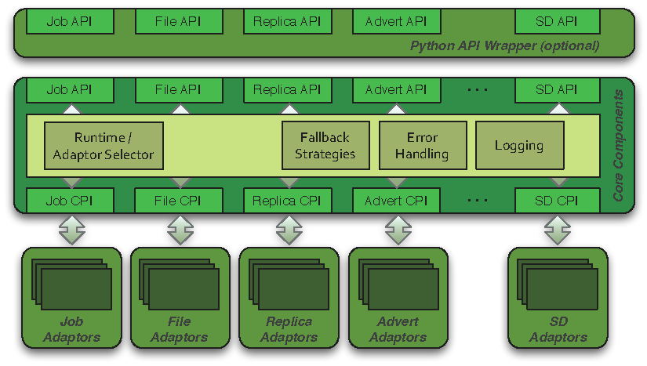
SAGA: Architecture

Slide 8
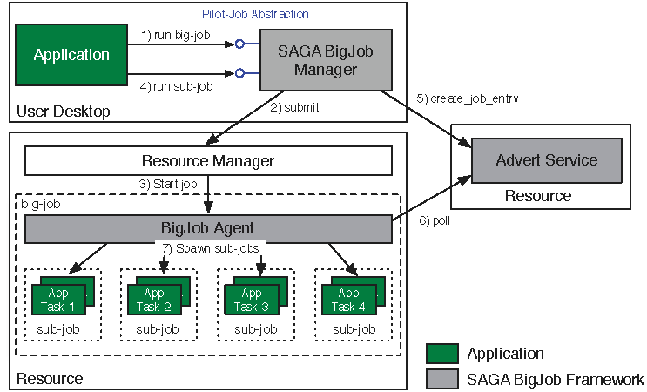
Abstractions for Dynamic Execution SAGA Pilot-Job (BigJob)

Slide 9
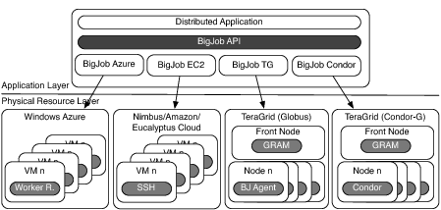
Deployment & Scheduling of Multiple Infrastructure Independent Pilot-Jobs

Slide 10
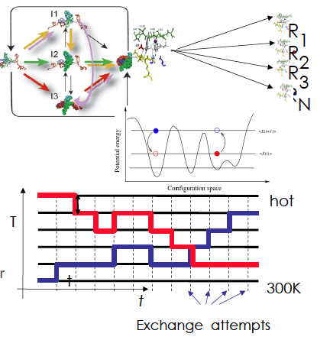
Ensemble and Replica-Exchange Simulations
Replica-Exchange (RE) methods:
Represent a class of algorithms that involve a large number of loosely coupled ensembles.
RE simulations are used to understand a range of physical phenomena
Protein folding, unfolding etc
MC simulations
Many successful implementations
e.g. folding@home [replica based]

Slide 11
BigJob for Azure
Azure BigJob library calls Azure APIs directly
BigJob Manager launches requested number of worker roles using the Service Management API
Python library created for this capability
BigJob Agents run within the worker roles (C#/.Net)
Primary responsibility to execute MD code
MPI-based MD tasks confined to a single worker role (8 cores)
For each sub-job, the BM creates a work-package
Distributed to agents using AQS – reliable and scalable msgs
Agents query AQS for new work-packages
Stage data from ABS

Slide 12
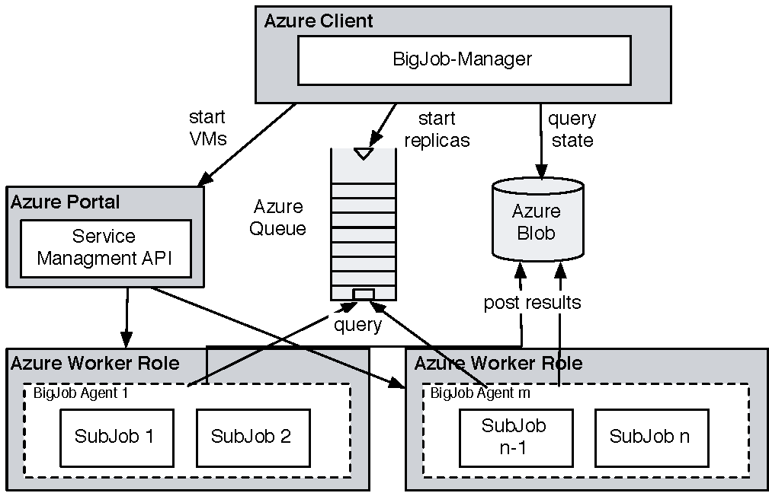
Coordinating Multiple Tasks Using BigJob for Azure
Support for Affinity Groups
Multiple Affinity Groups supported within the same BigJob for different worker-roles

Slide 13
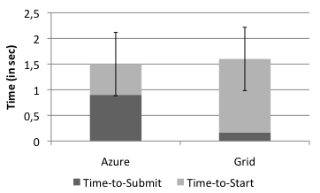
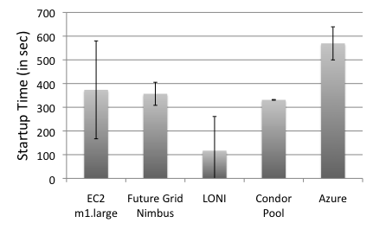
Pilot-Job for Azure: SAGA BigJob
BigJob Startup Times
In Grids the BigJob startup time depends mainly on queuing time
Azure shows a longer startup than Amazon EC2 and FutureGrid
Correlated to system load
Amazon EC2 has the highest fluctuation in the startup time (of all cloud resources)
Sub-Job submission times are comparable
BigJob Sub-Job Submission Times

Slide 14
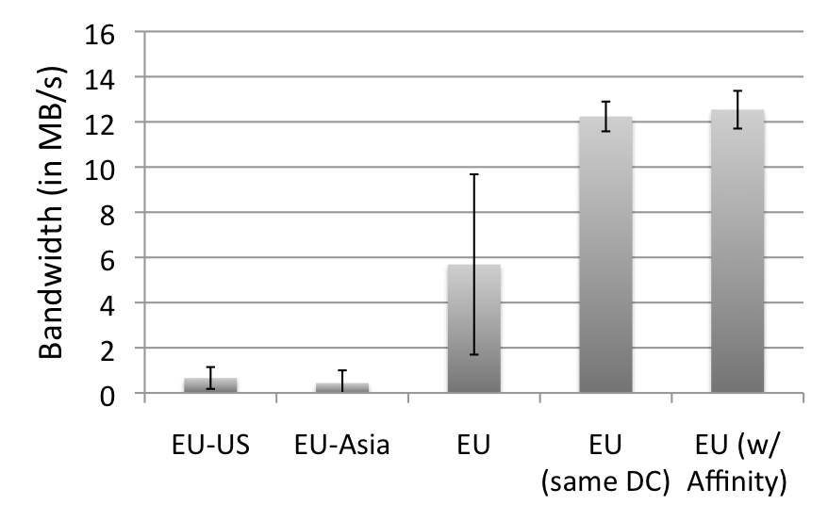
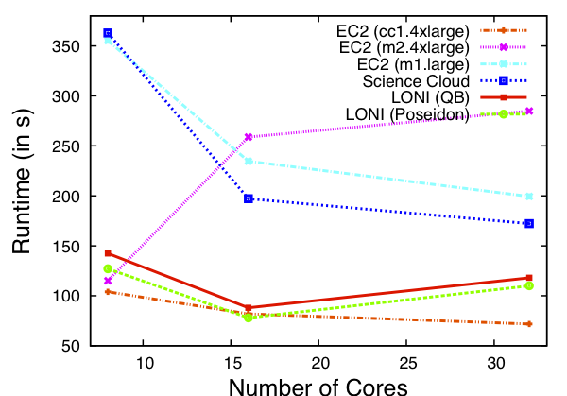
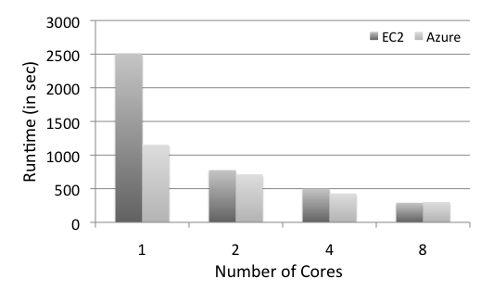
Azure: Scalability with Simplicity Providing Infra-level abstractions for DDIA
NAMD Performance on Azure
Three types of storage abstractions:
Azure Blob Service: Large amounts of raw data
Block Blob: Large chunks of 5GB
Page Blob: Mange storage as an array
Azure Table Storage: Semi-structured data
Azure Queue Storage: Message Queues
All three replicated and with strong consistency semantics
Current affinity operates at the data-center level;
Enhanced/finer-grained affinity to be made available

Slide 15
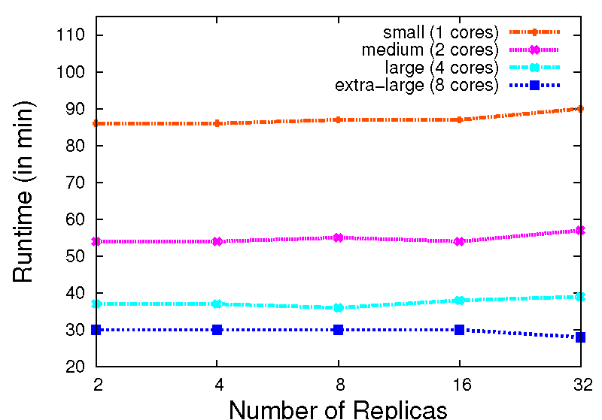
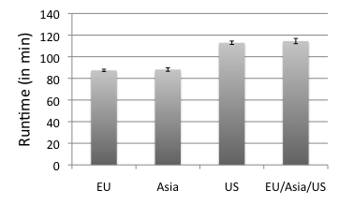
Replica-Exchange on Azure
Azure BigJob scales well with the number of replicas.
AQS proved to be effective for coordination of sub-jobs/replicas
Larger VMs have a better performance. But, efficiency drops < 0.4 for the extra-large VM
The different Azure data centers show a slight fluctuation in their performance
16 replicas, small VM

Slide 16
Conclusions
Relative Ease of implementation of the R-E Pattern
Thanks to combination of appropriate system-level abstractions (AQS) and user provided abstractions (BigJob)
“Trivially use distributed resources”
Performance comparable to TG
Cost of virtualization not a first order concern
Efficient and scalable messaging
Starting point for more sophistication implementations
Affinity becomes more fine-grained, data-compute affinity
Extensions to abstractions for dynamic data

Slide 17
Futuregrid Acknowledgement
This document was developed with support from the
National Science Foundation (NSF) under Grant No.
0910812 to Indiana University for "FutureGrid: An
Experimental, High-Performance Grid Test-bed." Any
opinions, ndings, and conclusions or recommendations
expressed in this material are those of the author(s)
and do not necessarily re ect the views

Slide 18
Azure: Scalability with Simplicity Providing Infra-level abstractions for DDIA
NAMD Performance on Azure
Three types of storage abstractions:
Azure Blob Service: Large amounts of raw data
Block Blob: Large chunks of 5GB
Page Blob: Mange storage as an array
Azure Table Storage: Semi-structured data
Azure Queue Storage: Message Queues
All three replicated and with strong consistency semantics
Current affinity operates at the data-center level;
Enhanced/finer-grained affinity to be made available
Azure Network Performance

