Slide 1



Interoperabilty: The SAGA Approach and Experience
Shantenu Jha, Andre Merzky, Ole Weidner & * Collaborators
http://saga.cct.lsu.edu

Slide 2
Outline
Introduction to SAGA:
Why SAGA for Interoperability?
Use of a standards-based approach for interoperability
Four Interoperability Projects – access layers and tools
HPC-HTC 1: EGEE-TG[-NAREGI]
HPC-HTC 2: KEK/NAREGI-TG
HPC-HTC 3: ExTENCI [TG-OSG]
HPC-HPC 1: TG-DEISA
Some thoughts on PGI Interoperability

Slide 3


SAGA: In a nutshell
There exists a lack of programmatic approaches that:
Provide general-purpose, basic &common grid functionality for applications and thus hide underlying complexity, varying semantics..
The building blocks upon which to construct “consistent” higher-levels of functionality and abstractions
Meets the need for a Broad Spectrum of Application:
Simple scripts, Gateways, Smart Applications and Production Grade Tooling, Workflow…
Simple, integrated, stable, uniform and high-level interface
Simple and Stable: 80:20 restricted scope and Standard
Integrated: Similar semantics & style across
Uniform: Same interface for different distributed systems

Slide 4
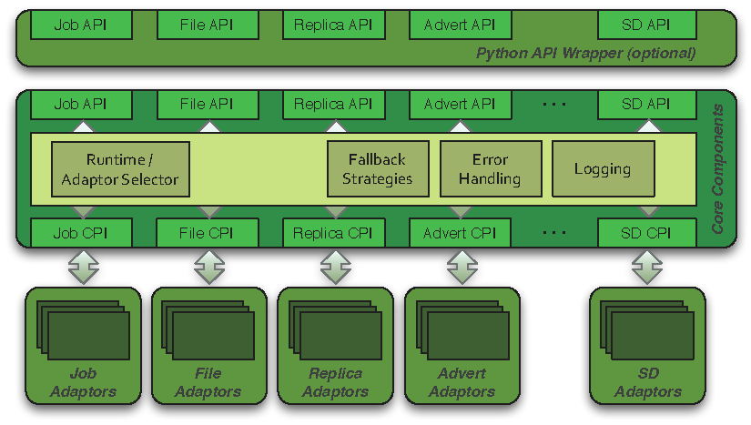
SAGA: Architecture

Slide 5
SAGA API: Standards promote Interoperability
The need for standard programming interface
Trade-off “Go it alone” versus “Community” model
Reinventing the wheel again, yet again, & then again
MPI a useful analogy of community standard
Vendors (Resource Provider), Software developers, users..
social/historic parallels also important
Time to adoption, after specification ....
OGF the natural choice (SAGA-RG, SAGA-WG)
Spin-off of the Applications Research Group
Driven by UK, EU (German/Dutch), US
Design derived from 23 Use Cases
different projects, applications and functionality
biological, coastal modelling, visualization
Will discuss the advantage of SAGA as a standard specification

Slide 6
SAGA-based Tools and Projects Advantage of Standards
JSAGA from IN2P3 (Lyon)
http://grid.in2p3.fr/jsaga/index.html
gLite adaptors exist
JAVASAGA (Amsterdam)
Has a wide range of adaptors
JAVASAGA gets released by gLite (next few weeks)
NAREGI/KEK (Active)
http://www.ogf.org/OGF27/materials/1767/OGF27_SAGA_KEK.pdf
DEISA/DESHL
http://www.fz-juelich.de/nic-series/volume38/pringle.pdf )
http://deisa-jra7.forge.nesc.ac.uk/ and http://www.ogf.org/OGF19/materials/501/SAGA-DEISA.ppt
XtreemOS
http://saga.cct.lsu.edu/index.php?option=com_content&task=view&id=95&Itemid=174

Slide 7
SAGA Implementation: Extensibility
Horizontal Extensibility – API Packages
Current packages:
file management, job management, remote procedure calls, replica management, data streaming
Steering, information services, checkpoint…
Vertical Extensibility – Middleware Bindings
Different adaptors for different middleware
Set of ‘local’ adaptors
Extensibility for Optimization and Features
Bulk optimization, modular design

Slide 8
SAGA: Access Layers Challenge of many Adaptors
Job Adaptors
BES, UNICORE, Globus GRAM2, gLite
Fork (localhost), SSH, Condor, OMII GridSAM, Amazon EC2, Platform LSF
File Adaptors
Local FS, Globus GridFTP, Hadoop Distributed Filesystem (HDFS), CloudStore KFS, OpenCloud Sector-Sphere
Replica Adaptors
PostgreSQL/SQLite3, Globus RLS
Advert Adaptors
PostgreSQL/SQLite3, Hadoop H-Base, Hypertable
Other Adaptors
Default RPC / Stream / SD

Slide 9
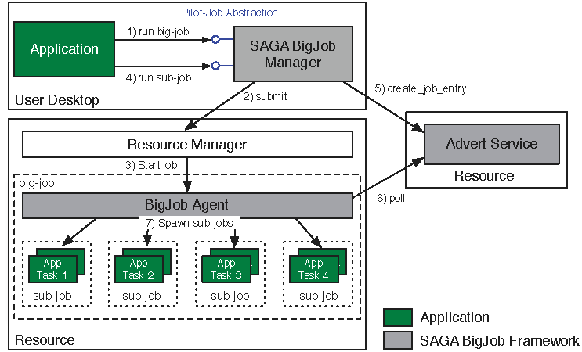
Abstractions for Dynamic Execution SAGA Pilot-Job (BigJob)

Slide 10
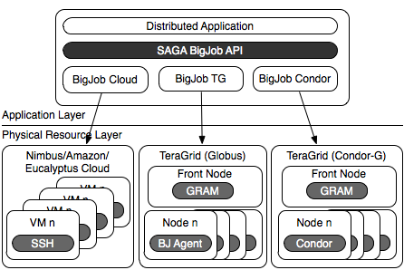
BigJob: Infrastructure Independent Pilot-Job

Slide 11
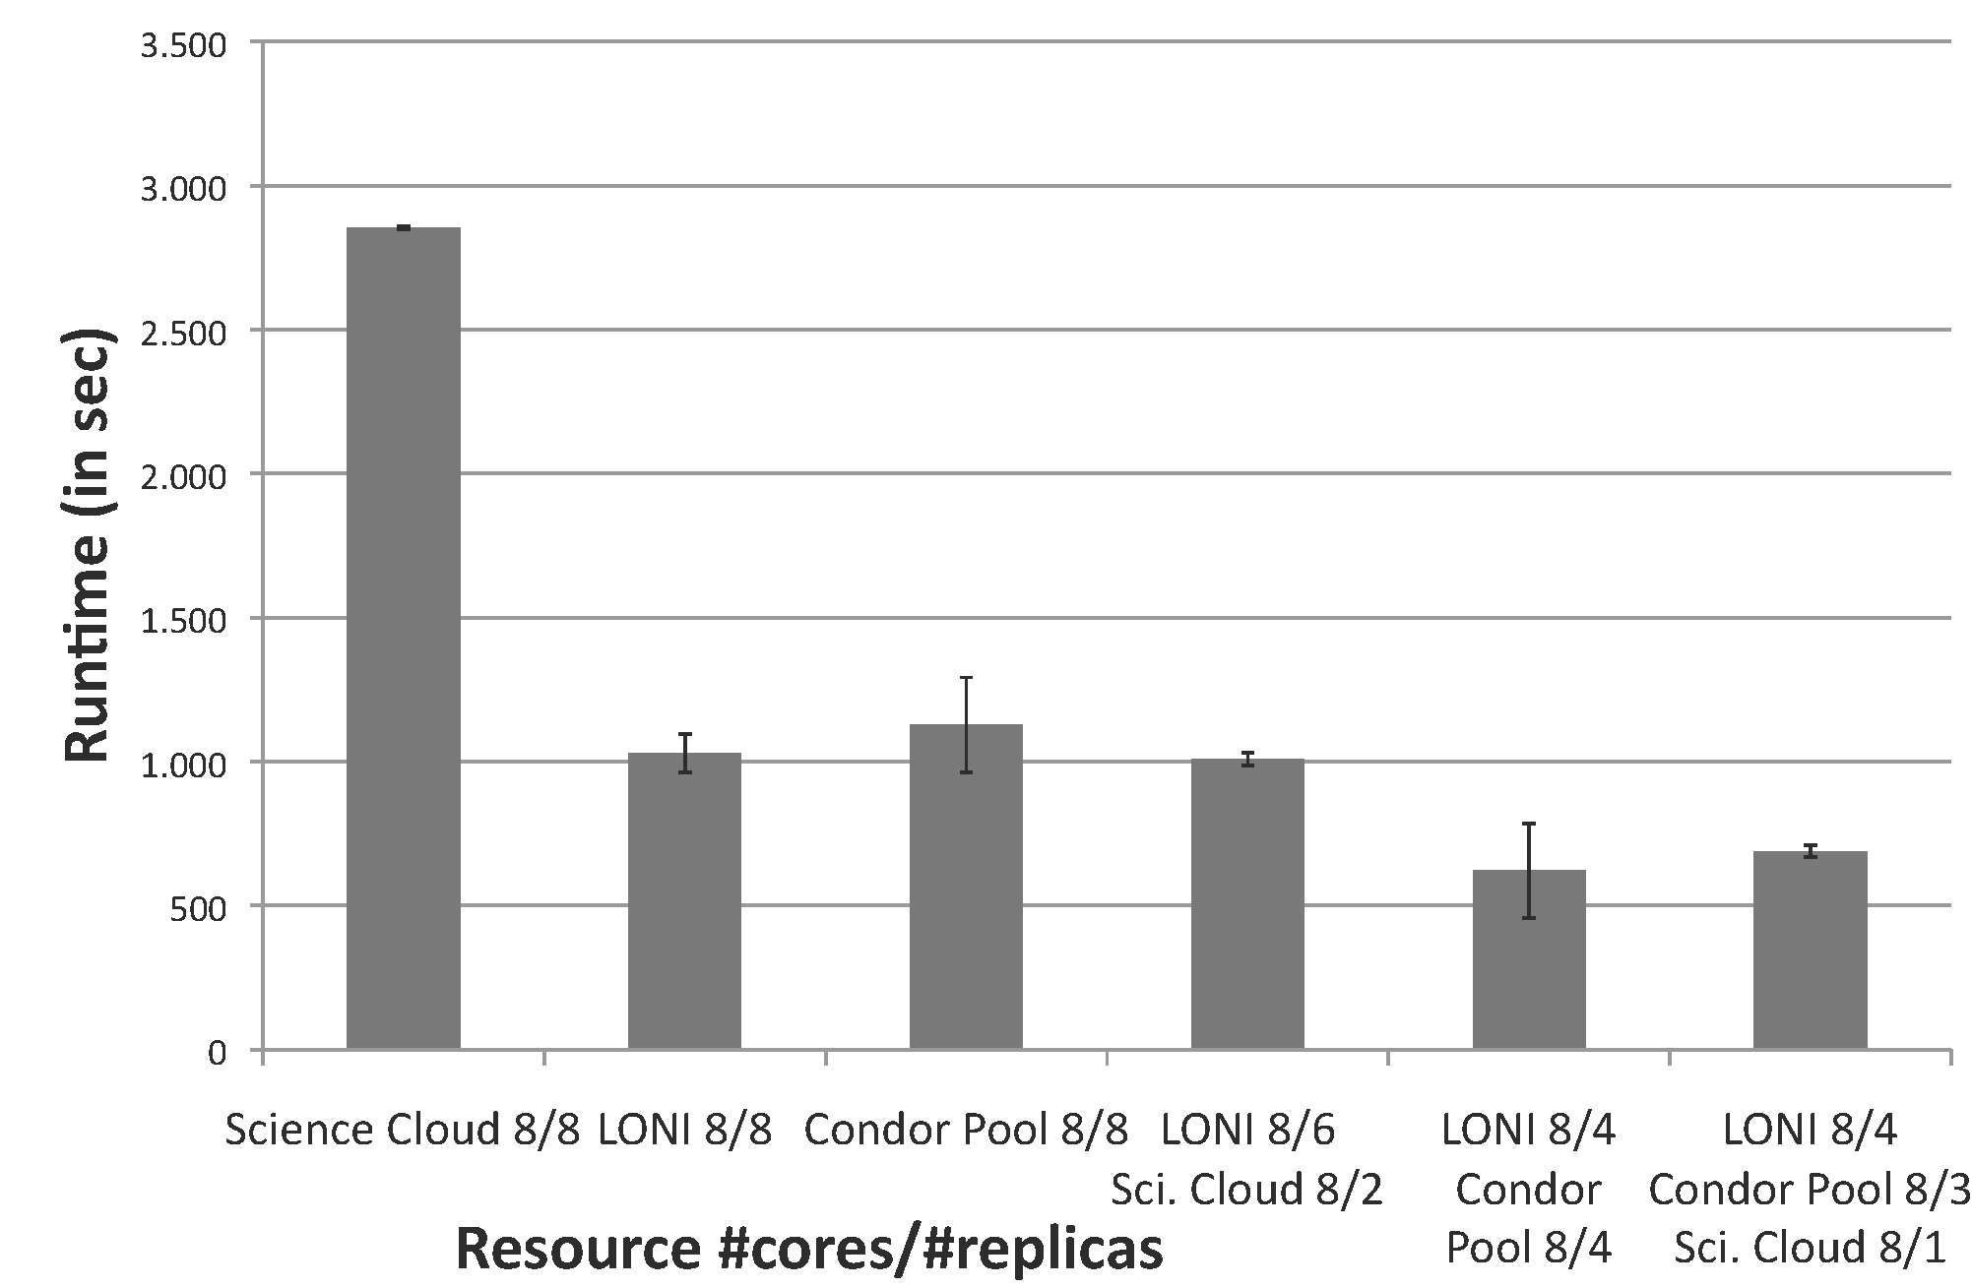
BigJob: Infrastructure Independent Pilot-Job (Each sub-job is a MPI-based MD)

Slide 12
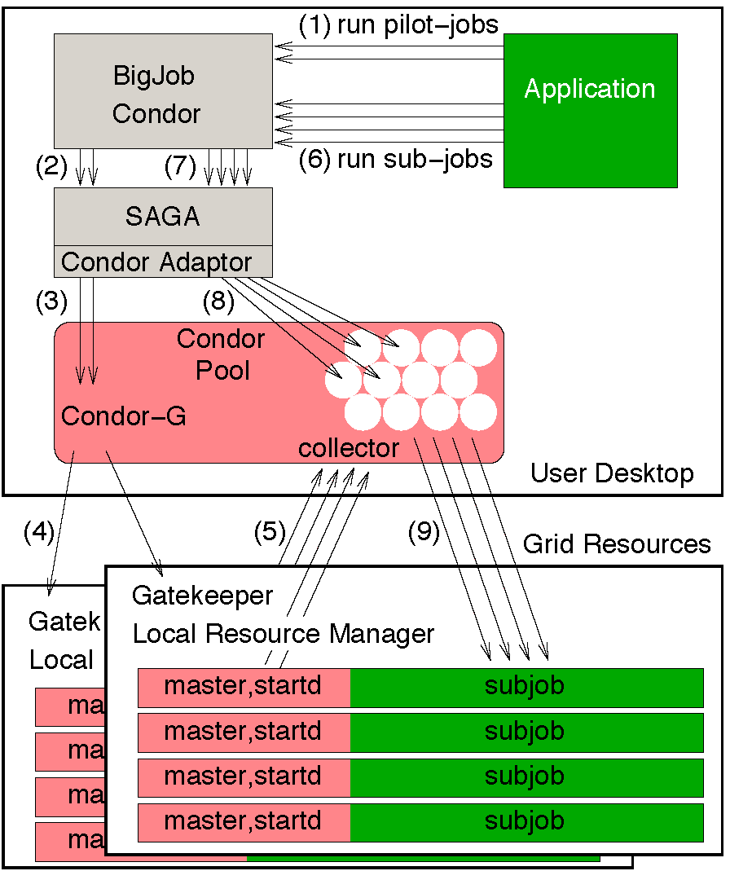
BigJob: Preserving Glide-in Semantics and Interface

Slide 13
SAGA Pilot-Jobs: What is different?
Pilot-Jobs: Decouple Resource Allocation from Resource-Workload binding
Pilot-Jobs are/have been typically used for:
Enhancing resource utilisation
Lowering wait time for multiple jobs (better predictibility)
Facilitate high-throughput simulations
Basis for Application-level Scheduling Resource binding
Two unique aspects about the SAGA-based Pilot-Job:
Pilot-Jobs have not been used for Science Driven Objectives:
First demonstration of supporting multi-physics simulations
Infrastructure Independent
Falkon, Condor Glide-in, Ganga-Diane (EGEE/EGI), DIRAC/WMS, PANDA
Frameworks based upon PJs (pull model) for specific PGI/back-end
Do not support MPI
SAGA-based Pilot-Job form the basis:
For autonomic scheduling and resource selection decisions
Advanced run-time frameworks for load-balancing and fault-tolerance

Slide 14
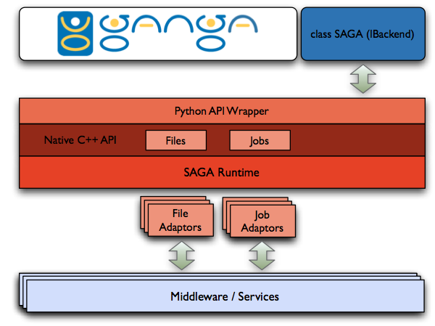
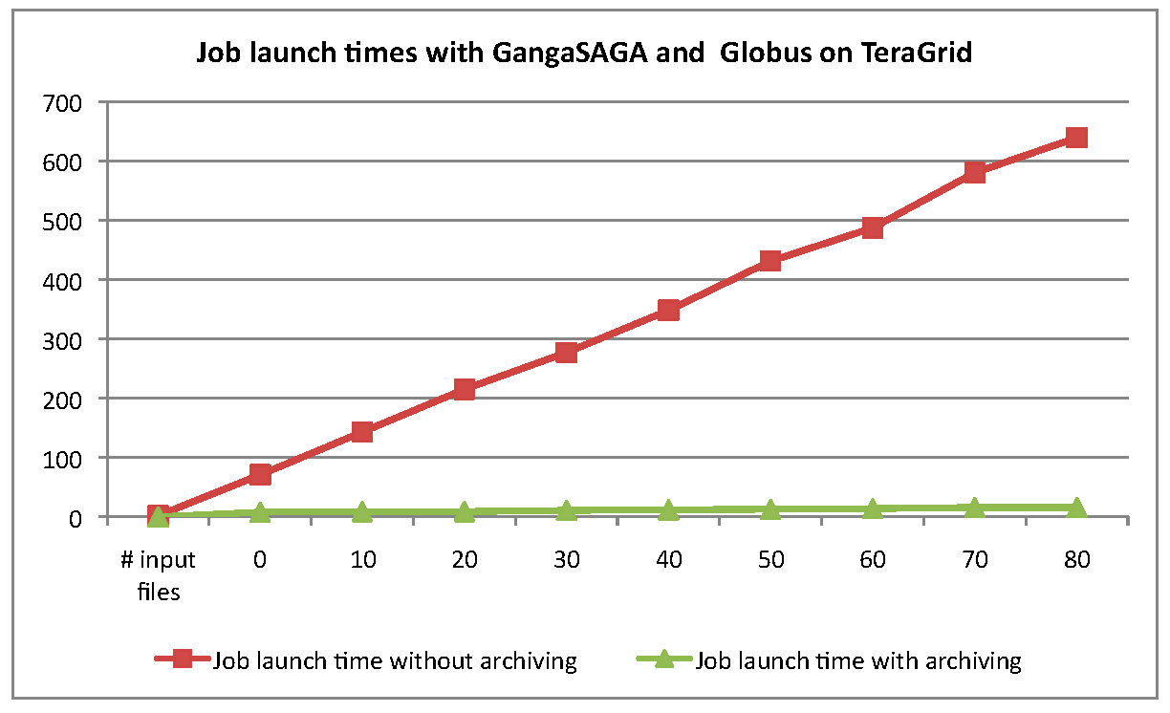
SAGA-GANGA Integration

Slide 15
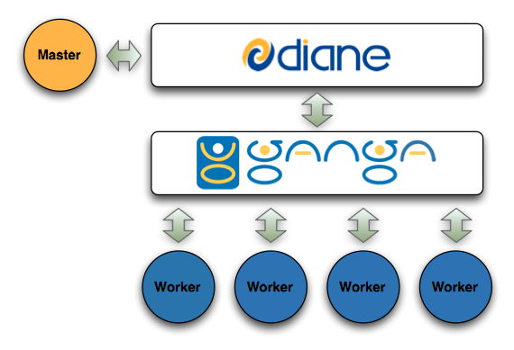
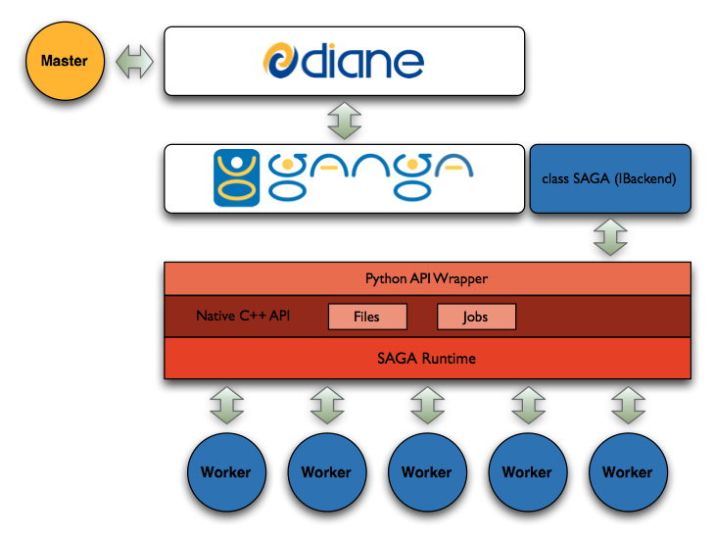
DIANE INTEGRATION
Diane without SAGA
Diane with SAGA
DIANE is an execution manager with support for pilot-jobs + worker agents
(IDEAS Redux)

Slide 16
ExTENCI: TeraGrid-OSG [2010-12] Cactus Application Scenarios
Problem size varies – determinant of Infrastructure used
TG, OSG or either..
MPI-based applications have a very complex SW environment that they need to worry about
Application Scenarios/Usage Modes
1. Ensemble of Cactus Simulations
NumRel, EnKF (Petroleum Eng)
2. Multiphysics Code
GR-MHD, CFD-MD
3. Spawning Simulations
Realtime ‘outsourcing’ from BlueWaters/Ranger to specialised architectures or less powerful resources

Slide 17
Some thoughts on PGI
Interoperation is needed. Now! [And forever..!]
The community has voted for Interoperation with their feet:
Application Scientists + Developers
Tool Developers
PGI - Resource Providers
The question is not whether to, but how to provide interoperation?
Ideal world: Infrastructure would be interoperable “out-of-the-box”
Ditch SAGA: “Price of success should be irrelevance” ☺
Application level? versus Infrastructure level?
ALI: Simple, limited [User Access-layer]
RLI: Complex, complete [System Access Layer]
SAGA CAN BE USED FOR BOTH !
ALI vs RLI: Is there a difference in the time-scale of capability?
User Access-layer via SAGA Vs System Access-Layer

