Slide 1
TeraSort using SAGA MapReduce
Committee
Dr. Gerald Knapp(Chair)
Dr. Shantenu Jha
Dr. Craig Harvey
By
Sharath Maddineni

Slide 2
Outline
Background
Problem Statement & Objectives
Methodology
Results
Analysis
Conclusion & Future work

Slide 3
Background
MapReduce: Special type of framework processing large amounts of data on large clusters
Advantages:
Automatic parallelization & distribution
Fault-tolerant
Provides status and monitoring tools
Abstraction for the programmer

Slide 4
Background(cont..)
Map: Map operation to each logical record(line) in the input in order to compute a set of intermediate (key,value)pairs
Partition: This determines the Partition file for the intermediate (key,value) pairs emitted from the Map phase. By default it is a hash function.
Reduce: Merge all intermediate (key,value) pairs applying a reduce function.

Slide 5
Background(cont..)
SAGA
Simple API for Grid Applications
SAGA API packages try to cover the bulk of the requirements needed for grid programming
SAGA is available in C++ , Python,Java
SAGA provides API packages for
File package
Job package
Stream package etc.,

Slide 6
Problem Statement & Objectives
Limitations in the previous approaches of MapReduce( Google, Yahoo)
Confined to a particular cluster
Filesystem
Often computational data is distributed over different locations like hospitals.
Large time spent in data transfer.
Applications like sorting, searching and many Genomic applications
In this project
Implement sorting application using SAGA MapReduce.
Run it on single cluster on multiple nodes.
Run it using two different machines.

Slide 7
Methodology
SAGA MapReduce Execution Overview
Start the Master
The Master reads input and chunks it.
The Master spawns Workers
Worker listens for Master’s commands
In the Map phase, Workers will process the chunks using Map function and Partition function
In the reduce phase, the Master assigns Workers a partition number to be reduced to the idle Workers.

Slide 8
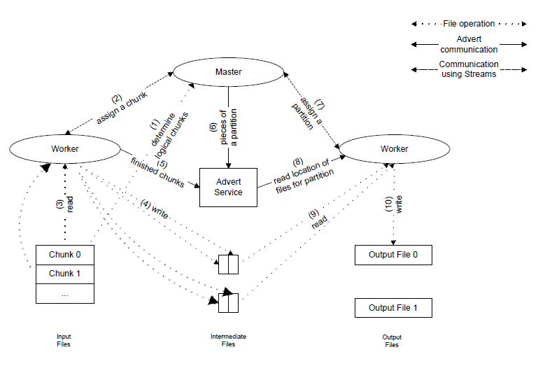

Slide 9
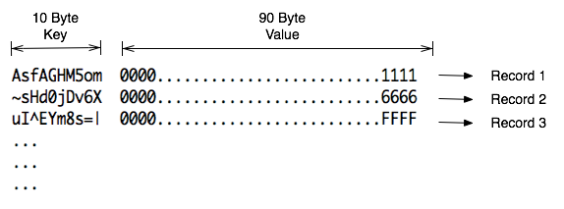
Methodology(cont.)
Input Data format
Input data is generated using “gensort”.
Output data is validated using “valsort”.

Slide 10
Methodology(cont.)
Terasort Implementation is similar to other SAGA MapReduce applications
Partition split list is generated.
Map Phase simply reads each line and extract 10 byte key, 90 byte value. Emits (key,value)pair
Partition function to partition the intermediate (key,value) pairs by using Partition split list.
Number of Intermediate files = Number of reducers * Number of chunks
Reduce function just combines files of a specific partition number and sorts them.

Slide 11
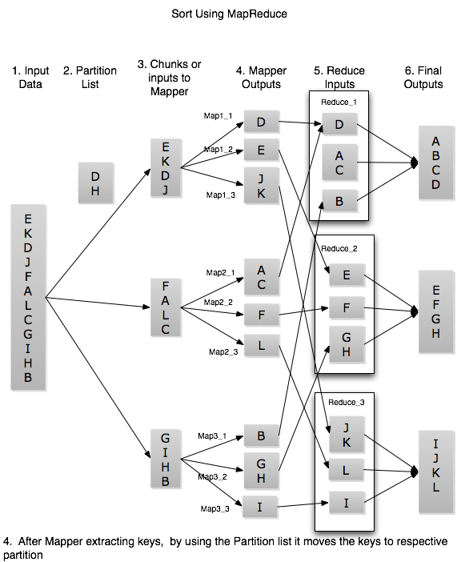

Slide 12
Methodology(cont.)
Limitations with existing SAGA MapReduce.
In Reduce phase workers were assigned sequentially.
Initialization in Partition function
Communication with advert server
In Reduce Phase
In Map Phase
Storing Chunks
Configuring MapReduce to run on multiple machines
Mounting input, output locations.
Environment
Number files per directory.
Notes:
For each record Partitiion function has read the partiotion list file

Slide 13
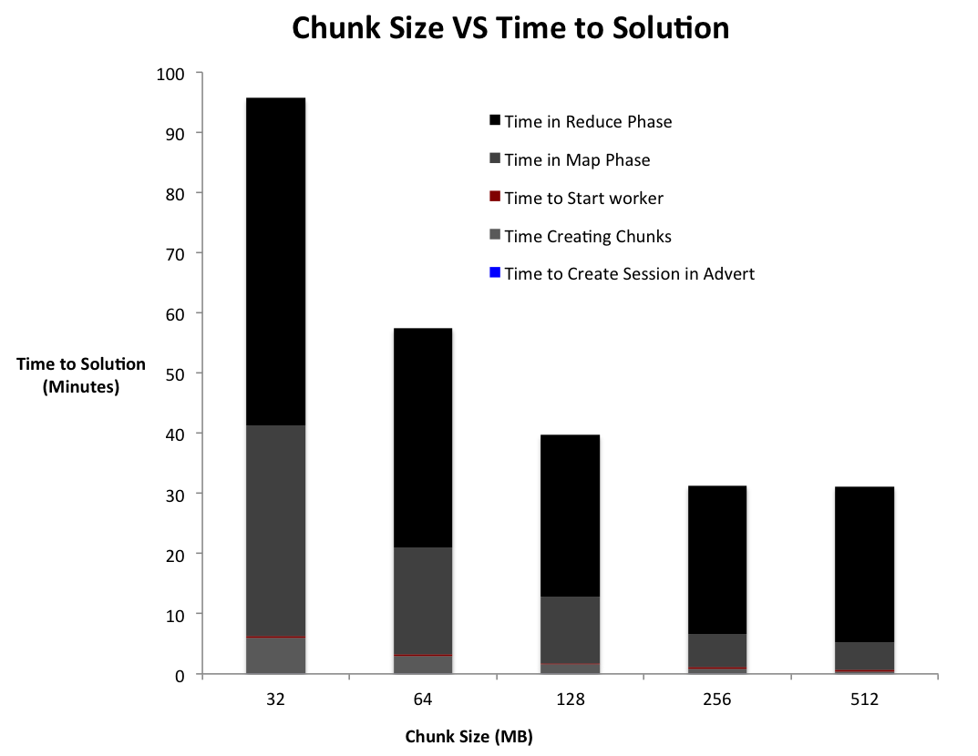
Results
On Sierra-FutureGrid
Number of workers = 8
Input size = 4 GB

Slide 14
Analysis
Influence of increase in chunk size
Reduce phase time decreases until 128MB chunk size; constant thereafter
It is dependent on number of intermediate files.
Proportion of Map Phase in total time in total time decreases with increasing chunk size
Number of assignments to fixed number of workers is dependent on chunk size
Less the chunk size more the assignments and thus higher overheard
The time for phases Reduce: Map at low chunk size is 60:40; at high chunk size is 80:20
Chunk Phase time decreases
Number of entries in advert service is proportional to number of chunks

Slide 15
Results
With 32GB input size, 16 workers ,32 reduces, and 256 MB chunk size
Time to sort on India was 173 minutes
Remotely located advert service(Indiana)
3 seconds per call
Time to sort on Cyder was 104 minutes
Reduced communication with advert service.
Local advert service(same domain)
3 calls per second

Slide 16
Conclusion
Sorting application was successfully implemented using SAGA MapReduce
Implemented it on multiple nodes of Cluster and multiple machines
Enhanced framework to improve the performance of sorting
What have we learnt?
How the factors influence the time to solution.
Connection speed to the Advert server, Input size, Chunk size and number of Workers.
Problems involved in utilizing heterogeneous environments.

Slide 17
Future Work
Reducing the dependency of fusermount
Optimize the usage of Advert server.
Capability to handle large number of intermediate files should be improved.

Slide 18
Questions

Slide 19
Thank You

