Slide 1



Efficient Replica-Exchange Simulations on Large-Scale Production Infrastructure

Slide 2
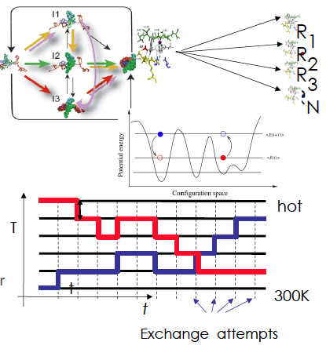
Replica-Exchange Simulations
Replica-Exchange (RE) methods:
represent a class of algorithms that involve a large number of loosely coupled ensembles.
RE simulations are used to understand a range of physical phenomena.

Slide 3
The Problem
Developing applications that are able to orchestrate heterogeneous resources across distributed resources is a complex task.
RE simulations involve a large number of loosely coupled ensembles.
The challenge is to break the coupling between the development and the underlying infrastructure, to enable RE to be flexible (across infrastructure), extensible (to new methods of communication and coordination) and scalable.

Slide 4
The Solution
We implement a flexible, extensible and scalable implementation of an efficient RE algorithm:
that can utilize a range of infrastructure concurrently
that supports different coordination mechanisms
that supports different replica pairing mechanisms (synchronous versus asynchronous) and thereby different variants of the RE algorithm

Slide 5
Different RE Algorithms
Traditional RE/Synchronous replica-exchange
Asynchronous RE

Slide 6
Traditional (synchronous) RE
For the traditional implementation of RE, depending on the number of replicas (N), the RE manager creates N/2 pairs of replicas.
When all the replicas reach a pre-determined state, the exchanges are attempted (the exchange step).
If an exchange is successful, parameters such as the temperature are swapped and replicas are re-started.

Slide 7
Limitations
The replicas are paired in ﬁxed groups. Exchanges can only take place between these paired replicas:
inhibits exchanges between replicas with non-nearest temperatures.
Synchronized exchange steps – inefficient with a heterogeneous infrastructure (different running times for each replica).
Synchronized exchange step means large overhead with large number of replicas.

Slide 8
Asynchronous RE
We use an asynchronous RE algorithm to overcome the limitations.
In an asynchronous RE, replicas can perform exchanges with any other available replica, whenever possible – instead of waiting for all the replicas to finish for a synchronized exchange step.
This does not limit exchanges to fixed pairs of replicas. Any two replicas can attempt to exchange.
We present two different implementations:
Centralized
Decentralized
Notes:
What do you mean asynchronously? Elaborate please? How does it eliminate the need to pair replicas?
We do not propose it. It has been already been proposed/implemented. We are trying to implement it using SAGA, which gives us the ability to test/implement on large-scale production infrastructure

Slide 9
Asynchronous RE - Centralized
In the centralized implementation of asynchronous RE, a master co-ordinates and manages all the replicas and exchanges.
We implement it using SAGA, which gives us the ability to test/implement on large-scale production infrastructure.

Slide 10
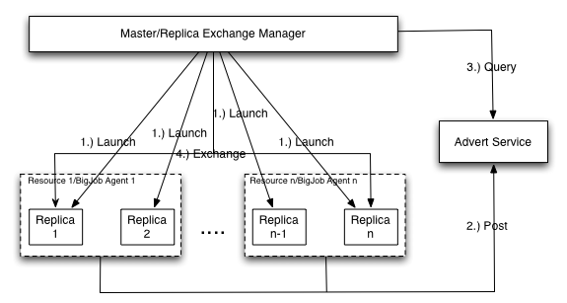
Control Flow – Asynchronous RE Centralized
Notes:
Control flow of what?

Slide 11
Advantages and Limitations
This is an improvement over the Synchronous RE algorithm.
Scales better with more replicas and distributed resources.
But with large number of replicas, the centralized implementation becomes a bottleneck.

Slide 12
Asynchronous RE – Decentralized
In the decentralized implementation, each replica is handled independently.
This prevents a central manager/master from becoming a bottleneck with large number of replicas.

Slide 13
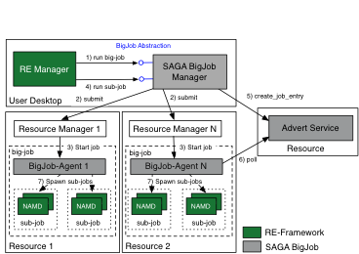
SAGA BigJob Framework
We use the SAGA BigJob (the SAGA Pilot-Job framework) to run RE simulations across multiple, heterogeneous distributed Grid infrastructures.
(Application)

Slide 14
Comparison – when running on one machine
We have implemented the following:
Synchronous RE
Case I: Synchronous (traditional) RE
Asynchronous RE
Case II: Asynchronous RE (centralized)
Case III: Asynchronous RE (decentralized)
In the following slides we compare these models when run on a single machine.

Slide 15
Configuration – One machine (locally)
We configured the traditional and asynchronous RE (both centralized and decentralized) to run a parallel NAMD simulation with 4, 8, 16, 32, 64, 128 and 256 replicas sampling a temperature between 300 K and 1000 K on QueenBee, a LONI/Teragrid machine. Note: The simulations involving 128 and 256 replicas have been done on Ranger, but the results have been normalized for comparison with simulations on QB.
Each replica uses 16 MPI processes and runs 500 time steps between exchange attempts. Therefore in each case a single BigJob is launched with sufficient number of cores. The metric used is the time to complete a particular number of exchanges.
The ratio between the number of replicas and the number of exchanges is kept constant, for the purpose of comparison.
Each experiment has been repeated at least 10 times.

Slide 16
Notes:
Plots/Results are not readable. Maybe pairwise compairision? Eg Sync vs Centralized, then Centralized vs Decentralised?

Slide 17
Analysis
As the ratio between the number of replicas and the number of exchanges is kept constant, ideally, the runtime must be constant too.
But with an increase in the number of replicas, the performance deteriorates.
The Logic behind synchronous and asynchronous RE inevitably influences the implementation and the consequent performance.
In synchronous RE, the overhead of managing a large group of replicas at each exchange step causes the degradation.
Asynchronous RE scales better with a large number of replicas and resources.
And the decentralized asynchronous RE beats the centralized version.
Notes:
It is possible to design a decentralized synchronous RE mechanism.
But then, with a heterogeneous infrastructure, each replica could have different run times.
The asynchronous RE mechanism eliminates the synchronization delays caused due to a heterogeneous infrastructure.
A decentralized implementation adds to the efficiency of the asynchronous RE method.

Slide 18
Comparison – when running on 2 and 4 machines
In the next few slides, we will see the results when run the experiments over 2 and 4 machines.
We used LONI machines for this purpose.
Each experiment has been repeated at least 10 times.

Slide 19
Configuration – Two/Four Machines
We configured the traditional and asynchronous RE (both centralized and decentralized) to run a parallel NAMD simulation:
(i) with 8 replicas sampling a temperature between 300 K and 450 K on two LONI machines and
(ii) with 16 replicas sampling a temperature between 300 K and 450 K on four LONI machines.
Each replica uses 16 MPI processes and runs 500 time steps between exchange attempts. In (i) two BigJobs are launched with each requesting 64 cores and in (ii) four BigJobs are launched with each requesting 64 cores. The metric used is the time to complete a particular number of exchanges.
In the graph, the distributed runs and local runs are compared.
Note: In the distributed runs, the start time is measured only after the BigJobs on all machines have become active. And then the simulation is allowed to make the required number of exchanges.

Slide 20
Notes:
Use this or 20 or 18.

Slide 21
Analysis – Asynchronous RE scales better with distributed resources
In the distributed runs, the start time is measured only after the BigJobs on all machines have become active. And then the simulation is allowed to make the required number of exchanges.
Asynchronous-centralized and asynchronous-decentralized almost equal their respective performances on a single machine.
With larger number of replicas and (distributed) exchanges, asynchronous-decentralized will continue to perform the way it does on a single machine, but asynchronous-centralized will not.
The synchronous RE underperforms when compared to its performance on a single machine.
The reasons are:
Heterogeneous infrastructure (Ranger and QueenBee)
Coordinating the exchange step across two machines takes longer, hence adding to the overhead at each exchange step

Slide 22
Questions/Comments

