Slide 1
Understanding MapReduce-based Next-Generation Sequencing Alignment on Distributed CyberInfrastructures
Pradeep Mantha, Nayong Kim, Andre Luckow, Joohyun Kim, Shantenu Jha
http://saga-project.org
Emerging Computational Methods for Life Sciences, 2012
Notes:
Added slide 3
I think there will not be time to focus on “assertion based” approach, i.e slides 4-7. Possibly include slide 8

Slide 2
Overview
Motivation
Advances in NGS platforms challenges NGS analytics on humongous amounts of sequencing data.
MapReduce is an effective scalable programming model for processing huge amounts of data.
Complexities of scaling applications for NGS analytics on DCI, using traditional MR implementations.
Provide an effective, extensible and scalable MapReduce framework to perform NGS analytics on DCI.
P* Model of Pilot-Abstractions
SAGA: A Standards layer upon which other abstractions are built
Uniform abstraction for compute and data
Interoperability and Extensibility
Pilot-MapReduce
MapReduce Topologies: Local, Distributed, Hierarchical
MapReduce based next-generation gene sequencing data
Conclusion

Slide 3
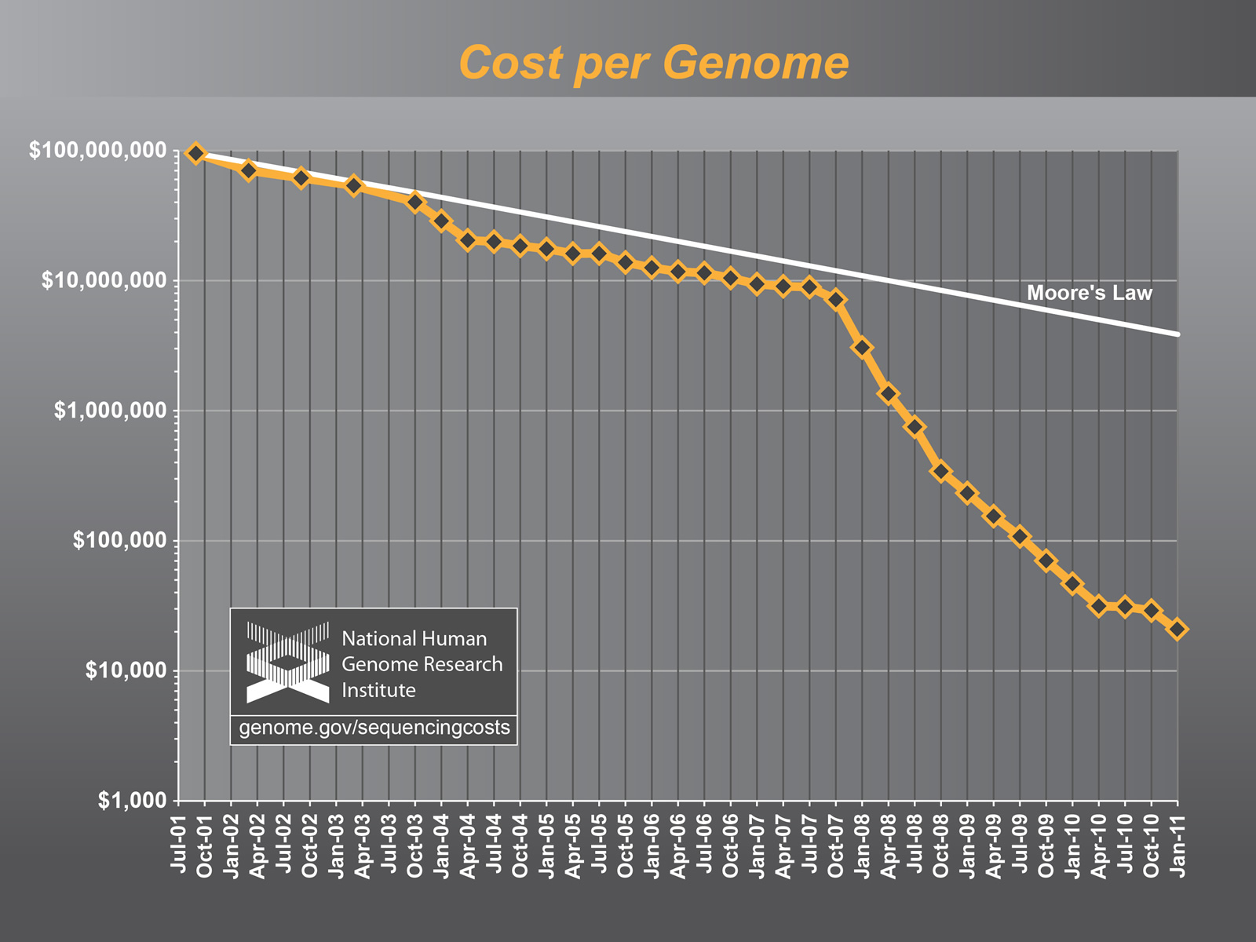
The case for advanced NGS Analytics

Slide 4
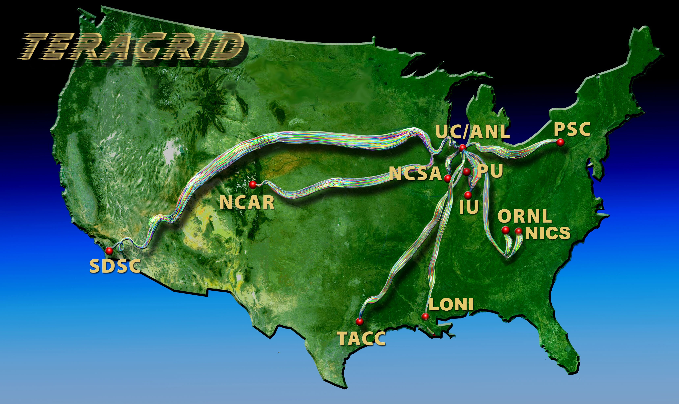
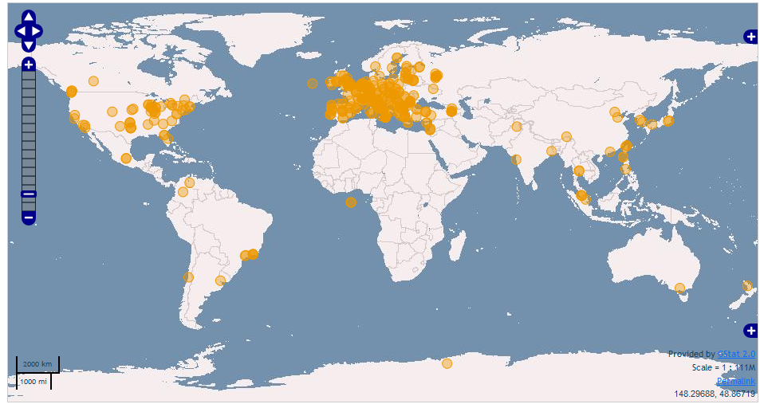
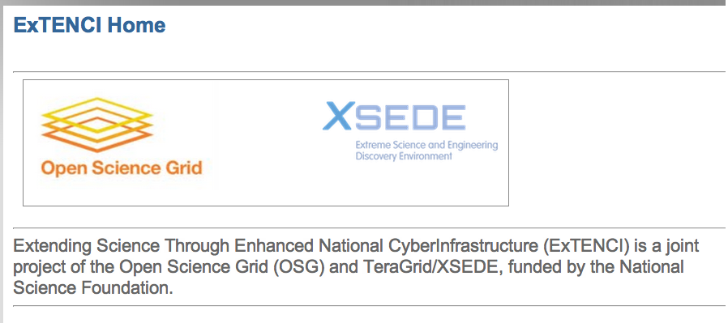
Grand Challenge: Building the Global Cyberinfrastructure
Notes:
This is a good time to pause and take stock: 1st generation done, new capabilities are emerging, new application requirements.
There have been failures. 1000 cores – 100 Gb – 10 sites not 10 people, but 1 graduate student.
Domain specific versus General purpose? Build upon existing infrastructure or split off and specialise

Slide 5
What are the Challenges for LS Applications on Clouds?
Clouds address several “barriers” of decade past
Better control over software environment via virtualization
Illusion of unlimited and immediate available resource can lead to better capacity planning and scheduling
Clouds do not remove many/all of the challenges inherent in DA
Coordination, decomposition, granularity, distribution:
Where, when, how to distribute? How to manage coordination?
What is the task decomposition granularity? Mapping to resources?
What are the data transfer/access/storage mechanisms
Clouds represent a natural and positive evolution but will need a careful interplay of application and system-level abstractions
If clouds part of a larger, richer distributed CI
Are certain tasks better suited for Grids, others on Cloud? When?
Notes:
“Clouds are about provisioning, grids are about federation”
“IF you can keep your head when all about you, Are losing theirs and blaming it on you..”
“The reason why we are so well prepared to handle the multi-core era, is because we took the trouble to understand parallel programming

Slide 6
What are the Challenges for LS Applications on Clouds?
Clouds as the natural CI for DI computing?
Need to support distributed, dynamic loads
Multi-parametric trade-offs exist: Mem vs I/O vs CPU vs DoD
Sequence length variation
DA challenges need to be addressed dynamically!
Resource Elasticity/Cloudburst + Heterogeneous task-resource binding and need for application configuration trade-offs
Is the Cloud data localization model scalable and/or sustainable?
Must address: How and when to move compute to data (or vice-versa) in scalable fashion?

Slide 7
Complexities involved for Scalable solutions to NGS Analytics on DCI
Traditional, open source MR implementation like Hadoop is limited by
Designed for single/local cluster
Infrastructure dependent – Need HDFS
Performance degradation when scaled to widely located clusters.
Cannot run on most of DCI like FutureGrid, due to firewall issues.
Complexity in configuring MR setup on DCI.
DCI is complex
Heterogeneous software, access-layers, policy..
Middleware: Heterogeneity and semantic incompatibility
Slow/lack of agreement towards a standards-based solution
Difficult to integrate services & software (service-level Interop)
This is not Google (i.e., uniform, single top-down solution), as much of a socio-cultural challenge as a technical one

Slide 8
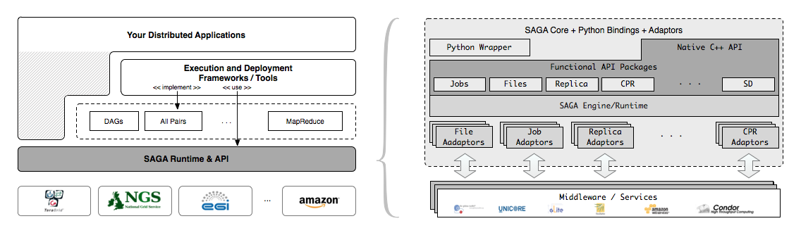
SAGA – An Overview
Simple, integrated, stable, uniform and community-standard
Simple and Stable: 80:20 restricted scope
Integrated: Similar semantics & style across primary functional areas
Uniform: Same interface for different distributed systems
The building blocks upon which to construct “consistent” higher-levels of functionality and abstractions
OGF-standard, “official” Access Layer/API of EGI, NSF-XD

Slide 9
Pilot-Jobs: Pilot-Abstractions for Compute on DCI
Pilot-Jobs: Decouple resource assignment & resource-workload binding
Pilot-Jobs are/have been typically used for:
Enhancing resource utilization; Facilitate high-throughput simulation
Lowering wait time for multiple jobs (better predictability)
Several unique aspects about the SAGA-based Pilot-Job
Pilot-Jobs have not been used for Science Driven Objectives:
First demonstration of multi-physics simulations, REMD simulations
Frameworks based upon PJs (pull model) for specific back-ends
Infrastructure Independent and “standard” PJ API to access other PJs
SAGA PJ (BigJob) API basis for inter-operable PJ (Azure, DIANE)
SAGA-based Pilot-Job form the basis for
Extension of Pilot-abstraction to other “dimensions”
For autonomic scheduling and application-level scheduling
Advanced run-time frameworks for load-balancing and FT

Slide 10
Pilot-Data - SAGA Pilot-Abstractions for Data on DCI
Similar levels of heterogeneity in the data infrastructure
File systems, storage, transport protocols, …
Support application level capabilities to specify dependencies at a logical level rather than specific file level
First class support for Affinities (D-C, D-D)
Typically placement and scheduling of data is decoupled from the compute-tasks
Integrated approach to compute and data ?
Dynamic decision for data
Analogous to late-binding of data
Fluctuating resources as a fundamental property of DCI
Abstraction for other factors and not application specific way:
Varying data sources, fluctuating data rates, etc
SAGA Based Pilot-Data abstraction - BigData

Slide 11
Exposing the P* Model: The Pilot-API
Interoperable and extensible and supports multiple distinct production cyber infrastructures.
Exposes the core functionalities of a Pilot framework via a unified interface.
The API provides five core classes:
PilotComputeService for managing Pilot-Jobs,
PilotDataService for managing Pilot-Data
ComputeDataService for the management of ComputeUnits (CUs) and DataUnits (DUs).
A CU represents a primary self-containing piece of work, while a DU represents a logical set for data.

Slide 12
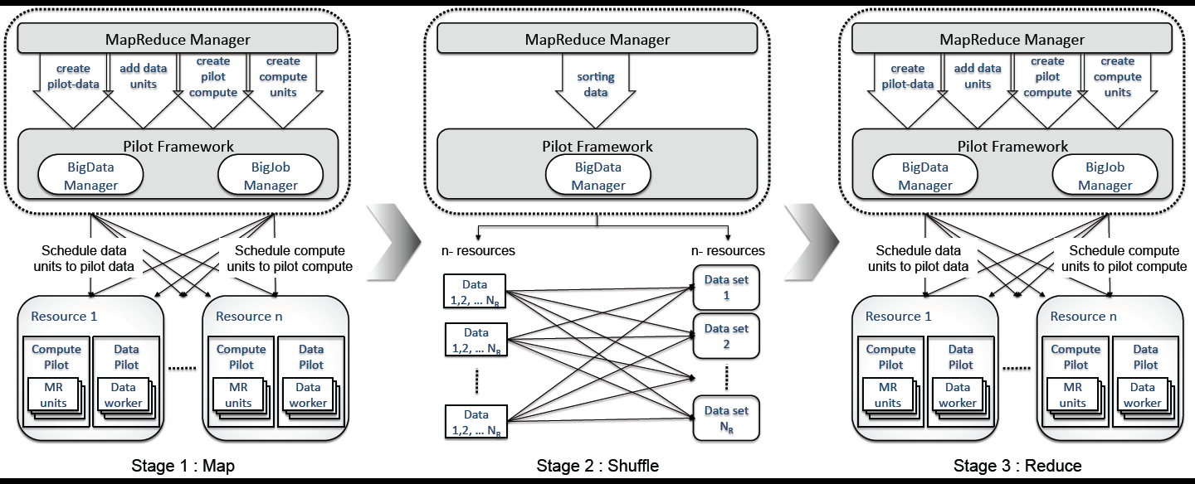
Pilot-MapReduce

Slide 13
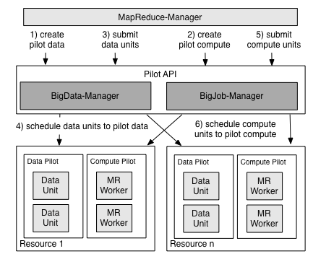
Pilot-MapReduce (for NGS)

Slide 14
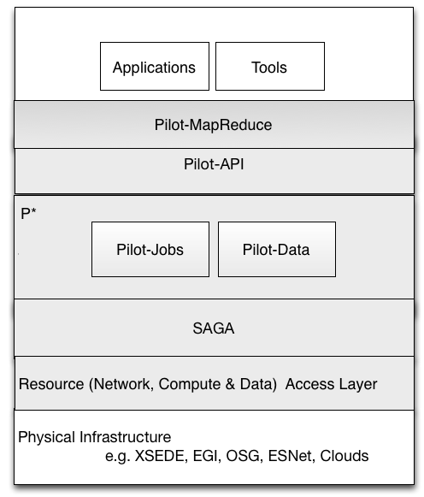
P* Model of Pilot-Abstractions Redux

Slide 15
PMR Topologies
Pilot-MapReduce (PMR) can be configured as
Local MR
Localization of data is costly
Hierarchical MR
Suitable for distributed data analysis. Global reduce is overhead and is not easy and straight forward to design for all kinds of application.
Distributed MR
Suitable for distributed data analysis. No global reduce is required.

Slide 16
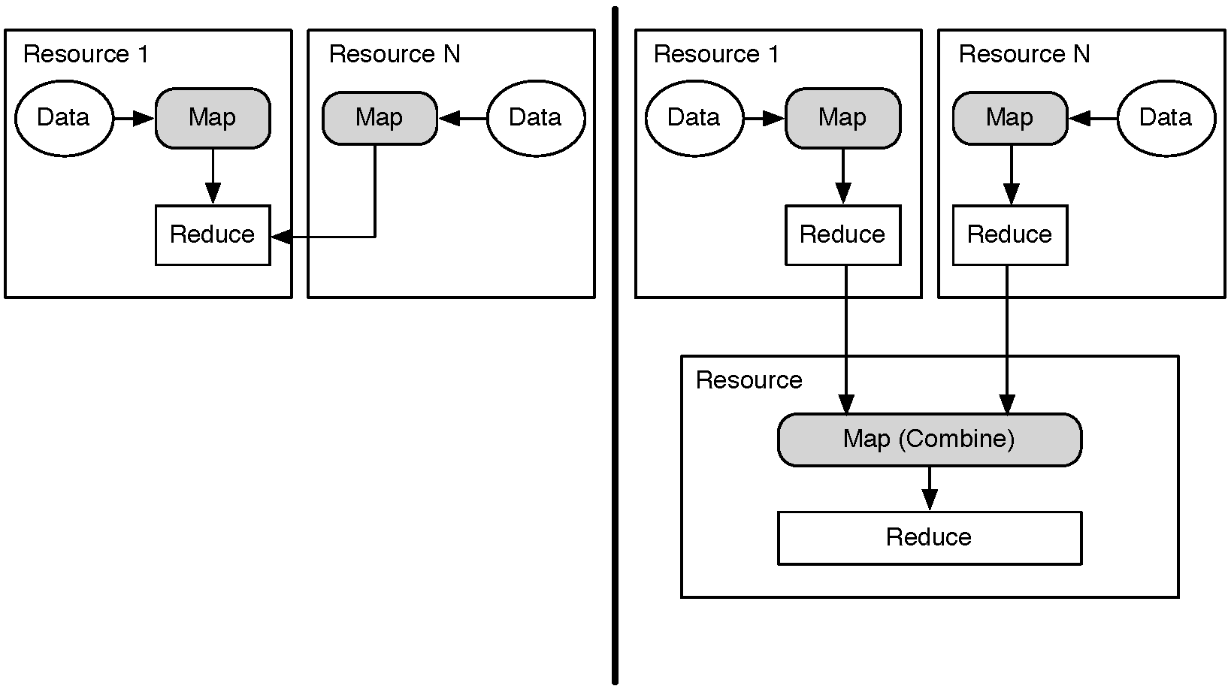
Distributed (DMR) versus Hierarchical (HMR)

Slide 17
Target NGS Analysis
Short Read Alignment
BWA, Bowtie etc.,
Post Alignment
Duplicate read removal, SNP Finding etc.,
Hadoop MapReduce for NGS Analysis
Seqal:
Hadoop API based
Short read alignment using BWA aligner in map phase
Duplicate read removal in reduce phase
Crossbow:
Hadoop Streaming
Contains 4 steps - preprocessing, Alignment, SNP finding and postprocessing.
Each step is a Hadoop streaming-based MapReduce application and the output of each step is stored in HDFS and read from HDFS by the next step

Slide 18
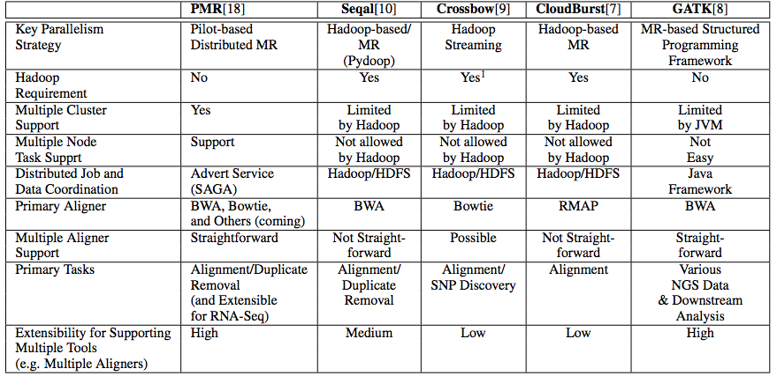
PMR versus other MapReduce Implementations

Slide 19
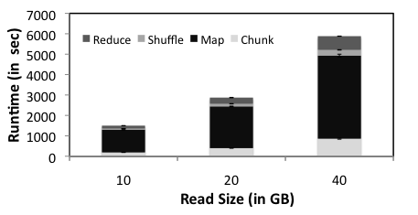
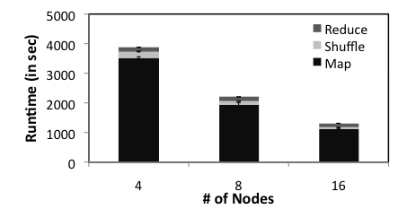
PMR Scalability
Scale-Out:
Read size dependent time-to-solution is measured for
MapReduce tasks of read alignment and duplicate read
removal. The number of nodes for this experiment is
16(128 cores), the number of Workers is 32, and the
chunk size is set to contain 625000 reads. The number of
Reducers is set to 8. BWA is used for read alignment.
Scale-Up:
PMR scalability of a MapReduce-based computation
for read alignment and duplicate read removal. The
number of workers per node is set to 2 and the
number of cores per each node is 8. The input read
file is 10GB, the number of Reducers is set to 8, The
number of reads in a chunk is 625000. BWA is used for
read alignment

Slide 20
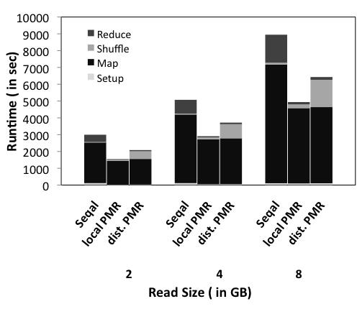
Scale-across:
Comparison of the total time-to-solution for a MapReduce- based computation of alignment and
duplicate read removal. Hadoop based Seqal is compared to local-PMR vs. distributed-PMR.
For this experiment, the number of Nodes is 4, the number of Workers is 8,the number of Reducers is 8,
And the number of reads in each chunk is 292,763. For the distributed-PMR, two machines of FutureGrid,
Sierra and Hotel were used, whereas Sierra was used for other cases.

Slide 21
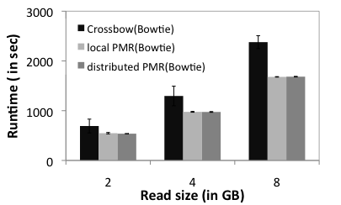
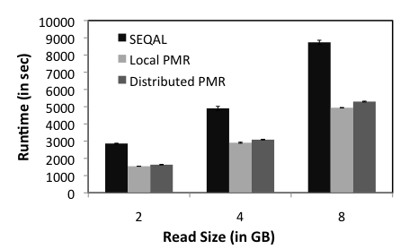
PMR Extensibility
Extensibility:
Comparison of runtimes for the map phase. The map phase of Seqal, local-PMR(BWA), distributed-PMR(BWA),
local- PMR(Bowtie), distributed-PMR(Bowtie), and Crossbow(Bowtie) are compared. The aligner used for each
case is indicated in a parenthesis. For this experiment, the number of nodes is 4, the number of Workers, is 8,and the number of reads in each chunk is 292,763. For the distributed-PMR, two machines of FutureGrid, Sierra and Hotel were used, whereas Sierra was used for other cases.

Slide 22
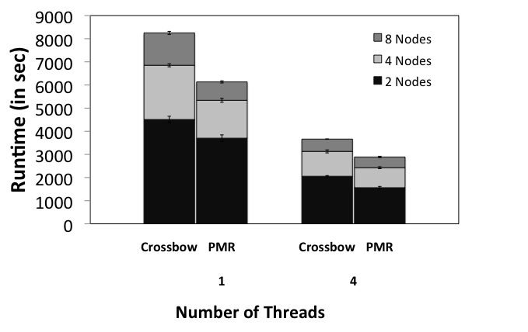
PMR Parallelism
Fine Grain Parallelism:
The map phase runtimes of PMR(Bowtie) and Crossbow(Bowtie) are compared, by varying number of threads for each map task. Number of workers/Node = 2 and input data size is 8 GB. The maximum number of cores assigned to a worker is 4, so we used 4 threads to achieve maximum fine-grain parallelism

Slide 23
Conclusions
NGS Applications – data intensive applications present broad range of challenges at scale
Have characterized Seqal and Crossbow as an example of alignment that can be used in production DCI
What are the CI challenges of NGS Analytics?
Exploring HTC, HPC-grids and Clouds
DARE and beyond
PMR-based NGS tools, implemented and scrutinized in this work, were developed in conjunction with our development of the runtime environment for dynamic applications, Distributed Application Runtime Environment (DARE)

Slide 24
Acknowledgements
SAGA Team and contributors: http://saga.cct.lsu.edu
Futuregrid Acknowledgement
This document was developed with support from the National Science Foundation (NSF) under Grant No.0910812 to Indiana University for "FutureGrid: An Experimental, High-Performance Grid Test-bed." Any opinions, findings, and conclusions or recommendations expressed in this material are those of the author(s) and do not necessarily reaect the views

