Slide 1
Abstractions for Life-Science Applications on Clouds
Shantenu Jha, Andre Luckow
In collaboration with Joohyun Kim, S Maddineni, P Mantha, Mark Santcroos, Ole Weidner
http://saga.cct.lsu.edu
Microsoft Cloud Futures Workshop, Redmond, WA
Notes:
Added slide 3
I think there will not be time to focus on “assertion based” approach, i.e slides 4-7. Possibly include slide 8

Slide 2
Overview
Lessons from decade of Developing Distributed Applications [PAST]
Unique Role for Abstractions for Distributed “Dynamic” Applications
LS Applications: Understanding common computational “characteristics”
Many LS applications require ensemble based simulations
Introduce abstractions for dynamic execution: “Autonomic” Pilot-Job
Application Exemplar I: EnMD and RE Simulations [PRESENT]
Azure Solution: Architecture, Performance and Scalability
Azure addresses several of the distributed programming challenges
Application Exemplar II: NGS Analytics using BFAST [FUTURE]
FutureGrid Solution: Architecture, Performance and Scalability
Lessons and Experience from TG/FG (DARE-based Gateways). Towards a Community Cloud-based solution? NGS Analytics as a Service?

Slide 3
Cloud Past: Lessons from past decade of Developing Distributed Applications
Space of Distributed Applications (DA) Is large (and rich), but the number of effective and extensible DA small
More than just submitting jobs here and there!
Developing DA is a hard undertaking
Coordination across resources & Execution Environment
Large number programming systems, tools & “incomplete solutions”
Think “distribution”
Understand distribution -- data-centric application drivers!
Heterogeneity & dynamic execution is fundamental
Point to a unique role for Pattern-oriented and Abstractions-based Development of Distributed Applications
Abstractions for Development, Deployment & Execution
“Abstractions allows innovation at more interesting layers”

Slide 4
Assertion #2: Developing DA is a hard undertaking
Intrinsic reasons why developing DA is fundamentally hard:
Control & Coordination over Multiple & Distributed sites
Effective coordination in order for whole > sum of the parts
Complex design points; wide-range of models of DA
Many reasons for using DA, more than (just) peak performance
Extrinsic:
Execution environments will be dynamic, heterogeneous and varying degrees-of-control
Fundamental different variation in role of Execution Environment- distinguishing feature of DA from “regular environment” HPC
Application types strongly coupled to the infrastructure capabilities, abstractions/tools, & policy:
Often development tools assume “specific” deployment and execution environments, or don’t where needed!
Policies, infrastructure & tools, e.g production DCI has been missing for DDDAS

Slide 5
Assertion #3: Think Distribution
“History of computing like pendulum, swings from centralized to distributed”
Indications this time there is a fundamental paradigm shift due to DATA
Too much to move around; learn how to do analytics/compute in situ
Decoupling and delocalization of the producers-consumers of computation
Localized special services; people and collaborations are distributed
(Ironically) Most applications have been developed to hide from heterogeneity and dynamism; not embrace them
Programming models that provide dynamic execution (opposed to static), address heterogeneity
“The reason why we are so well prepared to handle the multi-core era, is because we took the trouble to understand and learn parallel programming” – Ken Kennedy

Slide 6
Clouds Present: Relation to Past of DA
Clouds: Novel or more of the same?
Better control over software environment via virtualization
Illusion of unlimited and immediate available resource can lead to better capacity planning and scheduling
Clouds do not remove many/all of the challenges inherent in DA
Clouds are about provisioning, grids are about federation
Fundamental challenges in logical and physical distribution remain
Makes some thing worse as impose a model of strong localization
Clouds part of a larger distributed CI
Certain tasks better suited for Grids, others on Clouds
Notes:
“Clouds are about provisioning, grids are about federation”
“IF you can keep your head when all about you, Are losing theirs and blaming it on you..”
“The reason why we are so well prepared to handle the multi-core era, is because we took the trouble to understand parallel programming

Slide 7
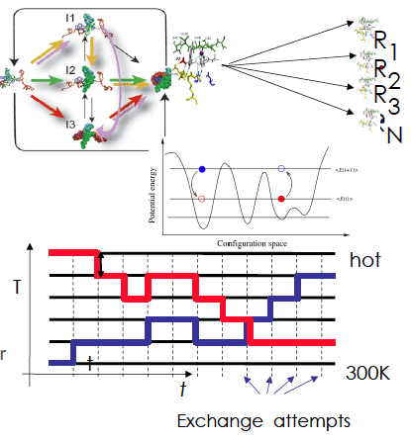
Application Exemplar I: Ensemble and Replica-Exchange Simulations
Replica-Exchange (RE) methods:
Represent a class of algorithms that involve a large number of loosely-coupled ensembles
Pattern not amenable to CIRRUS; explore Azure native abstractions
RE simulations are used to understand a range of physical phenomena
Protein folding, unfolding etc
MC simulations
Many successful implementations
e.g. folding@home [replica based]

Slide 8
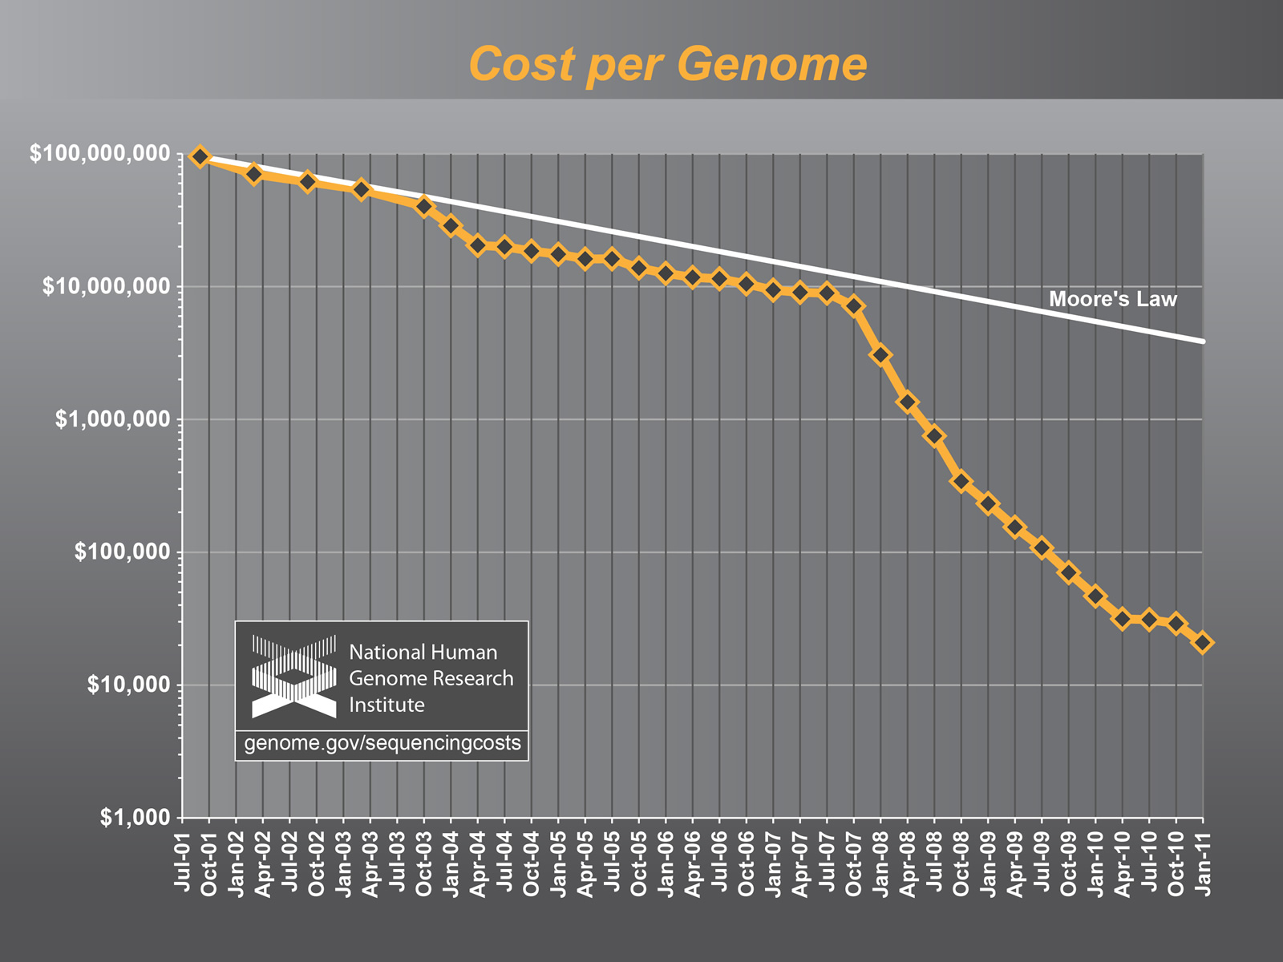
Application Exemplar II: NGS Analytics

Slide 9
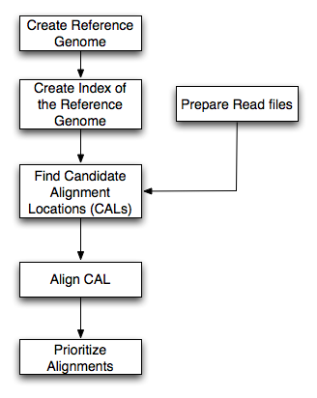
BFAST: An example of NGS Analytics
Higher sensitivity (CAL finding and gapped Smith-Waterman alignment)
Relatively large memory and disk space
Data types: (i) Short- Read (ii) Reference (iii) Index data
Advanced features: (i) Multi-threading support (ii) Low-memory option (index file splitting)
Breaking up short-read data permits task-level concurrency
Each Task requires full reference genome – possible I/O bottleneck
Tradeoffs: Comp. vs Mem. vs I/O vs DoD
Sensitive to specific data-set size
Ref. Genome
Mapping
(Bfast)
SNP finding
NGS short reads

Slide 10
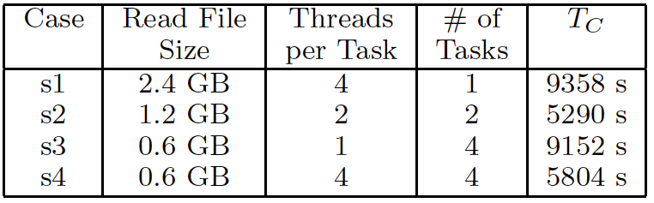
Tradeoffs: Comp. vs Mem. vs I/O vs DoD BFAST: File size vs Num Concurrent task
Scope for logical and physical distribution

Slide 11
BFAST: Configuration values for problem sizes
 |  | B. Glumae (BG) | Human Genome (HG) | HG - Chr 21
Genome Size |  | 7 Mbp | 2.8Gbp (hg18) | 47 Mbp (hg18-chr21)
NGS Type |  | Whole Genome | Exome | Exome
NGS Data Size |  | 12.6 GB | 5.6 GB | 5.6 GB
Ref. Index Data | 40 index files | 40 GB | 130 GB | 70 GB
 | 10 index files
Minimum Memory | 40 index files | 9.5 MB | 3 GB | 42 MB
 | 10 index files | 38 MB | 12 GB | 164 ΜΒ

Slide 12
What are the challenges for LS Applications on clouds?
LS Applications can be
Memory or I/O or CPU or Tx bound
Multi-parametric trade-offs exist
“Complex” coordination requirements
Distributed Applications Revisited
What is the task decomposition granularity?
Where, when to distribute? How to manage coordination?
What are the data transfer/access/storage mechanisms
Need Abstractions to Support Dynamic Applications
Now these have to be performed dynamically!
Resource Elasticity (Cloudburst) + Heterogeneous task-resource binding and need to modify application configuration
Abstractions: Programming + System/Infrastructure abstractions

Slide 13
What are the challenges for LS Applications on clouds?
Distributed, Dynamic Applications: Something in between a “black box” and full-blown low-level programming
Keep the black-box model but with some-useful knobs (abstractions)
What is the infrastructure?
No well-defined single infrastructure
Distinguish Astronomy, HEP community
Heterogeneous, Distributed, Variable Load-factors
“Building this infrastructure is not trivial” & “TeraGrid is not used for data-intensive applications” (Fox)
There are “hard” parts and tractable parts
SAGA handles the hard part, opening up innovation elsewhere

Slide 14

SAGA: In a nutshell
There exists a lack of Programmatic approaches that:
Provide general-purpose, basic & common distributed functionality for applications; hide underlying complexity, varying semantics..
The building blocks upon which to construct “consistent” higher-levels of functionality and abstractions
Meets the need for a Broad Spectrum of Applications
Simple scripts, Gateways, Tooling, Workflow…
Simple, integrated, stable, uniform and community-standard
Simple and Stable: 80:20 restricted scope
Integrated: Similar semantics & style across primary functional areas
Uniform: Same interface for different distributed systems
OGF-standard, “official” CLI of EGI, NSF-XD,
Standards-based approach: A Technical and an Economic (Moral?) imperative & case:

Slide 15
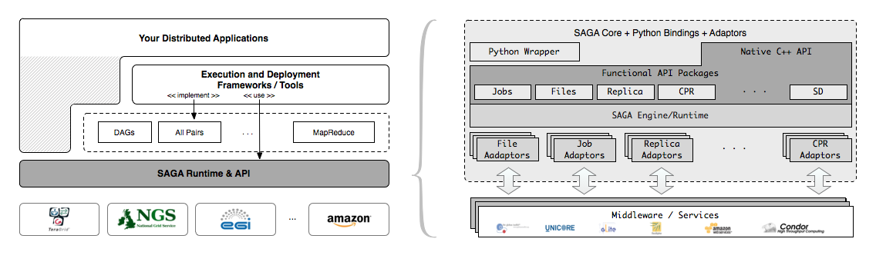
SAGA – An Overview

Slide 16
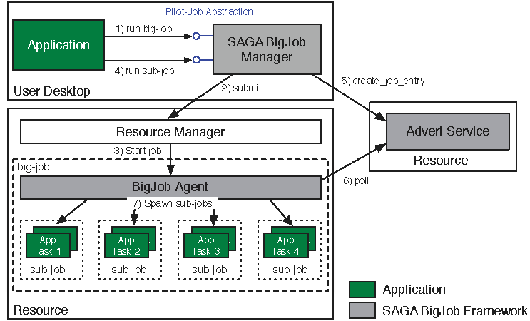
Abstractions for Dynamic Execution SAGA Pilot-Job (BigJob)

Slide 17
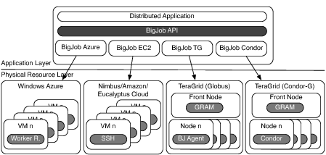
Deployment & Scheduling of Multiple Infrastructure Independent Pilot-Jobs

Slide 18
What is unique about Pilot-Jobs built using the right abstractions?
Pilot-Jobs: Decouple resource allocation from resource-workload binding
Pilot-Jobs are/have been typically used for:
Enhancing resource utilization; Facilitate high-throughput simulations
Lowering wait time for multiple jobs (better predictability)
Several unique aspects about the SAGA-based Pilot-Job
Pilot-Jobs have not been used for Science Driven Objectives:
First demonstration of multi-physics simulations, REMD simulations
Frameworks based upon PJs (pull model) for specific PGI/back-end
Infrastructure Independent and “standard” PJ API to access other PJs
SAGA PJ (BigJob) API basis for inter-operable PJ (Azure, DIANE)
SAGA-based Pilot-Job form the basis:
Extension of Pilot-abstraction to other “dimensions”
For autonomic scheduling and application-level scheduling
Advanced run-time frameworks for load-balancing and fault-tolerance

Slide 19
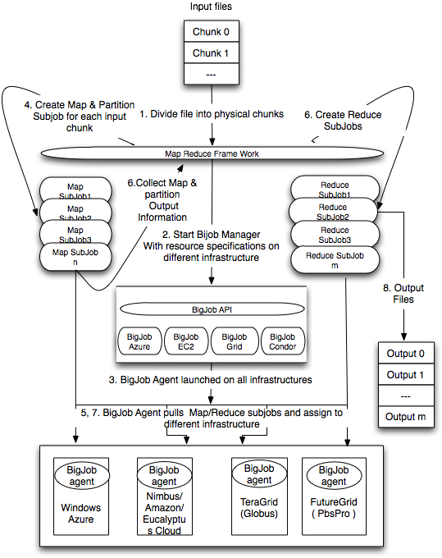
Using Pilot-Jobs as Runtime Execution Environment for MR

Slide 20
Ensemble MD simulations: BigJob for Azure
Azure BigJob API calls Azure APIs directly
BigJob Manager (BM) launches requested number of worker roles using the Service Management API
Python library created for this capability
BigJob Agents run within the worker roles (C#/.Net)
Primary responsibility to execute MD code
MPI-based MD tasks confined to a single worker role (8 cores)
For each sub-job, the BM creates a work-package
Distributed to agents using AQS – reliable and scalable msgs
Agents query AQS for new work-packages
Stage data from ABS

Slide 21
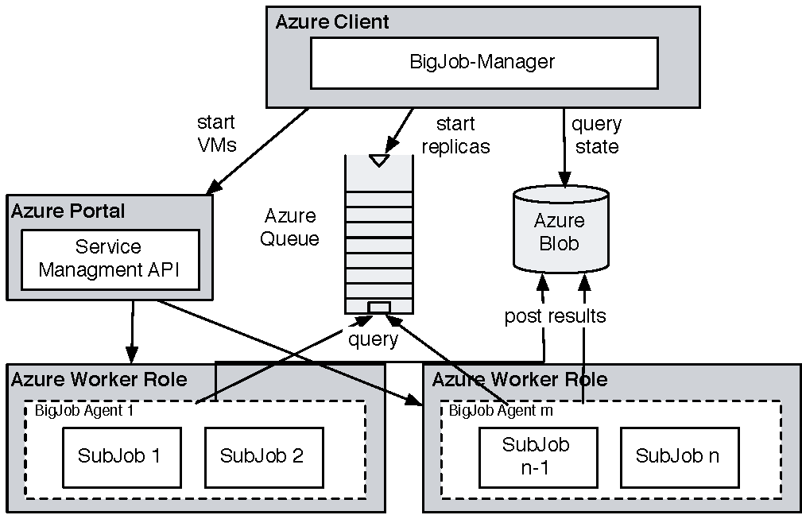
Coordinating Multiple Tasks Using BigJob for Azure
Support for Affinity Groups
Multiple Affinity Groups supported within the same BigJob for different worker-roles

Slide 22
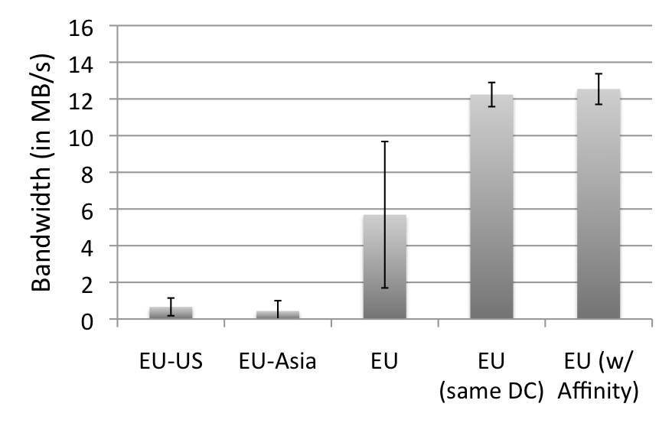
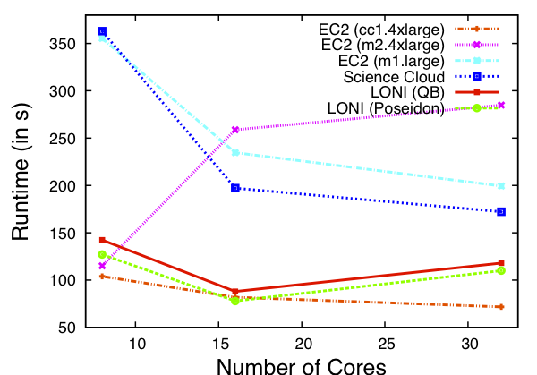
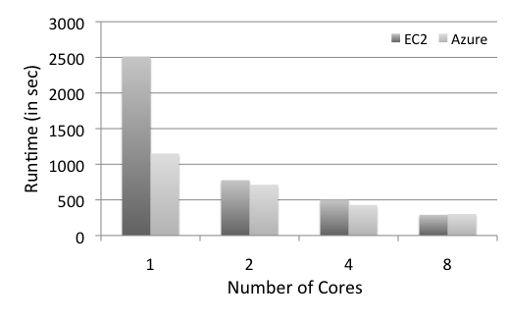
Azure: Scalability with Simplicity Providing Infra-level abstractions for DDIA
NAMD Performance on Azure
Three types of storage abstractions:
Azure Blob Service: Large amounts of raw data
Block Blob: Large chunks of 5GB
Page Blob: Mange storage as an array
Azure Table Storage: Semi-structured data
Azure Queue Storage: Message Queues
All three replicated and with strong consistency semantics
Current affinity operates at the data-center level;
Enhanced/finer-grained affinity to be made available

Slide 23
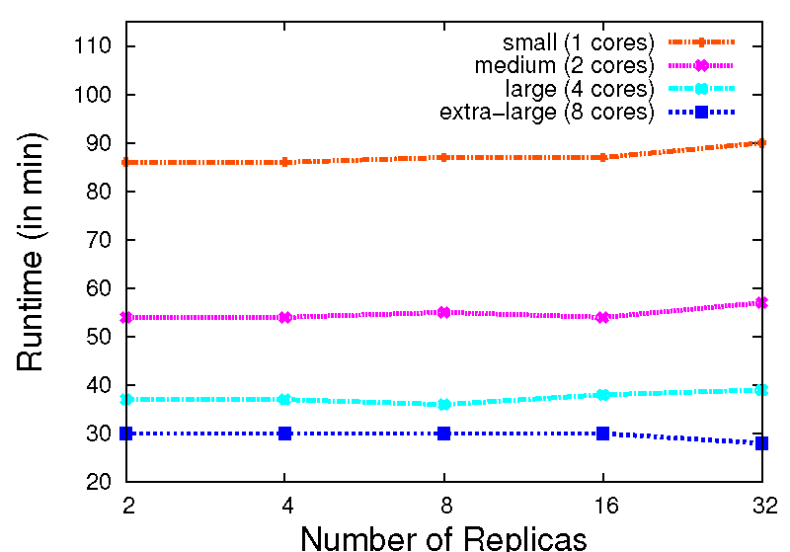
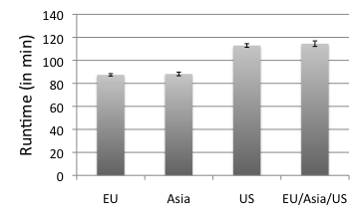
Replica-Exchange on Azure
Azure BigJob scales well with the number of replicas.
AQS proved to be effective for coordination of sub-jobs/replicas
Larger VMs have a better performance. But, efficiency drops < 0.4 for the extra-large VM
The different Azure data centers show a slight fluctuation in their performance
16 replicas, small VM

Slide 24
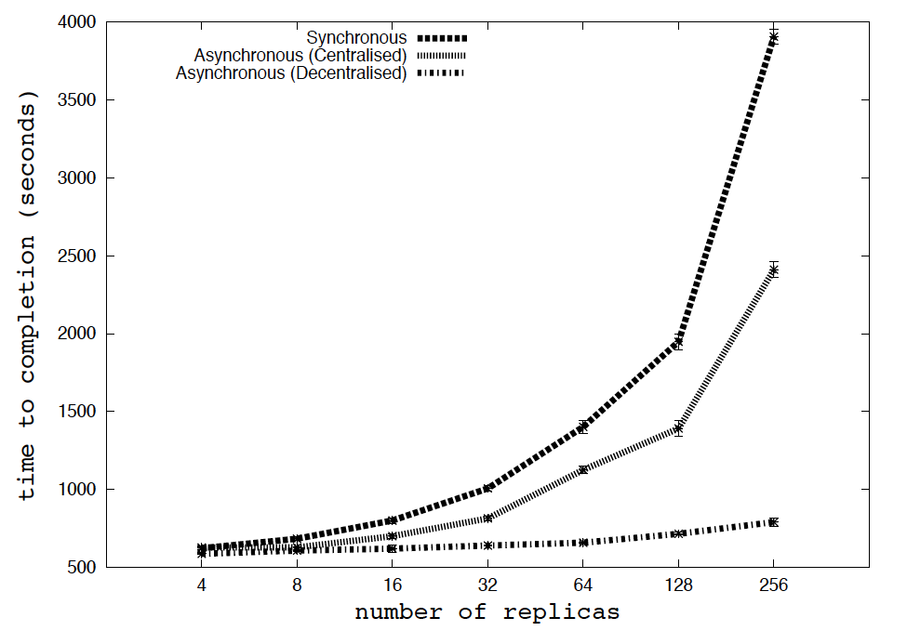
RE Algorithms at Scale (TeraGrid) Understand Algorithms at Scale on Azure?

Slide 25
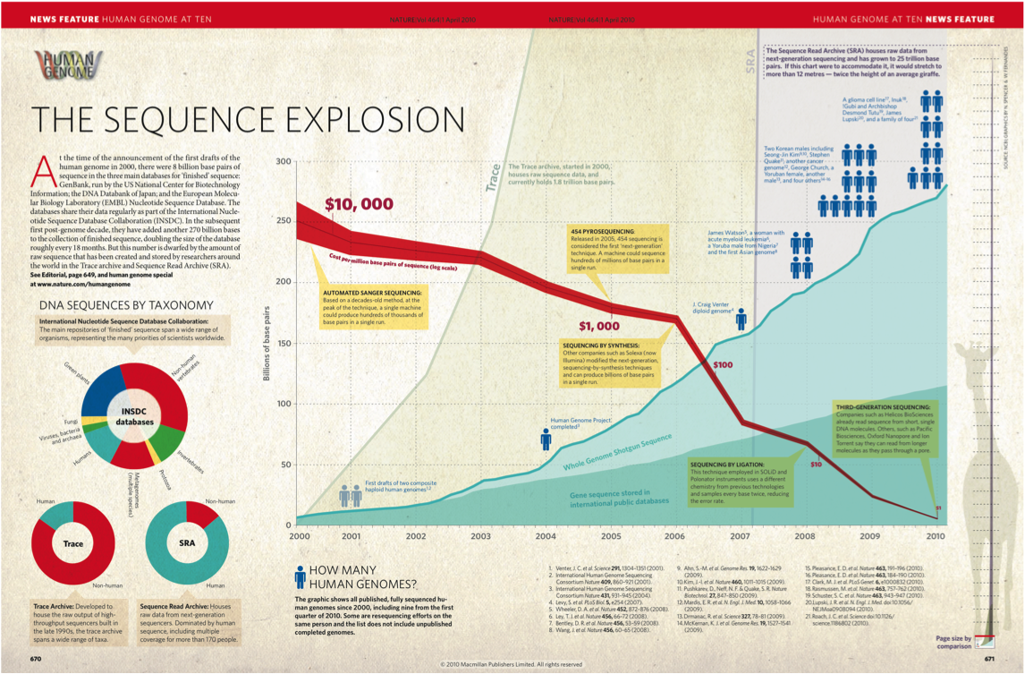
Application Exemplar II: NGS Analytics

Slide 26
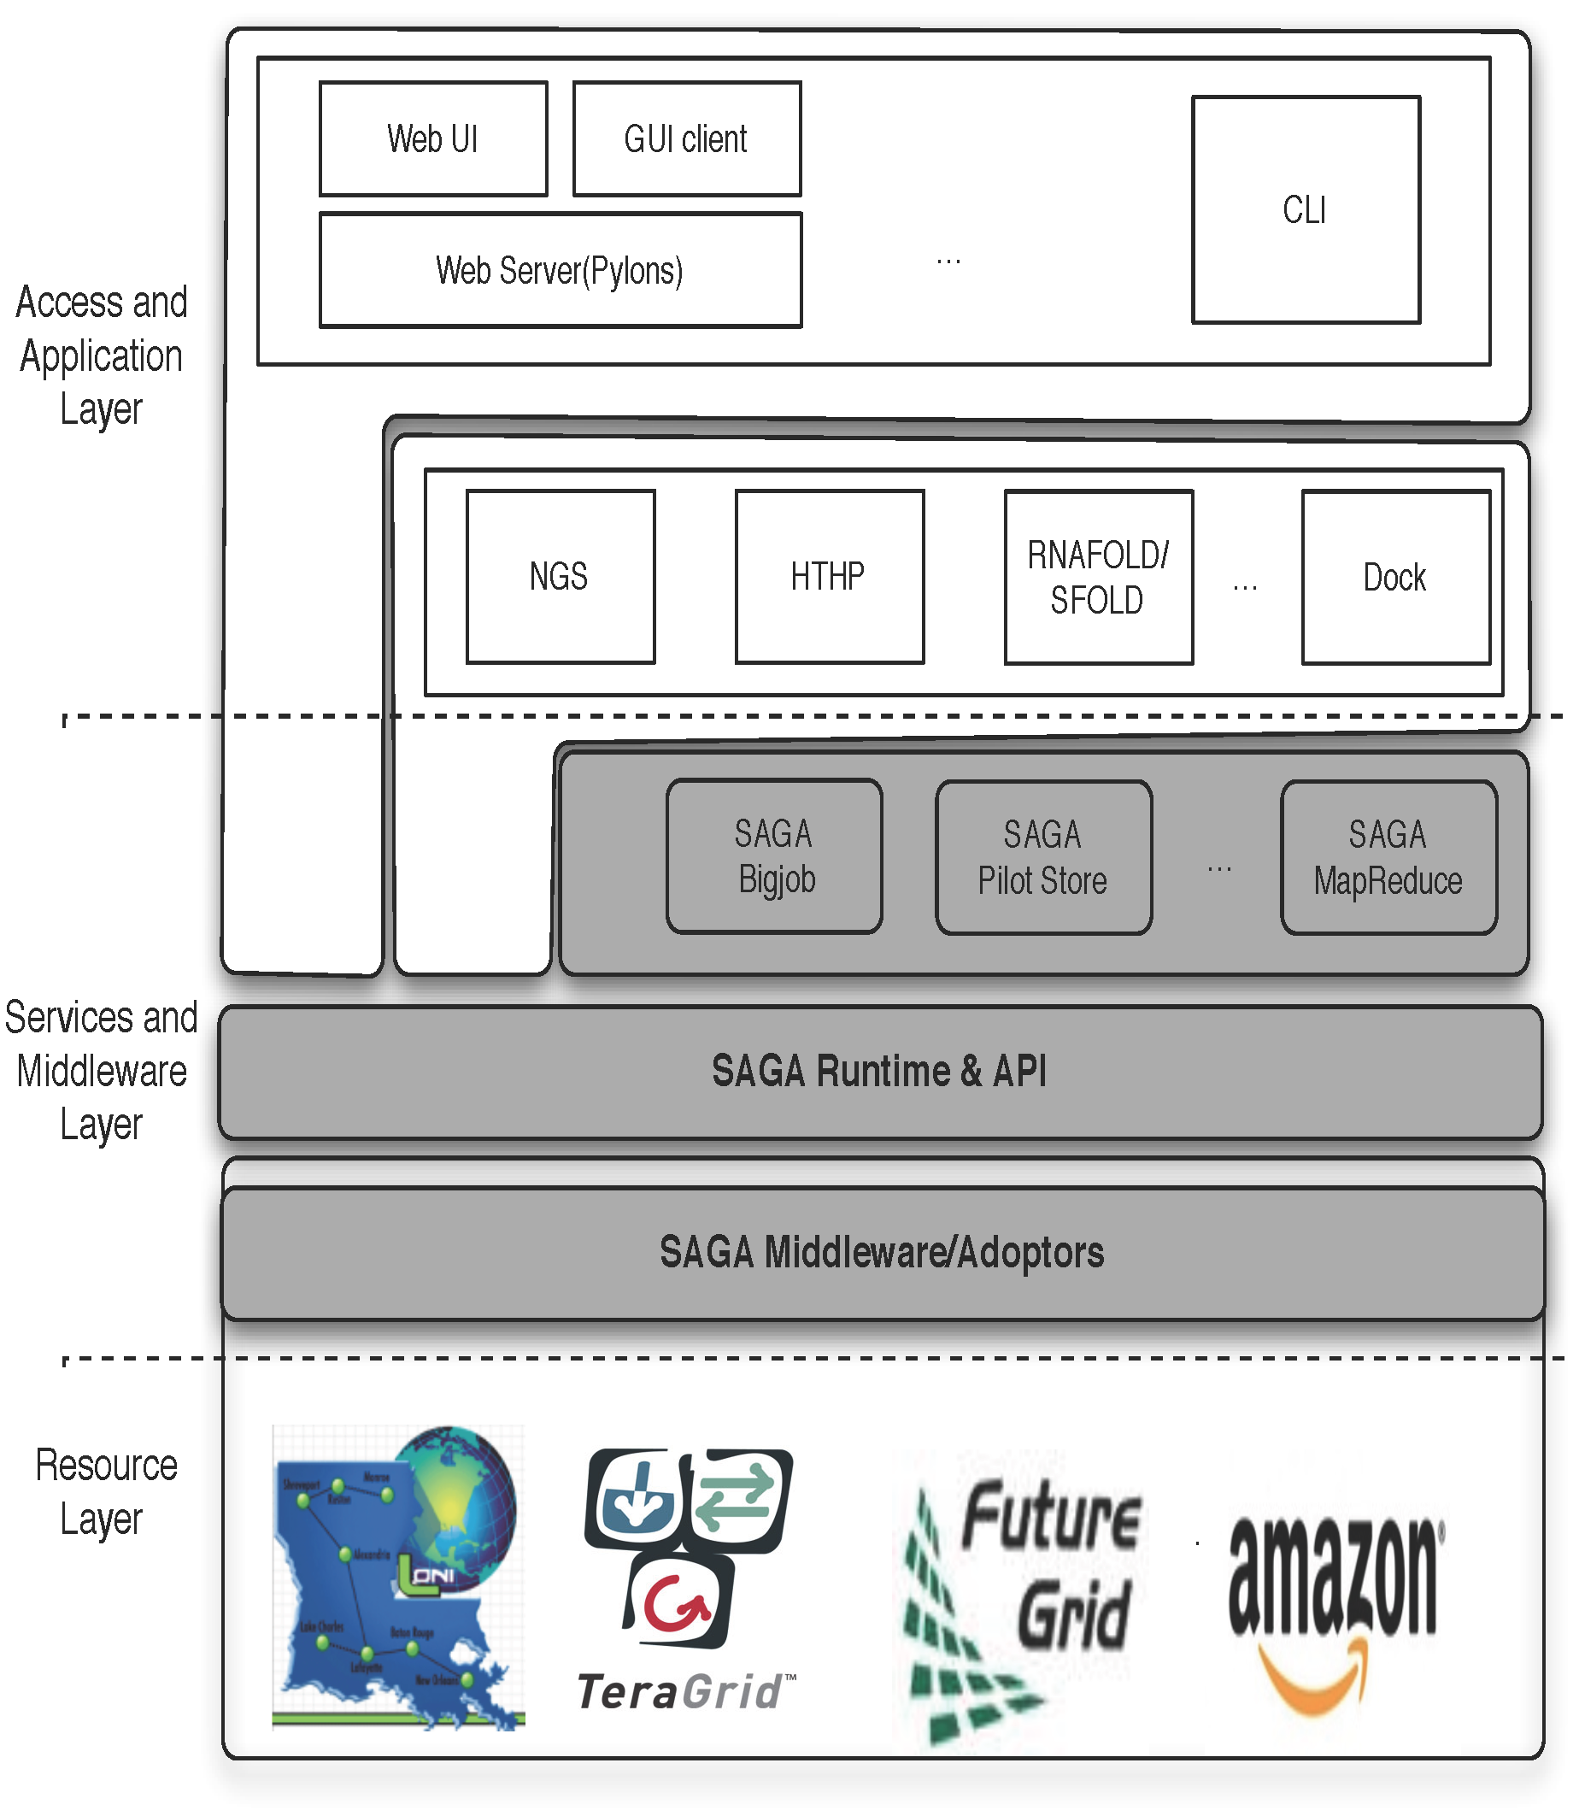
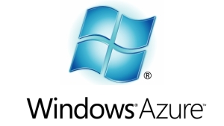
DARE: Dynamic Adaptive RE
Notes:
Fixed the diagram.. Please remove next slide if you are OK with this

Slide 27
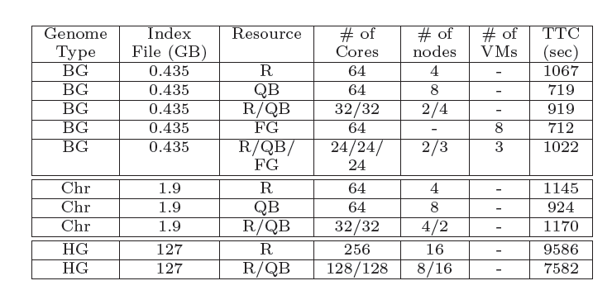
Tradeoffs: Comp. vs Mem. vs I/O vs DoD
Notes:
(JK) Here, upper two tables represent the benefits of task level concurrency and scale-out strategy

Slide 28
Extending the Pilot-Abstraction to Data

Slide 29
Pilot Data Features
Grouping of files that are often used together
Expression of affinities between file groups (data-data) as well as files and compute resources (data-compute)
Distributed access and file movement
Data partitioning and distribution of files
Integration with BigJob (for data-aware scheduling)
Future Work
Data scheduling
Data replication and consistency management
Integration of third party data management frameworks

Slide 30
Pilot-Data Map-Reduce Example

Slide 31
Providing NGS Analytics as a Service: Data Challenges
Challenges and Ongoing investigation
Efficient Distributed data management
Efficient Data transfer
Data transfer of Reference genome index files : O(hours) 130 GB,
Data transfer of Short read files : e.g. 9 GB, O(mins) local to QB
protocol | Local -> QB | Local -> Ranger | QB -> Ranger
SCP | 33 MB/s (1 h) | 1.8 MB/s (20 h) | 1 MB/s (36 h)
GridFTP | 70 MB/s (0.5 h) | 6.8 MB/s (5.3 h) | 25 MB/s (1.4 h)
Data Transfer (130 GB)

Slide 32
Providing NGS Analytics as a Service: Data Challenges
Challenges and Ongoing investigation
Distributed data management
Data transfer of Reference genome index files : HG18 : 130 GB, B.Glumae :447 MB
Data transfer of Short read files : e.g. 9 GB (about 2 min from local to QB using GridFTP)
protocol | Local -> QB | Local -> Ranger | QB -> Ranger
SCP | 33 MB/s (1 h) | 1.8 MB/s (20 h) | 1 MB/s (36 h)
GridFTP | 70 MB/s (0.5 h) | 6.8 MB/s (5.3 h) | 25 MB/s (1.4 h)
Data Transfer (130 GB)

Slide 33
Conclusions
LS Applications – compute and data intensive present broad range of challenges
Combination of appropriate system-level abstractions (AQS) and user provided abstractions (BigJob)
Relative Ease of implementation of the R-E Pattern
Efficient and scalable messaging
Performance comparable to TG
Cost of virtualization not a first order concern
Ready for sophistication abstractions + implemetnion
Affinity becomes more fine-grained, data-compute affinity
Extensions to abstractions for dynamic data

Slide 34
Futuregrid Acknowledgement
This document was developed with support from the National Science Foundation (NSF) under Grant No.0910812 to Indiana University for "FutureGrid: AnExperimental, High-Performance Grid Test-bed." Any opinions, findings, and conclusions or recommendationsexpressed in this material are those of the author(s)and do not necessarily re ect the views

