Slide 1



SAGA Components: Installation and Deployment
Building and Installing

Slide 2
Outline
SAGA’s components
Overview, structure, dependencies
Available middleware bindings
The SAGA build system
Mephisto: A SAGA bootstrapping tool
Ongoing cyber-infrastructure deployment
LONI (Louisiana Optical Network Initiative)
TeraGrid, FutureGrid
…
Outlook / Ongoing efforts

Slide 3
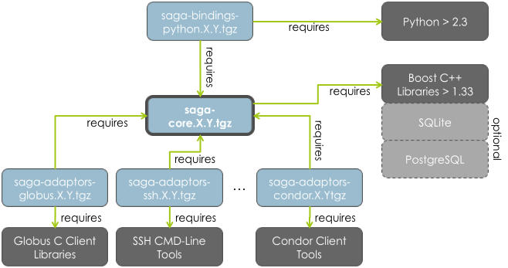
Overview | Structure | Dependencies
http://saga.cct.lsu.edu/software/cpp/download

Slide 4
Available Middleware Bindings (Adaptors)
saga-adaptors-default (fork, local fs, SQL advert & replica)
saga-adaptors-ssh (ssh job 'submission and fs ops via FUSE)
saga-adaptors-x509 (x509 security context)
saga-adaptors-globus (GRAM2/5, GridFTP, RLS)
saga-adaptors-condor (Condor jobs)
saga-adaptors-lsf (Platform LSF jobs)

Slide 5
Available (Beta) Adaptors (cont.)
saga-adaptors-aws (Amazon EC2, about to be released)
saga-adaptors-hdfs (Hadoop file op., about to be rel.)
saga-adaptors-glite (gLite-CREAM jobs, experimental)
saga-adaptors-pbspro (PBS Pro jobs, under review)
saga-adaptors-torque (Torque jobs, under review)
saga-adaptors-ogf (hpc-bp support, experimental)
… and: htable, kfs, naregi, ninfG, opencloud

Slide 6
SAGA’s Build System
Sophisticated configure/make-based build system
External dependencies are checked by configure/m4
Internal dependencies between components are checked via the environment variable SAGA_LOCATION
$> export SAGA_LOCATION=/install/location/
$> cd saga-bindings-python-0.9.3
$> ./configure
========================================================
SAGA Python BINDINGS - Configuration Summary
========================================================
Using SAGA from : /opt/saga-1.5.3-pre/ (install)
Python Found : yes
Python Version : 2.6.1
...

Slide 7
SAGA’s Build System (cont.)
./configure will tell you if a requirement is not met:
And if SAGA_LOCATION is not set, you will definitely end up with an error:
$> ./configure
...
checking for Boost headers version >= 1.33... no
configure: error: Could not find Boost headers version >= 1.33
$> unset SAGA_LOCATION=/install/location/
$> cd saga-bindings-python-0.9.3
$> ./configure
checking SAGA sources... not found
checking SAGA installation... not found
checking for saga-config... no
checking saga-config prefix... invalid
configure: error: Could find neither SAGA source tree nor installation.

Slide 8
SAGA’s Build System (cont.)
SAGA_LOCATION must point to your saga installation directory
Different Adaptors may have different configure options. ./configure --help is your friend
Each component comes with a file called: INSTALL Read it!

Slide 9
Mephisto: SAGA Bootstrapping
SAGA’s build system is standard for a *NIX library… BUT:
Installing SAGA on a machine that doesn’t meet any of the prerequisites can be a tedious and lengthy process:
E.g. downloading and installing the Boost C++ Libraries, PostgreSQL, Python, FUSE, Globus Toolkit client libs, saga-core, saga-bindings-python, saga-adaptors-x509, saga-adaptors-globus, saga-adaptors-ssh … will take forever.
Knowledge of certain configuration options that are relevant to saga (e.g. Python’s --enable-shared option)
Requires constant attention and interaction
Luckily, There’s an App for That! ™

Slide 10
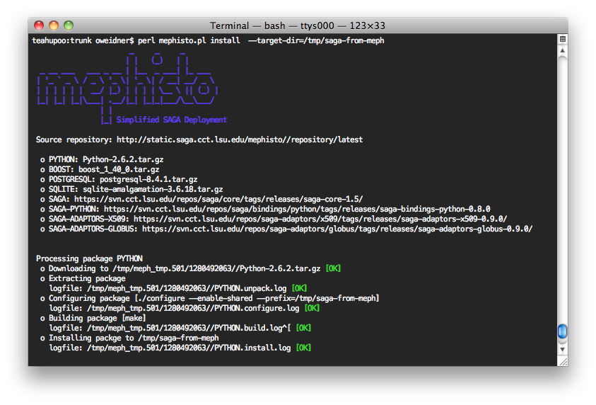
Mephisto: SAGA Bootstrapping (cont.)
http://faust.cct.lsu.edu/trac/mephisto

Slide 11
Mephisto: SAGA Bootstrapping (cont.)
When/where Mephisto should be used:
SAGA deployment in user space
Remote deployment (e.g. through batch system)
When/where Mephisto should not be used:
If you have no clue how to use a *NIX shell (You’ll have to learn that anyways if you want to use SAGA)
For custom-tailored, system-space deployments
If most of the required prerequisites are available

Slide 12
Deployment Status
LONI (Louisiana Optical Network Initiative)
Part of the Cyber-tools toolkit (on all non-PowerPC machines): http://cybertools.loni.org/
1.4.1 available via softenv – update to 1.5.3 in progress as part of the Ganga/SAGA deployment efforts
TeraGrid
SAGA is part of TG’s distributed programming toolkit: http://bit.ly/ff9c5B
1.4.1 available via softenv on some machines – will be updated soon
Users are asking for SAGA-support on Ranger and Kraken – we’re working on it!

Slide 13
Deployment Status (cont.)
FutureGrid
We’re discussing possible deployment of SAGA as part of the FutureGrid HPC VMs as well as a “bare metal” deployment
CERN
Available on lxplus SL5 clusters
LRZ (Munich)/DEISA
Part of softenv

Slide 14
Outlook | Ongoing Efforts
What we’re working on right now:
Hardening existing codebase
Mechanism to create custom binary packages (RPM and DEB) for RHEL, Ubuntu and Scientific Linux
Supporting developers to develop saga-based applications and tools
We’re working with infrastructure providers in the US as well as in Europe to make SAGA part of their standard software stack.

