Slide 1

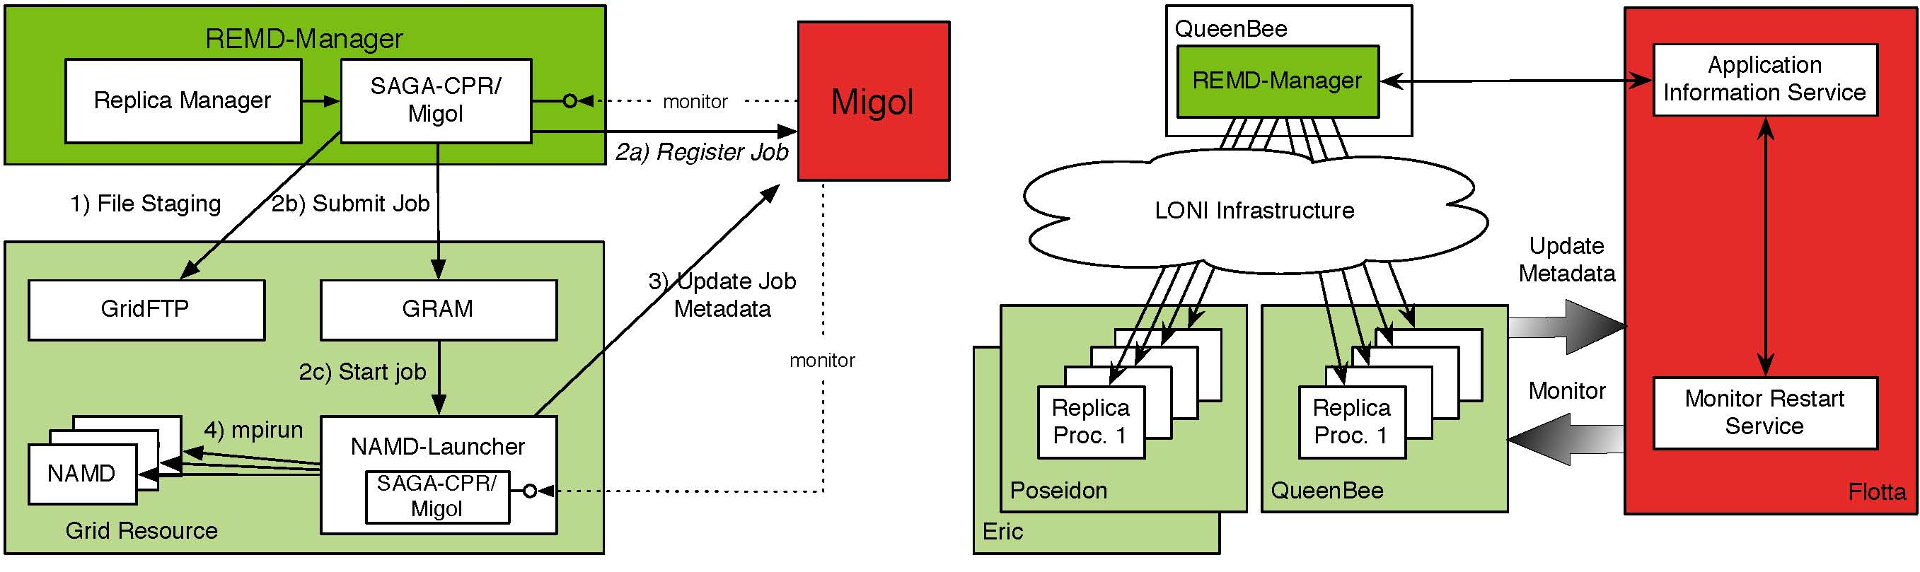

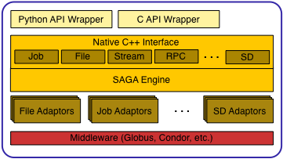
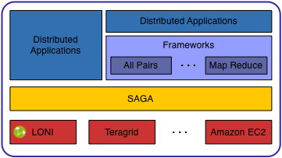
Enabling Distributed Applications with SAGA João Abecasis, Shantenu Jha, Hartmut Kaiser, Joohyun Kim, André Merzky, and Ole Weidner Center for Computation & Technology, Louisiana State University, Baton Rouge, U.S.A.
Abstract
The Simple API for Grid Applications (SAGA), a proposed recommendation of the Open Grid Forum (OGF), defines a high-level programmatic interface for developers of Distributed Applications [1]. The fundamental idea of SAGA is to lower the barrier for applications and application scientists to utilize distributed infrastructure. SAGA provides a simple, uniform, stable interface to the most often required functionality in order to construct general purpose, extensible and scalable applications.
Our group has lead the SAGA effort, starting from the specification effort at the OGF to providing the first C++ implementation [2]. We are also developing several different novel applications, using SAGA to harness the power of distributed infrastructure.
From the vision we have for the project and also from our experience developing on top of it, we believe SAGA is truly an enabler in the development of Distributed Applications. Here we present different types of distributed applications being developed on top of SAGA. Namely, (i) porting legacy applications to utilize distributed resources; (ii) development of applications based upon abstractions and frameworks that are themselves developed using SAGA; (iii) first principles applications, explicitly cognizant of the fact that they will operate in a distributed environment, where the application logic is coupled with the distributed logic. SAGA Supports all such development.
Simple, yet Powerful
CyberInfrastucture is all about
Connections with CyberTools
SAGA is being used within the Cybertools project in several critical ways:
It is being used to create a general purpose "Application Manager", that will enable many science drivers to utilize remote LONI machines without any changes to the execution environment. In particular it can be used to support specific application usage patterns, for example, it has been used for distributed replica-exchange (RE) simulations using NAMD. The same infrastructure can be used for use with other codes such as LAMMPS, etc. The figure above provides details on how SAGA is used to implement RE.
SAGA will be the interfaced with Cactus applications to use Information Services and other advanced CyberInfrastructure features.
SAGA will also provide the basic capability for interfacing multi-physics applications (via extension to the API to support messaging)
References
Goodale, T, Jha, S, Kaiser, H, Kielmann, T, Kleijer, P, Merzky, A, Shalf, J, Smith, C, (2007) GFD-R-P.90 A Simple API for Grid Applications (SAGA), Open Grid Forum
SAGA C++ Project [Online]. http://saga.cct.lsu.edu
Acknowledgements: This work was supported by NSF and the Louisiana Board-of-Regents.
Notes:
250 word abstract
Connections with cybertools
acknowledgements

