Slide 1


TA : Amany Sherif
Book rbit
A .NET Clean Architecture BackEnd System.
Connecting students through the orbit of knowledge sharing.

Slide 2
Team Members
Adham Eltantawi
(Lead)
Eyad Dawood
(Backend Lead)
Abdelrahman
Mohye
Abdelrahman Yasser
(Frontend Lead)
Omar Ashraf
Abdelrahman Nofal

Slide 3


The Problem & Why It's Hard
Financial Waste
Students waste money on textbooks by abandoning them after a single semester
Zero Trust & Identity Mandate
No trusted, centralized platform exists for secure student-to-student lending. Identity trust is non-negotiable — only verified university students can participate in the ecosystem.
State Complexity
Peer-to-peer lending requires strict transaction state integrity — one missed transition breaks the entire chain

Slide 4
The Solution: BookOrbit at a Glance
Verify Email & Admin Approve
Secures the platform through admin-gated onboarding utilizing mandatory university email verification.
Shared Catalog
Separates the shared Book catalog from physical BookCopy ownership to enforce a single source of truth.
Browse & Request
Allows students to list physical book copies while others browse, request, and manage borrowing lifecycles.
State Transitions
Manages the complete borrowing lifecycle through strict states: pending, accepted, rejected, or cancelled.

Slide 5
System Architecture — Clean Architecture
Api
(Controllers, Middleware)
Infrastructure
(EF Core, Identity, JWT)
Application
(CQRS, MediatR, DTOs)
Domain
(Entities, Value Objects, Events)

Slide 6
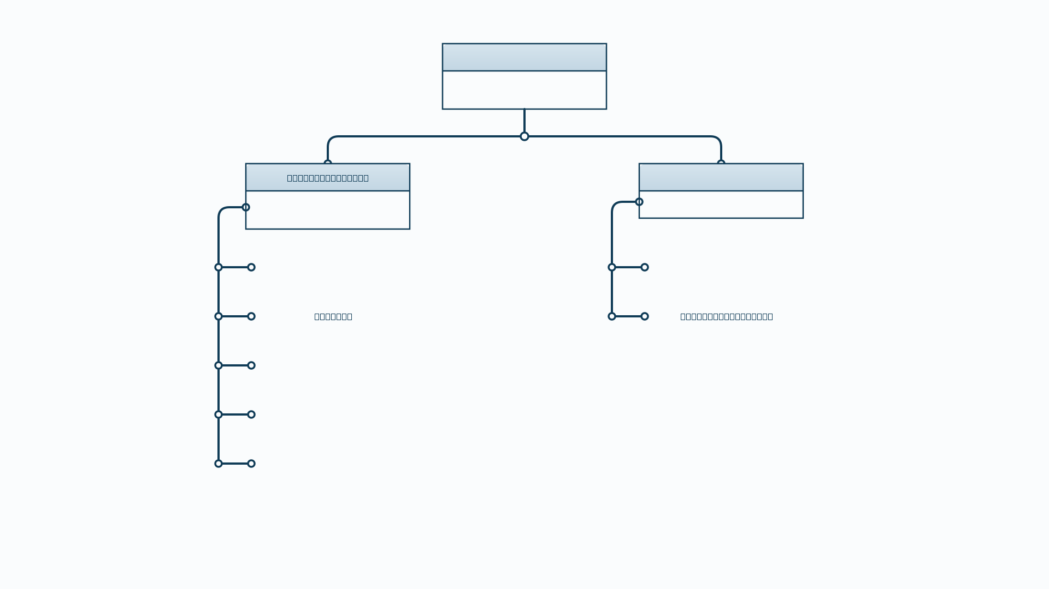
Domain Layer — Entity Hierarchy

Slide 7
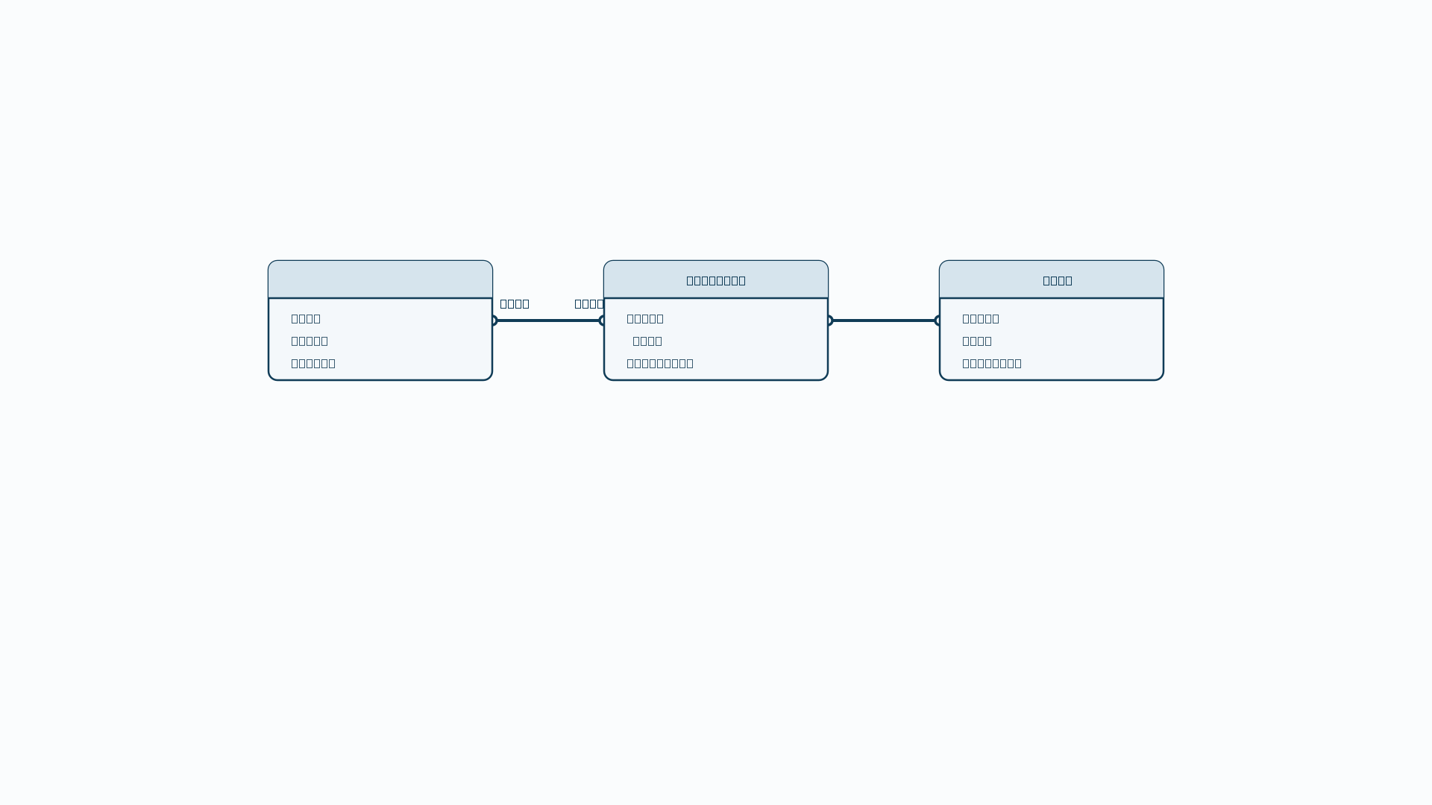
Domain Entities — Student, Book & BookCopy
Student: Points economy, verified identity.
Book: Master catalog entity.
BookCopy: Physical copy tracking condition.

Slide 8
The Lending & Borrowing Workflow
List (LendingListRecord)
Lender lists a physical book.
Shared Catalog
Separates the shared Book catalog from physical BookCopy ownership to enforce a single source of truth.
Browse & Request
Allows students to list physical book copies while others browse, request, and manage borrowing lifecycles.
State Transitions
Manages the complete borrowing lifecycle through strict states: pending, accepted, rejected, or cancelled.

Slide 9
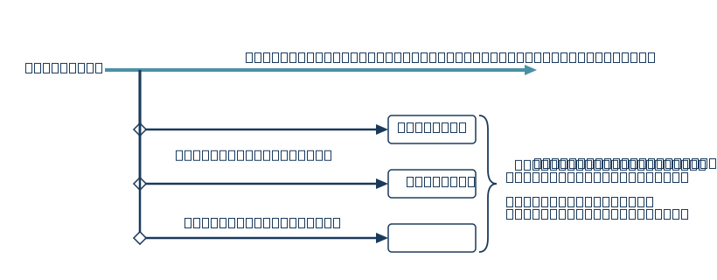
Exception-less Control Flow: Railway-Oriented Programming
Forced Acknowledgment
No Hidden Modes
Forces the Presentation layer to explicitly acknowledge and handle every potential failure path.
Delivers a 100% predictable API contract that eliminates unpredictable bubbling and hidden failure modes.

Slide 10
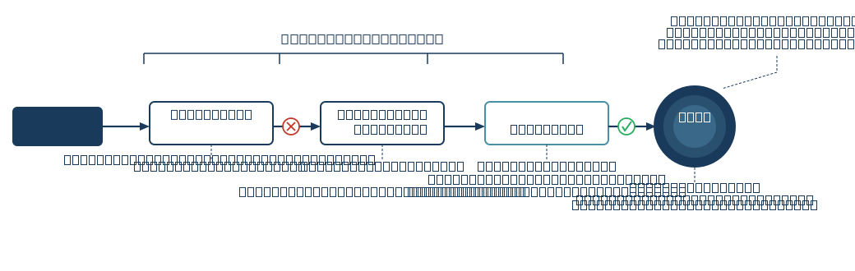
Application Pipeline: MediatR Behaviors
Pre-Flight Integrity:
Halts execution using FluentValidation so the handler never runs with invalid input.

Slide 11


Smart Persistence: EF Core Interceptors
Global Hook: Hooks directly into SaveChangesAsync via a globally registered AuditableEntityInterceptor.
CreatedAtUtc
Data Base
Entity Update
LastModifiedUtc
ModifiedBy
CreatedBy
Transactional Consistency: Dispatches Domain Events via MediatR strictly before the database commit to guarantee transactional consistency.
Automatic Injection: Automatically injects timestamps and user data on every single entity state change.

Slide 12
Frontend Architecture & Tech Stack
Browser
(React SPA)
Api Server
services/ Layer Boundary
React v19 & Tailwind CSS v3.4 deliver a highly responsive, utility-driven Single Page Application.
Feature-based architecture organizes the src/ directory by domains like pages/auth/ and pages/lending/.
React Router v7 handles all client-side navigation and protected route enforcement.
Service layer isolation ensures the UI never directly calls fetch, routing all API traffic through services/.
Framer Motion & Lucide React provide micro-interactions and consistent iconography without bloat.
Testing Library enforces reliability across critical UI components and custom hooks.

Slide 13
Authentication Flow & Session Management
Register
University email gating
strictly limits registration to verified institutional domain addresses.
Institutional email only
JWT dual-token strategy
Verify Email
isolates the short-lived access token from the secure, long-lived refresh token.
Silent refresh
Pending
runs automatically via AuthContext, ensuring users are never interrupted mid-session.
Manual gate check
Environment keys
securely isolate token identifiers away from the compiled application bundle.
Admin Approval
Manual gatekeeping
requires Admin approval to finally transition an account to activated.
Activated

Slide 14

Routing & State Architecture
pages/profile/
AuthContext (Session State)
pages/lending/
pages/admin/
Client-side routing via React Router v7 prevents full-page reloads while managing complex navigational state.
API boundary enforcement routes everything through services/, creating a single point of configuration.
Guard checkpoints ensure no protected view renders without first passing a strict authentication check.
Custom hooks extract complex business logic out of UI components into reusable, isolated functions.
Single source of truth is securely maintained by AuthContext for all session data across the application.
Centralized configuration makes adapting to backend URL changes a single-line adjustment.

Slide 15
Core User Flow: Listing a Book
Search Shared Catalog
Catalog-first architecture
requires students to search the shared database before creating new entries.
Physical copy attachment
Book Exists?
securely links a user's specific physical book to the centralized master record.
New entry suggestions
Suggest New Book
trigger when a book is missing, pushing the data to an admin review queue.
Asynchronous approval
prevents unverified or duplicate books from cluttering the shared market.
Admin Review Gate
Admin Review Gate
Explicit listing action
formally moves a verified physical copy into the active lending market.
Active Market Listing

Slide 16
Core User Flow: Borrowing a Book
Owner Action
Activated
Pending
Optional Direct Message attached to request
Borrower Action
Owner Action
Cancelled
Rejected
Faceted browsing allows students to filter the lending market by title, category, and real-time availability.
State transition controls grant the owner exclusive rights to move a request from pending to accepted or rejected.
Asynchronous requests allow borrowers to send targeted pings with optional direct messages.
Proactive cancellation allows the borrower to abort the request unilaterally before an owner responds.
Instant notification alerts the physical owner that their actively listed copy has a prospective borrower.
Physical handover occurs off-platform only after the accepted state is mutually confirmed.

Slide 17


Admin Panel & Platform Control
Permission
Standard Student Role
Administrator Role
Browse Lending Market
Access pages/admin/ routes
Approve New Book Suggestions
Ban / Unban User Accounts
Isolated administrative domain securely houses all governance tools exclusively under the pages/admin/ directory.
Route-level authorization strictly blocks standard students from accessing any administrative endpoints.
Granular account moderation empowers admins to approve, reject, ban, or unban user profiles.
Route-level authorization strictly blocks standard students from accessing any administrative endpoints.
Catalog hygiene enforcement routes all new book suggestions through a manual admin approval gate.

Slide 18




Future Program Roadmap
RECOMMENDATION SYSTEM.
AI OPTIMIZES IMAGES OF BOOKS CAPTURED.
AI-POWERED SEARCH: USER DOESN'T HAVE TO SEARCH BY EXACT NAME.
INTEGRATE AN AI CHATBOT.

Slide 19
Thank you!

