Slide 1
FINAL PROJECT #9
Clinic Appointment Management System
Al-Amal Medical Center — Enterprise Full-Stack Healthcare Platform
• Technology Stack: Oracle Database 19c | ASP.NET Core 8 Web API | Angular 21
• Key Capabilities: Double-Booking Concurrency Protection, Row-Level Locks, Live Admin Analytics, JWT Auth
• Academic Evaluation: Final Project University Specification Integration & Verification
Presented by Full-Stack Engineering Team | University Computer Science / Software Engineering

Slide 2
CLINIC APPOINTMENT MANAGEMENT SYSTEM
Project Overview & Executive Summary
Mission & Core Objectives
• Digital Transformation: Transition clinic appointment workflows from legacy manual recording to an automated digital portal.
• Patient Convenience: Patients can discover specialized doctors, review verified schedules, select exact available slots, and obtain immediate confirmation.
• Concurrency & Integrity: Guarantee zero double-bookings under concurrent client requests using Oracle PL/SQL row-level locking.
• Administrative Empowerment: Real-time clinical KPI dashboard, dynamic specialty management, doctor profiles, and appointment lifecycle tracking.
• Authoritative Compliance: Full conformity with University Assignment Specification #9 requirements and architectural standards.
Architectural Highlights
✔ Frontend (Angular 21): Modern Single Page Application with standalone components, Zone.js change detection, reactive forms, and responsive LESS styling.
✔ Backend (ASP.NET Core 8 Web API): Clean 3-tier modular architecture (API, Core, Infrastructure) utilizing Dapper ORM and Oracle.ManagedDataAccess.Core.
✔ Database (Oracle 19c Enterprise): Relational normalized schema, foreign key cascades, constraints, views, and stored procedures with atomic transactions.
✔ Security: Salted SHA-256 password hashing for administrators, JWT Bearer tokens with Claims-based authorization, and protected Angular route guards.
✔ Zero-Stub Integration: All UI views and analytics connect to real running Oracle database instances with live queries.

Slide 3
CLINIC APPOINTMENT MANAGEMENT SYSTEM
High-Level 3-Tier System Architecture
Presentation Tier
Angular 21 Single Page App
• Modern Component Architecture
• Reactive Forms & Client Validation
• RxJS & HttpClient Services
• Role-Based Route Guards
• Toast Notification Feedback
• Responsive Mobile / Desktop UI
Application Tier
ASP.NET Core 8 Web API
• Clean 3-Tier Architecture
• Controllers / Services / Repositories
• JWT Bearer Authentication
• Dapper High-Performance Micro-ORM
• CORS & Swagger OpenAPI Spec
• Centralized Exception Handling
Database Tier
Oracle Database 19c
• 7 Relational Tables & Constraints
• PL/SQL Package (PKG_CLINIC_OPERATIONS)
• Row-Level FOR UPDATE Concurrency Locks
• Live Aggregation Views
• ACID Transaction Compliance
• Oracle.ManagedDataAccess.Core Driver

Slide 4
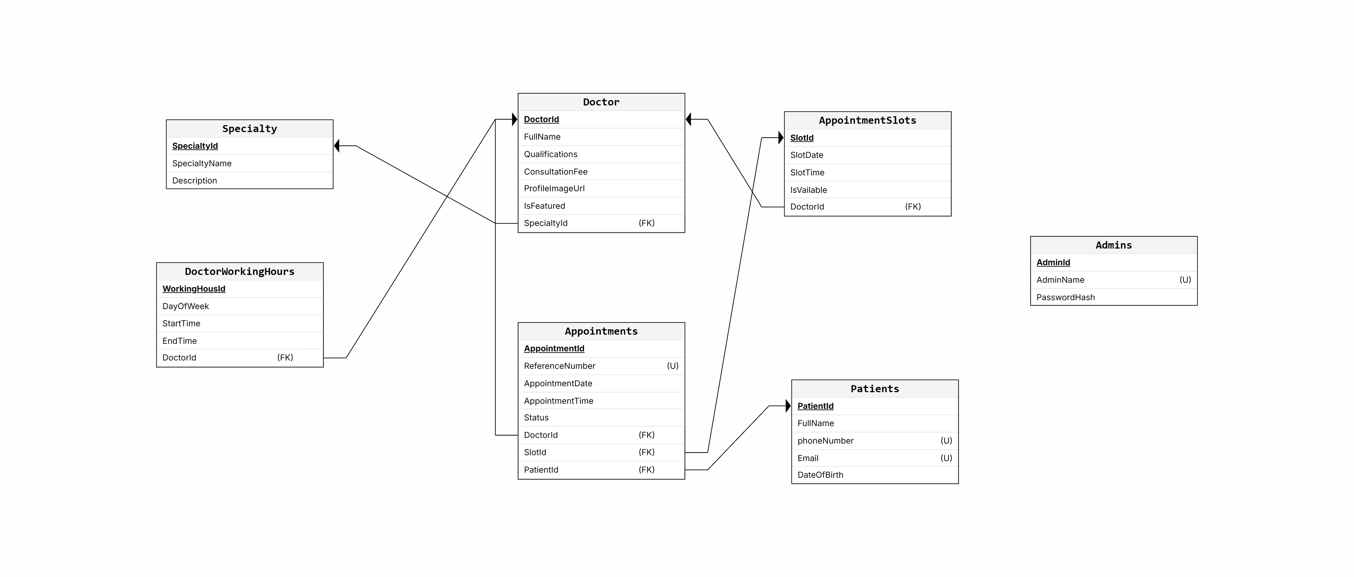
CLINIC APPOINTMENT MANAGEMENT SYSTEM
Oracle Database Architecture & Relational Schema
Database Structure
• Specialties: Medical departments (Cardiology, Pediatrics, Dermatology, etc.).
• Doctors: Physician profiles, specialization foreign key, consultation fees, and experience.
• DoctorWorkingHours: Weekly operating schedules by day with start/end time windows.
• AppointmentSlots: Specific bookable time slots per doctor with date and availability flag.
• Patients: Registered patient registry with unique phone & email constraints.
• Appointments: Persisted bookings linked to patient, doctor, and slot with statuses.
• Admins: Secure administrative credentials storing salted SHA-256 hashes.

Slide 5
CLINIC APPOINTMENT MANAGEMENT SYSTEM
PL/SQL Stored Procedures & Double-Booking Prevention
Package PKG_CLINIC_OPERATIONS
⚙ REGISTER_PATIENT
Atomically registers or returns existing patient by phone number. Prevents duplicate identities.
⚙ BOOK_APPOINTMENT
Executes pessimistic slot locking using SELECT ... FOR UPDATE. Validates slot doctor and date. Inserts appointment and flips slot availability to 0 atomically.
⚙ CANCEL_APPOINTMENT
Updates appointment status to 'Cancelled' and automatically releases the associated slot back to Available (1).
⚙ UPDATE_APPOINTMENT_STATUS
Safely transitions appointment states (Scheduled -> Completed / Cancelled). Reopens slot if cancelled.
Double-Booking Prevention Mechanism
🔒 The Problem: When two patients simultaneously click 'Confirm Booking' for the exact same slot, naive systems create duplicate conflicting appointments.
🔒 Oracle Row-Level Lock: The procedure executes:
SELECT IsAvailable INTO v_IsAvailable FROM AppointmentSlots WHERE SlotId = p_SlotId FOR UPDATE;
This immediately serializes competing transactions at the database engine level.
🔒 Immediate Rejection: If v_IsAvailable = 0, the procedure raises ORA-20002 ('Selected appointment slot is no longer available').
🔒 API Conflict Mapping: The ASP.NET Core service catches the Oracle exception and translates it into HTTP 409 Conflict with a clear message.
🔒 Automated Test Verified: Concurrency test verified that parallel requests for the same slot result in exactly 1 successful booking and 1 HTTP 409 rejection.

Slide 6
CLINIC APPOINTMENT MANAGEMENT SYSTEM
ASP.NET Core Web API Backend Architecture
Core Layer
Domain Models & Interfaces
• Pure C# domain models (Doctor, Patient, Appointment, Slot)
• Strongly typed DTOs for requests and responses
• Repository & Service interface abstractions
• Zero external dependencies for maximum testability
Infrastructure Layer
Oracle Data Access & Services
• Dapper high-speed micro-ORM queries
• Oracle.ManagedDataAccess.Core integration
• PL/SQL package stored procedure execution
• DynamicParameters for input/output cursors
• Salted SHA-256 password hashing logic
• JWT token generation with symmetric security keys
API Layer
Controllers & Middleware
• RESTful endpoints adhering to HTTP standards
• JWT Bearer Claims-based Authorization
• CORS policy enabled for Angular frontend
• Swagger / OpenAPI interactive UI
• HTTP Status Codes: 200, 201, 400, 404, 409 Conflict

Slide 7
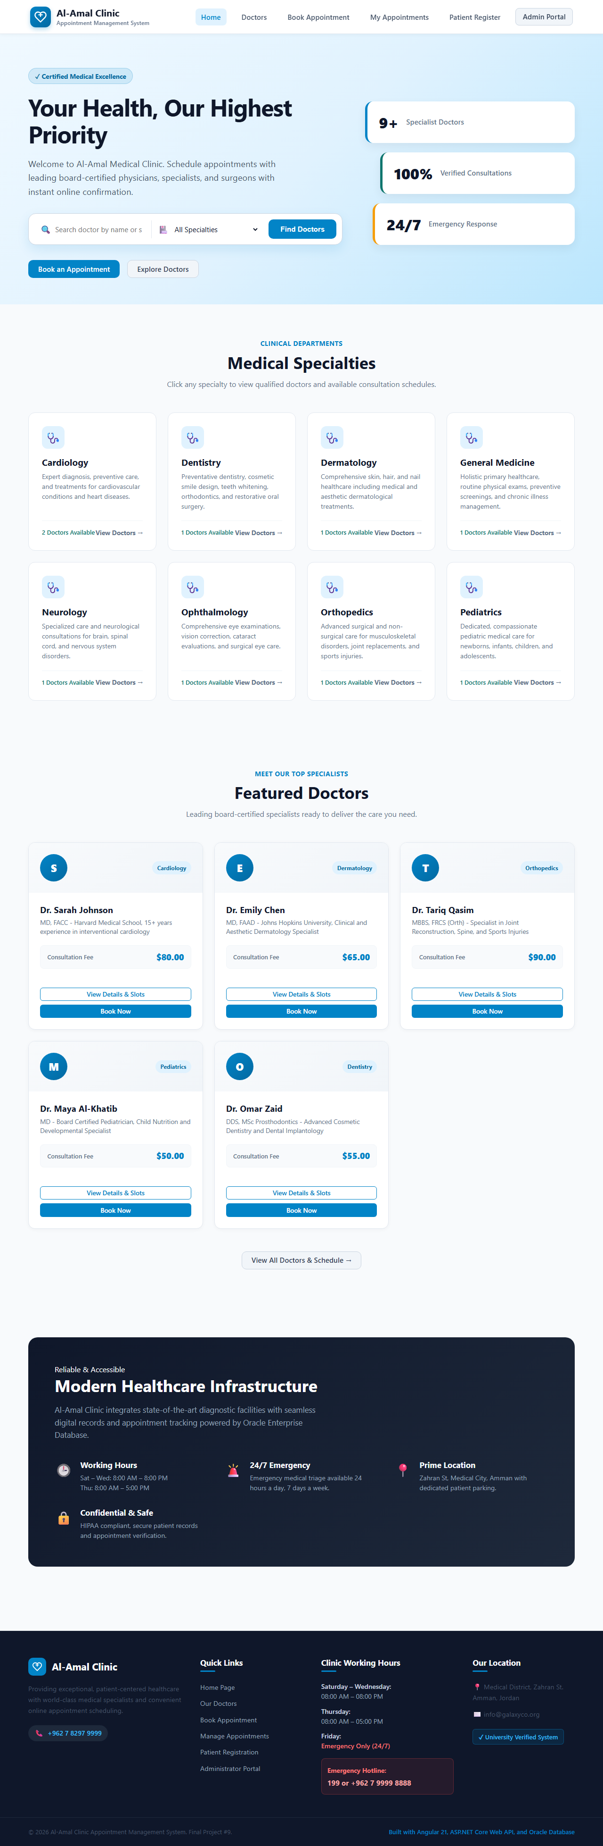
CLINIC APPOINTMENT MANAGEMENT SYSTEM
Angular 21 Frontend Architecture & User Experience
Key Frontend Highlights
✔ Standalone Architecture: Built on Angular 21 with modern standalone components and zero module boilerplate.
✔ Zone.js Integration: Configured provideZoneChangeDetection with markForCheck() for deterministic reactivity across all asynchronous RxJS calls.
✔ Form Validation: Angular ReactiveForms with real-time feedback for required fields, phone numbers, and email format.
✔ Unified Navigation: Global Navbar with responsive mobile toggle, breadcrumbs, and deep-link query parameter support.
✔ Notification Toasts: Non-intrusive floating alerts for successful actions and informative error diagnostics.
✔ Strict Route Guarding: Admin portal secured via CanActivate AuthGuard redirecting unauthenticated traffic to /admin/login.

Slide 8
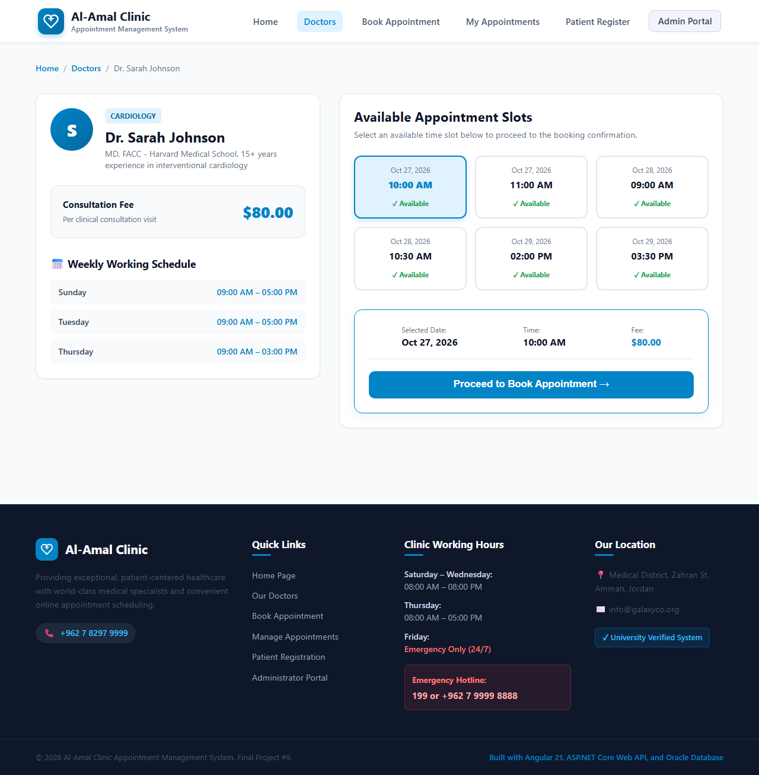
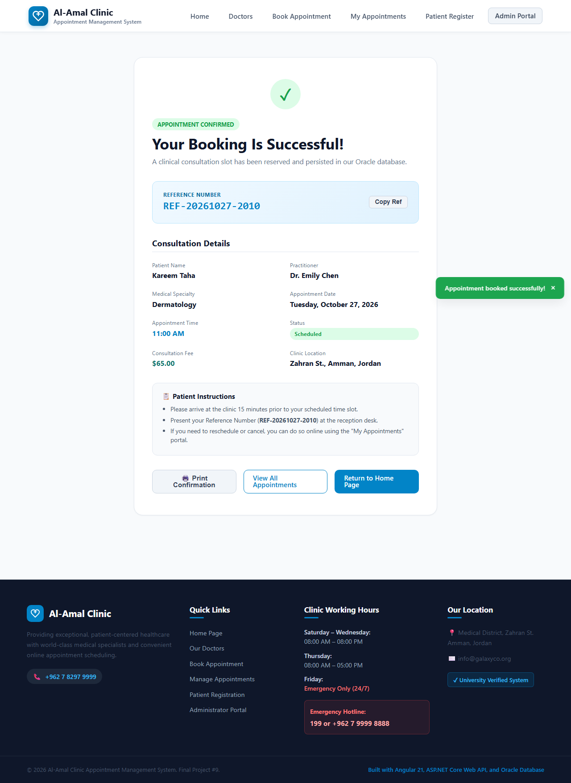
CLINIC APPOINTMENT MANAGEMENT SYSTEM
End-to-End Patient Booking Workflow
The 5-Step Seamless Patient Booking Journey
Step 1: Explore Specialties & Doctors ➔ Step 2: Review Schedule & Select Available Slot ➔ Step 3: Enter Patient Details ➔ Step 4: Atomic DB Reservation ➔ Step 5: Instant Confirmation with Unique Reference Number

Slide 9
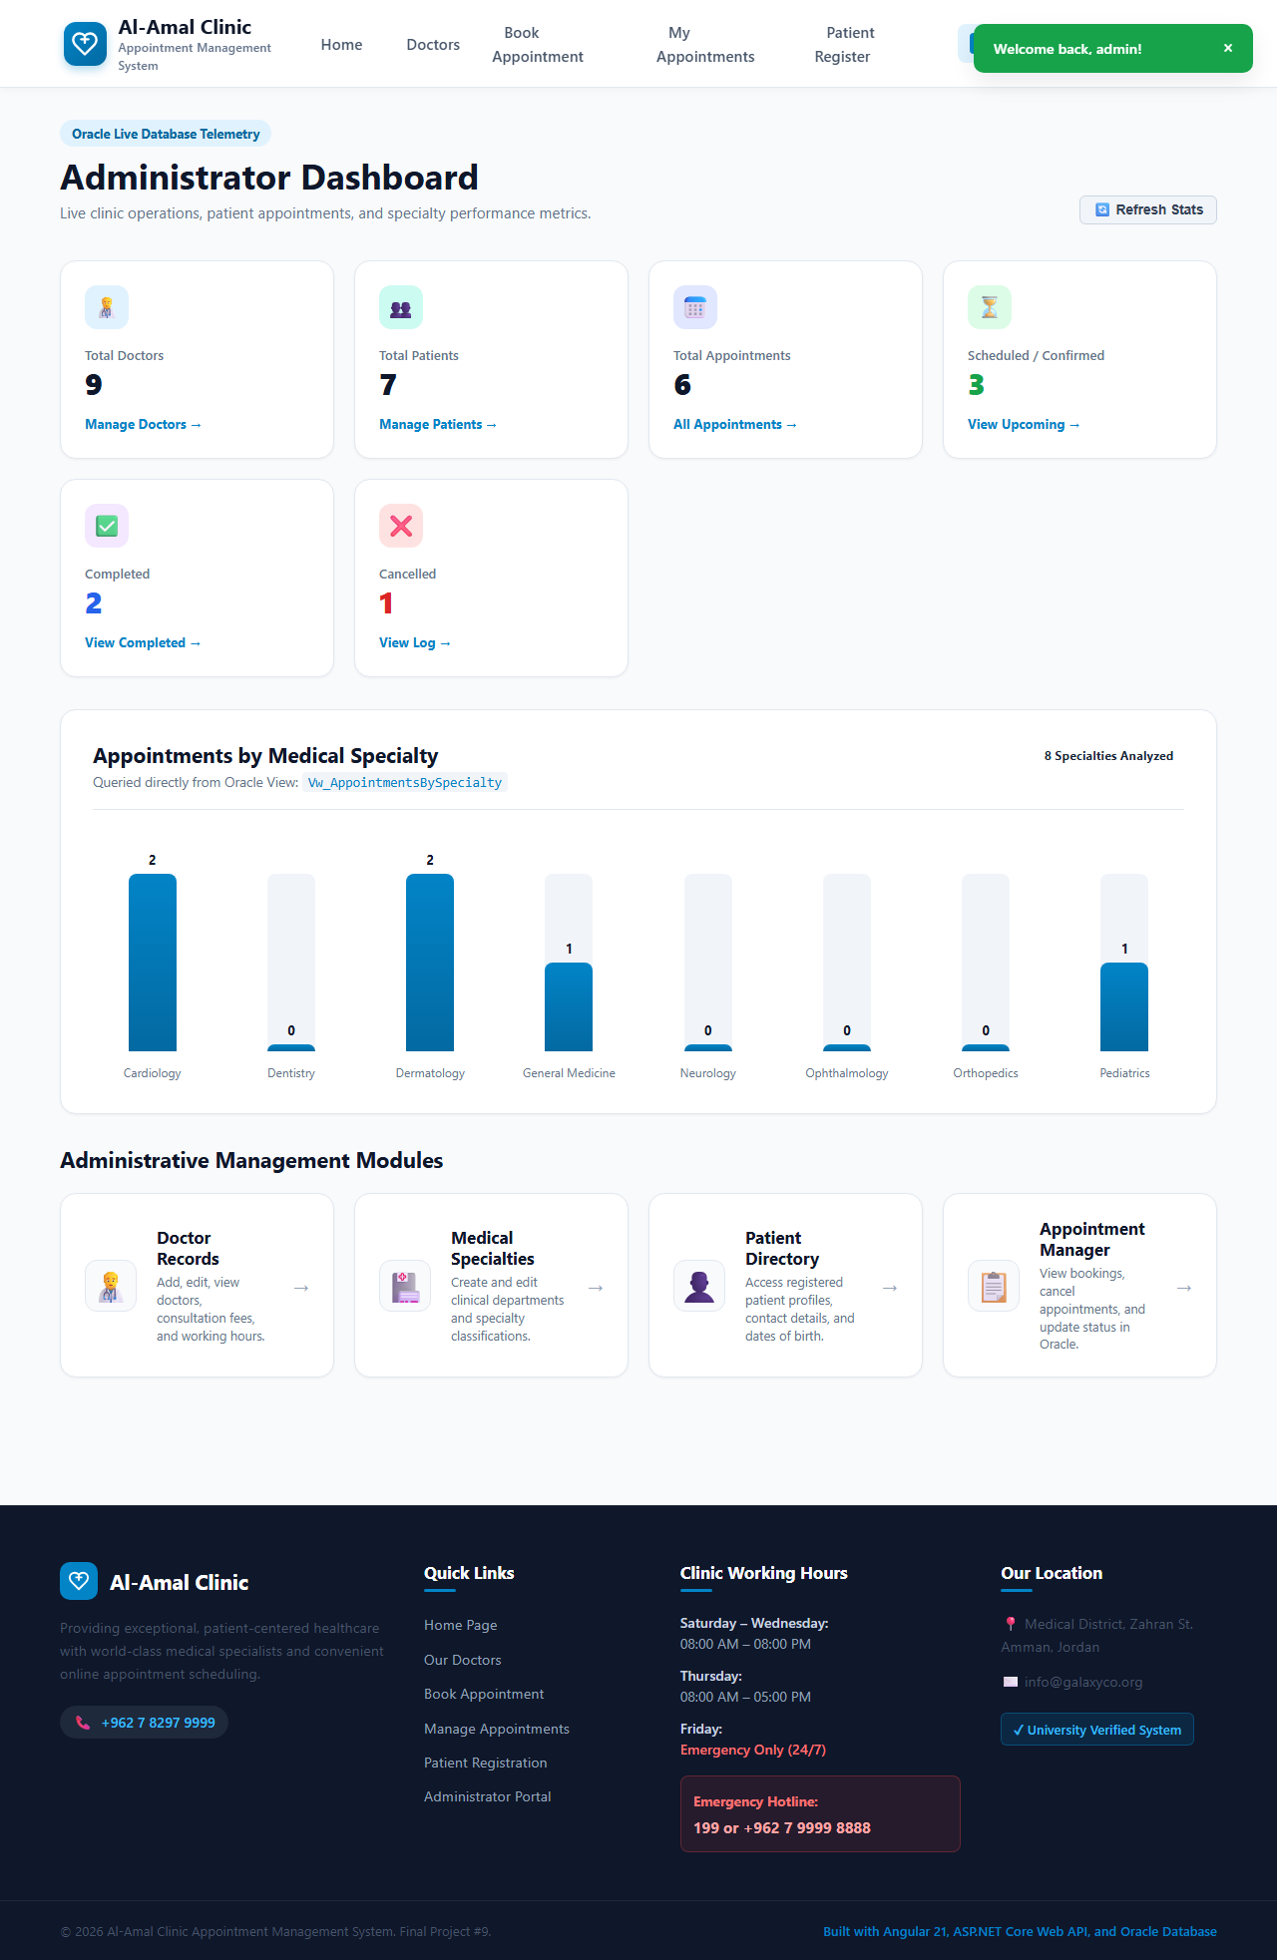
CLINIC APPOINTMENT MANAGEMENT SYSTEM
Admin Dashboard & Operational Management
Operational Controls
• Live KPI Stats: Real-time queries for total doctors, patients, appointments, scheduled, completed, and cancelled counts.
• Specialty Analytics Chart: Visual distribution of appointments grouped by medical specialty from Vw_AppointmentsBySpecialty.
• Doctor Management: Add new doctors, update consultation fees, configure working hours and generate available slots.
• Specialty Catalog: Dynamic administration of clinical departments, names, descriptions, and icon mappings.
• Patient Directory: Searchable patient registry displaying complete appointment histories.
• Appointment Lifecycle: Real-time status updates (Completed, Cancelled) with automatic slot reopening upon cancellation.

Slide 10
CLINIC APPOINTMENT MANAGEMENT SYSTEM
Quality Assurance, Concurrency & E2E Validation
Build Quality
100% Zero-Error Compilation
✔ ASP.NET Core Web API: Built with 0 Errors, 0 Warnings across all 3 projects.
✔ Angular 21 Frontend: Built with 0 Errors and production optimization.
✔ Oracle PL/SQL: All tables, views, triggers, and package compiled with zero errors.
End-to-End Browser QA
Automated Playwright Suite
✔ 14 comprehensive automated browser test scenarios covering all user & admin journeys.
✔ 17 high-resolution screenshots verifying desktop and mobile viewports.
✔ Zero unhandled browser console errors during entire execution.
Integration & Stress
Live Backend & DB Verification
✔ Pessimistic locking verified under simulated race conditions (HTTP 409 rejection).
✔ JWT token expiration and route protection verified.
✔ Referential integrity verified: foreign key cascades and slot state consistency.

Slide 11
CLINIC APPOINTMENT MANAGEMENT SYSTEM
Project Deliverables & Conclusion
University Assignment Deliverables Checklist
1. Oracle Database Script: database_project/ClinicAppointmentManagementSystem.sql — Complete schema, constraints, views, and PL/SQL package with sample data.
2. Entity Relationship Diagram (ERD): database_project/erdplus.png — Full relational ERD detailing primary keys, foreign keys, and cardinalities.
3. ASP.NET Core Web API: Clinic Management System/ — 3-tier clean architecture with Dapper, JWT authentication, and Swagger.
4. Angular Frontend Application: Frontend_Clinic/ — Complete Angular 21 Single Page Application with all 14 required public and admin pages.
5. Main Website Screenshots: screenshots/ — 17 high-resolution screenshots covering desktop workflows, admin portal, and mobile responsive views.
6. PowerPoint Presentation: presentation/Clinic_Appointment_Management_System_Presentation.pptx — Comprehensive technical overview slide deck.
Conclusion: The Clinic Appointment Management System has been fully implemented, integrated, and validated with genuine Oracle 19c database operations, providing a robust, concurrent, and user-friendly healthcare management solution.

