Slide 1


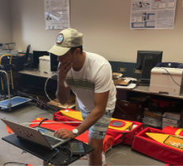

About Me
Name: Qusai Amer
College Station, TX
Texas A&M University
BS Chemical Engineering
MS Computer Science - Dec 2021
Work Experience
Reservoir Engineering Intern 2019 – Hunt Oil Company
Graduate Research Assistant – Texas A&M University
AI Robotics Lab
Hobbies
reading - watching & playing sports - chess

Slide 2
Diagnosis of Covid-19 with Machine Learning
Qusai Ahmed Amer
Mar 16th 2021

Slide 3


Project Overview
Problem statement: To build ML model that detects covid-19 using chest x-ray images
Workflow
Preprocess input images
Extract features
Select features
Input to ML model
Improve performance
Methods

Slide 4
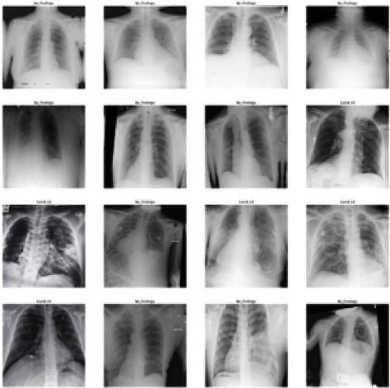
Data Preparation
Raw Data
Training: 250 image
Training labels: 0: negative and 1:Positive
Testing: 94 image
Data Preprocessing
Images cropped to square shape
Images resized to 200 x 200 pixels
Data Representation
Images loaded to dataframe (Pandas)
Dataframe turned to array (Numby)
Fig.1: Sample of input images

Slide 5
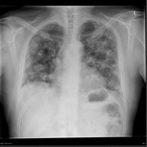
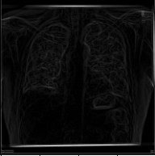
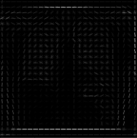
Features Extraction
Gabor Filters
Checks frequency in a specific direction of image
Horizontal and vertical filters used
Features Generated: 40,000 each
Prewitt operator
Used for edge detection in an image
Based on gradient of the image intensity
Features Generated: 40,000
Histogram of oriented gradients (HOG)
Object detection via gradient
Applied to dense grid
Features Generated: 42849
→ Total Features Generated: 162849
Fig.2: Source image
Fig.3: Prewitt
Fig.4: HOG

Slide 6
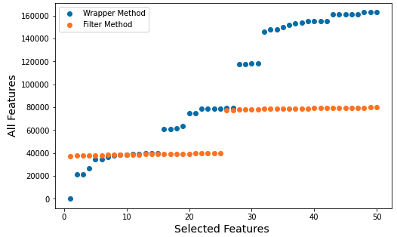
Feature Selection
Filter Method
Statistical calculations such as chi-square
SelectKbest from Scikit-learn is used
K=50
Time: fast (seconds)
Wrapper Method
Tests features in ML model
Recursive feature eliminate (RFE) is used with logistic regression
Time: very slow (+2 h)
Solution:
Select 1000 via filter method
Apply wrapper method to extract 50 features out of the 1000
Fig.5: Feature selection methods

Slide 7
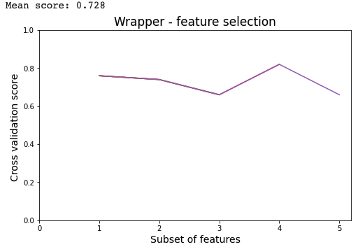
ML Model - LR
Logistic Regression
Linear classification method
Efficient for binary classification
Utilized scikit-learn library
Cross-Validation
Split training data into five folds (K=5)
Five iterations using each fold as a validating dataset
Fig.6: Cross-validation accuracy
Method | Folds Mean Accuracy
Filter Method | 63%
Wrapper Method | 73%
Notes:
we need to maximize the probability by minimizing loss function. Decreasing the cost will increase the maximum likelihood assuming that samples are drawn from an identically independent distribution.

Slide 8
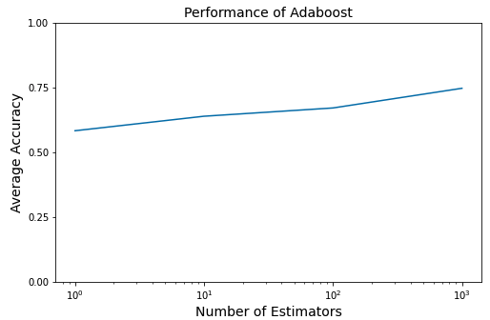
Improving Performance
Adaptive Boosting (Adaboost)
Boosts performance of binary classification
Uses different copies of the classifier
Increases the weights of misclassified samples
Different number of classifiers is tested:
Number of Classifiers | Accuracy
1 | 59%
10 | 64%
100 | 67%
1000 | 75%
Fig.7: Adaboost accuracy
Notes:
It boosts the performace of binary classification by increasing the weights of misclassified samples

Slide 9
Improving Performance
Convolutional Neural Network (CNN)
Learns features by itself
Hyperparameters: number of layers, max pooling, dropout, kernel size, activation function, etc
Bayesian optimization
Used for hyperparameter tunning
Tool: HyperOpt from Sikit lean
Different combinations are tested
Hyperparameter | Value
Number of layers | 5 (2 convolutional and 3 dense)
Activation function | Rectified linear (ReLU)
Max pooling | 1
Dropout | 22%
Kernel size | 3
Accuracy | 92.40 %
Notes:
A typical CNN structure has a convolution layer that extracts features from the input with the filters it applies, a pooling layer to reduce the size for computational performance, and a fully connected layer, which is a neural network. By combining one or more such layers, a CNN model is created, and its internal parameters are adjusted to accomplish a particular task, such as classification or object recognition.
convnet recognizes a object by first looking for low level features such as edges, lines and curves, and then building up more abstract features
Activation funtion introduces non-linearity
Dropout is a preferable regularization technique to avoid overfitting in deep neural networks.
the output after max-pooling layer would be a feature map containing the most prominent features of the previous feature map.

Slide 10
Conclusion
Feature Extraction
Logistic Regression
Adaboost
Feature Selection
ACC: 73%
ACC: 75%
Data Preprocessing
CNN
Bayesian Optimization
Input data
ACC: 92.4%

Slide 11
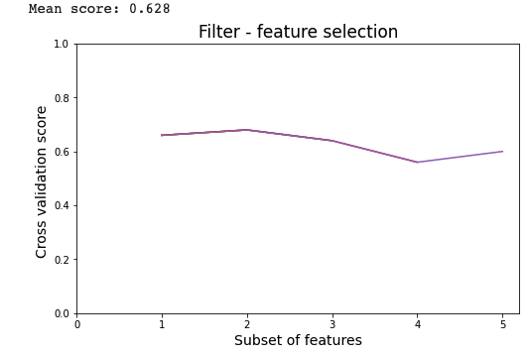
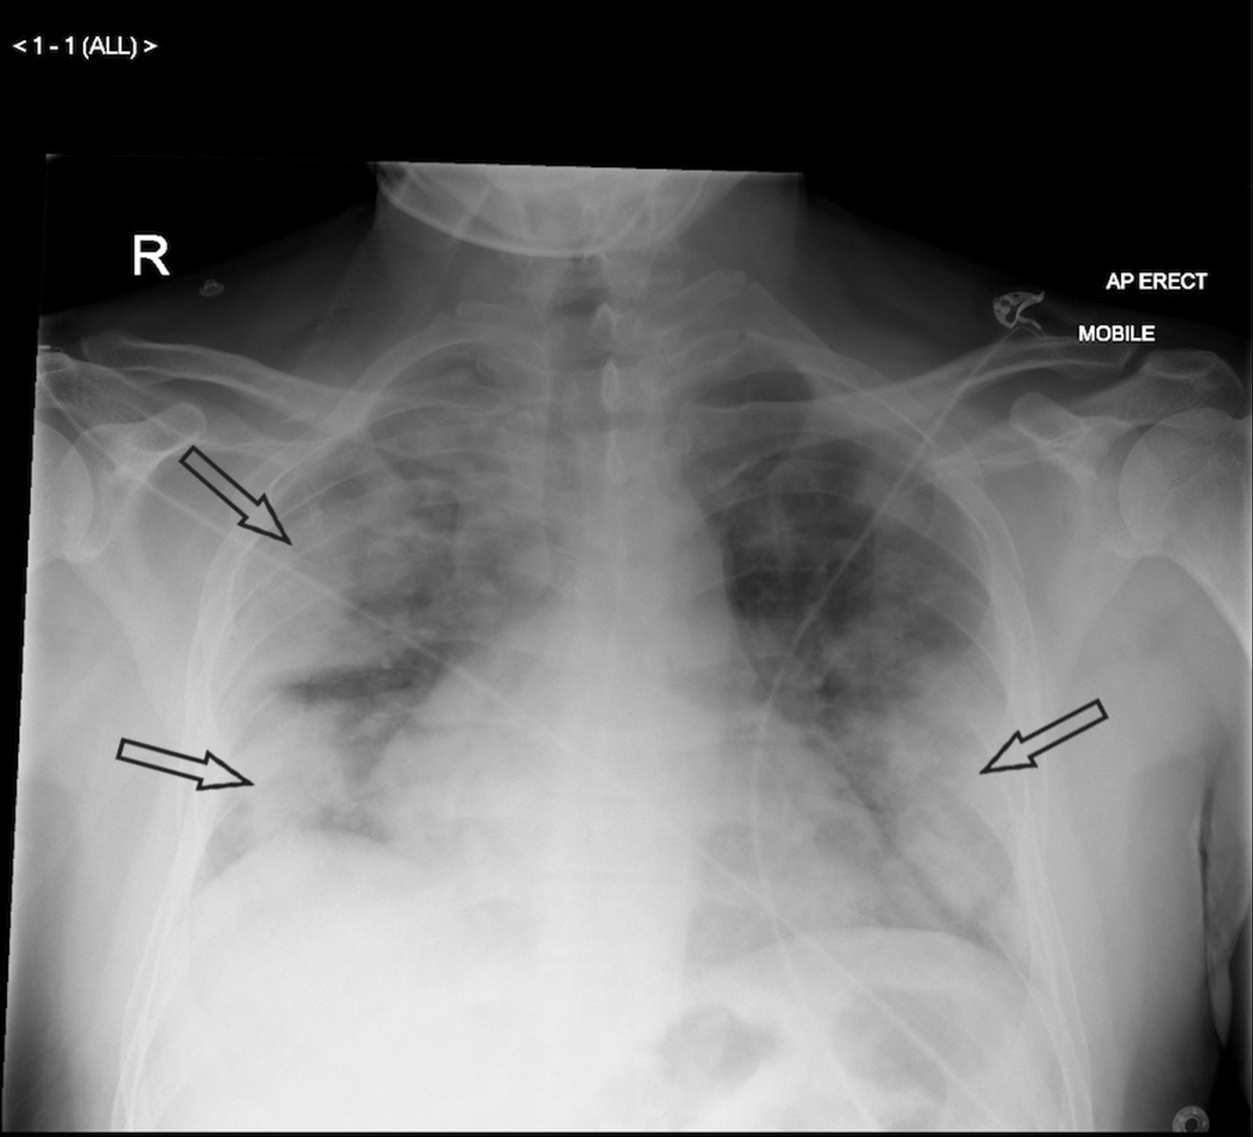
Appendix
Project available in my GitHub: Qusai23 – Amer_ML
For any further questions email me at Qusai3mer@tamu.edu
When lung markings are completely lost due to the whiteness,
it is known as consolidation (this is usually seen in severe disease)

