Slide 1

Medical Cost Analysis & Visualization System
Python Data Analytics Internship Project
Presented by: Qusai · Lovely Professional University

Slide 2

1,338
The Business Problem
Hidden Cost Drivers
Records
Age, BMI, smoking status — all buried in raw CSV data with no way to surface patterns at scale.
Zero Insights
Slow, Costly Decisions
Thousands of patient records processed every year — yet critical cost patterns remain completely invisible inside spreadsheets.
Manual analysis costs insurers millions in mispriced premiums every single year.
The Core Question
Who spends the most — and why? The answer is locked inside the data.

Slide 3


The Python Solution
A data analytics pipeline that transforms raw patient records into clear, actionable business intelligence — automatically.
Raw Dataset
Exploratory
Data Analysis
Business Insights
Insurance.csv
Statistics • Pattern discovery
Identify cost drivers
Decision Support
Support insurance business decisions
Data Cleaning
Data Visualization
Missing values Data preparation
Charts using Matplotlib & Seaborn
A repeatable Python workflow that converts raw medical data into actionable business intelligence.

Slide 4





Dataset at a Glance
Medical Insurance Dataset — 1,338 patient records used for healthcare cost analysis.
Age
BMI
Smoker Status
Patient age range: 18–64 years
Body Mass Index — key health risk indicator
Binary classification: Yes / No
Records : 1,338
Features : 7
Missing Values : 0
File Format : CSV
Region
Medical Charges
Northeast, Northwest, Southeast, Southwest
Insurance cost billed per patient

Slide 5


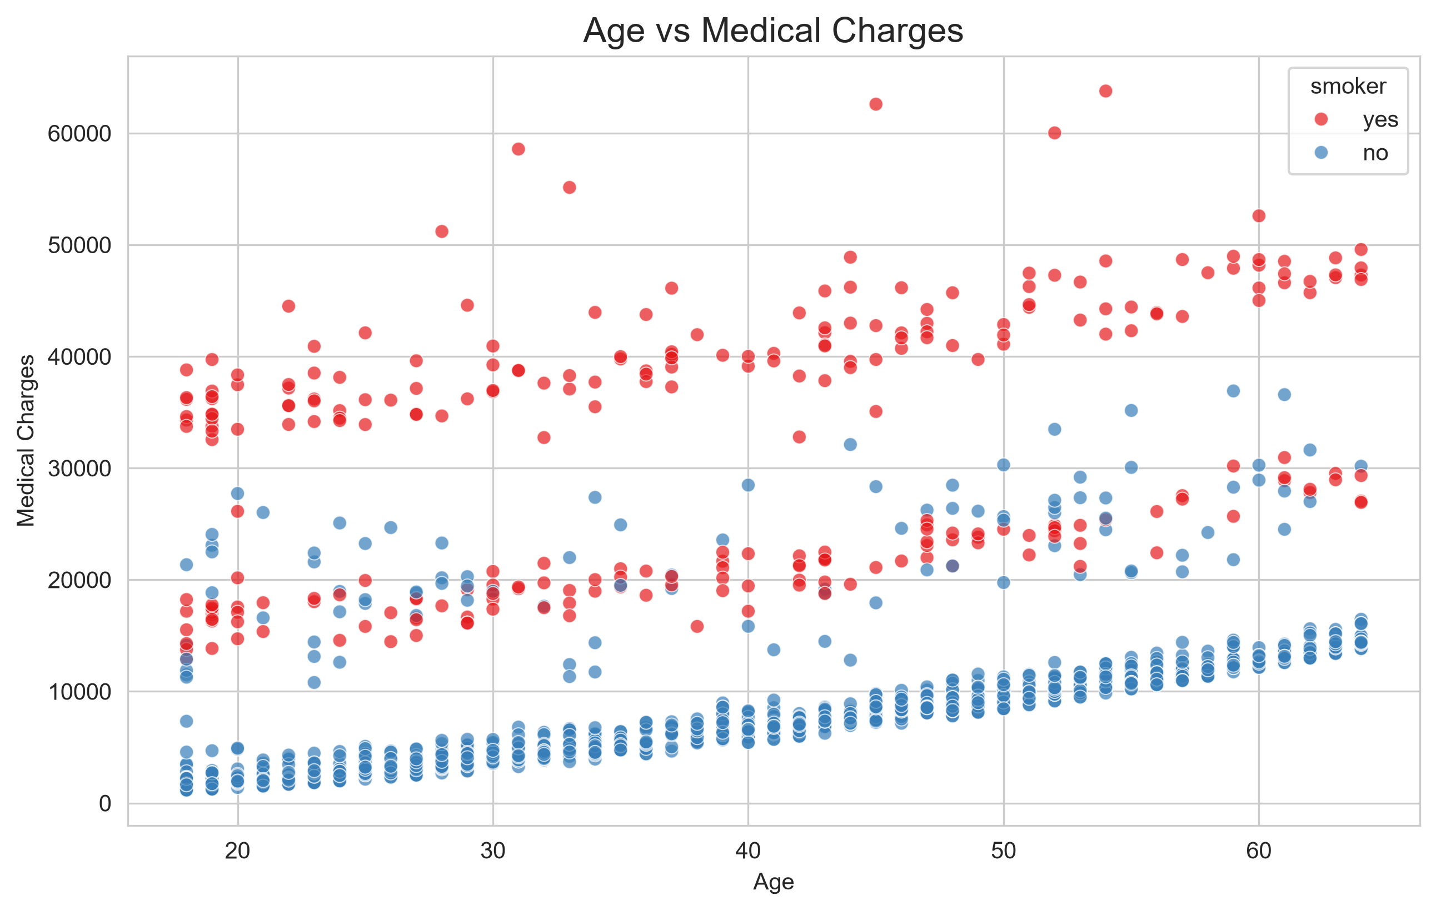
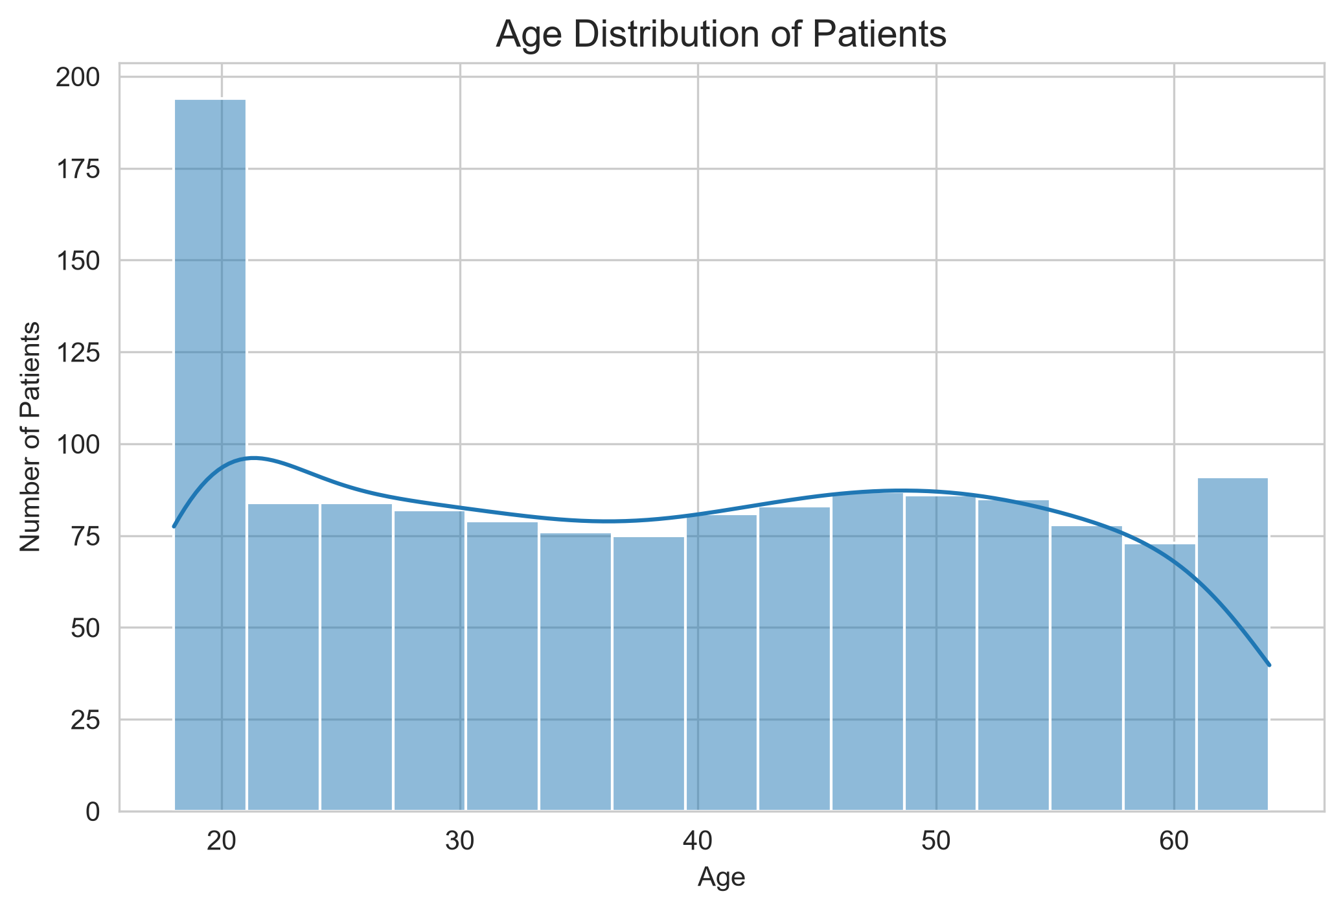



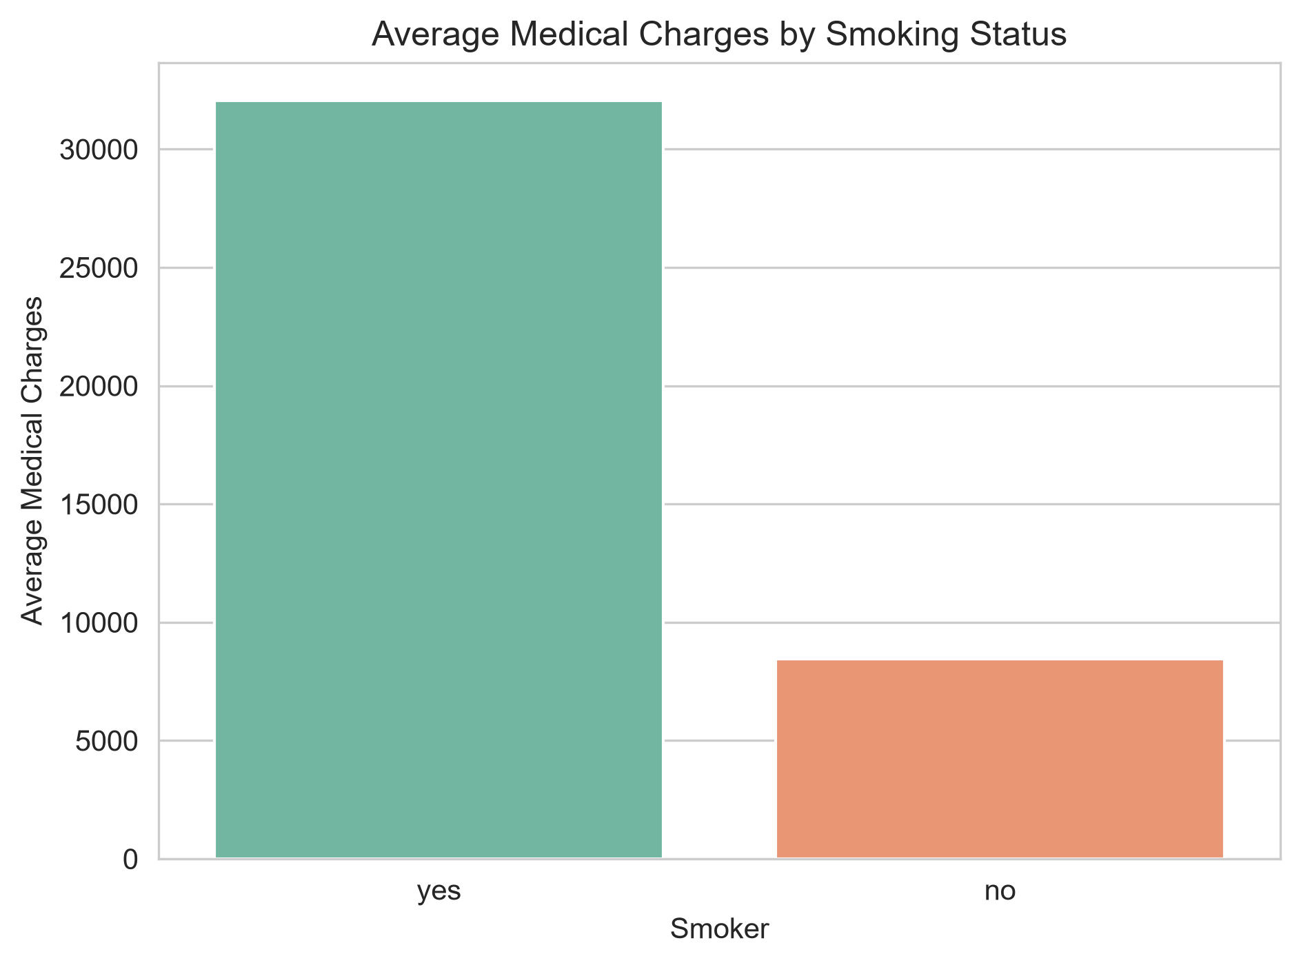
Visual Insights That Answer Business Questions
Six visualizations that transform raw medical data into business insights.
Age VS Medical charges: Does age influence medical insurance costs?
Age Distribution:
How is the patient population distributed by age?
How are medical costs distributed across all patients?
Smoking Status VS charges:
How much does smoking increase medical expenses?

Slide 6
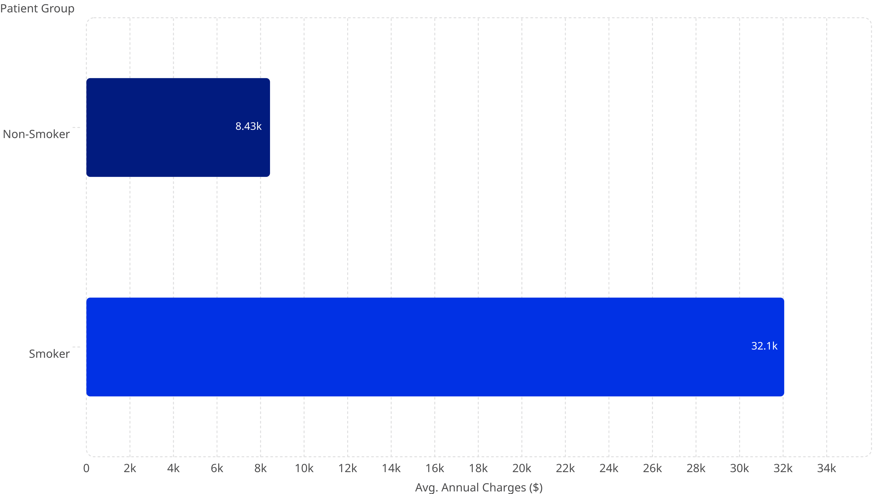
Key Business Findings
3×
40+
30+
Smoker Cost Multiplier
Age Risk Threshold
BMI Danger Zone
🚬 The single biggest cost driver in the entire dataset
📈 Charges rise steadily after age 40 — compounding year over year
⚖️ BMI above 30 correlates directly with elevated insurance charges
🗺️ Southeast region shows the highest average medical expenses of all four regions.
Average Medical Charges: Smokers vs Non-Smokers
Smoking status is the strongest cost predictor in the dataset — by a wide margin.

Slide 7

From Project to Product
This system is a foundation. With the right investment, it becomes a full-scale healthcare analytics platform.
📊 Streamlit Dashboard
Interactive, real-time data exploration for non-technical users — no code required.
🤖 ML Cost Prediction
Regression models forecast individual patient charges before claims are filed.
🏥 Hospital Integration
Connect directly to live EHR and claims systems for continuous intelligence.
☁️ Cloud Deployment
Scalable, secure, and accessible from anywhere — built for enterprise scale.

Slide 8

Data alone has no value.
Insights create better decisions.
GitHub Repository:
https://github.com/Qusvi/Medical-Cost-Analysis Live Application:
https://medical-cost-analysis-n9ya8jqvxyfvuk5brynd4l.streamlit.app/
This project proves that a single Python pipeline can turn thousands of raw records into clear, actionable intelligence — ready for real-world healthcare decisions.
Thank You · Questions? Let's talk data.
Qusai · Lovely Professional University

