Slide 1
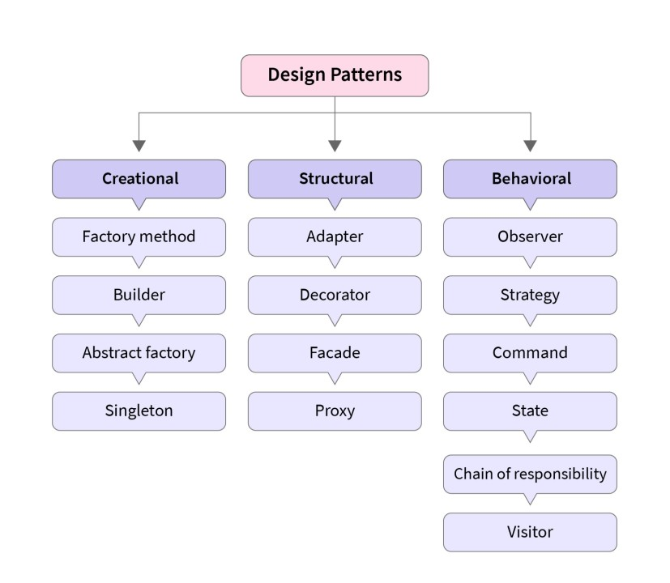
Design patterns
reusable solutions to common software design problems that occur in object-oriented systems. They provide proven, time-tested approaches for structuring code to improve flexibility, scalability, and maintainability.

Slide 2
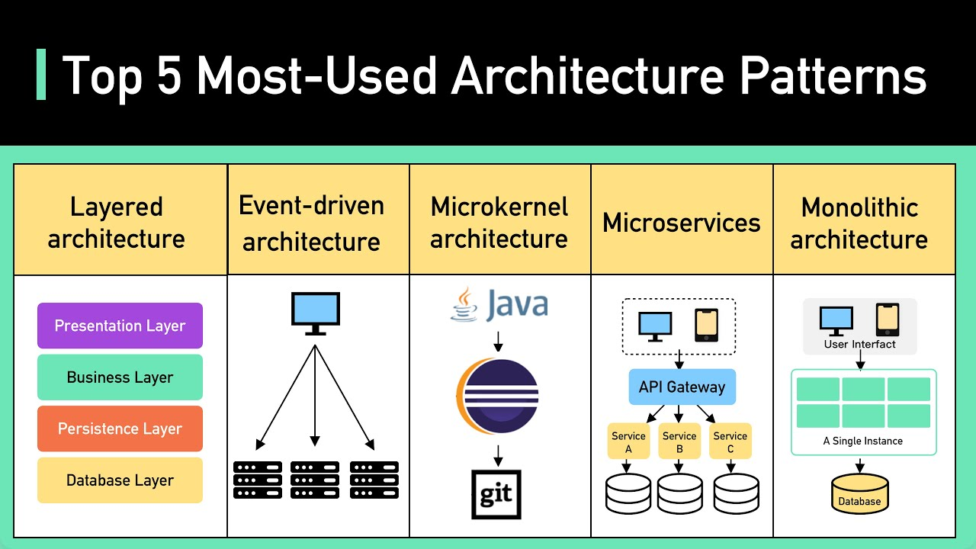
Architectural patterns
high-level solutions that define the overall structure and organization of a software system. They guide the design of system components, interactions, and their relationships to ensure scalability, maintainability, and performance.

Slide 3
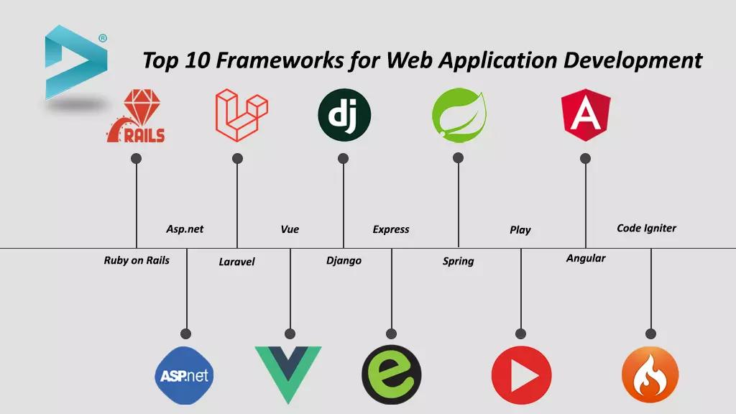
Application frameworks
Application frameworks are reusable software platforms that provide foundational structures for building specific types of applications. They offer pre-built components and functionality, allowing developers to focus on application-specific logic rather than reinventing common features.

Slide 4
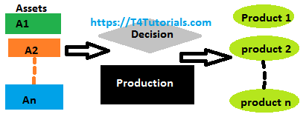
Software product lines
Software product lines are a set of related software systems that share a common core of features, allowing for the efficient creation of customized products. They enable developers to reuse common assets while tailoring specific functionalities for different market needs or user requirements.

Slide 5
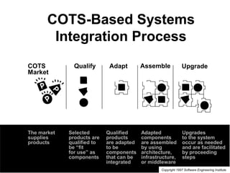
COTS integration
(Commercial Off-The-Shelf) integration involves incorporating pre-built, third-party software products into a custom system to reduce development time and cost. It leverages established, tested solutions for common functionality, allowing organizations to focus on unique aspects of their applications.

Slide 6
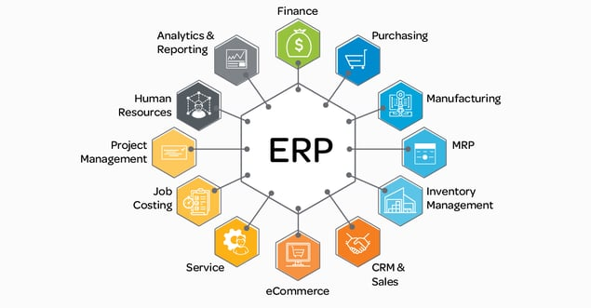
ERP systems
(Enterprise Resource Planning) systems are integrated software solutions that manage and streamline core business processes, such as finance, supply chain, and human resources. They provide a unified platform for real-time data access and decision-making across an organization.

Slide 7
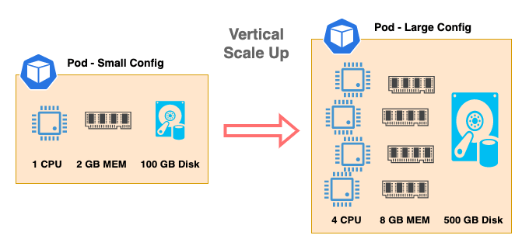
Configurable vertical applications
Configurable vertical applications are industry-specific software solutions that can be customized to meet the unique needs of different organizations within that sector. They provide tailored functionality with flexibility for adaptation.

Slide 8
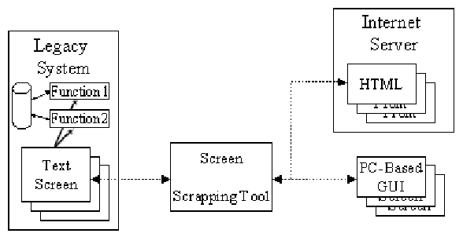
Legacy system wrapping
Legacy system wrapping involves creating a modern interface or layer around an older system to enable it to integrate with newer technologies without altering the underlying legacy code.

Slide 9
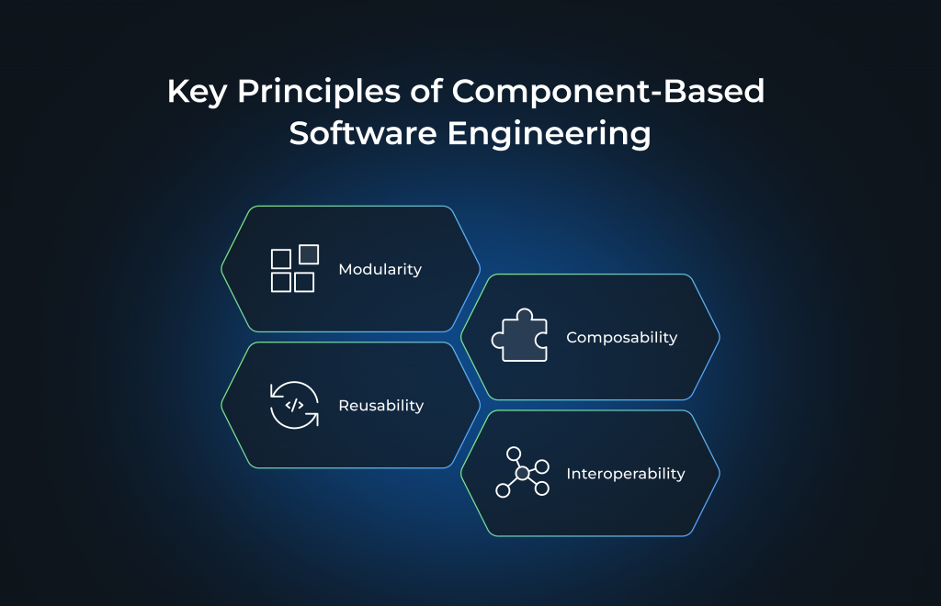
Component-based software engineering
Component-based software engineering (CBSE) is an approach where software is built by assembling reusable, self-contained components rather than developing functionality from scratch. It promotes modularity, scalability, and faster development by leveraging pre-built, interchangeable components.

Slide 10
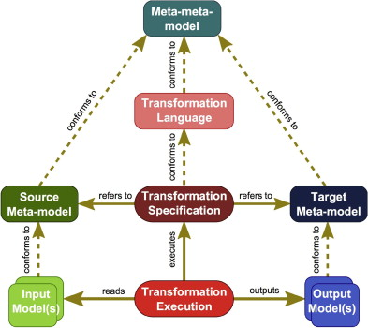
Model-driven engineering
Model-driven engineering (MDE) uses high-level models to automate and generate code, improving consistency and speeding up development. It focuses on model transformations instead of manual coding.

Slide 11
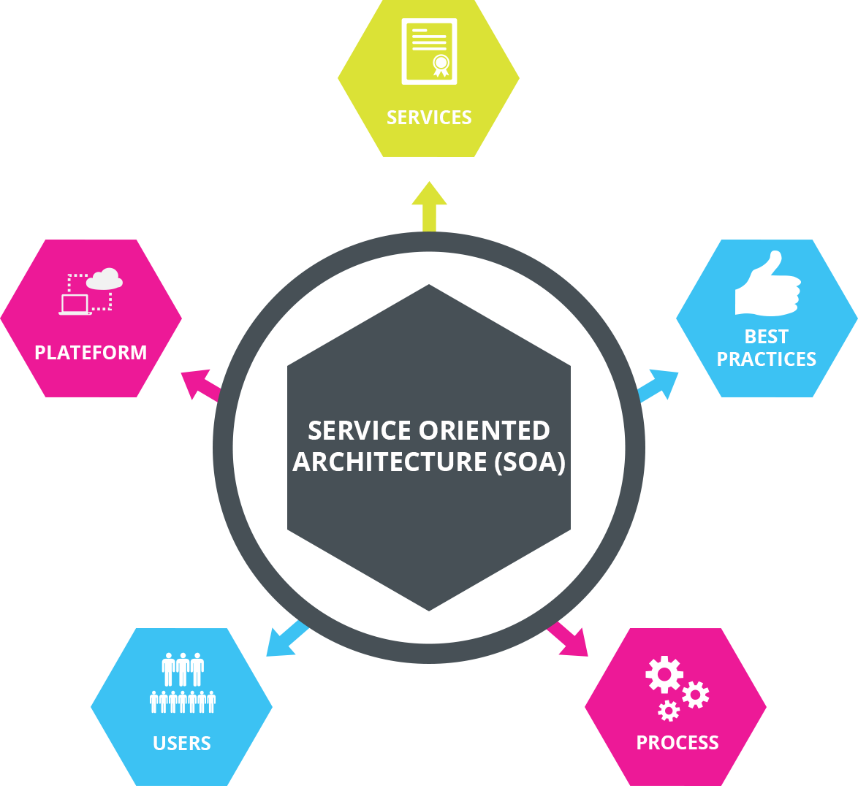
Service-oriented systems
Service-oriented systems are architectures where software components (services) are designed to provide specific functionality over a network, enabling interoperability and reuse. Services are loosely coupled, independent, and communicate through standardized protocols like HTTP or SOAP.

Slide 12
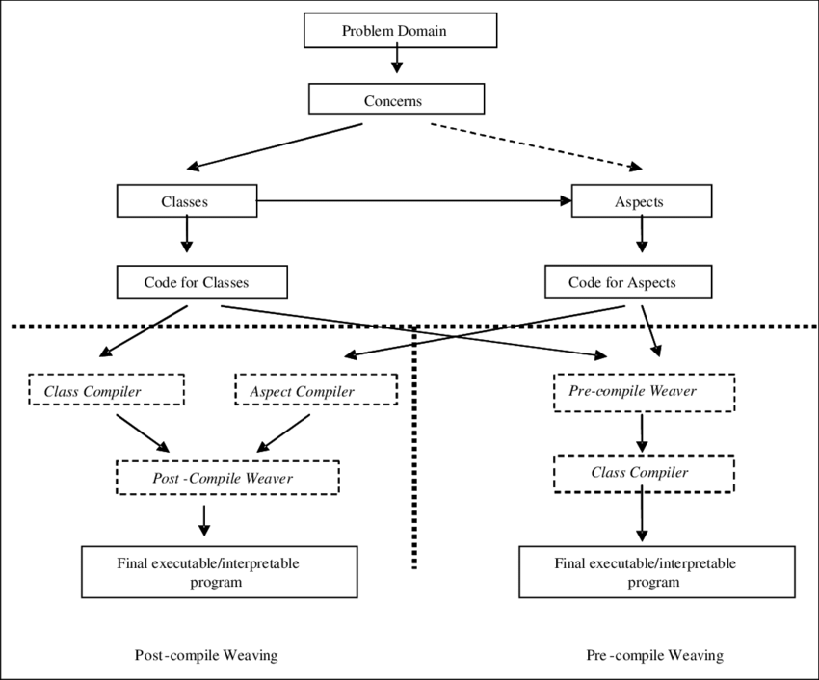
Aspect-oriented software development
Aspect-oriented software development (AOSD) is a paradigm that separates cross-cutting concerns (such as logging or security) from the main business logic. It allows these concerns to be modularized into "aspects," improving code maintainability and reducing duplication.

Slide 13
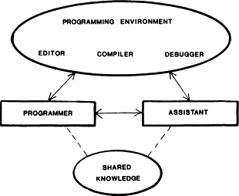
Program generators
Program generators are tools that automatically create source code or entire programs based on high-level specifications or templates. They help automate repetitive tasks, reduce errors, and accelerate software development by generating customized code from predefined patterns.

Slide 14
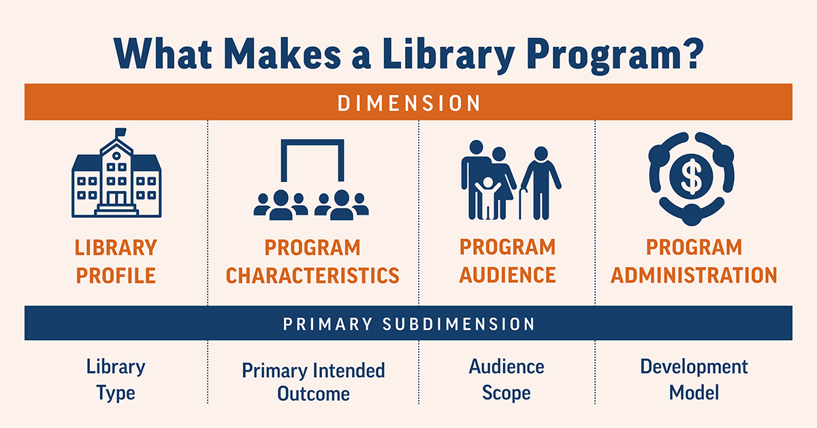
Program libraries
Program libraries are collections of pre-written code, functions, or routines that developers can reuse in their applications. They provide commonly used functionality, saving time and effort by eliminating the need to write code for standard operations from scratch.

