Slide 1
DOCUMENTATION
OCTOBER 2026
Cryptography
Symmetric Encryption • File Encryption • Cryptographic Hashing
Student
Supervised by
Date
Karim Hamd
Eng. Saher Waleed
October 2026
KARIM HAMD
01

Slide 2
CRYPTOGRAPHY
01 / TASK ONE
Online AES Symmetric Encryption & Decryption
Overview
In this task, an online tool was used to demonstrate symmetric encryption using the Advanced Encryption Standard (AES) algorithm.
Concept — Symmetric Encryption
Symmetric encryption uses a single pre-shared secret key to both encrypt the plaintext and decrypt the ciphertext. Without the correct secret key, the encrypted message cannot be reverted back to its original plain form.
In the demonstration, the plaintext “The engineer Saher is one, the monster of the security is the destroyer of the encryption, the octopus of the network” was encrypted with the secret key “Eng.Saher” using AES-256, producing a Base64 ciphertext. The same key successfully restored the original message.
KARIM HAMD
02

Slide 3
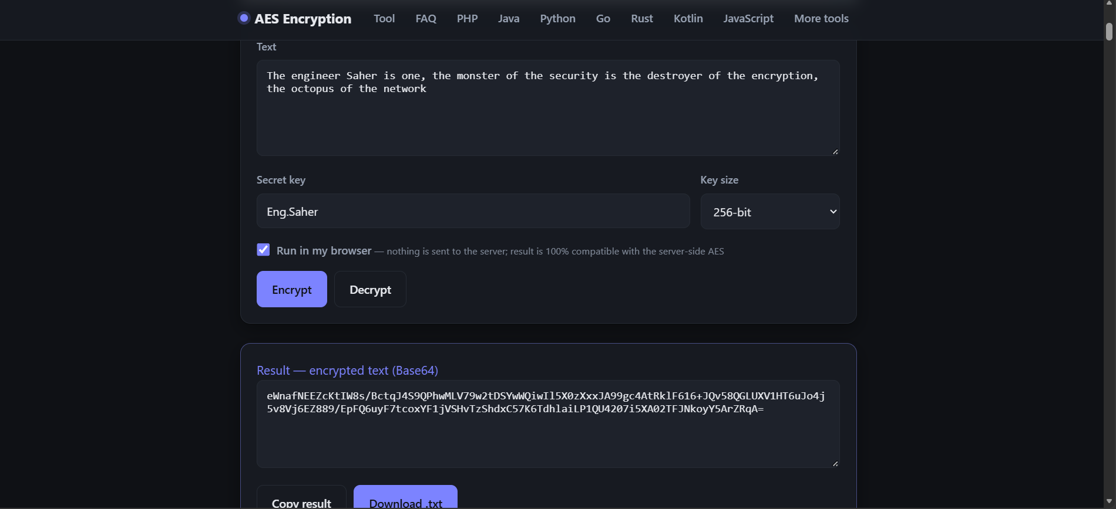
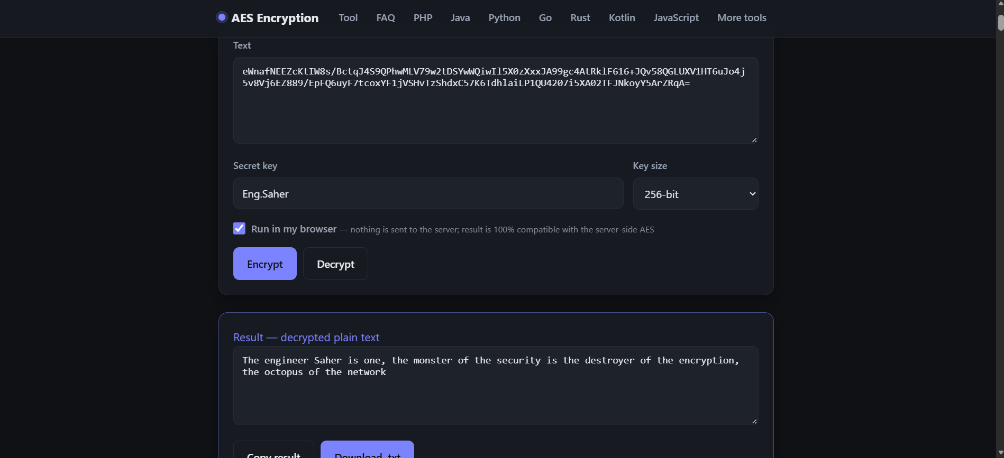
CRYPTOGRAPHY
01 / TASK ONE
Demonstration — Encrypt & Decrypt
Encryption Result (AES-256, Key: Eng.Saher)
Decryption Result — Original Plaintext Restored
KARIM HAMD
03

Slide 4
CRYPTOGRAPHY
02 / TASK TWO
File Encryption and Decryption using OpenSSL
Overview
A text file named “SafeSurf_file.txt” containing multiple lines of text was created on Kali Linux. The file was then encrypted and decrypted using the OpenSSL CLI tool with AES-256-CBC.
Commands Executed
1. File Creation
nano ~/SafeSurf_file.txt
2. File Encryption (AES-256-CBC)
openssl enc -aes-256-cbc -salt -in ~/SafeSurf_file.txt -out ~/SafeSurf_file.enc
3. File Decryption
openssl enc -d -aes-256-cbc -in ~/SafeSurf_file.enc -out ~/decrypted_file.txt
KARIM HAMD
04

Slide 5
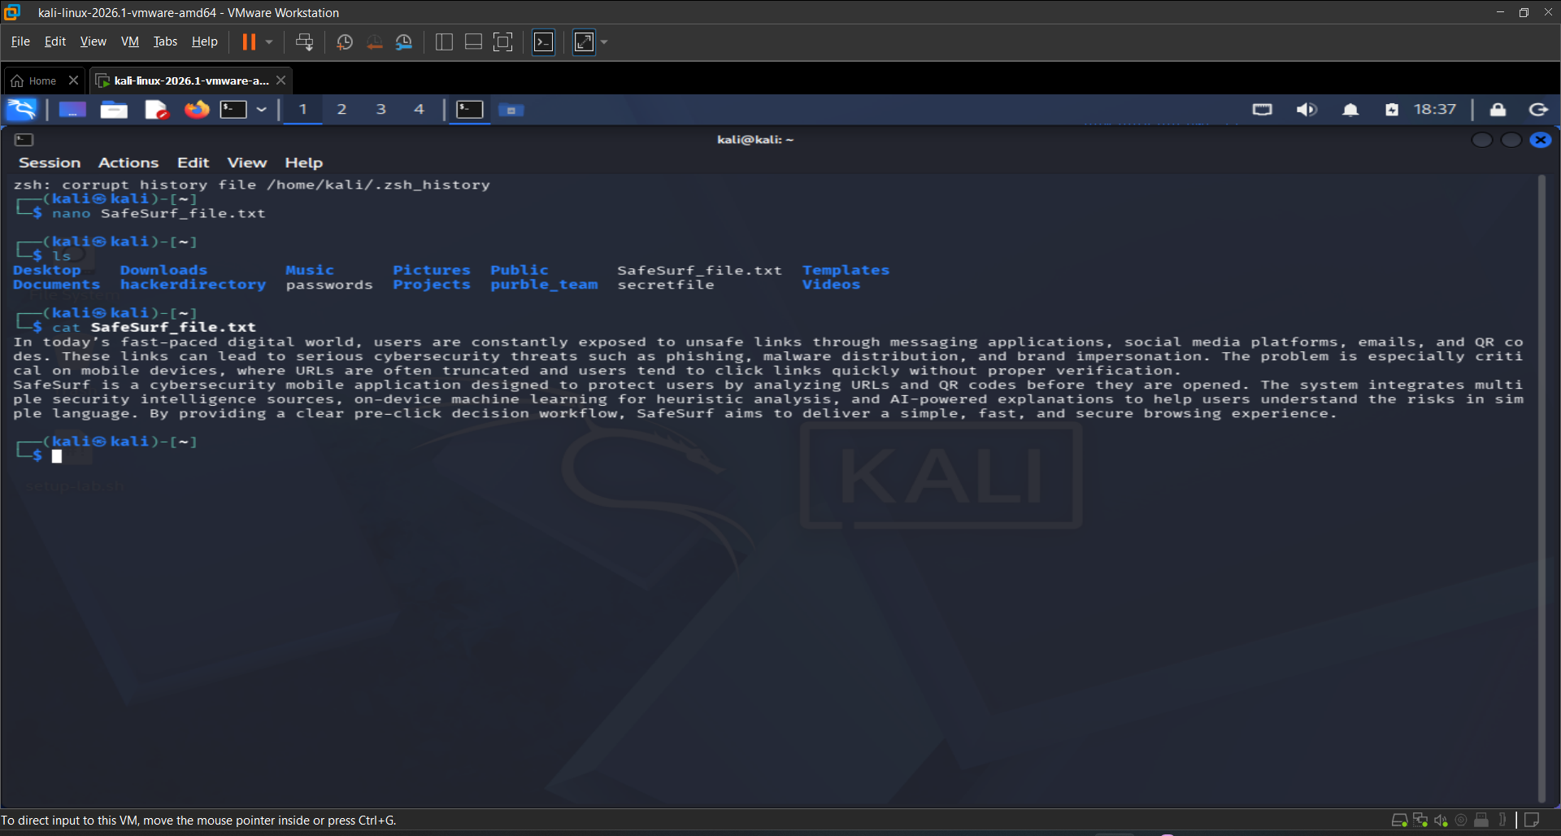
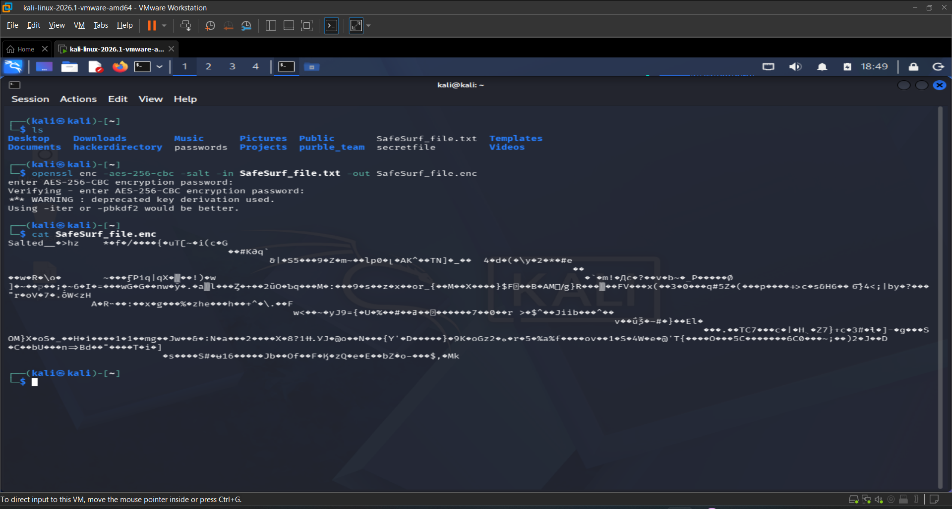
CRYPTOGRAPHY
02 / TASK TWO
File Content & Encryption
SafeSurf_file.txt (Original Content)
OpenSSL Encryption (AES-256-CBC)
KARIM HAMD
05

Slide 6
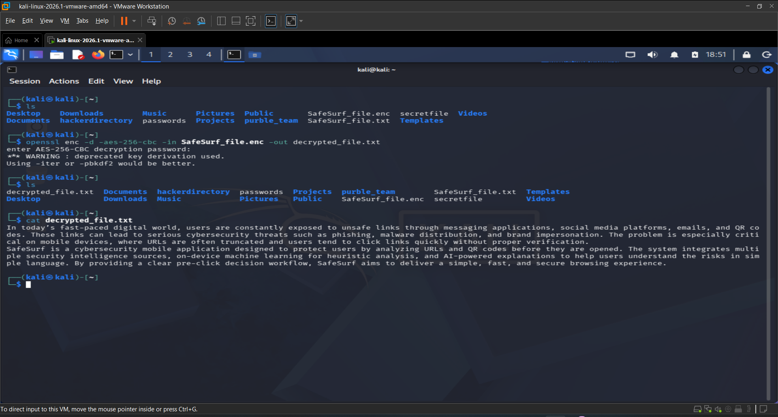
CRYPTOGRAPHY
02 / TASK TWO
Decryption Result & Concept
Concept
OpenSSL uses the AES-256-CBC algorithm along with a user-defined passphrase to transform the contents of “SafeSurf_file.txt” into a secure binary ciphertext file (“SafeSurf_file.enc”).
Decryption reverses this process using the same passphrase to ensure confidentiality. The original multi-line text was fully restored, confirming the integrity of the encryption workflow.
KARIM HAMD
06

Slide 7
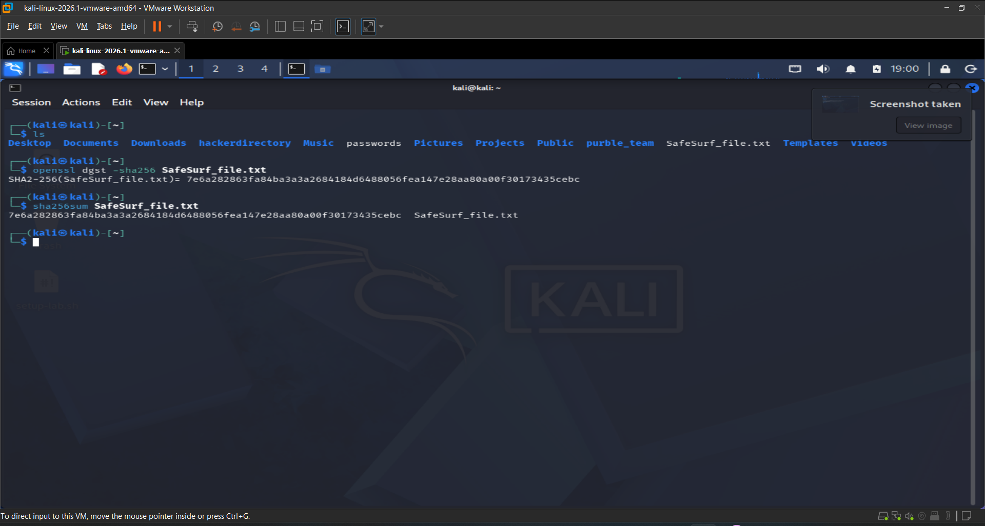
CRYPTOGRAPHY
03 / TASK THREE
Generating File Hash using OpenSSL (SHA-256)
Overview
A cryptographic hash of the multi-line file “SafeSurf_file.txt” was generated using the SHA-256 hashing algorithm via OpenSSL.
Command
openssl dgst -sha256 ~/SafeSurf_file.txt
Concept & Explanation
A cryptographic hash is a one-way mathematical function that generates a fixed-length unique fingerprint (digest) of the file. Hashing is non-reversible (unlike encryption). It is used to verify Data Integrity: if even a single character inside the file is modified, the resulting SHA-256 hash output will change completely.
KARIM HAMD
07

Slide 8
CRYPTOGRAPHY
TOOL / OPENSSL
Tool Description: OpenSSL
What is OpenSSL?
OpenSSL is a robust, commercial-grade, and full-featured toolkit for the Transport Layer Security (TLS) and Secure Sockets Layer (SSL) protocols. It is widely used in Linux distributions (such as Kali Linux) for various cryptographic tasks, including file encryption, decryption, generation of digital signatures, and cryptographic hashing.
Role in this Activity
01
02
Symmetric File Encryption & Decryption
Cryptographic Hashing
Utilizing the AES-256-CBC cryptographic cipher combined with a secure passphrase to safeguard file confidentiality.
Utilizing the SHA-256 digest function to compute a unique fingerprint of the file, ensuring data integrity.
KARIM HAMD
08

