Slide 1

DAIKAI ENGINEERING PTE LTD
Your equipment data.
Clearer decisions.
DRUMS is a customizable platform for industrial data collection, storage, visualization, and intelligent monitoring.
Engineered from CPU boards and field panels to server infrastructure, monitoring software, and project-specific local AI integration.
BUILT ON MARINE EXPERIENCE
Adaptable to industrial machinery and systems
DRUMS / DATA COLLECTION & MONITORING

Slide 2
01 / THE PLATFORM
One Platform. From Equipment to Insight.
Collect operating signals, retain history, visualize conditions, interpret data, and notify operators.
01
02
03
04
05
Collect
Store
Visualize
Analyze
Notify
Capture operating data from connected equipment.
Retain historical data for review and analysis.
View equipment status and operating trends.
Use monitoring rules and equipment knowledge.
Deliver alerts through configured channels.
Marine installations today · Adaptable to machines, production equipment, utilities, and other industrial systems
DRUMS · Daikai Engineering Pte Ltd
02

Slide 3
02 / ENGINEERED BY DAIKAI
From Board Design to Intelligent Monitoring
Daikai designs, builds, integrates, and commissions the complete monitoring solution.
HARDWARE
HARDWARE
PLATFORM
CPU Board Design & Assembly
Field Panel Engineering
Data & Server Infrastructure
PCB design and component assembly tailored to required interfaces and the operating environment.
Panel design, fabrication, wiring, and assembly for reliable field data collection.
Data collection, communications, storage, and application servers in one architecture.
PLATFORM
INTELLIGENCE
INTEGRATION
Monitoring Applications
Local AI & Equipment Knowledge
Integration & Commissioning
Equipment views, dashboards, trends, alarms, and notification workflows.
Project-specific analysis informed by documentation, limits, and relevant data.
Connection, signal verification, configuration, and commissioning.
DRUMS · Daikai Engineering Pte Ltd
03

Slide 4
03 / HOW IT WORKS
From Equipment Data to Timely Action
Illustrative logical architecture; configuration depends on equipment and project requirements.
→
Monitoring Application
→
Dashboards & Trends
FIELD
→
ACQUISITION
→
SERVER
Machinery &
Control Systems
DRUMS
Field Panel
Data
Storage
→
Monitoring Rules
→
Alerts & Notifications
→
Local AI Analysis
→
Context for Investigation
↑ informs
Equipment Knowledge
No feedback-control connection is implied.
DRUMS · Daikai Engineering Pte Ltd
04

Slide 5
04 / CUSTOMIZATION
Built Around the Equipment You Operate
Every machine has different signals, operating limits, and maintenance requirements.
1
Equipment interfaces and data acquisition requirements
2
Panel layout, hardware configuration, and installation arrangements
3
Data sampling, storage, and communication settings
4
Dashboards, operating trends, and reporting
5
Alarm thresholds, notification rules, and escalation workflows
6
Project-specific AI knowledge and analysis
The solution starts with your equipment and the information your team needs to operate and maintain it.
DRUMS · Daikai Engineering Pte Ltd
05

Slide 6
05 / INTELLIGENT MONITORING
Equipment Knowledge. More Meaningful Alerts.
Rules and project-specific AI support different parts of the monitoring workflow.
DEFINED CONDITIONS
PROJECT-SPECIFIC INTEGRATION
ILLUSTRATIVE WORKFLOW
Rule-Based Monitoring
AI-Assisted Analysis
Temperature exceeds
configured limit
Defined limits and configured conditions trigger alarms and notifications.
Equipment knowledge and operating data provide context for investigating abnormal conditions.
↓
Monitoring rule raises an alarm
↓
AI-assisted analysis reviews trends and documentation to support investigation
AI scope is defined and verified for each project.
DRUMS · Daikai Engineering Pte Ltd
06

Slide 7
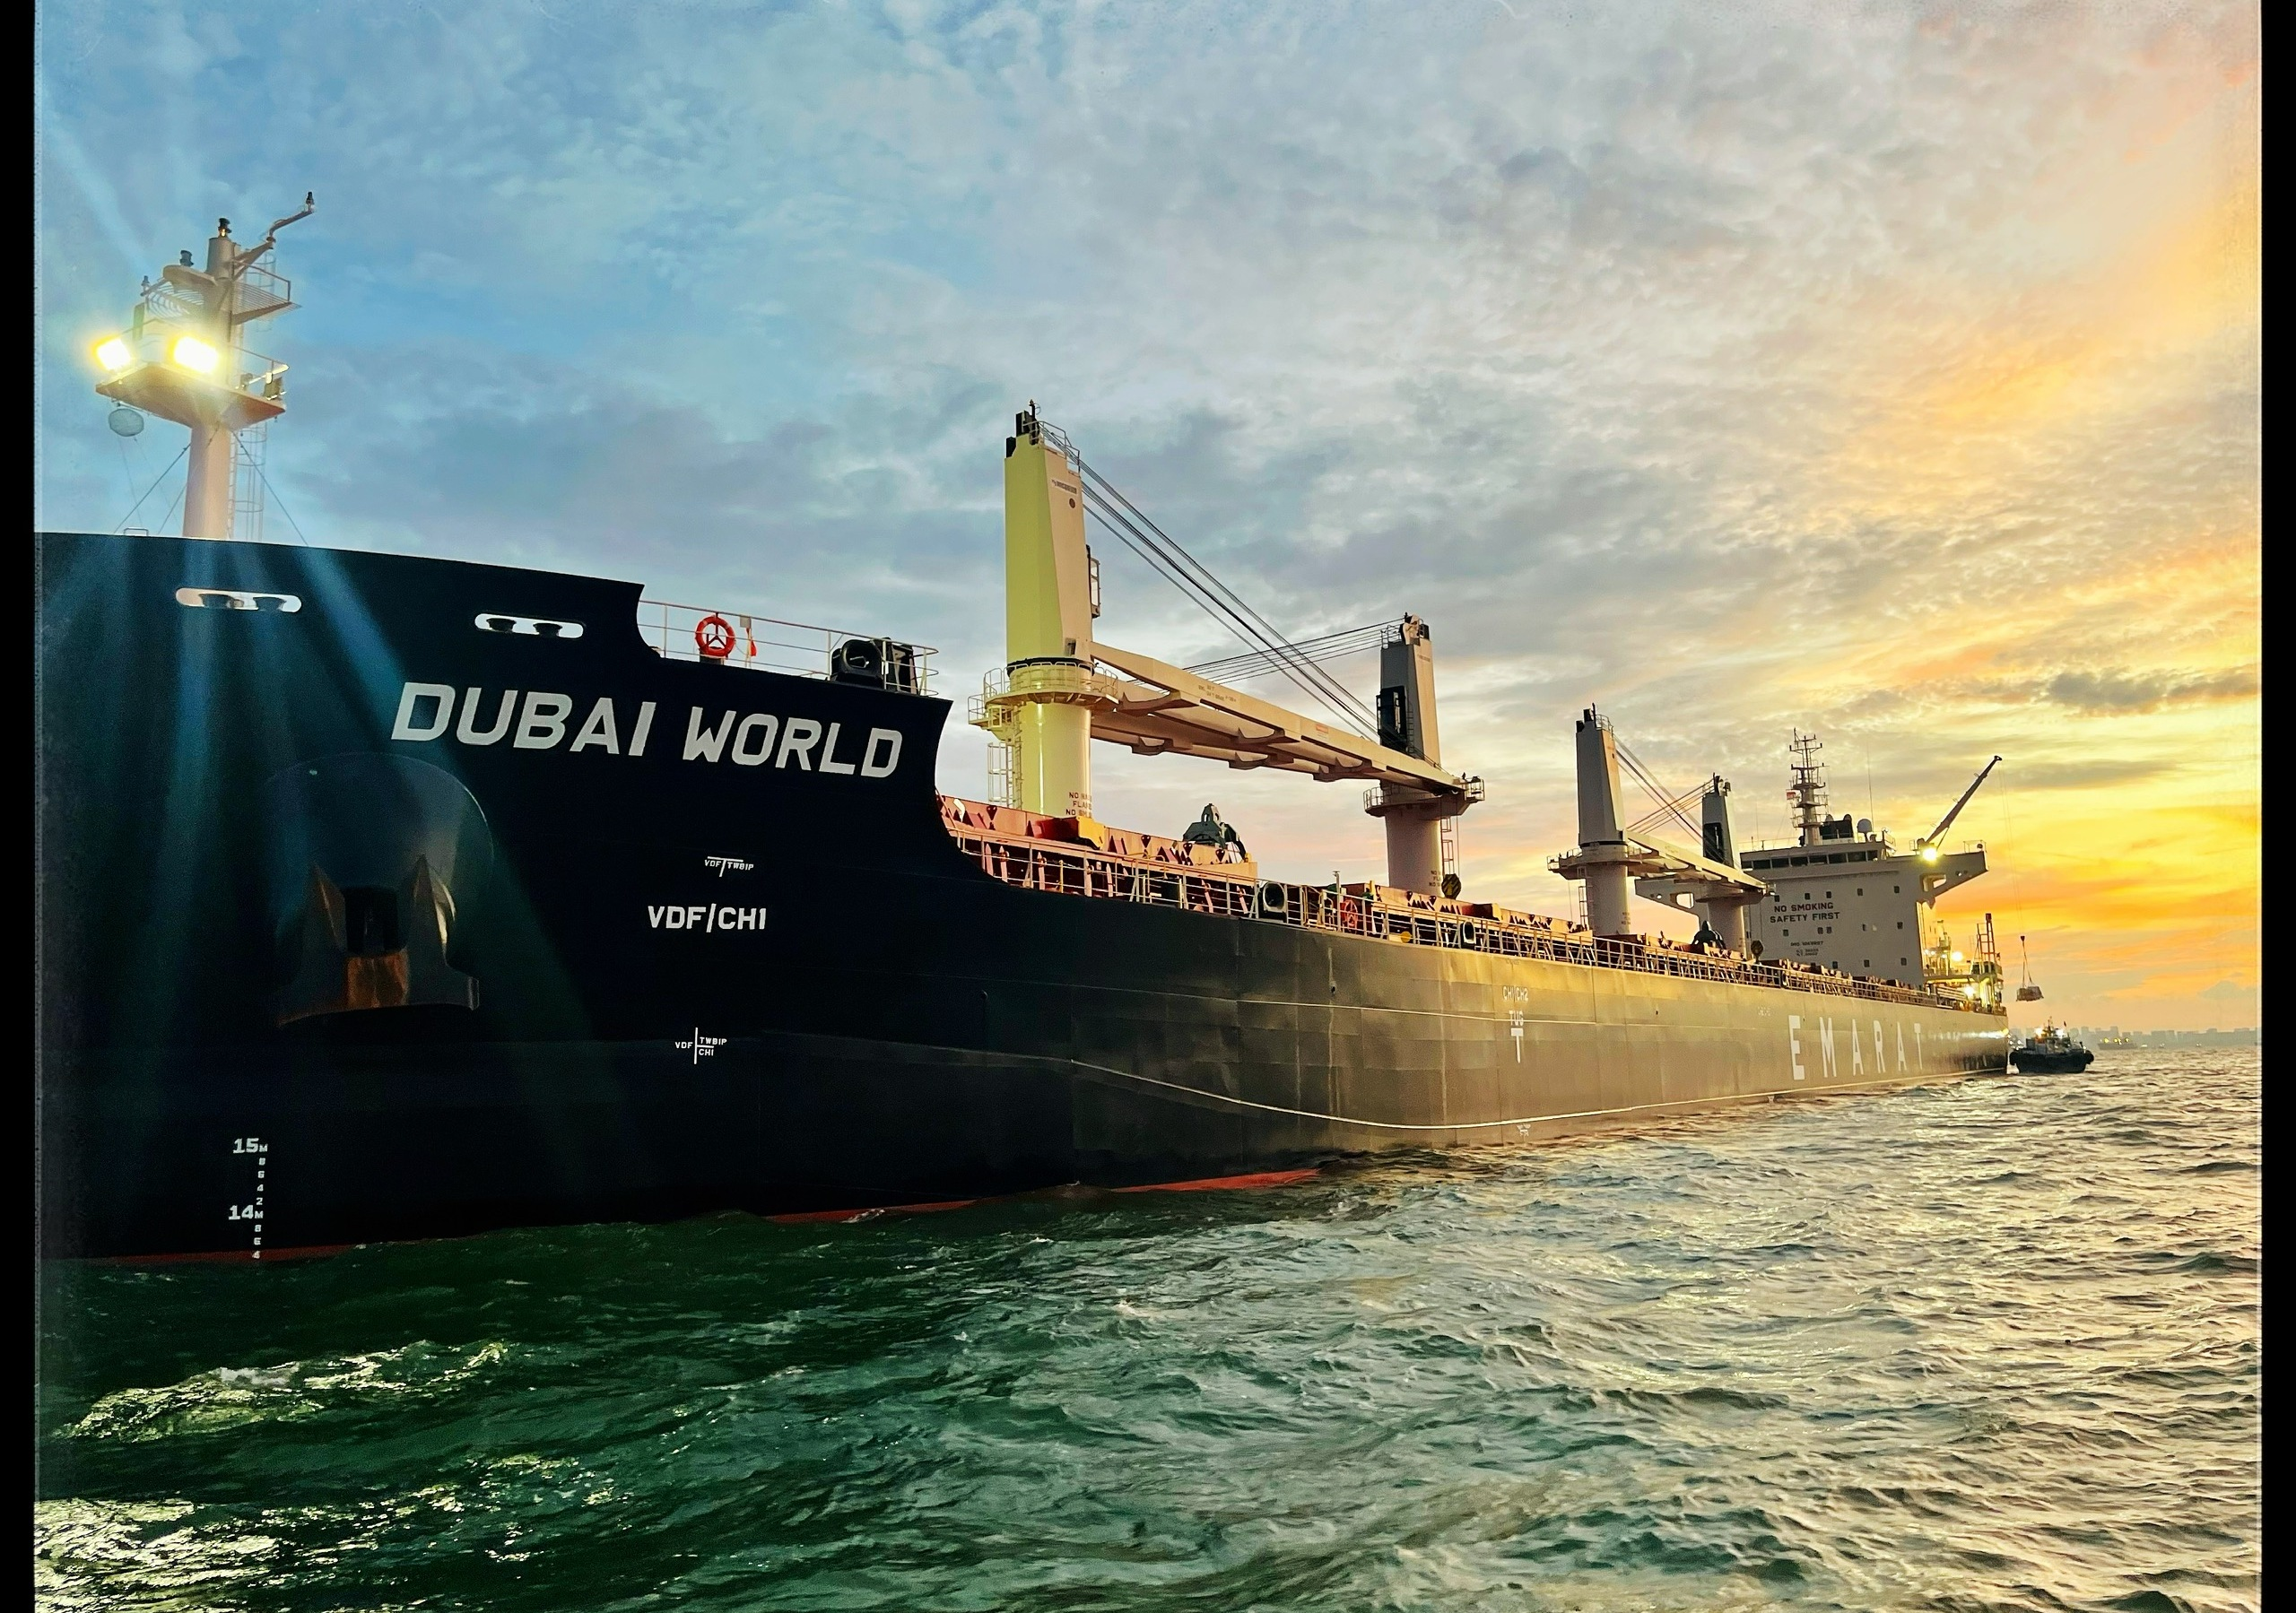
06 / APPLICATIONS
Marine Experience. Wider Industrial Possibilities.
Current deployment evidence is kept distinct from potential applications.
POTENTIAL APPLICATIONS
•
Engines & Generators
•
Pumps & Compressors
•
Production Machinery
•
Utility & Auxiliary Systems
CURRENT EXPERIENCE / MARINE INSTALLATIONS
Assessed and configured according to equipment interfaces, available signals, and project requirements.
DRUMS · Daikai Engineering Pte Ltd
07

Slide 8
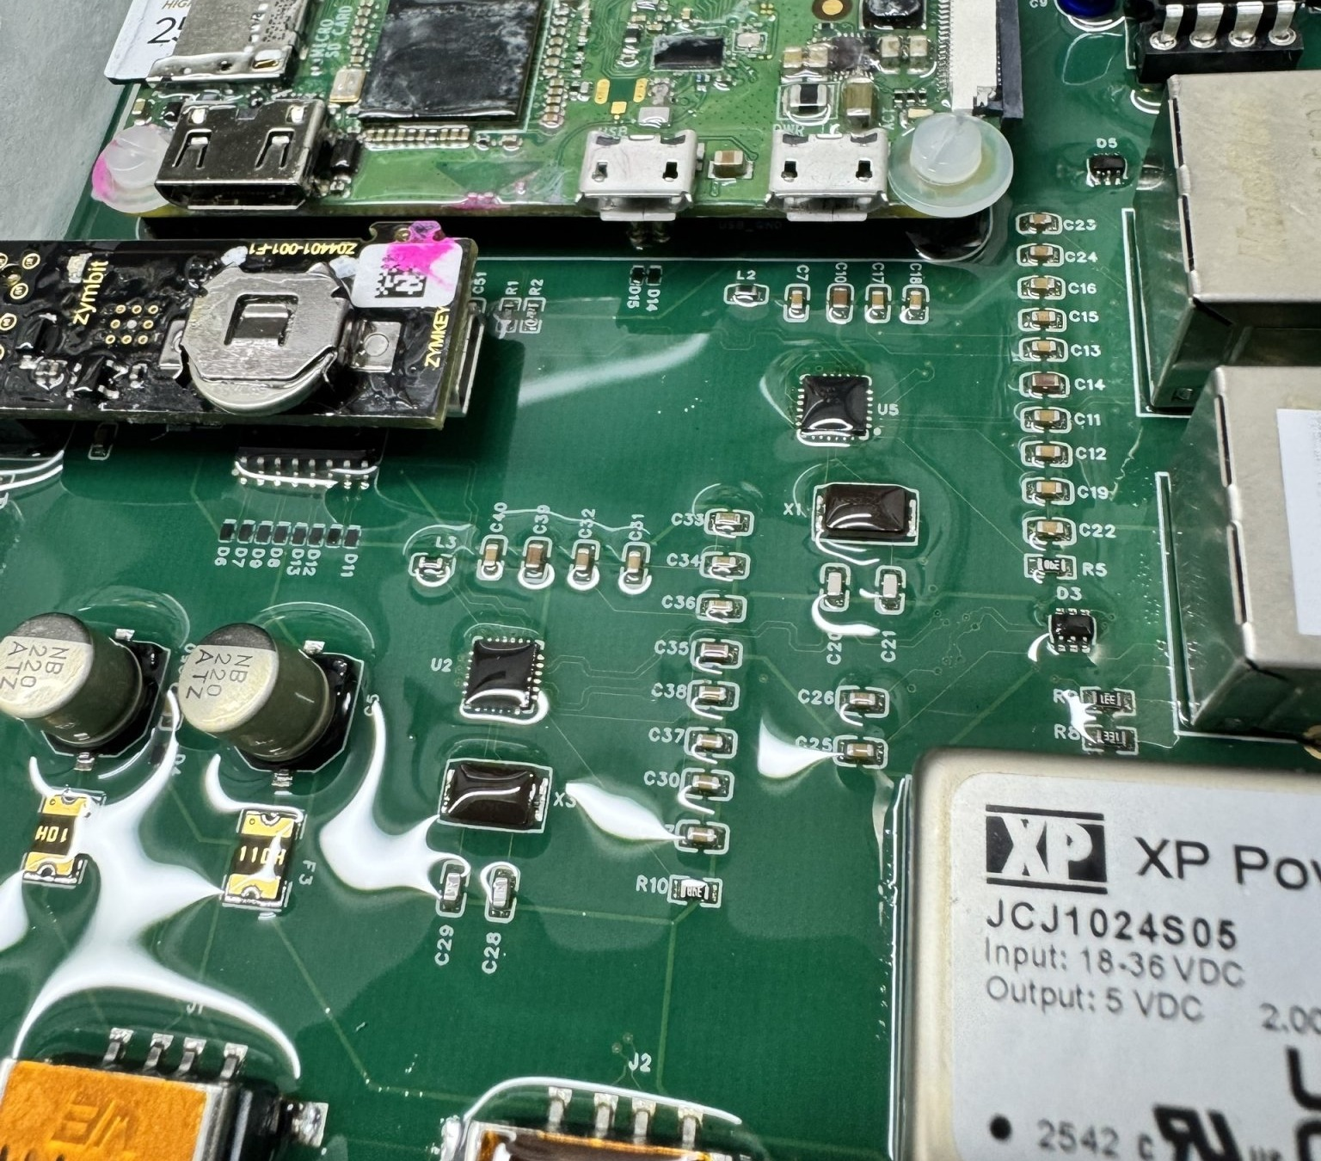
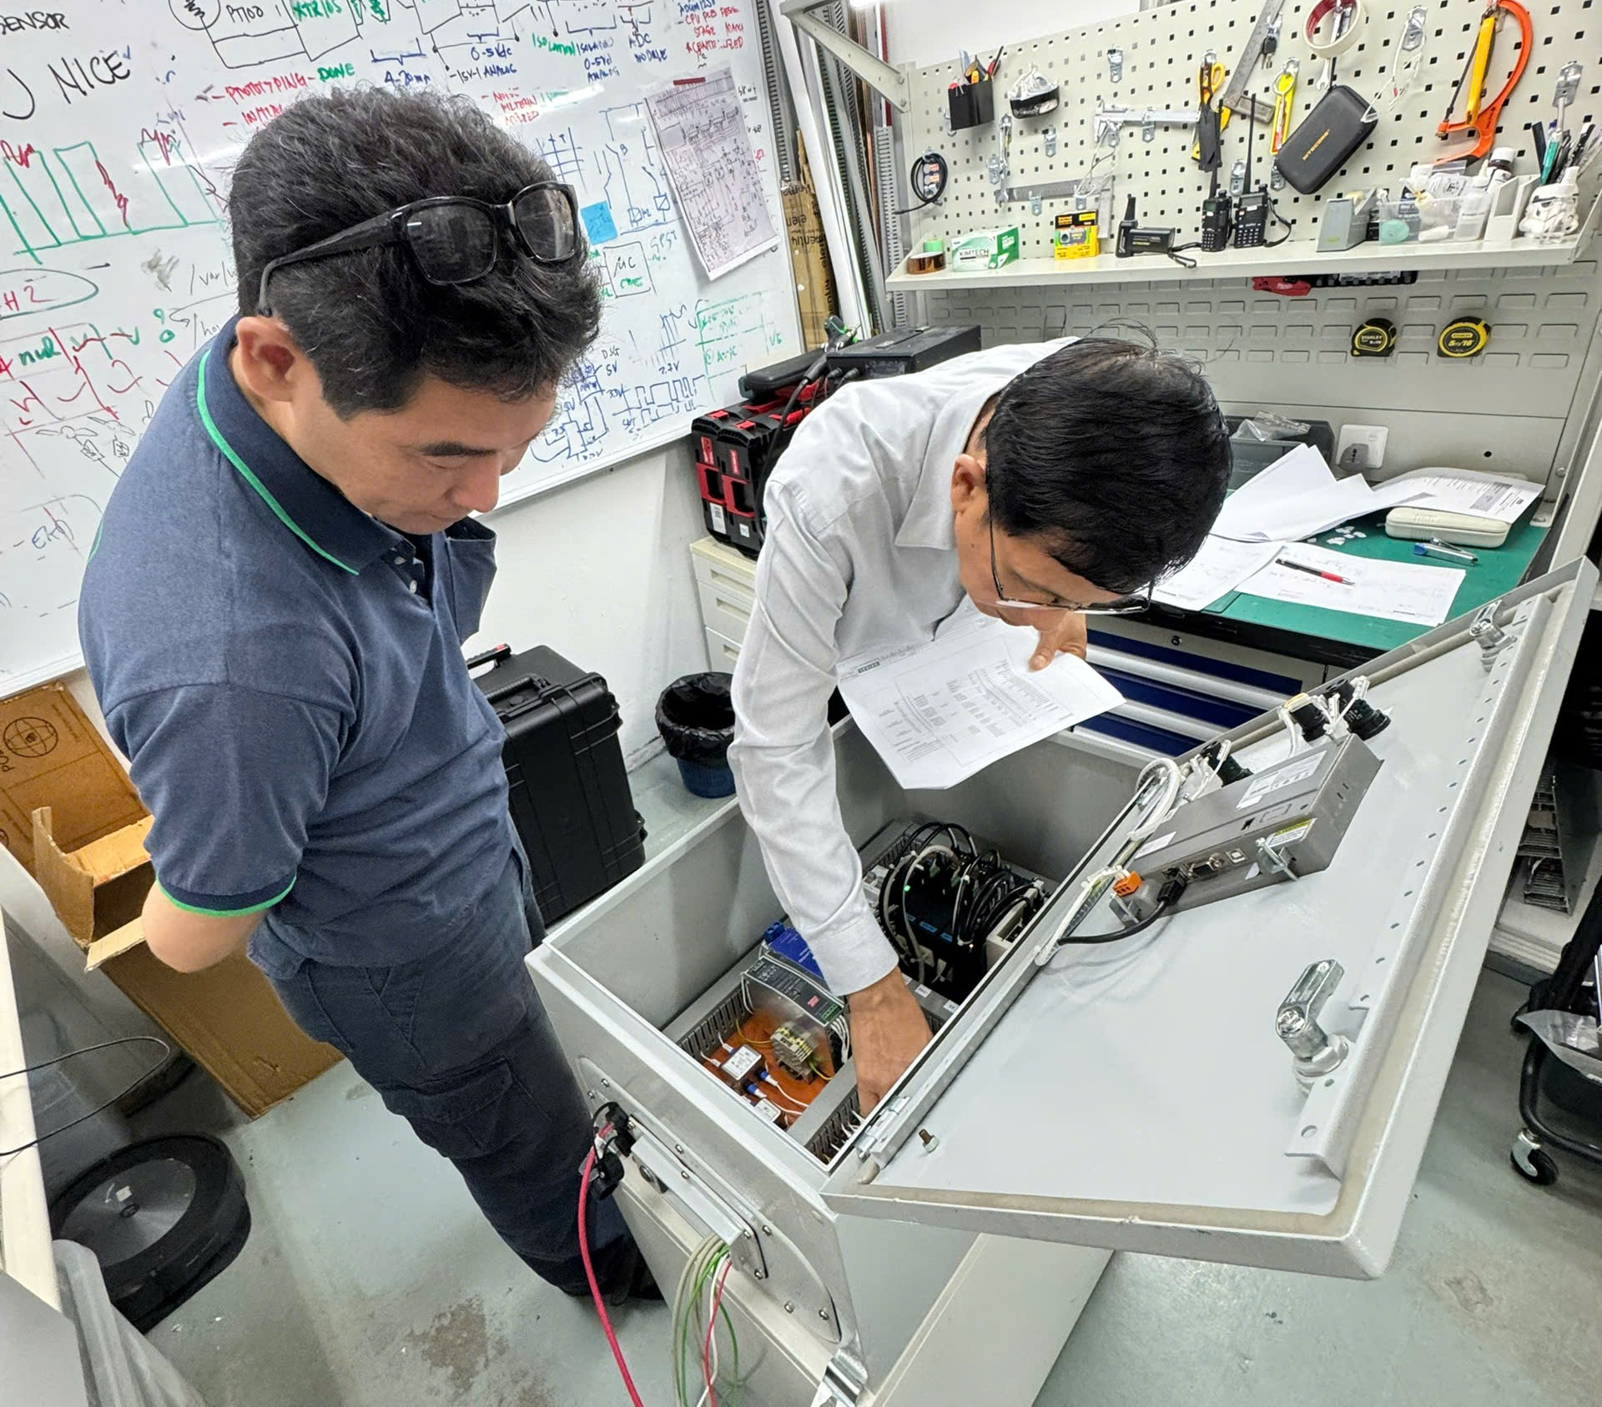
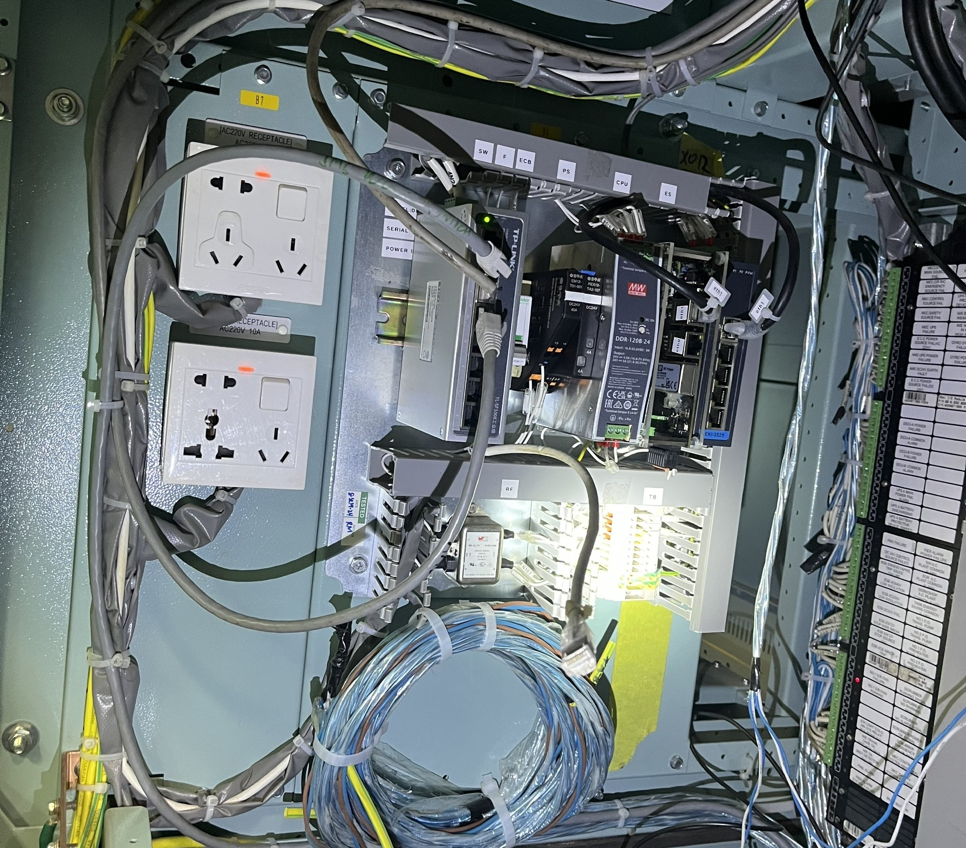
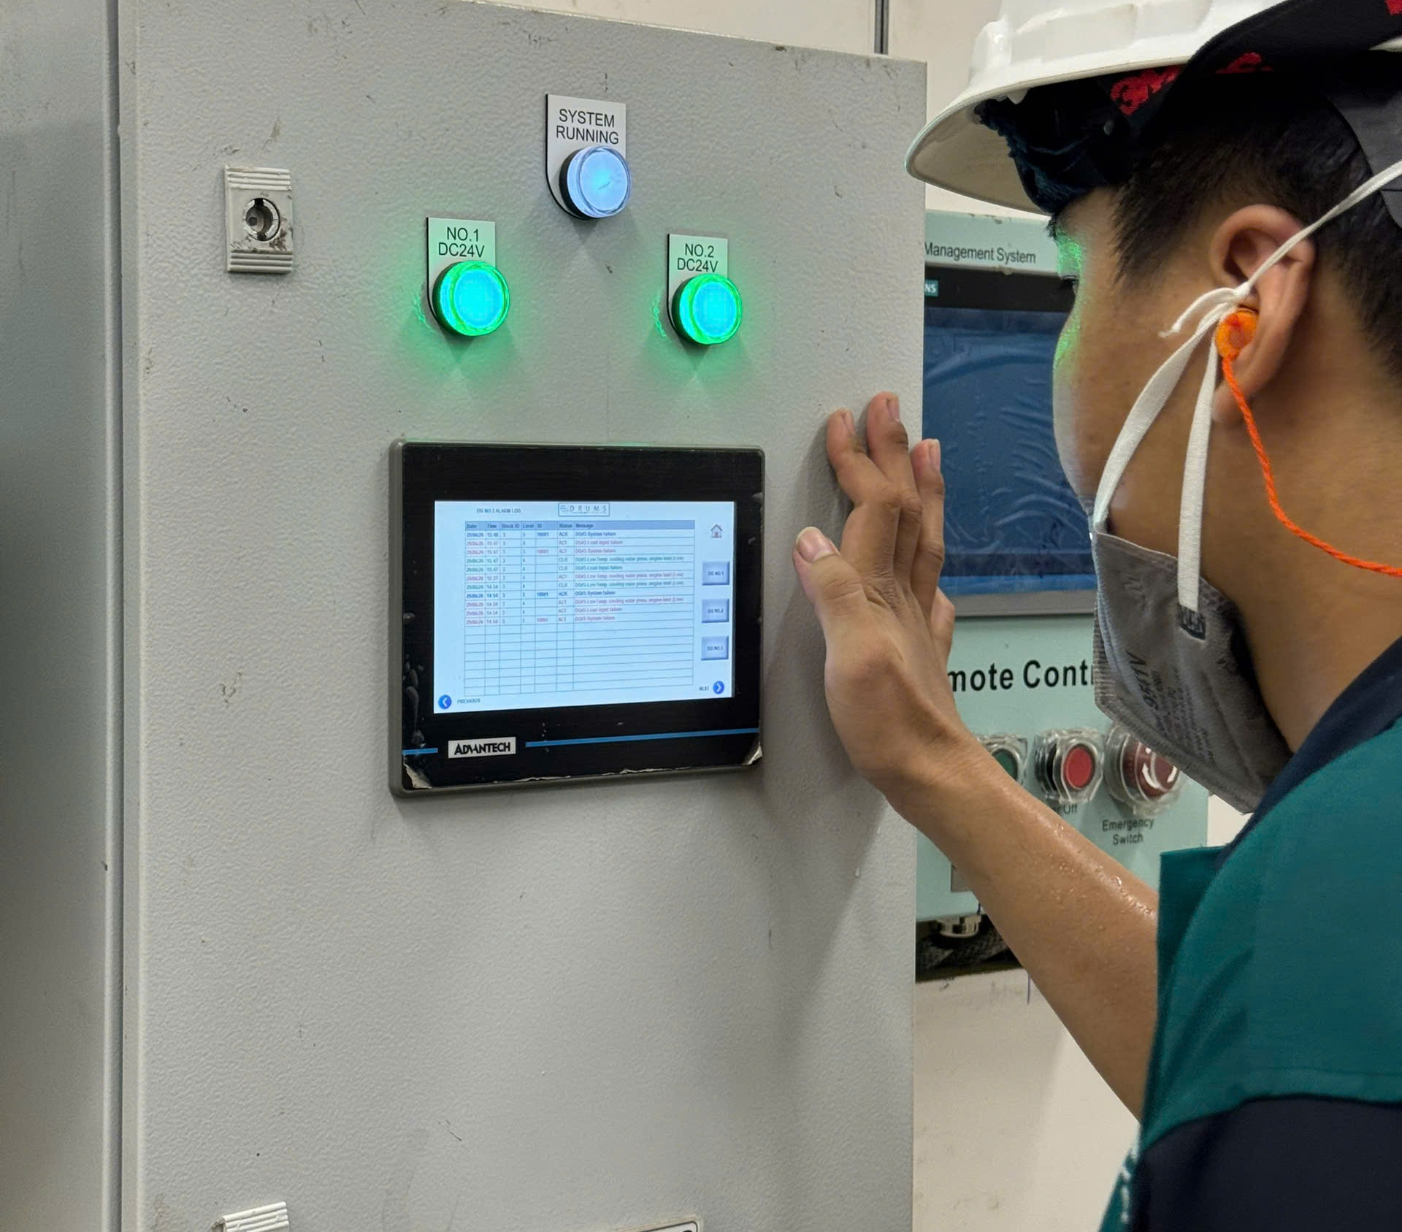
07 / INSTALLATIONS
Our Technology in Practice
Authentic DRUMS hardware, testing, commissioning, and onboard operation.
DRUMS CPU
Quality inspection
Installed in ECR
Monitoring operation
SUPPLY RECORDS · MARCH 2026 PRESENTATION
6
Emarat
vessels
1
Jemla
vessel
4
Vitol
vessels
4
Truongminh
vessels
DRUMS · Daikai Engineering Pte Ltd
08

Slide 9
08 / DATA SECURITY
Protection Throughout the Data Journey
Security configuration is defined for each deployment.
✓
Secure, encrypted data transmission
DATA
JOURNEY
✓
Authentication and role-based access control
Vessel
↓
Transmission
↓
Central platform
↓
Authorized access
✓
Vessel-level data protection
✓
Audit and monitoring
✓
Backup and system protection
DRUMS · Daikai Engineering Pte Ltd
09

Slide 10
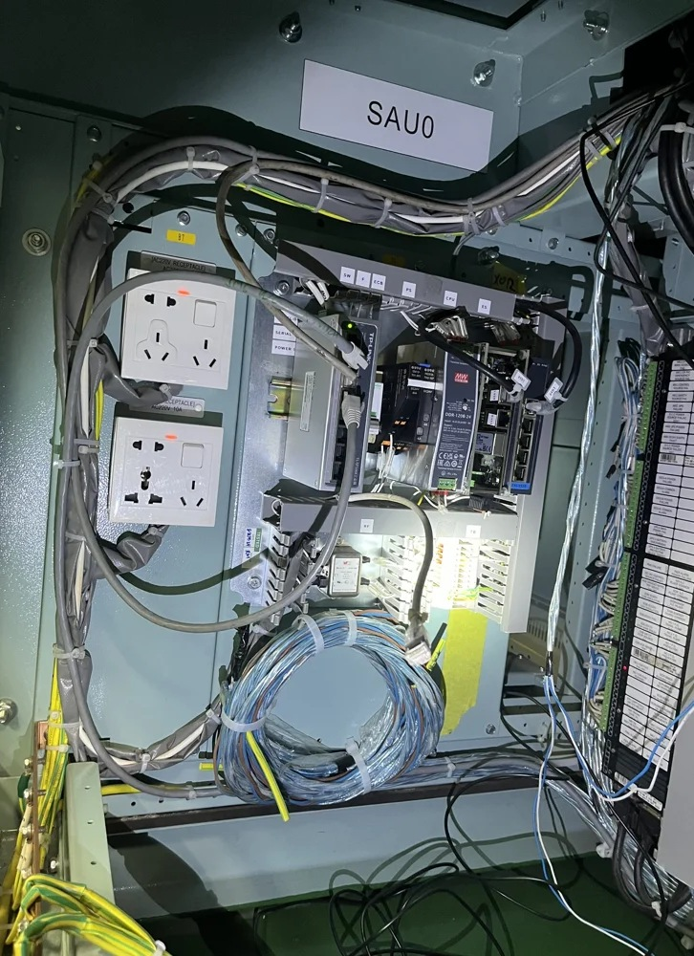
YOUR EQUIPMENT. YOUR REQUIREMENTS.
Let's Build the
Monitoring System
Your Equipment Needs
Tell us about your machinery, available signals, and monitoring requirements. We can discuss a DRUMS solution tailored to your application.
DISCUSS YOUR APPLICATION
Content exported from the project About page · Editable PowerPoint

