Slide 1

Your Tech Bootcamp
Group # - SKIN_Project
Notes:
Deck de présentation du DemoDay : https://docs.google.com/presentation/d/1KQAgW2PnA26K1B_kT7taHDvyLYgqLAoaKfjoNPBV29c/edit?usp=sharing
Template pour les slides : https://docs.google.com/presentation/d/15fl2DkXq3QWOVrYPi_1tHhvFuwk54DMZ4N-HKu_innA/edit?usp=sharing
Gsheet de suivi du DemoDay : https://docs.google.com/spreadsheets/d/1X3DMSP5GmzHSv1KsabI_9P6KcGh0e_pZ8MkJz2bZrvg/edit?usp=sharing
Lien de diffusion du DemoDay : https://www.linkedin.com/events/demoday-54-d-couvrezdequoinos-l7200779725894492160/theater/

Slide 2

Group members
Dominique OURMIAH – Dataset & Model
Patrice SINNAH – Transfer Learning
Philippe BAUCOUR - Architecture Quentin VILCOQUE – App & API

Slide 3
Pitch

Slide 4








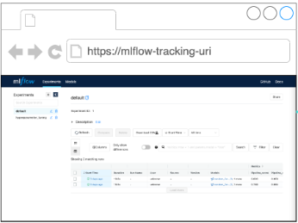
SkinCheck - Objectives
Training
EC2 others
MLFlow projects
Tracking
Consuming
Heroku
Consuming
MLFlow tracking
API+Web App
Flask
Data
Storing
S3
Monitoring
Iterate

Slide 5
Results

Slide 6
Results

Slide 7
Solution description

Slide 8
Solution description

Slide 9
What’s next?

Slide 10

Any questions ?

