Slide 1
Presentation Outline

Slide 2
Task (Introduce Briefly).
Task 1: Yelp Business Recommendation System
Task 2: Yelp Business Review Recommendation System
Task 3: Yelp Customer Social Network Analysis
PPT：萌萌做
Presentation：萌萌讲

Slide 3
Dataset
Our dataset is provided by Yelp. Yelp is an American multinational corporation which holds a large platform for publishing crowd-sourced reviews about businesses. Our dataset is related with business, user and checkin situation. The data was given in JSON format, and we import it into mongodb database, it turns out to have five collections: business, checkin, review, tip and user.
Business: 144072 records, 12% of them have more than 50 reviews.
User: 1029432 records, 10% of them have more than 50 reviews.
Review: 4153150 records
Tip: 946600 records
Checkin: 125532 records

Slide 4
Task 1: Yelp Business Recommendation System
Task 1.1: Rating Prediction(Detail)
Task 1.2 Recommendation(Detail)
Business Application Scenario -> System Architecture -> Result
(Add model comparison and analysis, like cold start problem, RMSE evaluation )
PPT&Presentation
Task 1: 萌萌&郭女侠

Slide 5
Task 2: Yelp Business Review Recommendation System
Task 2.1: Rating Prediction(Detail)
Task 2.2 Recommendation(Detail)
Business Application Scenario -> System Architecture -> Result
PPT&Presentation
Task 2: 我

Slide 6
Task 3: Yelp Customer Social Network Analysis
Business Application Scenario
Full yelp data contains some social network data in the form of “friends” list. We extract this single field and construct a social network.
By analyzing the network, we want to find user with wide influence and significant importance and recommend them to business. Then when business have some coupons or want to make advertisement on new dishes or event, they may want to choose these people to enlarge influencial coverage and spreading range.

Slide 7
Task 3: Yelp Customer Social Network Analysis
System architecture
DataFrame
mongoDB
Sparksql
GraphFrame
DataFrame
results
Algorithm

Slide 8
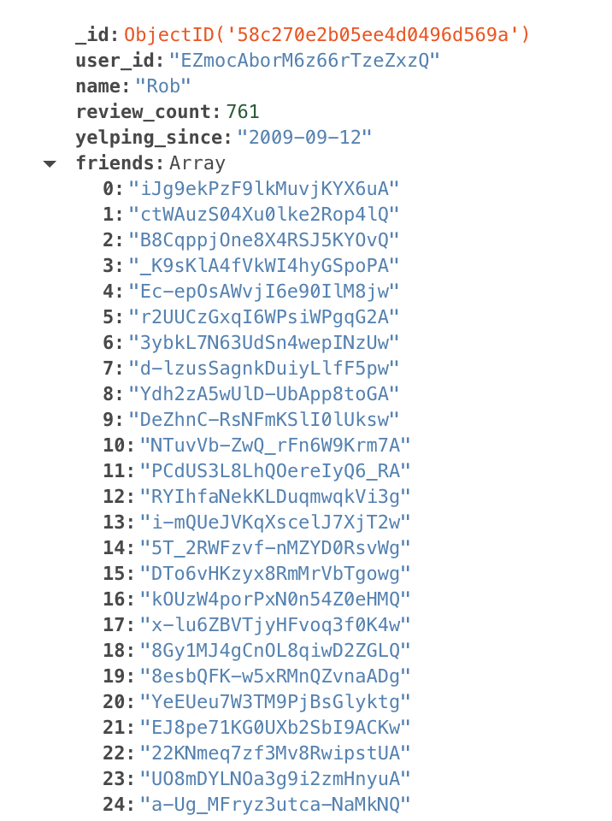
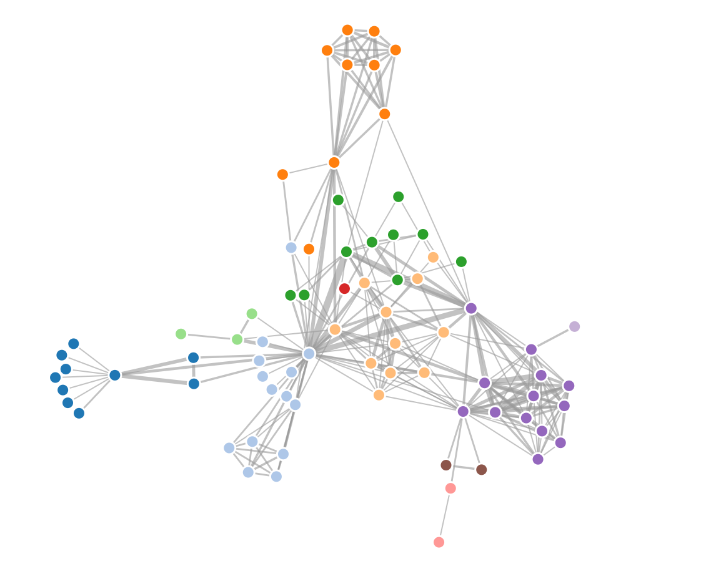
Task 3: Yelp Customer Social Network Analysis
Implementation details

Slide 9
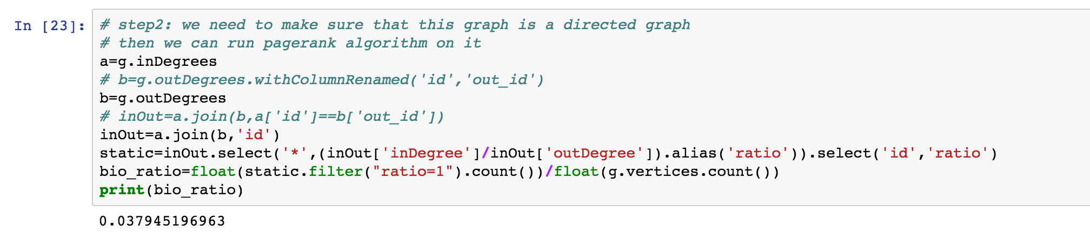
Task 3: Yelp Customer Social Network Analysis
Implementation details
After constructing the network, we want to know whether it’s a directed graph or un-directed graph. So we calculate the fraction in vertices whose inDegree equals to outDegree. Seen from our results, it’s a directed graph. We suppose that here “friend” relationship means: if B in A’s friend list, it means A follow B. Not the traditional undirected friendship data structure. So we can use some directed graph algorithm on it.

Slide 10
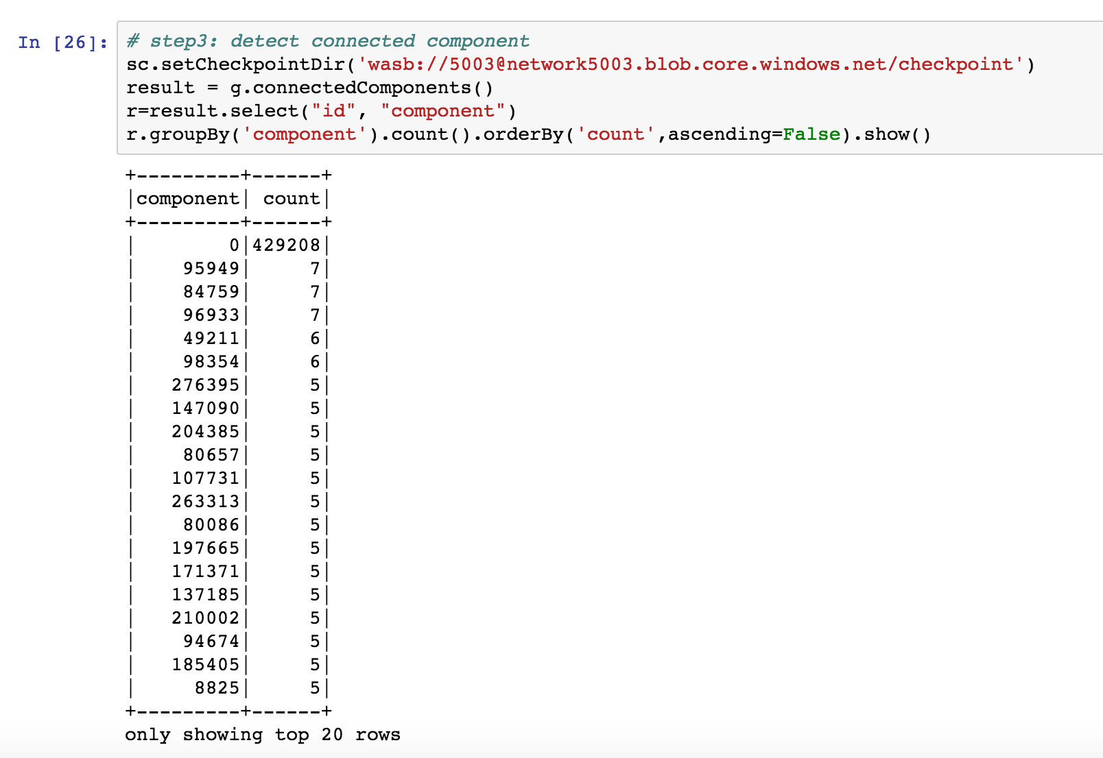
Task 3: Yelp Customer Social Network Analysis
Implementation details
this graph is not connected graph, so we need to find the largest connected component.

Slide 11
Task 3: Yelp Customer Social Network Analysis
Implementation details
Then, we extracted all the vertices and edges belongs to largest connected component from the original full graph and generate a new graph
But if the number of one business's review is too small, it will be meaningless for them to distribute coupons according to this network's results, for they do not have enough data and do not have enough user to expand influence in cascanding. So we first groupBy business_id and extract subset of business whose users' number is more than one threshold.

Slide 12
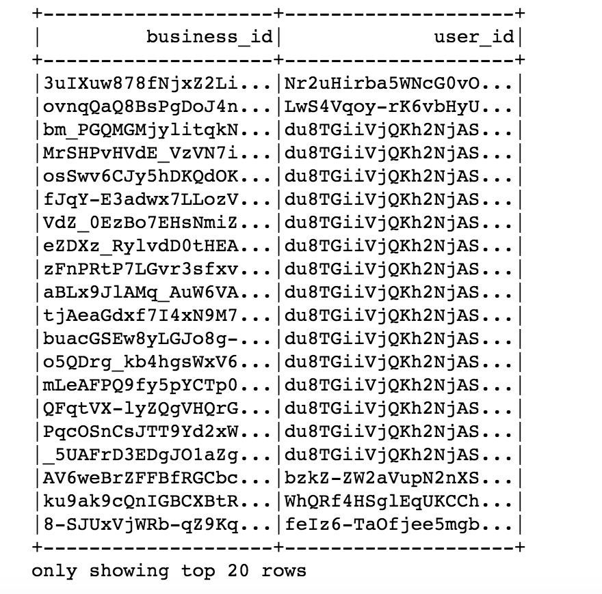
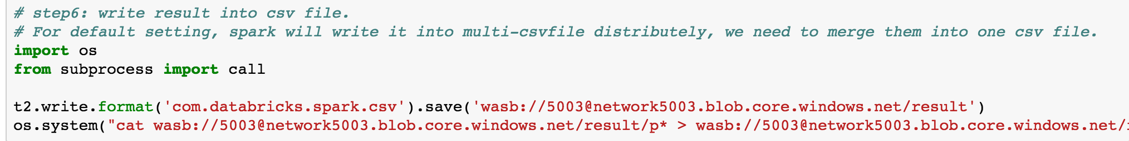
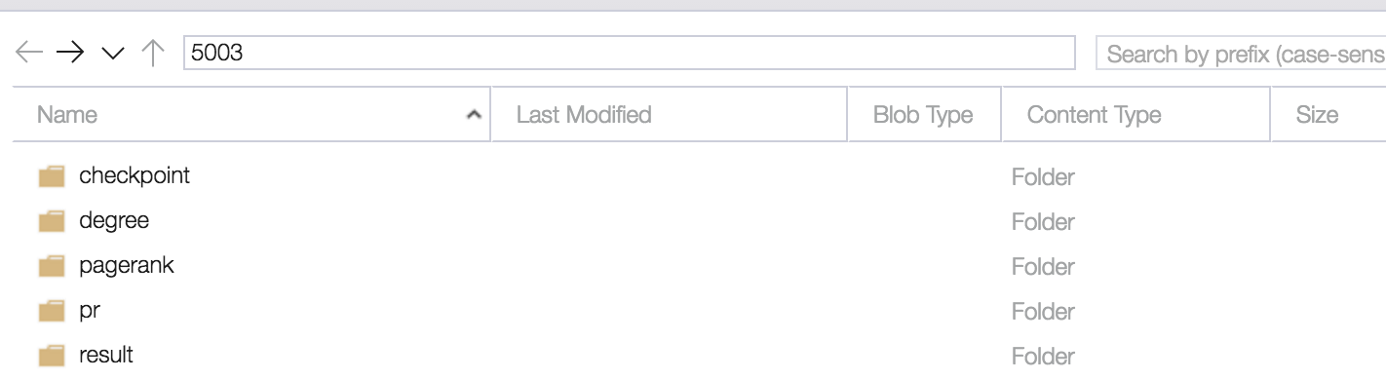
Task 3: Yelp Customer Social Network Analysis
Implementation details
Pagerank algorithm originates from website ranking, and nowadays it extends to social network area and used for finding import person or community leader. We decide to run pagerank algorithm on this graph to find most influential person in each business’s network and give the list to business for them to arrange advertisement or give out coupons
Write out to blob

Slide 13
Benefits of Using Big Data Technology
RDD
Spark SQL
MLLib
GraphX, GraphFrames
MongoDB
Github
Azure Cloud Service
PPT：
RDD，Spark SQL，Github：郭女侠 & 萌萌
MLLib，MongoDB：我
Azure Clould， Graphx：彭总
备注：GitHub移动到other benefits
Presentation： 彭总讲

Slide 14
Benefits of Using Big Data Technology
Azure Cloud
Wide services
Cover IaaS, PaaS, SaaS
Storage, database, virtual machine, cluster, etc.
High performance (run task which can not be implemented on local machine)
User-friendly user interface (Azure portal and dash board)
GraphX/GraphFrame
Connected with Dataframe
Good performance on graph processing
Rich library of graph algorithms
User can create personalized function

Slide 15
Bug
没有就删

