Slide 1
Portrait Tracking in Videos
Zhaoyang Chen
Wenqing Qu

Slide 2
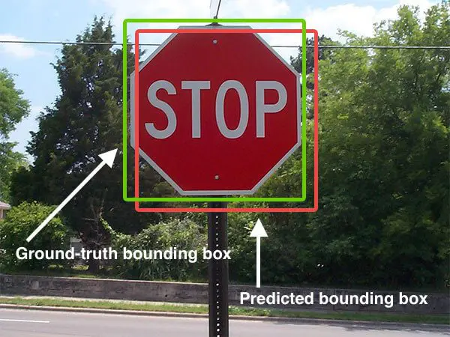
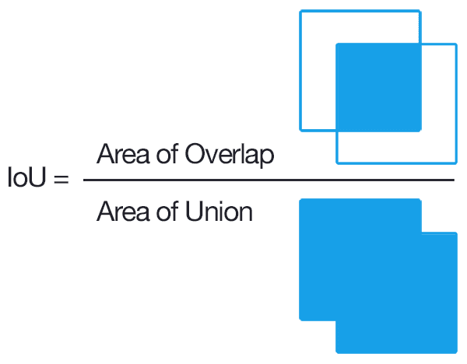
Bounding-Box Intersection over Union

Slide 3
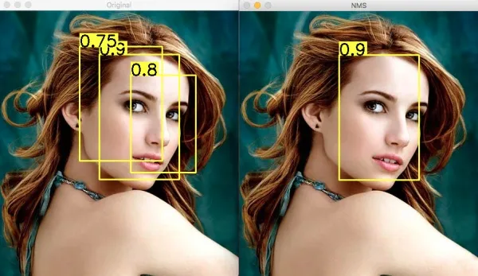
Bounding-Box Non-Maximum Suppression
The process of non-maximum suppression is as follows:
Sorting according to confidence scores
Select the bounding box with the highest confidence score to add to the final output list and remove it from the list of bounding boxes
Calculate the area of all bounding boxes
Calculate the IoU of the bounding box with the highest confidence score to the other candidate boxes
Remove the bounding boxes with IoU greater than the threshold value
Repeat the above process until the list of bounding boxes is empty.

Slide 4
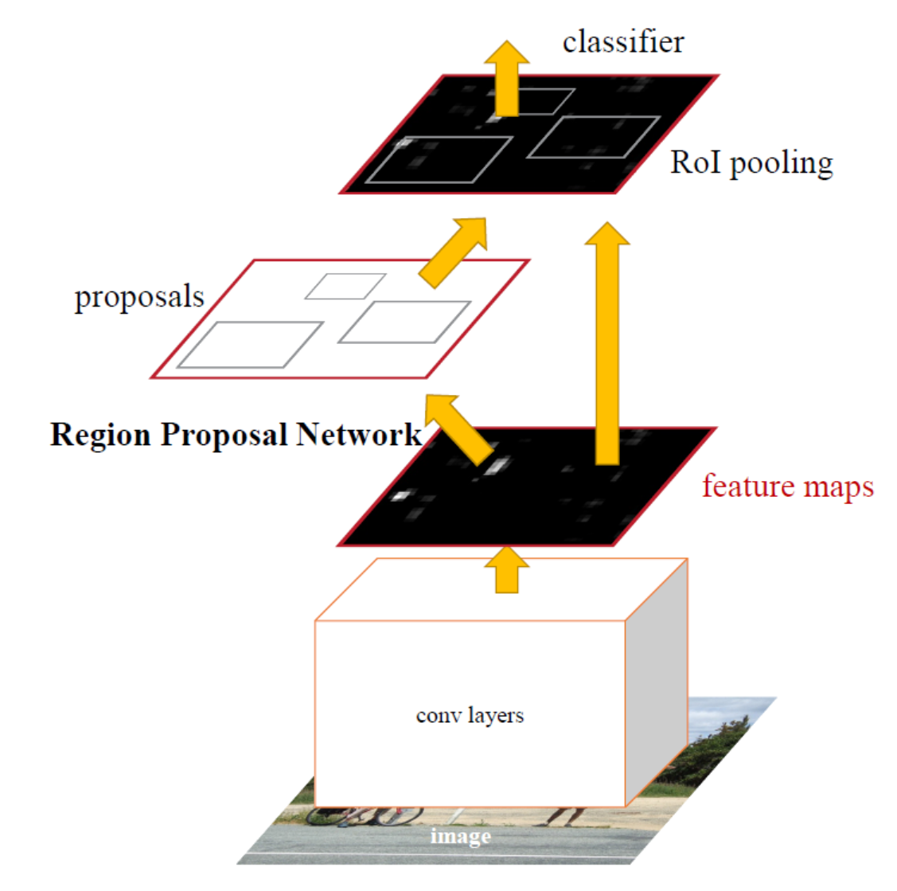
Methods based on FasterRCNN
The algorithm works in two stages: first, a region proposal network (RPN) is used to generate a set of region proposals, or potential object bounding boxes. These proposals are then fed into the CNN, which is trained to classify the proposals as either objects or background. The CNN also refines the bounding box locations for the objects it identifies.

Slide 5
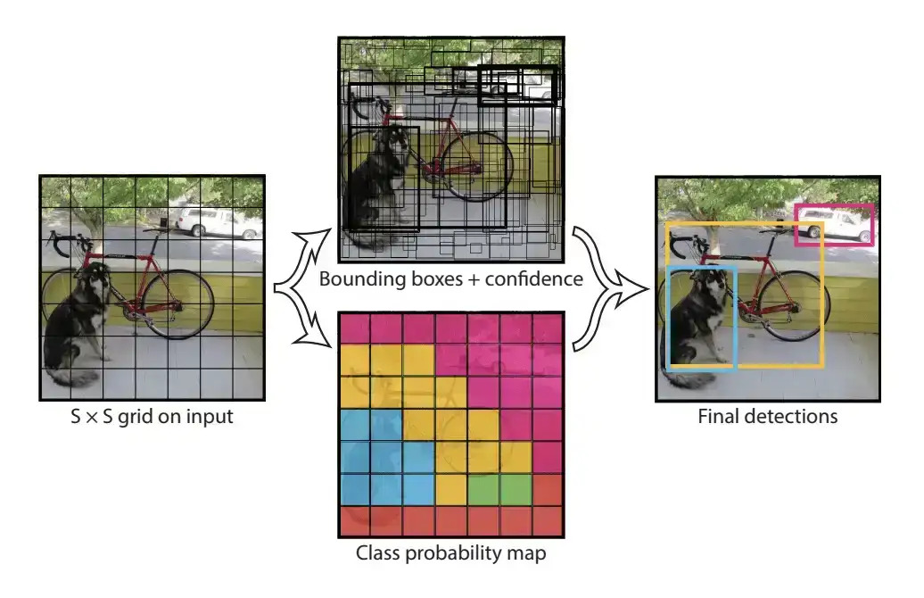
Methods based on YOLOv5

Slide 6
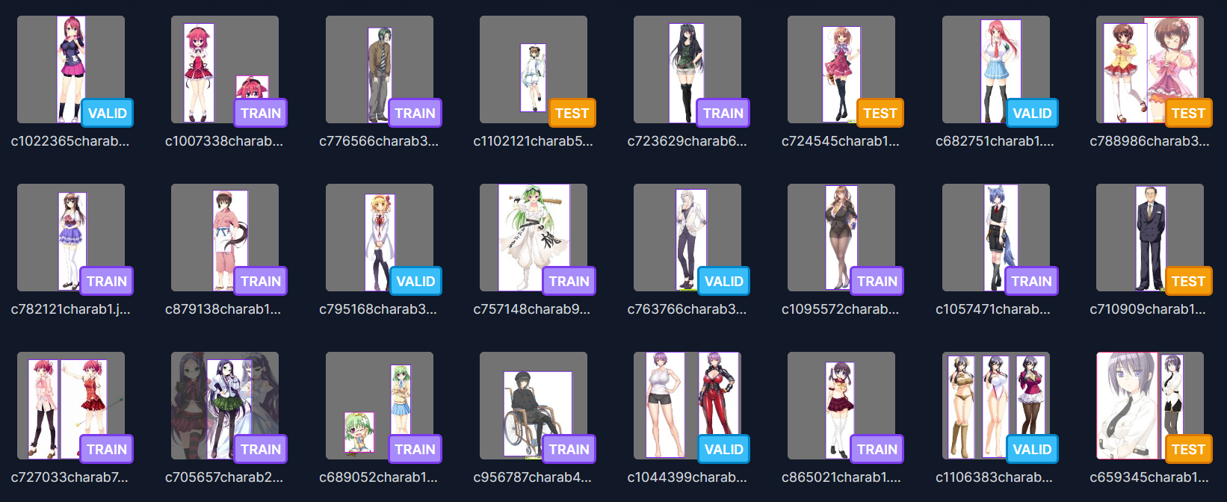
Training on custom dataset with ISDA
Watermark is a dataset on Roboflow, which contains many images of anime characters. We will use this dataset to train our model.

Slide 7
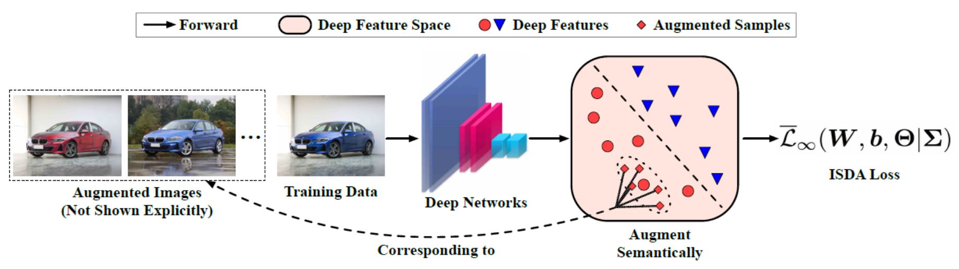
Training on custom dataset with ISDA
Implicit Semantic Data Augmentation (ISDA) is an algorithm which is intended to perform more advanced and semantic transformations on the dataset, such as changing the background, color, and perspective of the object, in order to better improve the training results.

Slide 8
Thank you for listening

