Slide 1
INF-554
Retweet prediciton
Team: AGoodTeam
Authors: Wen YANG, Ranyu FAN, Wenqing QU

Slide 2
Contents
Feature Selection/Extraction
Model Choice, Tuning and Comparison
Summary

Slide 3
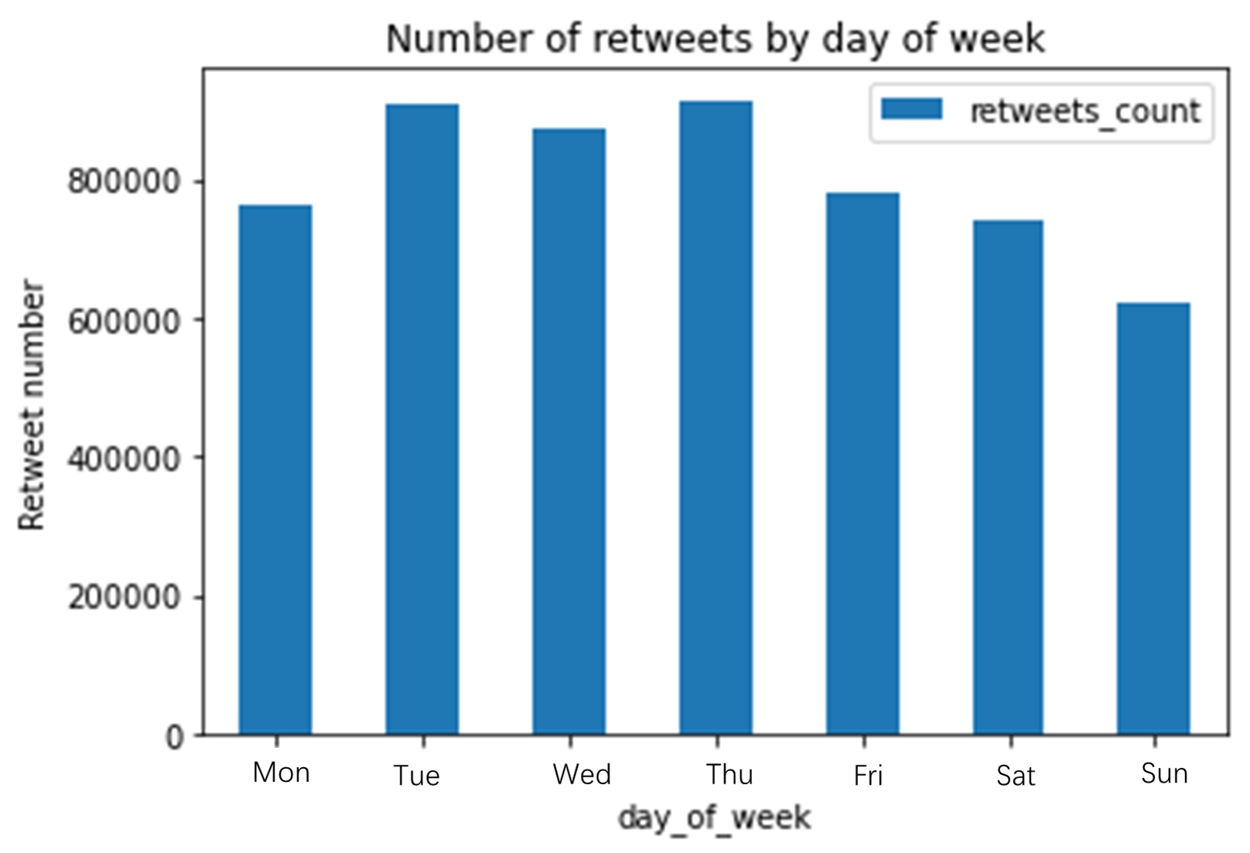
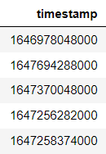
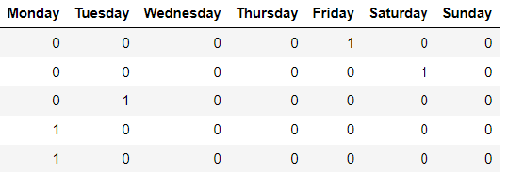
Feature Selection/Extraction
（1） Time related features
Timestamp → Day of week ：number of retweets varies in each day of the week
Categorized features : Monday to Sunday
One-hot encoding

Slide 4
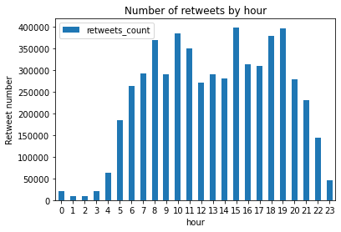
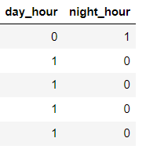
Feature Selection/Extraction
（1） Time related features
Timestamp → Hours ： more retweets from 6 AM to 21 PM (day hours)
less retweets from 22 PM to 5 AM (night hours)
Categorized features : day hour and night hour

Slide 5
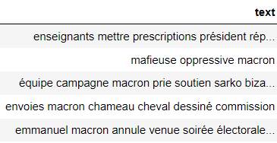
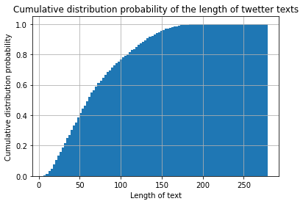
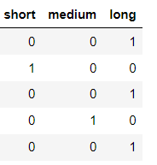
Feature Selection/Extraction
（2） Length of the text [1]
Categorized features : Short, Medium, Long
Short → 0 ~ 45 words,
Medium → 45 ~ 80 words,
Long → 80 ~ 250+ words.
Length
[1] Nelson Joukov Costa de Oliveira. (2018) Retweet Predictive Model in Twitter. University of Coimbra, Department of Informatic Engineering.

Slide 6


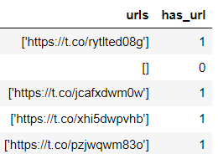
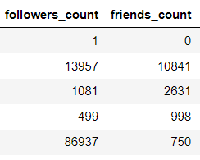
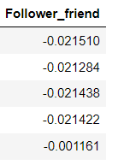
Feature Selection/Extraction
（3）has_url/mention/hashtag
str → 0/1
（4） Followers-Friends Ratio [2]
[2] T Vinayaka Ra. (2020) KM AnalytiCup 2020: COVID-19 Retweet Prediction with Personalized Attention. 2020 International Conference on Information and Knowledge Management AnalytiCup, CIKM AnalytiCup.

Slide 7
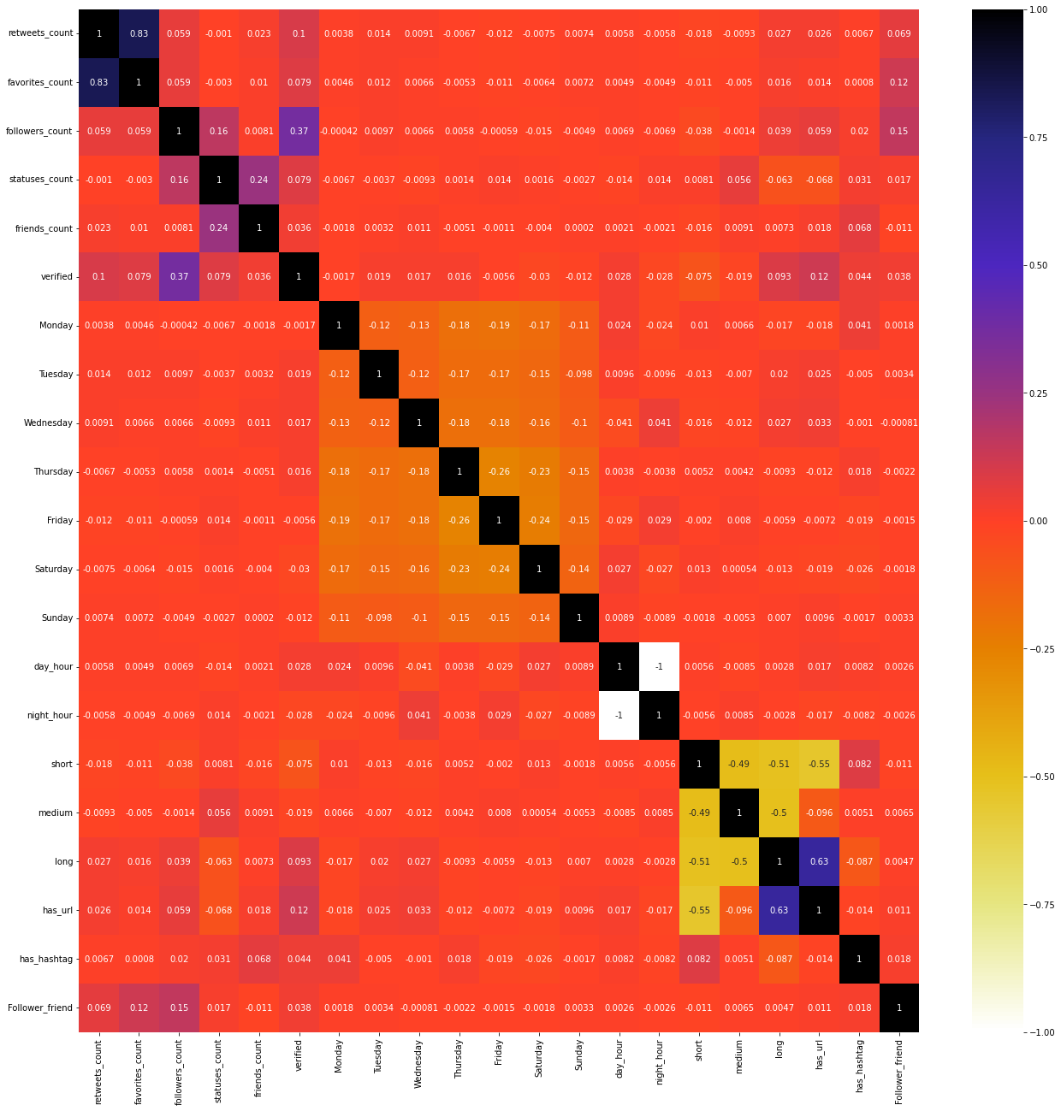
Correlation matrix
Only a few features correlated with number of retweets:
Eg: 'favorites_count', 'verified',
After one hot encoding, most features are represented by 0 and 1, it’s sparse, so correlation tends to be 0
We tried calculate feature importance using Extra Tree Classifier, since most of our models are tree based

Slide 8
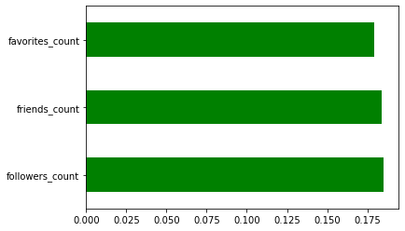
Feature importance
text → vectors
Word Embedding
We used the gensim doc2vec library to train the texts, then we combined the vectors with the other features together as the final selected features:
'text' (represented as vectors) ,
'favorites_count',
'followers_count',
'friends_count',
'verified',
'long' ( text with length more than 80 words)
Feature importance
We found several features which has a strong impact on retweets number:
'favorites_count',
'followers_count',
'friends_count'

Slide 9
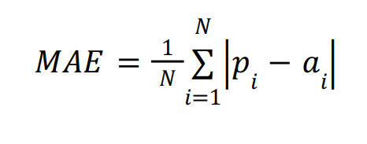
Model choice
Model evaluation
Gradient boosting
Linear regression
Regression trees
Random forests
Neuron networks
Mean absolute error (MAE)

Slide 10
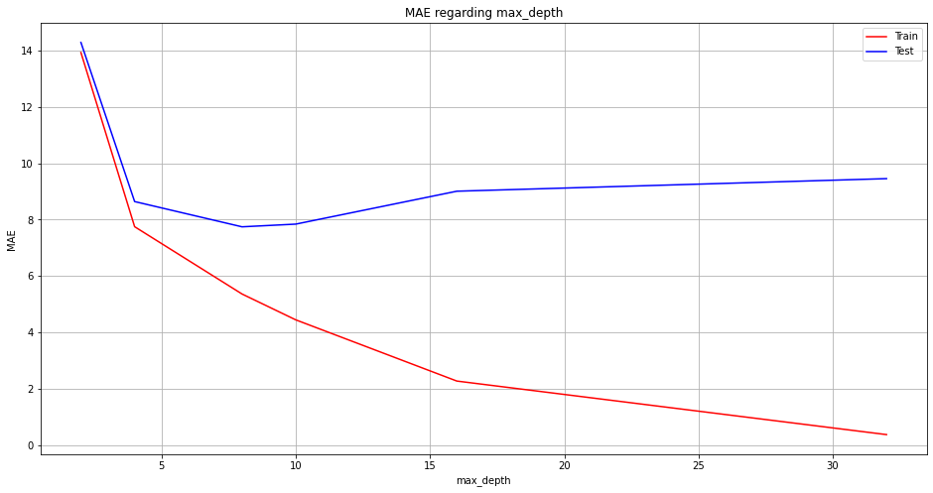
Model Choice, Tuning and Comparison
Regression trees
A regression tree is a set of ordered decision rules, going through the tree, we go through a succession of questions on the variables of the database, until ending up on a sheet, which allows us to know which output to assign to a given input.
Hyperparameter tuning
The classical algorithms of regression tree splits in a binary way until the size of the tree reaches a parameter ( 𝑚𝑎𝑥_𝑑𝑒𝑝𝑡ℎ )
Most optimized:
max_depth = 8
If max_depth>8:
test error increase, might be overfitting

Slide 11
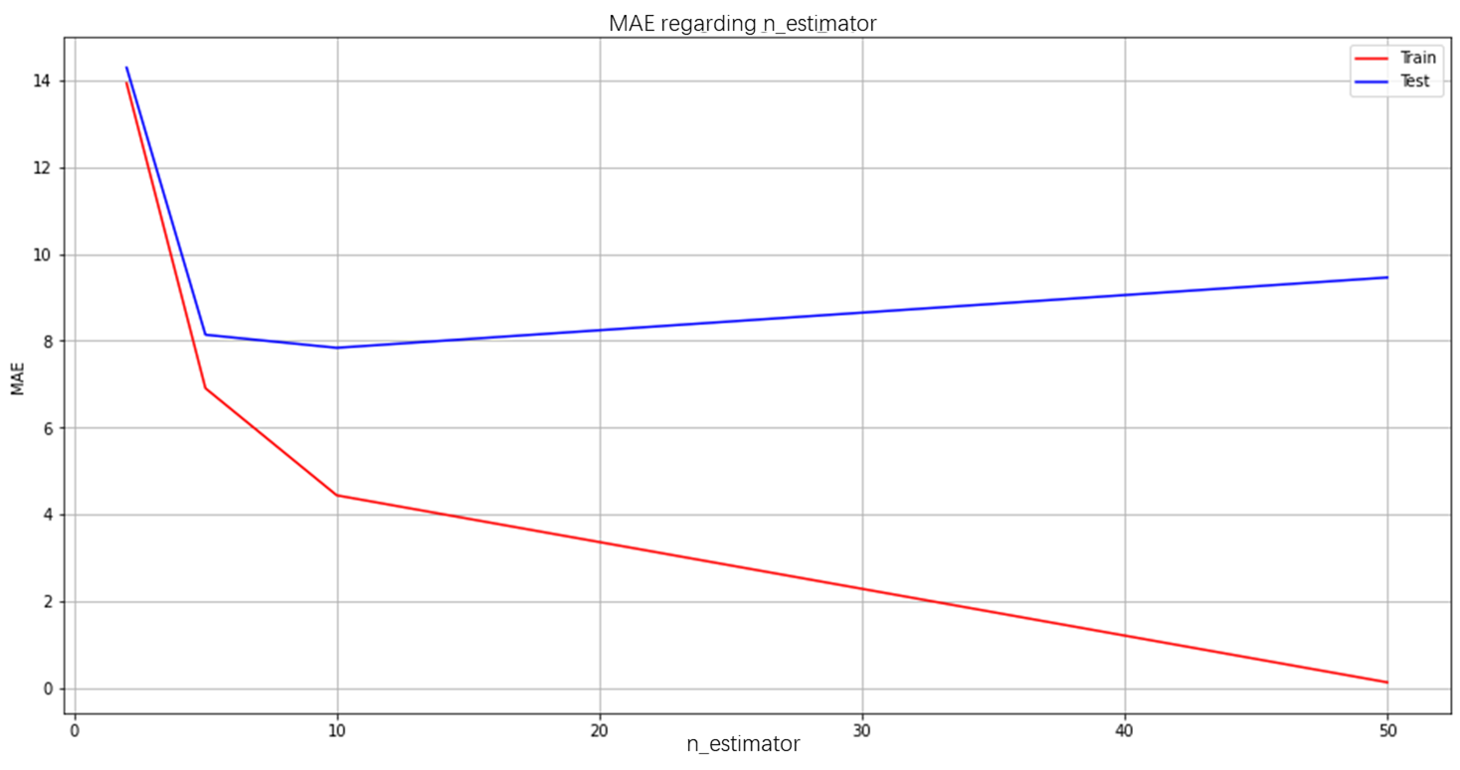
Model Choice, Tuning and Comparison
Random forests
The main problem with decision trees is their large variance: a tiny error at the top of the tree is propagated all the way down the tree and it gets worse quickly. To stabilize the tree's predictions, we prefer to generate a set of trees called random forests.
Hyperparameter tuning
n_estimators is the number of trees to be used in the random forest.
As the n_estimators increase, the result will become stable, so increasing n_estimators no longer improves the quality of the model
Most optimized:
n_estimator = 5
If n_estimator>5:
test error increase, might be overfitting

Slide 12
Model Choice, Tuning and Comparison
Gradient boosting
In gradient boosting algorithms, predictions are made by a group of decision trees. However, trees are fitted sequentially, so that each new tree is designed to reduce the overall error as much as possible.
Linear regression
The target is predicted by the linear approximation, linear regression model fits a linear model with coefficients to minimize the residual sum of squares between the observed targets in the dataset.
→ It has the worst results compared to other models during our project

Slide 13
Model Choice, Tuning and Comparison
Neuron networks
We’ve also implemented a neuron network as our model. We built a 3-layer neural network with 4, 5, 1 hidden nodes in each layer and relu as the activation function.

Slide 14
Result comparison
Table 1: MAE for different model on training data set
 | Gradient Boosting | Linear regression | Regression tree | Random forest | Neuron networks
MAE | 7.18 | 10.71 | 7.70 | 7.82 | 7.61
We decided to use the Gradient Boosting model to predict the number of retweets in the evaluation file, because it has a good performance on reducing MAE and we could run this model on our own laptops. Although Neuron networks also gave us good results, it takes too much time, which is inconvenient for our project.
Linear regression has the worst MAE.
Gradient Boosting has the best MAE.
Neuron network, regression tree and random forest model have slightly higher errors than gradient boosting model.

Slide 15
Summary
Feature Selection/Extraction
Timestamp → Day of week, hours
Text → length, vectors
Correlation matrix & feature importance
Model Choice
Linear regression, decision tree, random forest, gradient boost, neuron networks
study of max_depth, n_estimators to choose the optimized parameter and avoid overfitting
Future improvements
increase vector_size in doc2vec model
Grid search or random search cross validation to search the best set of hyperparameters

