Slide 1
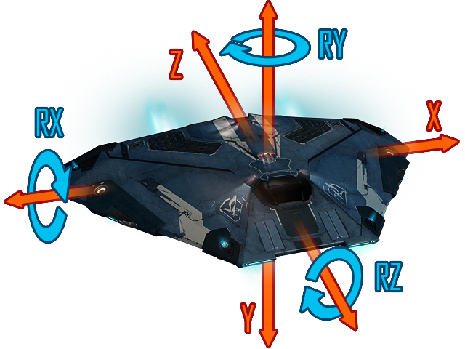
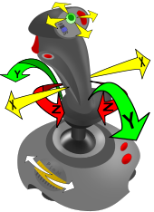
6DOF Controller Joystick

Slide 2
(Space Sim) ‘Problem’
HOSAS/HOTAS setups don’t use the full range of motion of our hands
Free up one hand for secondary tasks
More intuitive controls

Slide 3
Approach
For each Degree of Freedom, have a separate axis
Map position/ rotation of hand 1:1 to translational/rotational input
Put 3 DoF Rotational Controller on 3D-Printer like Rail System
Track Position in 3D Space with sensors
Track Rotation using typical controller

Slide 4
Applications
Space-Sims
Drones/submarines
Anything which can freely move and rotate independently

Slide 5
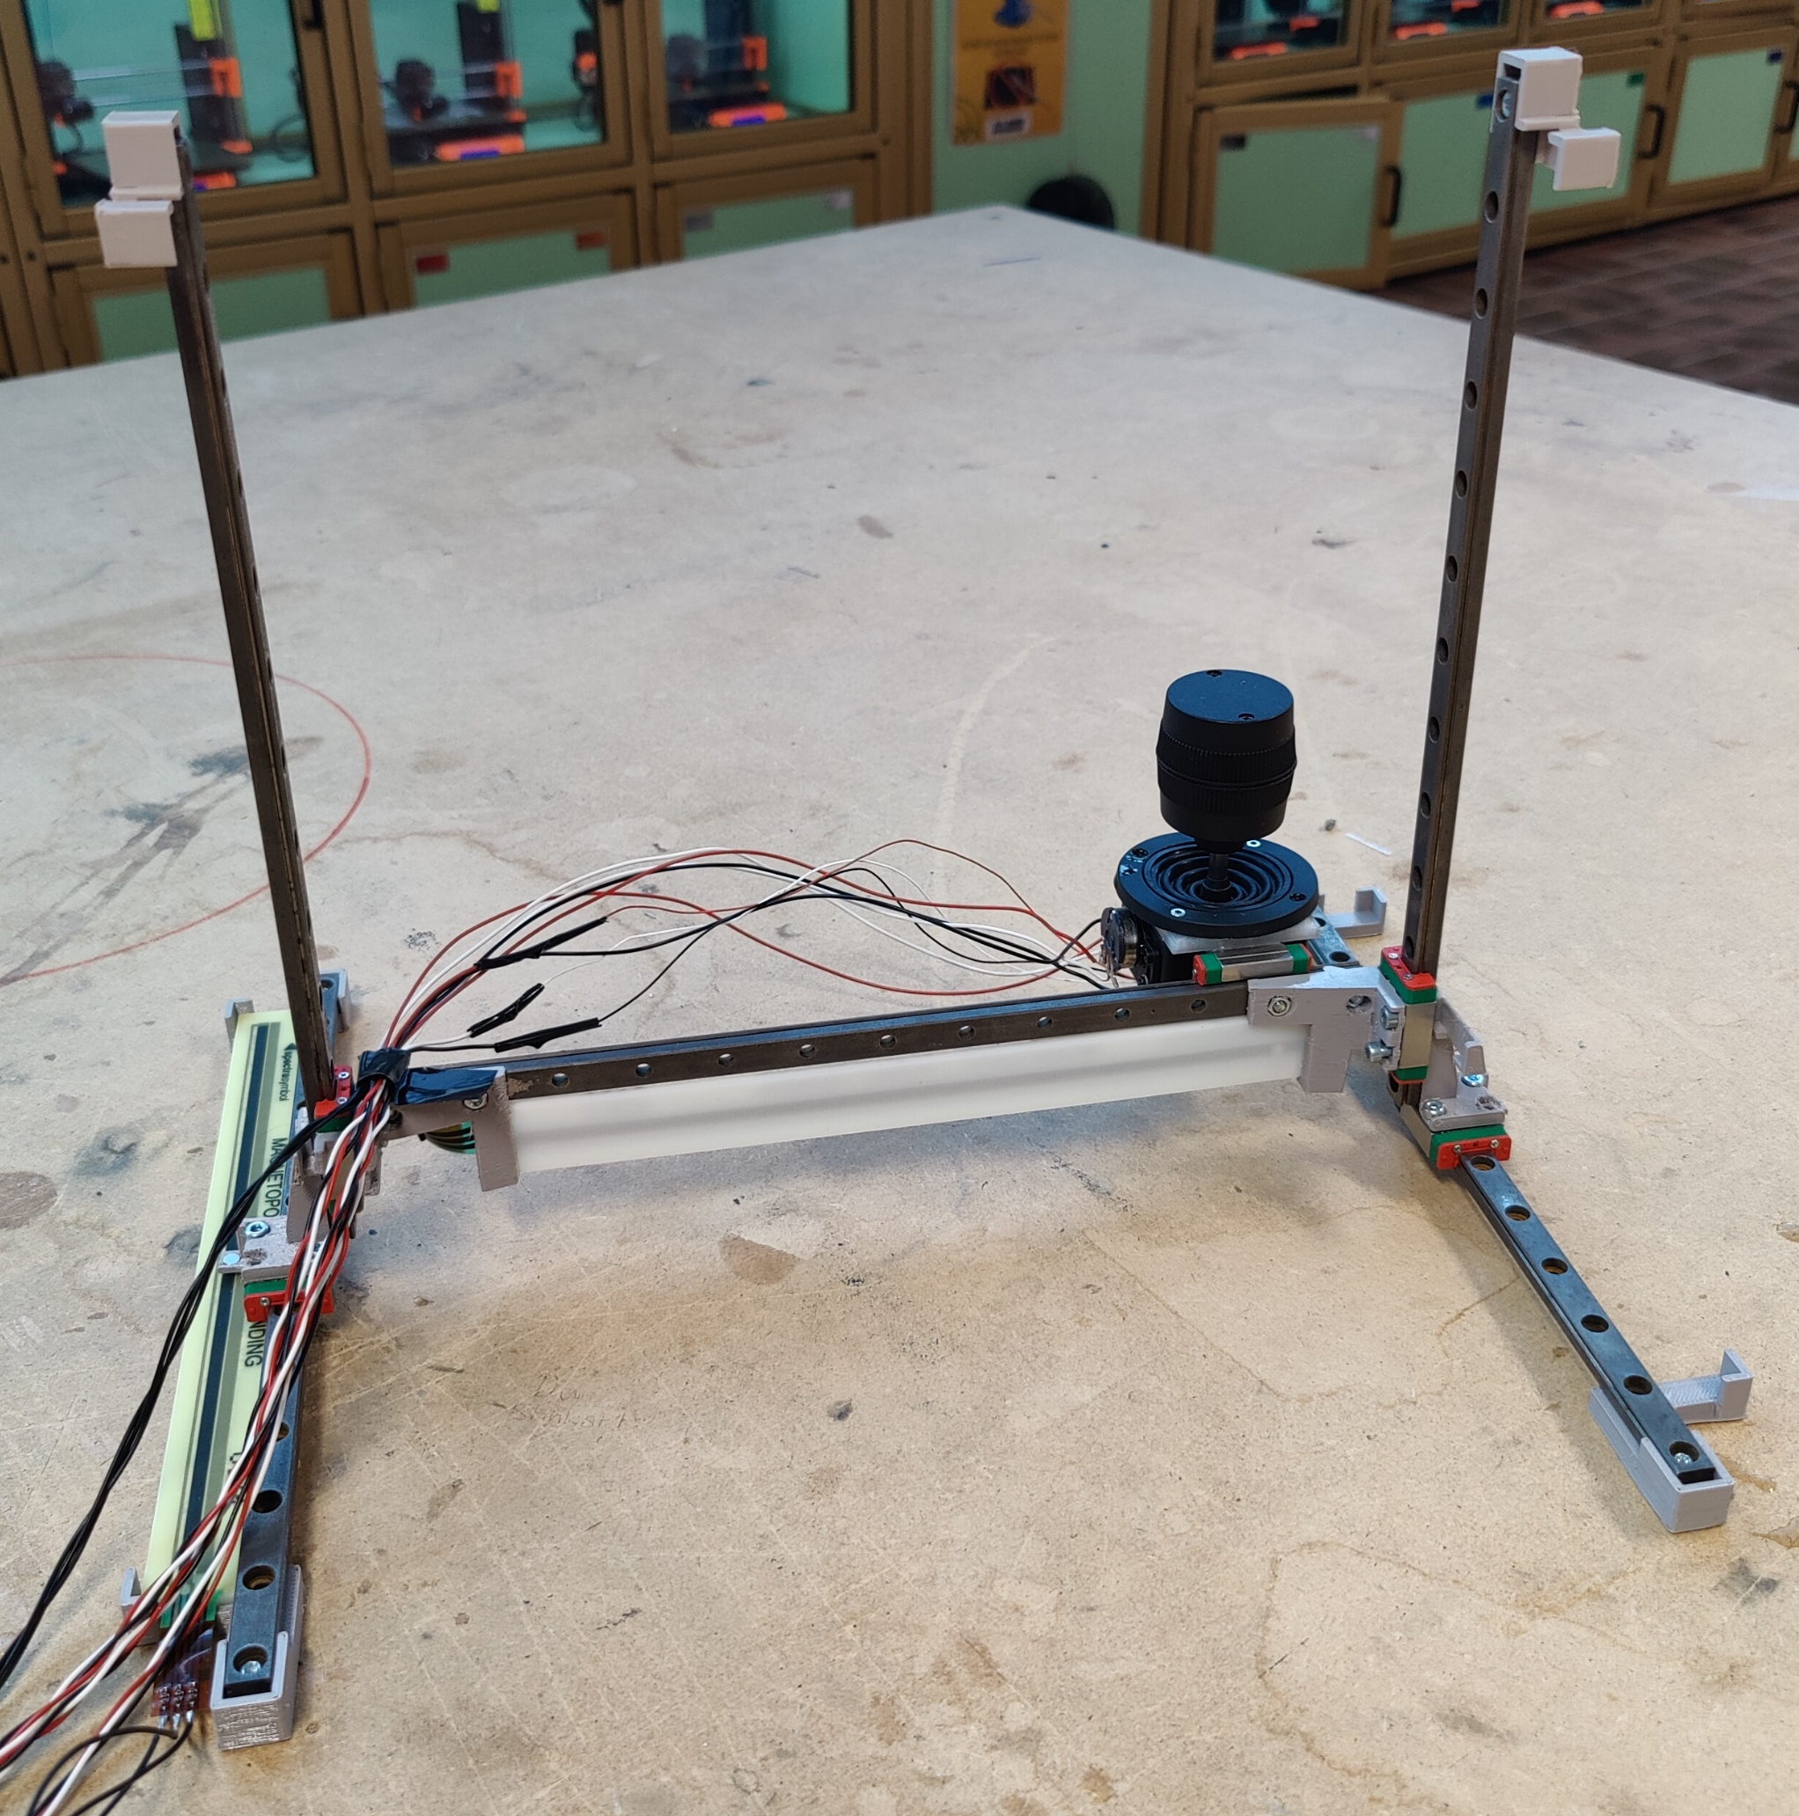
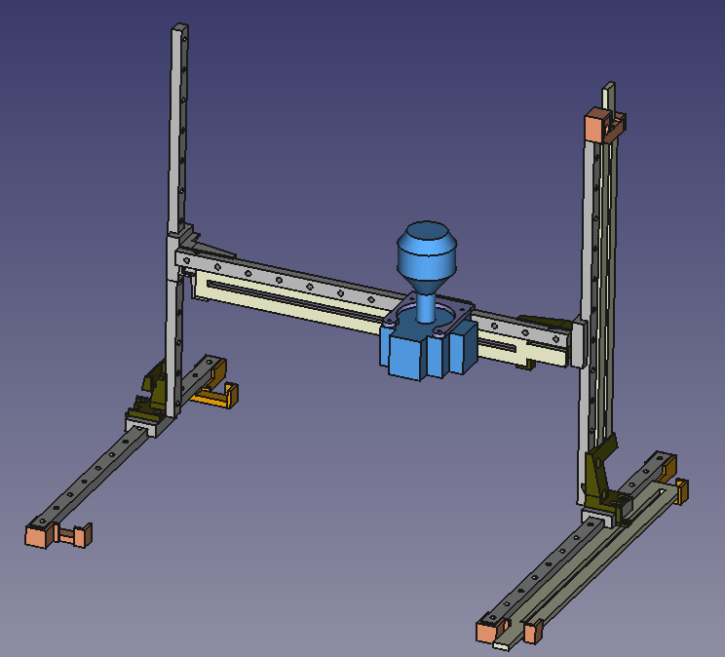
Current Progress
Translational Axes: X,Y functional
Rotational Axes X,Y,Z functional

Slide 6
Project Possibilities
Design of Rotational Joystick, Center of Rotation = Wrist
Implementation of End-Consumer grade Prototype for design evaluation
Research into the advantages/disadvantages of this type of controller

