Slide 1

ADVANCED DEEP LEARNING · FINAL REPORT
Facial Emotion Recognition
for Medicine and Art
Real-time recognition of seven facial expressions on Vietnamese faces, from data to a local application
Nguyễn Quang Trung (22011211) · Nguyễn Tiến Thành (22011103)
Advisor: Ph.D Minhhuy Le
Faculty of Electrical and Electronic Engineering, Phenikaa University · Hanoi, November 2026
Notes:
Final report of the facial emotion recognition project. Since the midterm the work moved from a course dataset to Vietnamese faces, a real-time application, and a clear use: helping professionals review recordings in medicine and in art.

Slide 2
Who needs facial emotion recognition?
MEDICINE
ART
Reading affect when patients cannot tell
Judging and finding emotional moments
Young children, people after a stroke, with dementia or in intensive care
Pain and distress show on the face
Facial behavior studied as a marker of depression
Hours of recorded therapy and telemedicine sessions
Does the actor's expression fit the scene?
Editors choose takes by the strength of a reaction
The emotional arc of an episode, the response of an audience
Finding every fearful moment of a 45-minute episode takes hours
Both are done by eye today: slow, subjective and rarely measured. A recognizer can do the tedious part; the professional checks the result.
Facial Emotion Recognition · Nguyễn Quang Trung, Nguyễn Tiến Thành
2 / 24
Notes:
Two fields read faces every day. In medicine, the face is often the only signal from patients who cannot say how they feel, and therapy and telemedicine sessions are recorded but rarely reviewed. In film and theatre, directors, editors and teachers judge expressions and hunt for emotional moments. Both are done by eye today.

Slide 3
Three problems for a Vietnamese user
01
02
03
Faces and data
Privacy
Trust
Public models learn mostly Western web photos or posed laboratory faces, and expressions differ between cultures. Vietnamese TV faces are hardly represented.
Commercial services send video to the cloud. Face images are personal data under Decree 13/2023/ND-CP; patient video must stay in the clinic.
Microsoft began retiring Azure's emotion recognition in 2022. A professional tool must show what it saw and say when it is unsure.
Task. For every face in a video, a webcam stream or an image, estimate the probabilities of seven expressions (angry, disgust, fear, happy, neutral, sad, surprise), in real time on a laptop, and help the user review long recordings.
Scope: facial expressions, not inner feelings. A research prototype that supports a professional, not a medical device.
Facial Emotion Recognition · Nguyễn Quang Trung, Nguyễn Tiến Thành
3 / 24
Notes:
Public models are trained mostly on Western faces, cloud services are a privacy problem for patient video, and vendors have withdrawn emotion recognition because of over-trust. The task is defined per face, in real time, on a laptop. The scope is expressions, not feelings.

Slide 4
Objectives of the final phase
01
02
03
Data
Models
Transfer
A Vietnamese TV face dataset, split by person, at least 1,000 faces per class
EmotionCNN, ResNet-18 and MobileNetV2 under one protocol, 3 seeds each
ImageNet → CK+ → target faces; CK+ tested on people never seen
04
05
06
Honest evaluation
Application
Responsible use
Accuracy only on human labels; model-suggested labels give agreement
≥ 10 analyzed frames/s at 1080p; seek, jump, own marks, whole-film scan
Local only, gray flags outside the training conditions, limits stated
Facial Emotion Recognition · Nguyễn Quang Trung, Nguyễn Tiến Thành
4 / 24
Notes:
Six objectives: a Vietnamese dataset split by person, a fair comparison of three networks, two-step transfer learning, honest evaluation on human labels only, a real-time application for long recordings, and responsible use.

Slide 5
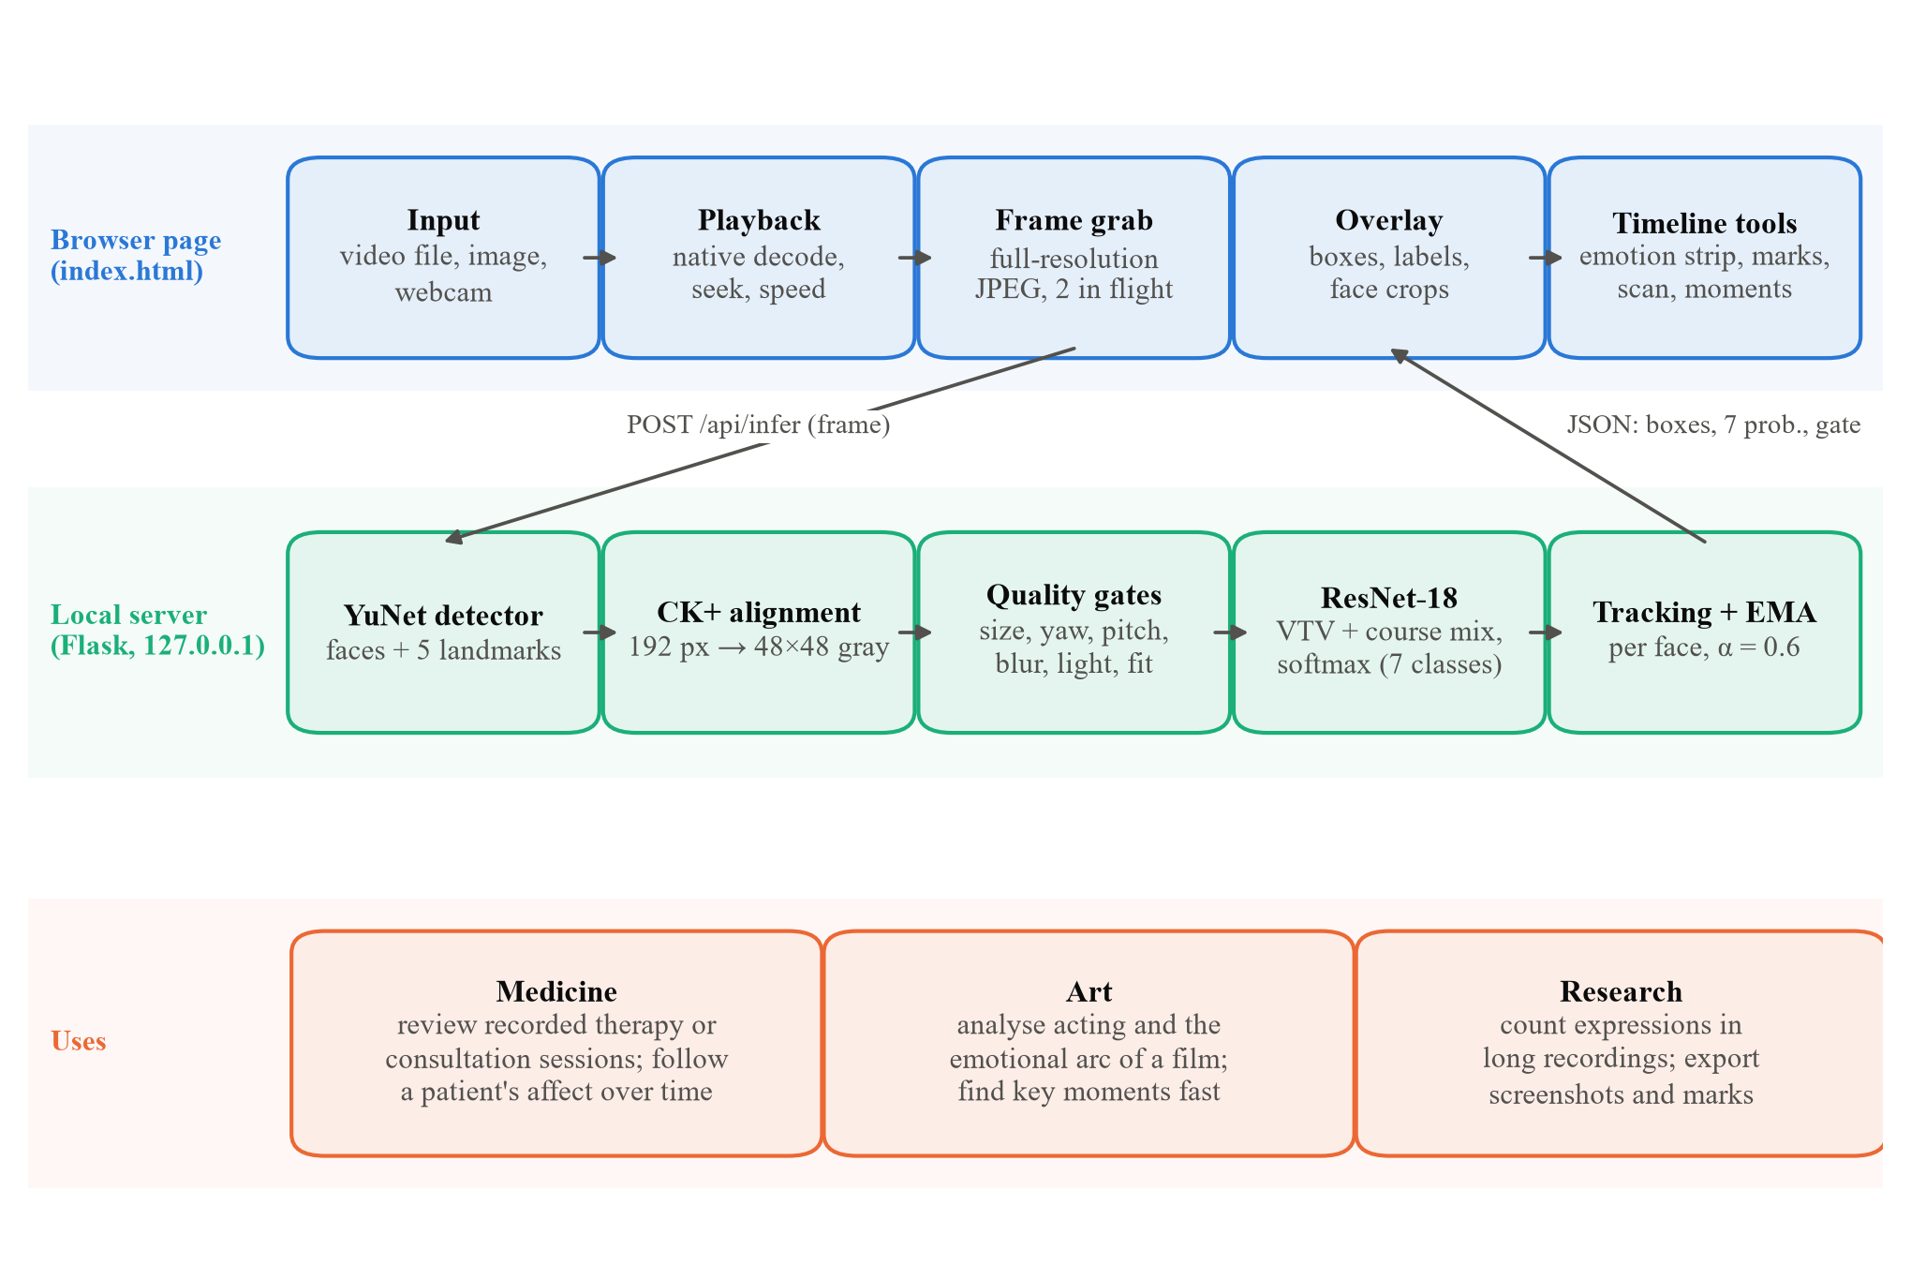
System overview
Browser page
Plays the file natively: seek, speed, own marks, scan. Sends two frames in flight.
Local server
YuNet → CK+ alignment → quality gates → ResNet-18 → tracking and smoothing.
Same pipeline as training
Faces are cut and aligned exactly like the training crops.
Runs on 127.0.0.1: no upload, no account.
Facial Emotion Recognition · Nguyễn Quang Trung, Nguyễn Tiến Thành
5 / 24
Notes:
The browser plays the file itself, so seeking and speed work like any video player. It sends frames to a local server that runs exactly the pipeline used to prepare the training faces: YuNet, alignment to the CK+ template, quality gates, ResNet-18, and smoothing per tracked face.

Slide 6
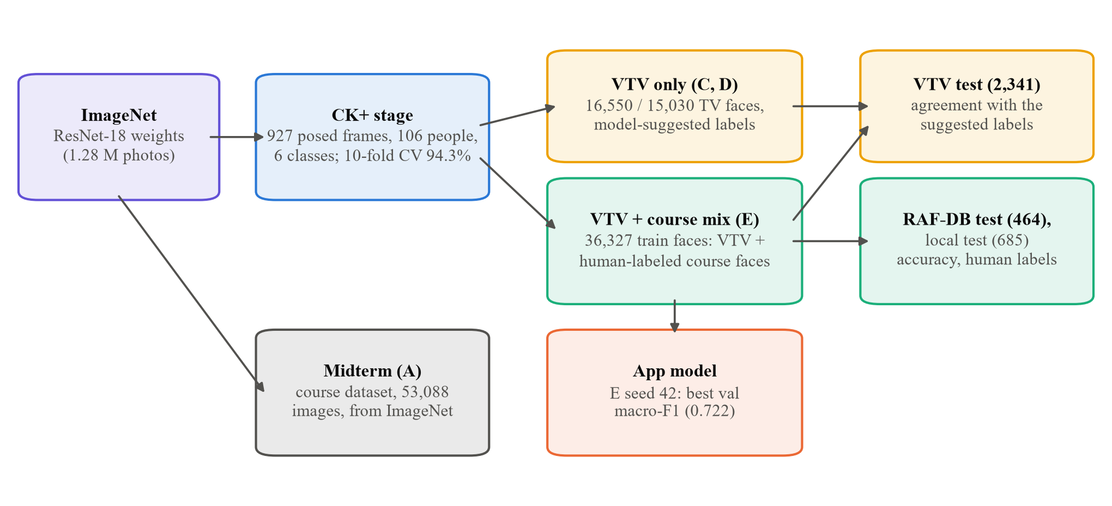
Training path: five stages
Transfer twice
ImageNet → CK+ posed expressions → target faces. Only the classifier is re-initialized (6 → 7 outputs).
Two-stage fine-tuning
3 epochs head only, then layer3 / layer4 / head at 5e-5 / 1e-4 / 5e-4; dropout 0.5, weight decay 5e-2.
Same protocol everywhere
Seeds 42, 123 and 2024; model chosen on validation macro-F1; each test set used once.
Facial Emotion Recognition · Nguyễn Quang Trung, Nguyễn Tiến Thành
6 / 24
Notes:
ImageNet gives general visual features, CK+ teaches clean posed expressions, and the target data adapts the model to TV faces and adds neutral. Stages A to E are the experiments of the next slides; E is the model of the application.

Slide 7
Stages A and B: ResNet-18 is the most stable
A · Course test set, 1,351 images, human labels
B · CK+ 10-fold CV by person, 927 images
Network | Accuracy (%) | Macro-F1
EmotionCNN | 68.02 ± 1.04 | 0.679
ResNet-18 | 68.32 ± 0.97 | 0.683
MobileNetV2 | 67.83 ± 0.88 | 0.678
Ensemble of 9 + flip TTA | 71.87 | 0.717
Network | Accuracy (%) | Macro-F1
EmotionCNN | 90.36 ± 1.18 | 0.867
ResNet-18 | 94.28 ± 0.39 | 0.926
MobileNetV2 | 93.38 ± 0.53 | 0.903
Tied on the course data: less than 0.5 points apart, smaller than the spread between seeds.
Clear posed faces are easy: 94.3% for ResNet-18 on people it never saw.
ResNet-18 varies least over seeds, so it carries stages C–E and the application.
Mean ± std over 3 seeds. CK+ has 6 classes (no neutral).
Facial Emotion Recognition · Nguyễn Quang Trung, Nguyễn Tiến Thành
7 / 24
Notes:
Stage A is the midterm: on the course test set the three networks are tied, and the nine-run ensemble with flip test-time augmentation reaches 71.9 percent. Stage B tests CK+ by person in ten folds: ResNet-18 reaches 94.3 percent with the smallest spread, so it is carried into stages C to E.

Slide 8
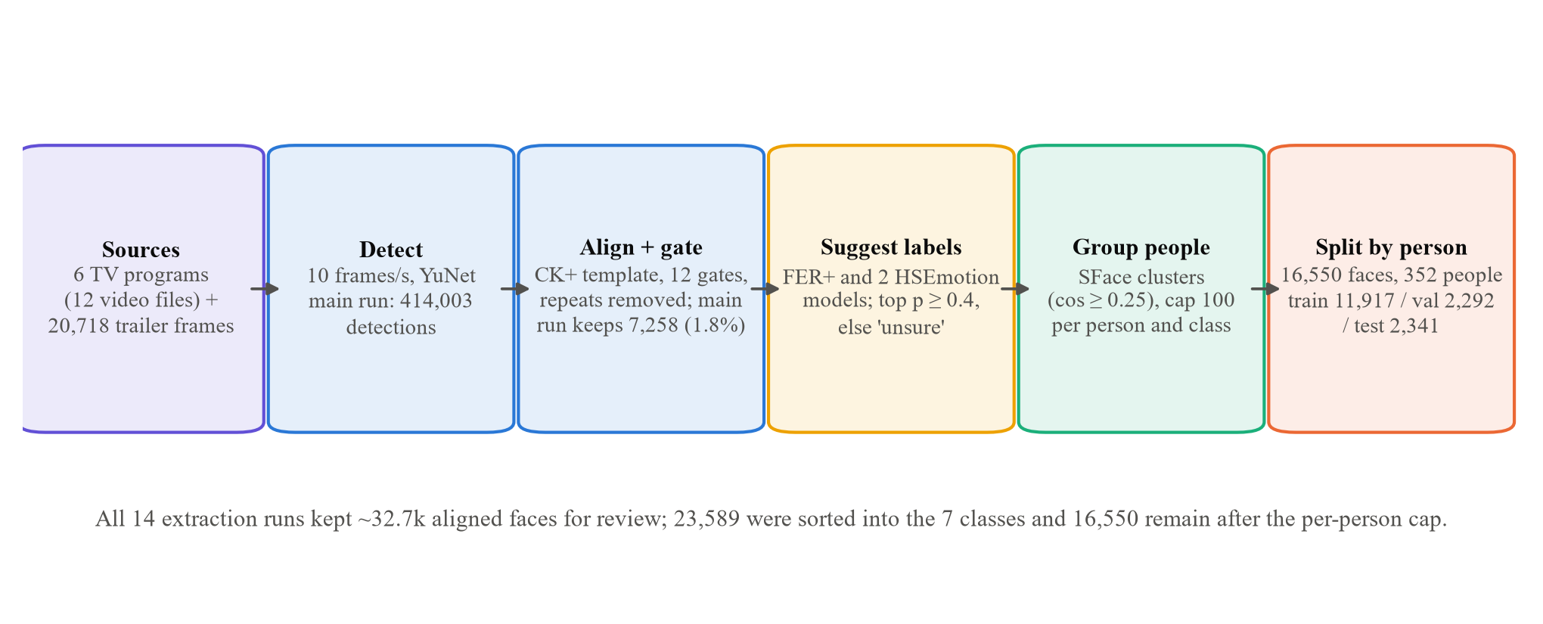
Building a Vietnamese TV face dataset
414,003
7,258
32.7k
16,550
faces detected in the main extraction run
passed every quality gate (1.8%)
aligned faces kept for review over 14 runs
faces of 352 people in the final build
Facial Emotion Recognition · Nguyễn Quang Trung, Nguyễn Tiến Thành
8 / 24
Notes:
Six programs and about 20 thousand trailer frames were sampled at ten frames per second. Most detected faces were too small, turned or repeated: in the main run only 1.8 percent passed every gate. After review folders and a cap per person, 16,550 faces of 352 people remain.

Slide 9
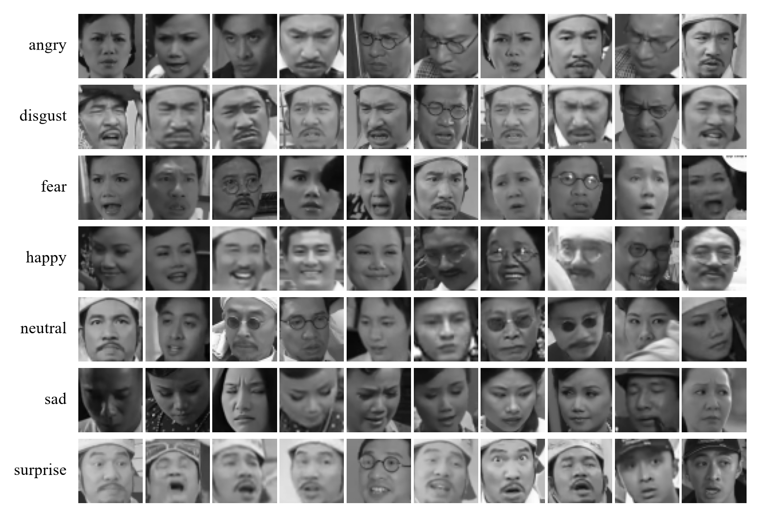
VTV dataset: 16,550 faces of 352 people
Class | Train | Val. | Test
angry | 788 | 149 | 156
disgust | 506 | 85 | 113
fear | 672 | 111 | 112
happy | 2,816 | 563 | 563
neutral | 4,629 | 926 | 926
sad | 1,920 | 364 | 364
surprise | 586 | 94 | 107
total (people) | 11,917 (247) | 2,292 (54) | 2,341 (51)
Train classes under 1,000 faces get 614 augmented copies; validation and test faces are all real. Leak check: 1.3% of test faces have five or more similar training faces.
Aligned 48×48 test faces per suggested class (random sample)
Facial Emotion Recognition · Nguyễn Quang Trung, Nguyễn Tiến Thành
9 / 24
Notes:
Neutral and happy dominate, as in real TV. Classes below one thousand faces got augmented training copies; validation and test are only real faces. The labels are model suggestions, explained next.

Slide 10
Keeping people and labels honest
ONE PERSON, ONE SPLIT
SUGGESTED LABELS
6% → 0%
FER+ alone → FER+ and two HSEmotion models, on faces prepared like the TV crops
of test faces had five or more near-identical training faces; the SFace clustering threshold went from 0.40 to 0.25
Accuracy on | FER+ alone | Ensemble
CK+ | 0.659 | 0.887
RAF-DB | 0.548 | 0.670
86%
of the test set was one comedy performer, until a cap of 100 faces per person and class
Faces with a top probability below 0.4 go to an “unsure” folder. On 48 RAF-DB faces the AI assistant's own eye scored 58%, below the ensemble (71%).
No person has checked these labels yet, so every VTV result is agreement, not accuracy.
Facial Emotion Recognition · Nguyễn Quang Trung, Nguyễn Tiến Thành
10 / 24
Notes:
Actors appear in many episodes, so faces are grouped by person with SFace embeddings. A threshold of 0.40 still leaked actors into the test set; 0.25 removed the leak. A cap per person stopped one performer from taking over the test set. Labels come from an average of three public models, which is much better than FER+ alone, but still unchecked.

Slide 11
Stages C and D: high agreement
Network | C: agreement (%) | C: macro-F1 | D: agreement (%) | D: macro-F1
EmotionCNN | 80.29 ± 1.73 | 0.731 | 77.31 ± 3.22 | 0.614
ResNet-18 | 83.64 ± 0.66 | 0.765 | 83.64 ± 0.66 | 0.701
MobileNetV2 | 80.21 ± 0.88 | 0.733 | 81.41 ± 0.85 | 0.663
VTV test set (2,341 faces of 51 people) · mean ± std over 3 seeds · agreement with the suggested labels
C: weakest classes
D: a screen that hurt
Lesson
Disgust 57% (taken for angry), fear 66%, surprise 74% (taken for fear): the classes with the fewest faces and the least reliable suggestions.
The AI assistant removed 1,844 doubtful faces. On 440 shared test faces ResNet-18 fell from 79.7% to 75.8%; surprise from 63–76% to 26–39%.
Removing faces emptied the rare classes instead of fixing their labels. C stayed the main VTV dataset.
Facial Emotion Recognition · Nguyễn Quang Trung, Nguyễn Tiến Thành
11 / 24
Notes:
Fine-tuned on the suggested labels, ResNet-18 agrees 83.6 percent with them. Disgust, fear and surprise are weakest. In D the AI assistant removed doubtful faces; models trained on that version agreed less on the faces both versions share, especially on surprise. Removing faces made the rare classes too small.

Slide 12
VTV-ONLY MODEL (D) ON HUMAN LABELS
53.4%
on RAF-DB test faces labeled by people: below the ensemble that made its labels (68.8%)
Surprise recall 11%, disgust 14%. The 83.6% agreement had hidden a weak model: it learned the suggesters' habits from a few hundred rare-class faces.
Facial Emotion Recognition · Nguyễn Quang Trung, Nguyễn Tiến Thành
12 / 24
Notes:
When the first demo looked weak on films, the model was scored on human-labeled RAF-DB faces prepared exactly like the TV crops. It reached only 53 percent, below its own label source. High agreement did not mean high accuracy; only human labels could show it.

Slide 13
Stage E: adding human-labeled faces
Source | Train | Val. | Test | Labels
VTV (Vietnamese TV) | 11,917 + 614 aug. | 2,292 | 2,341 | suggested
local (course) | 12,453 | 2,060 | 685 | human
RAF-DB | 8,049 | 1,396 | 464 | human
AffectNet | 2,538 | 441 | 153 | human
CK+ | 756 | 121 | 45 | human
total | 36,327 | 6,310 | 3,688
≈ 4,200
training faces per rare class, up from 500–800
unseen
RAF-DB and local test faces: each source keeps its own split
Real course faces (not their augmented copies) are aligned with the CK+ template, like the TV faces, so training and the application see the same crops.
3 × 23 epochs
≈ 29 min per seed on the laptop; best epochs 14–17
Facial Emotion Recognition · Nguyễn Quang Trung, Nguyễn Tiến Thành
13 / 24
Notes:
The fix: train on the TV faces together with the real faces of the course dataset, all aligned the same way. The rare classes grow about six times. Each source keeps its own split, so the RAF-DB and local test faces stay unseen. Three full seeds were trained on the laptop.

Slide 14
VTV + COURSE MIX (E), 3 SEEDS
79.4%
on the same human-labeled RAF-DB test faces (macro-F1 0.713), up from 53.4%
Surprise recall 11% → 81%, disgust 14% → 49%, angry 30% → 65%, sad 59% → 91%. Local test faces 41.6% → 60.8%. Part of the gain is in-distribution: E trained on other RAF-DB and local faces.
Facial Emotion Recognition · Nguyễn Quang Trung, Nguyễn Tiến Thành
14 / 24
Notes:
With human-labeled faces in training, accuracy on human labels rises by 26 points, and the rare emotions recover. The caveat is fair to state: model E has seen other faces from the same sources, model D had not.

Slide 15
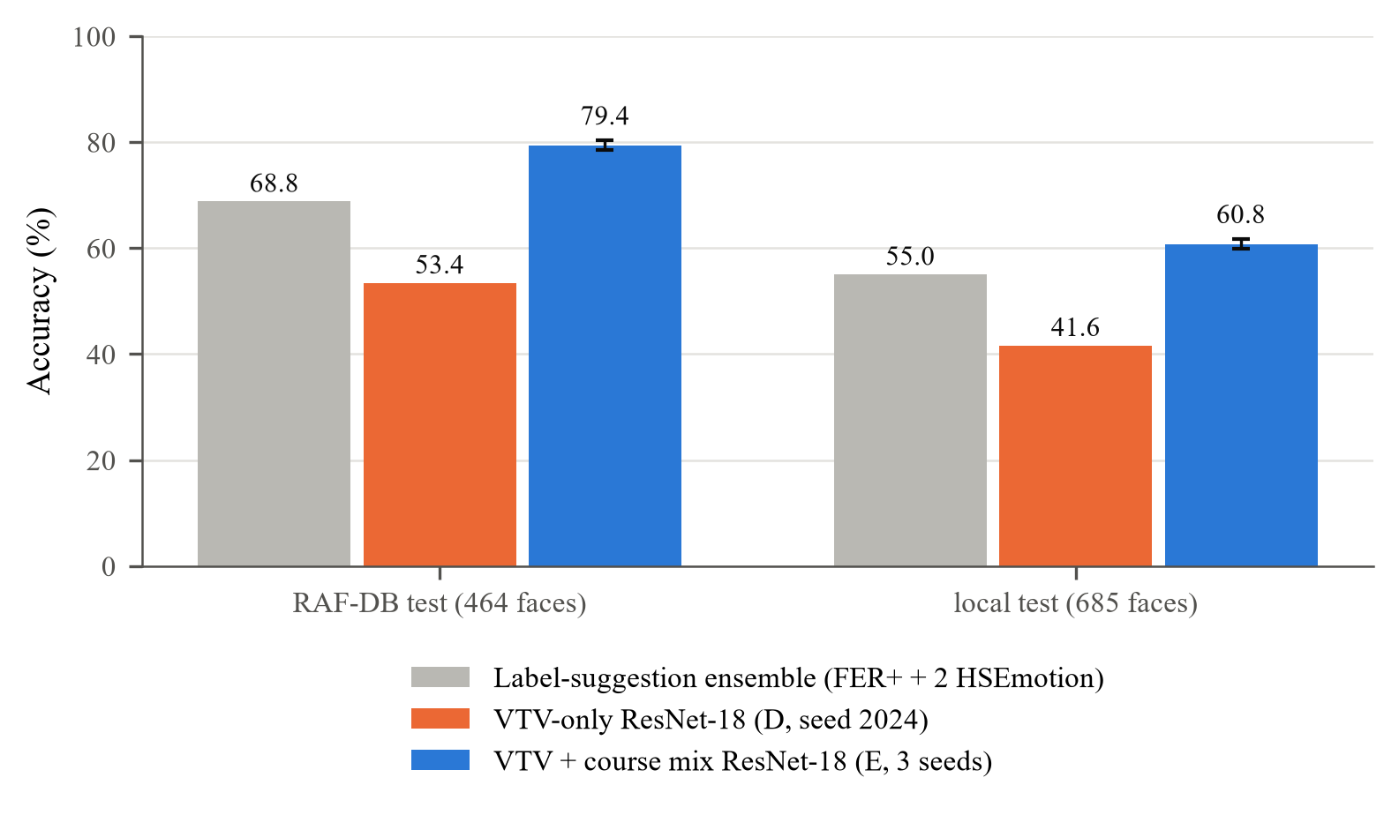
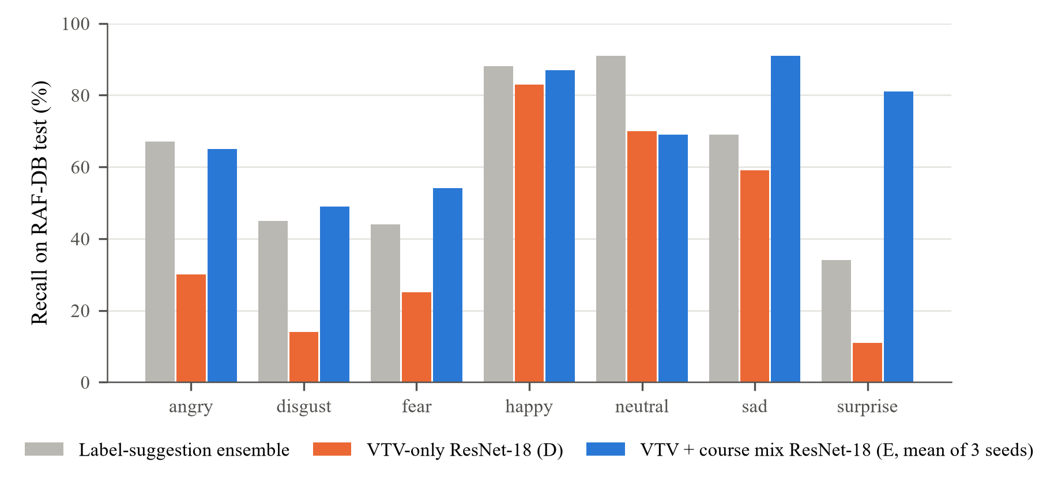
Accuracy on human labels
Accuracy on human-labeled test faces (std over 3 seeds)
Recall per class on the 464 RAF-DB test faces
RAF-DB: suggestion ensemble 68.8%, VTV-only 53.4%, mix 79.4%
Rare classes recover: surprise 11 → 81%, disgust 14 → 49%
Local test faces stay harder: 60.8% (ensemble 55.0%)
Facial Emotion Recognition · Nguyễn Quang Trung, Nguyễn Tiến Thành
15 / 24
Notes:
Left: on both human-labeled test sets, the mix model is above the suggestion ensemble and far above the VTV-only model. Right: recall per class on RAF-DB; the gains are largest on surprise, disgust, angry and sad.

Slide 16
All stages at a glance
Stage | Test data | Labels | Accuracy / agreement (%) | Macro-F1
A Midterm | Course test, 1,351 | human | 68.32 ± 0.97 (ensemble 71.87) | 0.683
B CK+ CV | CK+, 927 (10 folds) | human | 94.28 ± 0.39 | 0.926
C CK+ → VTV | VTV test, 2,341 | suggested | 83.64 ± 0.66 | 0.765
D CK+ → VTV screened | RAF-DB test, 464 | human | 53.4 (seed 2024) | 0.391
E CK+ → mix | RAF-DB test, 464 | human | 79.4 ± 0.9 | 0.713
E CK+ → mix | local test, 685 | human | 60.8 ± 0.9 | 0.610
E CK+ → mix | VTV test of C, 2,341 | suggested | 82.44 ± 1.24 | 0.748
Suggestion ensemble | RAF-DB / local test | human | 68.8 / 55.0 | 0.590 / 0.538
Only rows with human labels are accuracy; suggested rows are agreement with the label-suggestion ensemble.
ResNet-18 unless noted · mean ± std over 3 seeds
Facial Emotion Recognition · Nguyễn Quang Trung, Nguyễn Tiến Thành
16 / 24
Notes:
Only the rows with human labels are accuracy. The VTV rows measure agreement with the suggestion ensemble. On the VTV test set E agrees slightly less than C, because it learned from human labels that differ from the ensemble's habits; on human labels it is far ahead.

Slide 17
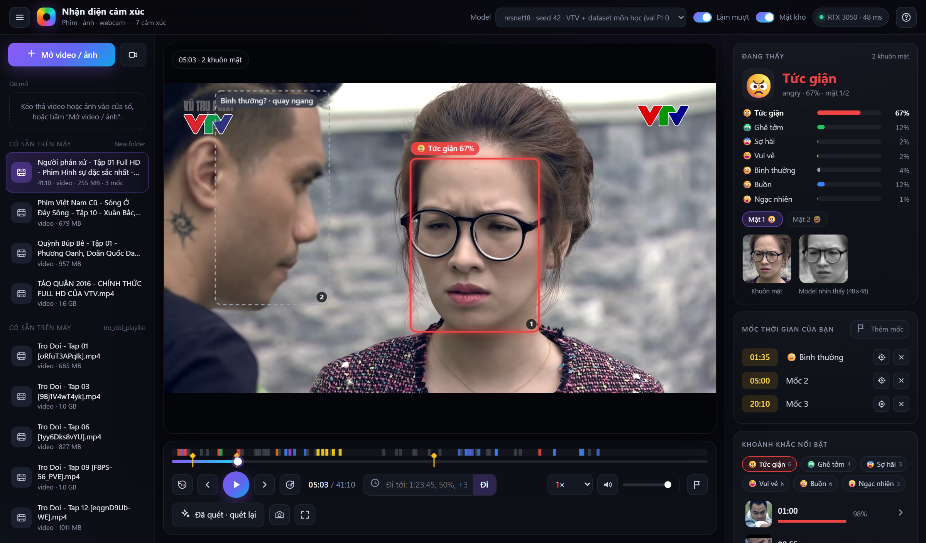
The application
Open anything: video, image or webcam; drag and drop
Jump to any time: 1:23:45, 83:20, 50%, +30
Own time marks with labels, saved per file
Whole-film scan: emotion strip and strongest moments
Gray faces: outside the training conditions
48×48 crop the model actually saw
Screenshot with boxes for a case note or log
Người Phán Xử, 41-minute episode after a whole-film scan (interface in Vietnamese)
Facial Emotion Recognition · Nguyễn Quang Trung, Nguyễn Tiến Thành
17 / 24
Notes:
The application after a whole-film scan of a 41-minute episode. The timeline is colored by the scanned emotions and carries the user's marks; the panel shows the seven probabilities, the face crop next to the 48 by 48 crop the model saw, and the strongest moments per emotion. A gray box marks a face outside the training conditions.

Slide 18
Real time on a laptop GPU
First version
one frame at a time · ≈ 8 fps
encode
server
send, draw
encode
server
send, draw
encode
server
send, draw
Now: two frames in flight
browser · encodes frame n+1
encode
encode
encode
encode
encode
encode
server · analyzes frame n
server
server
server
server
server
≈ 15–17 fps
0 ms
100 ms
200 ms
300 ms
encode: JPEG of the full 1080p frame in the browser (≈ 40 ms) · server: detect, align, gates, ResNet-18 for every face (≈ 46–49 ms)
15–17 fps
2.6 ms
70 s
43 MB
analyzed on 1080p films (13 with many faces)
per face for ResNet-18 on the GPU (17 ms on the CPU)
to scan a 41-minute episode at one frame every 10 s
model checkpoint; everything runs offline
Facial Emotion Recognition · Nguyễn Quang Trung, Nguyễn Tiến Thành
18 / 24
Notes:
The first version sent one frame and waited: about 8 analyzed frames per second. Now two frames are in flight, so the browser encodes the next frame while the server analyzes the current one, and the rate is set by the slowest stage: 15 to 17 frames per second on 1080p films. The network itself takes only 2.6 ms per face.

Slide 19
Built for review work in medicine and art
Function | Medicine | Art
Live view with probabilities | Follow a patient's expressions in a video consultation (with consent) | Feedback for an actor rehearsing in front of a webcam
Whole-file scan + emotion strip | Overview of affect across a recorded therapy session | Emotional arc of an episode; compare scenes or takes
Strongest moments per emotion | Jump to moments of distress for review | Find the strongest reactions for editing or teaching
Own time marks with labels | Clinician's notes at time points | Editor's or director's cue list
Gray faces and 48×48 crop | Shows when not to trust the output | Shows when lighting or angle defeats the model
Screenshot with boxes | Evidence for a case note | Material for a scene analysis
Use on people needs their informed consent. The output supports the professional and never replaces them.
Facial Emotion Recognition · Nguyễn Quang Trung, Nguyễn Tiến Thành
19 / 24
Notes:
Each function maps to a concrete task. The scan gives the overview of a recorded session or an episode, the moment list leads to the strongest expressions, marks hold the professional's notes, and the gray flags and the model crop show when not to trust the output.

Slide 20
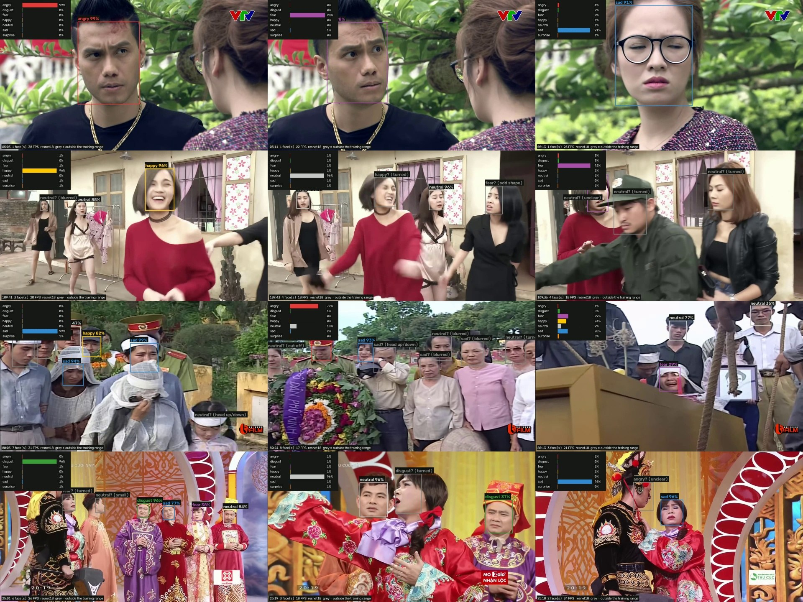
On Vietnamese programs
Close-ups work best
Frontal faces with clear expressions get confident labels.
Gray boxes
Turned, small or blurred faces: outside the training conditions, the label is only a guess.
Crowds and stage make-up
Many gray faces in crowd scenes and comedy stage shows.
A fair test is still to come
These programs also supplied training faces; a film outside the dataset is a fairer test.
Frames annotated by the demo (first stage E run)
Facial Emotion Recognition · Nguyễn Quang Trung, Nguyễn Tiến Thành
20 / 24
Notes:
Frames annotated by the demo on four programs. Close-ups get confident labels; crowd scenes and stage make-up give many gray faces. These programs also supplied training faces, so a film outside the dataset would be a fairer test.

Slide 21
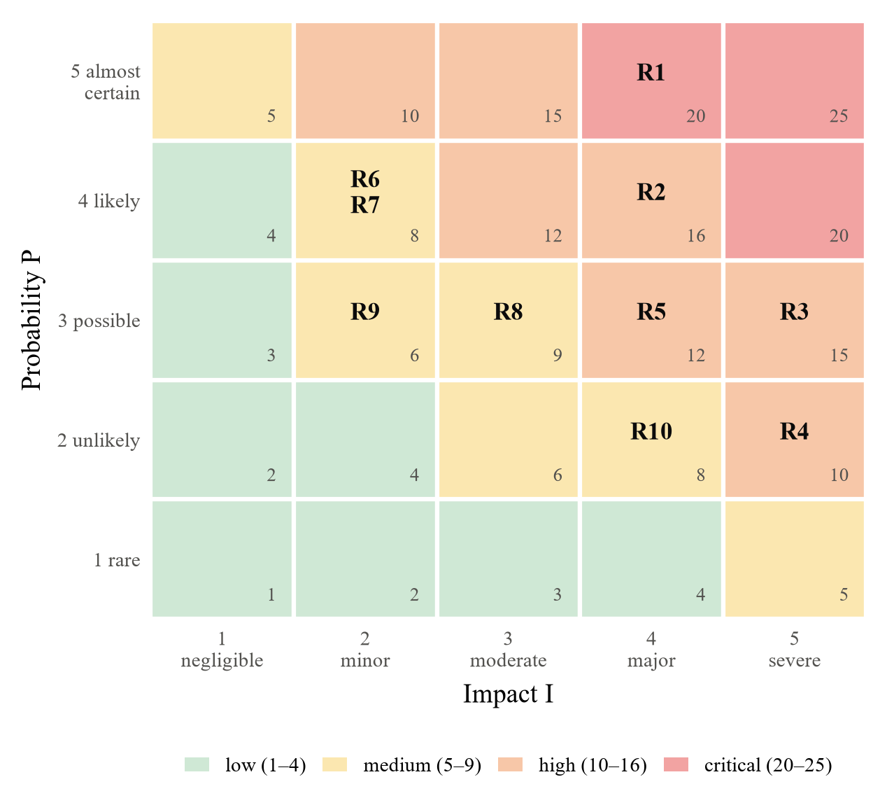
Risks and how they are handled
ID | Risk | S | Mitigation
R1 | Noisy TV labels | 20 | Human review; human-checked TV test subset; human-labeled faces in training (E)
R2 | Domain shift in use | 16 | Quality gates with gray flags; pilot on consented local data
R3 | Misuse or over-reading | 15 | Probabilities and model crop always shown; no work or school use
R5 | Bias | 12 | Measure accuracy by age, gender and skin tone; add data
R4 | Privacy breach | 10 | Server on 127.0.0.1; no upload; consent for recordings
S = probability × impact (1–5 each): 20–25 critical, 10–16 high
Facial Emotion Recognition · Nguyễn Quang Trung, Nguyễn Tiến Thành
21 / 24
Notes:
Ten risks were scored as probability times impact. The critical one is the noisy TV labels; then domain shift in real use, over-interpretation or misuse, bias and privacy. The table gives the mitigation of each.

Slide 22
Responsible use
Not a medical device
Local only
The output supports a clinician and never replaces one. Clinical use would need IEC 62304, ISO 14971 and a validation study.
Server bound to 127.0.0.1; no upload, no account. Face images are personal data under Decree 13/2023/ND-CP and Law 91/2025/QH15.
Medicine and art, not monitoring
Honest numbers and tools
The EU AI Act bans emotion recognition at work and in schools, except for medical or safety reasons. Those uses are out of scope.
Accuracy only on human labels. AI assistance (Claude Code) is disclosed. Guided by IEEE 7000 and IEEE 7014-2024 (emulated empathy).
Facial Emotion Recognition · Nguyễn Quang Trung, Nguyễn Tiến Thành
22 / 24
Notes:
The system is a research prototype. It stays on the computer, it is aimed at medicine and art, which the EU AI Act keeps open while it bans emotion recognition at work and in schools, and the numbers are reported honestly, including the help of an AI coding assistant.

Slide 23
Conclusion and next steps
What we found
Next
ResNet-18: 68.3% on the course test set, 94.3% on CK+ people it never saw
16,550 Vietnamese TV faces of 352 people, split by person
Human labels exposed a weak model (53%); the mix model reaches 79.4% on RAF-DB
A local app: any file, any time, own marks, whole-film scan, 13–17 fps
Human review of the TV labels, then retrain
Grad-CAM: do the models look at eyes, brows and mouth?
A faster MobileNetV2 mix model; more real rare-class faces
Valence, arousal and intensity outputs
Pilots with clinicians and film professionals, with consent
Facial Emotion Recognition · Nguyễn Quang Trung, Nguyễn Tiến Thành
23 / 24
Notes:
In short: ResNet-18 is the best and most stable network; a Vietnamese TV dataset now exists; measuring on human labels exposed a weak model and the mix fixed it; and the application is ready for review work. The first next step is human review of the TV labels.

Slide 24
Thank you
Questions?
Nguyễn Quang Trung (22011211) · Nguyễn Tiến Thành (22011103) · Advisor: Ph.D Minhhuy Le
Notes:
Thank the audience; offer a live demo of the application.

