Slide 1

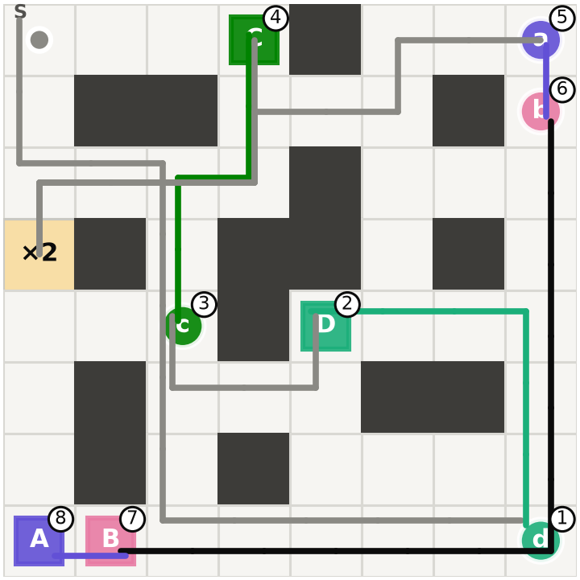
PHENIKAA UNIVERSITY
School of Engineering and Technology · Faculty of Electrical and Electronic Engineering
COURSE PROJECT · REINFORCEMENT LEARNING · TOPIC 13
Multi-Delivery Robot
A robot that learns its own pickup and delivery order with tabular Q-learning, SARSA and Monte Carlo ES, on four levels from easy to very hard
Level 4, learned route: 67 steps, return 13 = optimal
Student Nguyen Quang Trung · 22011211 · K16 AI&RB
Major Electrical and Electronic Engineering
Supervisor MSc. Vu Hoang Dieu
Hanoi, November 2026
Notes:
Introduce the topic: a robot on a grid has to pick up several parcels and deliver each to its own cell, and it learns the order by itself. The environment is a custom gymnasium environment based on Taxi. Three tabular methods are compared on four levels of increasing difficulty; no neural network is used. The picture is the route Q-learning learned on the hardest level.

Slide 2
At a glance: all three methods learn the optimal order
4
15,612
60 / 60
0
levels, from easy (5×5, 2 parcels) to very hard (8×8, 4 parcels, deadline, ×2 cell)
reachable states on level 4, out of 357,696 encoded
runs reach 100% accuracy (3 algorithms × 4 levels × 5 seeds)
wrong states for Q-learning and MC ES when started anywhere
What the talk covers
1
The task and the MDP
4
Results and comparison
2
The four levels
5
Where the robot goes wrong
3
Three algorithms and their settings
6
Demo of the app, conclusion
Notes:
The main message first: on every level, all three tabular methods end with the optimal delivery order from every start cell. The next slides explain the task, the levels, the algorithms, the results, the remaining mistakes and the app.

Slide 3
The task: pick up and deliver every parcel
S
Grid with walls; the robot starts at cell S
Rewards
Event | Reward
Each step (also into a wall) | −1
Correct delivery of one parcel | +20
Wrong Pickup or Drop | −10
Deadline parcel late (once) | −30
a
Each parcel has a pickup cell (circle, lowercase) and a drop cell (square, uppercase)
6
Actions: Up, Down, Left, Right, Pickup, Drop
✓
Success: every parcel delivered. Failure: max_steps runs out
The −1 per step makes short routes better; −30 only exists on levels 3 and 4.
Notes:
The robot only sees its cell, the status of each parcel and, on the harder levels, a deadline clock and a booster flag. Minus one per step pushes toward short routes, plus twenty per delivered parcel, minus ten for a wrong Pickup or Drop, and minus thirty once if the deadline parcel is late.

Slide 4
One state = cell + parcels + clock + booster
s = (row, col, σ₁ … σN, τ, b)
σᵢ ∈ {0, 1, 2}: parcel i is waiting, carried or delivered
τ: steps toward the deadline; without it the same cell could have two different futures
b ∈ {0, 1, 2}: ×2 cell unused, active or used up; without it Pickup would depend on the past
encode(s): one integer, the row of the Q table (the state code)
Notes:
Every state is a tuple. The statuses of the parcels say what is waiting, carried or delivered. Two extra variables keep the state Markov: the deadline clock tau and the booster flag b. encode packs the tuple into one integer, which is the row of the Q table. Far fewer states are reachable than encoded: 186 on level 1 up to 15,612 of 357,696 on level 4.

Slide 5
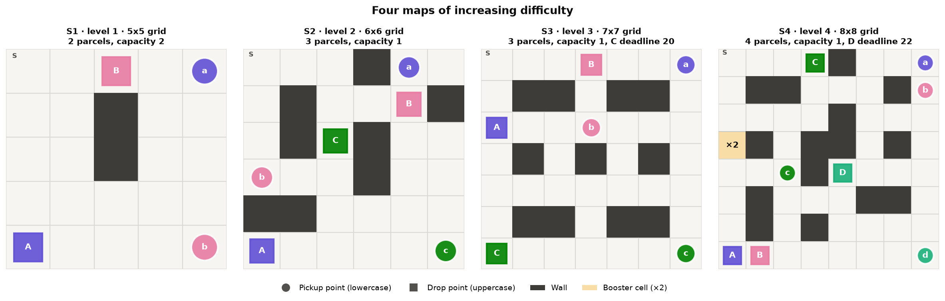
Four levels: each one adds a new mechanic
Level 1 · Easy
Level 2 · Medium
Level 3 · Hard
Level 4 · Very hard
5×5 · 2 parcels, carry both
6×6 · 3 parcels, carry 1: order matters
7×7 · parcel C within 20 steps
8×8 · 4 parcels, D within 22 steps, ×2 cell
Notes:
Each level adds one mechanic to the one before. Level 1: two parcels that can be carried together. Level 2: three parcels and only one at a time, so the order matters. Level 3: parcel C must arrive within 20 steps. Level 4: four parcels, a 22-step deadline for D and a x2 cell that lets the robot carry two parcels for one trip. Each map is a JSON file, so a level can be changed without touching the code.

Slide 6
The optimal route of each level (Value Iteration)
Level | Optimal order | Steps | Return | What the robot has to work out
1 · Easy | A → B | 22 | 18 | Pick up a and b, carry both, deliver A then B
2 · Medium | B → A → C | 36 | 24 | One parcel at a time: B first because b is on the way
3 · Hard | C → B → A | 44 | 16 | C first, delivered at step 20, exactly on the deadline; B → A → C would be 4 steps shorter but late
4 · Very hard | D → C → B → A | 67 | 13 | D first (step 22, on the deadline), then C, the ×2 cell at step 39, A and B together
Trade-offs a nearest-parcel rule would miss: the far deadline parcel comes first, and the detour to the ×2 cell saves 8 steps (67 instead of 75).
Notes:
Value iteration gives the exact optimum, so every learned policy can be checked against it. On level 3 the robot goes straight to C and delivers it at step 20, exactly on the deadline. On level 4 it delivers D at step 22, then C, switches the x2 cell on at step 39, picks up A and B and delivers both: 67 steps, return 13. Without the x2 cell the best route needs 75 steps.

Slide 7
Three tabular algorithms, one Q table each
QL
Q-learning
SA
SARSA
MC
Monte Carlo ES
y = r + γ maxₐ′ Q(s′, a′)
y = r + γ Q(s′, a′)
Gₜ = rₜ₊₁ + γ Gₜ₊₁
Q(s,a) ← Q(s,a) + α [target − Q(s,a)]
Q(s,a) ← Q(s,a) + α [target − Q(s,a)]
Q(s,a) ← Q(s,a) + α [target − Q(s,a)]
Off-policy: learns Q* while exploring
α = 1 · ε: 1 → 0.01
On-policy: a′ is the action it really takes next
α: 0.5 → 0.1 · ε: 1 → 10⁻⁵
Greedy (ε = 0): explores only through exploring starts
α = 1: Q = the latest return
Shared: exploring starts (random reachable state + random first action) · γ = 0.99 · 5 seeds · training loops compiled with numba (about 170× faster)
Notes:
All three keep a Q table and act greedily after training; they differ only in the update target. Q-learning bootstraps with the best next action, so it learns Q-star while it explores. SARSA uses the action it will really take, so it learns the value of its own epsilon-greedy policy and only matches Q-star when epsilon is almost zero. Monte Carlo ES waits for the end of the episode; with a greedy policy in a deterministic world the return is exact.

Slide 8
Training settings: how long each method needs
1
Exploring starts
random reachable state + random first action, so every (s, a) gets updated
2
ε per algorithm
Q-learning → 0.01, SARSA → 10⁻⁵, MC ES greedy
3
Step size α
Q-learning and MC ES: 1; SARSA 0.5 → 0.1
4
Episodes
100k on level 1 up to 6M on level 4
Result: 100% on every level, every algorithm, 5/5 seeds
Notes:
Four settings make all three methods work. Exploring starts are the key: the deadline clock and the booster multiply the states, and starting each episode from a random reachable state with a random first action updates every state-action pair directly. Epsilon is chosen per algorithm, alpha matches the noise of the target, and there are enough episodes. The chart shows how many episodes each method needs before its accuracy first reaches 100%: Q-learning is fastest on three levels, Monte Carlo ES on level 3, and SARSA needs the most, about three times Q-learning on level 4.

Slide 9
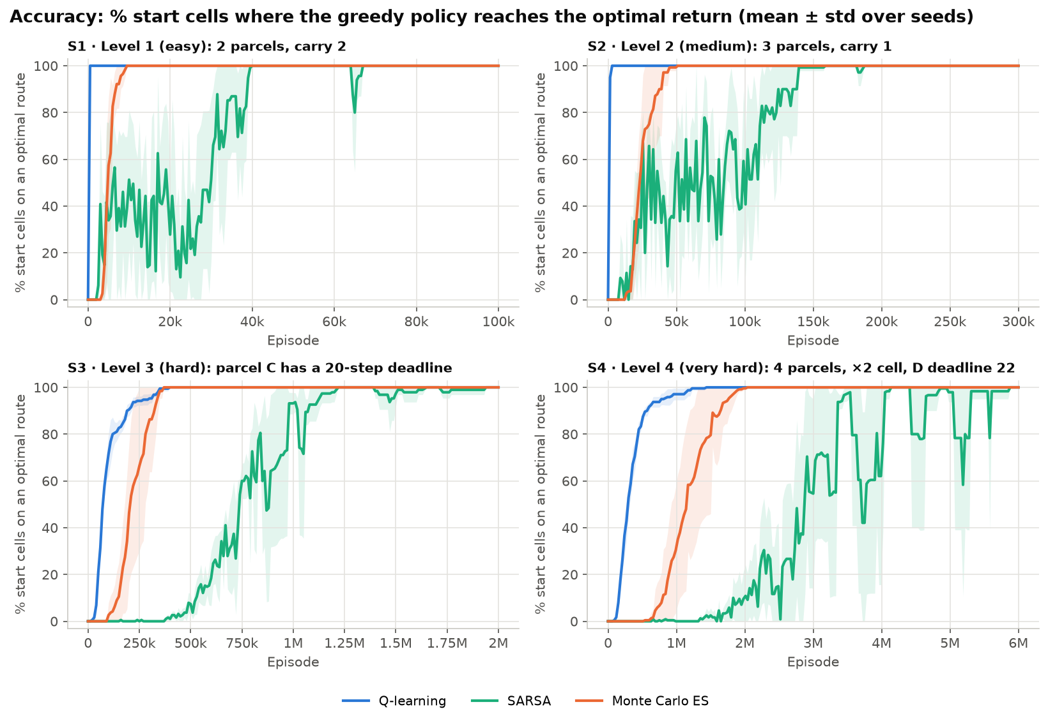
Accuracy: all three reach 100% on every level
60 / 60
runs end at 100% accuracy and the optimal return from S
1.14 M
episodes Q-learning needs on level 4 (median), the fastest
3.57 M
episodes SARSA needs on level 4, about 3× Q-learning
Notes:
Accuracy is the share of start cells from which the greedy policy reaches the optimal return of value iteration. All 60 runs end at 100%. Q-learning gets there first on three levels, Monte Carlo ES is slightly faster on level 3, and SARSA is the slowest and still dips after first reaching 100%.

Slide 10
Comparing the three algorithms
 | Q-learning | SARSA | Monte Carlo ES
Learns the value of | the optimal policy (off-policy) | its ε-greedy policy (on-policy) | its greedy policy
Episodes to 100% on level 4 | 1.14 M | 3.57 M | 1.74 M
Mean accuracy while learning (L1 → L4) | 0.99 / 0.99 / 0.95 / 0.94 | 0.77 / 0.77 / 0.60 / 0.48 | 0.95 / 0.91 / 0.89 / 0.80
Drops below 100% after reaching it | never | 9–19% of checks | never
Final mean |Q − Q*| | 0 | 0.001 – 0.047 | 0
Wrong if started anywhere (L3 / L4) | 0 / 0 | 0.3% / 1.8% | 0 / 0
Time per seed on level 4 | 38 s | 23 s | 38 s
Medians over 5 seeds. Q-learning is the fastest and most stable; MC ES is second; SARSA is slowest and still slightly off in a few states.
Notes:
Since all three reach the optimum, the comparison is about speed, stability and robustness. Q-learning learns Q-star from every step and its target has no noise, so it is the fastest and the most stable. Monte Carlo ES is slower at the start but exact once converged; it depends completely on exploring starts. SARSA's target depends on the sampled next action, so it needs about three times the episodes and keeps fluctuating.

Slide 11
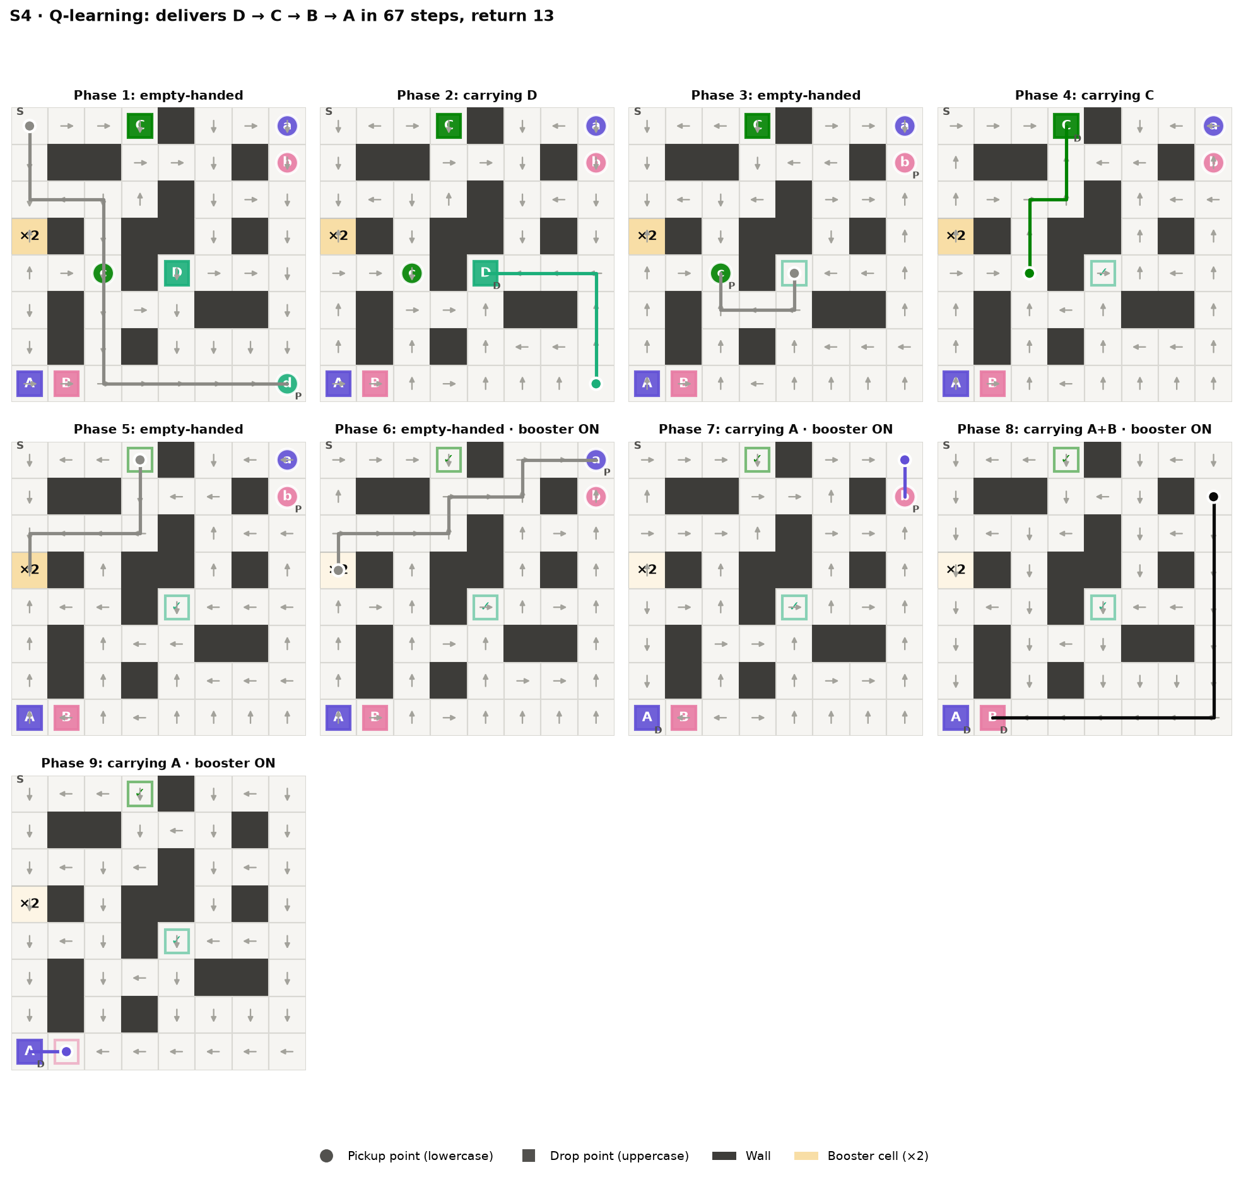
Level 4 policy: deadline first, then the ×2 cell
1
Pick up d in the bottom-right corner
2
Deliver D in the middle at step 22, on the deadline
3
Pick up c, deliver C on the top row
4
Go down to the ×2 cell: carry 2 from now
5
Pick up a, then b, in the top-right corner
6
Deliver B, then A, in the bottom-left corner
67 steps, return 13 = optimal
Notes:
Each panel is one phase: a combination of parcel statuses and booster status. Grey arrows are the greedy action in each cell, the coloured line is the route actually taken, black when two parcels are carried. The robot has learned both trade-offs: the far deadline parcel first, and a detour to the x2 cell so that A and B travel together.

Slide 12
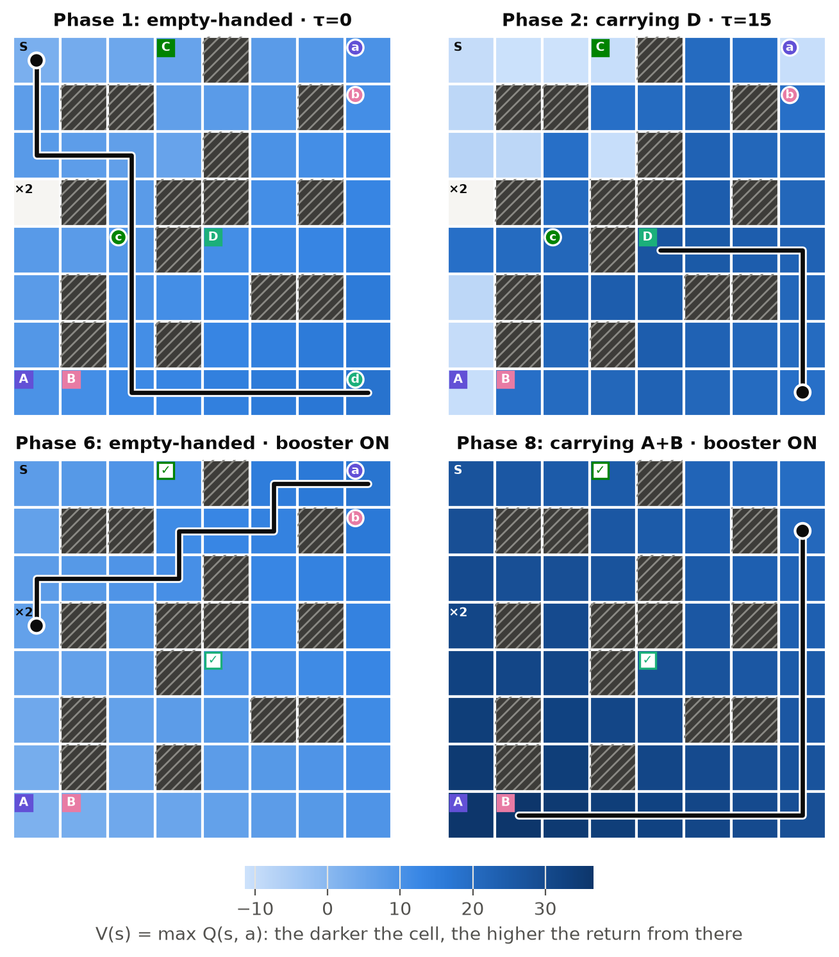
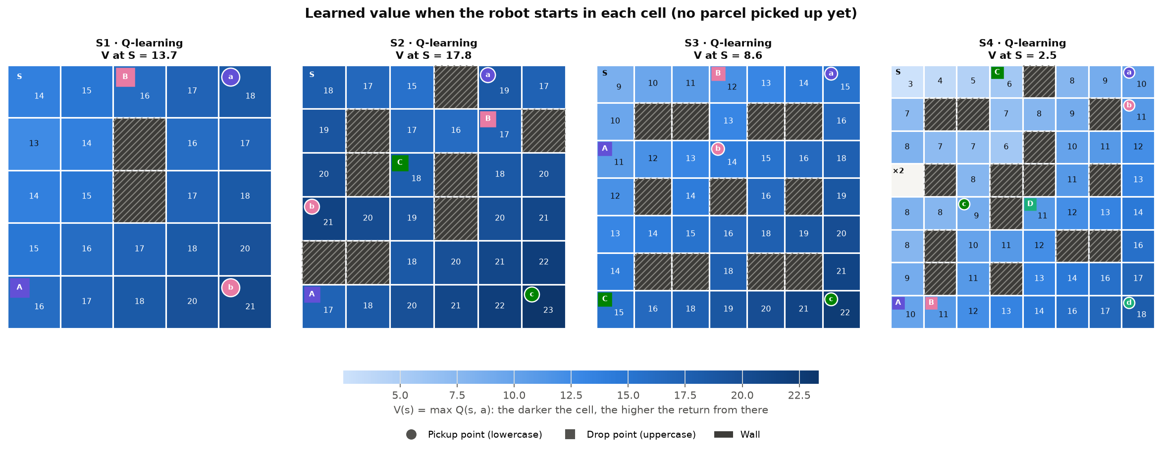
Learned values: the deadline becomes a cliff
Darker = higher V(s) = max Q(s, a); the greedy robot walks toward darker cells
Carrying D at τ = 15: cells too far from D's drop fall to about −11, the −30 penalty is certain
Carrying A + B with the ×2 cell: almost the whole map is dark, two +20 are close
V at S (13.7 / 17.8 / 8.6 / 2.5) is below the optimal return because γ = 0.99 discounts late rewards
Notes:
The heatmaps colour each cell by the learned value. Within a phase the value rises toward the current target. In the phase where the robot carries D with 15 of its 22 steps used, cells far from D's drop cell can no longer meet the deadline, so their value drops below zero. The value at S is below the undiscounted optimal return because gamma is 0.99.

Slide 13
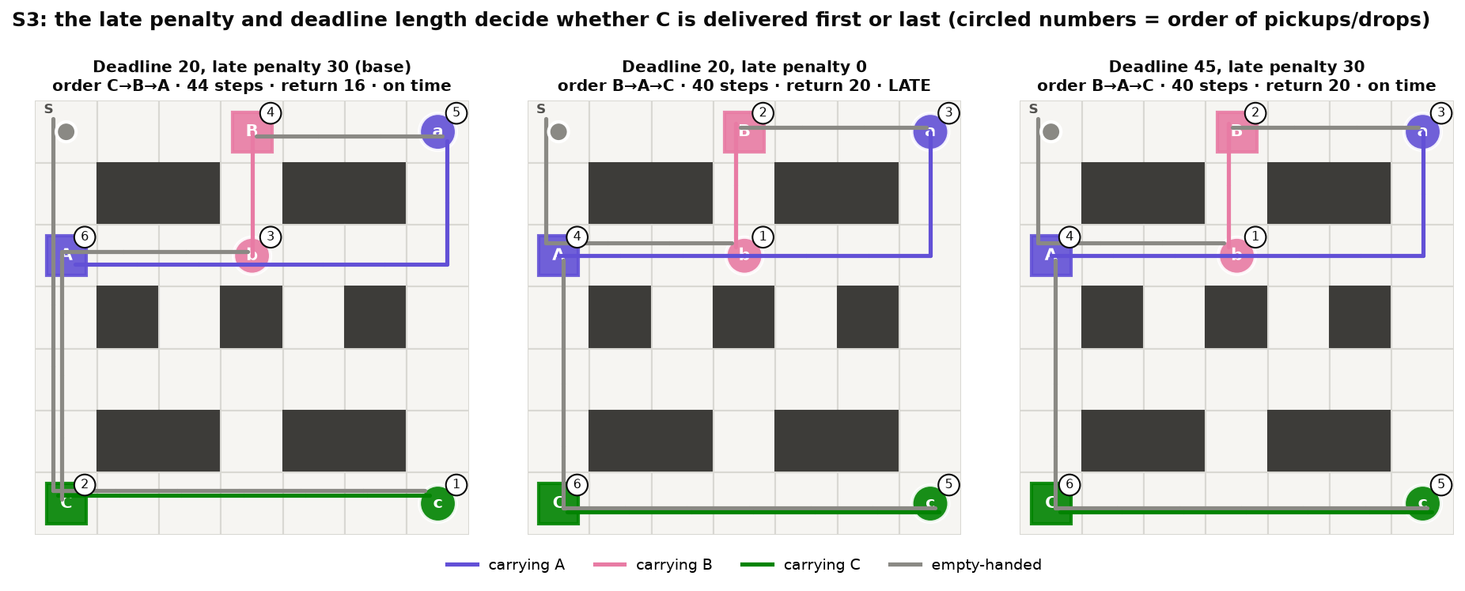
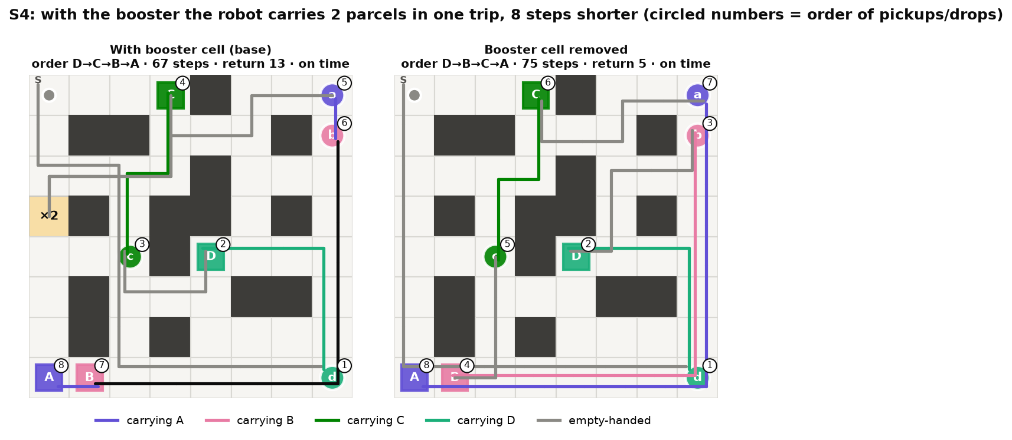
Change the reward or the map, and the order changes
Level 3, late penalty 30 → 0
C → B → A becomes B → A → C: 40 steps, C arrives late but it costs nothing
Level 3, deadline 20 → 45
B → A → C again, now on time; reachable states 4,027 → 14,558
Level 4, ×2 cell removed
D → B → C → A, four separate trips: 75 instead of 67 steps
In every case the learned order matches the optimum in 5/5 seeds.
Notes:
Three variants trained with Q-learning and five seeds. Without a late penalty, being late costs nothing, so the agent takes the four-step-shorter order B, A, C. With a 45-step deadline, C is still on time when delivered last. Without the x2 cell, level 4 needs four separate trips. The learned policy always matches value iteration.

Slide 14
Started in every reachable state: only SARSA slips
Robot put in every reachable, unfinished state; wrong = less than the optimal return from there
0
Level (states) | Q-learning | SARSA | MC ES
1 (184) | 0 | 0 | 0
2 (532) | 0 | 0 | 0
3 (4,024) | 0 | 0–46 (0.3%) | 0
4 (15,604) | 0 | 273–301 (1.8%) | 0
wrong states for Q-learning and MC ES, on all four levels, 5/5 seeds
≤ 6 steps
SARSA's mistakes are only longer routes: never a loop, never late, never an illegal action
1.8% → 0.9%
Number of wrong states per seed (range over 5 seeds; mean share in brackets)
SARSA on level 4 with final α = 0.02; 2× episodes do not help
Notes:
Accuracy only starts the robot with every parcel waiting. Here the robot is put in every reachable state, from 184 on level 1 to 15,604 on level 4, and a state is wrong when the policy collects less than the optimum from it. Q-learning and Monte Carlo ES are never wrong. SARSA takes a slightly longer route from a few dozen states on level 3 and about 300 states on level 4, at most six extra steps. Twice as many episodes do not help; a smaller final step size halves the mistakes on level 4 and removes them on level 3.

Slide 15
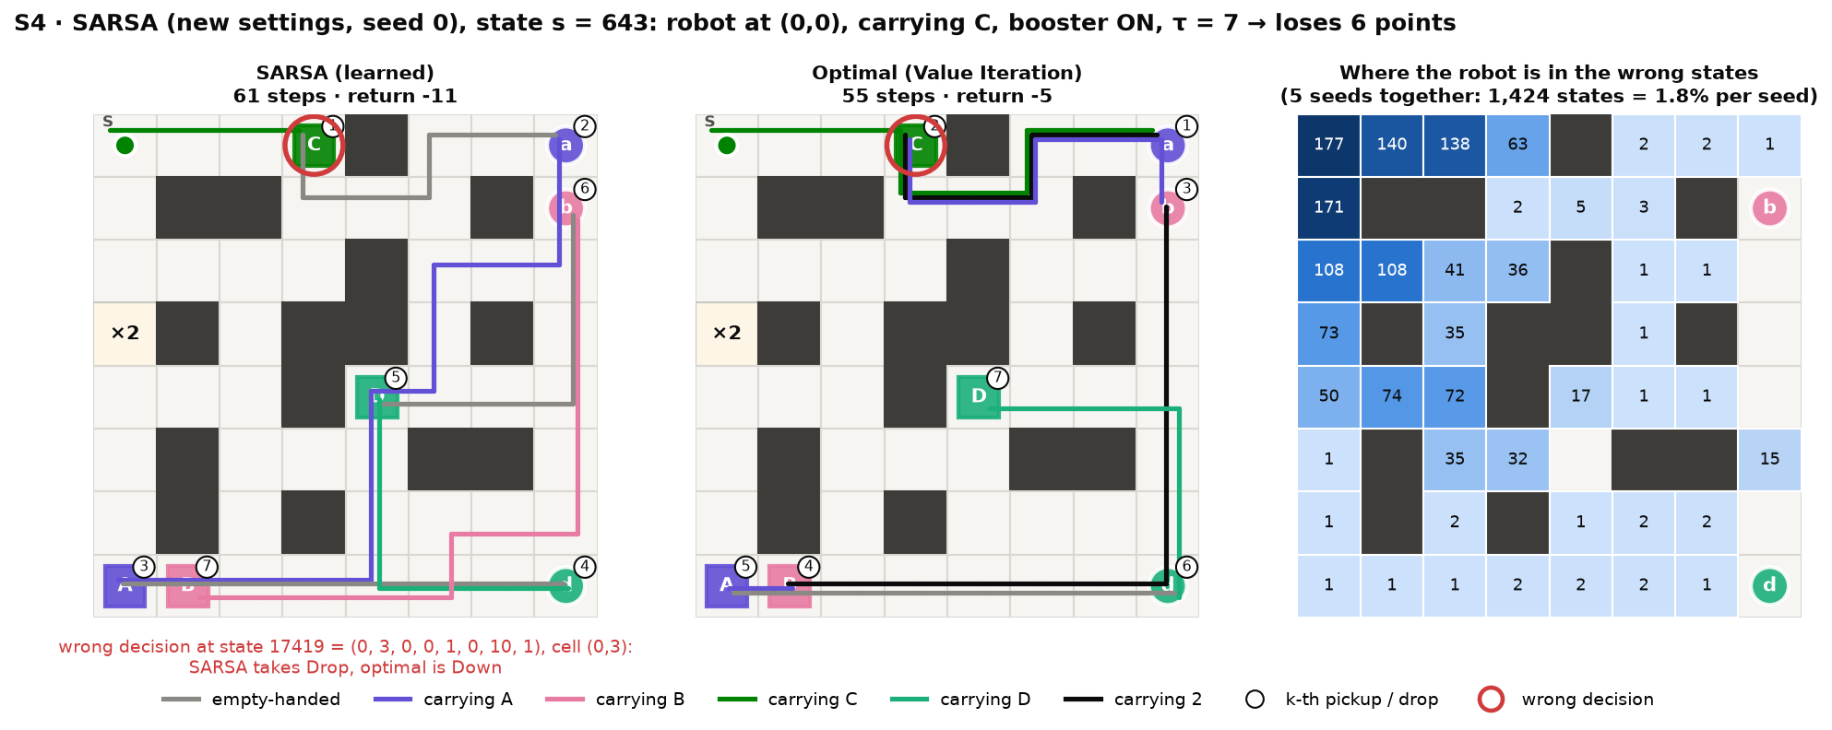
SARSA's slip: delivering C early wastes the ×2 cell
17419
0.04
61 vs 55
state code of the wrong decision: SARSA takes Drop, the optimum is Down
gap between the two actions in Q*; SARSA's error there is 0.12–0.24
steps from state 643: SARSA against the optimal route
Notes:
The costliest SARSA state on level 4, state code 643: top-left corner, carrying C, x2 cell on. SARSA turns wrong three steps later, at state 17419 on C's drop cell, where it drops C although going down is optimal. The two actions differ by only 0.04 in Q-star, less than SARSA's error, so the order flips. Dropping C ends the x2 trip and the other parcels go one by one: 61 instead of 55 steps. Twice as many episodes do not help; a smaller final step size halves these mistakes.

Slide 16
Every mistake is traced to a state code
def encode(self, state): # delivery_env.py
r, c, status, tau, boost = state
code = 0
for i, s in enumerate(status):
code += s * 3 ** i # parcels: base 3
idx = r * self.W + c # cell
idx = idx * self.n_codes + code
idx = idx * self.n_tau + tau
idx = idx * self.n_boost + boost
return idx # = row of Q
17419 → (0, 3, 0, 0, 1, 0, 10, 1): C's drop cell, carrying C, τ = 10, ×2 on
Row 17419 of SARSA's Q: Drop −10.05 > Down −10.13, but Q* prefers Down (−9.89 vs −9.93)
301 wrong states, 39 wrong decisions, all on two cells: C's pickup and drop cells
failure_cases.py writes every wrong state with its code to results/failure_states.csv
decode() undoes it with divmod; app.py jumps to any code you type
Notes:
encode packs the state tuple into one integer: the parcel statuses as a base-3 number, then the cell, the clock and the booster. That integer is the row of the Q table, so a mistake can be looked up directly. State 17419 is C's drop cell with C on board and the x2 cell on; in the app you can type this code and jump there.

Slide 17
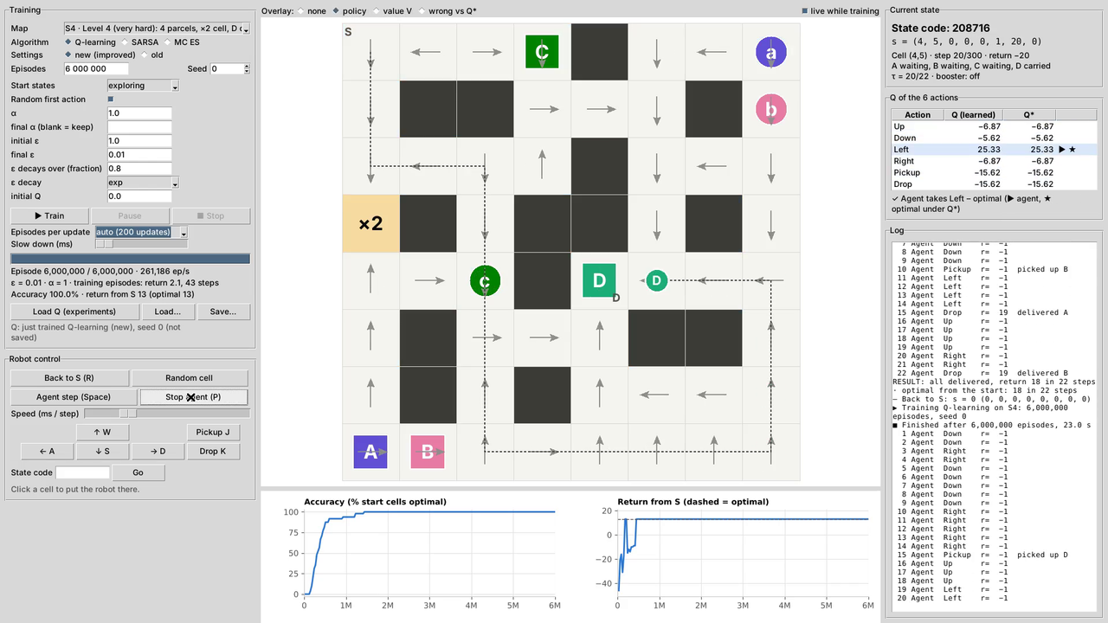
Demo: the app running for real
1
Level 1
train Q-learning from an empty Q table (slowed down), then the agent drives: 22 steps, return 18
2
Level 4
train 6 M episodes live (about 25 s), value overlay, then the agent drives: 67 steps, return 13
3
By hand
move the robot with the keyboard, type state code 17419, step the agent and read Q and Q*
Screen recording of app.py (3 min), click to play
Notes:
Play the video, or run python app.py live. Left: pick the level and the algorithm and train; the arrows and the learning curves update while it learns. Then let the agent drive. At the end the robot is driven by hand and a state code is typed in to jump to the state where SARSA goes wrong. The video is a real screen recording, figures_en/app_demo.mp4.

Slide 18
Run it yourself
P
play.py
pip install gymnasium numpy matplotlib numba
python experiments.py # 5 seeds, ~4 min
python plots.py --lang en # all figures
python failure_cases.py # wrong states
python demo.py # one episode
python play.py # play with keys
python app.py --lang en # the desktop app
You drive with W/A/S/D, J picks up, K drops; your score is compared with the optimum
A
app.py
Train any level and algorithm live, overlay policy, value or wrong cells, jump to a state code
C
Colab
No numba? Everything still runs in plain Python, only much slower. Results are deterministic for a given seed.
colab_train.ipynb runs the whole pipeline on Google Colab
G
GitHub
github.com/Qwup2112/multi-delivery-robot-rl: code, report, paper, video
Notes:
Everything in the talk can be reproduced with these commands. experiments.py trains the 60 runs in about four minutes on 12 cores; plots.py draws every figure; failure_cases.py finds every wrong state. play.py and app.py use exactly the same rules as the agents.

Slide 19
Conclusion
1
All three reach the optimum
2
Exploration design is the key
100% accuracy in 60/60 runs on four levels; the Q tables converge to Q*
Exploring starts + ε per algorithm let every (s, a) be learned, even with τ and the ×2 cell
3
Q-learning learns fastest
4
Rewards shape the order
MC ES second; SARSA needs about 3× the episodes and is off in 1.8% of the level-4 states
Late penalty, deadline and ×2 cell change the delivery order exactly as the optimum predicts
Limitations: exploring starts need a simulator that can reset to any state; one Q table per map; τ grows the state space with the deadline.
Next: a stochastic version (wheel slip), Expected SARSA and Q(λ), function approximation to share one model across maps.
Notes:
Four findings, then the limitations. Future work: a stochastic environment to see whether the ranking changes, Expected SARSA or Q-lambda, and function approximation so that one model can serve several maps.

Slide 20
Thank you — questions?
Nguyen Quang Trung · 22011211 · K16 AI&RB
Supervisor: MSc. Vu Hoang Dieu · Faculty of Electrical and Electronic Engineering, Phenikaa University
Code, report, IEEE paper and demo video: github.com/Qwup2112/multi-delivery-robot-rl
Notes:
Thank the audience and the supervisor, then take questions. Likely questions: why exploring starts, why SARSA is slower, what the state code is, what happens without the deadline clock in the state.

