Slide 1
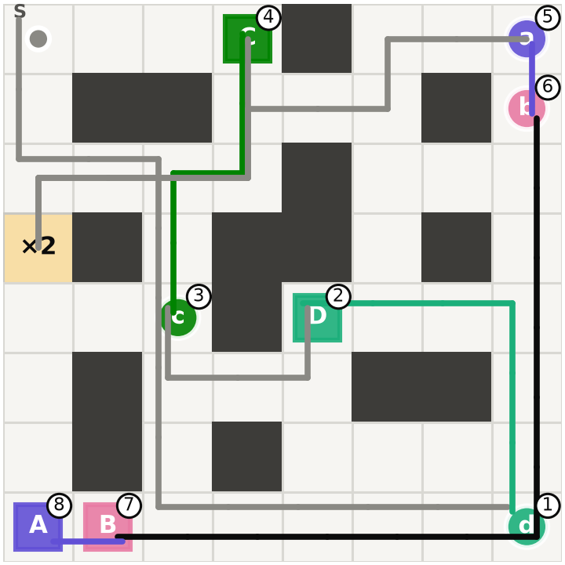
Multi-Delivery Robot
TOPIC 13 · REINFORCEMENT LEARNING
A robot that learns its own pickup and delivery order with tabular Q-learning, SARSA and Monte Carlo
Student: Nguyen Quang Trung
Student ID: 22011211
Hanoi, October 2026
Route learned on S4: 67 steps, return 13 (optimal)
Notes:
Introduce the topic: a robot on a grid delivers several parcels and learns the pickup and delivery order by itself. The environment is a custom gymnasium environment following the Taxi logic. Three tabular algorithms are compared, Q-learning, SARSA and Monte Carlo ES, on four maps of increasing difficulty. No neural network is used.

Slide 2
The task: deliver parcels in a learned order
Rules
Rewards
Grid of square cells with walls; the robot starts at cell S
Each parcel has its own pickup cell and drop cell
6 actions: Up, Down, Left, Right, Pickup, Drop
Success: every parcel delivered; failure: max_steps runs out
Event | Reward
Each step | −1
Correct delivery of one parcel | +20
Wrong Pickup / Drop | −10
Deadline parcel delivered late | −30
The −30 penalty only exists in the deadline maps (S3, S4).
Notes:
The robot only knows its position and the parcel statuses. The −1 step penalty pushes the agent toward short routes; +20 per delivered order is the per-order reward; −10 punishes wrong actions; −30 only exists in the deadline maps S3 and S4.

Slide 3
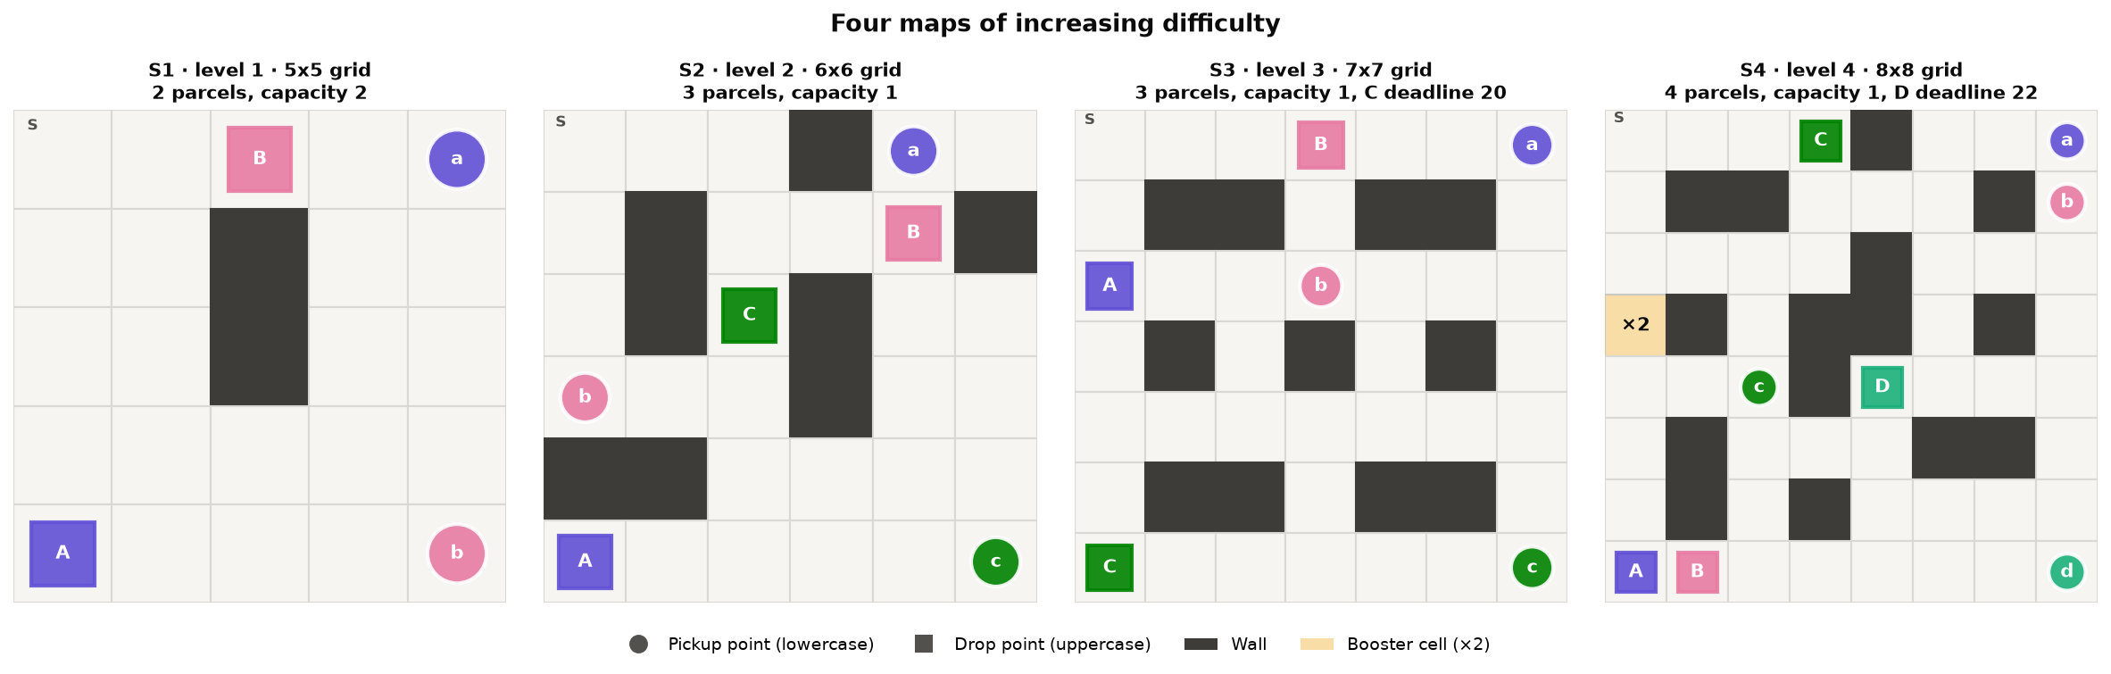
Four levels of increasing difficulty
S1 · level 1
2 parcels, carry 2
optimal route: 22 steps
S2 · level 2
3 parcels, carry 1
optimal route: 36 steps
S3 · level 3
deadline for C: 20 steps
optimal route: 44 steps
S4 · level 4
4 parcels, ×2 cell, deadline D
optimal route: 67 steps
Notes:
Each level adds one new mechanic. S1: two parcels that can be carried together. S2: three parcels but only one at a time, so the order matters. S3: parcel C must be delivered within 20 steps. S4: four parcels, a booster cell that allows carrying two parcels for one trip, and parcel D with a 22-step deadline. Reachable states grow from 186 to 15,612 and the optimal route from 22 to 67 steps; the optimal routes come from Value Iteration.

Slide 4
Three tabular algorithms
QL
Q-learning
SA
SARSA
MC
Monte Carlo ES
Q(s,a) ← Q(s,a) + α·δ
δ = r + γ max_{a′} Q(s′,a′) − Q(s,a)
Q(s,a) ← Q(s,a) + α·δ
δ = r + γ Q(s′,a′) − Q(s,a)
G_{t} = r_{t+1} + γ G_{t+1}
Q(s,a) ← Q(s,a) + α [G_{t} − Q(s,a)]
Off-policy: learns Q* while exploring
α = 1 · ε: 1 → 0.01
On-policy: a′ is the action it will take next
α: 0.5 → 0.1 · ε: 1 → 10⁻⁵
Greedy (ε = 0): explores only through exploring starts
α = 1: Q = the latest return
Shared: exploring starts (random reachable state + random first action) · γ = 0.99 · 5 seeds · accuracy = % of start cells that reach the optimal return
Notes:
All three keep a Q table and choose actions epsilon-greedily; they differ only in the update target. Q-learning bootstraps with the best next action, so it learns Q* even while exploring. SARSA bootstraps with the action it will actually take, so it learns the value of its own epsilon-greedy policy and only matches Q* when epsilon is close to zero. Monte Carlo ES waits for the whole episode and uses the real return; with a greedy policy in a deterministic world that return is exact. Every training episode starts from a random reachable state with a random first action.

Slide 5
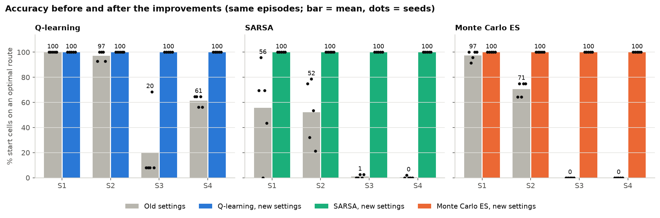
Same episodes, new settings: accuracy jumps to 100%
Exploring starts
random reachable state
+ random first action
ε per algorithm
QL → 0.01, SARSA → 10⁻⁵
MC ES: ε = 0 (greedy)
Step size α
QL 1 · SARSA 0.5 → 0.1
MC ES 1 (latest return)
More episodes
up to 6 M on S4
numba: about 170× faster
Notes:
Same maps, same number of episodes, only the settings change. Old settings: random start cell, linear epsilon decay to 0.05, alpha 0.5, Monte Carlo with 1/N averaging. With them SARSA and Monte Carlo almost never solve S3 and S4. Exploring starts are the biggest change: the deadline clock and the booster status multiply the states, and the robot rarely reaches most of them when it always starts with tau = 0. Old Q-learning was optimal from S in 5/5 seeds on S3, but correct from only 20% of the start cells.

Slide 6
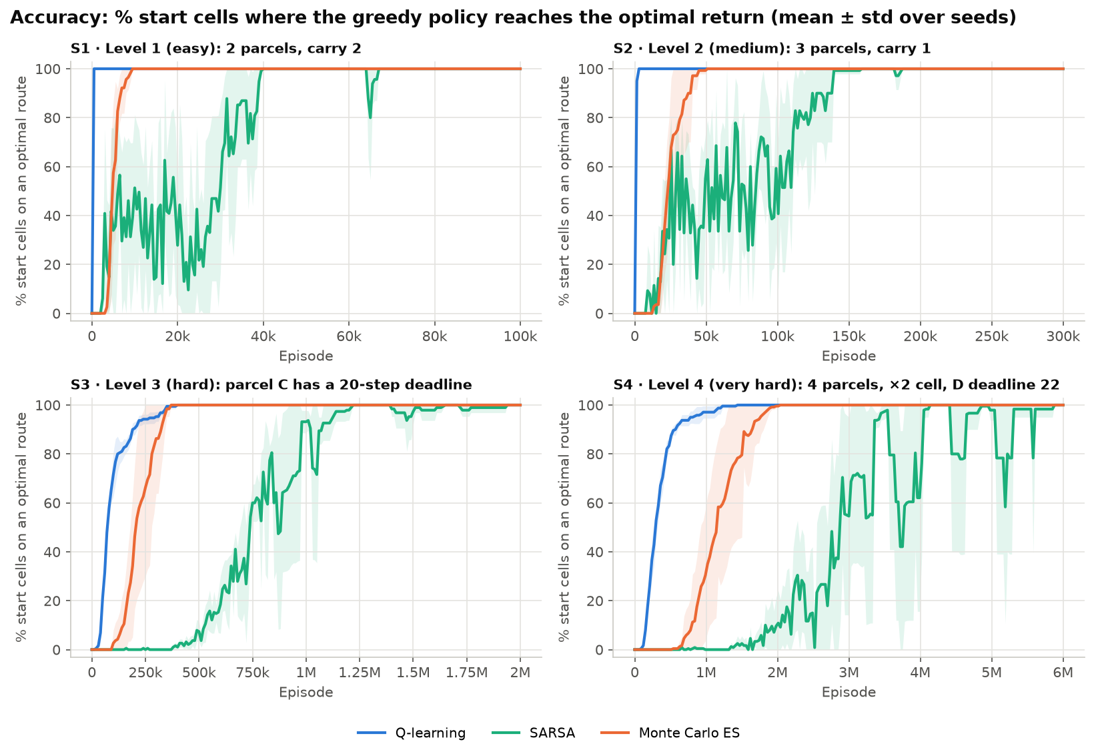
Accuracy: all three reach 100% on every map
60 / 60
runs end at 100% accuracy (3 algorithms × 4 maps × 5 seeds)
1.1 M
episodes Q-learning needs on S4 (median), the fastest
3.6 M
episodes SARSA needs on S4, about 3× Q-learning
Notes:
Accuracy is the share of start cells from which the greedy policy reaches the optimal return of Value Iteration, averaged over 5 seeds. All 60 runs end at 100%. Q-learning gets there first on three of the four maps; Monte Carlo ES is slightly faster on S3; SARSA is the slowest and still dips after reaching 100%.

Slide 7
Comparing the three algorithms
 | Q-learning | SARSA | Monte Carlo ES
Update target | r + γ max Q(s′, ·) | r + γ Q(s′, a′) | return G
Learns the value of | the optimal policy (off-policy) | its ε-greedy policy (on-policy) | its greedy policy
Episodes to 100% on S4 | 1.14 M | 3.57 M | 1.74 M
Mean accuracy while learning (S1 → S4) | 0.99 / 0.99 / 0.95 / 0.94 | 0.77 / 0.77 / 0.60 / 0.48 | 0.95 / 0.91 / 0.89 / 0.80
Drops below 100% after reaching it | never | 9–19% of checks | never
Final mean |Q − Q*| | 0 | 0.001 – 0.047 | 0
Wrong if started anywhere (S3 / S4) | 0 / 0 | 0.3% / 1.8% | 0 / 0
Old settings (S1 → S4) | 100 / 97 / 20 / 61% | 56 / 52 / 1 / 0.4% | 97 / 71 / 0 / 0%
Medians over 5 seeds. Accuracy = % of start cells from which the greedy policy reaches the optimal return.
Notes:
All three end at 100%, so the comparison is about speed, stability and robustness. Q-learning is the fastest and most stable, and the least sensitive to settings. Monte Carlo ES is slower at the start but exact once converged; it depends completely on exploring starts. SARSA needs about three times the episodes of Q-learning on S4 and keeps fluctuating, because its target depends on the sampled next action. SARSA's usual advantage, safer behaviour while exploring, does not show here because the maps have no dangerous cells.

Slide 8
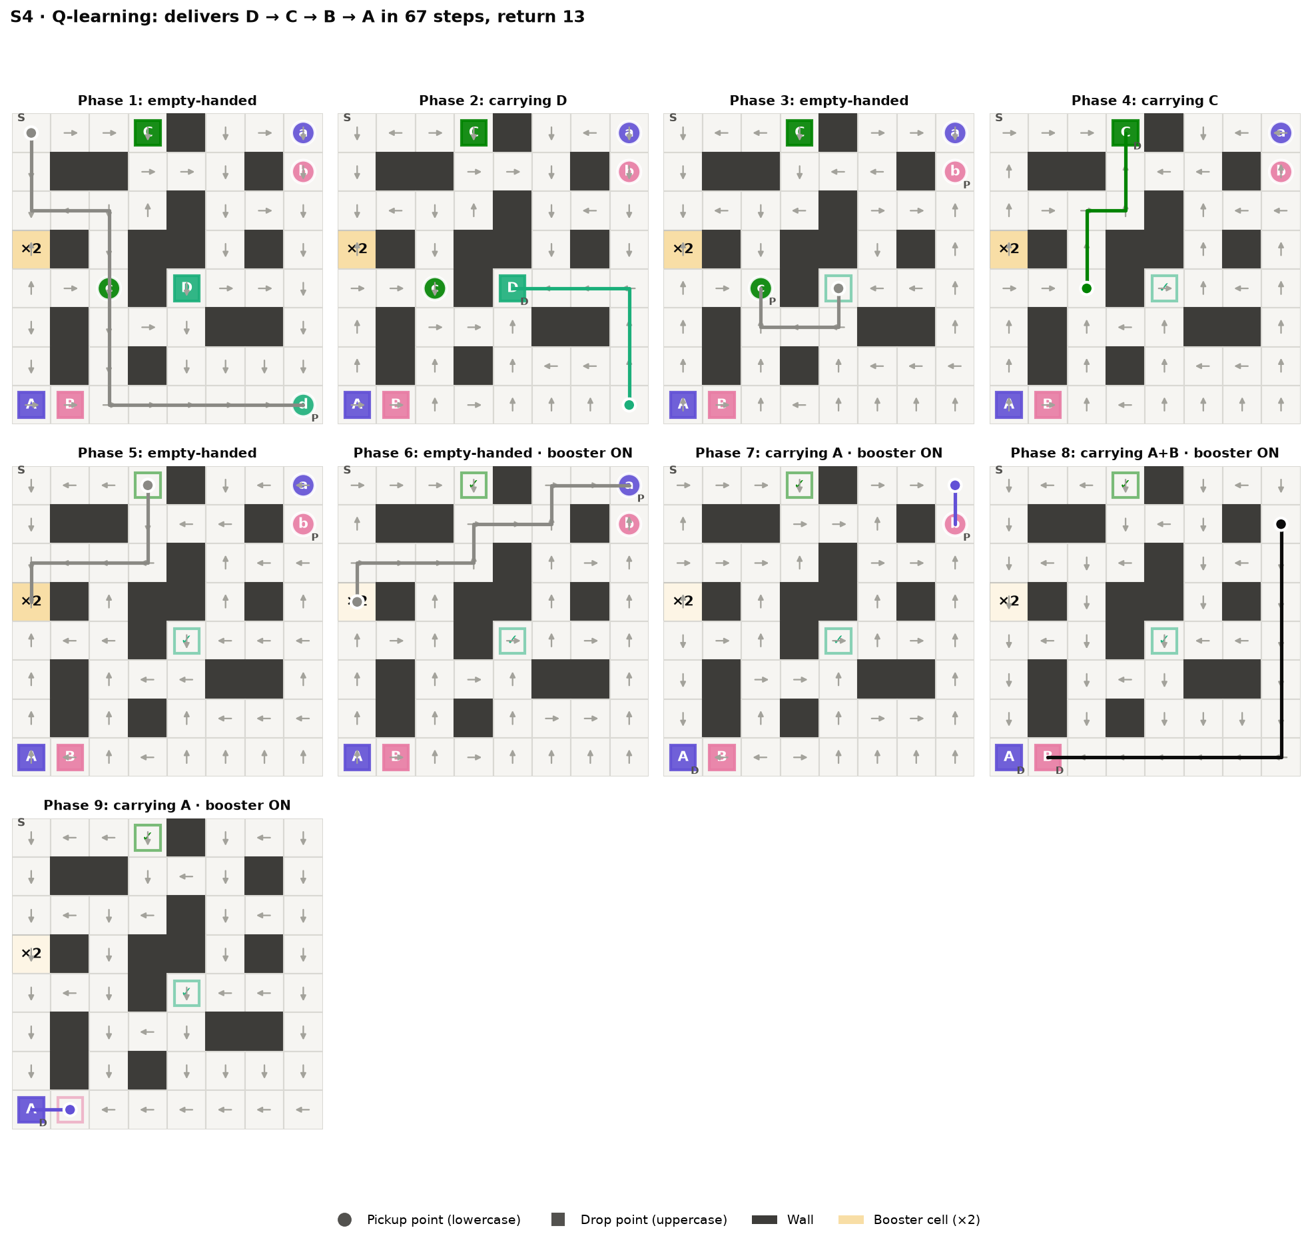
S4 policy: deadline first, then the booster
Pick up D in the bottom-right corner
Deliver D in the middle, before its 22-step deadline
Pick up C and deliver it on the top row
Go down to the ×2 cell: booster on
Pick up A, then B: carrying 2 parcels
Deliver B, then A, in the bottom-left corner
67 steps, return 13 = optimal
Notes:
Each panel is one phase: a combination of parcel statuses and booster status. Grey arrows show the action the policy would choose in that cell; P and D mean Pickup and Drop. The robot learns two trade-offs: deliver the far deadline parcel D first, and accept a detour to the booster cell so that A and B travel together. The black line is when it carries two parcels.

Slide 9
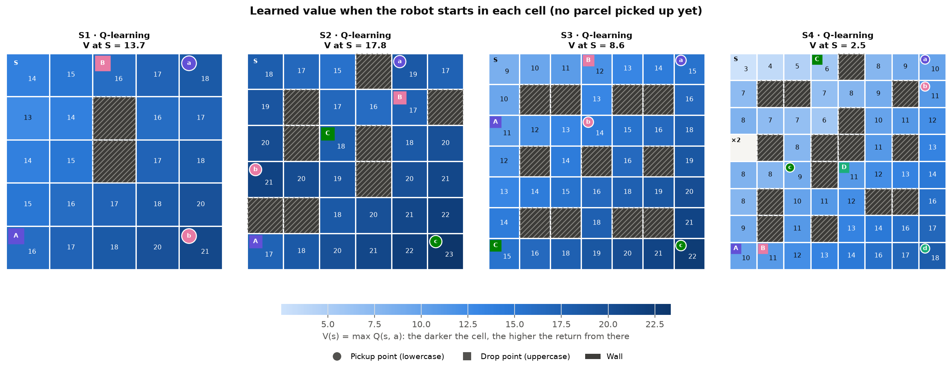
Learned values: darker cells promise a higher return
V(s) = max Q(s, a) when the robot starts in a cell. V at S (13.7 / 17.8 / 8.6 / 2.5) is below the optimal return (18 / 24 / 16 / 13) because γ = 0.99 discounts late rewards.
Notes:
Each cell is coloured by the learned value V(s), the largest Q value of that state, when the robot starts there with every parcel waiting. Darker means a higher expected return. Values rise toward the first parcel to collect. The value at S is below the optimal return because the discount factor 0.99 makes a reward collected later worth less.

Slide 10
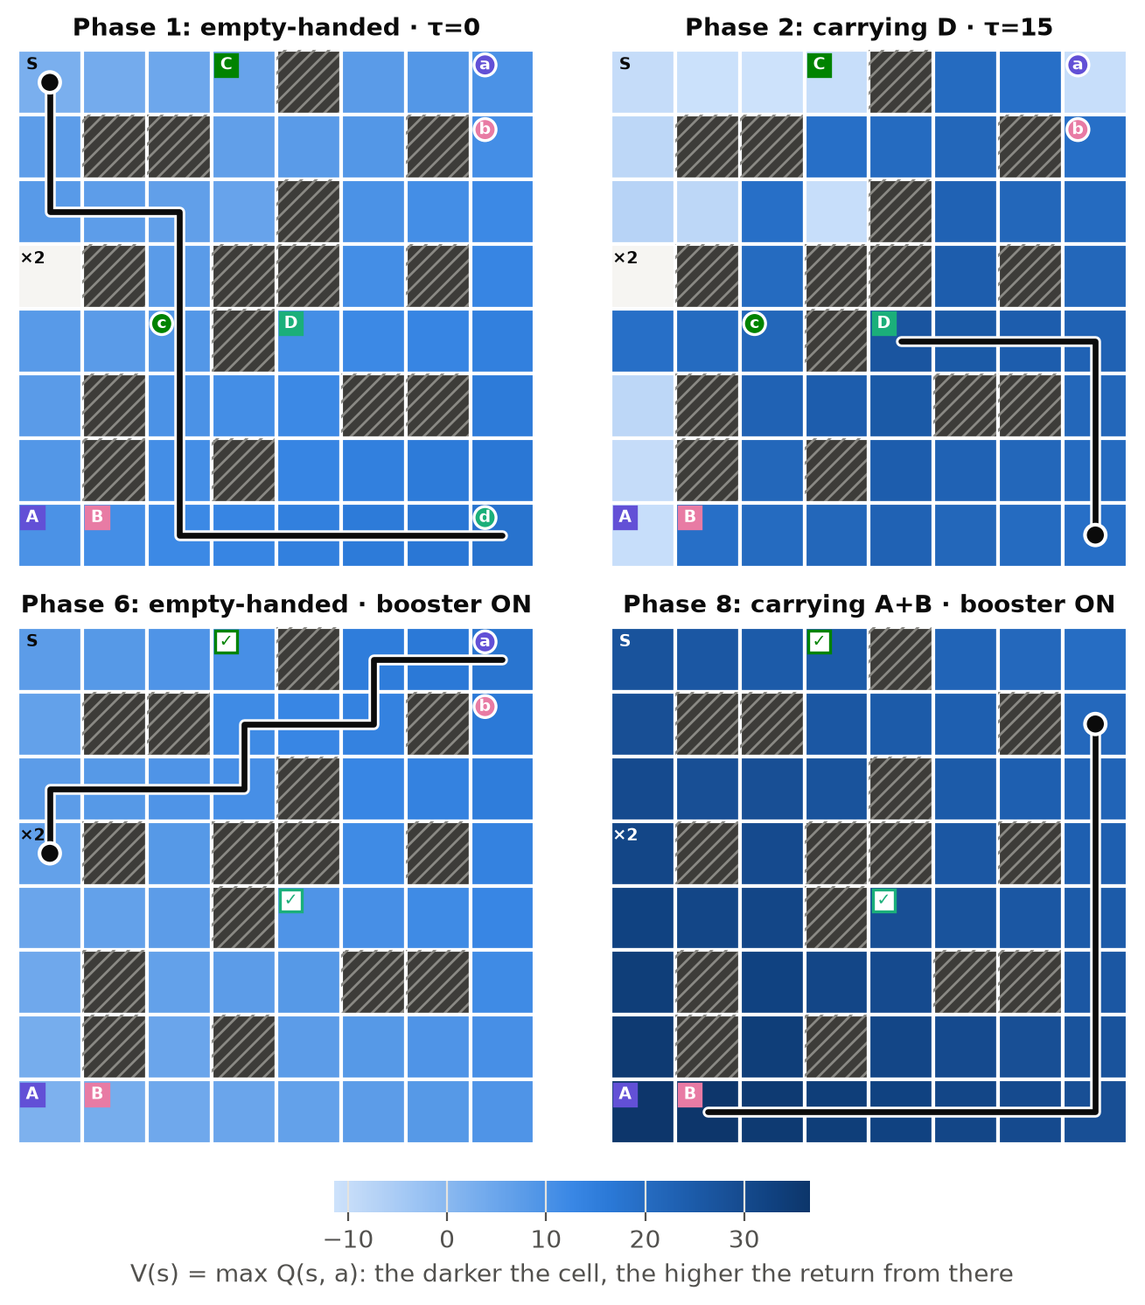
S4 values per phase: the deadline becomes a cliff
Four of the nine phases of the greedy route; the black line is the robot's path
Cells near the current target are darker, so the robot walks toward darker cells
Phase 2 (carrying D, τ = 15): cells far from D's drop fall to about −11, too late for the deadline
Phase 8 (A + B with the booster): the whole map is dark, two +20 rewards are close
Deadline and booster show up in the values
Notes:
The same heatmap for four of the nine phases of the S4 route; the report shows all nine. Within a phase the colour grows toward the current target, which is why the greedy robot follows the darker cells. In phase 2 the robot carries D with 15 of its 22 steps used: from cells far from D's drop cell the deadline can no longer be met, so the value drops below zero. In phase 8 the robot carries A and B together, so almost every cell is dark.

Slide 11
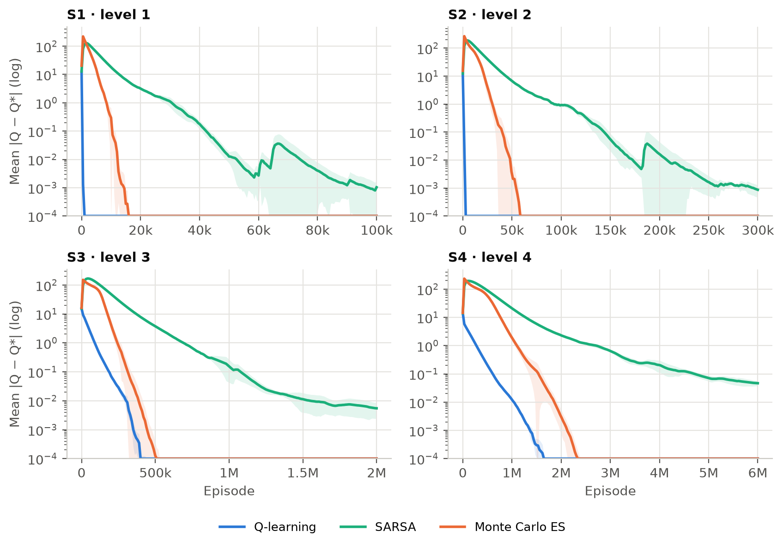
Why the new settings work
1
Exploring starts cover τ and b
Every (s, a) gets direct updates, even states rarely reached from τ = 0
2
SARSA needs ε → 0
It learns the value of its own ε-greedy policy, so ε falls to 10⁻⁵ and α decays to 0.1
3
MC ES returns are exact
A greedy policy in a deterministic world gives the true value in one return, so α = 1
Notes:
The figure shows the mean error between the learned Q table and Q* from Value Iteration, on a log scale, for each level: it reaches zero for Q-learning and Monte Carlo ES and about 0.05 for SARSA on S4. Exploring starts give every state direct updates; SARSA needs epsilon close to zero; Monte Carlo ES works with alpha = 1 because each return of the greedy policy is exact.

Slide 12
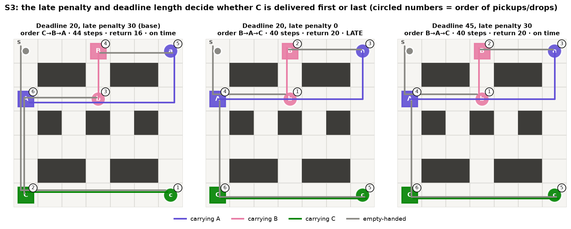
Reward or deadline changes the delivery order
Late penalty 30 → 0 or deadline 20 → 45: C→B→A becomes B→A→C, 4 steps shorter (5/5 seeds, matching the optimum).
Notes:
When being late costs nothing, B then A then C is 4 steps shorter, so the agent stops prioritising parcel C and accepts being late. With a 45-step deadline, delivering C last is still on time, so it also switches to B-A-C. The reachable states grow from 4,027 to 14,558, and Q-learning is still optimal in 5/5 seeds.

Slide 13
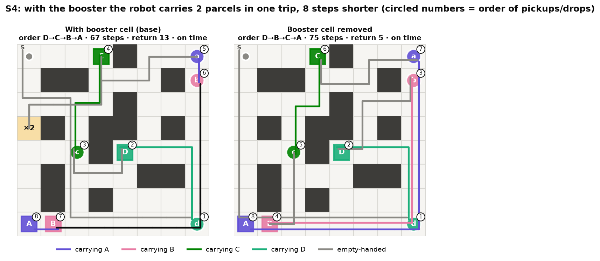
The booster cell saves 8 steps
67 steps
with booster: D→C→B→A
75 steps
without booster: D→B→C→A
Even with the booster, the robot delivers the deadline parcel D first, then detours via the ×2 cell to carry A and B together.
Notes:
Both configurations learn the optimal route in 5/5 seeds. With the booster cell the robot still delivers the deadline parcel first, then detours to the booster and carries A and B together. Without it, it needs four separate trips. The circled numbers give the order of the pickup and drop events.

Slide 14
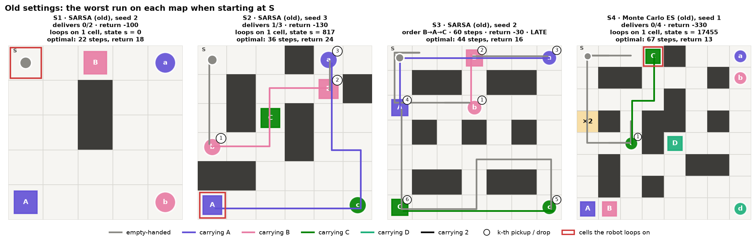
Old settings: stuck in loops or late, even from S
Worst run per map from S: the robot bumps into a wall or the edge forever (red frame) or delivers C late. Old Q-learning was still optimal from S.
Notes:
With the old settings the robot already goes wrong from the start cell S. SARSA never finishes in 3 of 5 seeds on S1 and S4, Monte Carlo in 4 of 5 seeds on S4: the robot stands on a cell and keeps walking into a wall or the edge of the map, because that blocked move has a slightly higher Q value than the right action, for example Drop. The state does not change, so it repeats the move until max_steps. On S3 both deliver parcel C late in all 5 seeds.

Slide 15
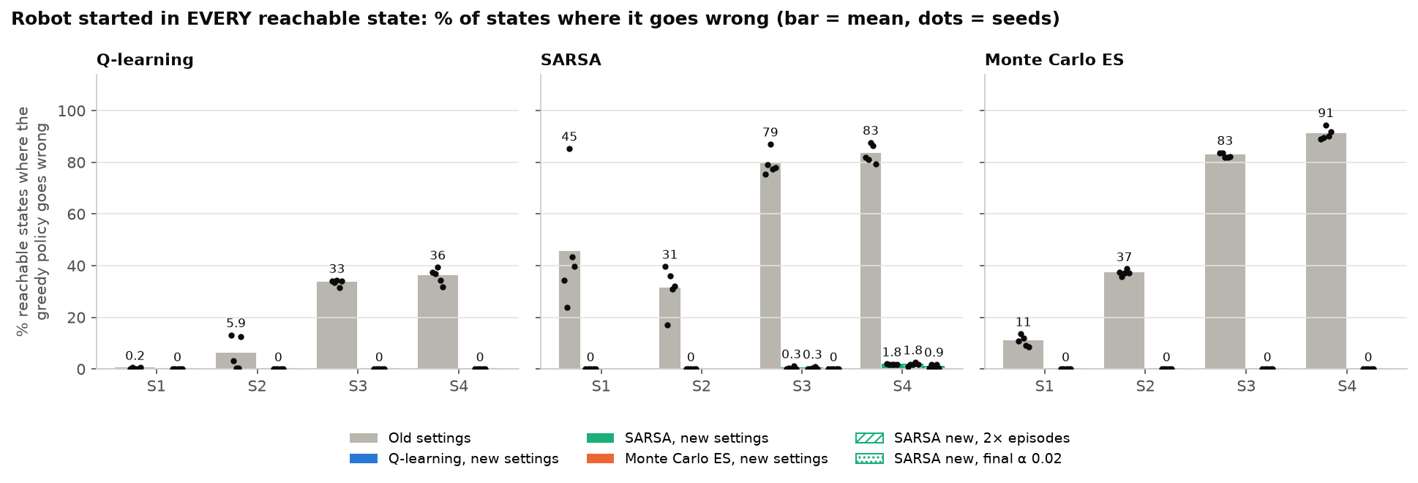
Started anywhere: only SARSA still slips a little
Robot put in each of the 184–15,604 reachable states. New settings: Q-learning and MC ES are never wrong; SARSA takes a longer route in 0.3% (S3) and 1.8% (S4).
Notes:
Accuracy only starts the robot at an empty cell with every parcel waiting. Here the robot is put in every reachable state: carrying parcels, after some deliveries, with the deadline clock running or the booster on. The grey bars are the old settings: wrong in up to 91 percent of the states, with loops, late deliveries and illegal actions. With the new settings Q-learning and Monte Carlo ES are right in every state in all 5 seeds. SARSA is slightly off in a few hundred states of S4; twice as many episodes do not help, a smaller final step size halves it.

Slide 16
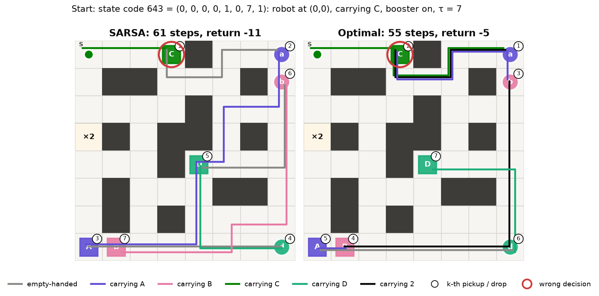
SARSA's slip: delivering C early wastes the booster
17419
state code of the wrong decision (red ring): SARSA takes Drop, optimal is Down
0.04
gap between the two actions in Q*; SARSA's Q error there is 0.12–0.24
61 vs 55
steps from start state 643: SARSA vs optimal
Notes:
The costliest SARSA state on S4, state code 643: the robot is in the top-left corner, carries C and has the booster on. SARSA's first move is still right; it turns wrong three steps later at state 17419, on C's drop cell, where it drops C although going Down is optimal. In the true values the two actions differ by only 0.04, and SARSA's values there are off by 0.12 to 0.24, so the order flips. Dropping C ends the booster trip, so A, B and D are carried one by one: 61 steps. The optimal route first fetches A while still holding C and then carries A and B together: 55 steps. Every SARSA mistake is a longer route like this one, at most 6 steps, never a loop. Q-learning and Monte Carlo ES have no wrong state at all. A smaller final step size for SARSA halves the mistakes on S4.

Slide 17
Where SARSA turns wrong: the state codes
State code | State (row, col, σA–σD, τ, b) | Wrong states | SARSA takes (Q*) | Optimal (Q*) | Q* gap
190921 | (4, 2, 0, 1, 1, 0, 22, 1) | 109 | Down (26.73) | Up (26.76) | 0.03
190915 | (4, 2, 0, 1, 1, 0, 20, 1) | 20 | Down (−2.97) | Up (−2.94) | 0.03
190918 | (4, 2, 0, 1, 1, 0, 21, 1) | 20 | Down (−3.27) | Up (−3.24) | 0.03
190909 | (4, 2, 0, 1, 1, 0, 18, 1) | 17 | Down (−2.38) | Up (−2.35) | 0.03
190912 | (4, 2, 0, 1, 1, 0, 19, 1) | 17 | Down (−2.68) | Up (−2.64) | 0.04
17455 | (0, 3, 0, 0, 1, 0, 22, 1) | 15 | Drop (16.93) | Down (16.97) | 0.04
S4, SARSA seed 0: 301 wrong states come from 39 wrong decisions. Old-settings loops from S: S1 state 0 (2 runs) · S1 state 202 (1 run) · S2 state 817 (1 run) · S4 state 17455 (4 runs). All rows: results/failure_states.csv
Notes:
The state code is the integer index of a state, the row of the Q table, from encode in delivery_env.py. For every wrong state the script follows the learned route to the first state where the greedy action is not optimal. The 301 wrong states of SARSA seed 0 on S4 come from only a few dozen such states, all on two cells: the pickup cell of C, carrying B and C with the booster on, where SARSA goes Down instead of Up, and the drop cell of C, where it drops C instead of going Down. The true values of the two actions differ by a few hundredths, so SARSA's small errors flip them. The CSV file lists every wrong state.

Slide 18
State code: one integer per state
def encode(self, state): # delivery_env.py
r, c, status, tau, boost = state
code = 0
for i, s in enumerate(status):
code += s * 3 ** i # parcels: base 3
idx = r * self.W + c # cell
idx = idx * self.n_codes + code
idx = idx * self.n_tau + tau
idx = idx * self.n_boost + boost
return idx # = row of Q
def decode(self, idx): # the reverse
idx, boost = divmod(idx, self.n_boost)
idx, tau = divmod(idx, self.n_tau)
pos, code = divmod(idx, self.n_codes)
r, c = divmod(pos, self.W)
... # code -> σ digits
State s = (row, col, σA…σD, τ, b) → encode() packs it into one integer, the state code
S4: idx = (((8·row + col)·81 + Σ σᵢ·3ⁱ⁻¹)·23 + τ)·3 + b
17419 → (0, 3, 0, 0, 1, 0, 10, 1): C's drop cell, carrying C, τ = 10, booster on
Row 17419 of Q: Drop −10.05 > Down −10.13, but Q* prefers Down (−9.89 vs −9.93)
failure_cases.py writes every wrong state and its wrong decision, by state code, to results/failure_states.csv
Notes:
Every state is a tuple: the robot's cell, the status of each parcel, the deadline clock and the booster. encode packs it into one integer, the state code, which is simply the row of the Q table. Parcel statuses are read as a base-3 number, then each component is multiplied in, and decode undoes it with divmod. For example state 17419 decodes to row 0, column 3, carrying C, clock 10, booster on: that is where SARSA drops C although going down is optimal. The CSV file lists every wrong state by this code.

Slide 19
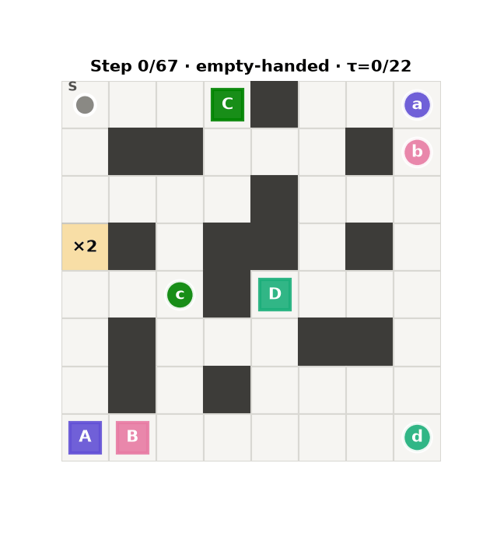
Demo: one episode with the learned policy
python experiments.py
python plots.py --lang en
python demo.py --algo sarsa
python demo.py --gif --lang en
python failure_cases.py
experiments.py: 5 seeds × 3 algorithms, about 4 minutes on 12 cores
colab_train.ipynb runs the whole pipeline on Google Colab
demo.py prints a text map after every step
Symbols: @ robot · a–d waiting parcels · A–D drop cells · + booster cell
Notes:
Run python demo.py during the talk: it loads the learned Q table from results/, runs the greedy policy from cell S and prints every step with its action, reward and event. On S4 the robot finishes at step 67 with return 13. Add --config to choose another map and --algo sarsa or mc to see the other algorithms. colab_train.ipynb runs the whole pipeline on Google Colab.

Slide 20
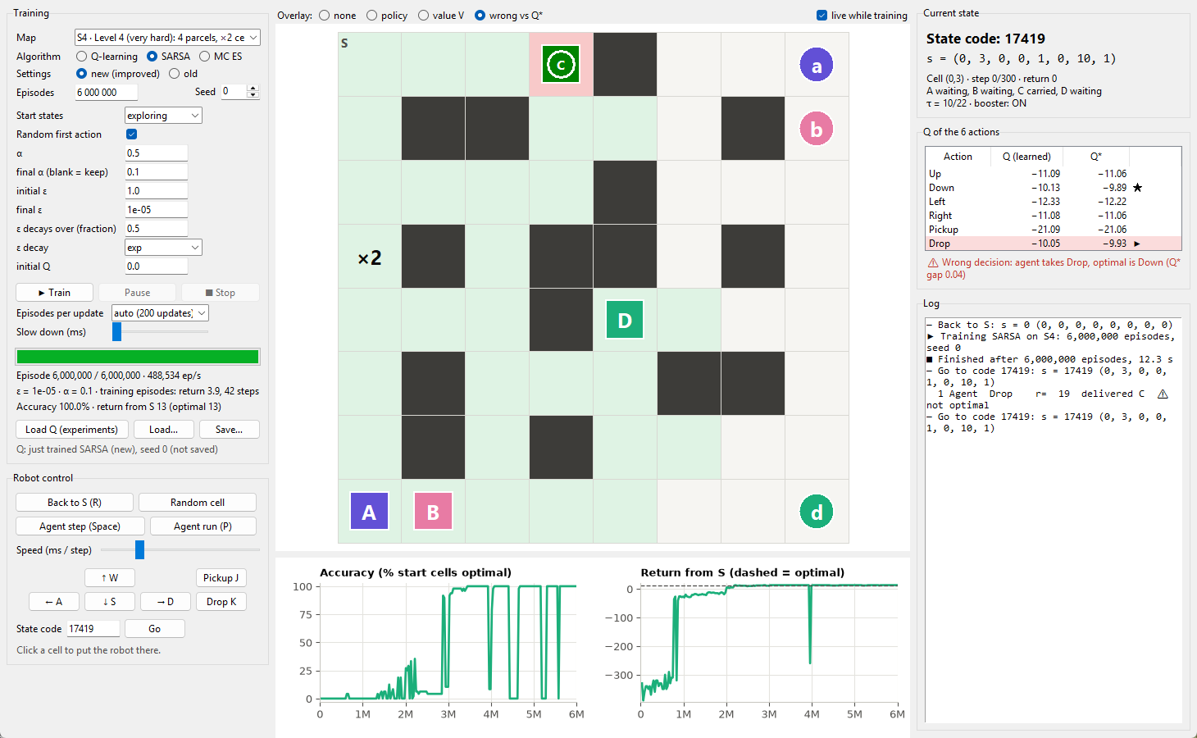
App: train live and control the robot
python app.py --lang en
Train any map, algorithm and setting; pause, stop, or slow down to one episode per update
Map and curves update live from the shared Q table; same seed = same Q as experiments.py
Drive the robot (W/A/S/D, J, K) or let the agent step / run
Click a cell or type a state code to start anywhere
Overlays: policy, value V, wrong vs Q*; the Q / Q* table flags wrong decisions
Notes:
This is the desktop app in app.py. On the left you pick the map, the algorithm and every hyperparameter and start training. Training runs in a separate process with the same numba code, so the map and the learning curves update live and you can pause, stop or slow it down to one episode per update; with the same seed it gives exactly the Q table of the experiments. In the middle you can drive the robot yourself or let the agent move, click any cell or type a state code. The screenshot shows SARSA on S4 after training, at state 17419: the red cell and the warning on the right show its wrong decision, Drop instead of Down, with a gap of only 0.04 in Q*.

Slide 21
Conclusion
1
All three reach the optimum
2
Exploration design matters most
100% accuracy in 60/60 runs; the Q tables converge to Q*
Exploring starts + per-algorithm ε: SARSA on S4 goes from 0.4% to 100%
3
Q-learning learns fastest
4
Rewards shape the order
Monte Carlo ES is second; SARSA needs about 3× more episodes and is still off in 1.8% of the S4 states
Late penalty, deadline and booster cell all change the delivery order
Limitations: exploring starts need a simulator that can reset to any state; the Q table is relearned for every map; τ grows the state space with the deadline.
Notes:
Summarise the four findings, then the limitations. Future work: a stochastic version of the environment (wheel slip) to see whether the ranking changes, Expected SARSA or Q(lambda), and function approximation so one model can serve several maps.

