Slide 1
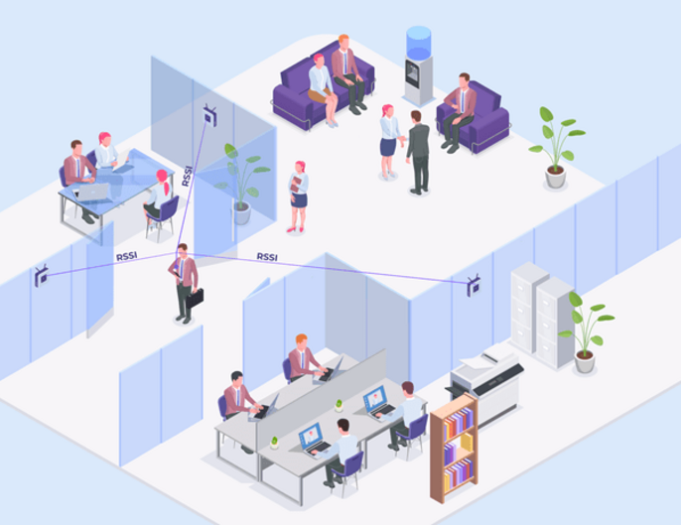
Indoor Positioning System
12/10/2024
STAT410
Qwyn Petersen & Truong Lam
DATA-lectable

Slide 2
Indoor Positioning System
STAT410
1.
Introduction
2.
Data Collection and Preprocessing
3.
Algorithms and Methods
4.
Results and Visualizations
5.
Recommendations and Conclusion

Slide 3
Indoor Positioning System
STAT410
1.
Introduction
2.
Data Collection and Preprocessing
3.
Algorithms and Methods
4.
Results and Visualizations
5.
Recommendations and Conclusion

Slide 4
What is an Indoor Positioning System?
An Indoor Positioning System (IPS) is a technology used to track the real-time location of objects/people within indoor environments, where the GPS signals are weak/unavailable.
IPS typically relies on technologies such as Wi-Fi/Bluetooth frequency signals to estimate positions with high accuracy. It is commonly used in: malls, airports, hospitals, and warehouses.

Slide 5
Why IPS? Why not GPS?
GPS can’t work indoor:
GPS Needs Satellite Signals:
  GPS works by receiving signals from satellites in space.
  These signals travel in straight lines and need a clear path to the GPS receiver (like your phone or a car's GPS).
Indoor Barriers Block Signals:
  Inside buildings, walls, ceilings, and furniture block or weaken the satellite signals.
  This makes it hard for the GPS to "see" the satellites and determine your exact location.
How IPS Addresses These Challenges:
Utilization of Local Access Points:
  IPS leverages Wi-Fi signals, Bluetooth, or other local network infrastructure for accurate localization.
  Unlike GPS, it uses signal strength and trilateration techniques to calculate positions within a few meters.
High Precision:
  IPS systems like your project can achieve localization accuracy that is much finer than GPS, down to less than a meter.

Slide 6
Project Overview
Environment: A single-floor building with six Wifi access points
Data-driven approach: Use signal strengths to model device locations
Expected deliverables:
  Predictive model
  Accuracy and precision evaluation

Slide 7
Indoor Positioning System
STAT410
1.
Introduction
2.
Data Collection and Preprocessing
3.
Algorithms and Methods
4.
Results and Visualizations
5.
Recommendations and Conclusion

Slide 8
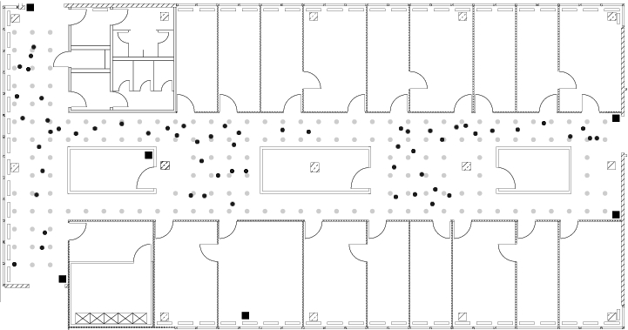
Data Collection Setup
Indoor Positioning System
STAT410
Floor plan ~ 15mx36m
Testing devices are connected to the network, taken to various locations and oriented in various directions
Testing device generates data by recording the signal strength of all access points

Slide 9
Indoor Map
Access points are squares
Grey dots are offline data locations
Black dots are online locations.

Slide 10
Data Sets
Offline Data (training)
Source: offline.final.trace.txt
166 locations
Eight orientations were measured at each location in 45-degree increments
Every orientation combination was sampled 110 times. Each location was sampled 880 times total with the same device
Online Data (testing)
Source: online.final.trace.txt
Simulates real-word data
60 orientation combinations were chosen randomly
Each orientation combination was sampled 110 times, total of 6600 measurements

Slide 11
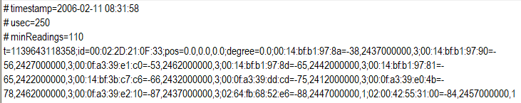

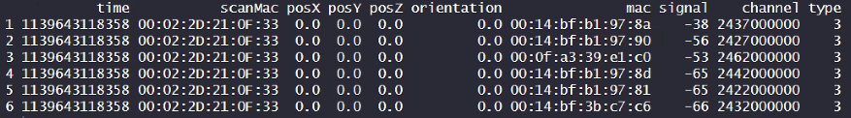
Data Format
Before Format
After Format

Slide 12
Preprocessing
Removing observations with missing values
Converting timestamps to readable formats
Grouping device orientations into bins : 0°, 45°, 90°, 135°, 180°, 225°, 270°, 315°,
Remove unnecessary/redundant information
Filtering access points to retain only relevant data

Slide 13
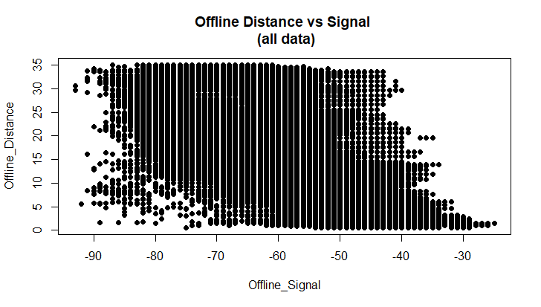
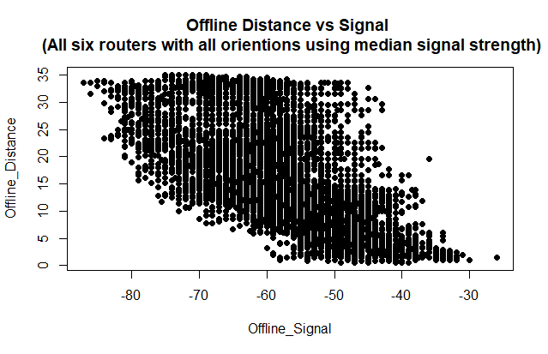
Remove Noise
Offline dataset

Slide 14
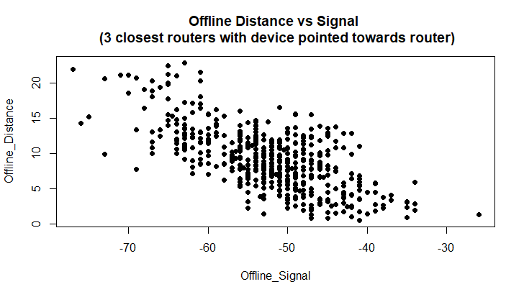
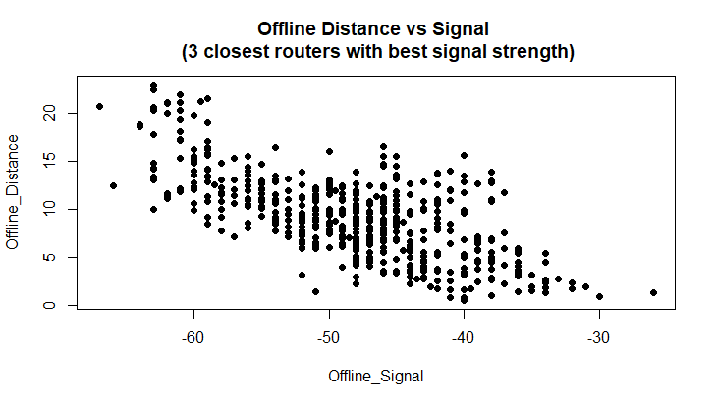
Remove Noise
Offline dataset

Slide 15
Indoor Positioning System
STAT410
1.
Introduction
2.
Data Collection and Preprocessing
3.
Algorithms and Methods
4.
Results and Visualizations
5.
Recommendations and Conclusion

Slide 16
Algorithms
K-Nearest Neighbors (k-NN)
Trilateration using Least Squares Regression

Slide 17
Algorithms
K-Nearest Neighbors Regression
A simple, intuitive algorithm used for classification and regression tasks. It predicts outcomes based on the similarity of input data points to their closest neighbors in a dataset.
In the context of indoor positioning systems, KNN Regression is used to estimate distance between the device and the router based on signal strength

Slide 18
Algorithms
How it works
Compute the distance (e.g., Euclidean distance) between the target observation and all training observations.
Identify the k nearest neighbors (observations with the smallest distances).
Predict the distance by averaging the positions of the k neighbors.
Find the best K value gives the most accurate prediction.
K-Nearest Neighbors (k-NN)

Slide 19
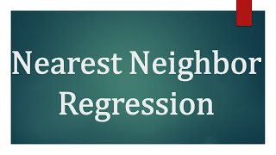

Slide 20
Algorithms
Trilateration using Least Squares Regression
A geometric approach to determine an object's position using distances from multiple reference points (e.g., Wi-Fi access points).
Least Squares Regression is used in trilateration when measurements are noisy or inconsistent. It finds the best-fit solution by minimizing the error between observed distances and predicted distances based on the estimated position.

Slide 21
Algorithms
Trilateration using Least Squares Regression
Input: Known positions of access points (APs) and distances (calculated from signal strength) to the APs.
Linearize:
  Reformulate as a linear system Ax=b where:
  A: From the derived system of equations (right side)
  x: A 1x2 matrix with the x and y coordinate predictions
  b: From the derived system of equations (left side)
Solve for Position:
  Use least squares regression (pseudoinverse or direct matrix solution) to minimize the error between observed and predicted distances.

Slide 22
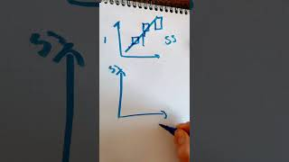

Slide 23
Indoor Positioning System
STAT410
1.
Introduction
2.
Data Collection and Preprocessing
3.
Algorithms and Methods
4.
Results and Visualizations
5.
Recommendations and Conclusion

Slide 24
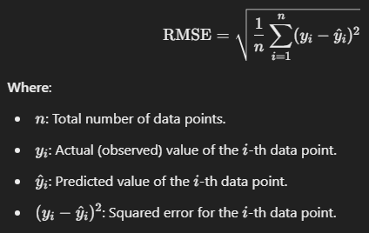
What is Root Mean Square Error (RMSE)?
What is RMSE?
RMSE is like a "report card" for how good or bad a model is at making predictions.
It tells us how far off our predictions are from the actual values, on average.
Why Do We Use It?
Imagine you're throwing darts at a target. RMSE helps us measure how far our darts (predictions) land from the bullseye (actual value).
It’s used to check the accuracy of systems like indoor positioning, where being close to the correct location is critical.
How Does It Work?
RMSE looks at the difference between the predicted and actual values.
It squares these differences (to remove any negative signs), averages them, and then takes the square root.
This gives us a single number that shows the typical error in the same units as the data (e.g., meters for distances).
Key Insights:
A smaller RMSE means the model is more accurate.
A larger RMSE indicates bigger errors and less accurate predictions.

Slide 25
Unique location/Mac address using the median signal
RMSE for KNN model: 5.78666918342235
(when k = 17)
The RMSE of the least squares method is: 12.51
Which method of reducing noise is better based on the RMSE??
Closest Routers With Device Facing Router
RMSE for KNN model: 3.18282388244569
The RMSE of the least squares method is: 4.81
All Data
RMSE for KNN model: 5.55568311498002
The RMSE of the least squares method is: 12.71
Closest Routers With Strongest Signal
RMSE for KNN model: 3.77678311088506
The RMSE of the least squares method is: 6.27

Slide 26

Data Exploration!

Slide 27
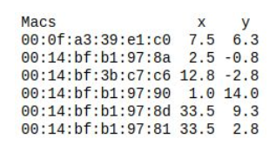
Using a Sample of the Data Set we…
Proved that orientation recordings are based on polar coordinates.
That there is a strong correlation between distance and signal strength. (distance = space between the device and router)
The influence of the orientation on the signal strength is present.
There is more exploration of the orientations potential role in predicting distance that needs to be done.
Identified the coordinates of the routers where there measurement were taken (there were other access points)

Slide 28
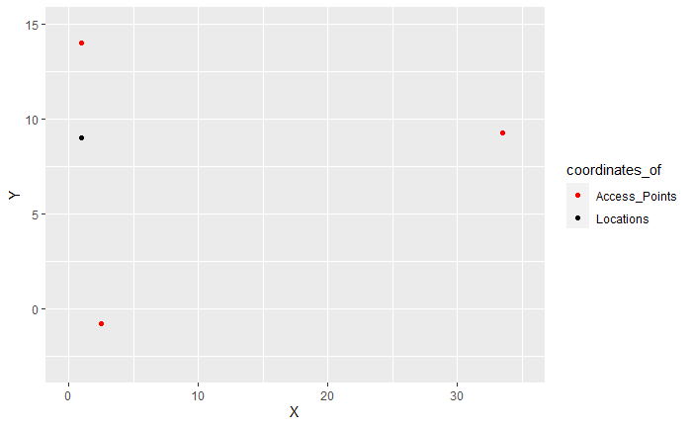


Slide 29
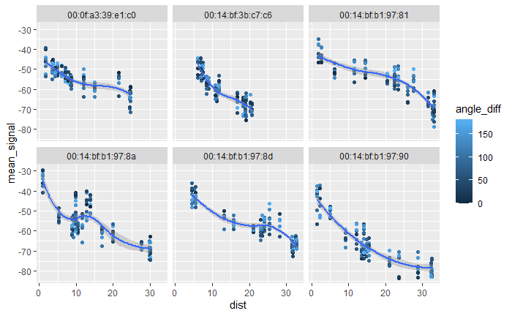

Slide 30
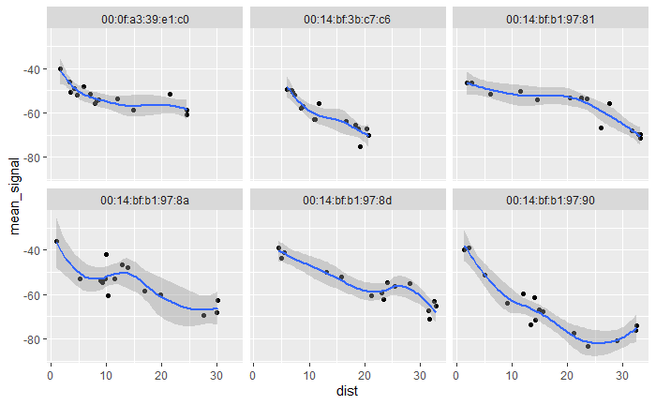

Slide 31
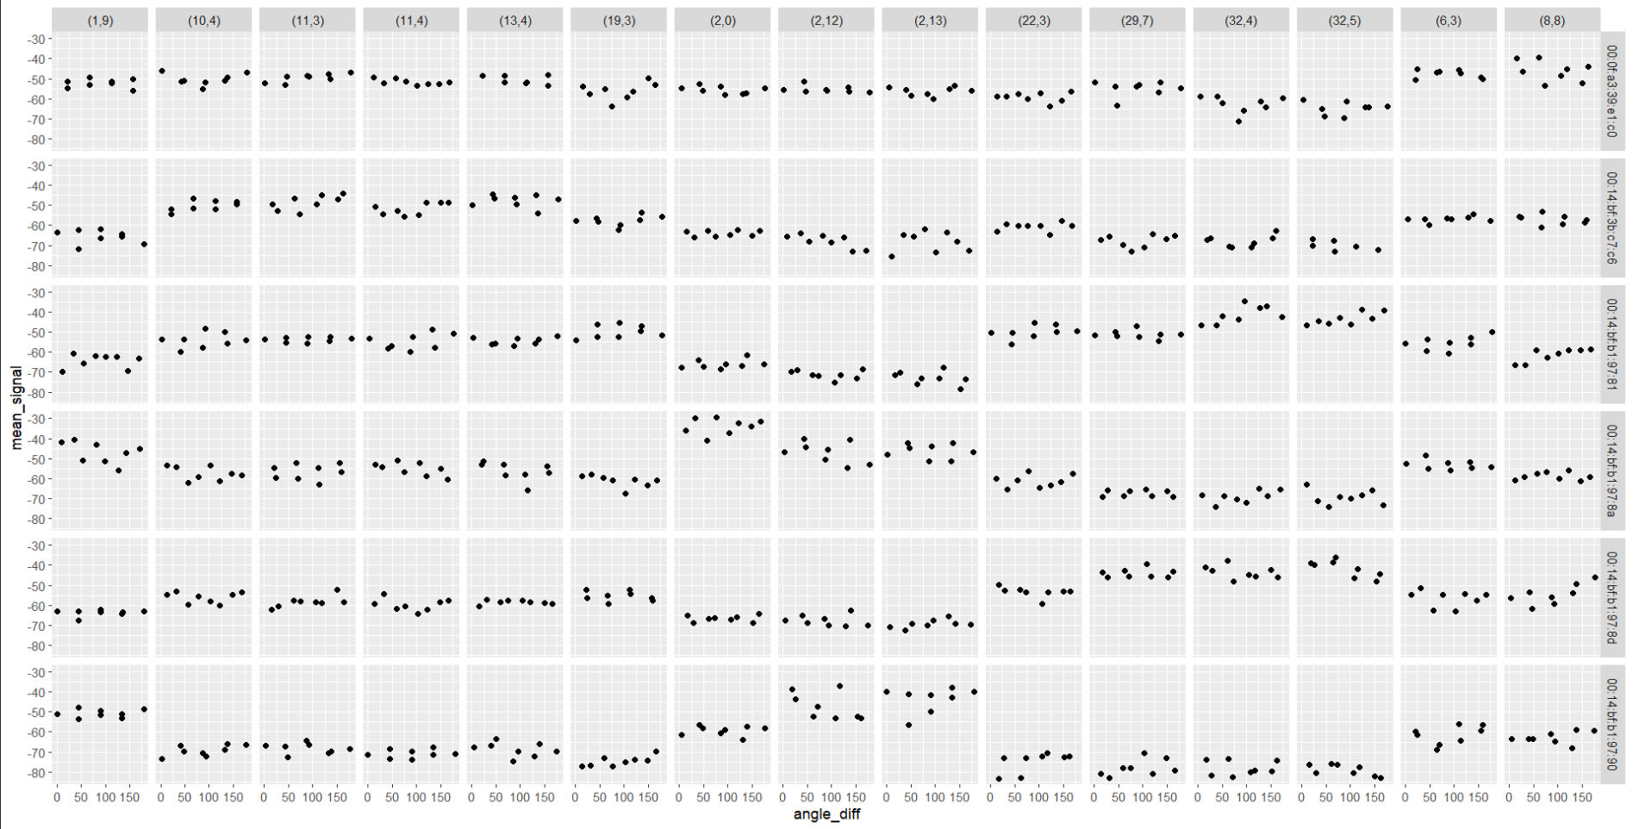

Slide 32
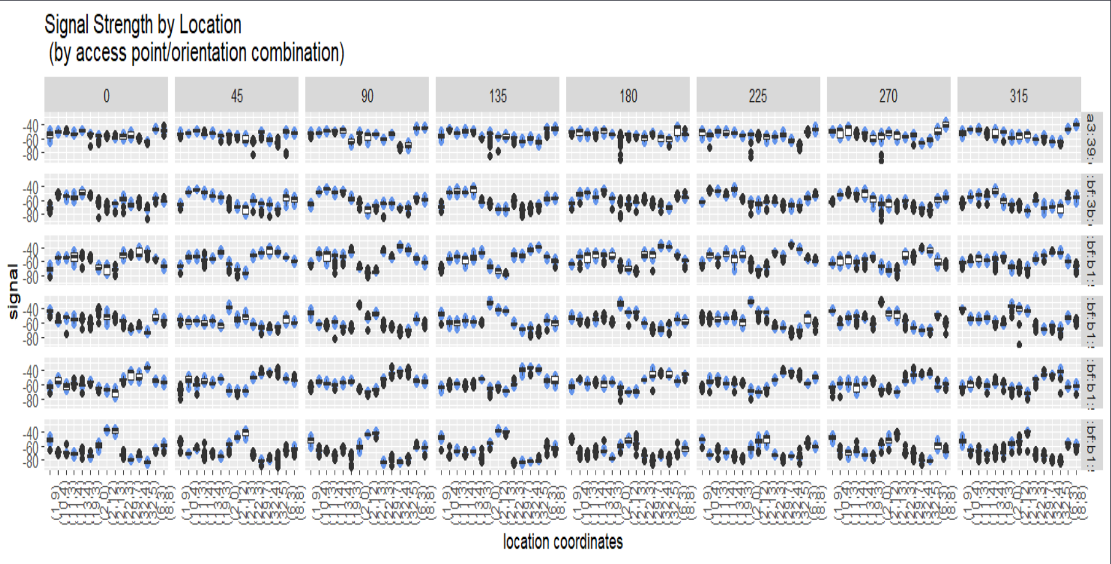

Slide 33
Let’s Look at the KNN Regression Model!
K-Nearest Neighbor Regression Result with K = 15

Slide 34
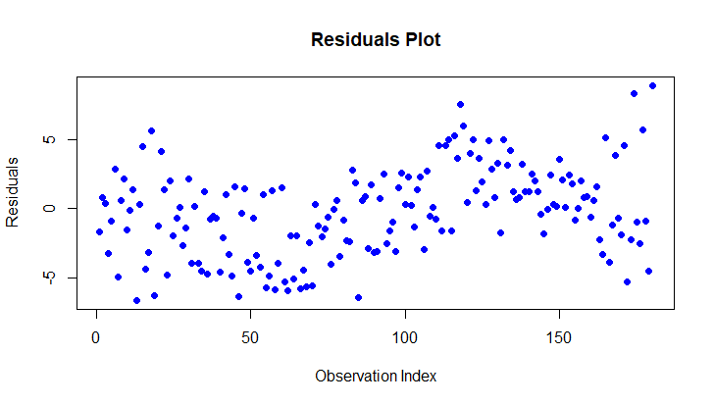
Notes:
Residual plot for each observation

Slide 35
What does it mean?
The error of the model is greater in certain observation groupings and lesser in the others. We should identify if the how the observation groupings relate to each other.
Like where the recordings taken near each other? And if so what could be causing greater errors in the predictions (like obstacles?)

Slide 36
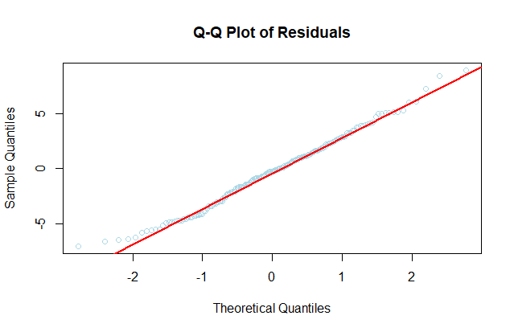
Notes:
It shows if it is normally distributed

Slide 37
What’s the Distribution of the Residuals?
At the center is it normally distributed.
The lower left (extreme negative values) and upper right (extreme positive values), the points deviate from the line. This could be a cause for concern a further testing researching are needed. (Like how does partial normality affect the model? Maybe we need to transform the data?)

Slide 38
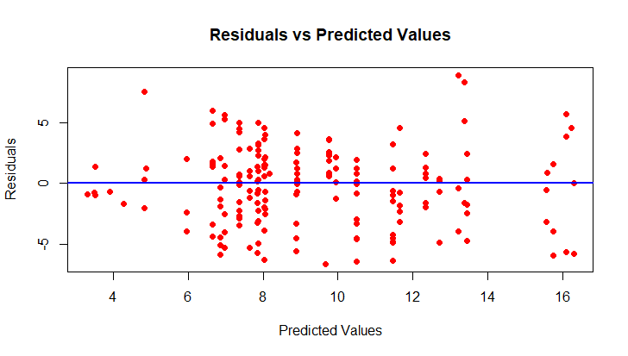
Notes:
For equal variance

Slide 39
The spread of the residuals
This plot has some mild heteroscedasticity. We can see at the lower end (predicted values around 4–6) and the higher end (around 14–16), the residuals appear slightly more spread out. It’s not severe but we should do some further investigation and research.

Slide 40
What About the Least Squares Model?

Slide 41
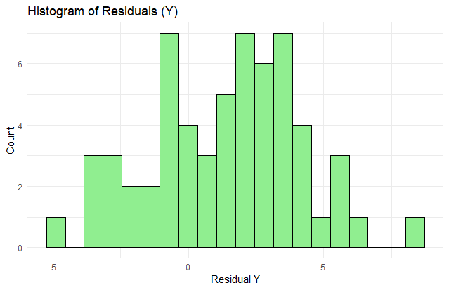

Slide 42
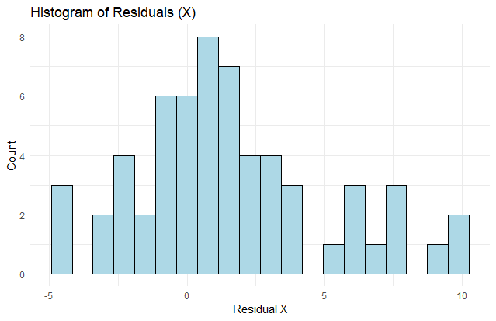

Slide 43
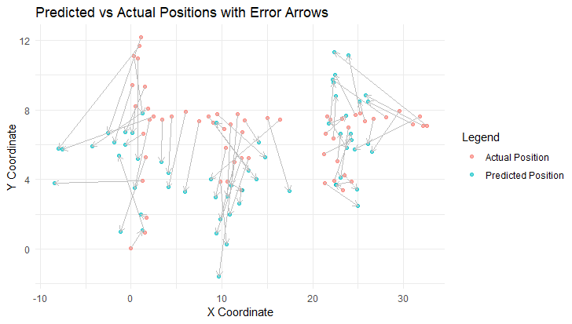
Notes:
Notice where they are obstacles between the locations and the routers. Could it influence the model?

Slide 45
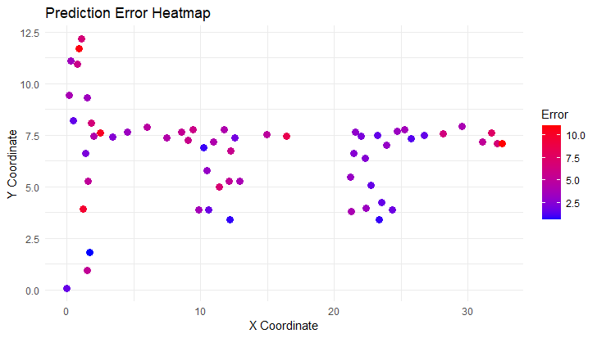

Slide 46
Indoor Positioning System
STAT410
1.
Introduction
2.
Data Collection and Preprocessing
3.
Algorithms and Methods
4.
Results and Visualizations
5.
Recommendations and Conclusion

Slide 47
Conclusion
Performance of Models
Key Insights from Data
Effectively we able to predict the location by up to 4.8m (16ft), which is not very accurate. Further adjustments will need to be made.
Using orientation-based filtering and selecting the three closest routers improved the accuracy significantly.
A clear relationship was observed between signal strength and distance, confirming the feasibility of using signal strength as a predictor for indoor positioning.
Orientation of the device influences signal strength, highlighting the importance of accounting for directional effects in predictive modeling.
Noise Reduction
Strengths and Limitations
Noise filtering, such as removing outliers and irrelevant access points, improved the predictive accuracy of both methods.
However, residual noise and obstacles in the environment remain challenges, impacting prediction reliability.
KNN is simple to implement and effective for scenarios with clean, well-labeled data.
Trilateration using Least Squares Regression works well in scenarios with minimal noise but is sensitive to outliers and signal variability.

Slide 48
Concerns
Potential Factors Affecting the Model's Performance
What factors might be causing inaccuracies in the model? Could it be due to:
Heteroscedasticity (i.e., unequal variance in the signal data)?
Physical obstacles in the building interfering with signal strength?
Ensuring the Sample Appropriateness
Since we are working with a sample of the data, how can we ensure it is representative of the entire dataset? Are there biases or limitations in the sample that could affect the model’s performance?
Exploring Alternative Variables
Could other variables, such as channel frequency or timestamp, be used for predicting locations more effectively than signal strength alone?
Noise Reduction in the Training Set
Role of Orientation in Signal Strength
How can we effectively reduce noise in the training dataset to improve the model's predictive accuracy? What preprocessing techniques might help?
How does the orientation of the device affect signal strength? Should orientation play a more significant role in the model's predictions, and how can we account for its impact?

Slide 49
Recommendations
Explore Hybrid Methods Combining KNN and Trilateration
Investigate Additional Factors like Environmental Obstacles
or Multi-Floor Layouts
Experiment with Other Machine Learning Algorithms
A hybrid approach could use trilateration to narrow down a general area and then use KNN for finer predictions within that area. For example:
Use trilateration to predict a rough location based on access points.
Refine the prediction using KNN based on nearby labeled data points.
Obstacle Mapping: Identify and map potential obstacles (e.g., walls, furniture) that could affect signal strength.
Potential Algorithms:
Random Forest: Combines multiple decision trees to improve accuracy and handle noisy data effectively.
Neural Networks: Can model complex, nonlinear relationships in the data and adapt to diverse environments.

Slide 50
References
Teixeira-Pinto, A. (2022, July 23). Machine Learning for Biostatistics. 2 K-nearest Neighbours Regression. https://bookdown.org/tpinto_home/Regression-and-Classification/k-nearest-neighbours-regression.html
Uniwide WIFI based Positioning System | IEEE conference publication | IEEE Xplore. (n.d.). https://ieeexplore.ieee.org/abstract/document/5514639/
An adaptive K-nearest neighbor algorithm | IEEE conference publication | IEEE Xplore. (n.d.-a). https://ieeexplore.ieee.org/abstract/document/5569740/
Holtz, Y. (n.d.). Help and inspiration for R charts. The R Graph Gallery. https://r-graph-gallery.com/

