Slide 1

Learning the Language of Invasion:
A Deep Learning Framework for Cell-Cell Interaction
and ERK Signaling
Qwynestria Petersen, Vaibhav Murthy, Jeremy Copperman, Alexander Davies

Slide 2
Questions
What causes breast cancer cells to invade beyond the mammary gland?
Which patterns in 4D imaging link microenvironment interactions to ERK signaling?

Slide 3
Challenges
Understanding cancer in 4D is hard. Why?
    It's computationally expensive.
    It's complex.
    It's time consuming.

Slide 4
Challenges
It's computationally expensive.
  Requires significant amounts memory, storage and processing power.
It's complex.
  Involves capturing multi-cell microenvironments with spatial relationships, structures, signaling states, and time dynamics.
It's time-consuming.
  Inadequate model segmentation forces manual annotation, which is slow, subjective, and inconsistent.

Slide 5
Solution
Our pipeline overcomes these challenge​s..
..and turns questions into answers!

Slide 6
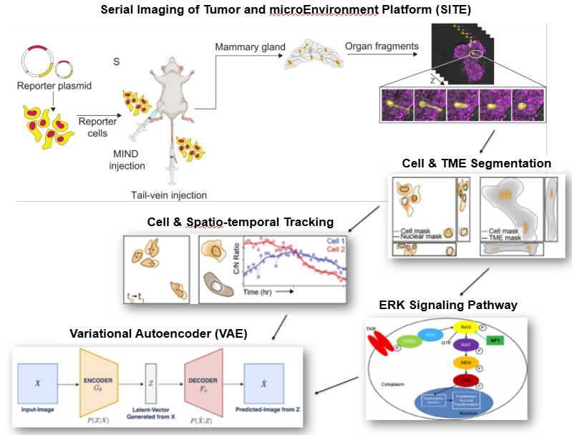
The pipeline
Captures 4D cell interactions with SITE.
Turns images into structured data.
Maps cell movement and ERK signaling.
Detects invasion patterns with a VAE.

Slide 7
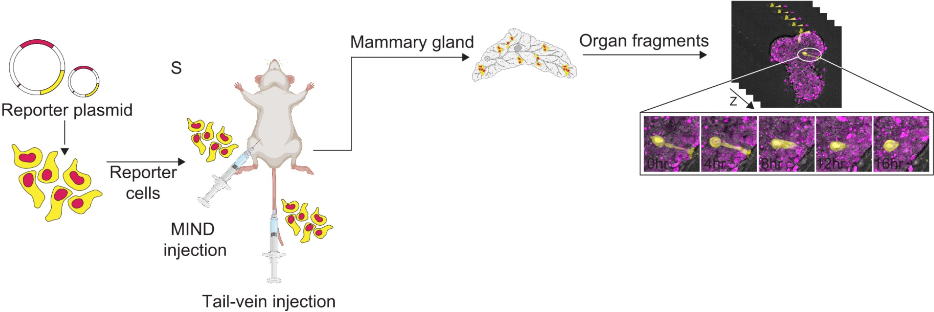
DATa
The SITE platform enables 4D imaging of live-cell interactions and analysis.
Images of ex-vivo host organoids from mammary tissue combined with our tumor cell lines (T4-2, MDA-MB-231) days 0, 2, and 7.
Each 24-hour recording is taken in 20-minute intervals, using 20–30 z-slices spaced 3 μm apart (1024 × 1024 pixels each).

Slide 8
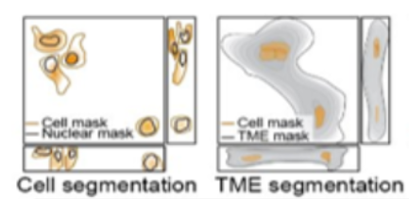
segmentation
Uses software package (Cellpose) to outline key cell features like nuclei and ERK activity.
Identifies surrounding tissue structures, such as host cells, extracellular matrix, and cancer cell regions. (ilastik)

Slide 9
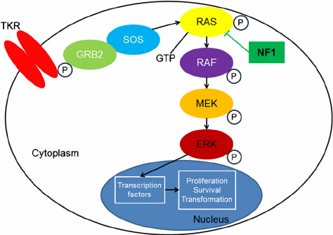
ERK Signaling
ERKTR signaling is tied to cancer growth and changes how cells behave by affecting their ability to multiply, survive, and transform.

Slide 10
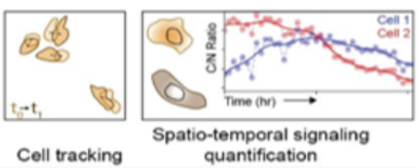
tracking
Maps each cell’s 3D shape, measured how its surface moved, and tracked changes over time.
Matches the same cells across frames by comparing their position and shape.
Analyzes ERK activity based on distance to host tissue, cluster size, cell density, etc.

Slide 11
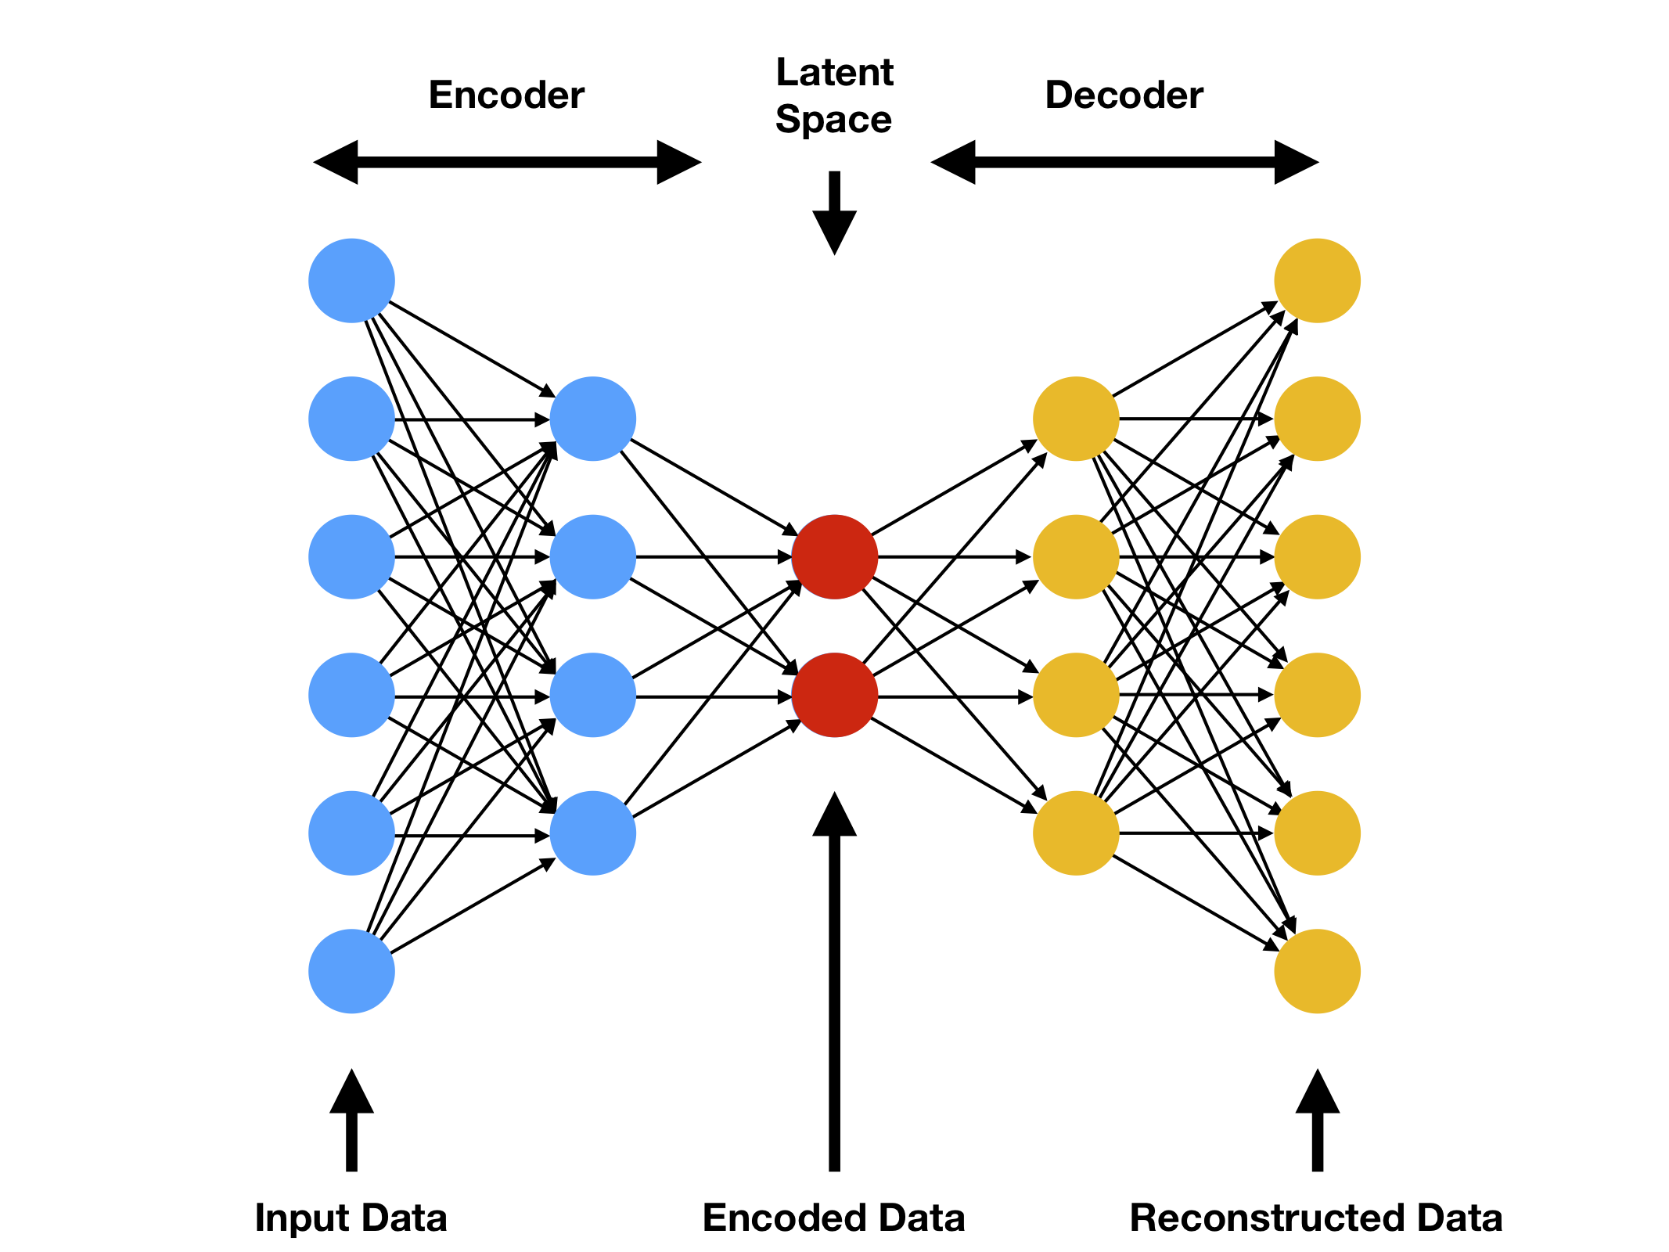
Machine Learning
Trained a variation autoencoder (VAE) on cell images to see if it could identify signs of invasive behavior.

Slide 12
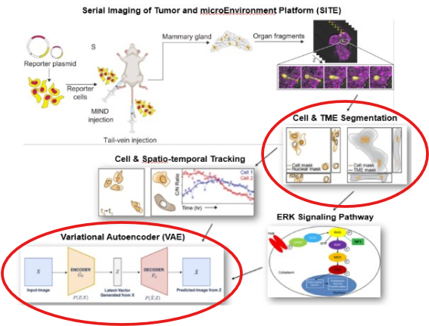
Obejective
To optimize cellular segmentation and explore the use of a
variational autoencoder (VAE) for modeling early-stage invasion dynamics.

Slide 13
Cellpose
Cellpose detects and segments cells in microscopy images, dividing them into meaningful regions.
With large datasets, manual labeling is impossible — segmentation models save time by automating the process.
Models aren’t always accurate, so I trained one with manual annotations, greatly improving segmentation accuracy for cancer cells and downstream tracking of movement and ERK signaling.

Slide 14
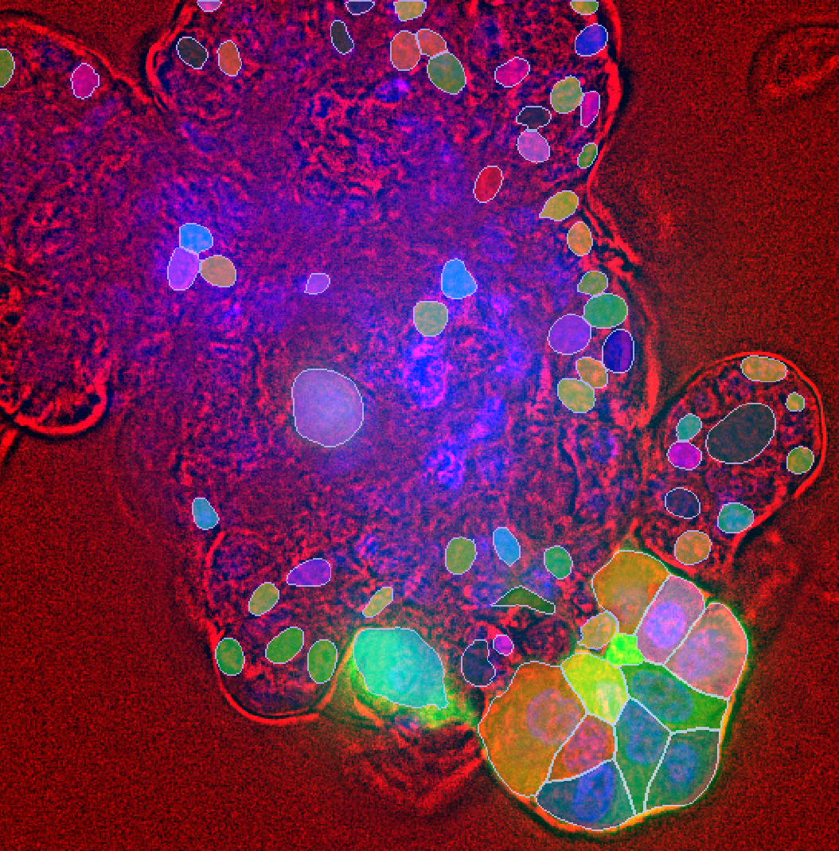
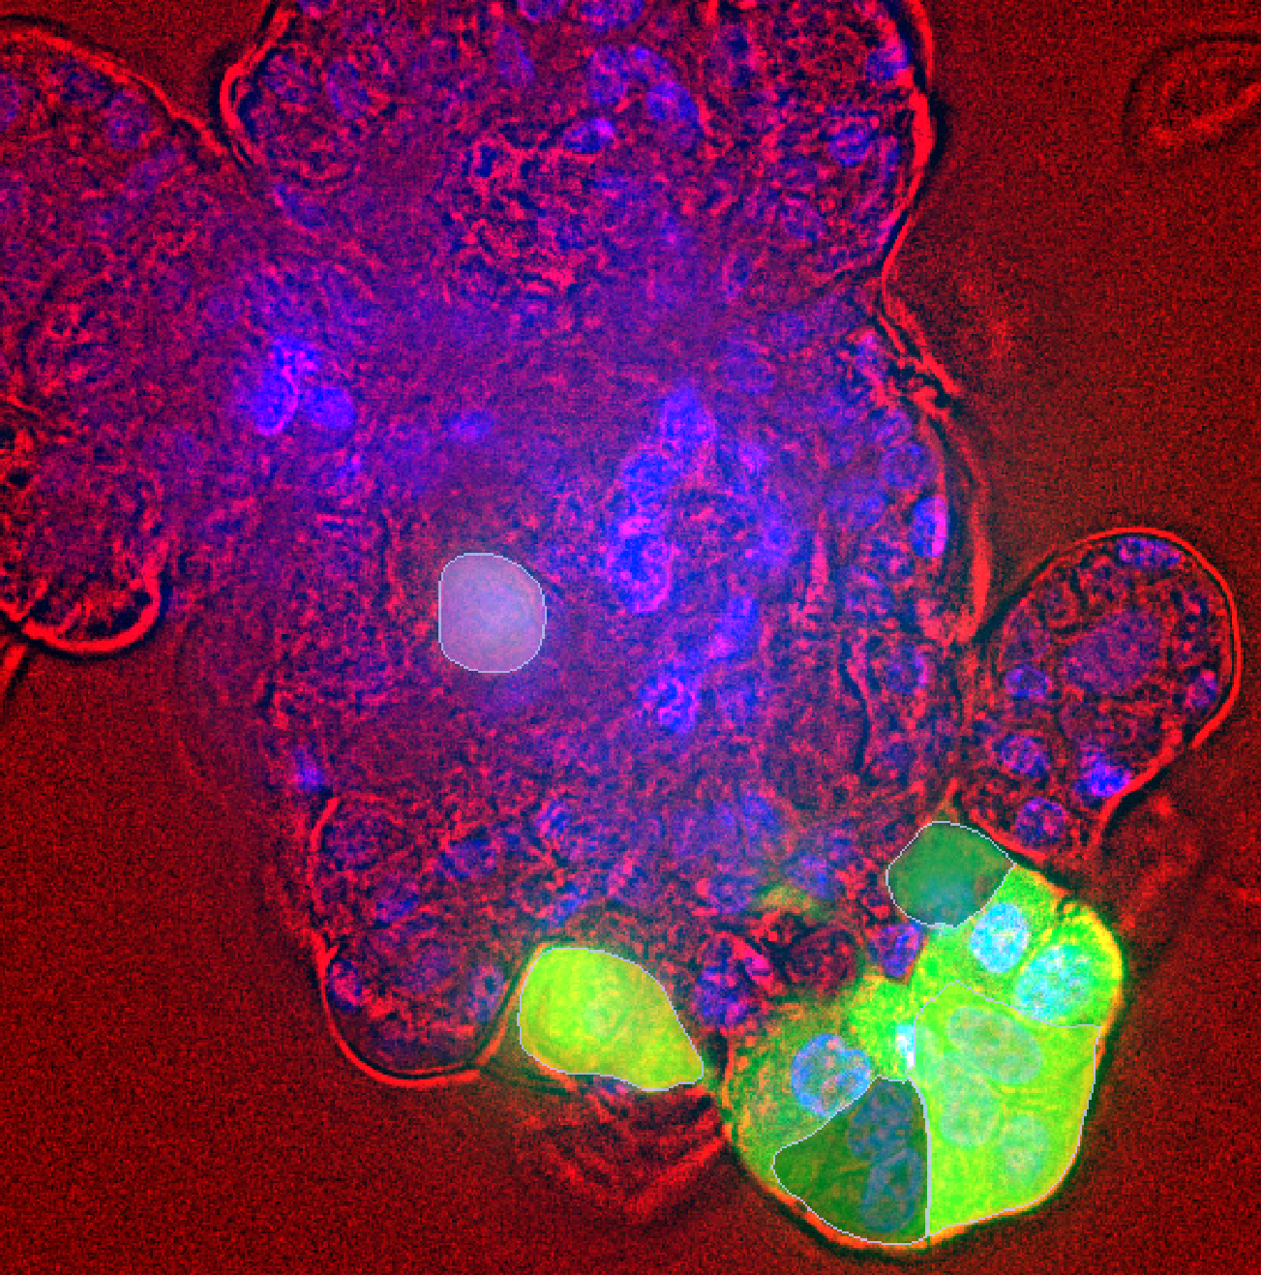
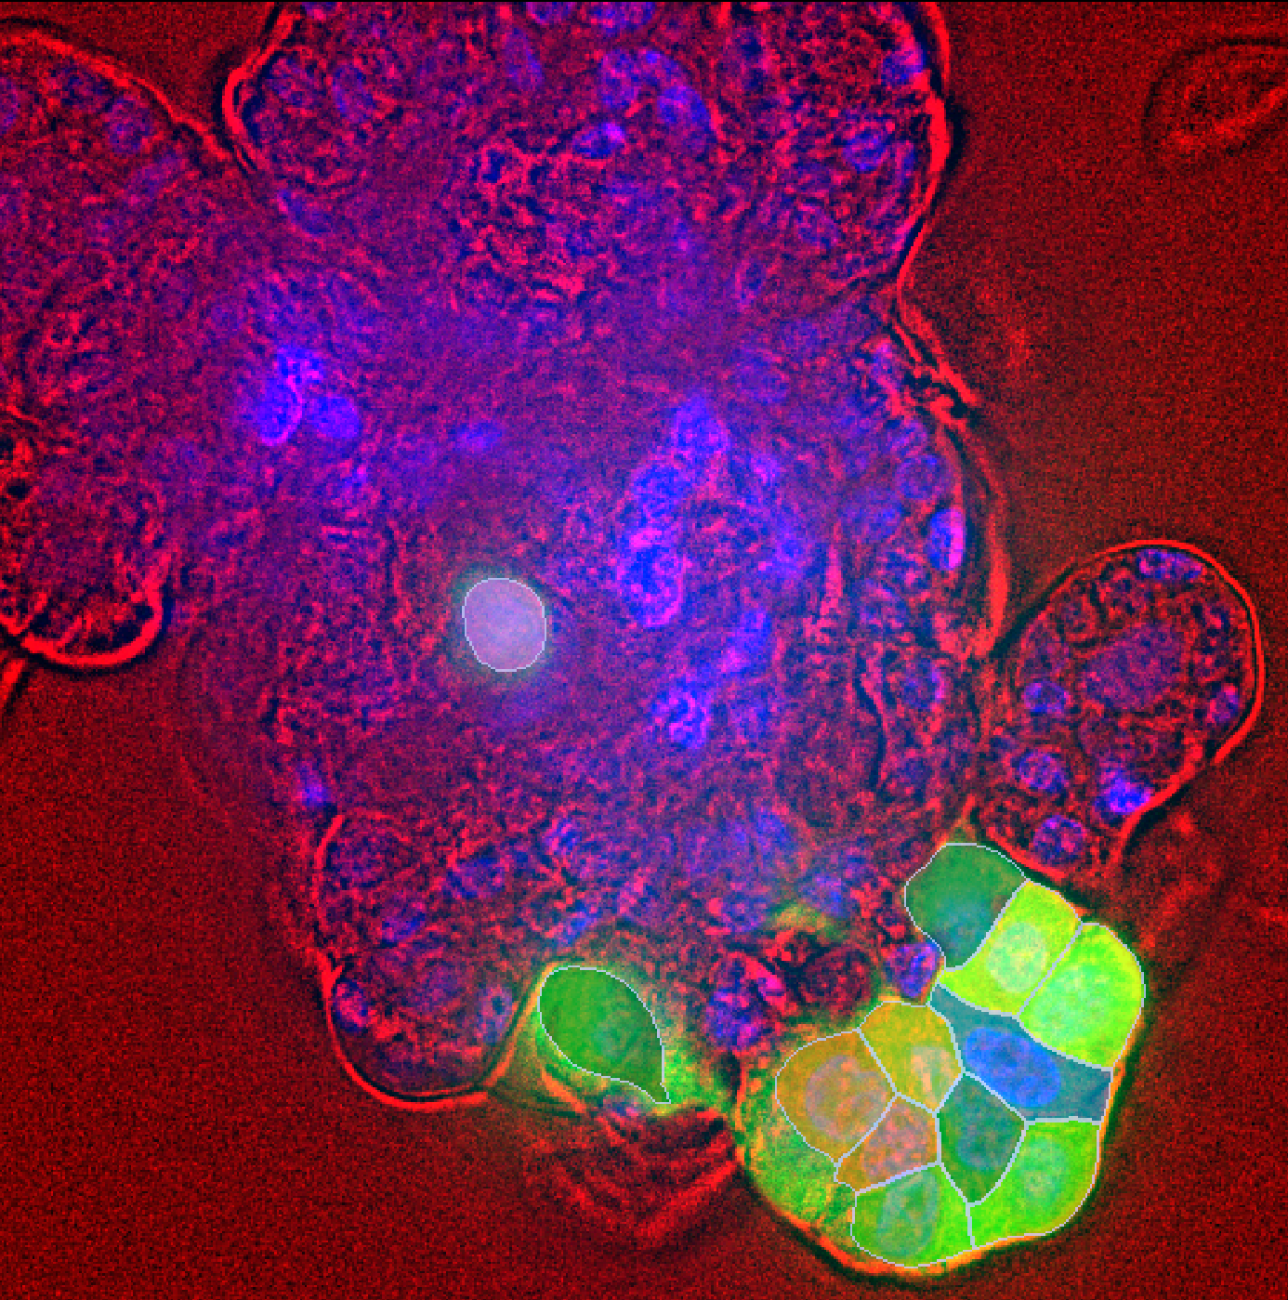
Results
Cellpose3 model
Sanjay's model
Qwyn's model
<-------------------------------------------------T4_Day7_t73_z7_xy1_roi1.tif -------------------------------------------->

Slide 15
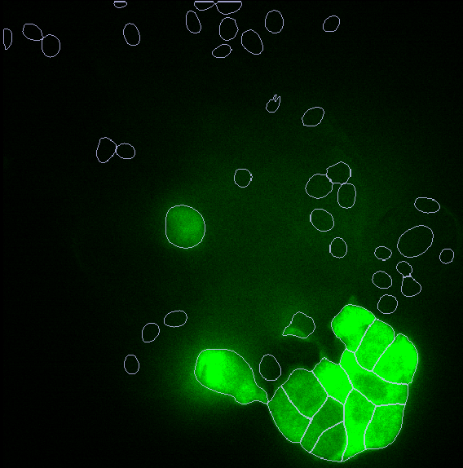
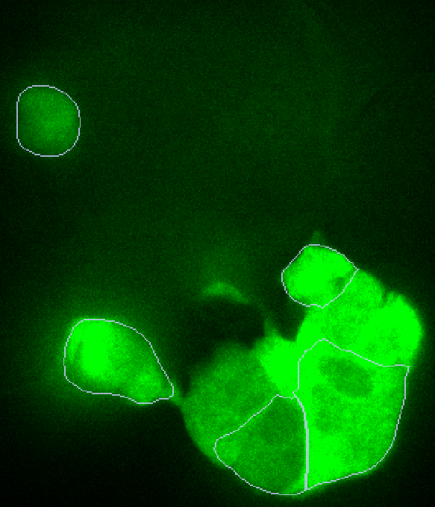
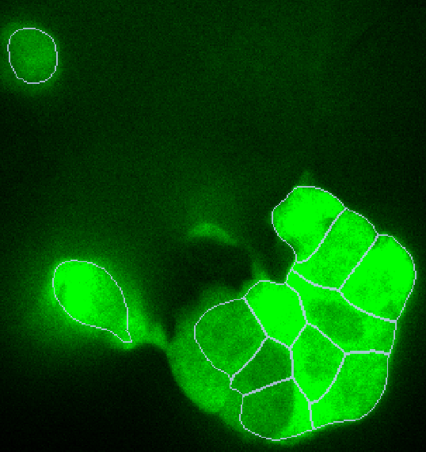
Results
Cellpose3 model
Sanjay's model
Qwyn's model
<-------------------------------------------------T4_Day7_t73_z7_xy1_roi1.tif -------------------------------------------->

Slide 16
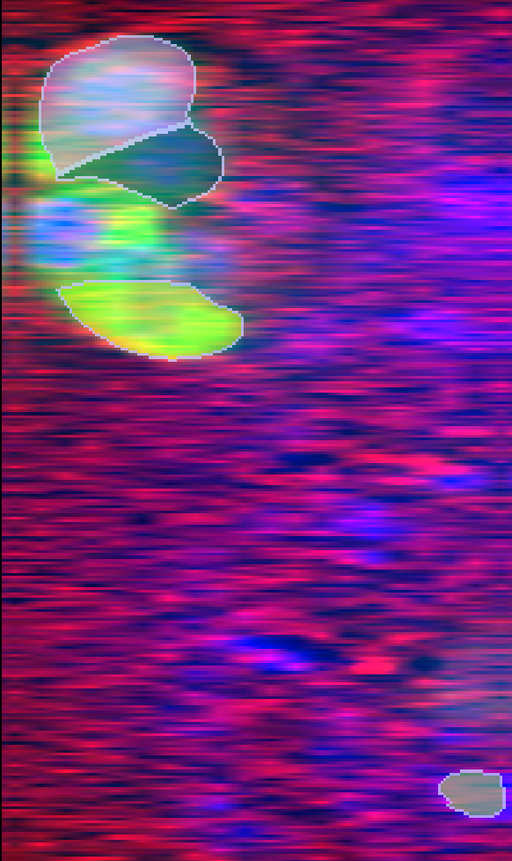
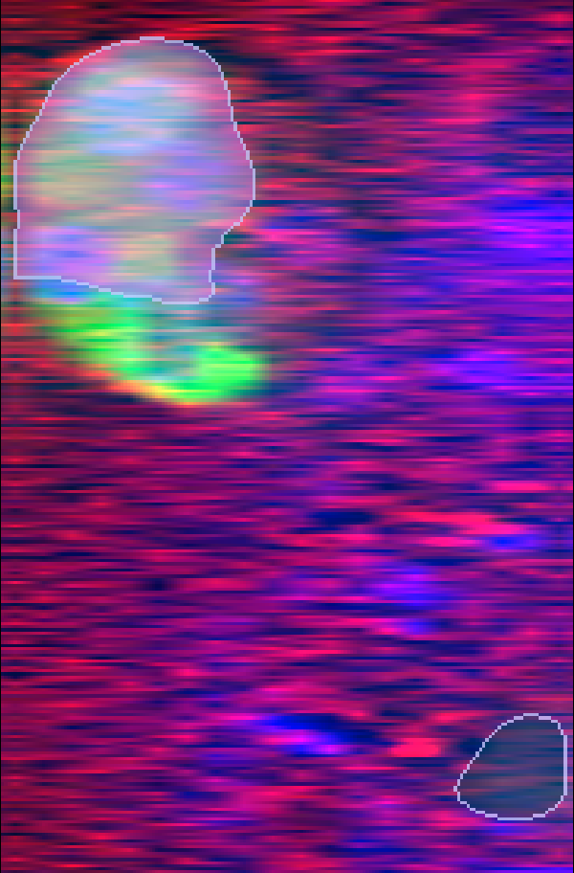
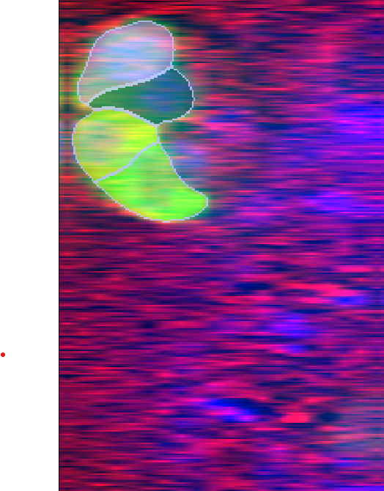
results
Cellpose3 model
Sanjay's model
Qwyn's model
<-------------------------------------------------T4_day7_t73_x1_xy11_roi1.tif -------------------------------------------->

Slide 17
VAe
VAE: A VAE is a neural network that compresses data into a smaller form (called a latent space) and then tries to recreate the original data.
In this process it also learns patterns and variations, which makes it useful for analysis.

Slide 18
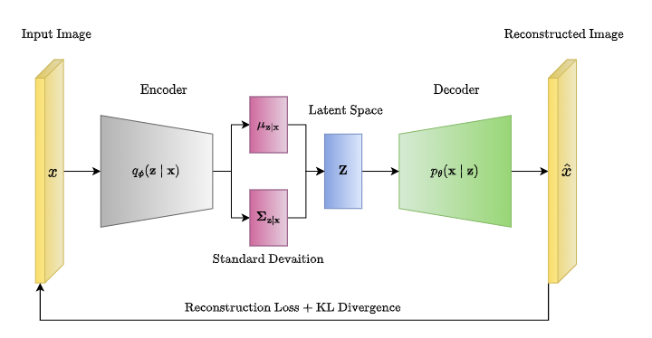

Slide 19
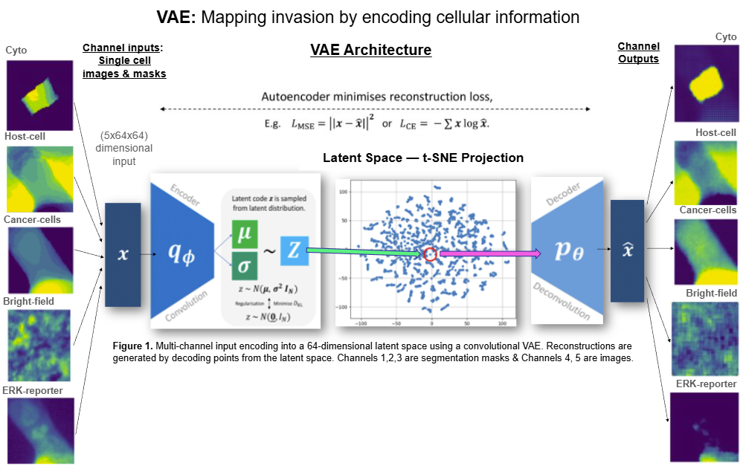

Slide 20

VAe
But wait! Why a VAE exactly?? Why not just use some other method?
Generative = learns patterns, not just finds them — can reconstruct and imagine new data.
Turns compact data into something you can see, not just measure.
Supports prediction by simulating plausible future or unseen behaviors.

Slide 21
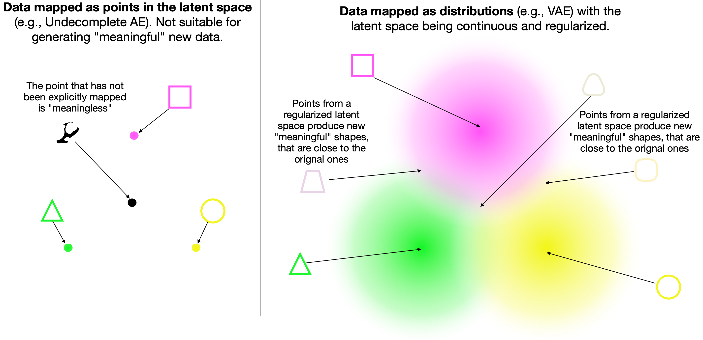

Slide 22
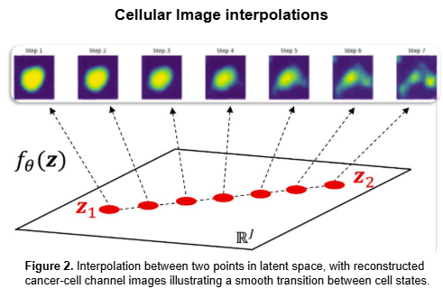
Interpolation: If the latent space actually captured meaningful factors, the decoded images along the path should show smooth, realistic transitions

Slide 23
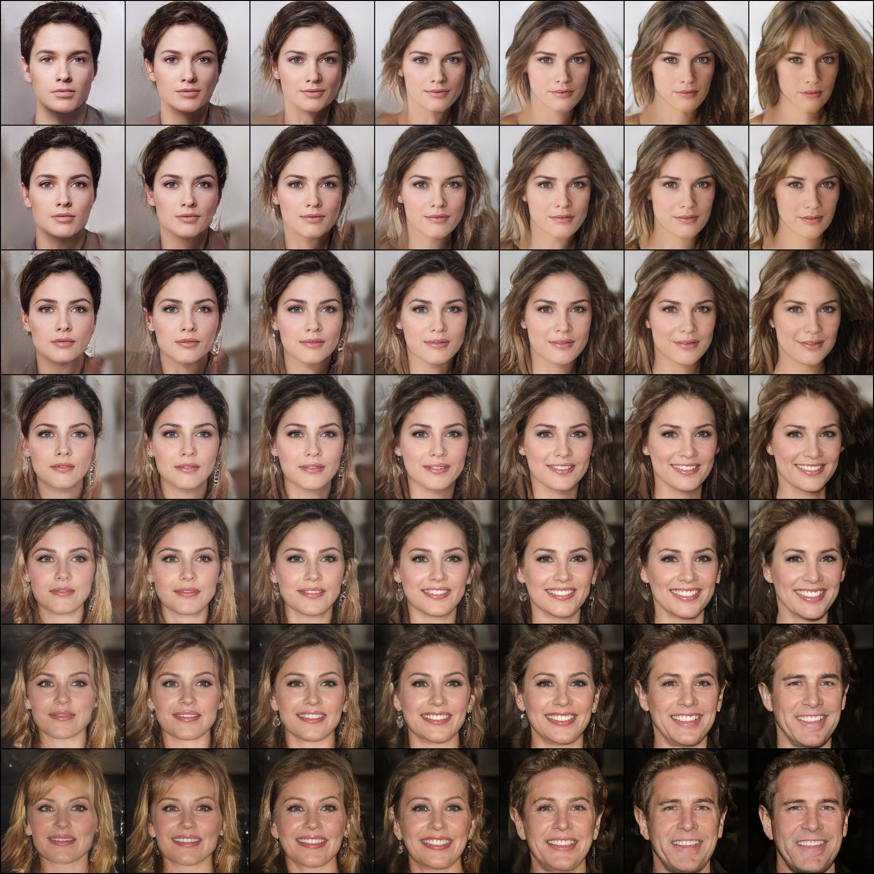

Slide 24
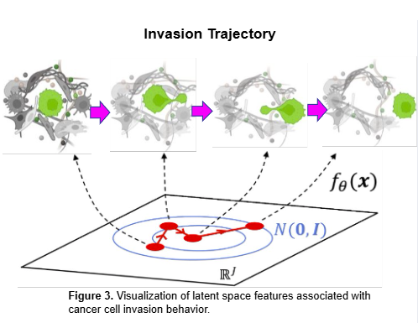
Trajectories link cellular behavior to microenvironment cues
(i.e. host tissue contact -> ERK signaling, cancer cell cluster sizes, etc)

Slide 25
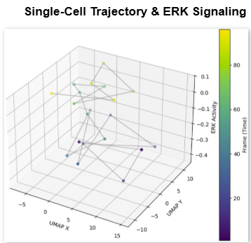
Latent space maps ERK activity to microenvironmental cues

Slide 26

Picture this: a city wakes up to find a crime has been committed. You’re the detective. You’ve got hours of CCTV footage, piles of fingerprints, shoeprints in the mud, and witness statements...but they’re scattered everywhere and way too much to sort through one by one.
A VAE works like your detective’s caseboard. It takes all that messy evidence (in my case, 3D multi-channel cell images) and distills it into neat, connected clues on the board (latent space). Suddenly, patterns emerge: who was near the scene, when people moved, what events happened close together.
Now we can:
1️⃣ Rebuild the crime scene — recreate what happened from the condensed clues (decode)
2️⃣ Connect the dots — imagine the missing moments between two known events (interpolate)
3️⃣ Spot the future culprits — identify which “suspects” or cells are most likely to make their move next. (predict)

Slide 27
Implications
Accurate cellular segmentation is critical for our pipeline, supporting reliable tracking, classification, and measurement, and provides the VAE with high-quality inputs to detect patterns.
VAEs show promise in modeling early-stage invasion by capturing subtle single-cell transitions in latent space. Still, further refinement is required to optimize this approach.

Slide 28

Summary
Cancer in 4D is like a puzzle with thousands of hidden pieces. We’re building tools to see how they fit, and my piece could help reveal what drives cancer cells to invade

Slide 29
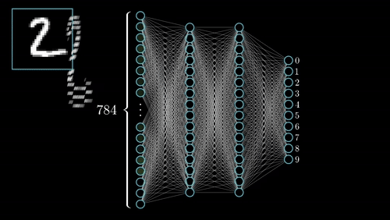
Methods

Slide 30
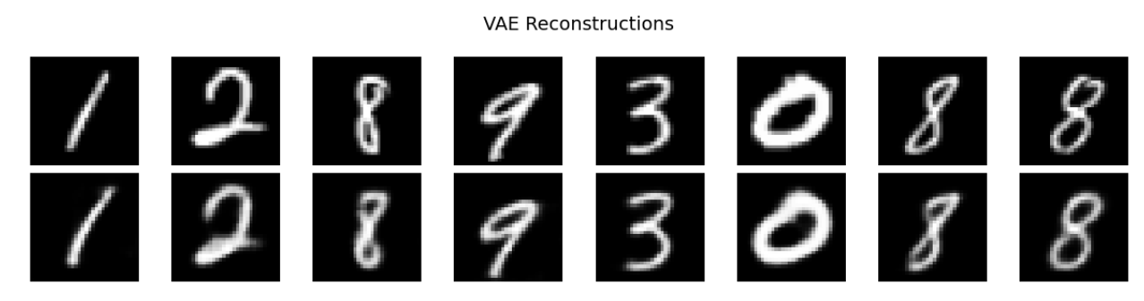
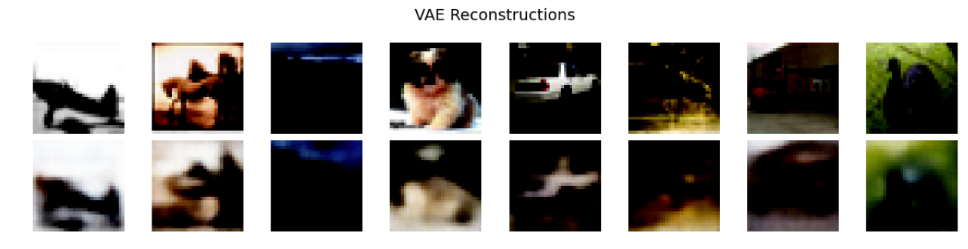
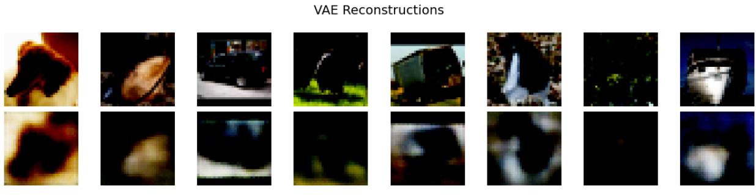
Results

Slide 31
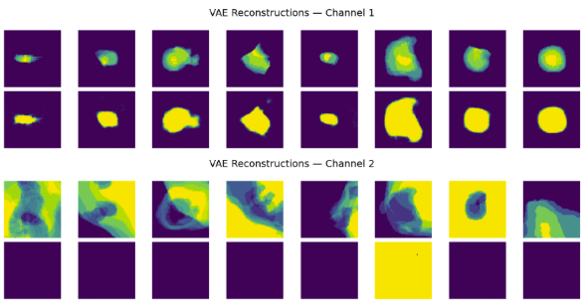
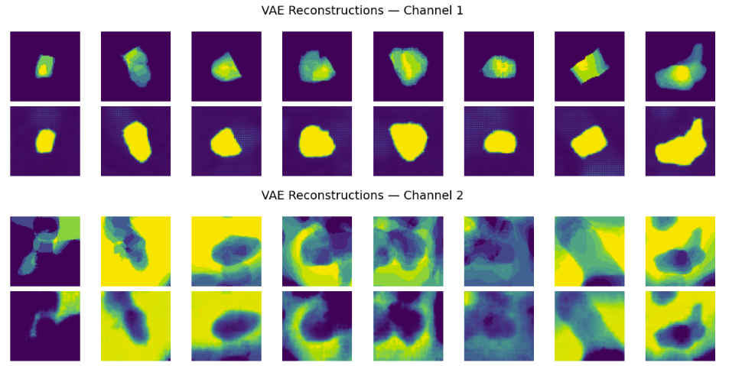
results

Slide 32
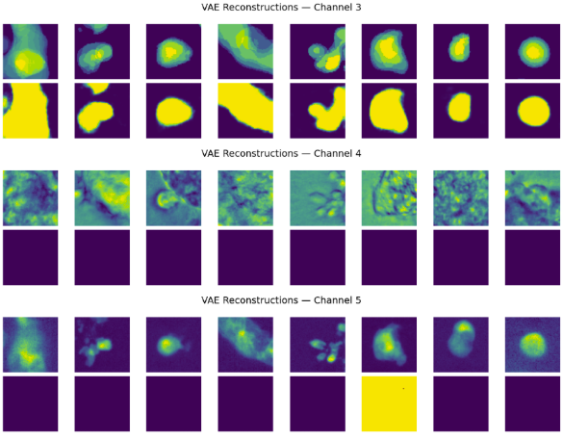
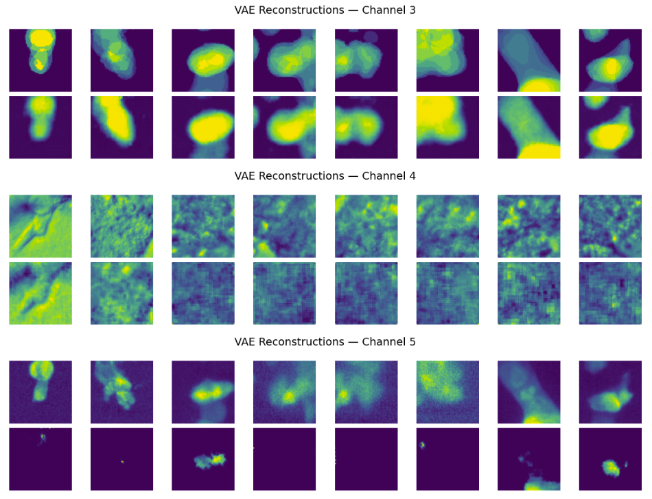
results

Slide 33
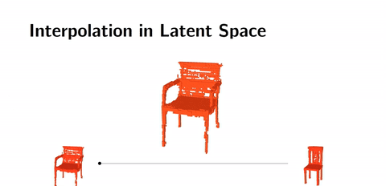
Methods

