Slide 1
Runtime System for GPU-based LU factorization of Hierarchical Low-Rank Matrices & Associated Shared-basis preprocessing
Qianxiang Ma
Rio Yokota Lab
School of Computing
Tokyo Institute of Technology

Slide 2
Presentation Outline
Problem Review
LU factorization
Hierarchical Low-rank Matrices
Necessity of using a runtime system
System design & GPU execution
Specific optimizations for Hierarchical LU

Slide 3
Problem Review

Slide 4
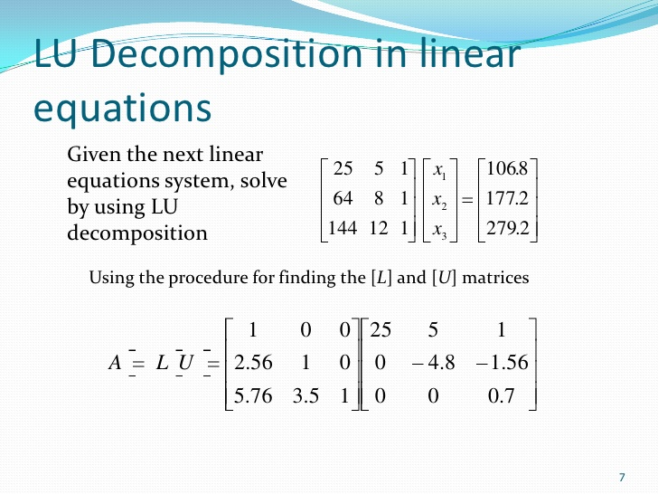
Solving Linear Systems - LU factorizations
Expressed as: Ax = b
A = LU: solve Ly = b then Ux = y
Exact / Dense solver
Compares to:
Inexact iterative solvers
Sparse solvers
https://pt.slideshare.net/gilandio/lu-decomposition

Slide 5
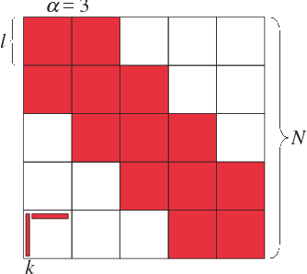
Block Low Rank Matrices
Low rank compression:
Represent blocks as products of matrices of smaller ranks
Kernel matrices:
Higher ranks closer to the diagonal
Blocks further away have lower ranks
https://www.semanticscholar.org/paper/Parallel-Hierarchical-Matrices-with-Block-Low-rank-Ida-Nakashima

Slide 6
Low-rank blocks in Hierarchical Matrix:
Same representations

Slide 7
Runtime System Necessity

Slide 8
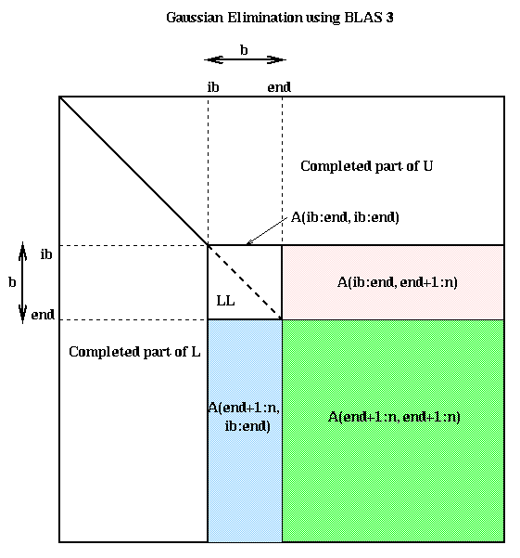
GETRF (In-place LU)
TRSM (Triangular Solve)
GEMM (Mat-Mat Mult)
A = L * U
TRSM needs GETRF results
-1
A = L⁻¹ * B
GEMM needs TRSM results
GETRF needs GEMM results
A~ = A + B * C
https://people.eecs.berkeley.edu/~demmel/cs267/lecture12/lecture12.html
Problem 1:
Data dependency in block & hierarchical LU factorization

Slide 9
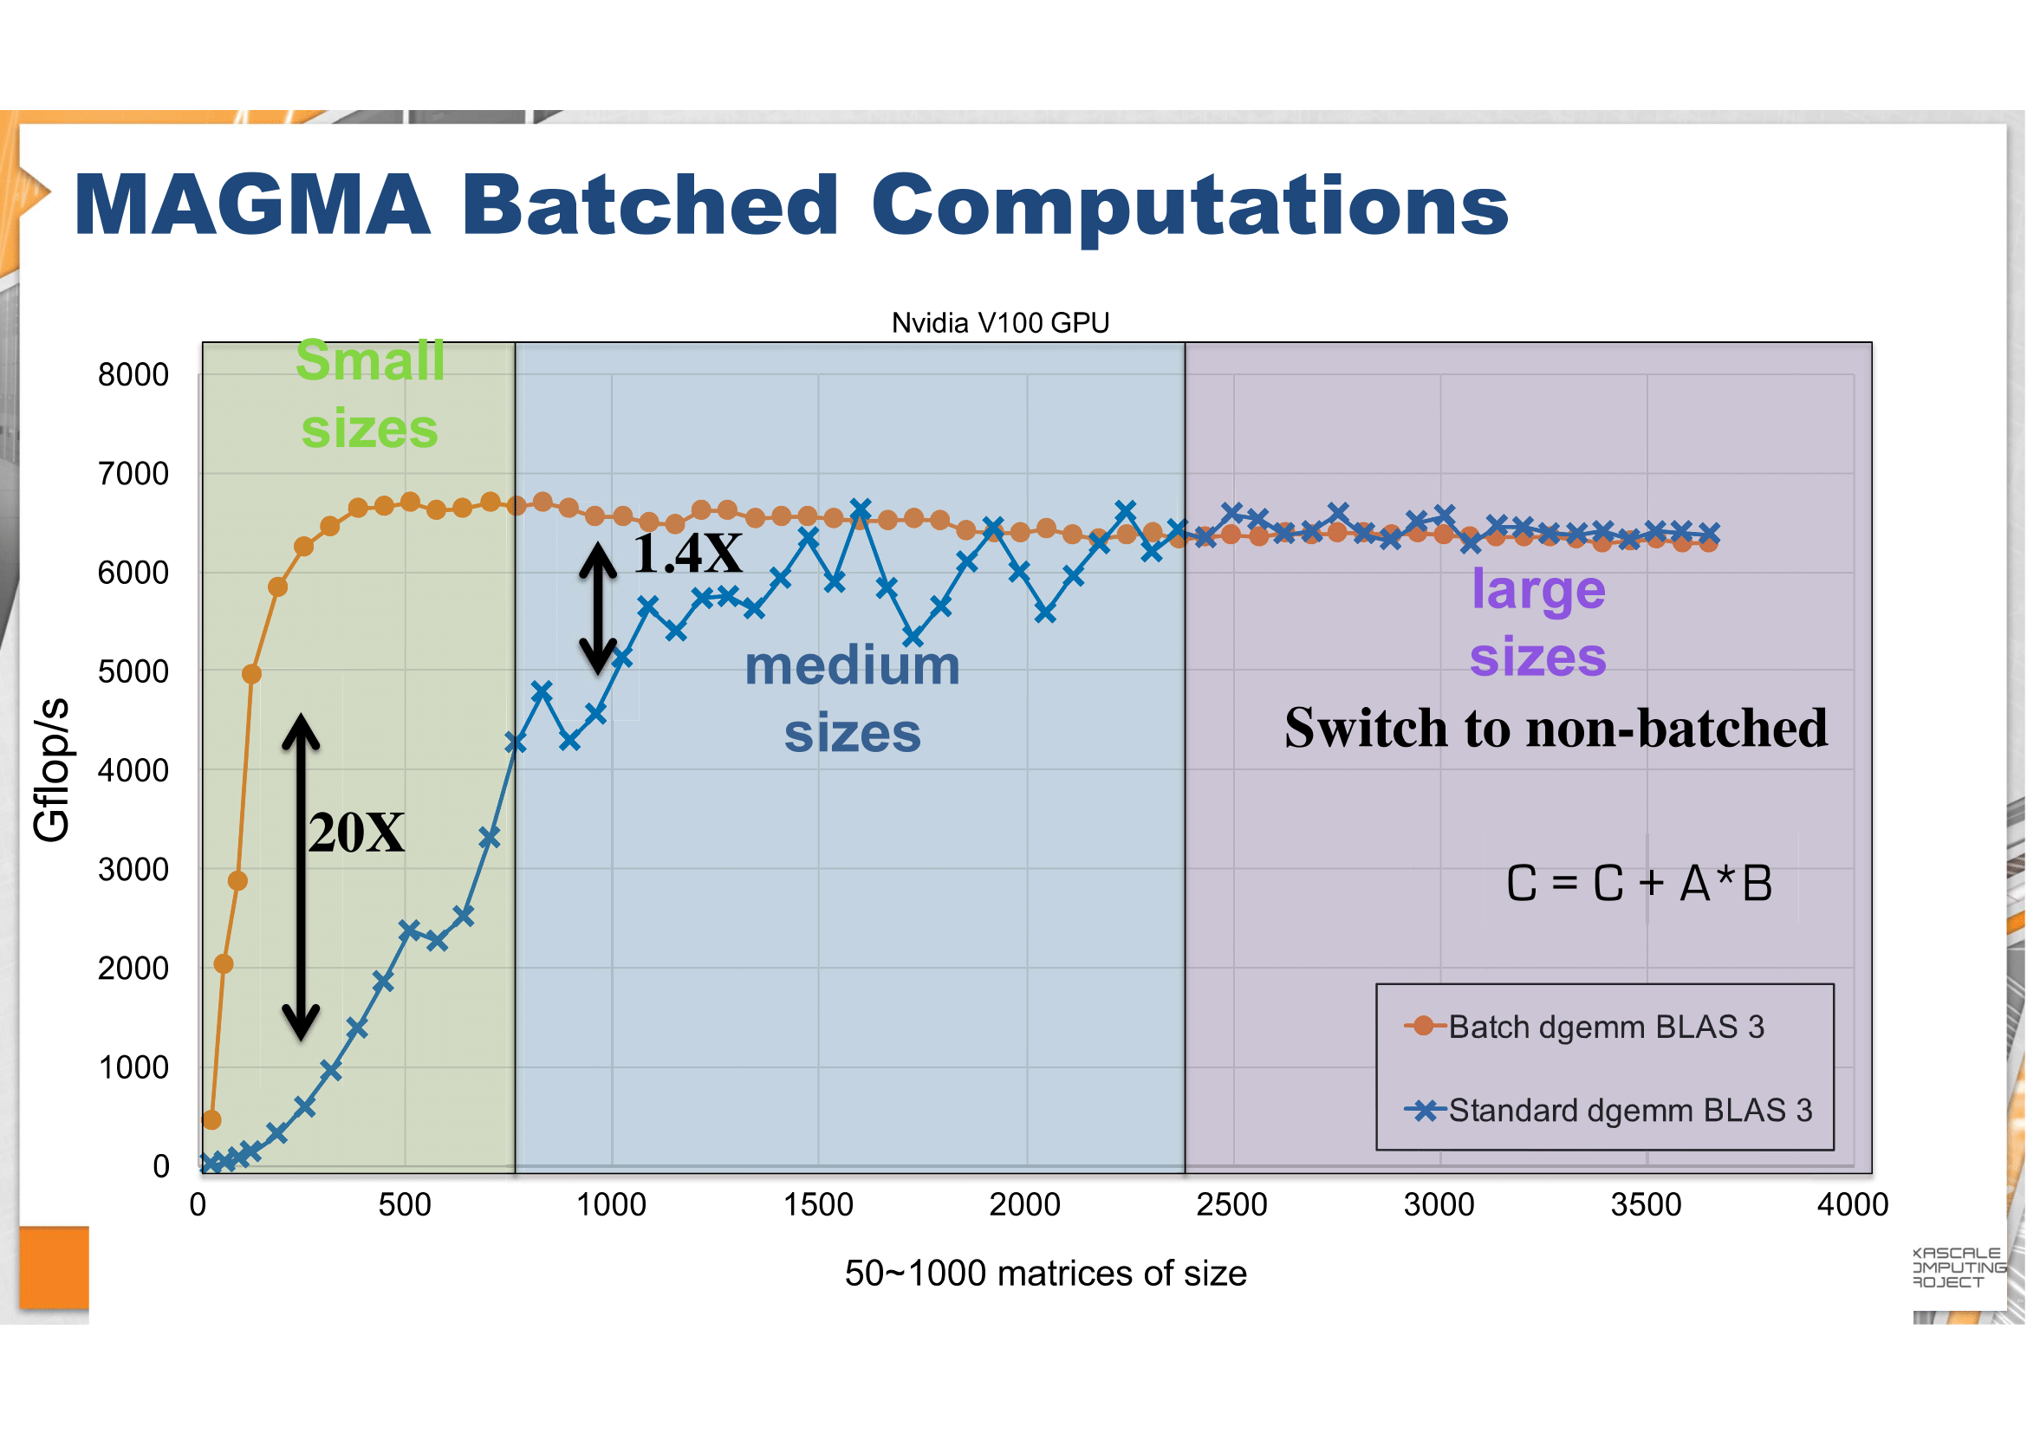
http://icl.utk.edu/projectsfiles/magma/tutorial/ecp2018-magma-tutorial.pdf
Problem 2:
LR blocks can exhibit large kernel setup overheads, if they are not batched.

Slide 10
System Design & GPU Execution

Slide 11
CPU:
1. Processes H-matrix tree structure.
2. Batches tasks together.
GPU:
3. Processes the matrix block by block.

Slide 12
H.GETRF
H.GETRF
D.GETRF
D.TRSM
H.TRSM
LR.TRSM
…
D.GEMM
LR.GEMM
…
…
0. D.GETRF
1. D.TRSM
2. D.GEMM
3. LR.TRSM
4. LR.GEMM
…
1. Task tree generation
2. Tree Flattening &
DAG generation
Worker 1
Exe 0
Exe 1
Worker 2
Wait 1
Exe 2
Worker 3
Wait 0
Exe 3
…
…
Exe 4
GPU readable:
Routine IDs
Matrix Dims
Data Ptrs
…
3. Scheduling the Tasks
4. GPU Inst generation

Slide 13
CUDA Grid
GETRF
TRSM
GEMM
ACCM
GPU readable:
Routine IDs
Matrix Dims
Data Ptrs
…
Thread Block 0
Thread Block 1
-1
Thread Block 2
Thread Block 3
Low-rank Accumulation
LR += LR
Comm Space (Global Mem)

Slide 14
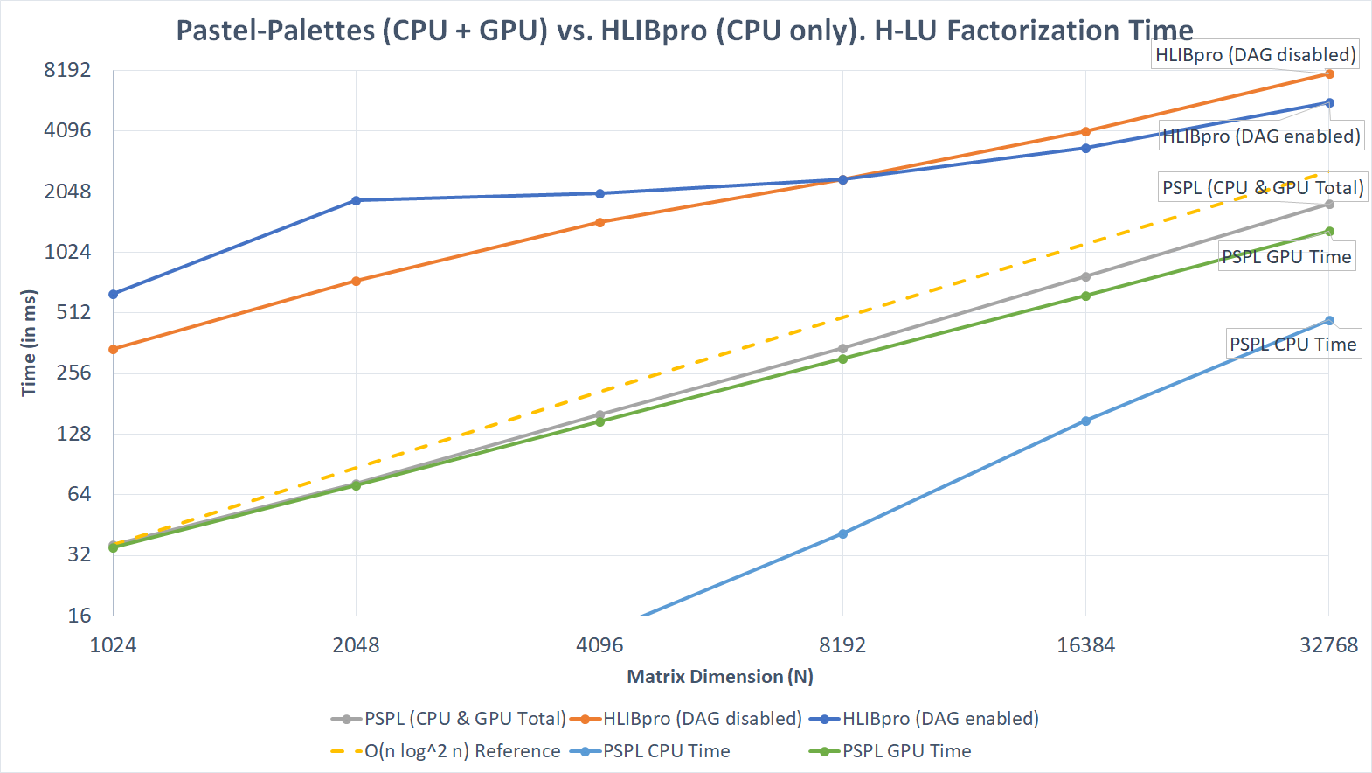

Slide 15
Specific optimizations for Hierarchical LU

Slide 16
1. Dependency Checker
0. D.GETRF
1. D.TRSM
2. D.GEMM
3. LR.TRSM
4. LR.GEMM
…
Traditional:
Check between every two instructions
Deeper hierarchy produces more instructions: O(Levels^3)
Checking between every two instructions complexity: O(Levels^6)!
Flow Dependency:
Read after write
Output Dependency:
Write after write

Slide 17
More Optimized Dependency Checker
Instruction 3 lastly updated this region
Checker state n
Checker state n+1
Graph based
Ignore old instructions
Update as progress
Results:
~40% less DAG density
~?% faster DAG generation
(still being worked on)
A: 1
B: 3
A: 1
B: 3
C: 4
D: 5
C: 4
D: 6
List of dependencies for Instruction 6: D~ = D - B * C
Output dependencies: 5 (from overwriting D)
Flow dependencies: 3, 4 (from reading B, C)
Now instruction 6 is the last one updated region D
Later instructions that reads/writes D only depends on Inst 6

Slide 18
2. More Optimized Intermediate Result Management for GPU
Pre-allocated low-rank accumulators for Dense and Hierarchical blocks
Streaming Multiprocessor (SM) dedicated space for temporary results
Advantages:
GPU focuses on calculation, no more dynamic allocation of memories
No temporary results passed between SMs, avoided race conditions
SM: 0 SM: 1
Dense
Accumulator
Associated with Dense
Accum to Dense
Accum to Accumulator
Intermediate Dense Results
Intermediate Low-rank Results

Slide 19
Plans for the Future

Slide 20
Plans for the Future
1. Shared-basis low rank compressions, that introduces potential speed ups on low rank accumulations
2. Multi-GPU support

Slide 21
Thank you!
Any question is welcomed

