Slide 1
Runtime System for GPU-based LU factorization of Hierarchical Low-Rank Matrices & Associated Shared-basis preprocessing
Qianxiang Ma
Rio Yokota Lab
School of Computing
Tokyo Institute of Technology

Slide 2
Presentation Outline
Problem Review
LU factorization
Hierarchical Low-rank Matrices
Necessity of using a runtime system
System design & GPU execution
Specific optimizations for Hierarchical LU

Slide 3
Problem Review

Slide 4
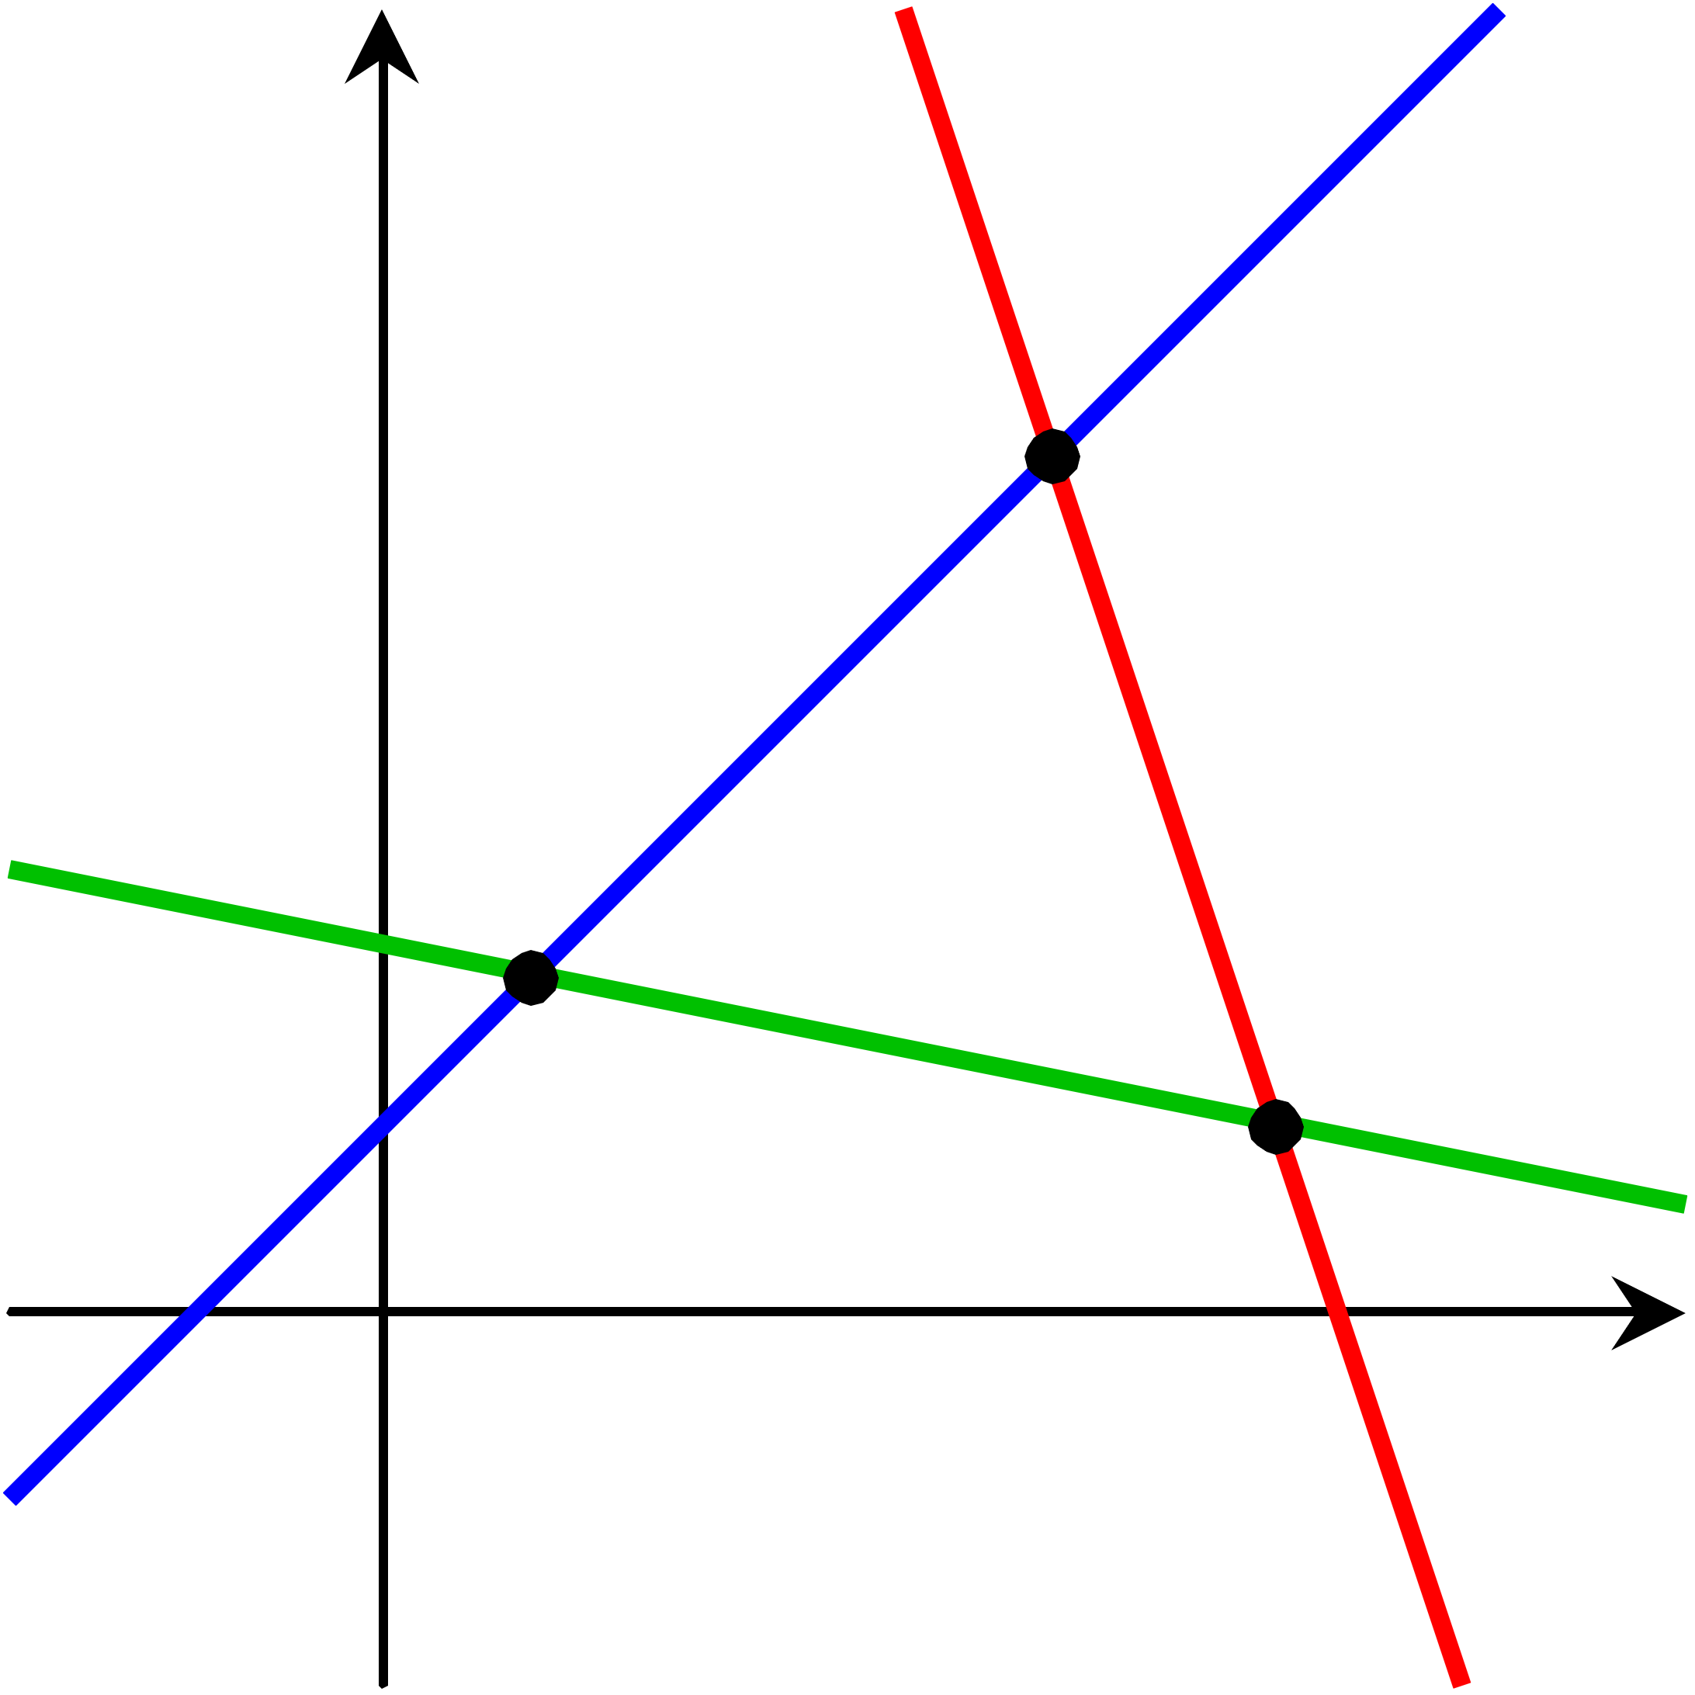
Solving Linear Systems - LU factorizations
Expressed as: Ax = b
A = LU: solve Ly = b then Ux = y
Exact / Dense solver
Compares to:
Inexact iterative solvers
Sparse solvers
https://upload.wikimedia.org/wikipedia/commons/d/df/Three_Lines.svg

Slide 5
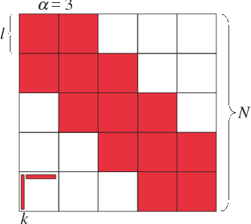
Block Low Rank Matrices
Low rank compression:
Represent blocks as products of matrices of smaller ranks
Kernel matrices:
Higher ranks closer to the diagonal
Blocks further away have lower ranks
https://www.semanticscholar.org/paper/Parallel-Hierarchical-Matrices-with-Block-Low-rank-Ida-Nakashima

Slide 6
Low-rank blocks in Hierarchical Matrix:
Same representations

Slide 7
Runtime System Necessity

Slide 8
Problem 1:
Data dependency in block & hierarchical LU factorization

Slide 9
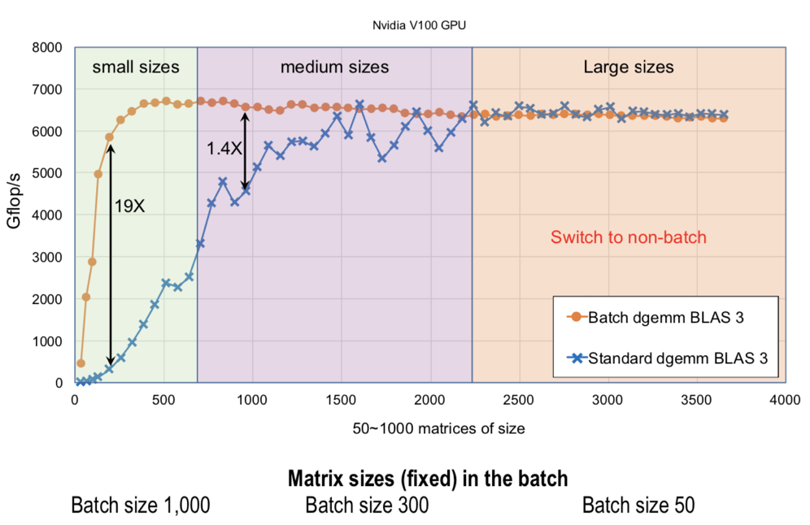
Find where this picture comes from!
Problem 2:
LR blocks can exhibit large kernel setup overheads, if they are not batched.

Slide 10
System Design & GPU Execution

Slide 11
CPU:
1. Processes H-matrix tree structure.
2. Batches tasks together.
GPU:
3. Processes the matrix block by block.

Slide 12
H.GETRF
H.GETRF
D.GETRF
D.TRSM
H.TRSM
LR.TRSM
…
D.GEMM
LR.GEMM
…
…
0. D.GETRF
1. D.TRSM
2. D.GEMM
3. LR.TRSM
4. LR.GEMM
…
1. Task tree generation
2. Tree Flattening &
DAG generation
Worker 1
Exe 0
Exe 1
Worker 2
Wait 1
Exe 2
Worker 3
Wait 0
Exe 3
…
…
Exe 4
GPU readable:
Routine IDs
Matrix Dims
Data Ptrs
…
3. Scheduling the Tasks
4. GPU Inst generation

Slide 13
CUDA Grid
GETRF
TRSM
GEMM
ACCM
GPU readable:
Routine IDs
Matrix Dims
Data Ptrs
…
Thread Block 0
Thread Block 1
Thread Block 2
Thread Block 3
Comm Space (Global Mem)

Slide 14
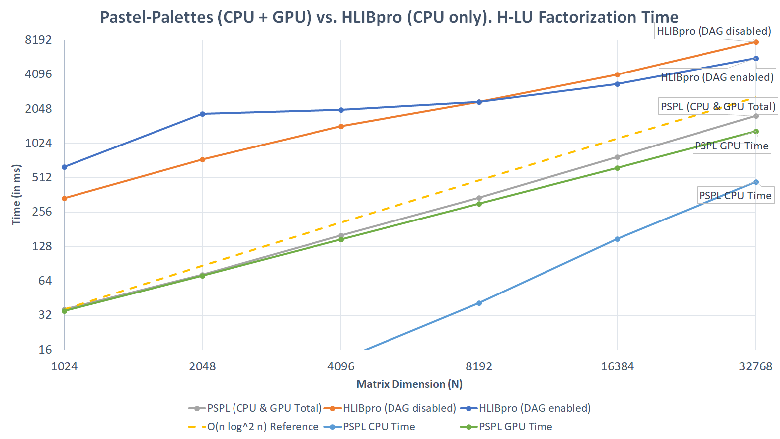

Slide 15
Specific optimizations for Hierarchical LU

Slide 16
1. Dependency Checker
0. D.GETRF
1. D.TRSM
2. D.GEMM
3. LR.TRSM
4. LR.GEMM
…
Traditional:
Check between every two instructions
Deeper hierarchy produces more instructions: O(Levels^3)
Checking between every two instructions complexity: O(Levels^6)!
Flow Dependency:
Read after write
Output Dependency:
Write after write

Slide 17
Optimized Dependency Checker
Graph based
Ignore old instructions
Update as progress
Results:
~40% less DAG density
~?% faster serial DAG generation
A: 1
B: 3
A: 1
B: 3
C: 4
D: 5
C: 4
D: 6
Instruction 6: D = D - B * C
Output dependencies: 5
Flow dependencies: 3, 4

Slide 18
2. Optimized Intermediate Result Management for GPU
Pre-allocated low-rank accumulators for Dense and Hierarchical blocks
Streaming Multiprocessor (SM) dedicated space for temporary results
Advantages:
GPU focuses on calculation, no more dynamic allocation of memories
No temporary results passed between SMs, avoided race conditions
SM: 0 SM: 1
Dense
Accumulator
Associated with Dense
Accum to Dense
Accum to Accumulator
Intermediate Dense Results
Intermediate Low-rank Results

Slide 19
Plans for the Future

Slide 20
Plans for the Future
1. Shared-basis low rank compressions, that introduces potential speed ups on low rank accumulations
2. Multi-GPU support

Slide 21
Thank you!
Any question is welcomed

