Slide 1
Factorization of Hierarchical Low-rank Matrices with Nested Basis
Qianxiang Ma
Rio Yokota Lab
School of Computing
Tokyo Institute of Technology

Slide 2
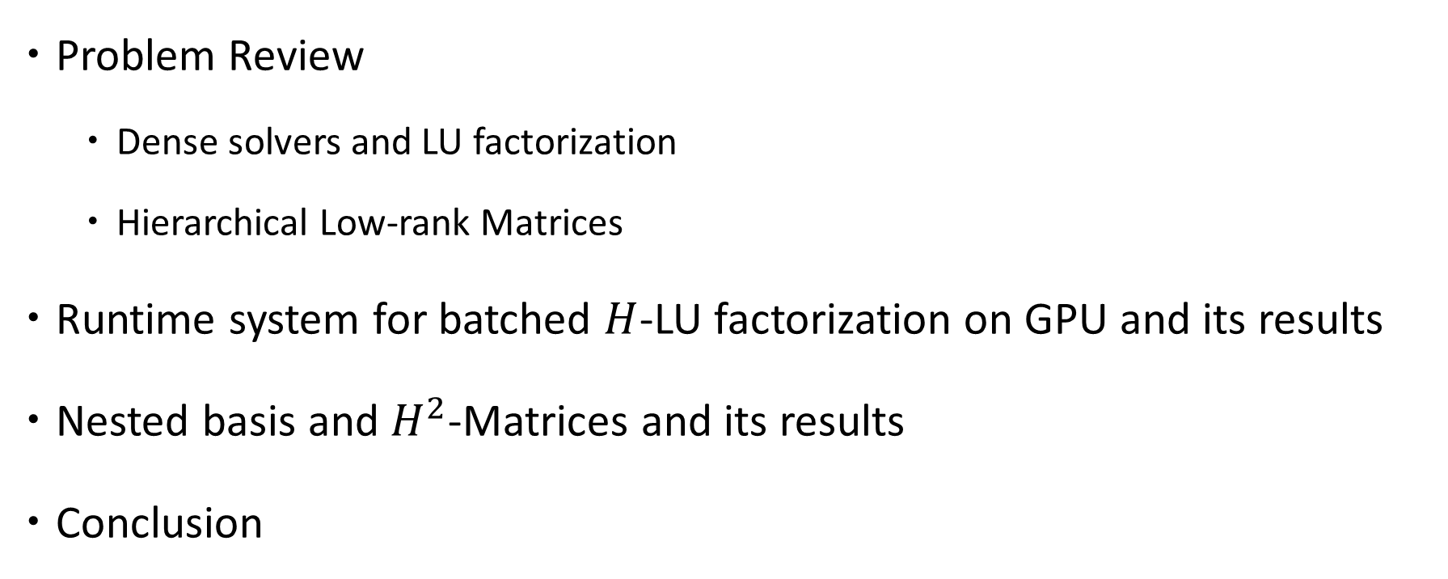
Presentation Outline
Problem Review
Dense solvers and LU factorization
Hierarchical Low-rank Matrices
Runtime system for batched $H$-LU factorization on GPU and its results
Nested basis and $H^{2}$-Matrices and its results
Conclusion

Slide 3
Problem Review

Slide 4
Block Low Rank Matrices
Low-rank approximation:
Represent blocks as products of matrices of smaller ranks
Kernel matrices:
Full in entries / not sparse
Higher ranks closer to the diagonal
Blocks further away have lower ranks
Green’s function, radial basis functions etc.

Slide 5

Admissibility Condition
0 1
Low-rank approximated
X Cluster { }
Y Cluster { }
Well Separated Distance - Admissible
X Cluster { }
Y Cluster { }
Dense matrix
High Entanglement - Not Admissible

Slide 6
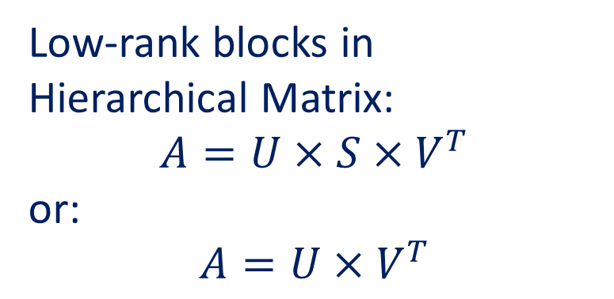
Low-rank blocks in Hierarchical Matrix:
$$A=U×S×V^{T}$$
or:
$$A=U×V^{T}$$

Slide 7
Solving Linear Systems - LU factorization
Solvers
Dense matrix
Sparse matrix
Gaussian Elimination
LU Factorization
Iterative
Direct
Expressed as: Ax = b
A = LU: solve Ly = b then Ux = y
Direct / Dense solver
Compares to:
Inexact iterative solvers
Sparse solvers
L
U

Slide 8
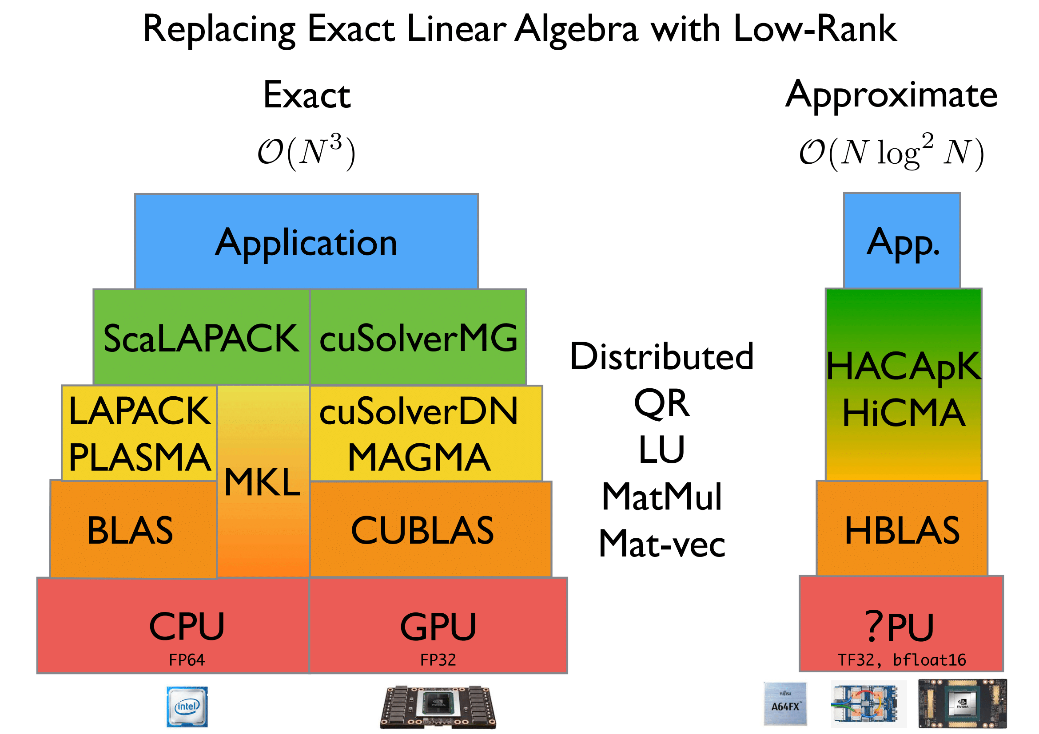
H-LU Factorization

Slide 9
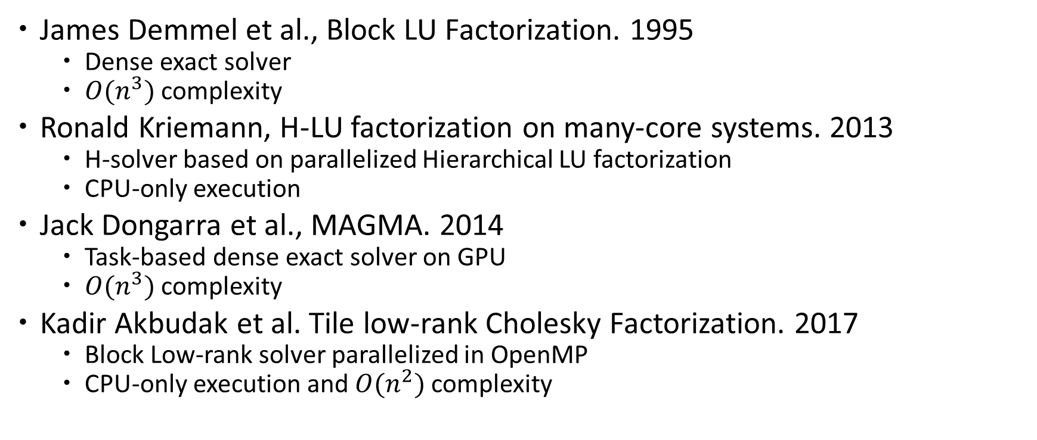
Related Work
James Demmel et al., Block LU Factorization. 1995
Dense exact solver
$O(n^{3})$ complexity
Ronald Kriemann, H-LU factorization on many-core systems. 2013
H-solver based on parallelized Hierarchical LU factorization
CPU-only execution
Jack Dongarra et al., MAGMA. 2014
Task-based dense exact solver on GPU
$O(n^{3})$ complexity
Kadir Akbudak et al. Tile low-rank Cholesky Factorization. 2017
Block Low-rank solver parallelized in OpenMP
CPU-only execution and $O(n^{2})$ complexity

Slide 10
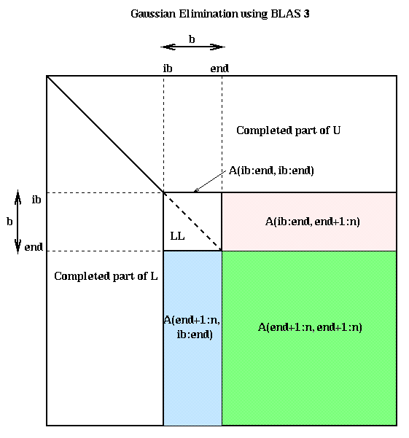
GETRF (In-place LU)
TRSM (Triangular Solve)
GEMM (Mat-Mat Mult)
A = L * U
TRSM needs GETRF results
-1
A = L⁻¹ * B
GEMM needs TRSM results
GETRF needs GEMM results
A = A + B * C
https://people.eecs.berkeley.edu/~demmel/cs267/lecture12/lecture12.html
Problem 1:
Data dependency in block & hierarchical LU factorization

Slide 11
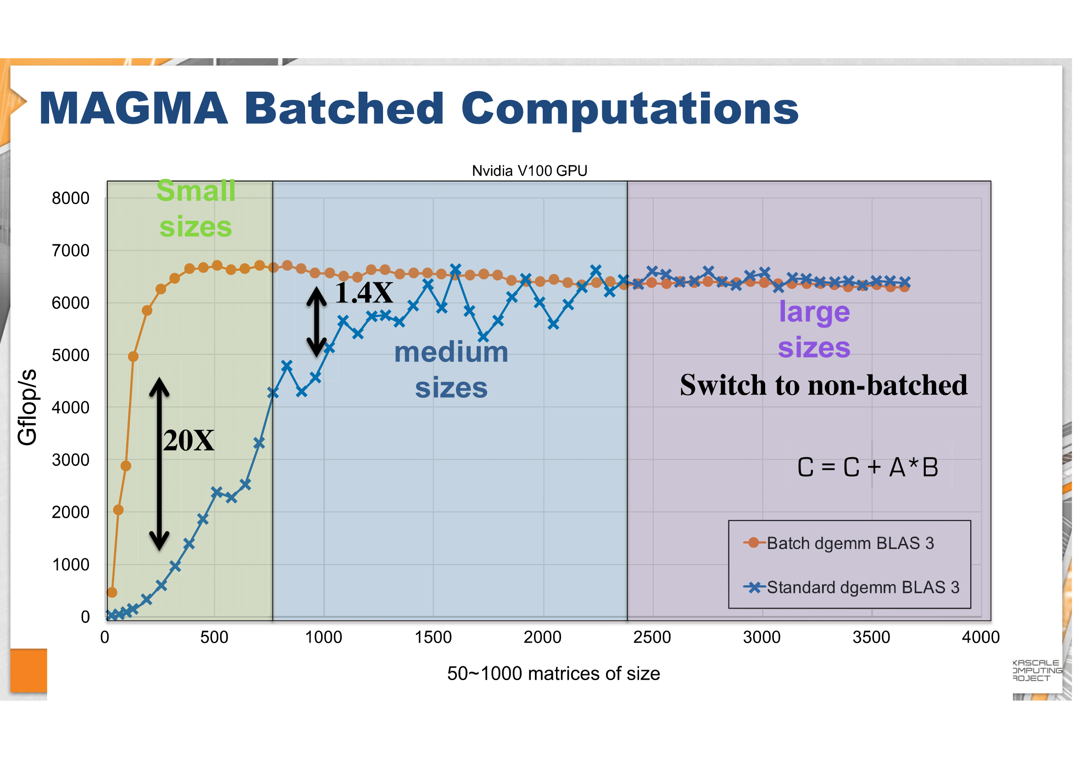
http://icl.utk.edu/projectsfiles/magma/tutorial/ecp2018-magma-tutorial.pdf
Problem 2:
LR blocks can exhibit large kernel setup overheads, if they are not batched.

Slide 12
Runtime System Design

Slide 13
CPU:
1. Processes H-matrix tree structure.
2. Batches tasks together.
GPU:
3. Processes the matrix block by block.

Slide 14
H.GETRF
H.GETRF
D.GETRF
D.TRSM
H.TRSM
LR.TRSM
…
D.GEMM
LR.GEMM
…
…
0. D.GETRF
1. D.TRSM
2. D.GEMM
3. LR.TRSM
4. LR.GEMM
…
1. Task tree generation
2. Tree Flattening &
DAG generation
Worker 1
Exe 0
Exe 1
Worker 2
Wait 1
Exe 2
Worker 3
Wait 0
Exe 3
…
…
Exe 4
GPU readable:
Routine IDs
Matrix Dims
Data Ptrs
…
3. Scheduling the Tasks
4. GPU Inst generation

Slide 15
CUDA Grid
GETRF
TRSM
GEMM
ACCM
GPU readable:
Routine IDs
Matrix Dims
Data Ptrs
…
Thread Block 0
Thread Block 1
-1
Thread Block 2
Thread Block 3
Low-rank Accumulation
LR += LR
Comm Space (Global Mem)

Slide 16
1. Dependency Checker
0. D.GETRF
1. D.TRSM
2. D.GEMM
3. LR.TRSM
4. LR.GEMM
…
Naive:
Check between every two instructions
More optimized:
Inherits dependency relations from parent operation
Flow Dependency:
Read after write
Output Dependency:
Write after write

Slide 17
2. Scheduler
Worker 1
Exe 0
Exe 1
Worker 2
Wait 1
Exe 2
Worker 3
Wait 0
Exe 3
…
…
Exe 4
3 Heuristics
Schedule using FLOPs estimates
Everyone busy;
Start early

Slide 18
2. Scheduler
Worker 1
Exe 0
Exe 1
Worker 2
Wait 1
Exe 2
Worker 3
Wait 0
Exe 3
…
…
Exe 4
3 Heuristics
Schedule using FLOPs estimates
Dependency relations
Some are idle;
Least wait
Dependent Task

Slide 19
2. Scheduler
Worker 1
Exe 0
Exe 1
Worker 2
Wait 1
Exe 2
Worker 3
Wait 0
Exe 3
…
…
Exe 4
3 Heuristics
Schedule using FLOPs estimates
Dependency relations
Reduce Communications
Start right after dependent task finishes
Dependent Task

Slide 20
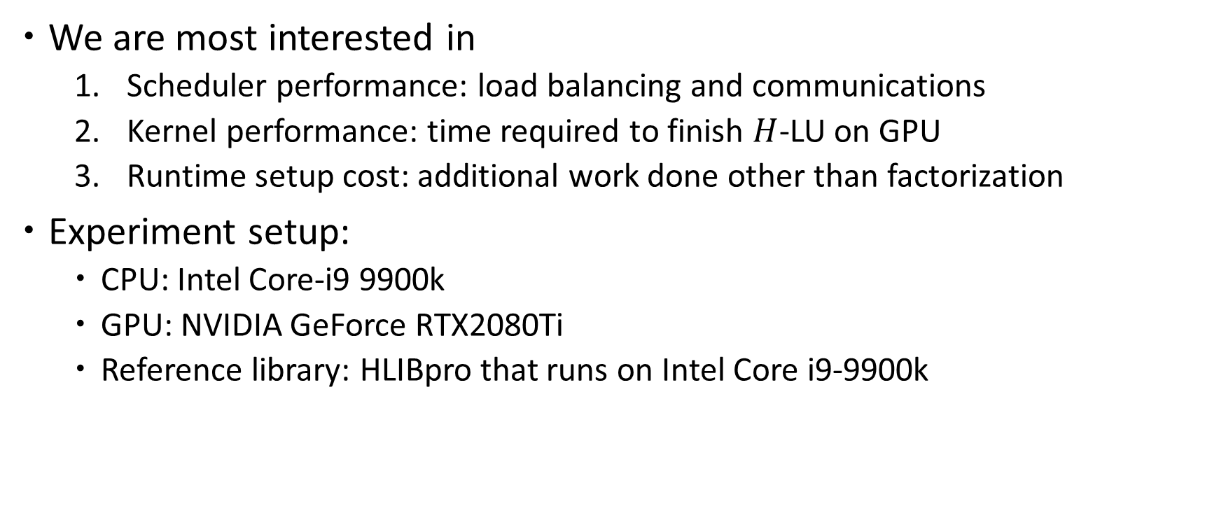
Experiments and Results
We are most interested in
Scheduler performance: load balancing and communications
Kernel performance: time required to finish $H$-LU on GPU
Runtime setup cost: additional work done other than factorization
Experiment setup:
CPU: Intel Core-i9 9900k
GPU: NVIDIA GeForce RTX2080Ti
Reference library: HLIBpro that runs on Intel Core i9-9900k

Slide 21
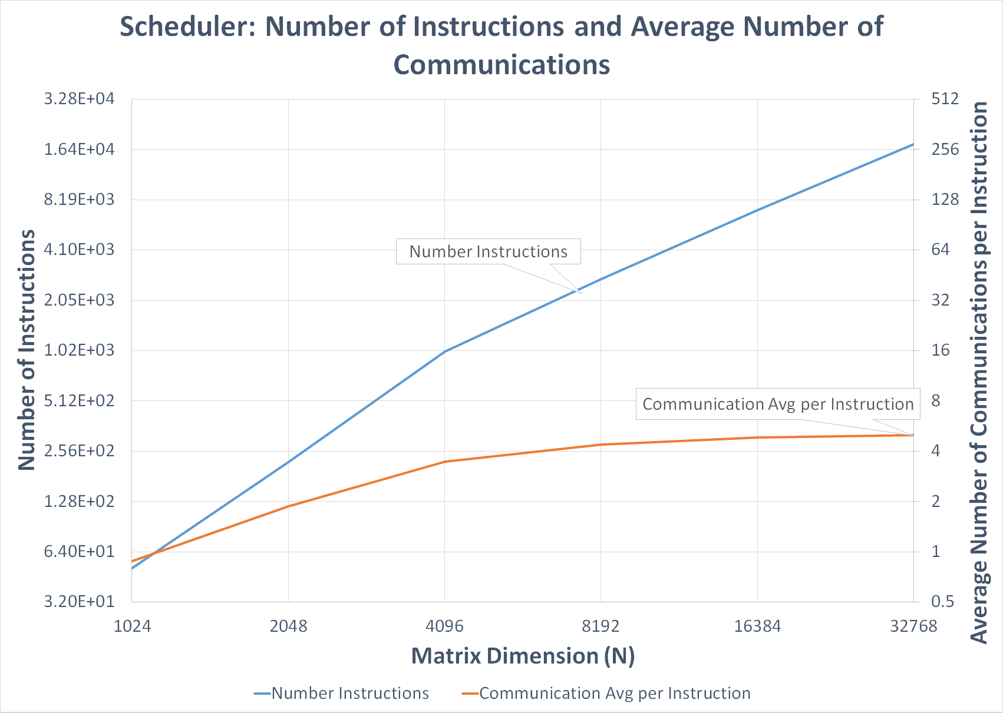
21

Slide 22
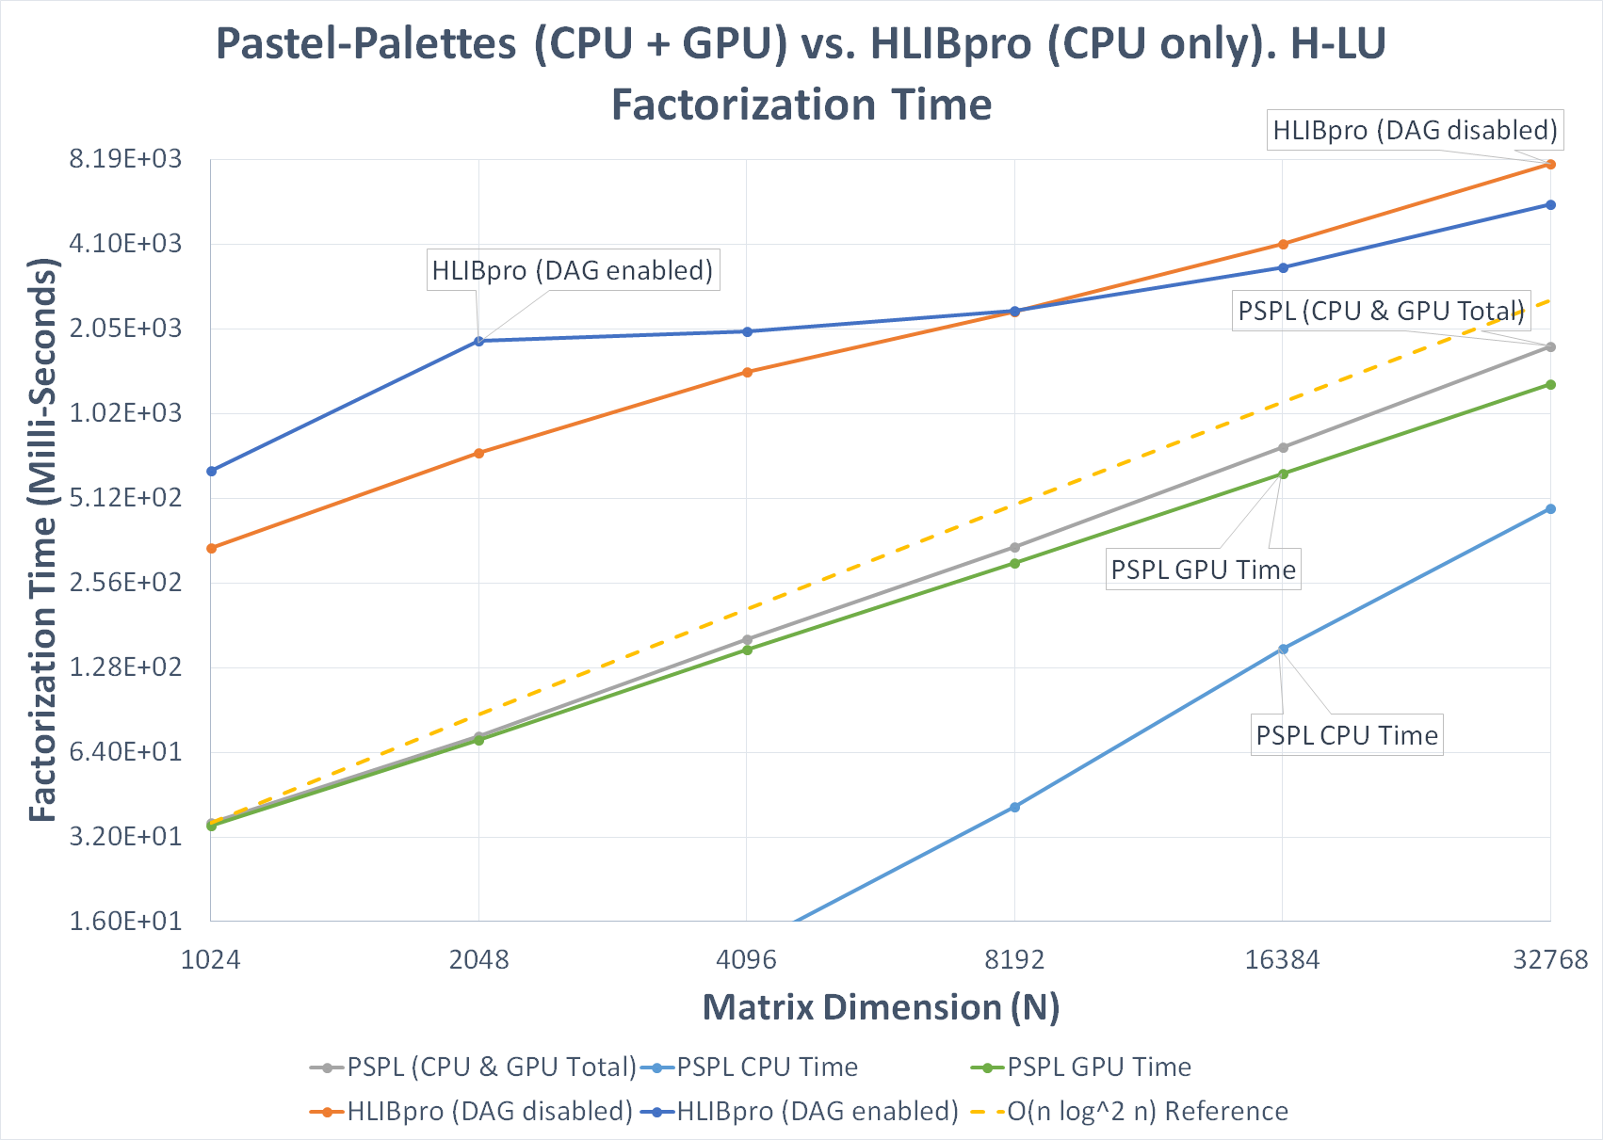
22

Slide 23
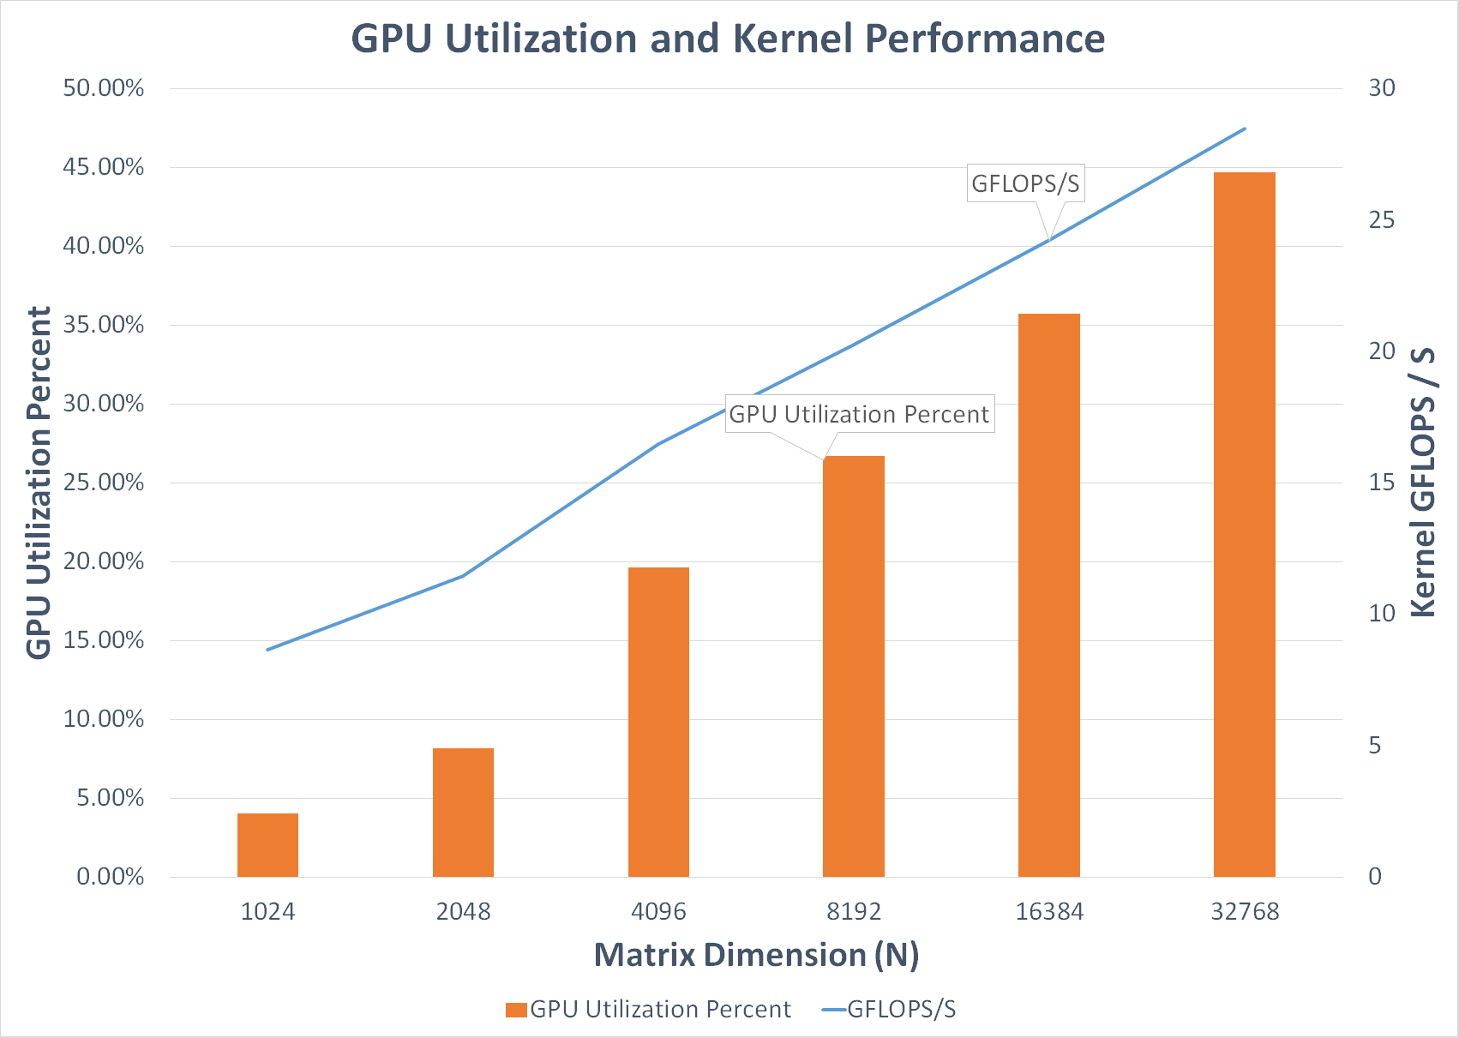
23

Slide 24

Nested basis and $H^{2}$-Matrices

Slide 25
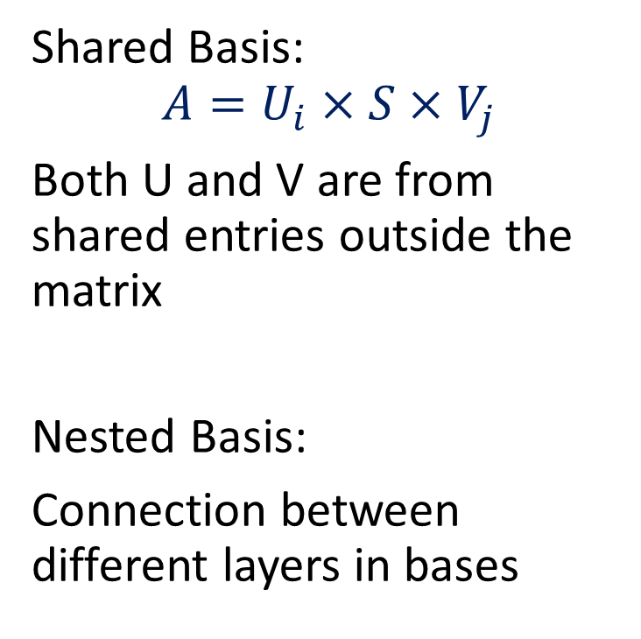
H2-Matrix
Shared Basis:
$$A=U_{i}×S×V_{j}$$
Both U and V are from shared entries outside the matrix
Nested Basis:
Connection between different layers in bases
U
H-Matrix
V
H2-Matrix

Slide 26
H2-Matrix Construction
Cluster basis construction - directly from the entries, 4 steps
Accumulation (Top-down recursion on hierarchy)
Propagation (Top-down recursion on basis)
Orthogonalization (Top-down recursion on basis)
Translation (Top-down recursion on basis)
Cluster basis constructed using admissibility condition
(More error but generally faster)

Slide 27
Split
Slice the U and V portion to use in the hierarchical matrix
V:
U:

Slide 28
Split in nested basis context
V:
V:
Slice the U and V portion to use in the hierarchical matrix
Multiplied by translation matrices, sliced parts still shares the basis
U:
U:

Slide 29
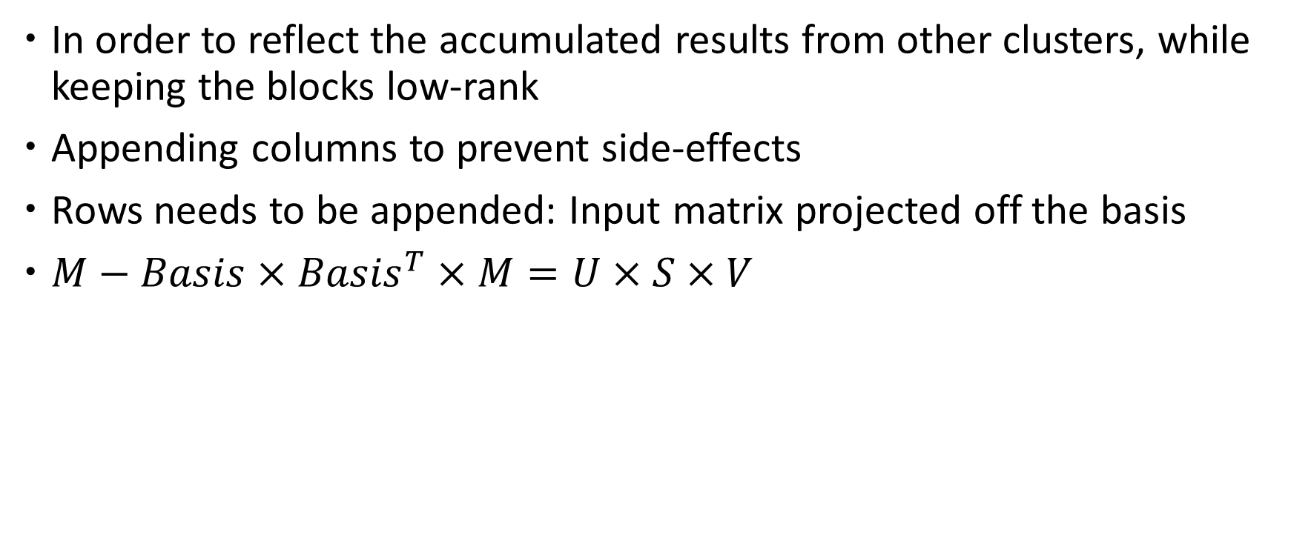
Nested basis update
In order to reflect the accumulated results from other clusters, while keeping the blocks low-rank
Appending columns to prevent side-effects
Rows needs to be appended: Input matrix projected off the basis
$M−Basis×{Basis}^{T}×M=U×S×V$
Enlarged S uses the original entries + appended rows
Other S uses only the original entries, so no contents changed

Slide 30
Experiments and Results
We are most interested in:
Construction of nested basis: comparing with H-matrix and its algorithmic complexity
Storage cost difference between H2-matrix and H-matrix
Accuracy of H2-LU factorization and H-LU factorization, with respect to larger matrix dimensions
Experiment setup:
CPU: Intel Core-i9 9900k
Reference: H-LU factorized results from GPU

Slide 31
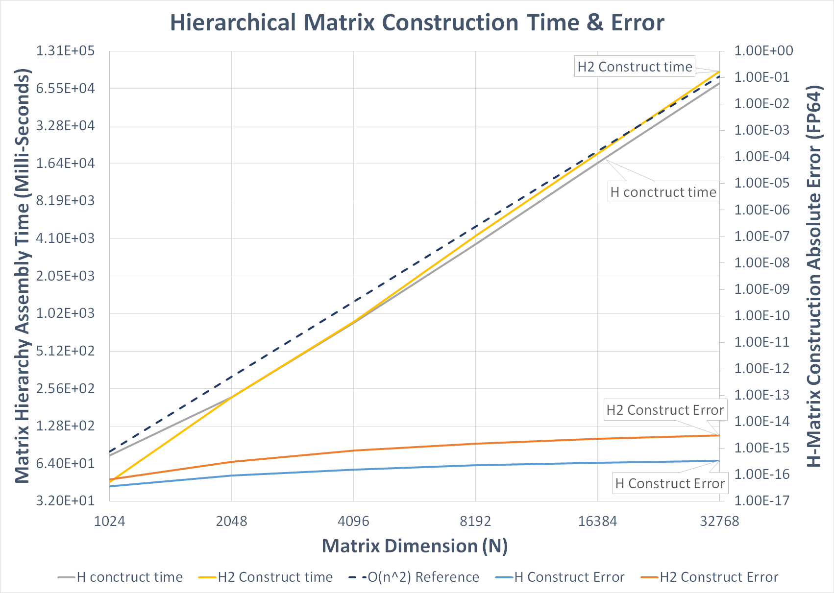
31

Slide 32
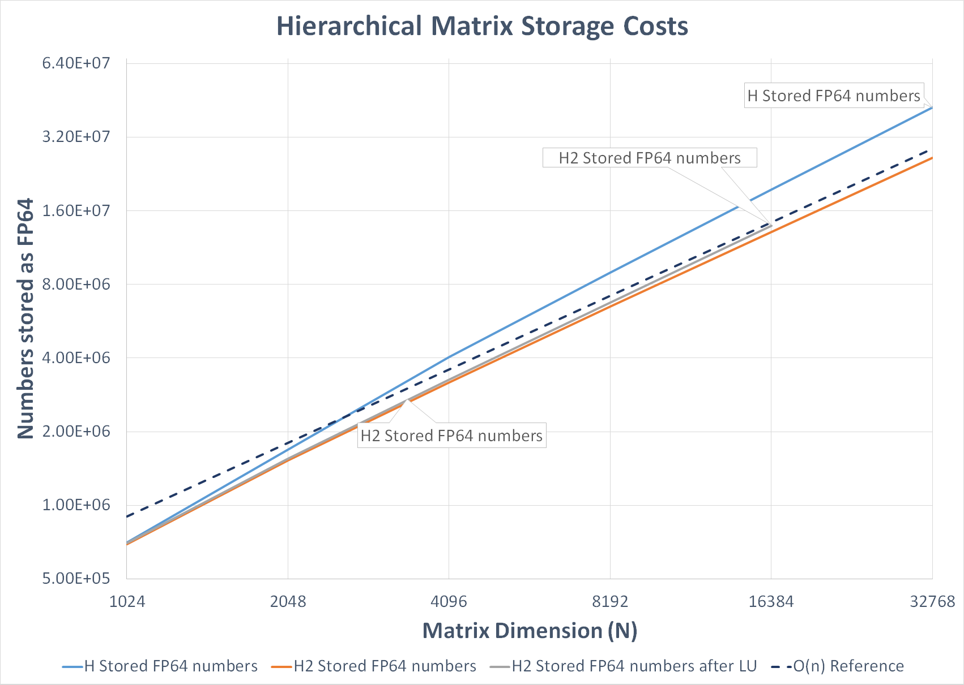
32

Slide 33
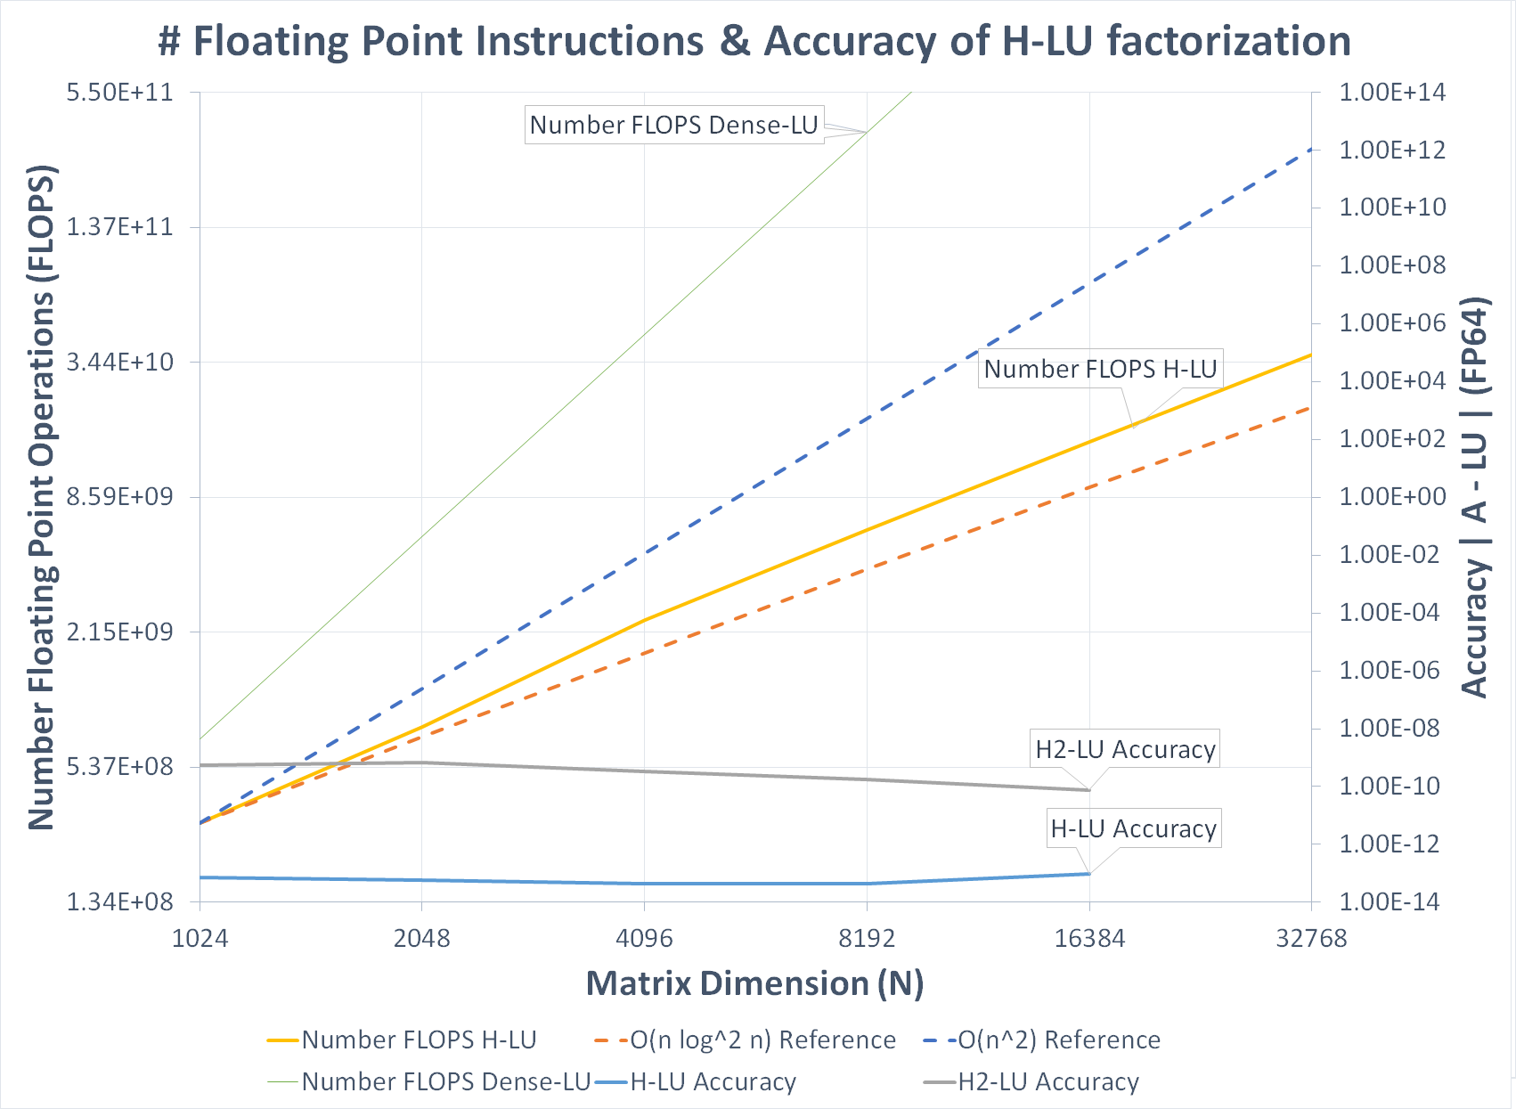
33

Slide 34
Conclusion and Future Work

Slide 35
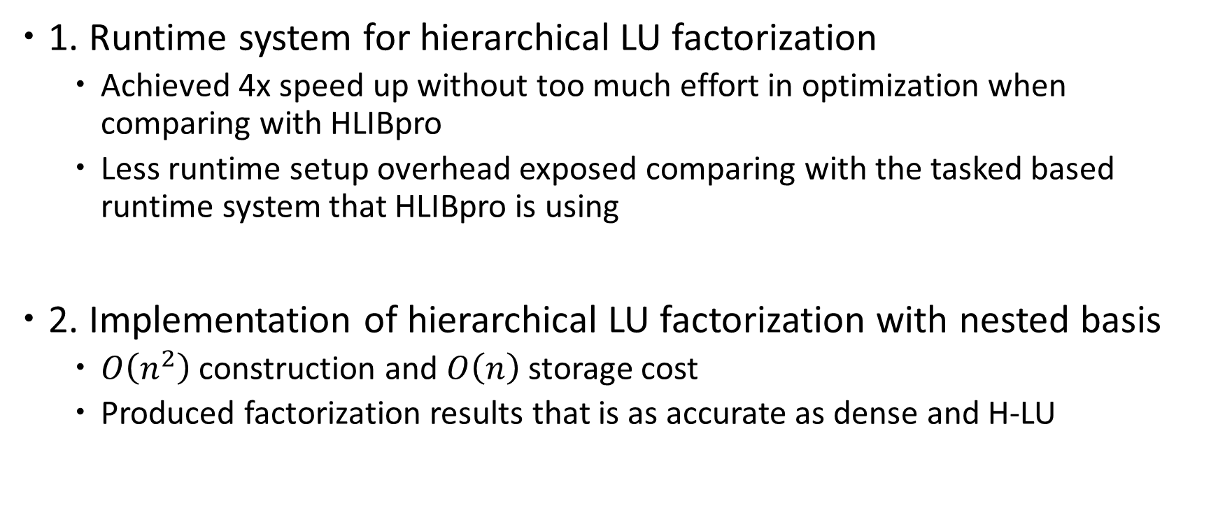
Conclusion
1. Runtime system for hierarchical LU factorization
Achieved 4x speed up without too much effort in optimization when comparing with HLIBpro
Less runtime setup overhead exposed comparing with the tasked based runtime system that HLIBpro is using
2. Implementation of hierarchical LU factorization with nested basis
$O\left(n^{2}\right)$ construction and $O\left(n\right)$ storage cost
Produced factorization results that is as accurate as dense and H-LU

Slide 36
Future Work
1. Aims on both performance and accuracy controlling
2. Runtime extendibility to nested basis factorization
Hierarchical LU Factorization | CPU | GPU
Non-nested (H-matrix) | HLIBpro | 〇
Nested (H2-matrix) | 〇 | In the future

Slide 37
Thank you!
Any question is welcomed

Slide 38
Accumulation
Admissible blocks contribute to their corresponding row/col
Init basis with all 0s, fixed dim & rank
Only accumulate admissible block on current recursion level
Basis += d x rand_mat(d.n, rank);
Some might be accumulated more than once
And some others might never have been accumulated

Slide 39

Accumulation
Recursion:
If the node on basis tree has no children, generate empty basis for it (Red Arrow)
Accumulation on lower level has no effect on the upper level and vice versa (Blue Arrow and Gray Arrow)
$$×Rand$$

Slide 40
Accumulation (finished)

Slide 41
Propagation
A non-leaf node with n children:
Slice the basis into n parts b0 - bn-1, where the row dimension matches its corresponding children.
For children i:
Basis += bi;
Or
Basis += bi x rand_mat(rank, rank); // More randomization
So that:
1. No empty low-level bases
2. Lower-level bases also takes higher-
level admis blocks into calculation

Slide 42
Orthogonalization
Basis gets updated with its orthogonalized version:
Option 1: Interpolative decomposition (with randomization already completed)
Basis = Basis.qr().getQ();
Option 2: RSVD (with randomization already completed)
Y = Basis.qr().getQ();
U x S x VT = svd(YT x Basis);
Basis = Y x U;
RSVD is more costly but sorts the basis according to their singular values
Might be better for adaptive-rank H2 construction

Slide 43
Translation
Use translation matrices at non-leaf levels for more efficient storage
basis = lower x Trans;
Which is also:
Trans = lowerT x basis;
Lower is aligning the children bases diagonally:
H2 hierarchy assembly should happen before translation for more efficient calculation

Slide 44
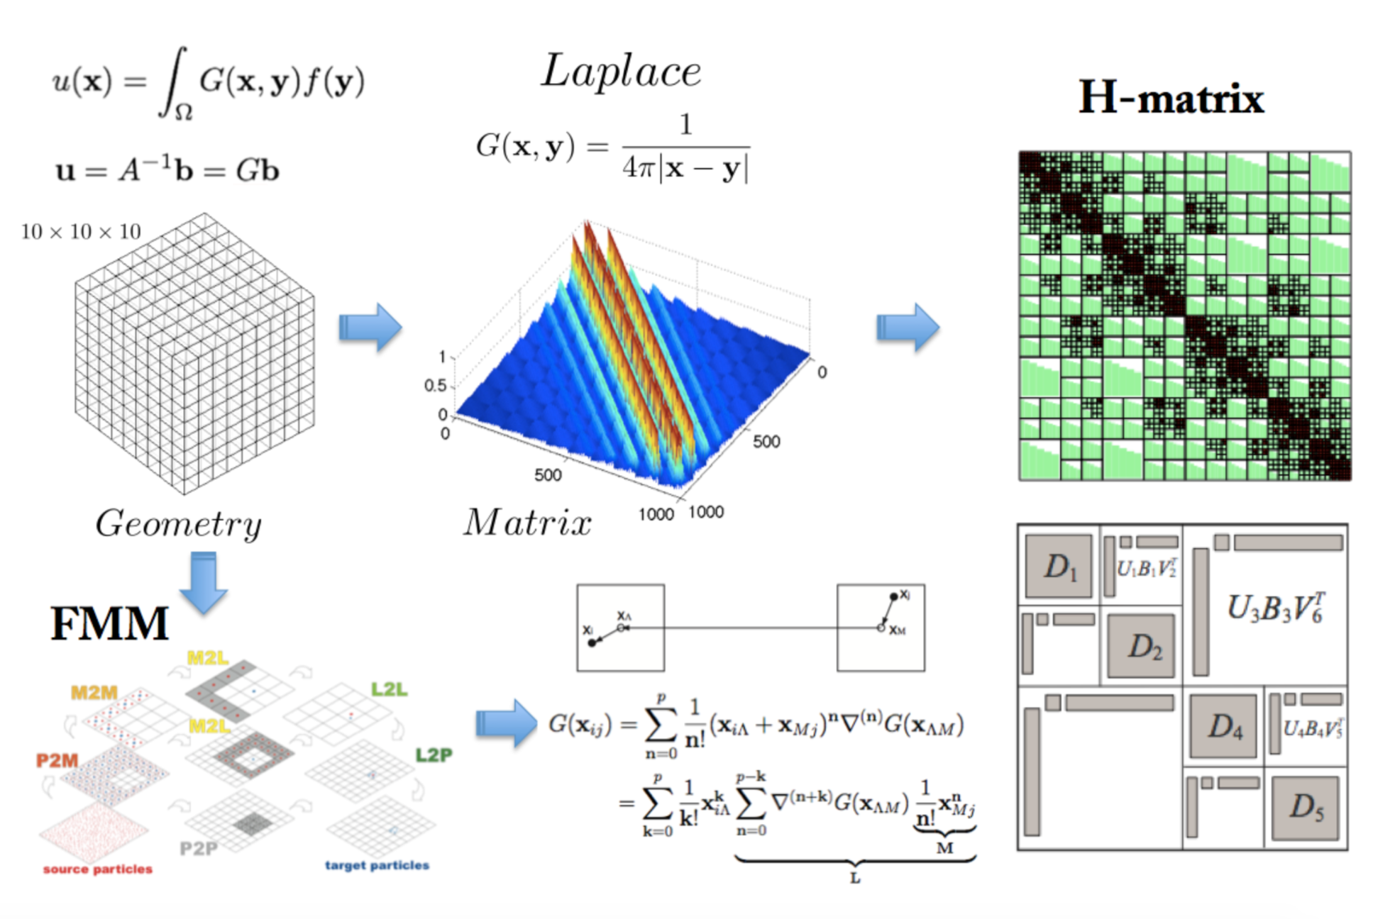
Cluster basis from admissibility condition
Only one cluster determines values in U/V
Use a “representative” block to obtain U/V
X Cluster { }
Y Cluster { }
Well Separated Distance - Admissible
V used by all blocks formed using X cluster
Rio Yokota - Introduction of FMM lecture

Slide 45
Matrix Vector multiplication with nested basis
Two accumulator vectors: admissible and non-admissible
Non-admissible: same as H-matrix

Slide 46
Matrix Vector multiplication with nested basis
Two accumulator vectors: admissible and non-admissible
Admissible: Approximates all admissible blocks

