Slide 1
Runtime System for GPU-based LU factorization of Hierarchical Low-Rank Matrices & Associated Shared-basis preprocessing
Qianxiang Ma
Rio Yokota Lab
School of Computing
Tokyo Institute of Technology

Slide 2
Presentation Outline
Problem Review
LU factorization
Hierarchical Low-rank Matrices
Necessity of using a runtime system
System design & GPU execution
Specific optimizations for Hierarchical LU

Slide 3
Problem Review

Slide 4
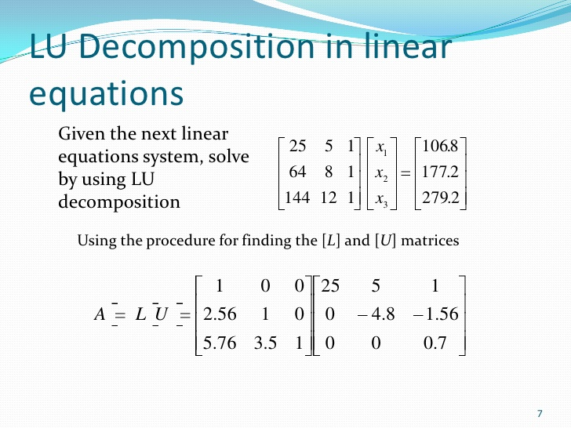
Solving Linear Systems - LU factorizations
Expressed as: Ax = b
A = LU: solve Ly = b then Ux = y
Exact / Dense solver
Compares to:
Inexact iterative solvers
Sparse solvers
https://pt.slideshare.net/gilandio/lu-decomposition

Slide 5
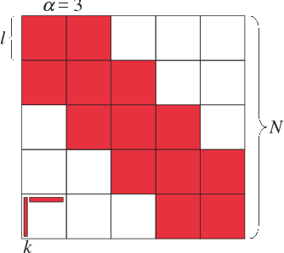
Block Low Rank Matrices
Low rank compression:
Represent blocks as products of matrices of smaller ranks
Kernel matrices:
Higher ranks closer to the diagonal
Blocks further away have lower ranks
https://www.semanticscholar.org/paper/Parallel-Hierarchical-Matrices-with-Block-Low-rank-Ida-Nakashima

Slide 6
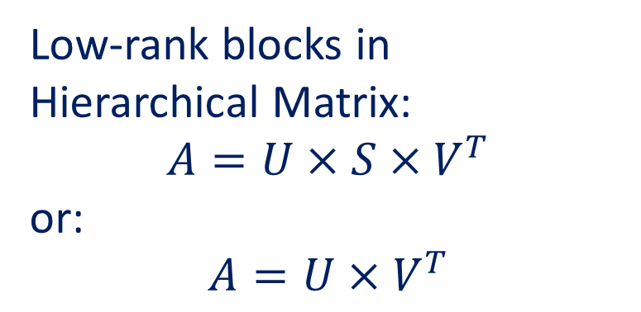
Low-rank blocks in Hierarchical Matrix:
$$A=U×S×V^{T}$$
or:
$$A=U×V^{T}$$

Slide 7
Runtime System Necessity

Slide 8
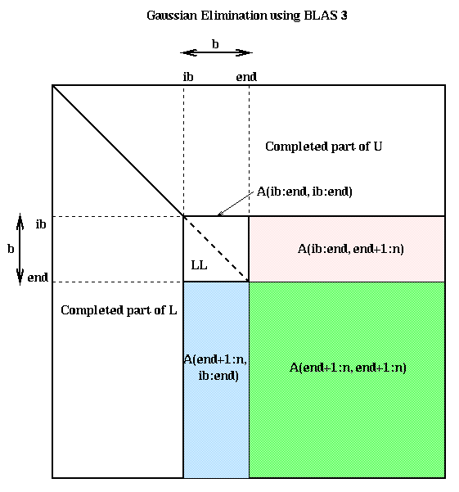
GETRF (In-place LU)
TRSM (Triangular Solve)
GEMM (Mat-Mat Mult)
A = L * U
TRSM needs GETRF results
-1
A = L⁻¹ * B
GEMM needs TRSM results
GETRF needs GEMM results
A~ = A + B * C
https://people.eecs.berkeley.edu/~demmel/cs267/lecture12/lecture12.html
Problem 1:
Data dependency in block & hierarchical LU factorization

Slide 9
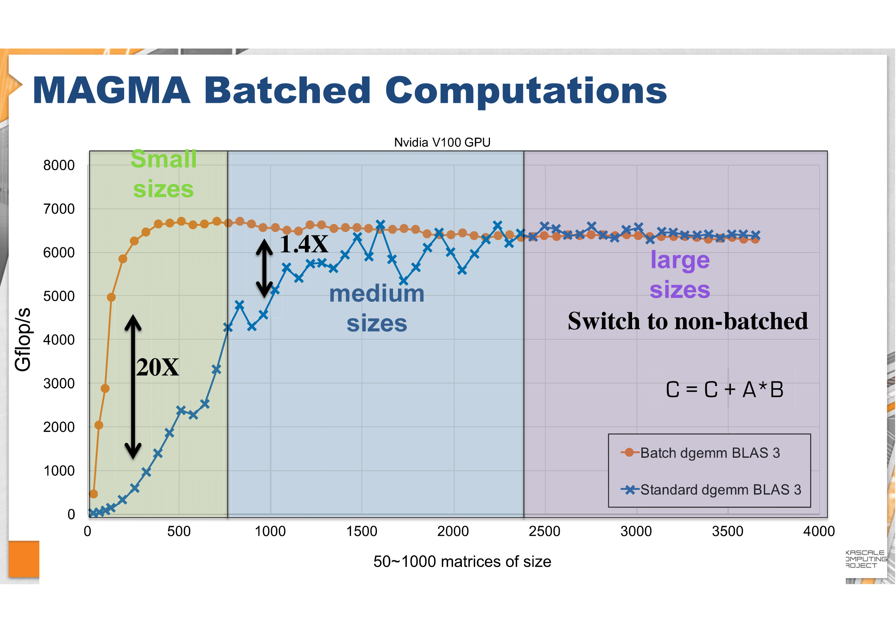
http://icl.utk.edu/projectsfiles/magma/tutorial/ecp2018-magma-tutorial.pdf
Problem 2:
LR blocks can exhibit large kernel setup overheads, if they are not batched.

Slide 10
System Design & GPU Execution

Slide 11
CPU:
1. Processes H-matrix tree structure.
2. Batches tasks together.
GPU:
3. Processes the matrix block by block.

Slide 12
H.GETRF
H.GETRF
D.GETRF
D.TRSM
H.TRSM
LR.TRSM
…
D.GEMM
LR.GEMM
…
…
0. D.GETRF
1. D.TRSM
2. D.GEMM
3. LR.TRSM
4. LR.GEMM
…
1. Task tree generation
2. Tree Flattening &
DAG generation
Worker 1
Exe 0
Exe 1
Worker 2
Wait 1
Exe 2
Worker 3
Wait 0
Exe 3
…
…
Exe 4
GPU readable:
Routine IDs
Matrix Dims
Data Ptrs
…
3. Scheduling the Tasks
4. GPU Inst generation

Slide 13
CUDA Grid
GETRF
TRSM
GEMM
ACCM
GPU readable:
Routine IDs
Matrix Dims
Data Ptrs
…
Thread Block 0
Thread Block 1
-1
Thread Block 2
Thread Block 3
Low-rank Accumulation
LR += LR
Comm Space (Global Mem)

Slide 14
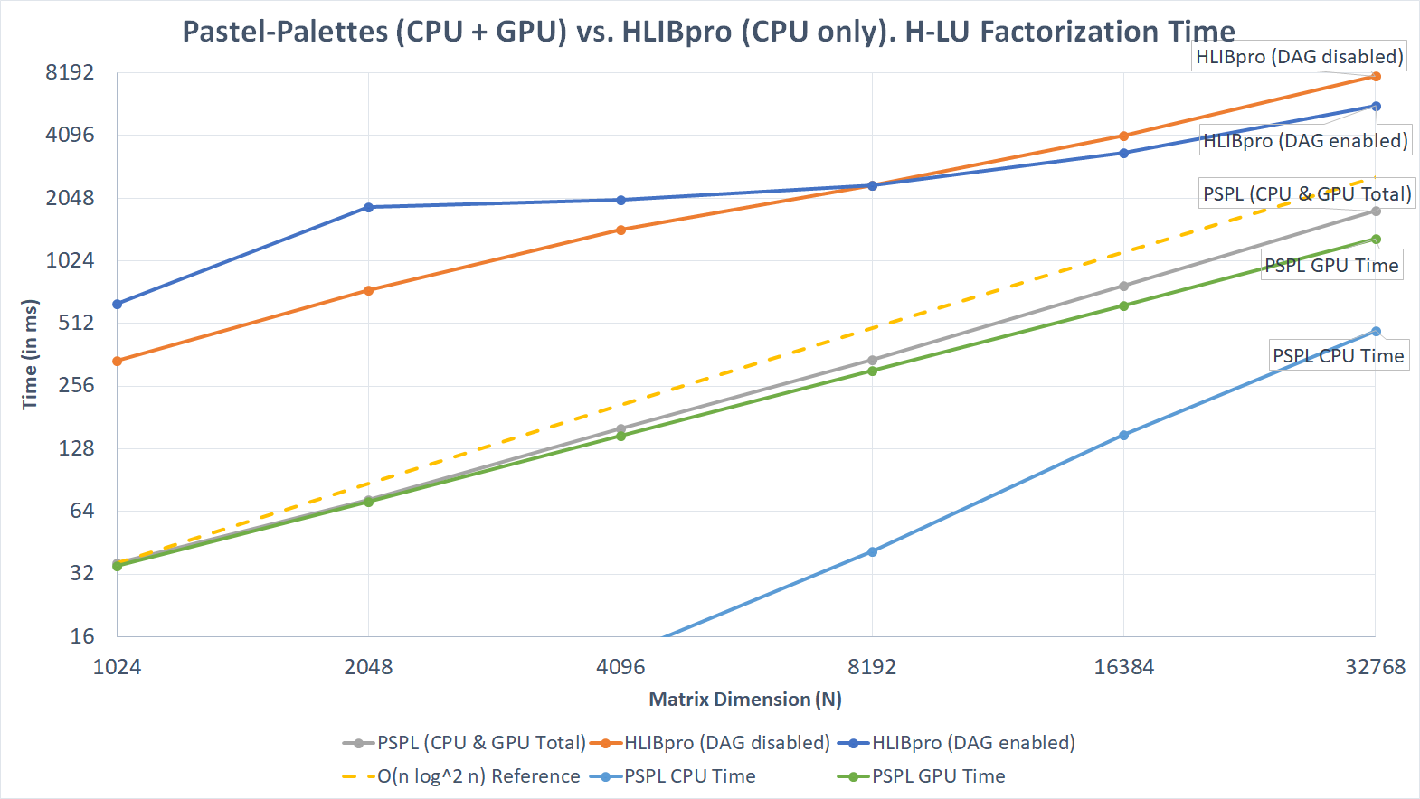

Slide 15
Specific optimizations for Hierarchical LU

Slide 16
1. Dependency Checker
0. D.GETRF
1. D.TRSM
2. D.GEMM
3. LR.TRSM
4. LR.GEMM
…
Traditional:
Check between every two instructions
Deeper hierarchy produces more instructions: O(Levels^3)
Checking between every two instructions complexity: O(Levels^6)!
Flow Dependency:
Read after write
Output Dependency:
Write after write

Slide 17
More Optimized Dependency Checker
Instruction 3 lastly updated this region
Checker state n
Checker state n+1
Graph based
Ignore old instructions
Update as progress
Results:
~40% less DAG density
~?% faster DAG generation
(still being worked on)
A: 1
B: 3
A: 1
B: 3
C: 4
D: 5
C: 4
D: 6
List of dependencies for Instruction 6: D~ = D - B * C
Output dependencies: 5 (from overwriting D)
Flow dependencies: 3, 4 (from reading B, C)
Now instruction 6 is the last one updated region D
Later instructions that reads/writes D only depends on Inst 6

Slide 18
2. More Optimized Intermediate Result Management for GPU
Pre-allocated low-rank accumulators for Dense and Hierarchical blocks
Streaming Multiprocessor (SM) dedicated space for temporary results
Advantages:
GPU focuses on calculation, no more dynamic allocation of memories
No temporary results passed between SMs, avoided race conditions
SM: 0 SM: 1
Dense
Accumulator
Associated with Dense
Accum to Dense
Accum to Accumulator
Intermediate Dense Results
Intermediate Low-rank Results

Slide 19
Plans for the Future

Slide 20
Plans for the Future
1. Shared-basis low rank compressions, that introduces potential speed ups on low rank accumulations
2. Multi-GPU support

Slide 21
Proposed H2 Construction
1. Cluster basis construction - directly from the entries, 4 steps
1.1 Accumulation (Top-down recursion on hierarchy)
1.2 Propagation (Top-down recursion on basis)
1.3 Orthogonalization (Top-down recursion on basis)
1.4 Translation (Top-down recursion on basis)

Slide 22
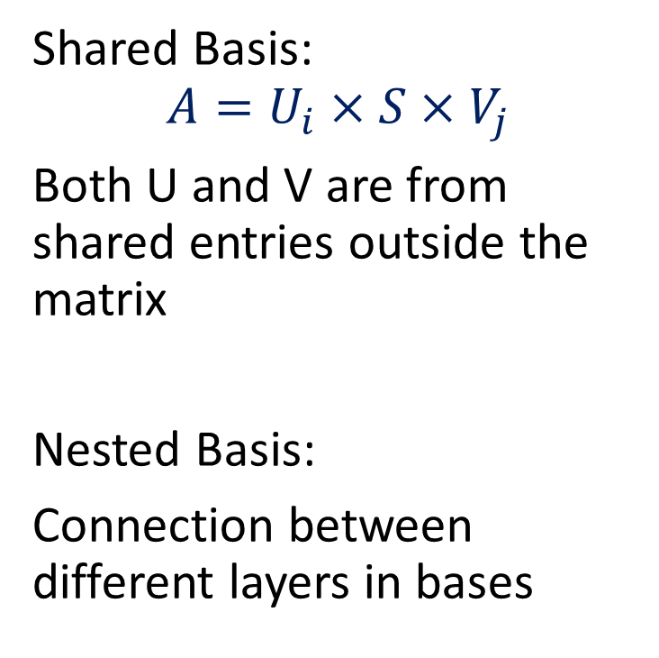
H2-Matrix
Shared Basis:
$$A=U_{i}×S×V_{j}$$
Both U and V are from shared entries outside the matrix
Nested Basis:
Connection between different layers in bases
U:
V:

Slide 23

Admissibility Condition
0 1
X Cluster { }
Y Cluster { }
Well Separated Distance - Admissible
X Cluster { }
Y Cluster { }
High Entanglement - Not Admissible

Slide 24
Accumulation
Admissible blocks contribute to their corresponding row/col
Init basis with all 0s, fixed dim & rank
Only accumulate admissible block on current recursion level
Basis += d x rand_mat(d.n, rank);
Some might be accumulated more than once
And some others might never have been accumulated

Slide 25

Accumulation
Recursion:
If the node on basis tree has no children, generate empty basis for it (Red Arrow)
Accumulation on lower level has no effect on the upper level and vice versa (Blue Arrow and Gray Arrow)
$$×Rand$$

Slide 26
Accumulation (finished)

Slide 27
Propagation
A non-leaf node with n children:
Slice the basis into n parts b0 - bn-1, where the row dimension matches its corresponding children.
For children i:
Basis += bi;
Or
Basis += bi x rand_mat(rank, rank); // More randomization
So that:
1. No empty low-level bases
2. Lower-level bases also takes higher-
level admis blocks into calculation

Slide 28
Orthogonalization
Basis gets updated with its orthogonalized version:
Option 1: Interpolative decomposition (with randomization already completed)
Basis = Basis.qr().getQ();
Option 2: RSVD (with randomization already completed)
Y = Basis.qr().getQ();
U x S x VT = svd(YT x Basis);
Basis = Y x U;
RSVD is more costly but sorts the basis according to their singular values
Might be better for adaptive-rank H2 construction

Slide 29
Translation
Use translation matrices at non-leaf levels for more efficient storage
basis = lower x Trans;
Which is also:
Trans = lowerT x basis;
Lower is aligning the children bases diagonally:
H2 hierarchy assembly should happen before translation for more efficient calculation

Slide 30
Split
Slice the U and V portion to use in the hierarchical matrix
V:
U:

Slide 31
Thank you!
Any question is welcomed

