Slide 1
Runtime System for GPU-based LU factorization of Hierarchical Low-Rank Matrices
Qianxiang Ma
Rio Yokota Lab
School of Computing
Tokyo Institute of Technology

Slide 2
Presentation Outline
Problem Identification
Design
Current Results
Future Directions

Slide 3
Problem Identification

Slide 4
Low-rank blocks in Hierarchical Matrix:
Represented as products of matrices of smaller ranks

Slide 5
Problem 1:
Data dependency in block & hierarchical LU factorization

Slide 6
Problem 2:
LR blocks can exhibit large kernel setup overheads, if they are not batched.

Slide 7
Design

Slide 8
CPU:
1. Processes H-matrix tree structure.
2. Batches tasks together.
GPU:
3. Processes the matrix block by block.

Slide 9
H.GETRF
H.GETRF
D.GETRF
D.TRSM
H.TRSM
LR.TRSM
…
D.GEMM
LR.GEMM
…
…
0. D.GETRF
1. D.TRSM
2. D.GEMM
3. LR.TRSM
4. LR.GEMM
…
1. Task tree generation
2. Tree Flattening &
DAG generation
Worker 1
Exe 0
Exe 1
Worker 2
Wait 1
Exe 2
Worker 3
Wait 0
Exe 3
…
…
Exe 4
GPU readable:
Routine IDs
Matrix Dims
Data Ptrs
…
3. Scheduling the Tasks
4. GPU Inst generation

Slide 10
CUDA Grid
GETRF
TRSM
GEMM
ACCM
GPU readable:
Routine IDs
Matrix Dims
Data Ptrs
…
Thread Block 0
Thread Block 1
Thread Block 2
Thread Block 3
Comm Space (Global Mem)

Slide 11
Current Results

Slide 12
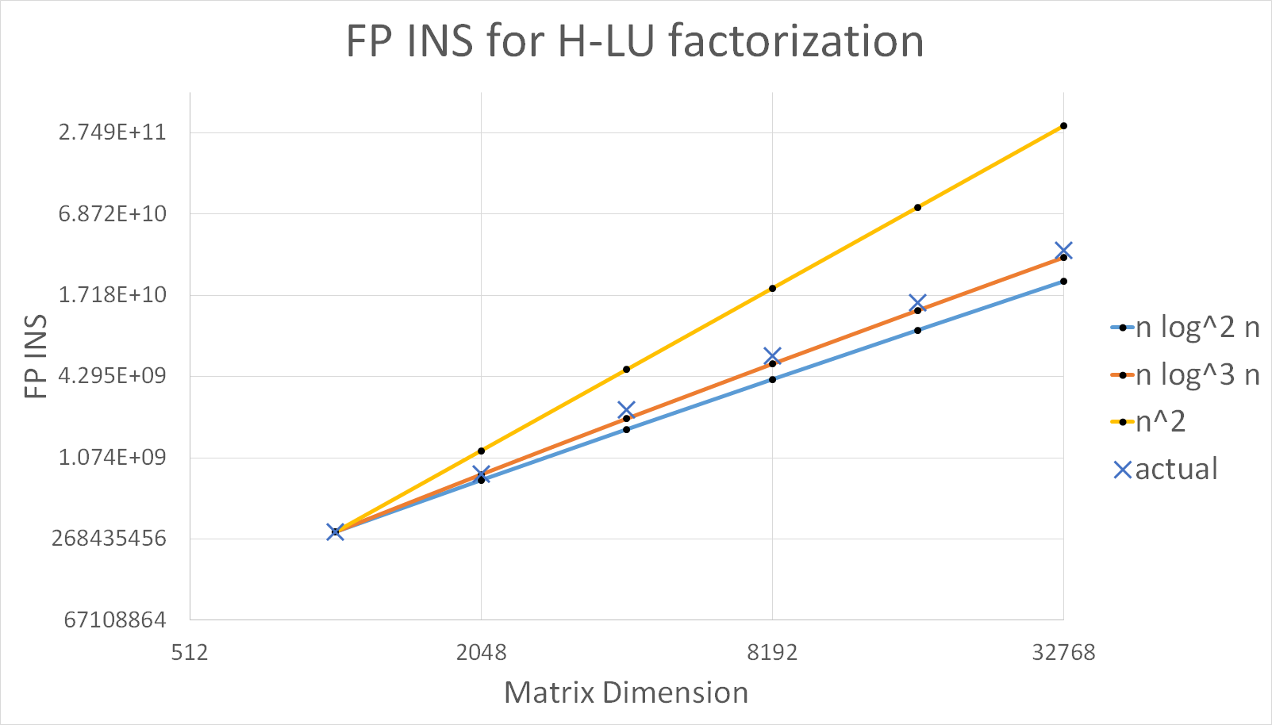

Slide 13
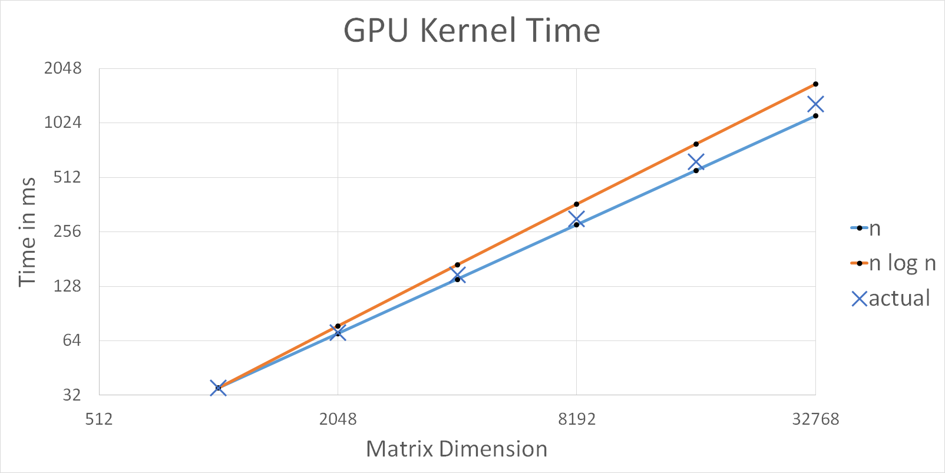

Slide 14
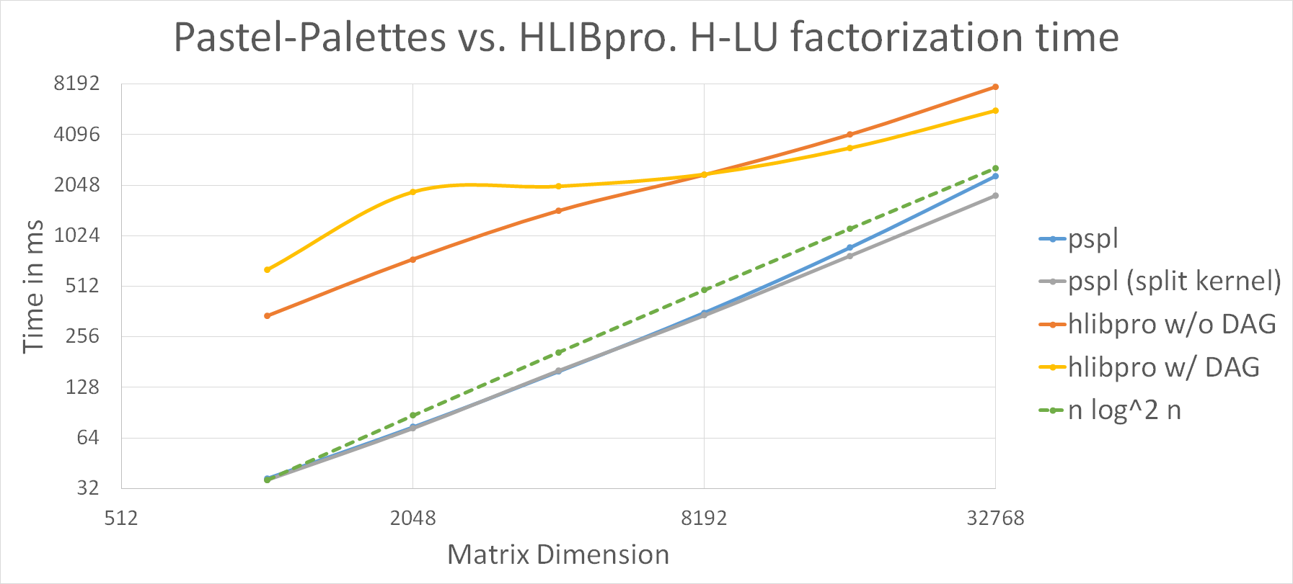

Slide 15
Future Directions

Slide 16
Supporting Multiple GPUs
Update scheduler to support:
Distributed matrix data among multiple GPUs
Porting data / cache from one GPU to another
Even more precise latency estimation
Trying different scheduling heuristics to find a balanced schedule of:
GPU-wide communications
Local communications

Slide 17
Optimizations on Existing Routines
Even better cache utilization
Resolving shared memory bank conflicts
Vectorized load-write words
More unrolled loops
* Tensor cores and low precision arithmetic functions

Slide 18
Thank you!
Any question is welcomed

