Slide 1
Runtime System for GPU-based LU factorization of Hierarchical Low-Rank Matrices
Qianxiang Ma
Rio Yokota Lab
School of Computing
Tokyo Institute of Technology

Slide 2
Presentation Outline
Problem Identification
Design
Current Results
Future Directions

Slide 3
Problem Identification

Slide 4
Low-rank blocks in Hierarchical Matrix:
Represented as products of matrices of smaller ranks

Slide 5
Problem 1:
Data dependency in block & hierarchical LU factorization

Slide 6
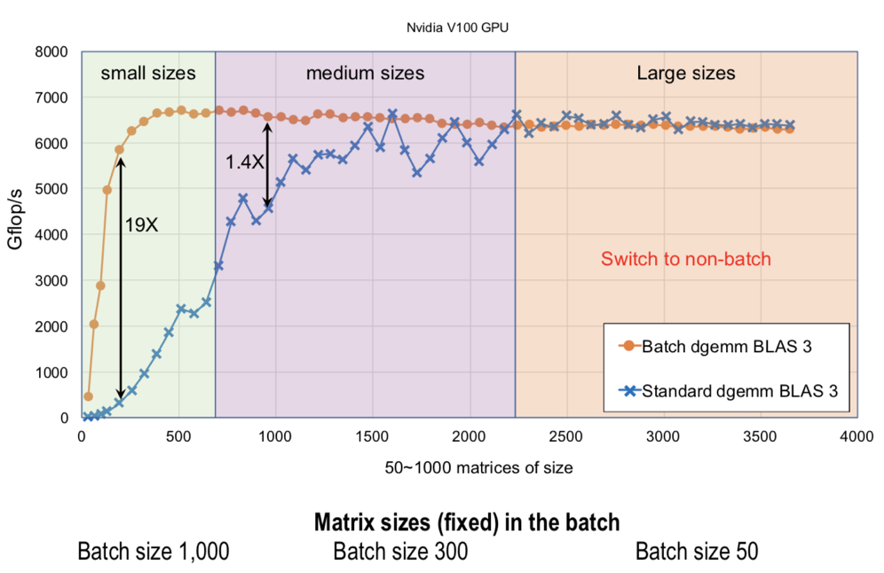
Problem 2:
LR blocks can exhibit large kernel setup overheads, if they are not batched.

Slide 7
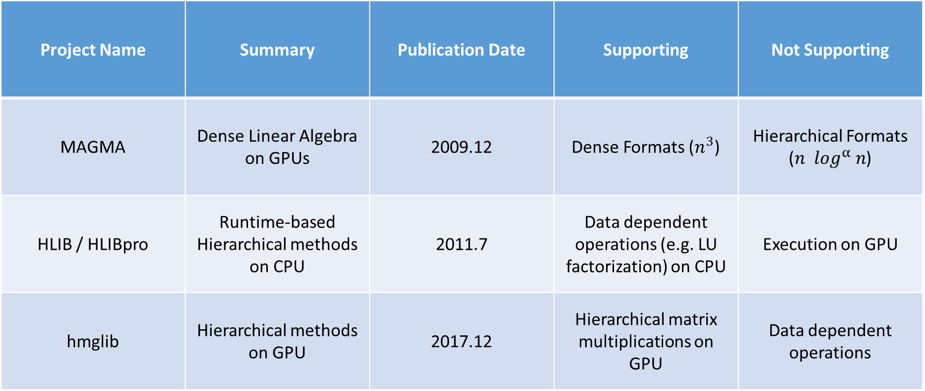
Related Projects
Project Name | Summary | Publication Date | Supporting | Not Supporting
MAGMA | Dense Linear Algebra on GPUs | 2009.12 | Dense Formats ($n^{3}$) | Hierarchical Formats ($n \log^{α} n$)
HLIB / HLIBpro | Runtime-based Hierarchical methods on CPU | 2011.7 | Data dependent operations (e.g. LU factorization) on CPU | Execution on GPU
hmglib | Hierarchical methods on GPU | 2017.12 | Hierarchical matrix multiplications on GPU | Data dependent operations

Slide 8
Design

Slide 9
CPU:
1. Processes H-matrix tree structure.
2. Batches tasks together.
GPU:
3. Processes the matrix block by block.

Slide 10
H.GETRF
H.GETRF
D.GETRF
D.TRSM
H.TRSM
LR.TRSM
…
D.GEMM
LR.GEMM
…
…
0. D.GETRF
1. D.TRSM
2. D.GEMM
3. LR.TRSM
4. LR.GEMM
…
1. Task tree generation
2. Tree Flattening &
DAG generation
Worker 1
Exe 0
Exe 1
Worker 2
Wait 1
Exe 2
Worker 3
Wait 0
Exe 3
…
…
Exe 4
GPU readable:
Routine IDs
Matrix Dims
Data Ptrs
…
3. Scheduling the Tasks
4. GPU Inst generation

Slide 11
CUDA Grid
GETRF
TRSM
GEMM
ACCM
GPU readable:
Routine IDs
Matrix Dims
Data Ptrs
…
Thread Block 0
Thread Block 1
Thread Block 2
Thread Block 3
Comm Space (Global Mem)

Slide 12
Current Results

Slide 13
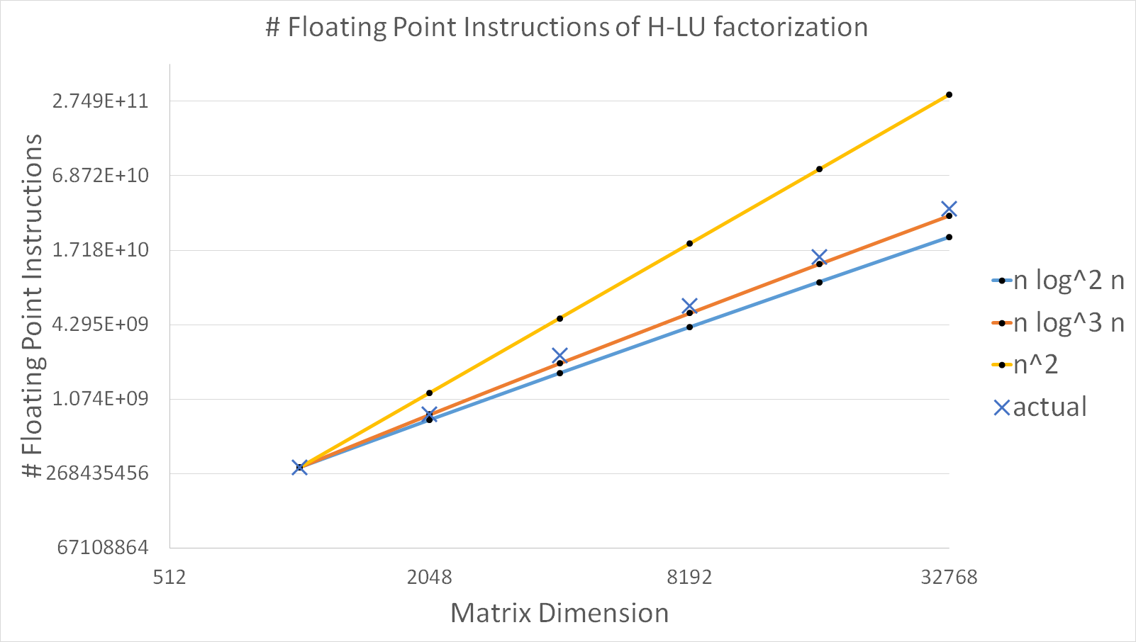

Slide 14
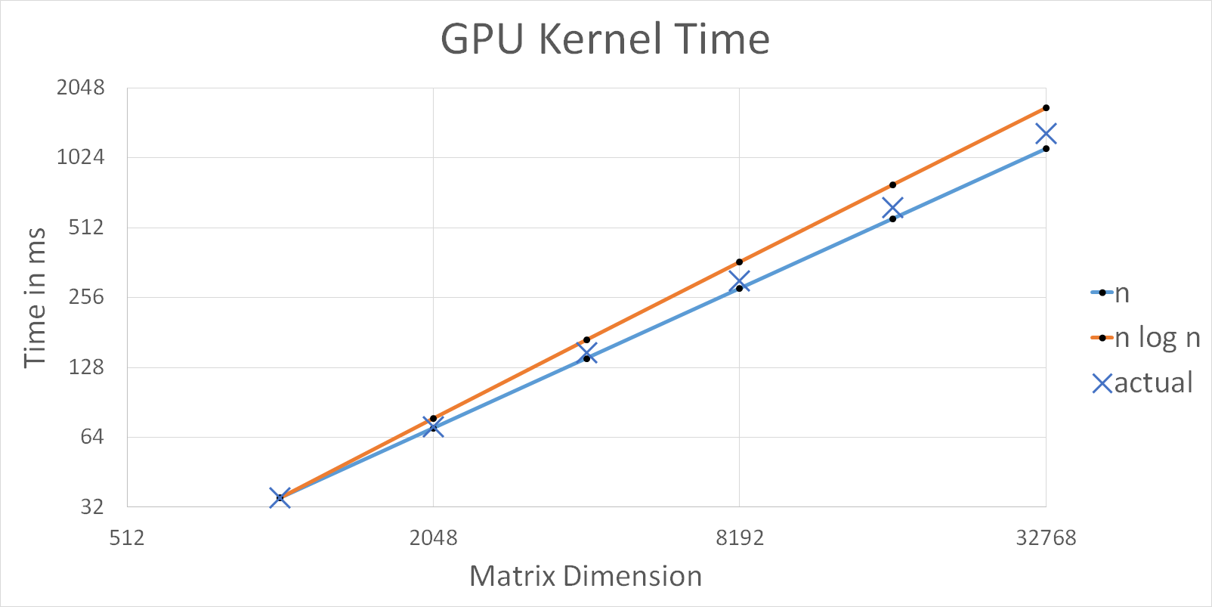

Slide 15
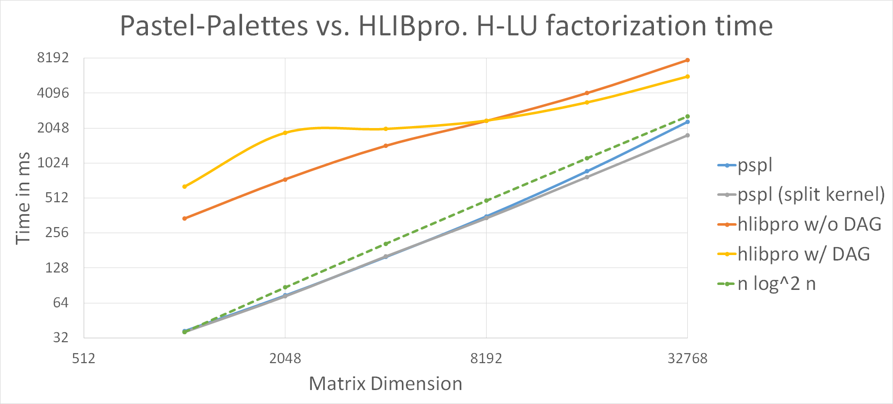

Slide 16
Future Directions

Slide 17
Supporting Multiple GPUs
Update scheduler to support:
Distributed matrix data among multiple GPUs
Porting data / cache from one GPU to another
Even more precise latency estimation
Trying different scheduling heuristics to find a balanced schedule of:
GPU-wide communications
Local communications

Slide 18
Optimizations on Existing Routines
Even better cache utilization
Resolving shared memory bank conflicts
Vectorized load-write words
More unrolled loops
* Tensor cores and low precision arithmetic functions

Slide 19
References
Emmanuel Agullo, Cédric Augonnet, Jack Dongarra, Mathieu Faverge, Julien Langou, et al.. LU Factorization for Accelerator-based Systems. 9th ACS/IEEE International Conference on Computer
Systems and Applications (AICCSA 11), Jun 2011, Sharm El-Sheikh, Egypt. ffhal-00654193Jack Dongarra, Iain Duff, Mark Gates, Azzam Haidar, Sven Hammarling, Nicholas J. Higham, Jonathan Hogg, Pedro Valero Lara, Piotr Luszczek, Mawussi Zounon, Samuel D. Relton, Stanimire Tomov, Timothy Costa, and Sarah Knepper "Batched BLAS (Basic Linear Algebra Subprograms) 2018 Specification”, July 2018.
H. Harbrecht and P. Zaspel. A scalable H-matrix approach for the solution of boundary integral equations on multi-GPU clusters. Preprint 2018-11, Fachbereich Mathematik, Universität Basel, Switzerland, 2018.
Ronald Kriemann. ℋ-LU Factorization on Many-Core Systems, Computing and Visualization in Science, 16, pp. 105-117, 2013.

Slide 20
Thank you!
Any question is welcomed

