Slide 1

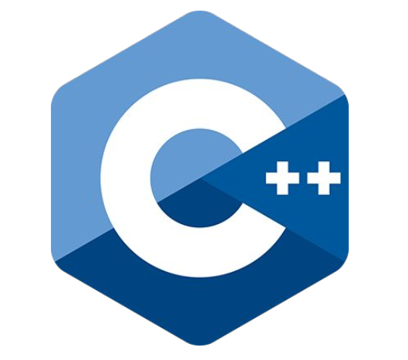

Lab 1
Learning goals:
Install ubuntu 20.04
Learn the basics of shell and git
Learn C++

Slide 2
Lab 1
Installing Ubuntu 20.04
Choose installation media：
VM (recommend for class)
Disk (recommend for production environment)
Tips: ROS only available on Linux based system, so we can’t use Windows or MacOS

Slide 3
Lab 1
Shell Basics
Basics: pwd, ls, cd, find, mkdir, touch, rm, cp, mv, cat, nano, chmod
Download file, uncompress: wget, tar
Pipe: using | , example $cat 1.txt | sort
Output redirect: > , redirect terminal output to file, example $ls > output.txt, also you can try >, &>, | tee, |& tee,and see what’s the difference
Documentation:
https://www.tutorialspoint.com/unix/index.htm
https://blog.csdn.net/weilaaer/article/details/131105614

Slide 4
Lab 1
C++
Resources:
Book 《C++ Primer》
Online C++ course:
  https://www.runoob.com/cplusplus/cpp-tutorial.html
  https://www.w3cschool.cn/cplusplus/

Slide 5
Lab 1
Git
Documentations of git:
Official https://git-scm.com/doc
Unofficial https://www.runoob.com/git/git-basic-operations.html

Slide 6
Lab 1
CMAKE
Documentation:
https://www.runoob.com/cmake/cmake-tutorial.html

Slide 7
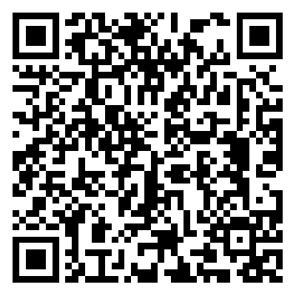
Lab 1
Here is a simple guidance：
https://spurious-cornflower-507.notion.site/Lab-1-Linux-C-Git-e788685e06a84200ae587ffe64258c76

