Slide 1

Machine Learning Implementation Without Coding Using KNIME
Athithraja R (2022503702)

Slide 2

OUTLINE
Introduction to KNIME
Features of KNIME
Installation of KNIME
Linear Regression – Predict Car Price Based on Mileage
Linear Regression – Predict Car Sales Based on Mileage and Price
Classification Model Using Multilayer Perceptron for Forest Fire Prediction
Naïve Bayes Classifier
Decision Tree Using ID3 Algorithm for PIMA Indian Diabetes Dataset
Conclusion

Slide 3
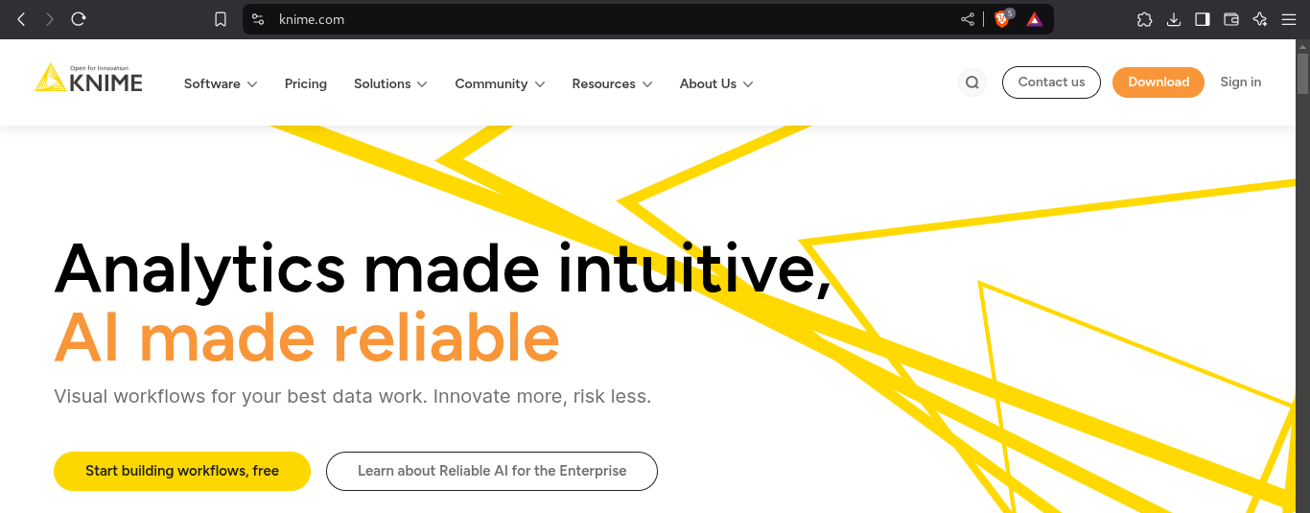
Introduction to KNIME
KNIME (Konstanz Information Miner) is an open-source data analytics platform that enables users to build machine learning models without writing code.
Provides a drag-and-drop interface for data preprocessing, machine learning, and visualization.

Slide 4
Features of KNIME
No programming required.
Supports various ML algorithms and data preprocessing techniques.
Provides integration with Python, R, and other tools.
Enables workflow automation.
Open-source and highly extensible.

Slide 5
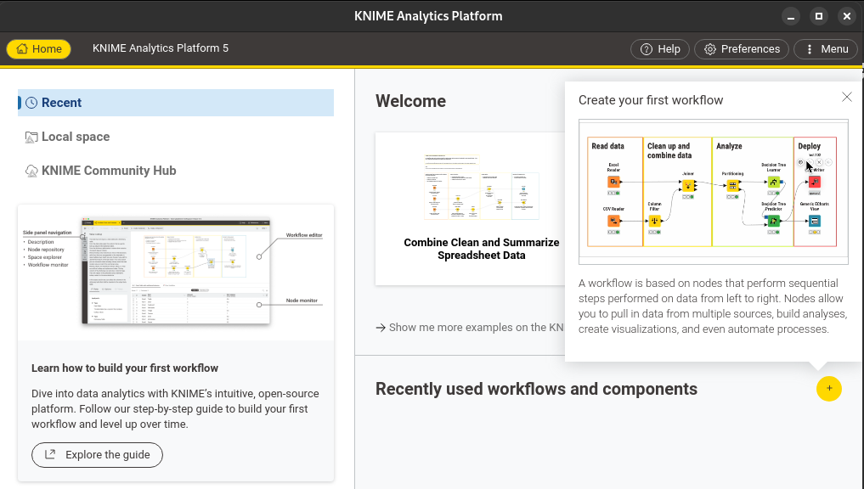
Installation of KNIME
Download KNIME:
Visit KNIME Official Website and download the KNIME Analytics Platform for your OS.
Install KNIME:
Run the installer and follow the on-screen instructions.
Launch KNIME:
Open KNIME and familiarize yourself with the interface.

Slide 6
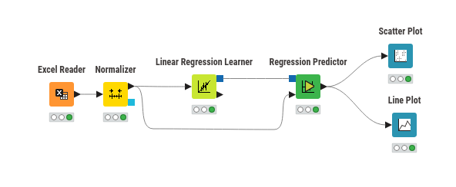
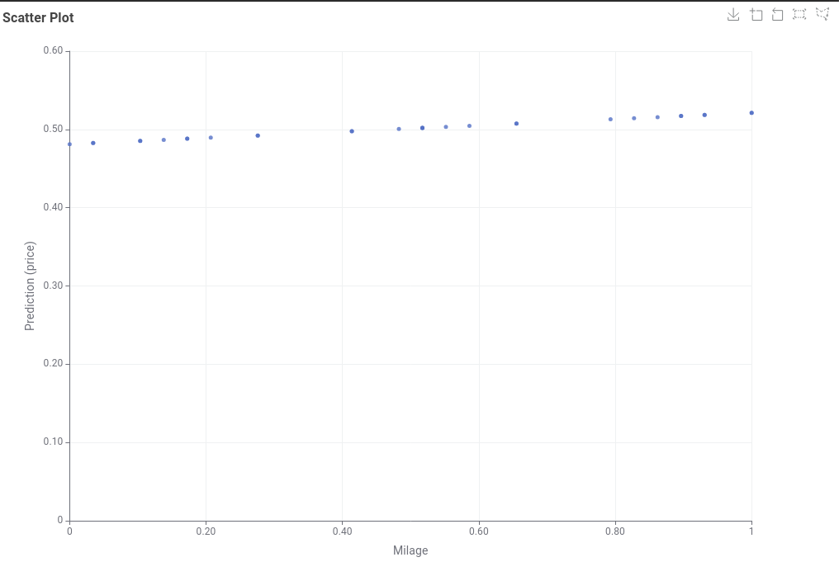
Linear Regression – Predict Car Price Based on Mileage
Load Dataset: Use File Reader node.
Handle Missing Data: Use Missing Value node.
Normalize Data (Optional): Use Normalizer node if necessary.
Train Model: Use Linear Regression Learner node.
Target Variable: Price
Feature: Mileage
Make Predictions: Use Linear Regression Predictor node.
Plot Results: Use Scatter Plot node.
Demo Video

Slide 7
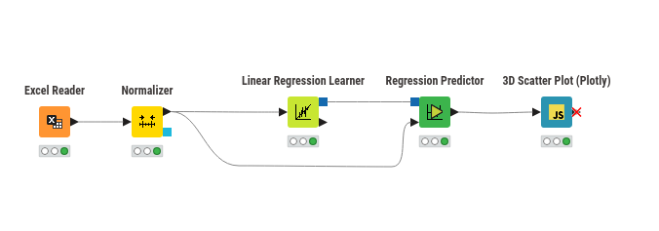
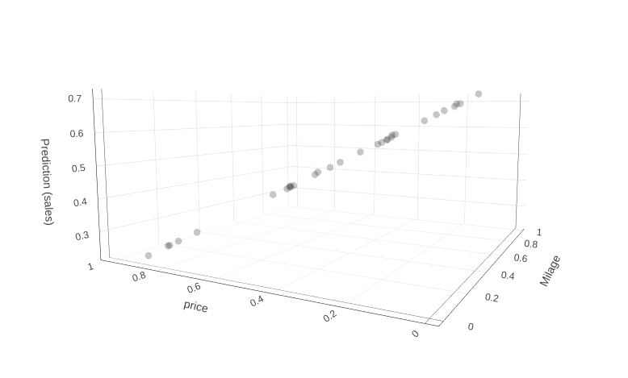
Linear Regression – Predict Car Sales Based on Mileage and Price
Load Dataset: Use File Reader node.
Preprocessing: Handle missing values and normalization if necessary.
Train Model: Use Linear Regression Learner node.
Target Variable: Sales
Features: Mileage, Price
Make Predictions: Use Linear Regression Predictor node.
Visualize: Use 3D Scatter Plot node.
Demo Video

Slide 8
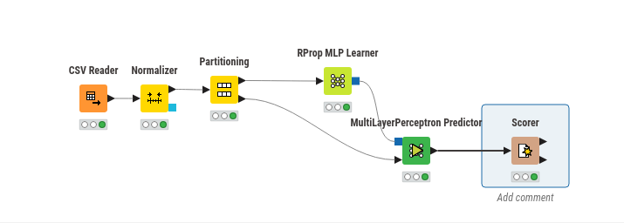
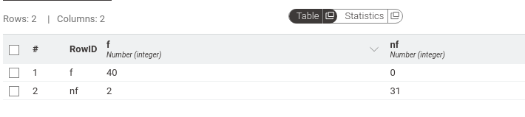
Classification Model Using Multilayer Perceptron for Forest Fire Prediction
Load Dataset: Use File Reader node.
Preprocess Data: Apply Normalizer node if required.
Train Model: Use Multilayer Perceptron Learner node.
Target Variable: Fire Occurrence
Make Predictions: Use Multilayer Perceptron Predictor node.
Evaluate Model: Use Scorer node.
Demo Video

Slide 9
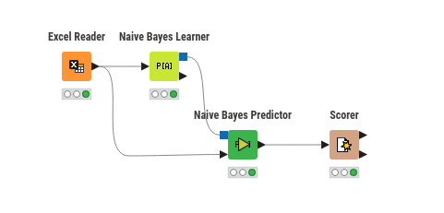
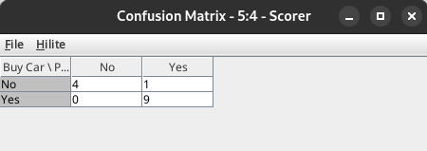
Naïve Bayes Classifier
Load Dataset: Use File Reader node.
Preprocessing: Ensure categorical variables are properly handled.
Train Model: Use Naïve Bayes Learner node.
Select Target Category.
Include categorical attributes.
Make Predictions: Use Naïve Bayes Predictor node.
Evaluate Accuracy: Use Scorer node.
Demo Video

Slide 10
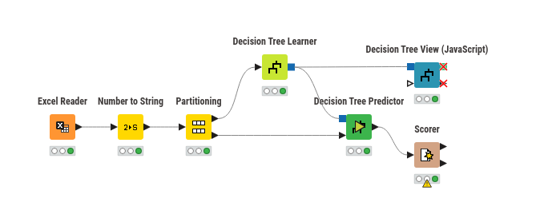
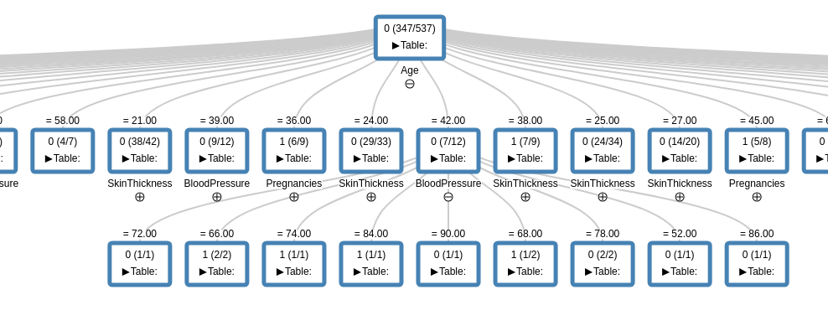
Decision Tree Using ID3 Algorithm for PIMA Indian Diabetes Dataset
Load Dataset: Use File Reader node.
Preprocess Data: Handle missing values if required.
Train Model: Use Decision Tree Learner (ID3) node.
Target Variable: Diabetes Diagnosis
Features: Other attributes
Make Predictions: Use Decision Tree Predictor node.
Evaluate Model: Use Scorer node.
Visualize Tree: Use Decision Tree View node.
Demo Video

Slide 11

Conclusion
KNIME is a powerful tool for implementing ML models without coding. By following these steps, we can efficiently build and evaluate ML models for various real-world applications.

Slide 12
Thank you!

