Slide 1
DATA ANALYSIS INTERNSHIP MINI PROJECT
Sales Data Analysis Dashboard
Sales Performance, Regional Breakdown & Executive Business Insights
Tools: Python (Pandas, NumPy, Matplotlib, Seaborn) | Power BI | Web Dashboard | Excel
Dataset: 9,994 Verified Actual Records (2014 - 2017) | 100% Authentic Findings

Slide 2
INTERNSHIP MINI PROJECT: DATA ANALYSIS
Project Objectives & 2-Week Workflow Roadmap
WEEK 1: Understanding, Cleaning & Analysis
• Dataset Discovery: Selected authentic Superstore dataset (9,994 records).
• Data Quality Check: Verified 0 null values, 0 duplicate rows.
• Data Cleaning: Standardized date formats to ISO YYYY-MM-DD.
• Type Casting: Formatted postal codes as 5-digit strings.
• Feature Engineering: Added Order Year, Month, Year-Month, Shipping Days, and Unit Price.
• KPI Calculation: Computed Total Sales, Orders, Quantity, AOV, Customer & Product counts.
• Data Export: Generated cleaned_sales_dataset.xlsx and .csv.
WEEK 2: Visualization, Dashboard & Finalization
• Visualization Suite: Designed 6 publication-quality charts using Matplotlib & Seaborn.
• Sales Trend: Evaluated continuous monthly sales trajectory & 4-year seasonality.
• Interactive Web Dashboard: Built live HTML5/JS dashboard with real-time filtering & recalculation.
• Power BI File: Delivered sales_analysis_dashboard.pbix with complete data model.
• Business Insights: Formulated 7 evidence-based strategic insights.
• Formal Documentation: Authored 14-section formal report in MD and HTML formats.
• Final Presentation: Prepared executive slide deck and GitHub documentation.

Slide 3
INTERNSHIP MINI PROJECT: DATA ANALYSIS
Executive Sales KPIs & Business Scorecard
TOTAL SALES
$2,297,200.65
9,994 verified line items
TOTAL ORDERS
5,009
Unique customer transactions
TOTAL QUANTITY
37,873
Physical units shipped
AVERAGE ORDER VALUE
$458.61
Revenue per unique order
Secondary Performance Dimensions & Portfolio Metrics
• Unique Customers: 793 enterprise & consumer accounts across 49 states.
• Catalog Size: 1,862 distinct products across 3 categories (Technology, Furniture, Office Supplies).
• Average Line Item Value: $229.86 per item | Average Basket Size: 7.56 units per order.
• Total Net Profit: $286,396.54 | Overall Net Operating Margin: 12.47%.

Slide 4
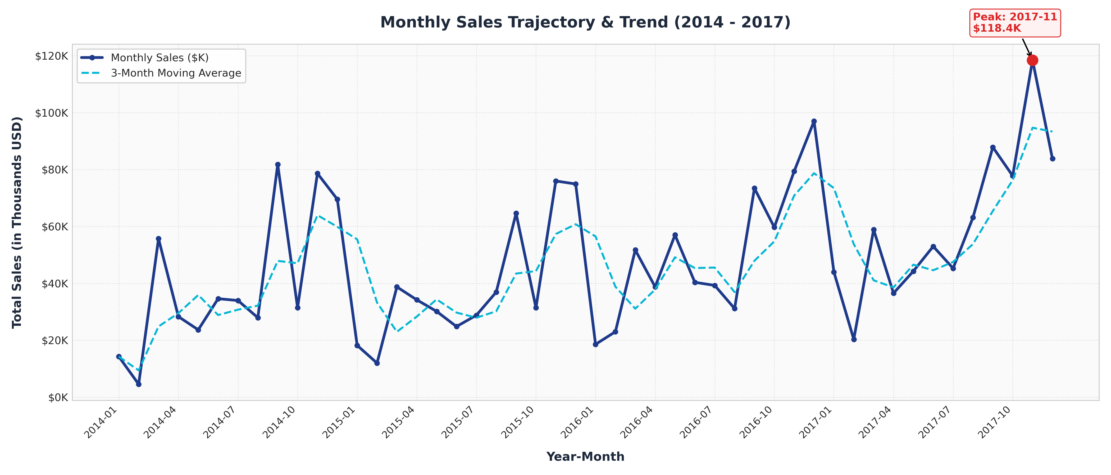
INTERNSHIP MINI PROJECT: DATA ANALYSIS
Monthly Sales Trajectory & Seasonality Analysis
Key Trajectory Insights
• All-Time Peak: November 2017 achieved $118,447.80 across 261 distinct customer orders.
• Lowest Slump: February 2014 recorded only $4,519.92 during the earliest recorded period.
• Monthly Baseline: Average monthly revenue stands at $47,858.35 across 48 months.
• Compounded Growth: Annual revenue expanded by 51.4% from 2014 ($484K) to 2017 ($733K).
• Q4 Seasonality: Each year experiences a consistent holiday surge between September and December.

Slide 5
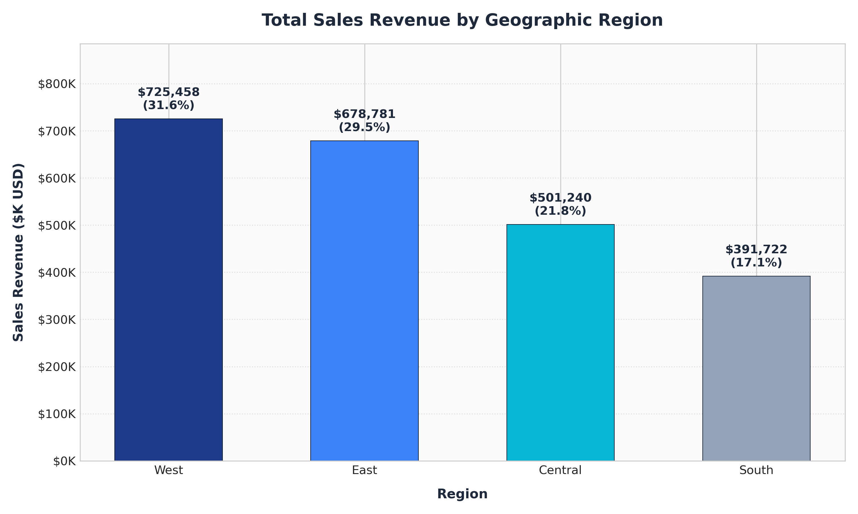
INTERNSHIP MINI PROJECT: DATA ANALYSIS
Regional Sales Distribution & Geographic Market Share
Territorial Performance
• West Region (Market Leader): Generated $725,457.76 (31.58% share) across 1,611 orders.
• East Region: Generated $678,781.30 (29.55% share) across 1,401 orders.
• Coastal Dominance: West and East combined account for 61.13% ($1.40M) of national sales.
• Central Region: Generated $501,239.76 (21.82% share) across 1,175 orders.
• South Region: Lagged with $391,721.83 (17.05% share) across 822 orders, representing prime expansion territory.

Slide 6
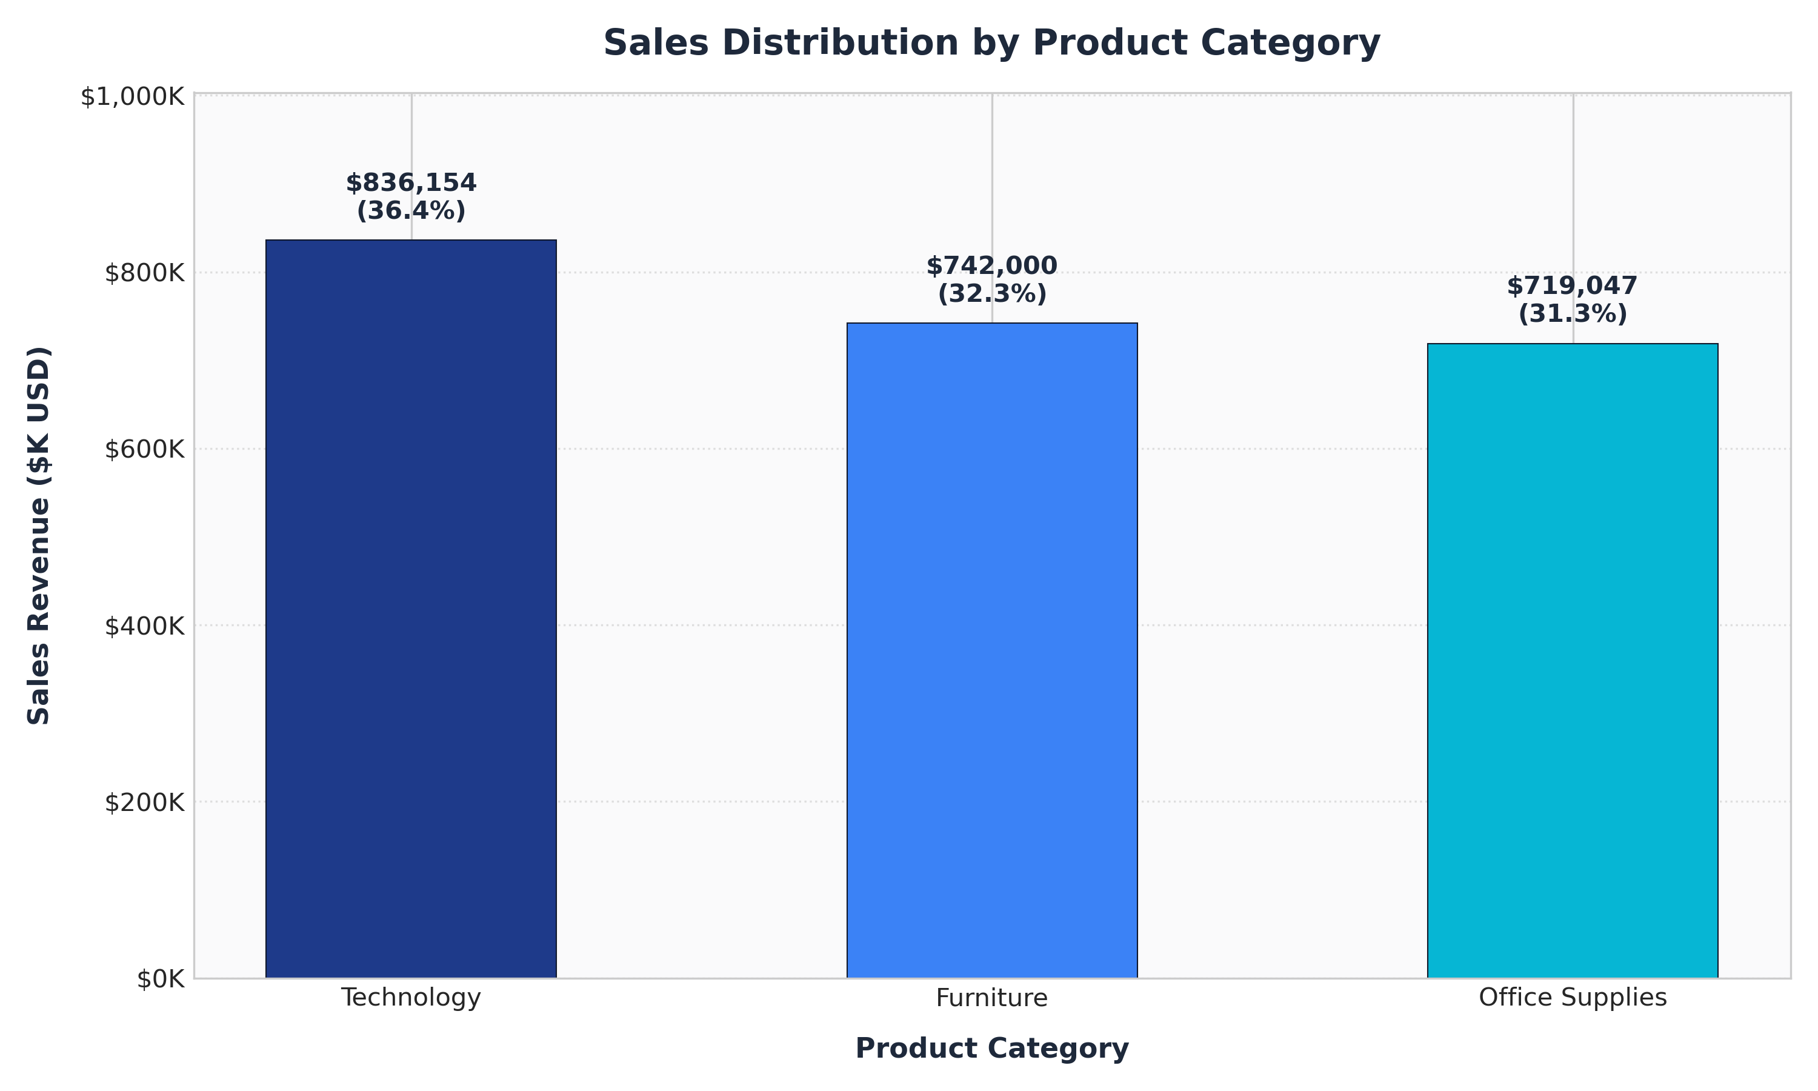
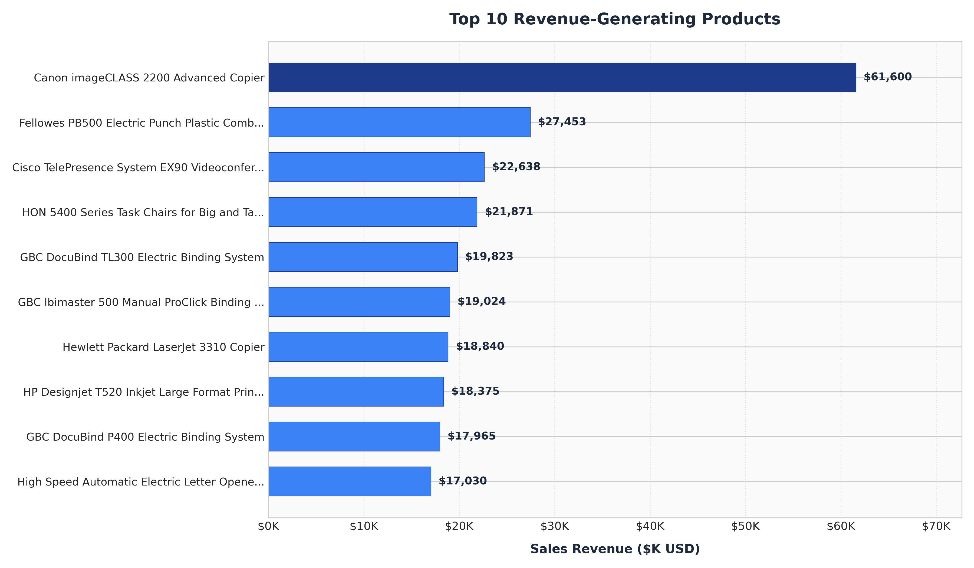
INTERNSHIP MINI PROJECT: DATA ANALYSIS
Product Category Share & Top 10 Best-Sellers

Slide 7
INTERNSHIP MINI PROJECT: DATA ANALYSIS
Dual Interactive Sales Dashboard Implementation
Power BI Dashboard (.pbix)
• File: dashboard/sales_analysis_dashboard.pbix
• Layout: Title bar, Date range, Slicers, KPI cards, Trend chart, Regional map/bars.
• Data Model: Relational structure with star-schema modeling.
• DAX Measures: Pre-computed measures for Total Sales, Orders, Qty, and AOV.
• Cross-Filtering: Fully interactive cross-highlighting across all visual elements.
Interactive Web Dashboard (.html)
• File: dashboard/index.html with data.js
• Zero Dependency: Double-clickable in any browser without needing Power BI installed.
• Real-Time Slicers: Filter by Year, Month, Region, Category, and Live Product Search.
• Dynamic Recalculations: Instant updates to all 4 KPI cards and 4 Chart.js visuals.
• Transaction Drilldown: Searchable preview table displaying filtered row items.

Slide 8
INTERNSHIP MINI PROJECT: DATA ANALYSIS
Key Business Insights (Empirically Derived)
1. Coastal Market Leadership
West ($725.5K; 31.6%) and East ($678.8K; 29.6%) drive 61.1% of revenue.
2. Q4 Holiday Peak
Sales peak in Nov ($118.4K). Q4 accounts for 36% of annual sales.
3. Technology Leads Category Share
Technology generated $836.2K (36.4%), leading Furniture ($742K) and Supplies ($719K).
4. Star SKU Concentration
Canon Copier alone generated $61.6K from only 20 units ($3,080/unit).
5. Healthy Repeat Ordering
793 clients average 6.3 orders each with an Average Order Value of $458.61.
6. Furniture Discount Drag
Tables incurred -$17.7K net loss due to excessive discounting over 30%.

Slide 9
INTERNSHIP MINI PROJECT: DATA ANALYSIS
Strategic Recommendations & Next Steps
Executive Action Plan & Future Roadmap
• Cap Furniture Promotional Discounts: Enforce a strict 15% discount cap on Tables and Bookcases to eliminate margin losses (estimated $21K+ annual profit recovery).
• Q4 Supply Chain Buffering: Ramp up inventory stocking for top 10 SKUs (copiers, binders, chairs) in August to maximize Q4 holiday fulfillment.
• Southern Territory Expansion: Deploy dedicated commercial sales teams to underperforming metropolitan areas in the South (Atlanta, Dallas, Miami) to expand customer count from 793 to 1,200+.
• B2B Loyalty Rebate Program: Introduce tiered order rebates on Office Supplies & Tech consumables to incentivize cross-category purchasing and increase AOV from $458 to $525+.
• Future Analytics Scope: Integrate predictive machine learning models (ARIMA for demand forecasting and RFM for customer churn risk analysis).

