Slide 1
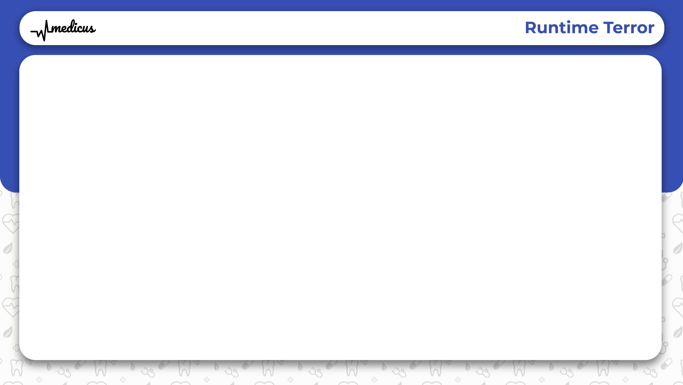
Introduction

Slide 2
What is Medicus?
A website bringing e-medical assistance
Derived from Latin , meaning Doctor
Contains:
Information about the hospitals
Reviews for the corresponding hospitals
Feedback from real patients about their experience
Rating of Doctors in the corresponding hospital

Slide 3
Why Medicus?
Finds the best doctor that suits you
Finds the best hospital that suits you
No fake feedbacks
Pure reviews from verified people
Easy booking

Slide 4
Where is Medicus?
I

Slide 6




Team
01
02
03
04
ARAVIND R
AKHIL RAVINDRAN
JESSWIN W VARGHESE
JEENU CHACKO
DESIGNER,DEVELOPER
BACK-END DEVELOPER
DESIGNER,DEVELOPER
DEVELOPER
Contributed to the design and front-end of the site
Contributed to the back-end of the site
Contributed to the design and documentation
Contributed to the overall design and presentation

