Slide 1


Slide 6
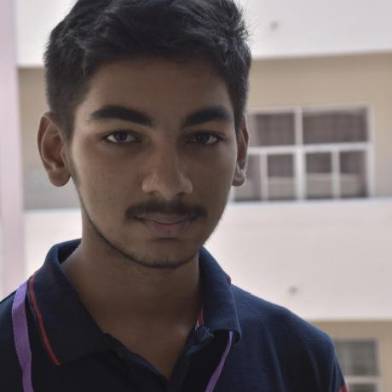
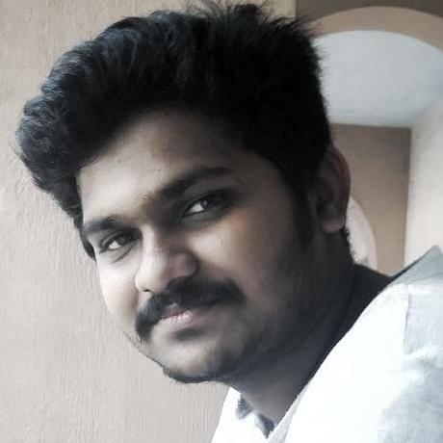


Team
01
02
03
04
ARAVIND R
AKHIL RAVINDRAN
JESSWIN W VARGHESE
JEENU CHACKO
DESIGNER,DEVELOPER
BACK-END DEVELOPER
DESIGNER,DEVELOPER
DEVELOPER
Contributed to the design and front-end of the site
Contributed to the back-end of the site
Contributed to the design and documentation
Contributed to the overall design and presentation

