Slide 1
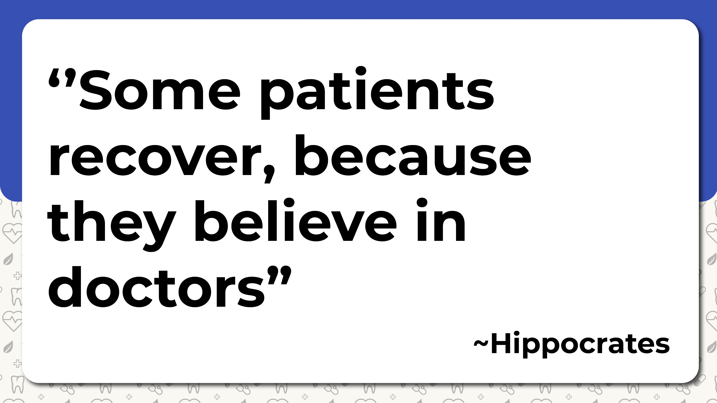

Slide 2
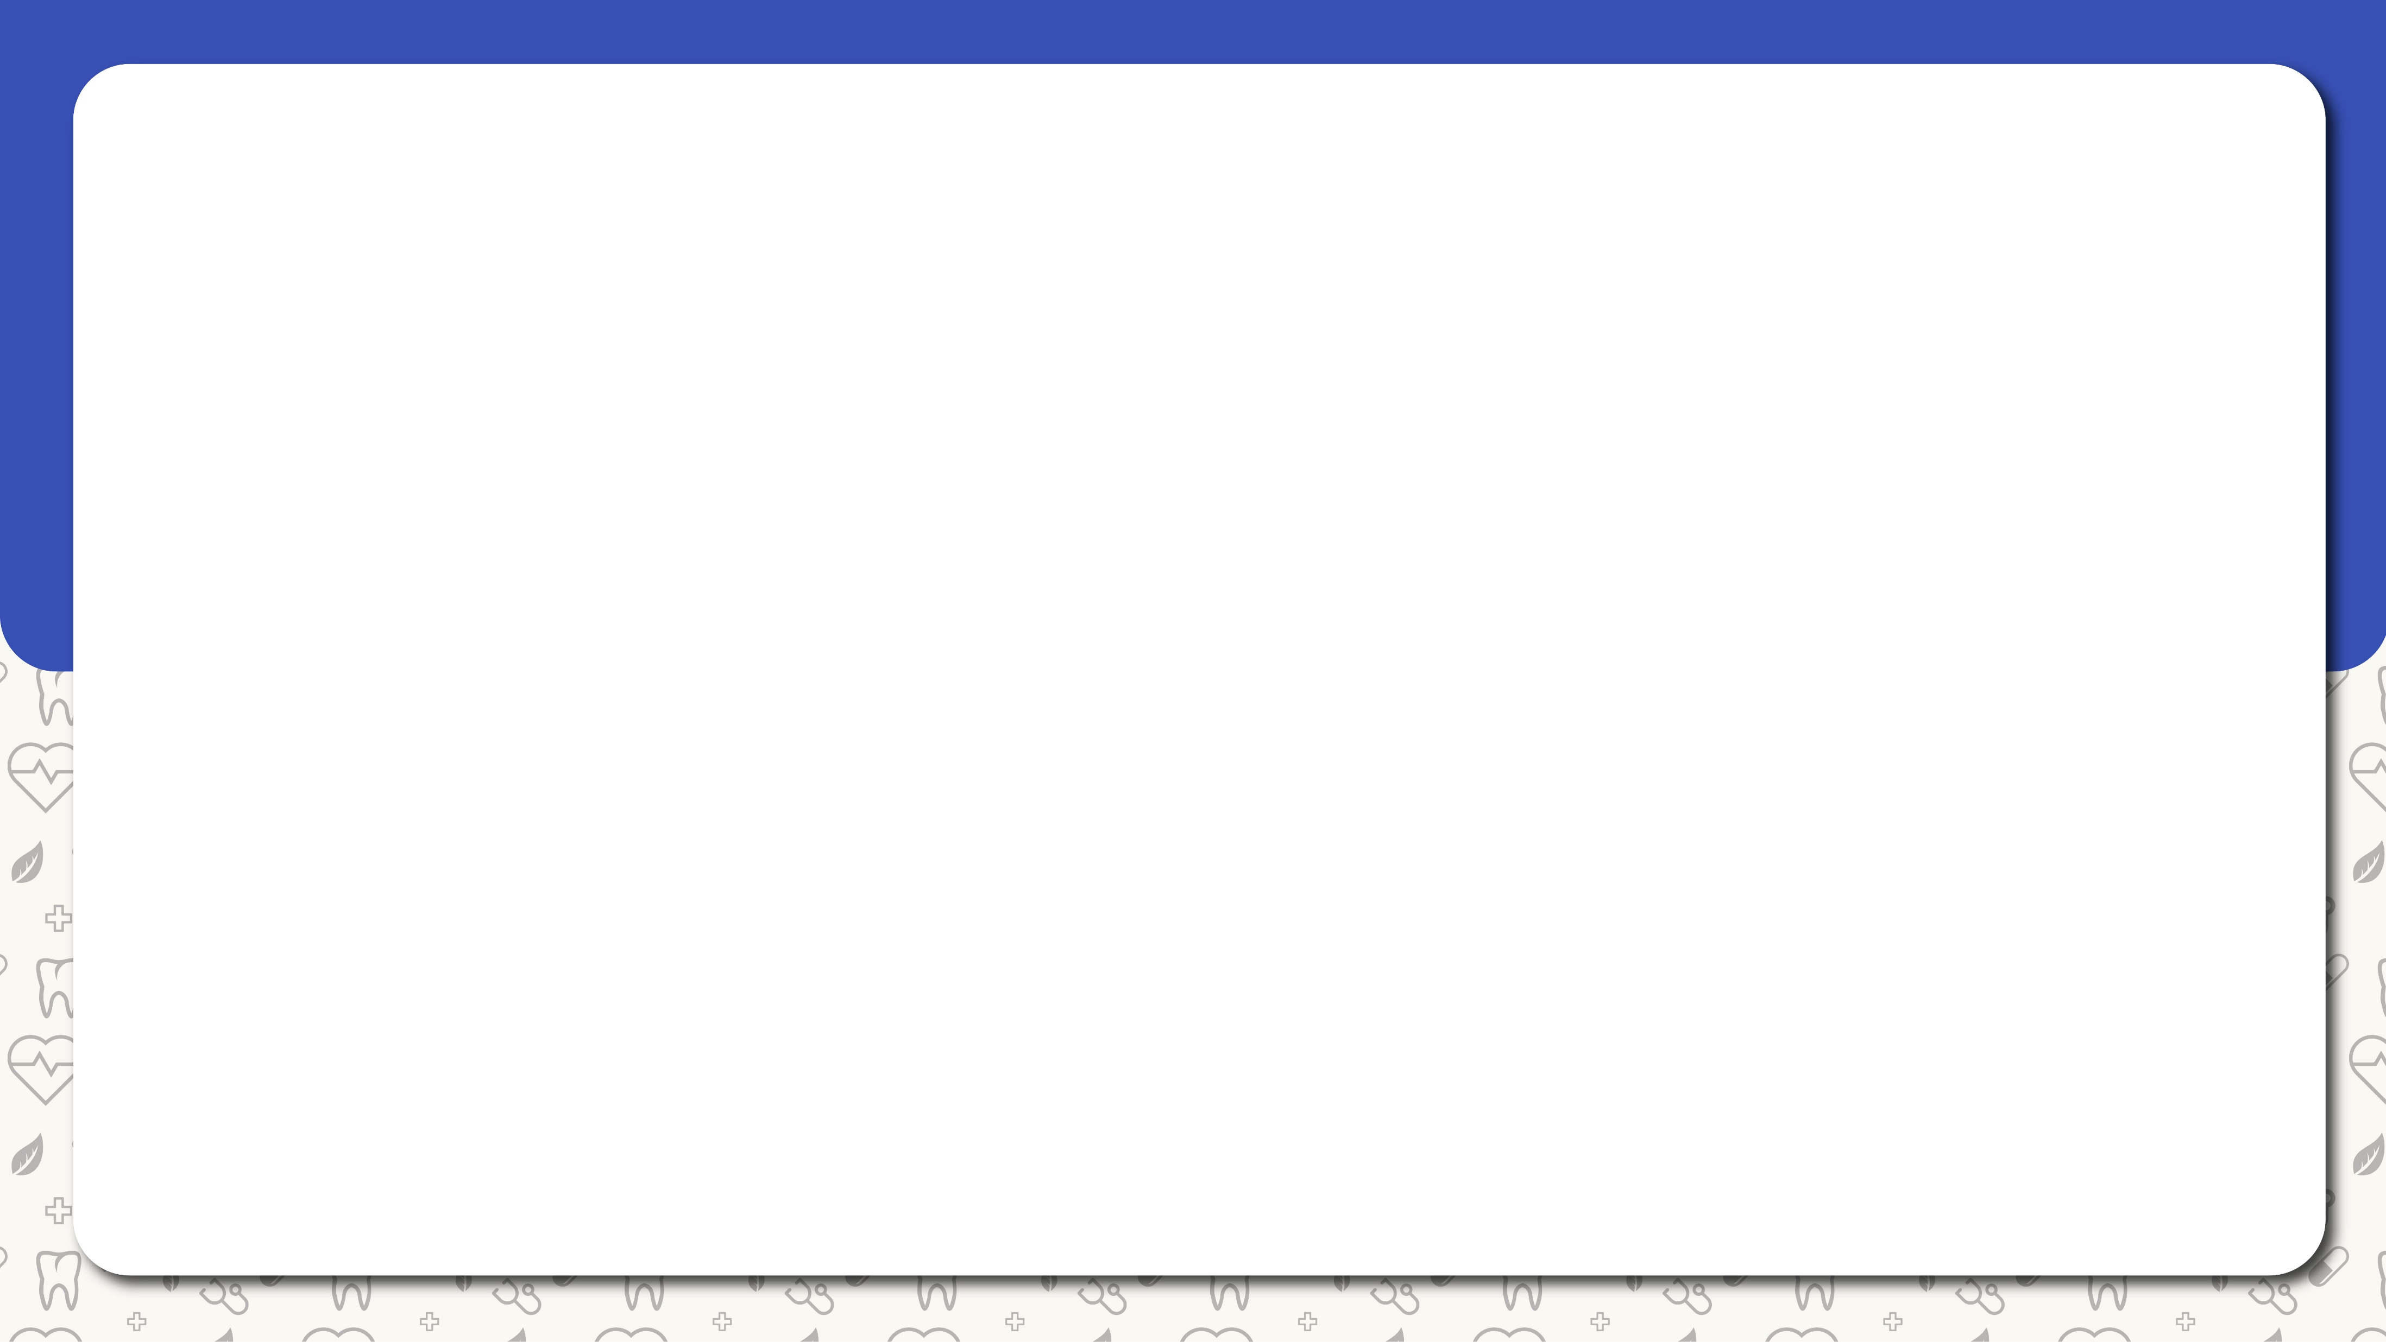
Introduction
5.2 million medical errors are happening in India annually
Majority of people don’t have access to quality medical care
To reduce these problems we have

Slide 3


Slide 4
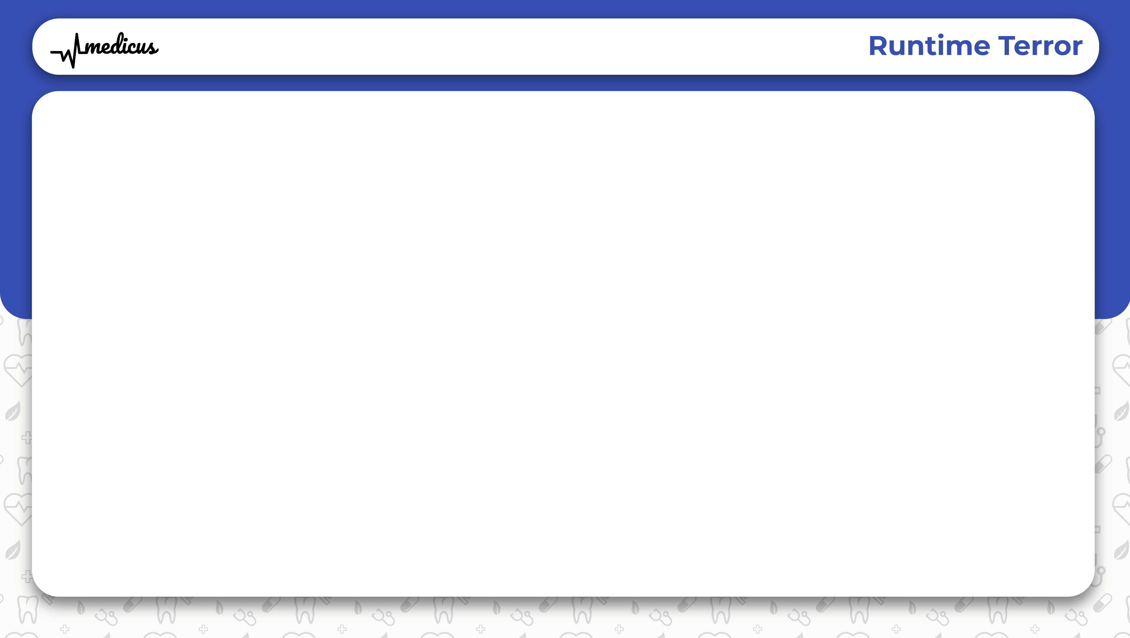
What is Medicus?
A web app bringing medical assistance
Derived from Latin , meaning Doctor
Contains:
Information about the hospitals
Reviews of the corresponding hospitals
Feedback from patients about their experience
Rating of Doctors

Slide 5
Why Medicus?
Finds the best doctor that suits you
Finds the best hospital near you
No fake feedbacks
Pure reviews from verified people

Slide 6
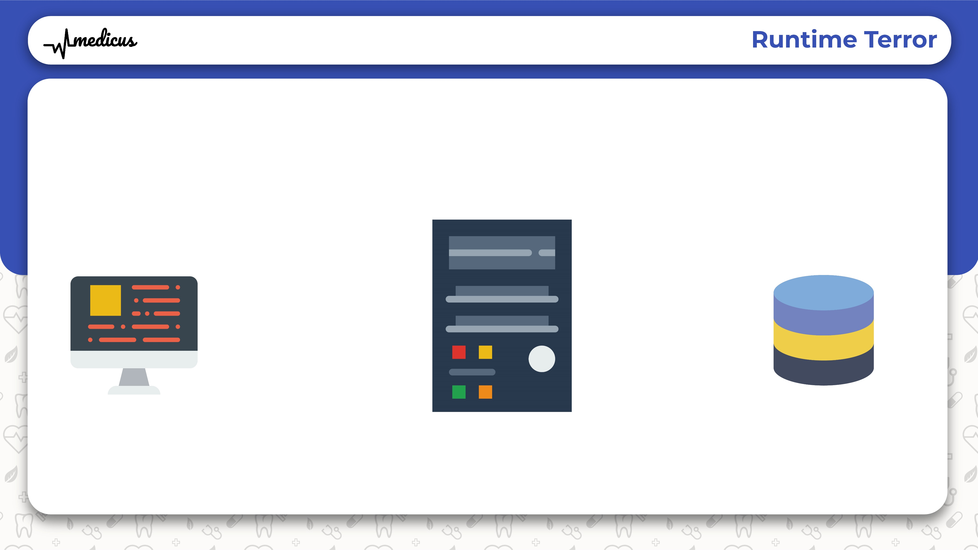
WORKING
SERVER
WEBAPP
DB
QUERY
ACCESSING DATA
RESULT

Slide 7
Upcoming Features
Booking Service
Emergency Assistance
Mobile App

Slide 8

Thank You

