Slide 1
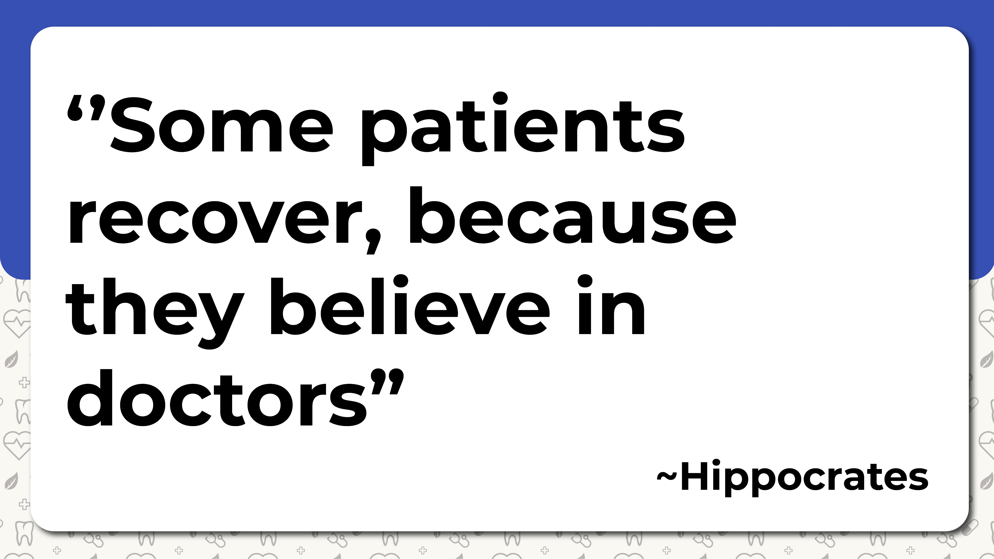

Slide 2
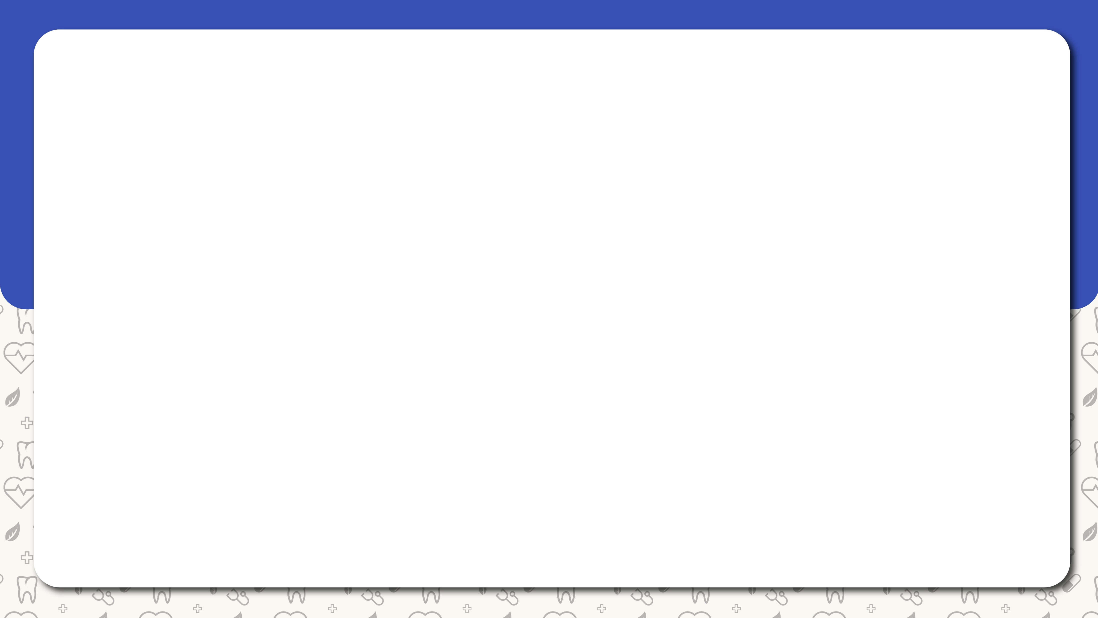
Introduction
5.2 million medical errors are happening in India annually
Majority of people don’t have access to quality medical care
To reduce these problems we have

Slide 3


Slide 4
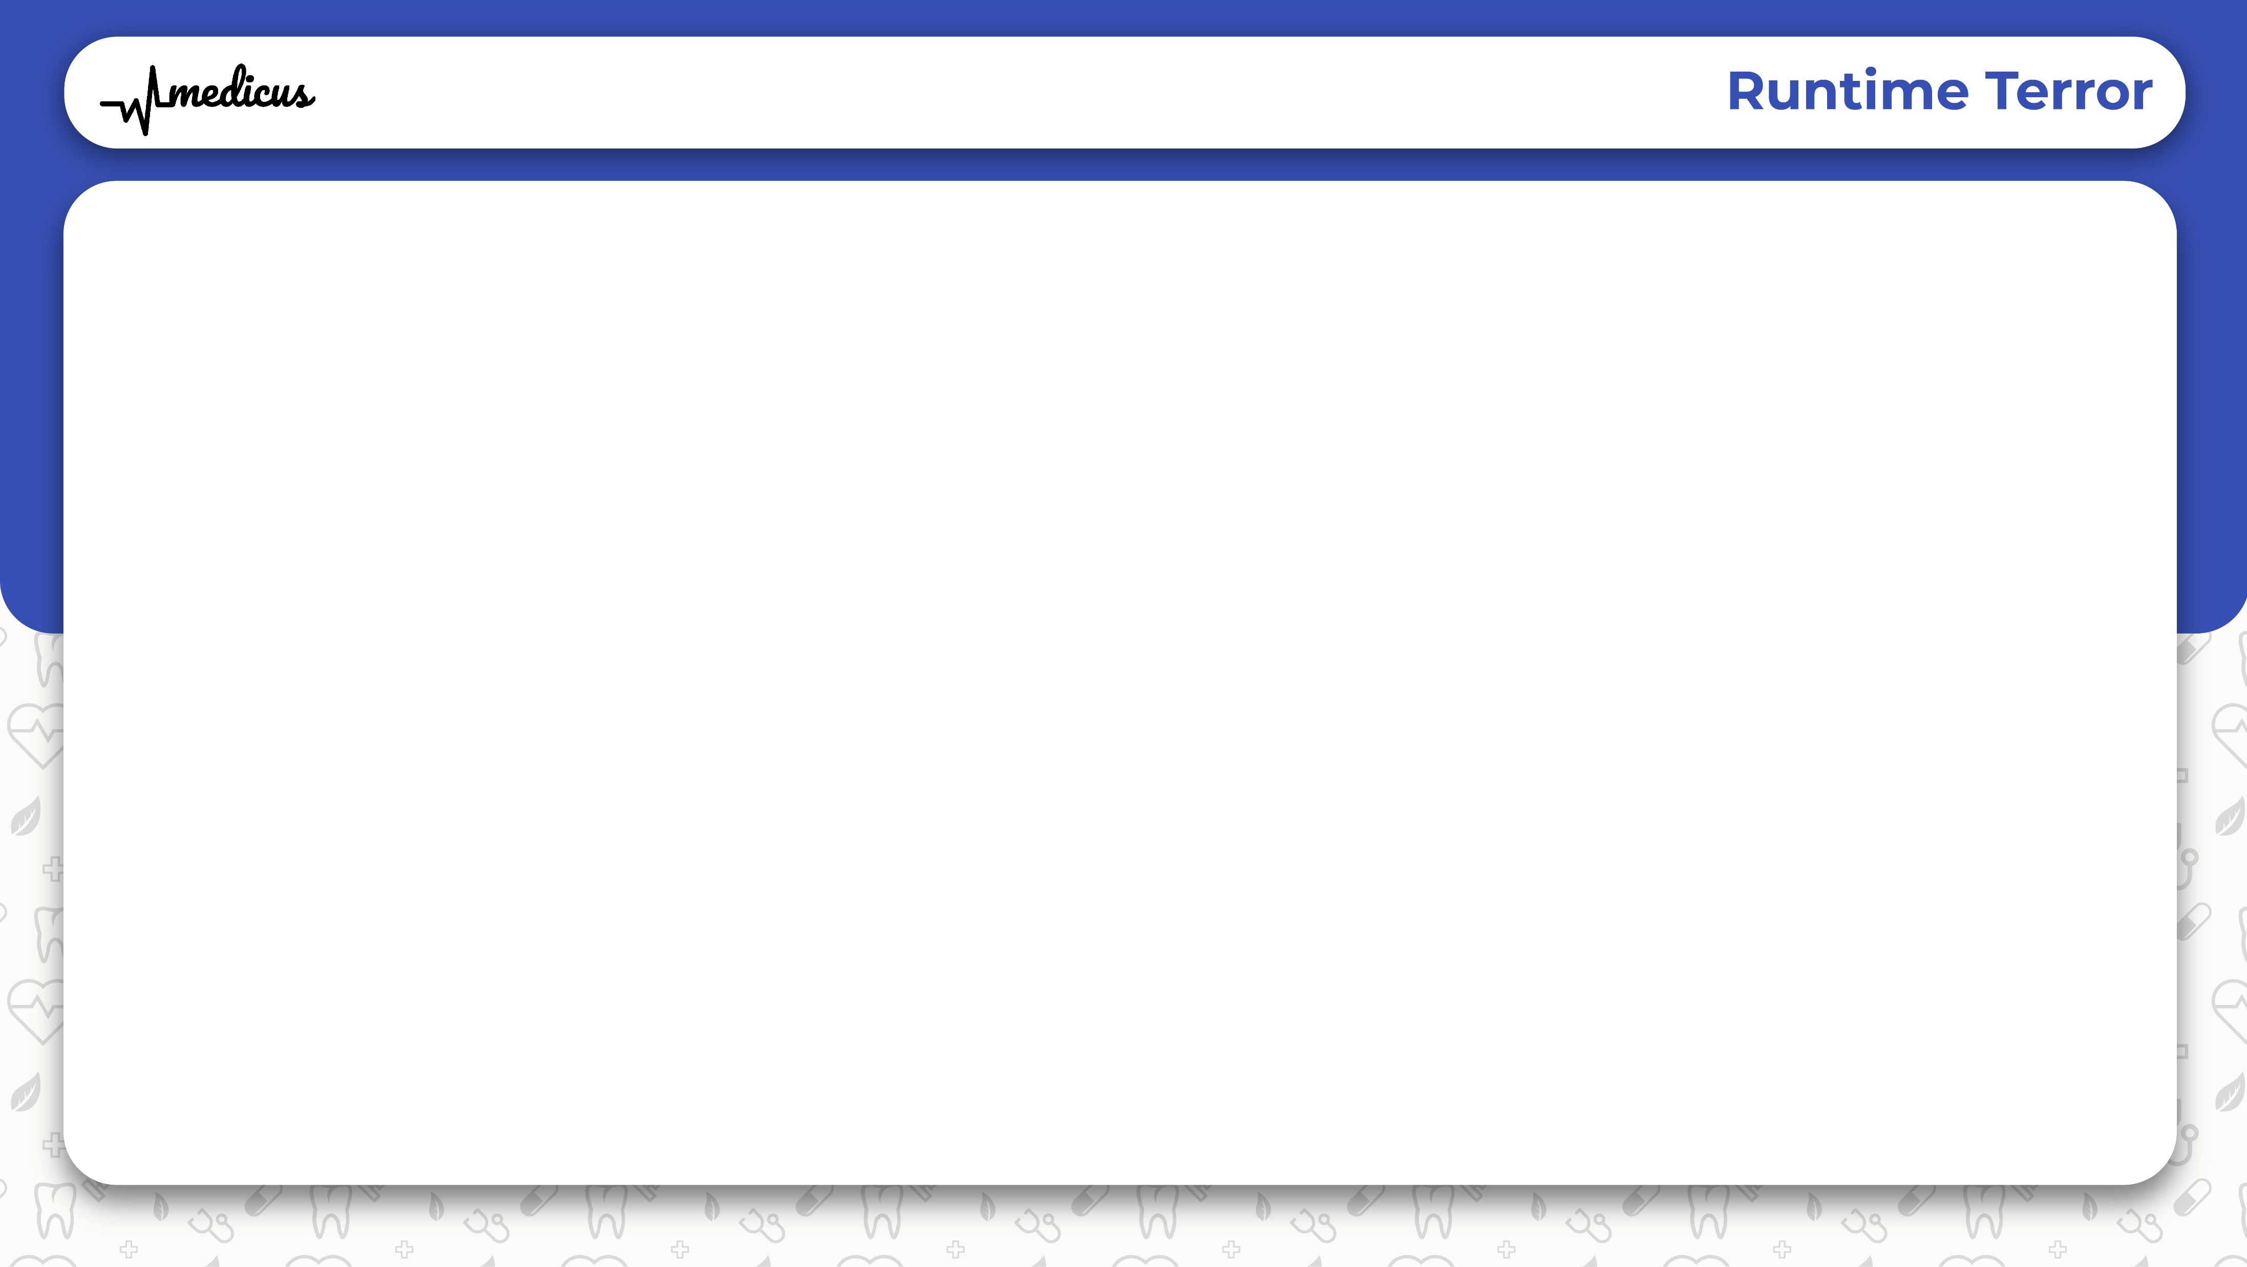
What is Medicus?
A web app bringing medical assistance
Derived from Latin , meaning Doctor
Contains:
Information about the hospitals
Reviews of the corresponding hospitals
Feedback from patients about their experience
Rating of Doctors

Slide 5
Why Medicus?
Finds the best doctor that suits you
Finds the best hospital near you
No fake feedbacks
Pure reviews from verified people

Slide 6
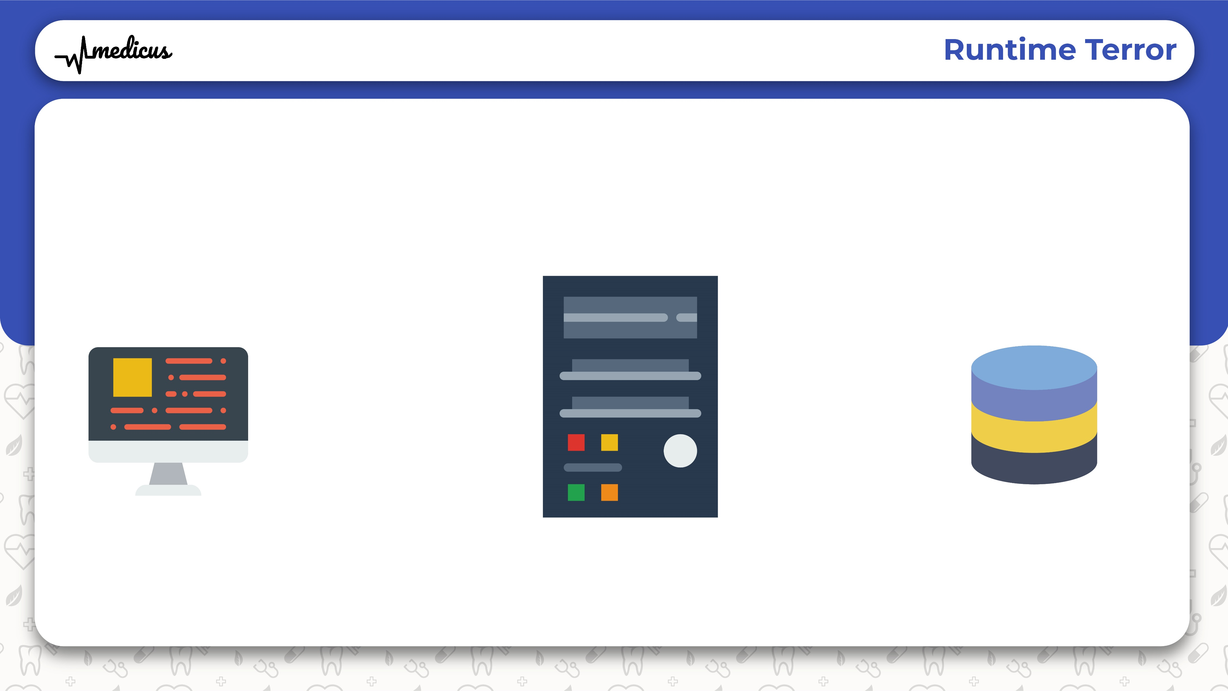
WORKING
SERVER
WEBAPP
DB
QUERY
ACCESSING DATA
RESULT

Slide 7
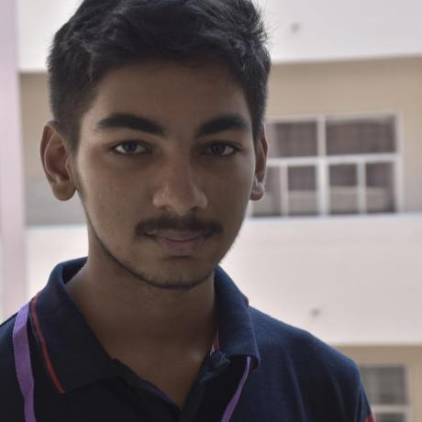
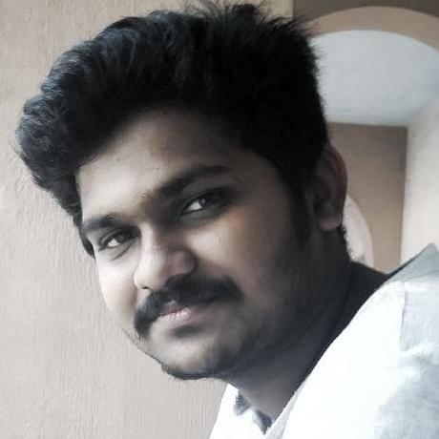

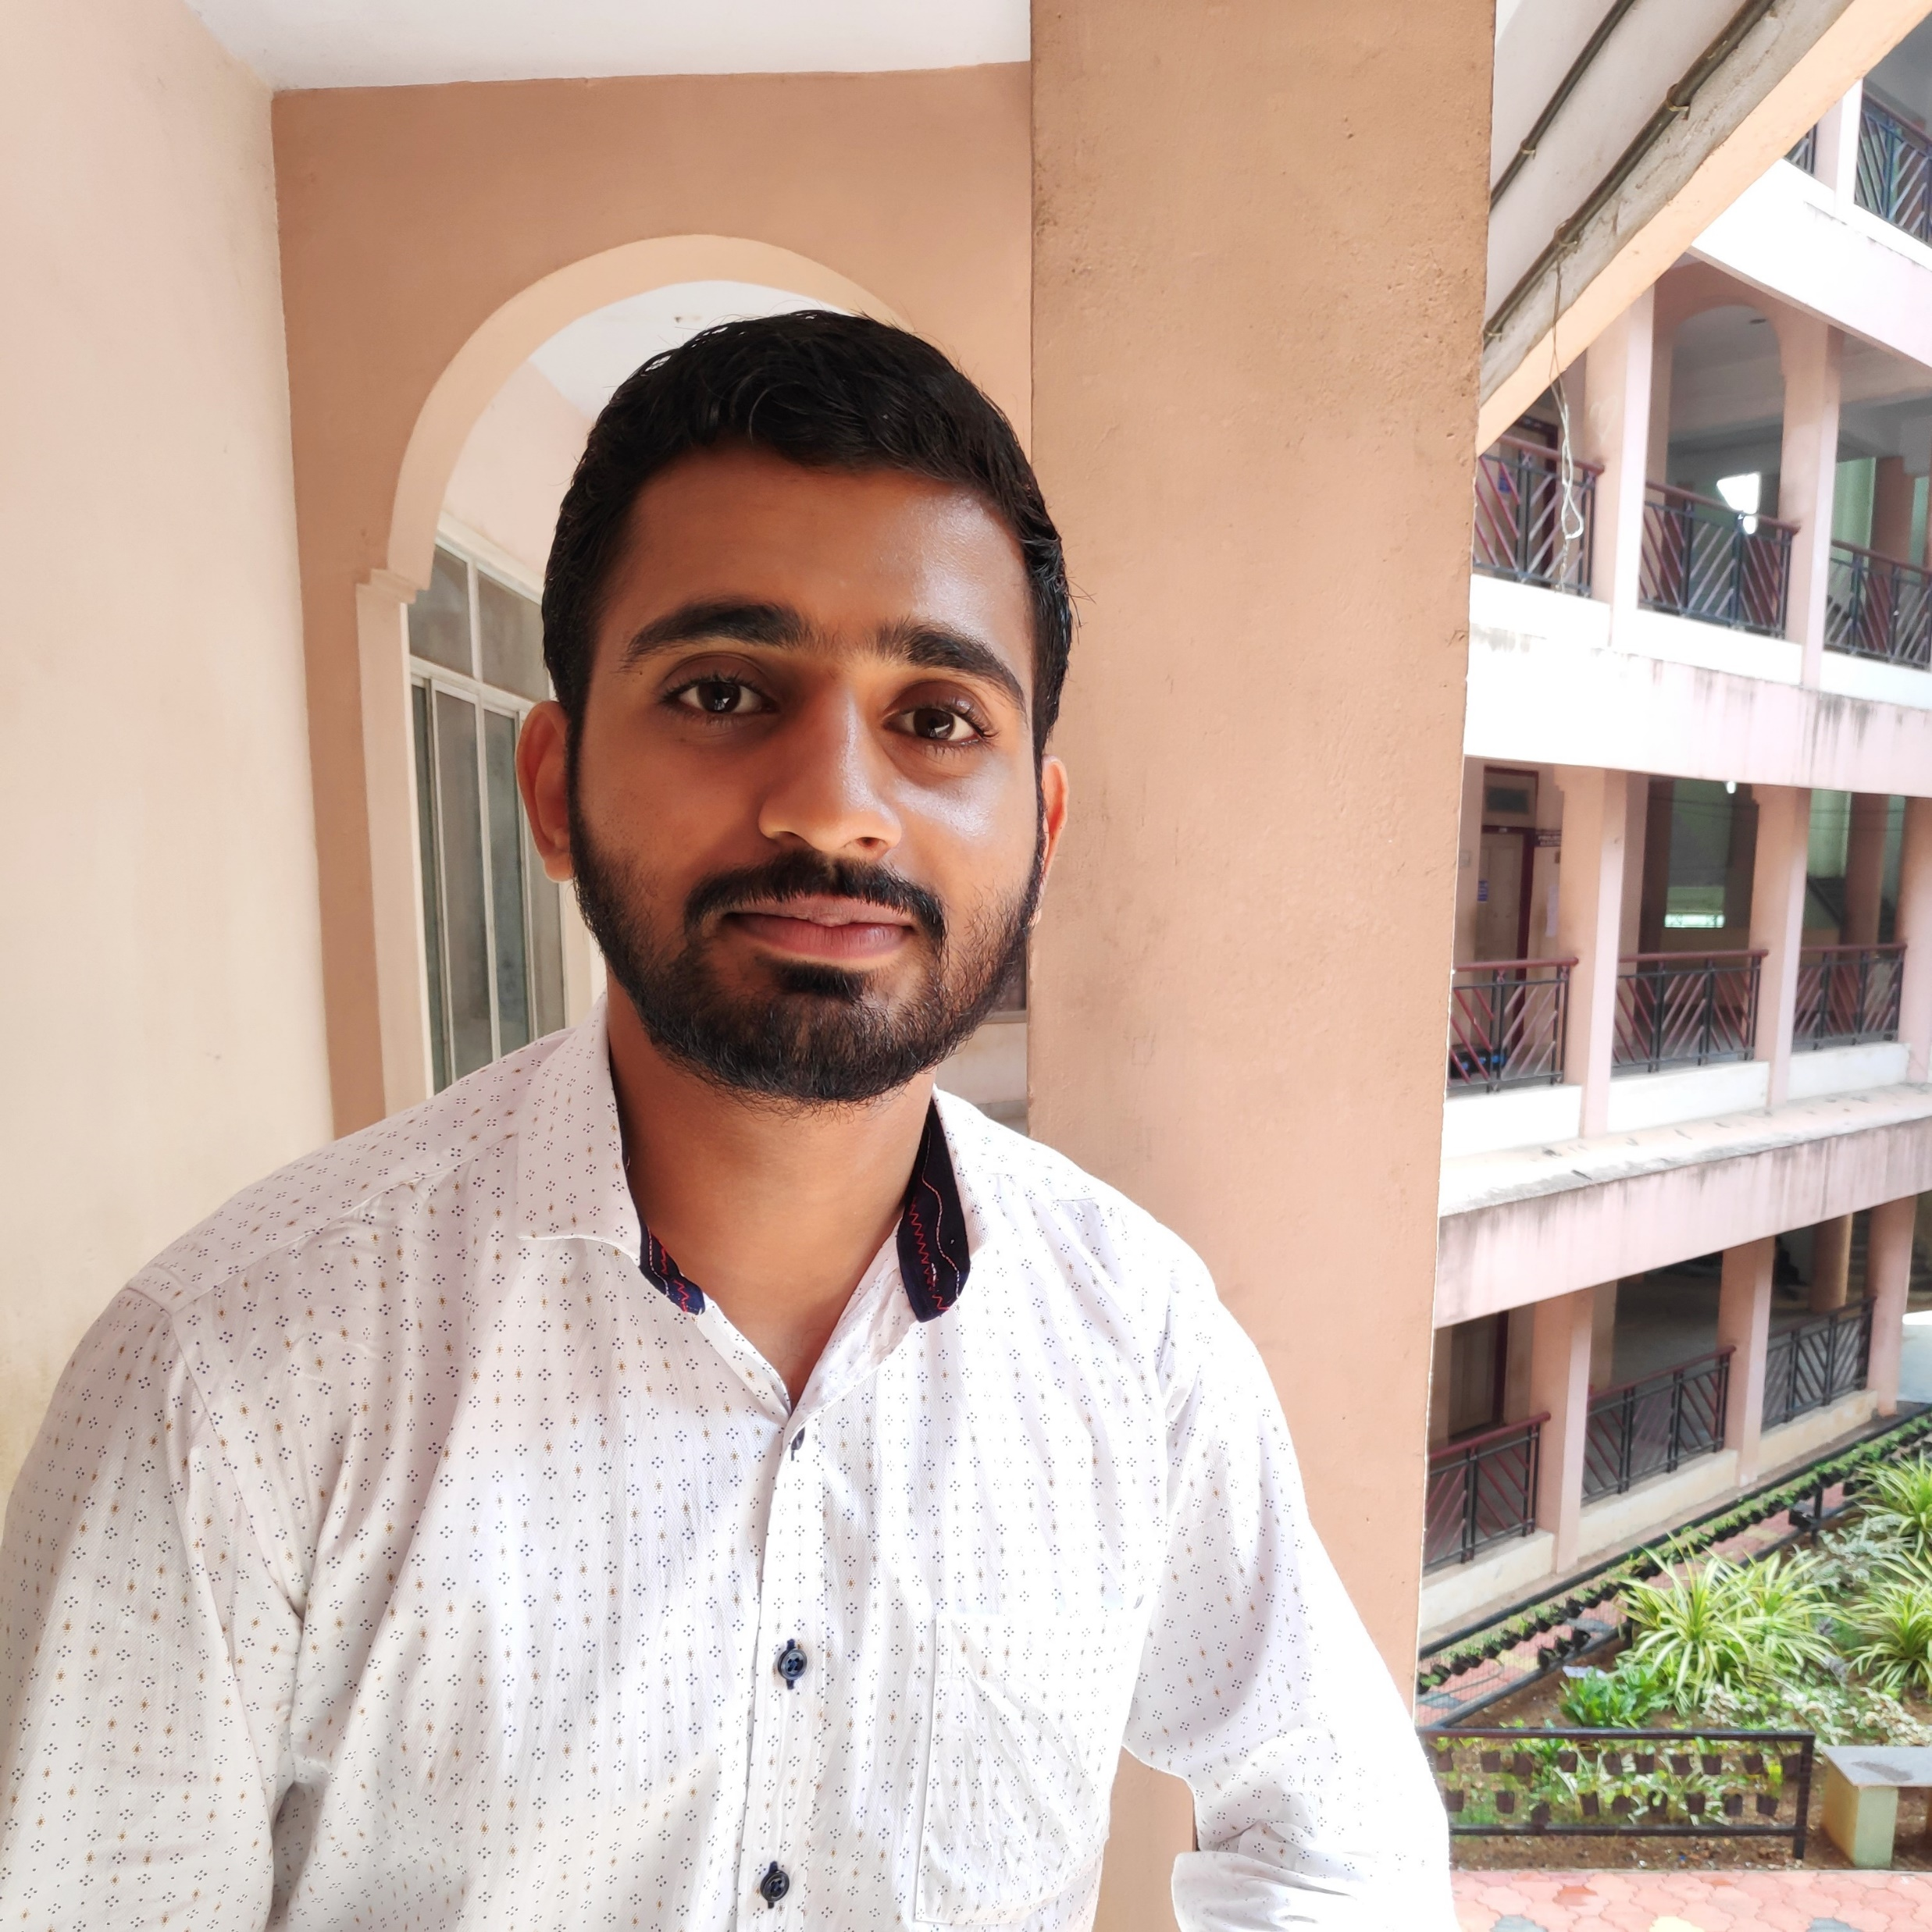
Team
01
02
03
04
ARAVIND R
AKHIL RAVINDRAN
JESSWIN W VARGHESE
JEENU CHACKO
DESIGNER,DEVELOPER
BACK-END DEVELOPER
DESIGNER,DEVELOPER
DEVELOPER
Contributed to the design and front-end of the site
Contributed to the back-end of the site
Contributed to the design and documentation
Contributed to the overall design and presentation

Slide 8
Upcoming Features
Booking Service
Emergency Assistance
Mobile App

Slide 9

Thank You

