Slide 1
If you want to run the ESS tool now, continue reading
This demo will have instructions for pulling data from the database that you just made a connection with
The ESS code was written using R 3.5.3

Slide 2
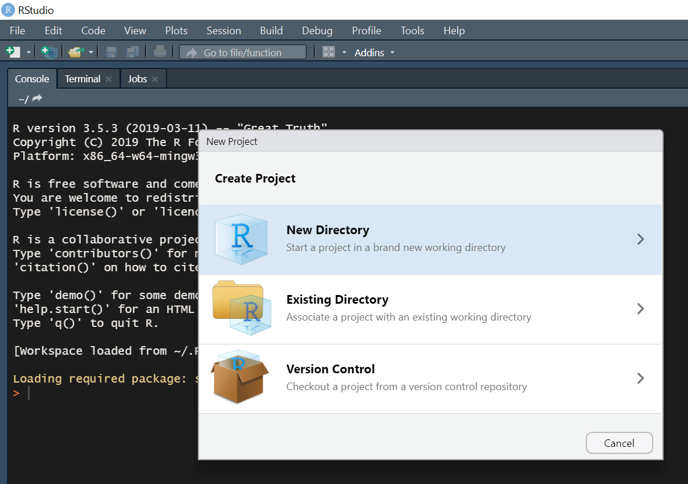
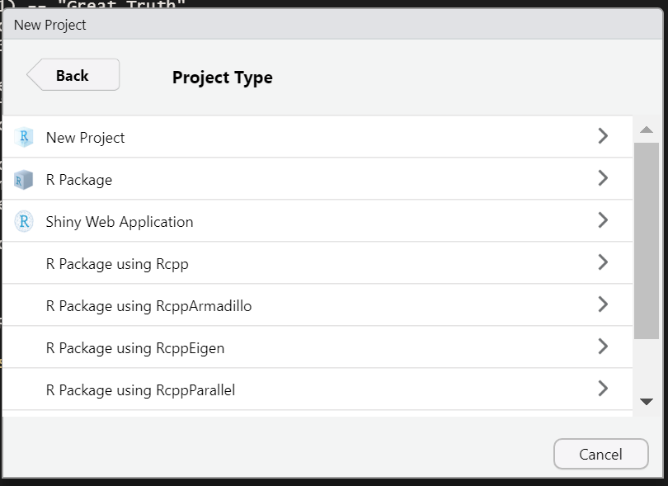
Starting a project in RMarkdown
Once you’re connected to the database and have R Studio up and running,
Open R Studio
Start a new project (File -> New Project -> New Directory)
Within your project will live your files, including images, the R script, and outputs
Click new project. Create a directory in your documents folder on your local drive (C:/users/) . This will create a folder that you will work in for this report.

Slide 3
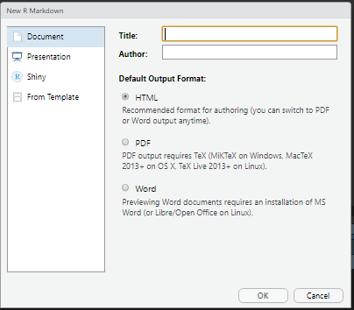
Once you have a project set up,
Create a new file within the project
File → New File → RMarkdown…
Give your file a title. Make sure the output is set to HTML

Slide 4
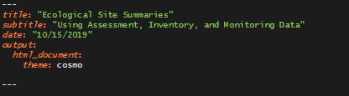
Now you’re ready to get started.
Delete everything in your RMarkdown Template (including any markup like ``` --- ## etc).
Go to:
https://github.com/R-Burke/EcologicalSiteSummaries/blob/master/EcologicalSiteSummaryTool.Rmd
Select everything in the code (including markup)
Copy and paste into your *blank* RMarkdown document
Edit these fields if you wish, but make sure they stay in quotations. Spacing/indentation matters here, so don’t indent or change any spacing under the output field

Slide 5
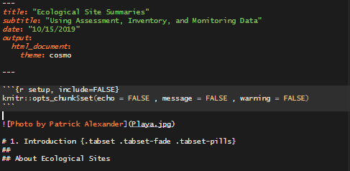
This report has 2 embedded images, a banner image and an image to help interpret a boxplot.
To insert a banner image:
Save an image in your project directory.
Use the Playa photo for download here: https://github.com/R-Burke/EcologicalSiteSummaries/blob/master/Playa.jpg
Or save your own photo. If using your own photo, you will probably want to crop it to make it “banner sized.” Make sure you specify the photo extension (i.e. jpg, .png). Don’t change anything else.
Name of banner image here
Image caption here
To insert the boxplot image:
Download here: https://github.com/R-Burke/EcologicalSiteSummaries/blob/master/boxplot_text.png
(Click download button, then right click to save as. Place in your project directory. Don’t change the name (save it as boxplot_text.png in your project directory).
Now you don’t need to specify anything in the code

