Slide 1
MED Genomics \
Pipelines

Slide 2
A
Mapping and QC
Variant calling / Transcript count
Filtering / Diff Expression
Functional Analysis
- cgpMAP
- Alignment statistics
- Duplicate removal
- Freebayes
- VCF filter (QUAL/DP)
- gnomAD allele freq.
- SIFT / Polyphen
- MAFtools
- GO analysis
Figure 1: General pattern of workflow with variant calling as an example.

Slide 3
TrimGalore
DNA-seq
cgpMAP
Exome
Hybridisation statistics
sort
RNA-seq
verifyBAMID
Somalier ancestry & relatedness
CollectRNASeq Metrics
Hybridisation statistics
PCR removal
WGS
insert size
alignment stats

Slide 4
Sample name
Lane number
SSSS-FFFF-LLL-UOI
Family ID /
Tumour or Normal
Unique ID
E.g.
S101-F010-L01-S101F010L01.fq.gz

Slide 5
TrimGalore
DNA-seq
cgpMAP
Exome
Hybridisation statistics
verifyBAMID
sort
Somalier ancestry & relatedness
Hybridisation statistics
PCR removal
insert size
alignment stats

Slide 6
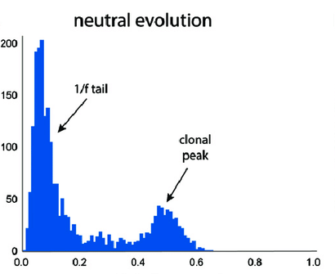
neutral evolution
No. of Mutations
clonal peak
Allele frequency

Slide 7
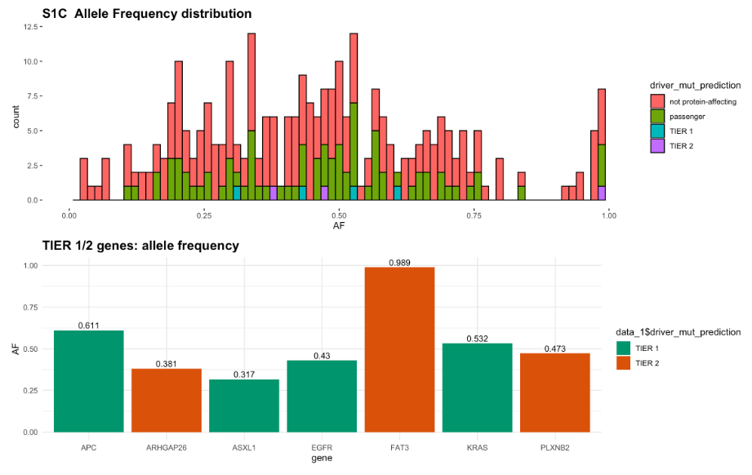


not protein affecting
passenger
TIER1
TIER2
TIER1
TIER2
gene1
gene2
gene3
gene4
gene5
gene6
gene7

Slide 8
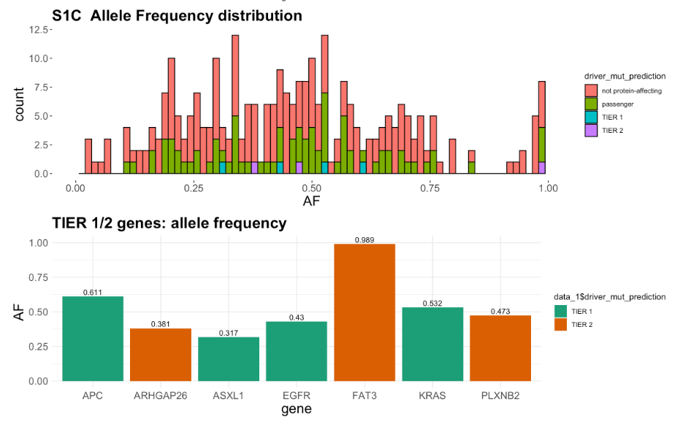
gene1
gene2
gene3
gene4
gene5
gene6
gene7

Slide 9
