Slide 1
MED Genomics \
Pipelines

Slide 2
Input: “$baseDir/input/*{1,2}.fq.gz”
cgpMAP
Output: "$baseDir/output/BAM/merged_lanes/*.rmd.bam”
Freebayes
Haplotypecaller
Mutect2
cgpWXS
*.freebayes.vcf.gz
*.GATK.vcf.gz
*mutect2.vcf.gz
*.cgpwxs.vcf.gz
Output: "$baseDir/output/VCF_collect/”
Output: "$baseDir/output/VCF_collect/”
*.vcf.gz
*.vcf.gz
Germline variant processing
Somatic variant processing
Output: $baseDir/output/VCF_collect/merge_vcf/snps/family/*.snps.family.merged.vcf.gz”
Output: $baseDir/output/VCF_collect/merge_vcf/snps/family/*.snps.family.merged.vcf.gz”
Output: “$baseDir/output/VCF_collect/merge_vcf/indels/family/*.indels.family.merged.vcf.gz”
Output: “$baseDir/output/VCF_collect/merge_vcf/indels/family/*.indels.family.merged.vcf.gz”

Slide 3
A
Mapping and QC
Variant calling / Transcript count
Filtering / Diff Expression
Functional Analysis
- cgpMAP
- Alignment statistics
- Duplicate removal
- Freebayes
- VCF filter (QUAL/DP)
- gnomAD allele freq.
- SIFT / Polyphen
- MAFtools
- GO analysis
Figure 1: General pattern of workflow with variant calling as an example.

Slide 4
TrimGalore
DNA-seq
cgpMAP
Exome
Hybridisation statistics
sort
RNA-seq
verifyBAMID
Somalier ancestry & relatedness
CollectRNASeq Metrics
Hybridisation statistics
PCR removal
WGS
insert size
alignment stats

Slide 5
Sample name
Lane number
SSSS-FFFF-LLL-UOI
Family ID /
Tumour or Normal
Unique ID
E.g.
S101-F010-L01-S101F010L01.fq.gz

Slide 6
TrimGalore
DNA-seq
cgpMAP
Exome
Hybridisation statistics
verifyBAMID
sort
Somalier ancestry & relatedness
Hybridisation statistics
PCR removal
insert size
alignment stats

Slide 7
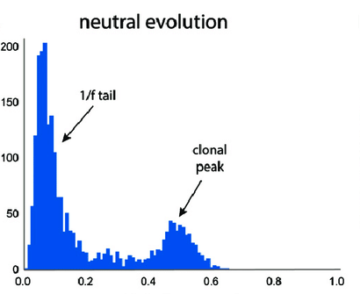
neutral evolution
No. of Mutations
clonal peak
Allele frequency

Slide 8
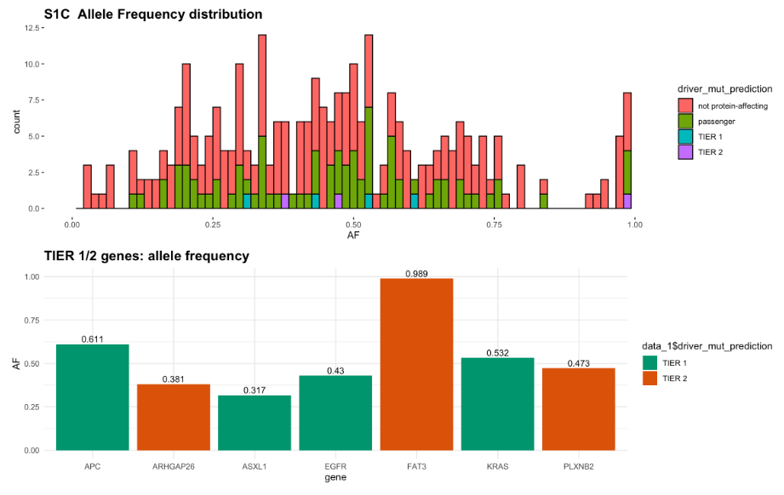


not protein affecting
passenger
TIER1
TIER2
TIER1
TIER2
gene1
gene2
gene3
gene4
gene5
gene6
gene7

Slide 9
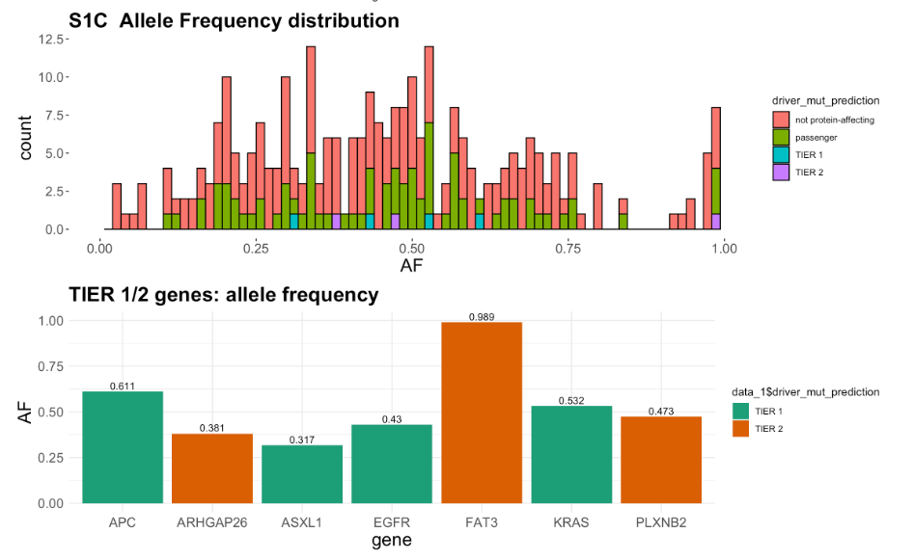
gene1
gene2
gene3
gene4
gene5
gene6
gene7

Slide 10
