Slide 1


Trends in US Breweries
A repot prepared by Tajar, Inc.
Rajat Chandna, Andy Ho, An Nguyen, Jodi Pafford, and Tori Wheelis

Slide 2
The TAJAR, Inc Team:
Rajat Chandna
Andy Ho
An Nguyen
Jodi Pafford
Tori Wheelis

Slide 3
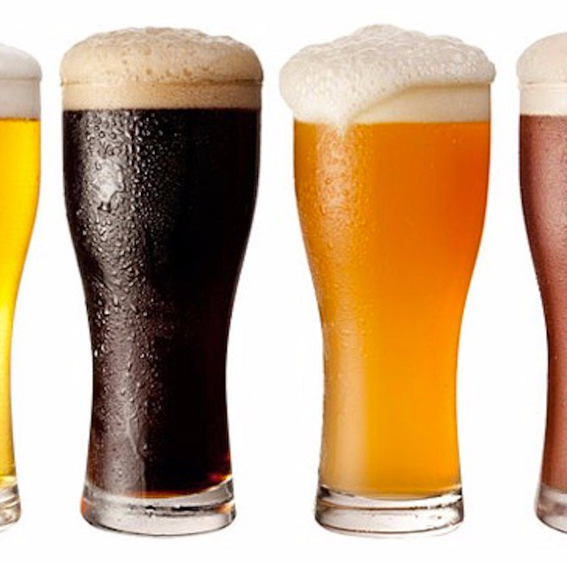
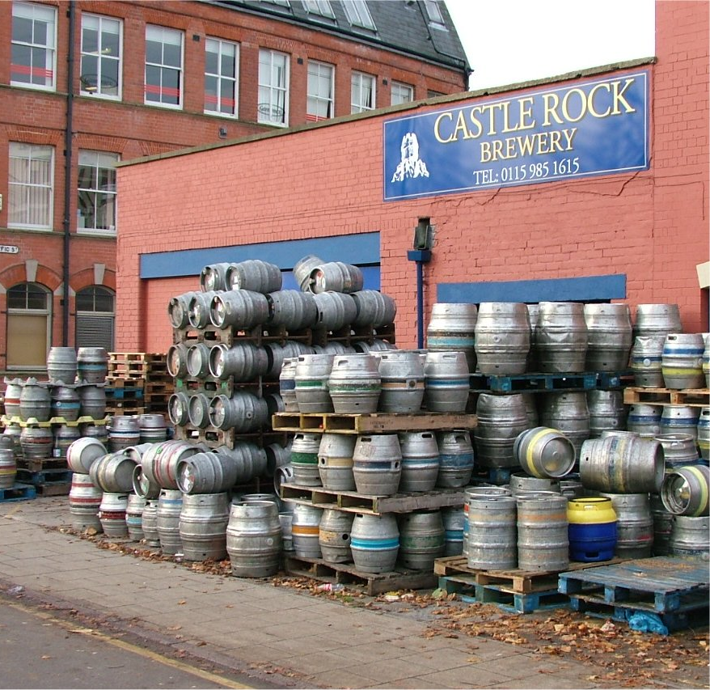
Data and Information used in this report
Data File with Beer Information
Data File with Brewery Information
This Photo by Unknown Author is licensed under CC BY-SA
This Photo by Unknown Author is licensed under CC BY-NC-ND

Slide 4
Example of Data
Insert Data for Question 2 – Print the first 6 observations and the last 6 observations.

Slide 5
Further Discoveries:
Insert data for question 3 – How many N/As are in each column

Slide 6
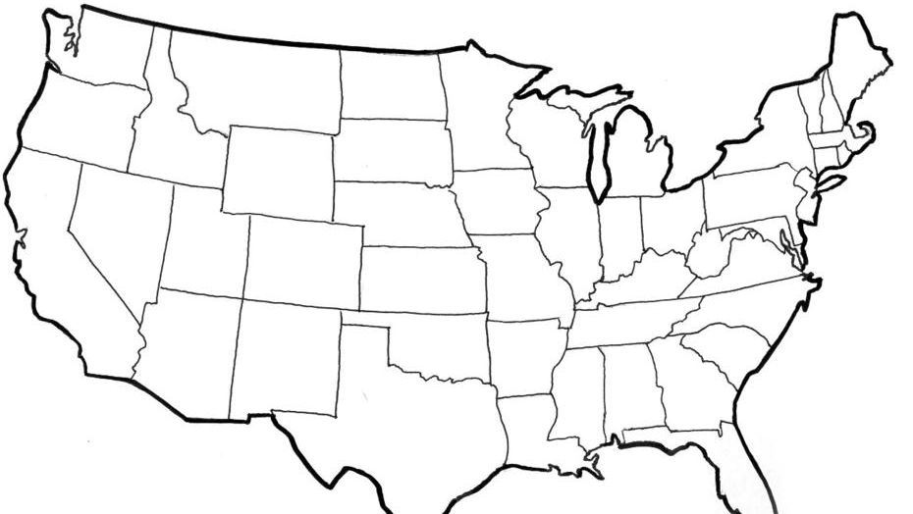
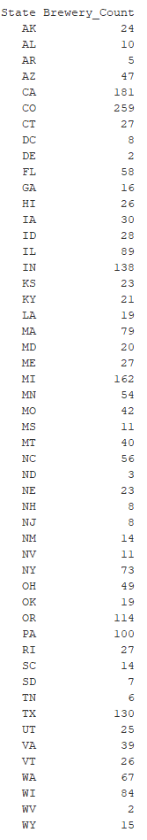
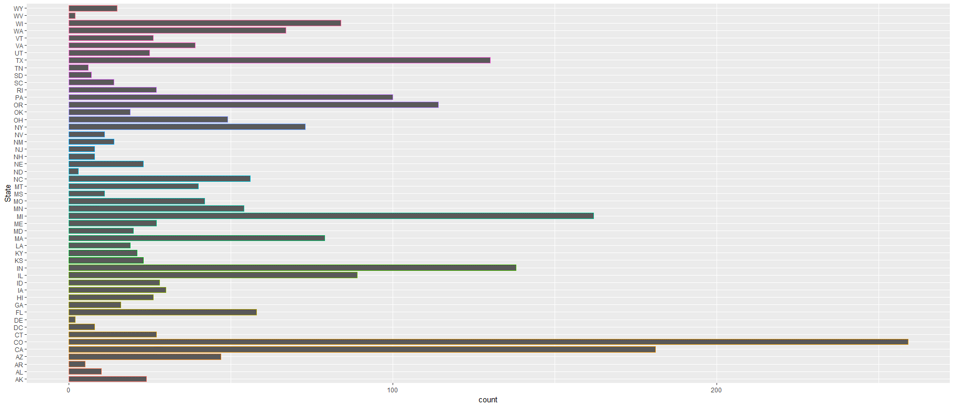
US Brewery Locations
This Photo by Unknown Author is licensed under CC BY-SA

Slide 7
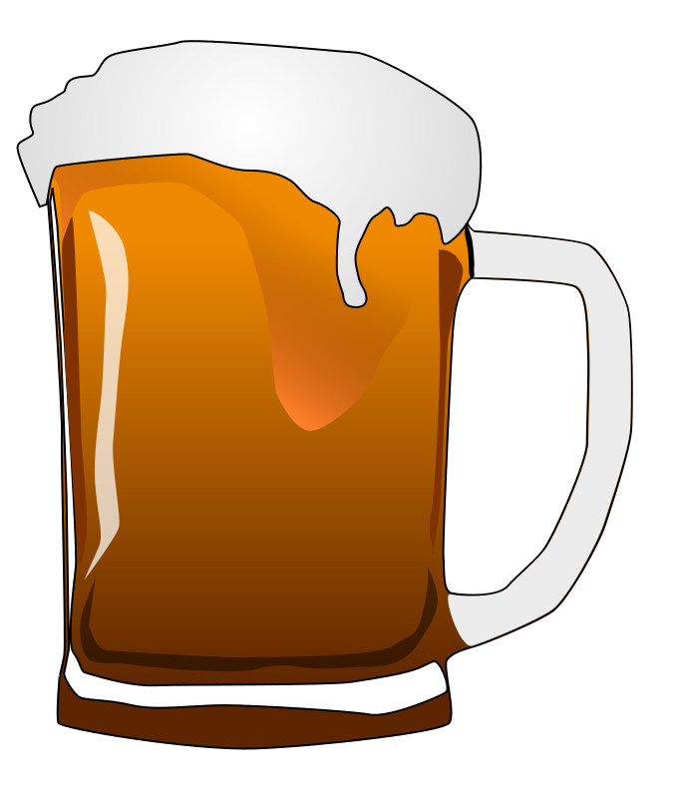
Median Alcohol Content & International Bitterness Units
Highlight a few states from question 4 – Median alcohol content and international bitterness units

Slide 8
Median Alcohol Content & International Bitterness Units
Highlight a few states from question 4 – Median alcohol content and international bitterness units

Slide 9
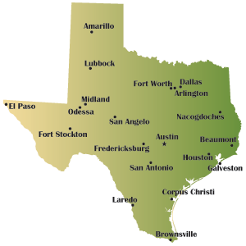
Maximum ABV
Just Guessing it will be Texas….we’ll change picture if needed.
This Photo by Unknown Author is licensed under CC BY-SA

Slide 10
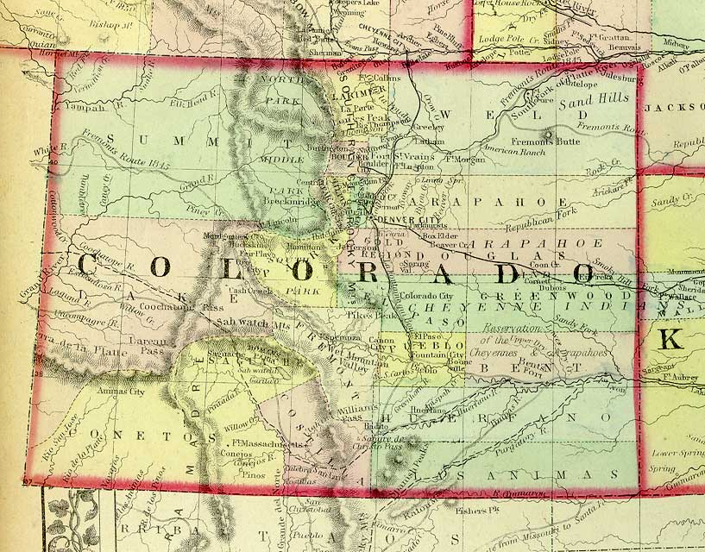
Most Bitter (IBU)
Just Guessing it will be Colorado….we’ll change picture if needed.
This Photo by Unknown Author is licensed under CC BY-NC-SA

Slide 11
Other Notable Information about ABV
Summary Stats about ABV from question 6

Slide 12
IBU vs ABV Relationship?
Insert scatterplot from question 7

Slide 13

Questions?

Slide 14
Thank You for allowing us to partner with you

